Slide 1
What I’m learning in Maths today
Maths – Y6 (Increase and Decrease %) Date: 1.2.21
L.Obj: *I can calculate a % of an amount.
*I understand and use the meaning of ‘increase’, ‘decrease’ and ‘reduce’.
*I can solve % problems by calculating % of amounts.

Slide 2
Y6s
1) 56 ÷ 8 = _____
2) 4 x 83 = _____
5,120 – 215 = _____
4) 2/6 + 1 5/6 = _____
5) ____ - 100 = 1,272
30 + 8² = ______
7/9 x 6/9 = _____

Slide 3
Y6s
1) 56 ÷ 8 = 7
2) 4 x 83 = 332
5,120 – 215 = 4,905
4) 2/6 + 1 5/6 = 13/6 or 2 1/6
5) 1,372 - 100 = 1,272
30 + 8² = 94
7/9 x 6/9 = 42/81 or 14/27

Slide 4
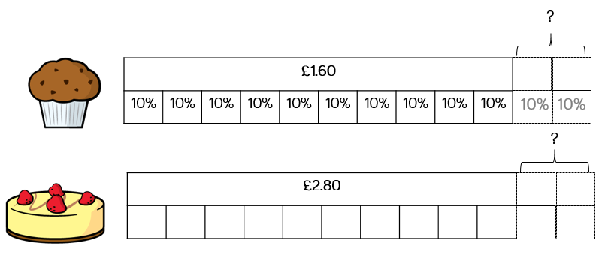
Janet is increasing the prices in her café by 20%
Calculate the percentage increase for the following items:

Slide 5
Janet is increasing the prices in her café by 20%
Calculate the percentage increase for the following items:
So, £1.60 + 16p + 16p = £1.92
16p
16p
28p
28p
So, £2.80 + 28p + 28p = £3.36

Slide 6
The price of houses has increased by 10% in the last year.
Complete the table.
House | Original cost | 10% increase | New cost
A | £195,500
B | £378,250

Slide 7
The price of houses has increased by 10% in the last year.
Complete the table.
House | Original cost | 10% increase | New cost
A | £195,500 | £19,550 | £215,050
B | £378,250 | £37,825 | £416,075

Slide 8
Varied Fluency 4
True or false?
A 5% decrease in price from £30 means there is £1 off.
© Classroom Secrets Limited 2018

Slide 9
Varied Fluency 4
True or false?
False. There is £1.50 off.
A 5% decrease in price from £30 means there is £1 off.
© Classroom Secrets Limited 2018

Slide 10
Problem Solving 1
Theo is buying some trainers.​
​
There is 5% off for today only. ​
​
Theo calculates that 5% of the cost of the trainers is £6.50.​
​
What is the original price of the trainers?
© Classroom Secrets Limited 2018

Slide 11
Problem Solving 1
Theo is buying some trainers.​
​
There is 5% off for today only. ​
​
Theo calculates that 5% of the cost of the trainers is £6.50.​
​
What is the original price of the trainers?
£130
© Classroom Secrets Limited 2018

Slide 12
Balancing Equations – Fill in the missing number
5/7 of 42 = 3 x __
Extra challenge!
8³ = ½ of ____
7.1 x 4 = 40 - ___
4.2 x __ = 60 x 70
___ ÷ 10 = 0.7 + 0.15
132 ÷ 11 = Double __
60% of 45 = 30 - ___
1% of 700 = ¼ of ___
____ + 60 = 4³

