Slide 1
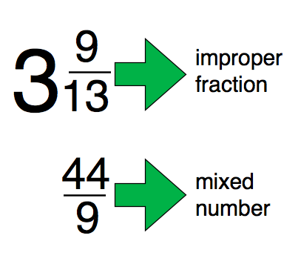
What I’m learning in Maths today
Maths – Y5 (Mixed numbers and Improper fractions) Date: 27.1.21
L.Obj: *I can convert mixed numbers (mixed fractions) into improper fractions.

Slide 2
RECAP –
Fractions can be PROPER or IMPROPER.
PROPER
3
5
The denominator is greater than the numerator.

Slide 3
Fractions can be PROPER or IMPROPER.
IMPROPER
7
4
The numerator is greater than the denominator.

Slide 4
IMPROPER FRACTIONS CAN BE WRITTEN AS MIXED NUMBERS.
IMPROPER
7
4
MIXED NUMBER
3
4
1
=
seven quarters
1 whole and three quarters

Slide 5
MIXED NUMBERS CAN BE TURNED INTO IMPROPER FRACTIONS – IT’S EASY!
MIXED NUMBER
4
9
IMPROPER
13
4
1
=
1 whole and four ninths
thirteen ninths
What is 1 x 9 ? (whole number x denominator)
Then + 4 (numerator)
13
Denominator stays as 9

Slide 6
MIXED NUMBERS CAN BE TURNED INTO IMPROPER FRACTIONS – IT’S EASY!
MIXED NUMBER
5
7
IMPROPER
12
7
1
=
1 whole and five sevenths
twelve sevenths
What is 1 x 7 ? (whole number x denominator)
Then + 5 (numerator)
12
Denominator stays as 7

Slide 7
MIXED NUMBERS CAN BE TURNED INTO IMPROPER FRACTIONS – IT’S EASY!
MIXED NUMBER
3
4
IMPROPER
11
4
2
=
2 whole and three quarters
eleven quarters
What is 2 x 4 ? (whole number x denominator)
Then + 3 (numerator)
11
Denominator stays as 4

Slide 8
MIXED NUMBERS CAN BE TURNED INTO IMPROPER FRACTIONS – IT’S EASY!
MIXED NUMBER
7
9
IMPROPER
34
9
3
=
3 whole and seven ninths
thirty four ninths
What is 3 x 9 ? (whole number x denominator)
Then + 7 (numerator)
34
Denominator stays as 9

