Slide 1
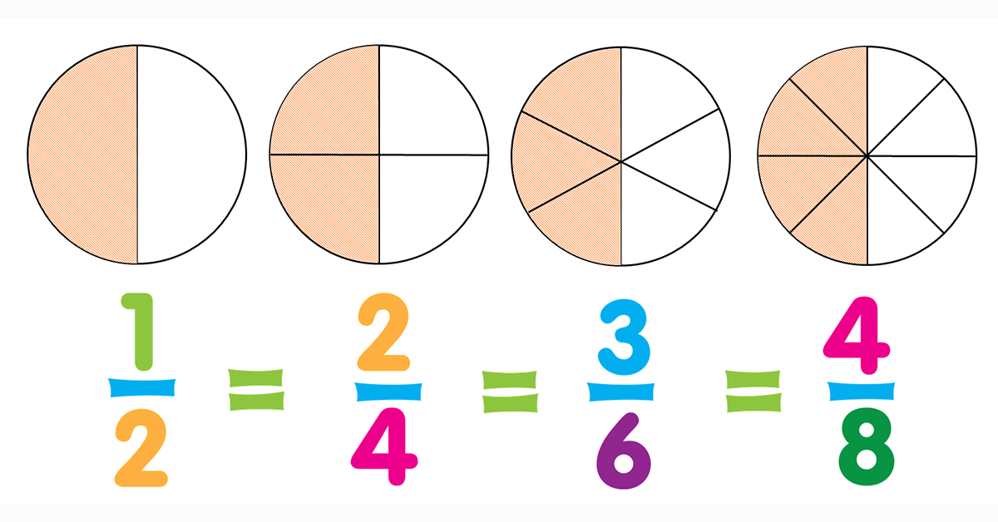
What I’m learning in Maths today
Maths – Y5 Date: 19.1.21
L.Obj: *I can become more confident at understanding, showing and recognising fractions and equivalent fractions.

Slide 2
Other Y5s
Sam, Ollie, Esme and Sophie
72 ÷ ___ = 6
___ ÷ 5 = 11
20 x 20 = ____
____ = 5³
41 ÷ 8 = _
10 x 30 x 10 = __
728 ÷ 10 = ___
60 x 30 = __
0.27 x 100 = _
98 ÷ 10 = ___
25.4 x 100 = __
1.6 ÷ 100 = __
3,298 ÷ 100 = __
4.2 x 1,000 = _
4 x 7 = ____
48 ÷ 8 = ___
12 x 3 = ___
45 ÷ 5 = ___
7 x 800 = ___
36 ÷ 4 = ___
2,000 x 9 = _
210 ÷ 3 = _
1,500 ÷ 5 = _
60 x 700 = _
91 x 10 = _
620 ÷ 10 = _

Slide 3
Other Y5s
Sam, Ollie, Esme and Sophie
72 ÷ 12 = 6
55 ÷ 5 = 11
20 x 20 = 400
125 = 5³
41 ÷ 8 = 5r1
10 x 30 x 10 = 3,000
728 ÷ 10 = 72.8
60 x 30 = 1,800
0.27 x 100 = 27
98 ÷ 10 = 9.8
25.4 x 100 = 2,540
1.6 ÷ 100 = 0.016
3,298 ÷ 100 = 32.98
4.2 x 1,000 = 4,200
4 x 7 = 28
48 ÷ 8 = 6
12 x 3 = 36
45 ÷ 5 = 9
7 x 800 = 5,600
36 ÷ 4 = 9
2,000 x 9 = 18,000
210 ÷ 3 = 70
1,500 ÷ 5 = 300
60 x 700 = 42,000
91 x 10 = 910
620 ÷ 10 = 62

Slide 4
Watch these two video links (they are also on the Jaguar page of the school website) to help you to understand more about fractions and equivalent fractions.
Keep pausing the video if you need to to help you.
https://www.bbc.co.uk/bitesize/topics/zsxhfg8/articles/zwjwgdm
https://www.bbc.co.uk/bitesize/articles/zb8wqp3
When you have finished watching the videos, you can use these activities to further your understanding.
Confident at equivalent fractions?
https://www.mathplayground.com/Triplets/index.html
Need more support on understanding fractions?
https://www.bbc.co.uk/bitesize/topics/z3rbg82/articles/zt7nfrd
https://phet.colorado.edu/sims/html/fractions-intro/latest/fractions-intro_en.html

