Slide 1
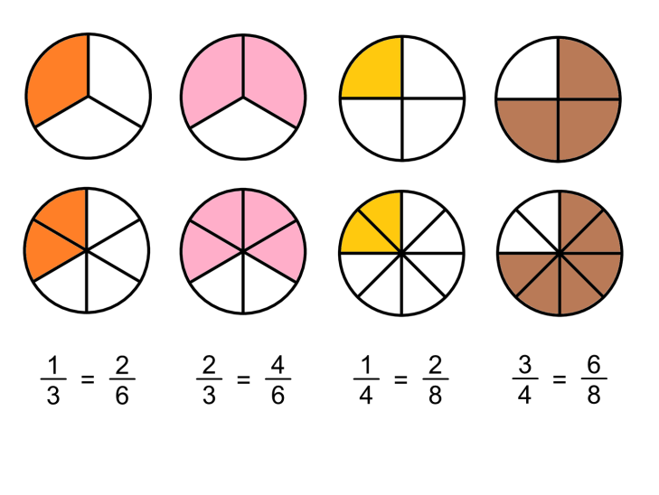
What I’m learning in Maths today
Maths – Y5 (Improper fractions to Mixed numbers) Date: 28.1.21
L.Obj: *I can show equivalent fractions and explain my use of division or multiplication to help me.
*I understand and can explain the meaning of a ‘mixed number’ (mixed fraction) and an ‘improper’ fraction.
*I can convert improper fractions into mixed fractions.

Slide 2
Other Y5s
Sam, Sophie, Esme and Ollie
320 ÷ ___ = 4
___ ÷ 6 = 11
12 x 11 = ____
____ = 6 x 200
4,500 ÷ 9 = _
60 x 60 x 10 = __
910 ÷ 10 = ___
4² + 20 = __
3.2 x 100 = _
79 ÷ 10 = ___
2.18 x 100 = __
498 ÷ 100 = __
1,293 ÷ 100 = __
5.8 x 1,000 = _
4 x 8 = ____
42 ÷ 7 = ___
11 x 3 = ___
32 ÷ 4 = ___
7 x 800 = ___
56 ÷ 6 = ___
300 x 9 = _
210 ÷ 3 = _
1,600 ÷ 4 = _
90 x 300 = _
71 x 10 = _
250 ÷ 10 = _

Slide 3
Other Y5s
Esme, Ollie, Sophie and Sam
320 ÷ 80 = 4
66 ÷ 6 = 11
12 x 11 = 132
1,200 = 6 x 200
4,500 ÷ 9 = 500
60 x 60 x 10 = 36,000
910 ÷ 10 = 91
4² + 20 = 36
3.2 x 100 = 320
79 ÷ 10 = 7.9
2.18 x 100 = 218
498 ÷ 100 = 4.98
1,293 ÷ 100 = 12.93
5.8 x 1,000 = 5,800
4 x 8 = 32
42 ÷ 7 = 6
11 x 3 = 33
32 ÷ 4 = 8
7 x 800 = 5,600
56 ÷ 6 = 9r2
300 x 9 = 2,700
210 ÷ 3 = 70
1,600 ÷ 4 = 400
90 x 300 = 27,000
71 x 10 = 710
250 ÷ 10 = 25

Slide 4
We can turn improper fractions into mixed numbers.
Do you want to see how?

Slide 5
TO CHANGE AN IMPROPER FRACTION INTO A MIXED NUMBER, IT’S EASY!
IMPROPER
7
4
MIXED NUMBER
3
4
1
=
What is 7 ÷ 4?
(How many 4s go into 7) ?
1 r 3
The denominator stays as 4

Slide 6
TO CHANGE AN IMPROPER FRACTION INTO A MIXED NUMBER, IT’S EASY!
IMPROPER
8
3
MIXED NUMBER
2
3
2
=
What is 8 ÷ 3?
(How many 3s go into 8) ?
2 r 2
The denominator stays as 3

Slide 7
TO CHANGE AN IMPROPER FRACTION INTO A MIXED NUMBER, IT’S EASY!
IMPROPER
7
5
MIXED NUMBER
2
5
1
=
What is 7 ÷ 5?
(How many 5s go into 7) ?
1 r 2
The denominator stays as 5

Slide 8
TO CHANGE AN IMPROPER FRACTION INTO A MIXED NUMBER, IT’S EASY!
IMPROPER
14
3
MIXED NUMBER
2
3
4
=
What is 14 ÷ 3?
(How many 3s go into 14) ?
4 r 2
The denominator stays as 3

Slide 9
Varied Fluency 1
Show these improper fractions as a diagram and write
as a mixed number.
a. | 7
 | 4
b. | 11
 | 3
c. | 14
 | 11
3
4
1
2
3
3
3
11
1
© Classroom Secrets Limited 2019

Slide 10
Varied Fluency 2
Convert these improper fractions into mixed numbers.
a. | 14 |  | b. | 19 |  | c. | 17 |  | d. | 23
 | 8 |  |  | 12 |  |  | 5 |  |  | 7
© Classroom Secrets Limited 2019

Slide 11
Varied Fluency 2
Convert these improper fractions into mixed numbers.
a. | 14 |  | b. | 19 |  | c. | 17 |  | d. | 23
 | 8 |  |  | 12 |  |  | 5 |  |  | 7
a. 1 | 6 |  | b. 1 | 7 |  | c. 3 | 2 |  | d. 3 | 2
 | 8 |  |  | 12 |  |  | 5 |  |  | 7
1 | 3
 | 4
© Classroom Secrets Limited 2019

Slide 12
Varied Fluency 3
Which answer matches the diagram?
a. | 28 |  | b. | 12 |  | c. | 31 |  | d. | 20
 | 7 |  |  | 7 |  |  | 7 |  |  | 7
© Classroom Secrets Limited 2019

Slide 13
Varied Fluency 3
Which answer matches the diagram?
a. | 28 |  | b. | 12 |  | c. | 31 |  | d. | 20
 | 7 |  |  | 7 |  |  | 7 |  |  | 7
© Classroom Secrets Limited 2019

Slide 14
Reasoning 1
Find and correct the mistakes. Explain your answer.
a. | 19 |  | = |  | 2 | 1
 | 9 |  |  |  |  | 9
b. | 24 |  | = |  | 3 | 4
 | 7 |  |  |  |  | 7
c. | 31 |  | = |  | 3 | 8
 | 8 |  |  |  |  | 7
d. | 24 |  | = |  | 2 | 4
 | 10 |  |  |  |  | 10
© Classroom Secrets Limited 2019

Slide 15
Reasoning 1
Find and correct the mistakes. Explain your answer.
B – the numerator should be 3.
C – the numerator and denominator have been mixed up.
a. | 19 |  | = |  | 2 | 1
 | 9 |  |  |  |  | 9
b. | 24 |  | = |  | 3 | 3
 | 7 |  |  |  |  | 7
c. | 31 |  | = |  | 3 | 7
 | 8 |  |  |  |  | 8
d. | 24 |  | = |  | 2 | 4
 | 10 |  |  |  |  | 10
© Classroom Secrets Limited 2019

Slide 16
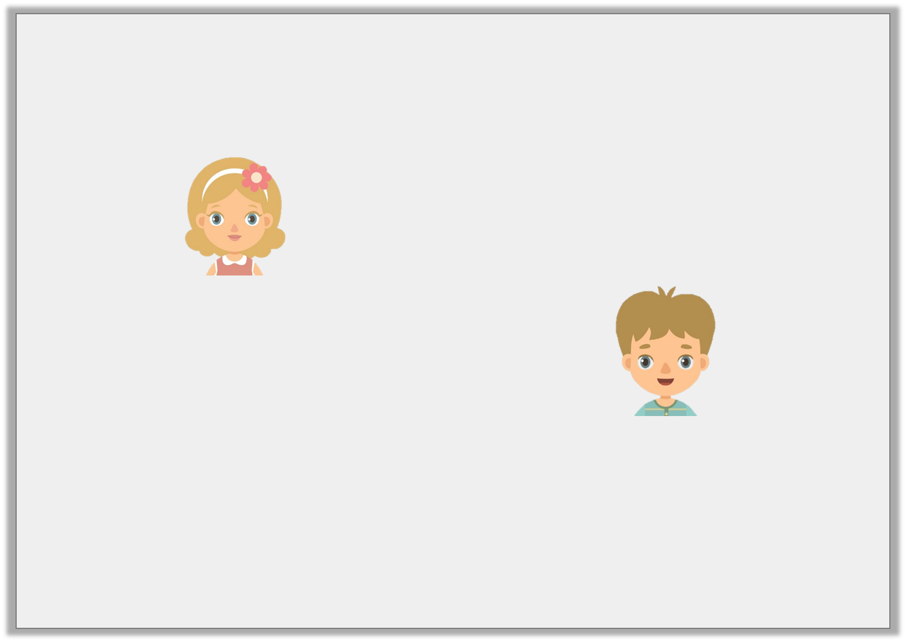
Reasoning 2
Four pizzas are bought for a party. They are cut into 6 equal slices. At the end of the party, there are 9 slices of pizza left.
Who is correct? Prove it.
There is left.
1 | 3
 | 6
Jane
There is left.
1 | 9
 | 6
Tom
© Classroom Secrets Limited 2019

Slide 17
Reasoning 2
Four pizzas are bought for a party. They are cut into 6 equal slices. At the end of the party, there are 9 slices of pizza left.
Who is correct? Prove it.
Jane is correct because there is of the pizza left which, as a mixed number, is 1 .
There is left.
1 | 3
 | 6
Jane
There is left.
1 | 9
 | 6
Tom
9
6
3
6
© Classroom Secrets Limited 2019

Slide 18
Balancing Equations – Fill in the missing number
80 - 50 = 5 x ___
30 x 20 = 1,000 - ____
9 x 4 = ___²
60 ÷ 5 = 7 + ___
Double 65 = 150 - ___
4.2 x 10 = 6 x ___

