Slide 1


Slide 3


1) Which symbol means ‘is equal to’?
2) Which symbol means ‘is greater than’?
3) Which symbol means ‘is less than’?
4) What is the correct symbol?
>
<
=
>
<
=
>
<
=

Slide 4
1) Which symbol means ‘is equal to’?
2) Which symbol means ‘is greater than’?
3) Which symbol means ‘is less than’?
4) What is the correct symbol?
>
<
=
>
<
=
>
<
=
>

Slide 6



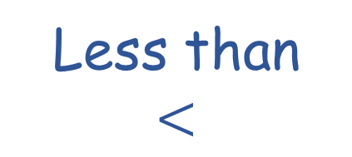
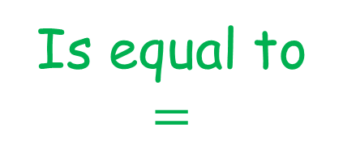
What do we say when we compare objects?
Fewer
Is equal to
$$=$$
More
Less than
$$<$$
Greater than
$$>$$

Slide 7

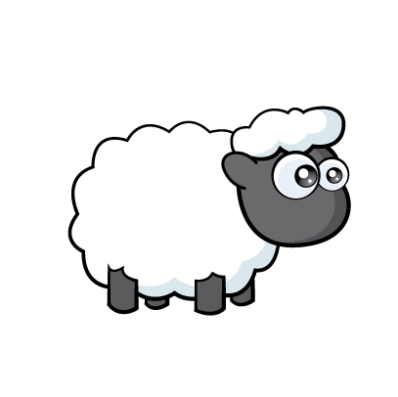
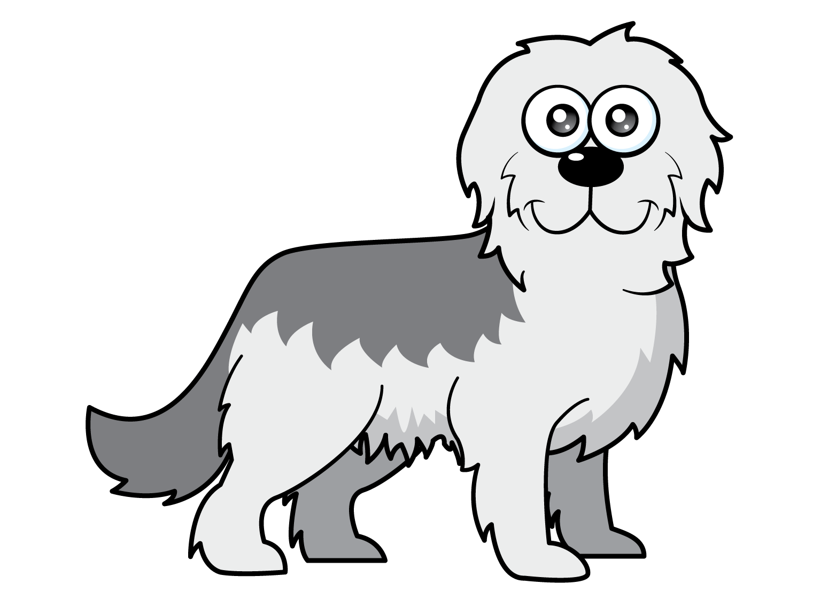
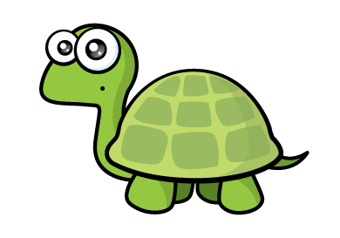
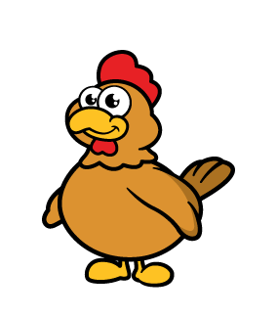
Let’s compare animals!
10
9
16
13
The number of is greater than
the number of
v

Slide 8
Let’s compare animals!
10
9
16
13
The number of is less than
the number of

Slide 9
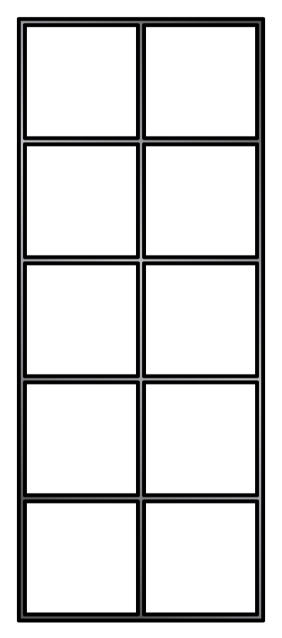



How can we compare objects?
There are 18 donuts
Have a think
There are 19 biscuits
There are fewer than
There are more than

Slide 10
Have a go at question 1 on the worksheet

Slide 11
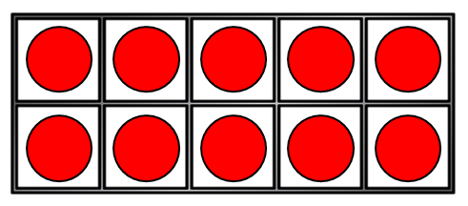
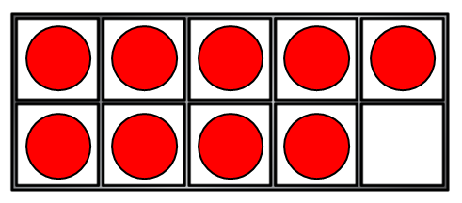
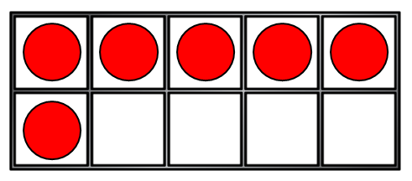
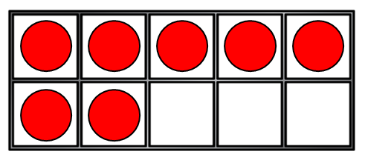
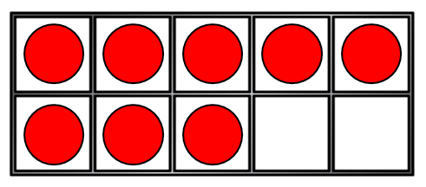
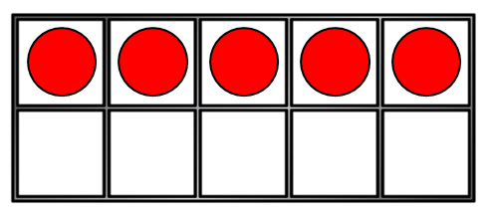
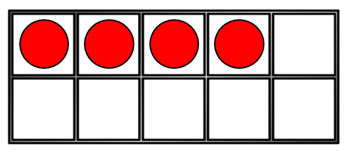
Let’s compare!
Have a think
16
=
16
13
<
14

Slide 12
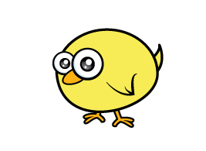
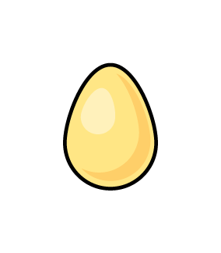
Have a think
There are 30 chicks.
There are 28 eggs.
There are more chicks than eggs.
How many eggs could there be?
26, 27, 28, 29

Slide 13
Have a go at question 2 on the worksheet

