Slide 1
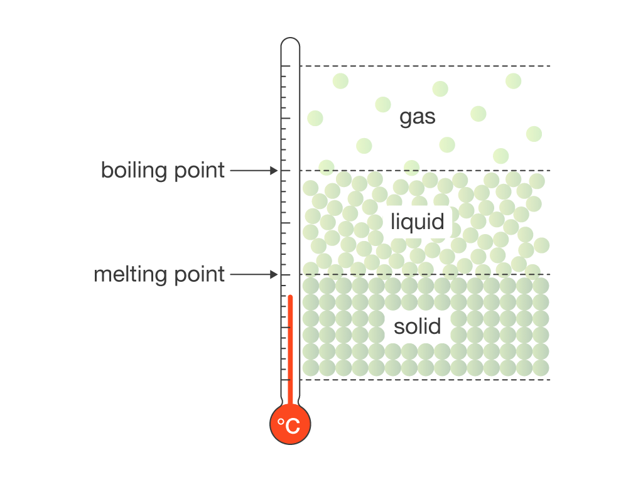
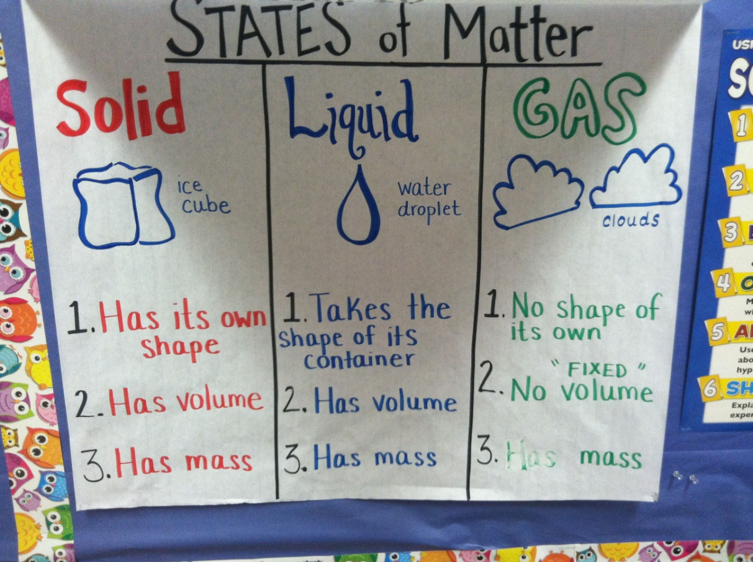
What I’m learning in Science today
Date: Wednesday 27th January 2021
L.Obj: *I can explain how ‘boiling’ and ‘melting’ points affect solids, liquids and gases.
*I know the ‘boiling point’ and ‘melting point’ temperatures.

Slide 2
Last week, we learned about how the three states of matter can change from one state to another.
What do these scientific words mean?
expand
contract
freezing
melting
condensing
boiling
evaporating

Slide 3
Today, we are going to be learning about what happens when the three states ‘boil’ and ‘melt’.
We are also going to learn at what temperature materials ‘boil’ and ‘melt’ at.

Slide 4
Watch the links below.
Link 1 is a live lesson.
Link 2 is a quiz to test your understanding afterwards
Link 1
https://classroom.thenational.academy/lessons/what-are-melting-points-and-boiling-points-6djp8r?step=2&activity=video
Link 2
https://classroom.thenational.academy/lessons/what-are-melting-points-and-boiling-points-6djp8r?step=4&activity=exit_quiz

Slide 5
Tuesday 26th January 2021
Boling and Melting points
In your Science book, can you explain what you’ve learned about ‘boiling’ and ‘melting’, at what temperatures this happens at, and how it affects substances.
OTHER VIDEO TO WATCH
https://www.bbc.co.uk/bitesize/clips/zrmqxnb

