Slide 1
What I’m learning in Science today
Date: Tuesday 5th January 2021
L.Obj: *I can describe a material’s properties.
*I can sort and compare materials according to their properties.

Slide 2
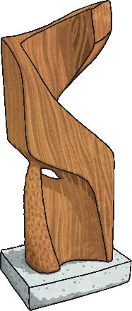
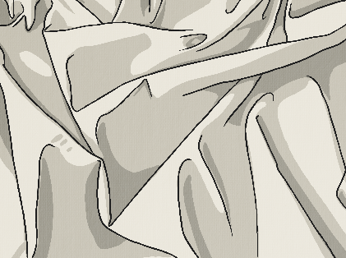
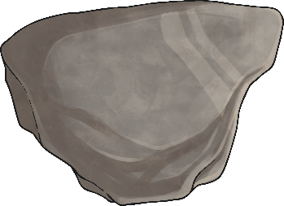
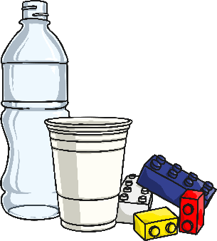
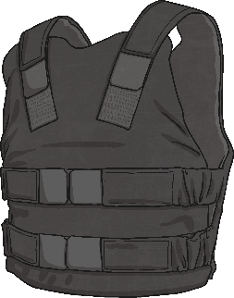
Describing Materials
Any substance that is used to make something is a material.
Natural materials such as stone, wood and cotton are used or worked with in the way they are found in nature.
Synthetic or human-made materials are made from natural materials, but are altered with the help of heat or chemicals. Some examples include plastics, polyester and Kevlar.
Natural
Human-made

Slide 3
Describing Materials
Look at the objects on your table which are made from different materials.
Whilst you are looking, think of words to describe each material, such as hard, soft, cold or rough.

Slide 4
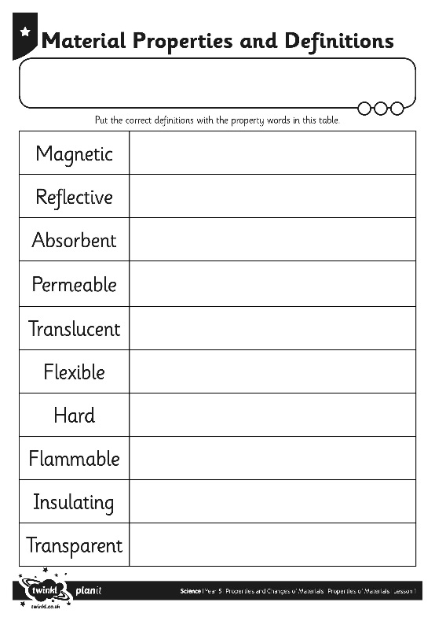
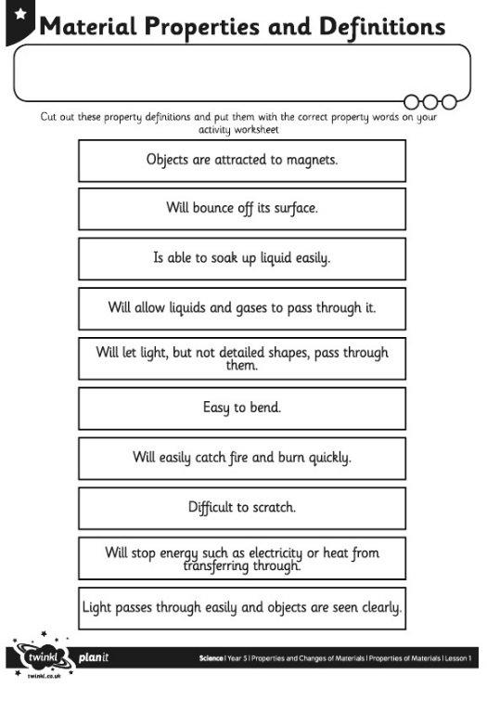
Properties
The words used to describe a material are known as its properties.
Each material has its own set of properties.
These properties make different materials useful for different purposes.
Can you match the properties with their definitions on your Material Properties Activity Sheet?

Slide 5
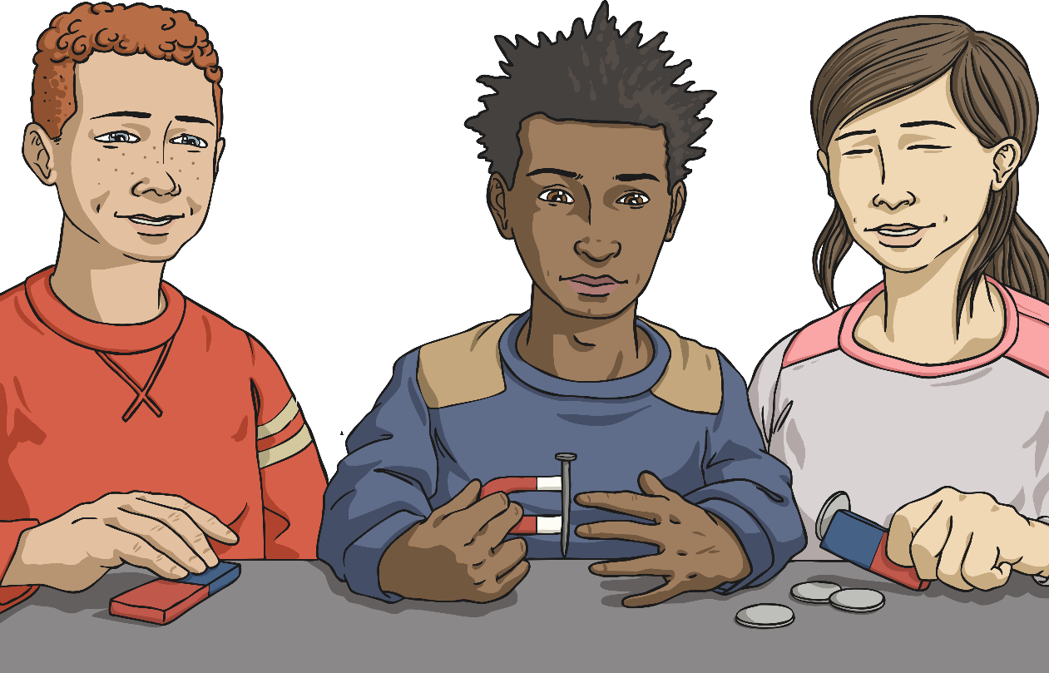
Testing Properties
To find out which properties a material has, they have to be tested.
You are going to test several different materials to find their properties.
You will test for:
magnetism;
hardness;
transparency;
flexibility;
permeability.

Slide 6
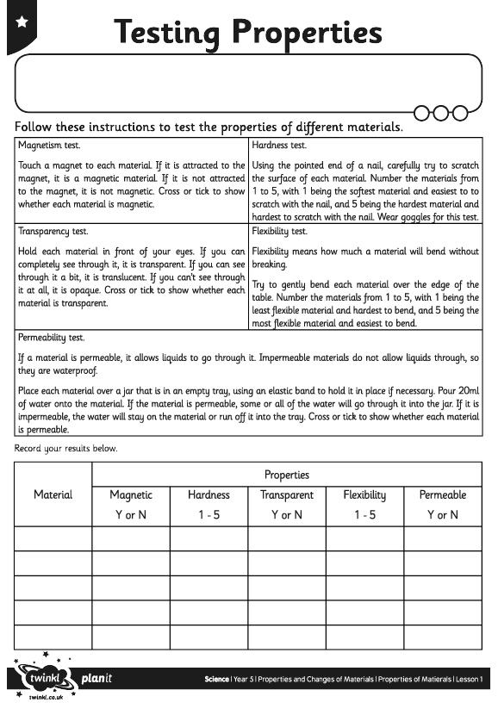
Testing Properties
Follow the instructions for each test, and try out each test with each material.
Complete your Testing Properties Activity Sheet with your results.

