Slide 1
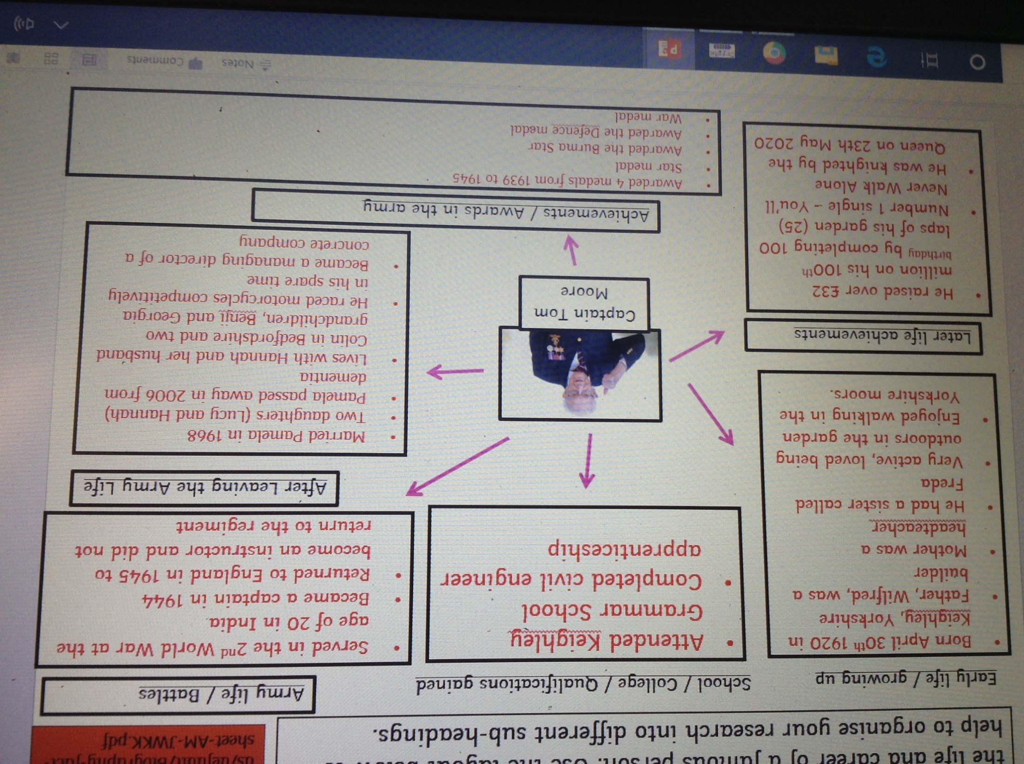
Class research about the life of Captain Tom

Slide 2
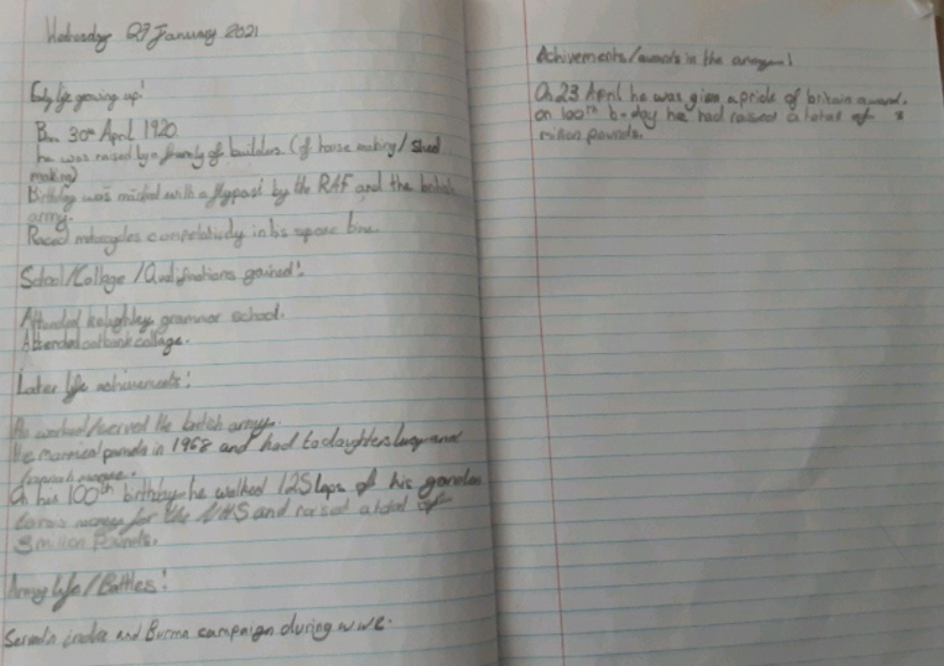
Lilly has been gathering and organizing her notes about Captain Tom Moore.

Slide 3
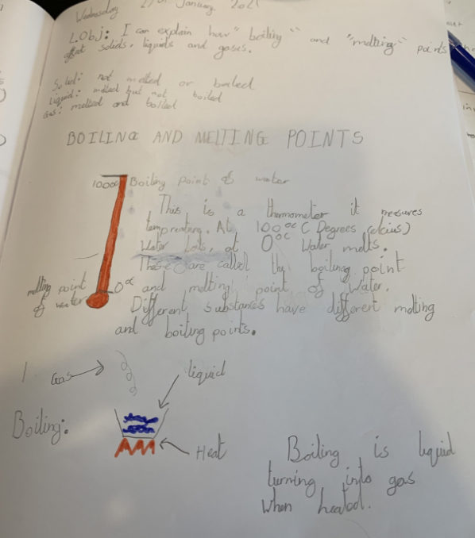
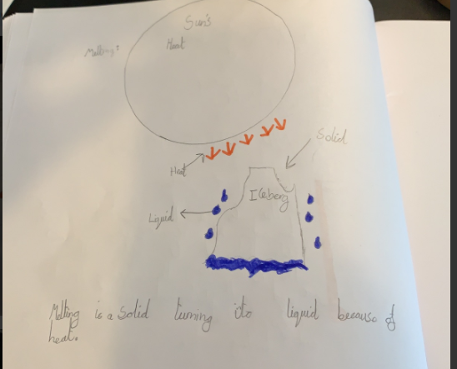
Alex has used writing and diagrams to show his understanding of boiling and melting points in Science.

Slide 4
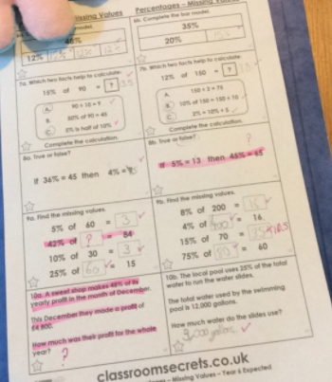
Holly H found these % a challenge today but showed great determination.

Slide 5
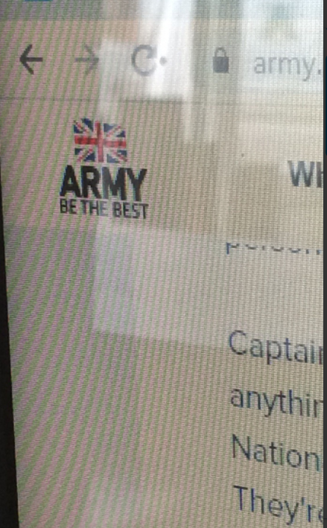
Isla used this website to help her to research the facts about the life of Captain Tom Moore.

Slide 6
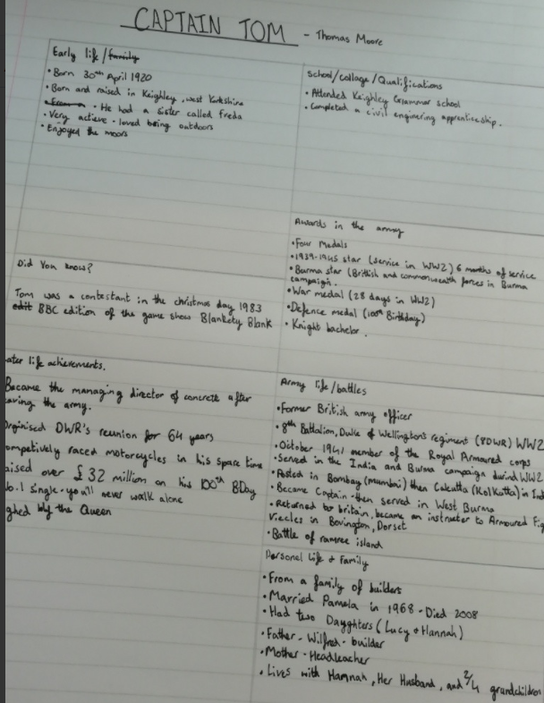
Amy has used her own layout to organise her research about the life of Captain Tom Moore.

Slide 7
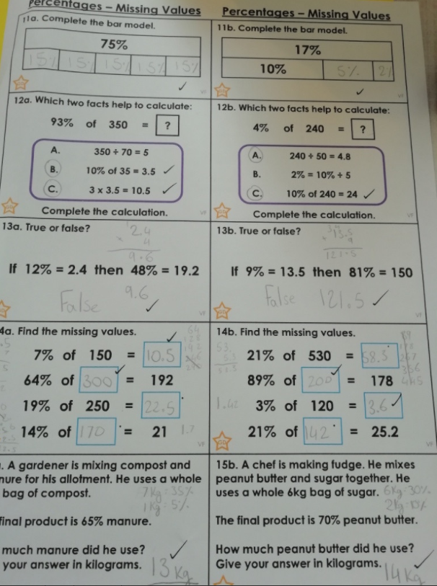
Amy needed to think really hard to be able to solve these tricky % calculations today.

Slide 8
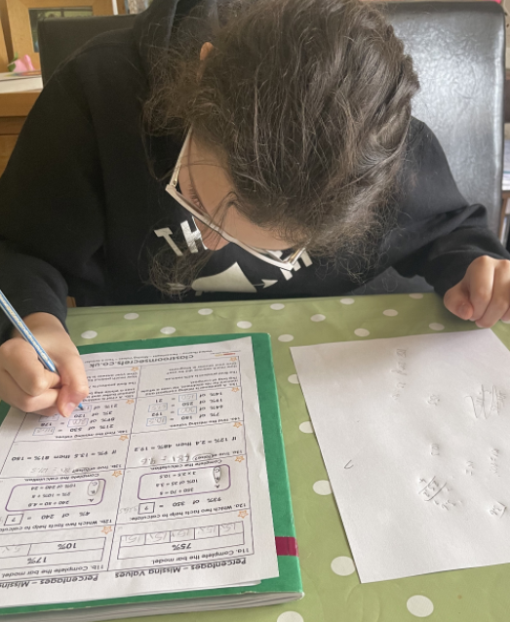
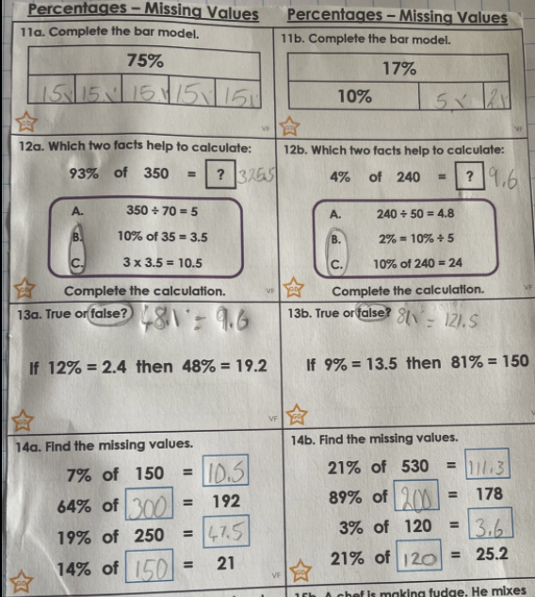
Nelly needed to be fully focused in her maths today.

Slide 9
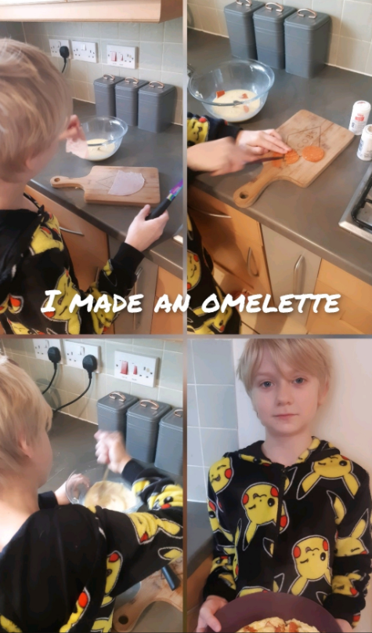
Ollie has found the time to make an omelette today.

Slide 10
Ollie has been gathering his own research.

Slide 11
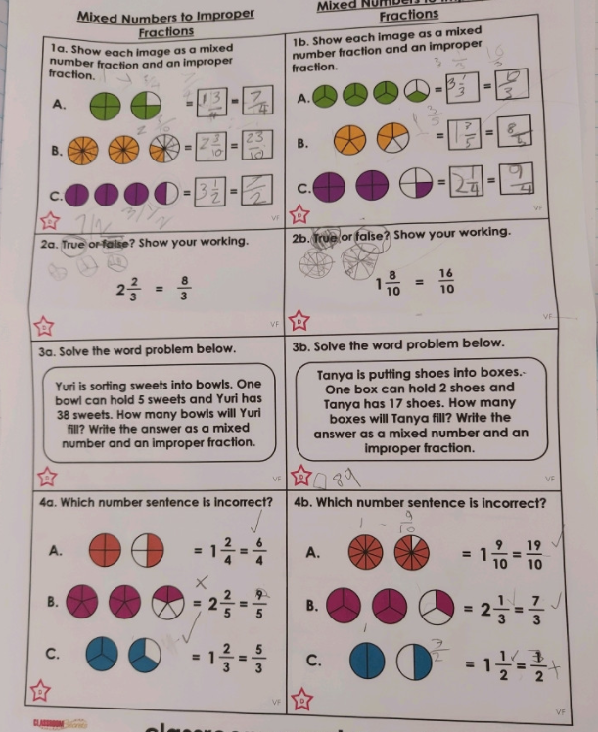
Ollie tried hard to convert his mixed numbers into improper fractions today in maths.

Slide 12
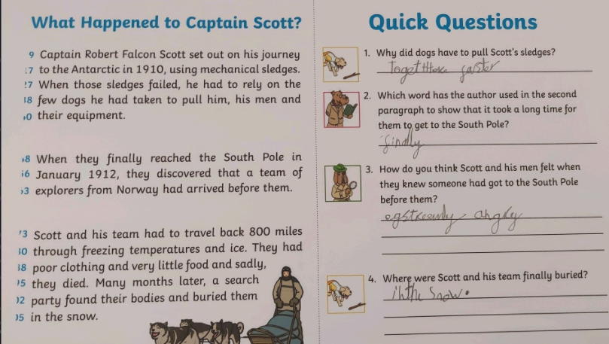
Ollie read his text about Captain Scott before locating the answers.

Slide 13
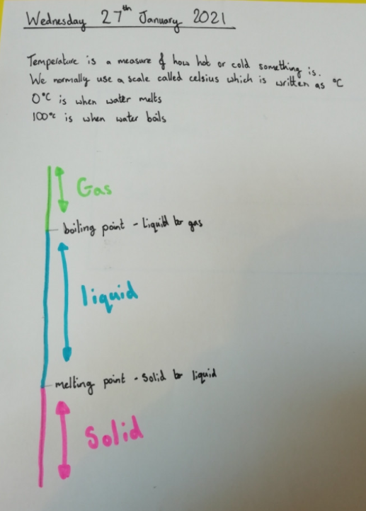
Amy has shown in written and diagram form what she understands about the melting point (ice to water) and the boiling point (water to gas).

Slide 14
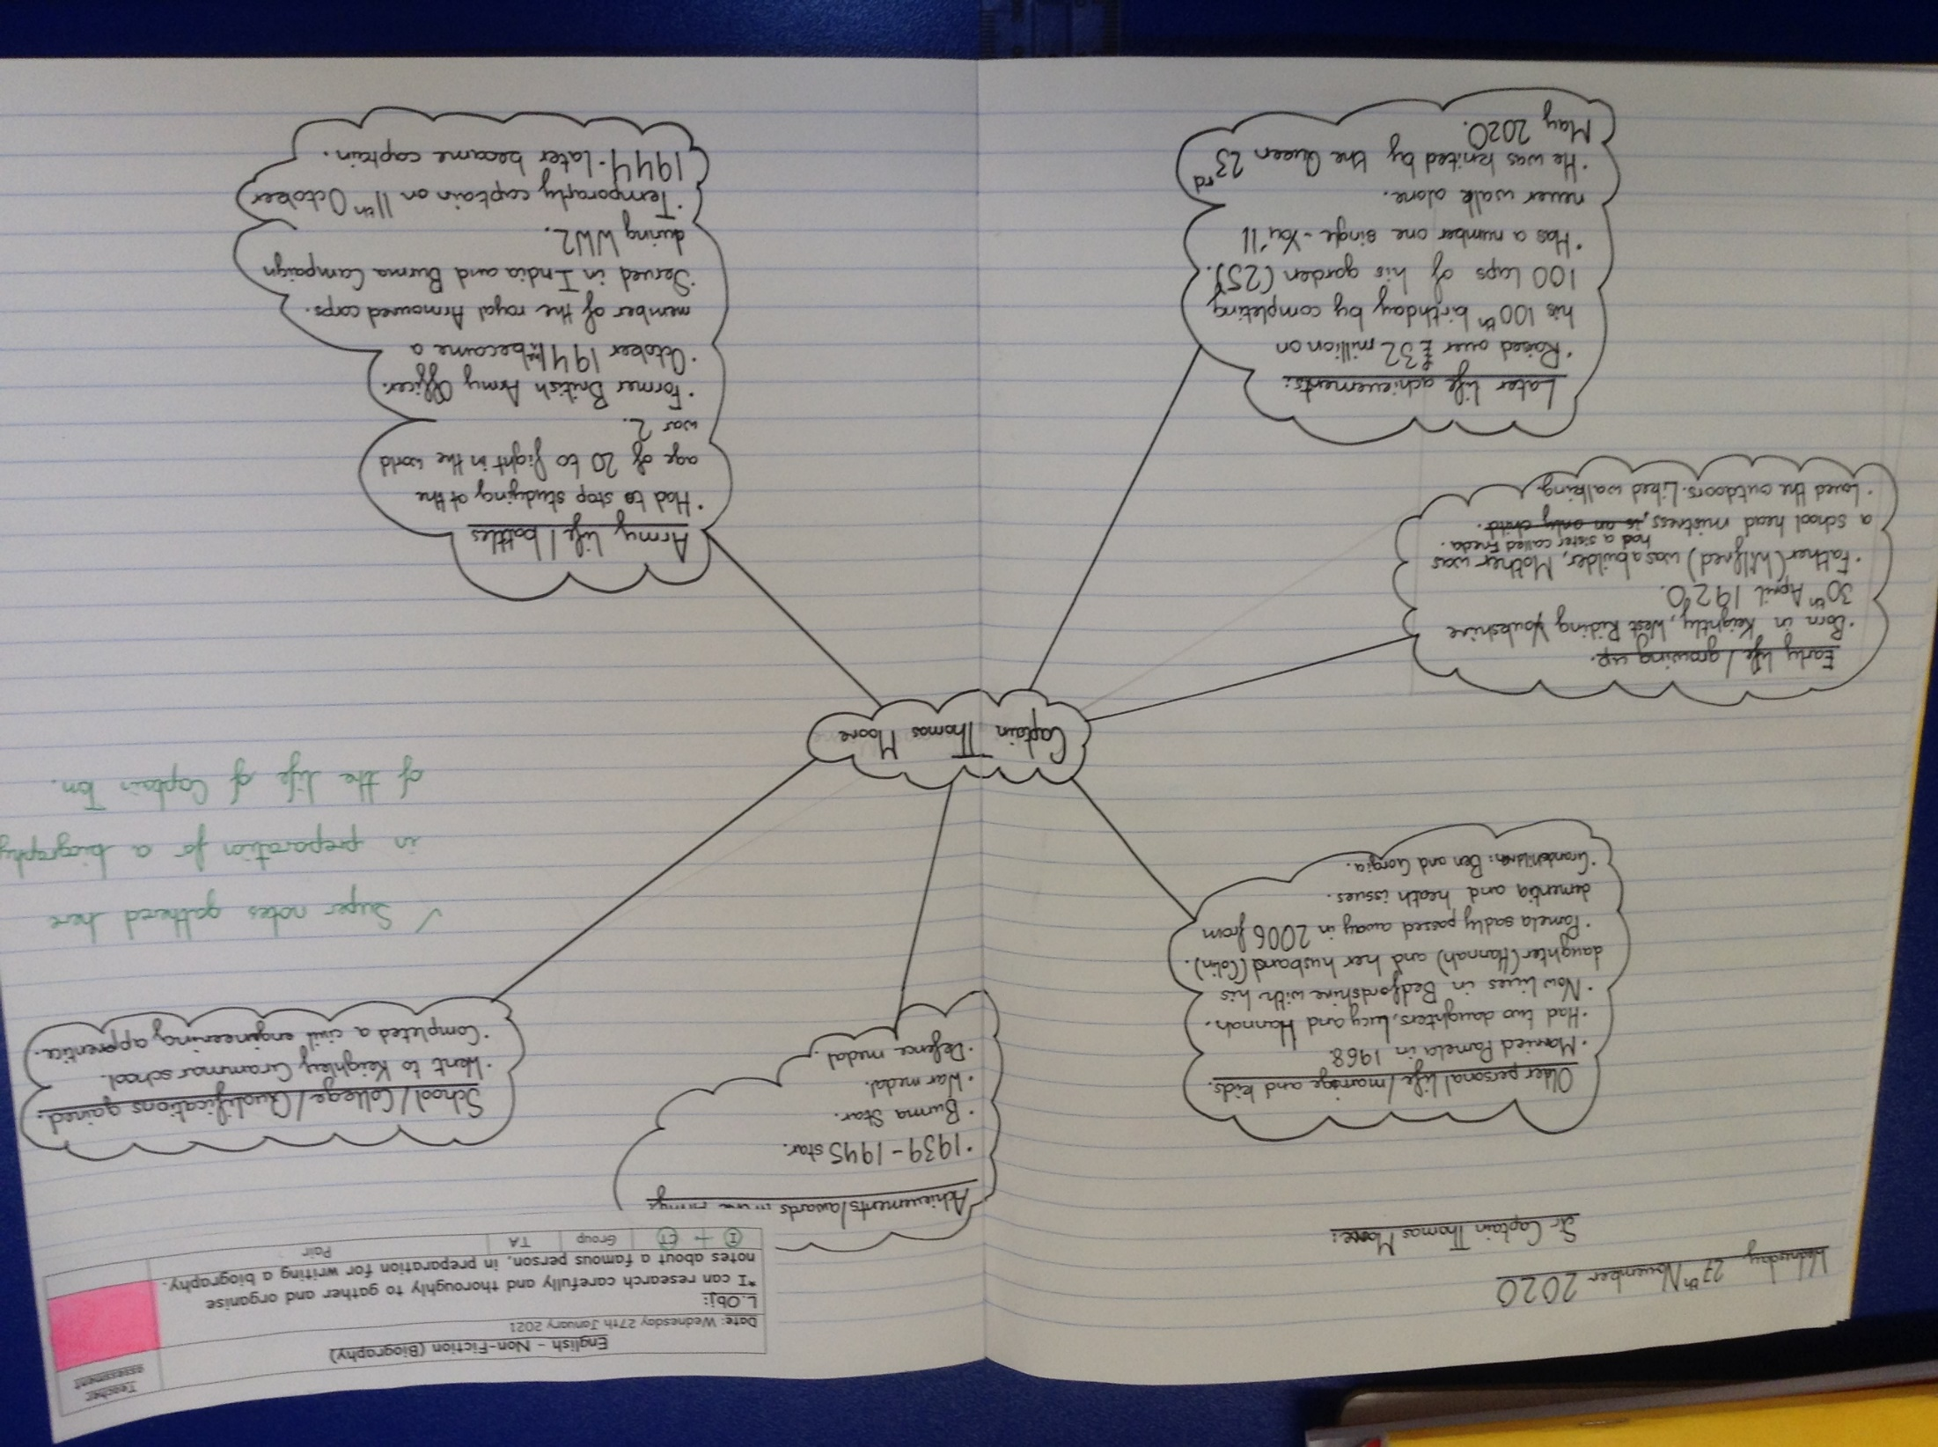
Nelly scored 100% on her maths calculations today.

Slide 15
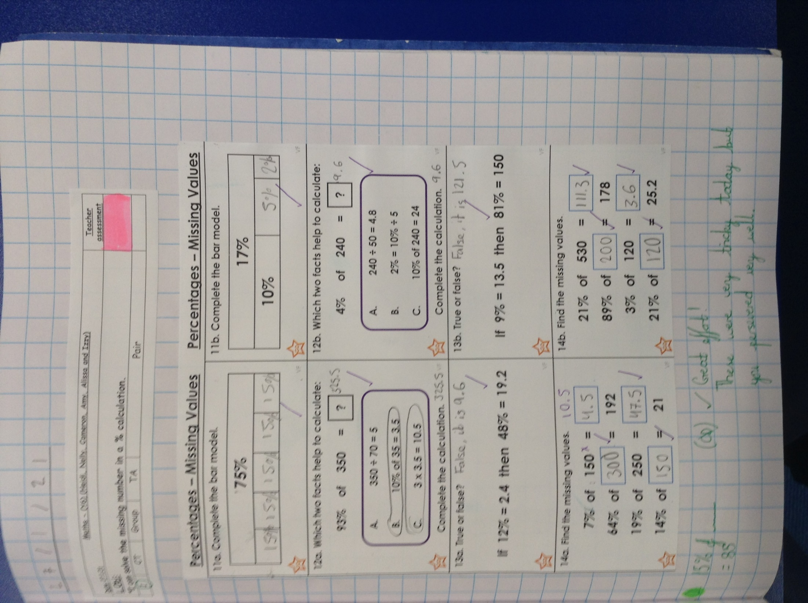
Amy’s comprehension answers today.

Slide 16
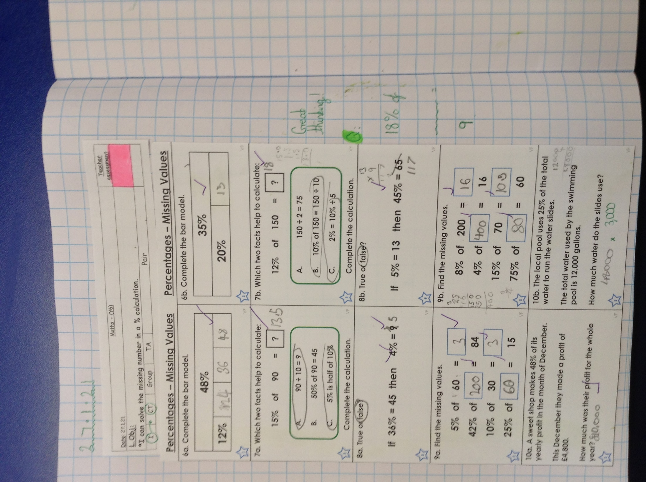
Cameron scored 100% on his maths calculations today.

Slide 17
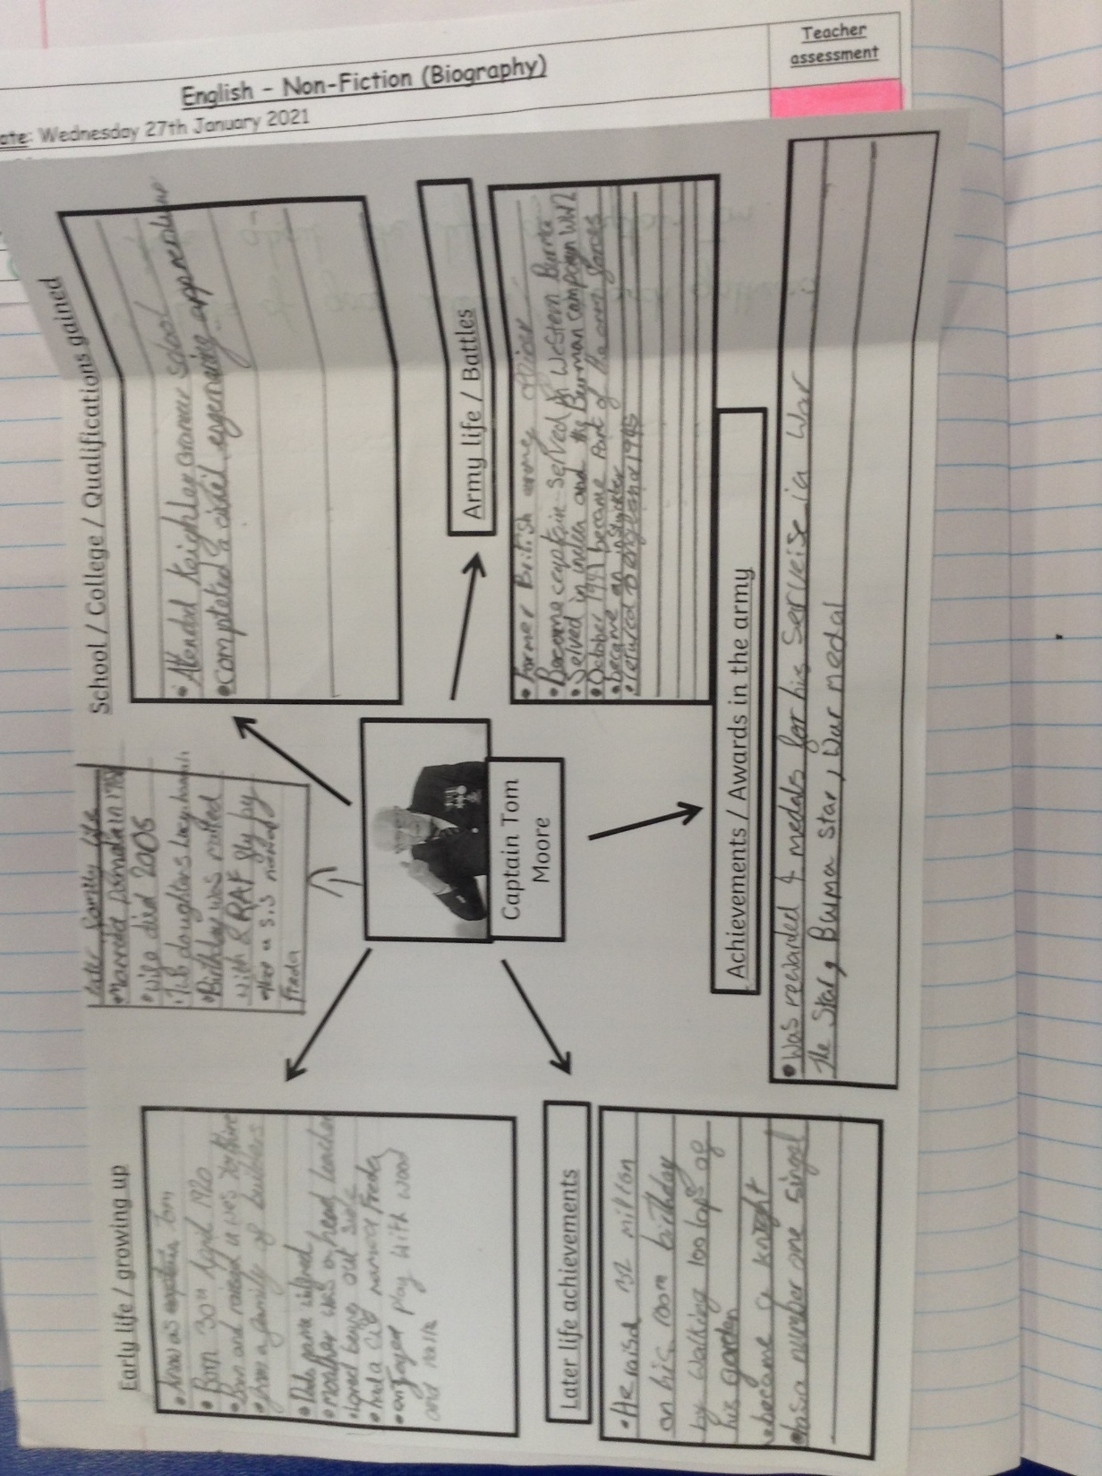
Sophie scored 100% on her maths calculations today.

Slide 18
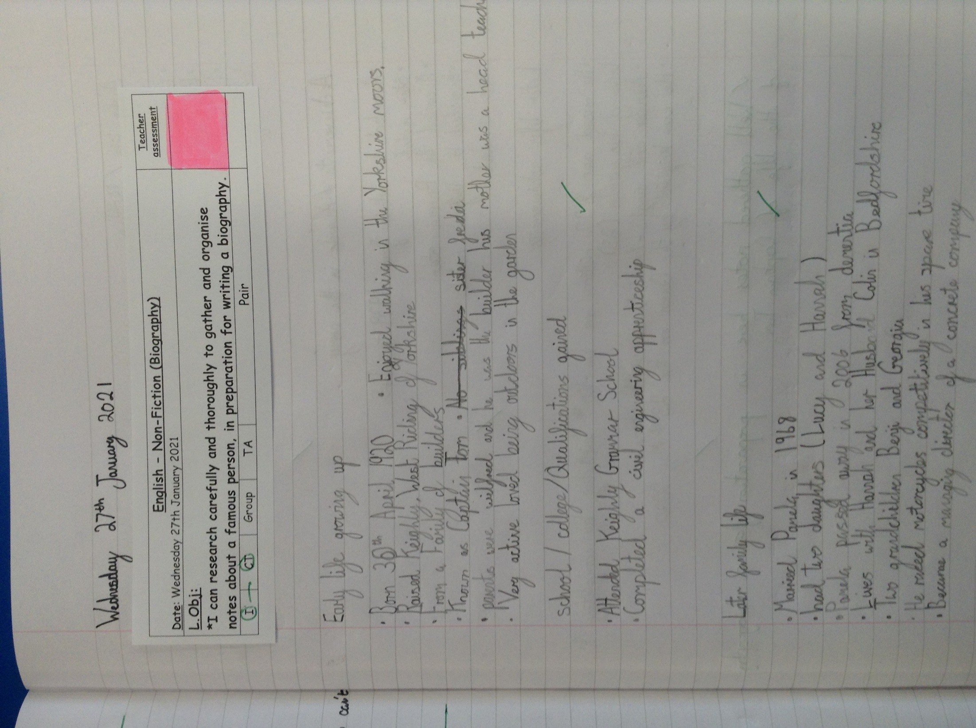
Heidi scored 100% on her multiplying and dividing by 10, 100 and 1,000 calculations today.

Slide 19
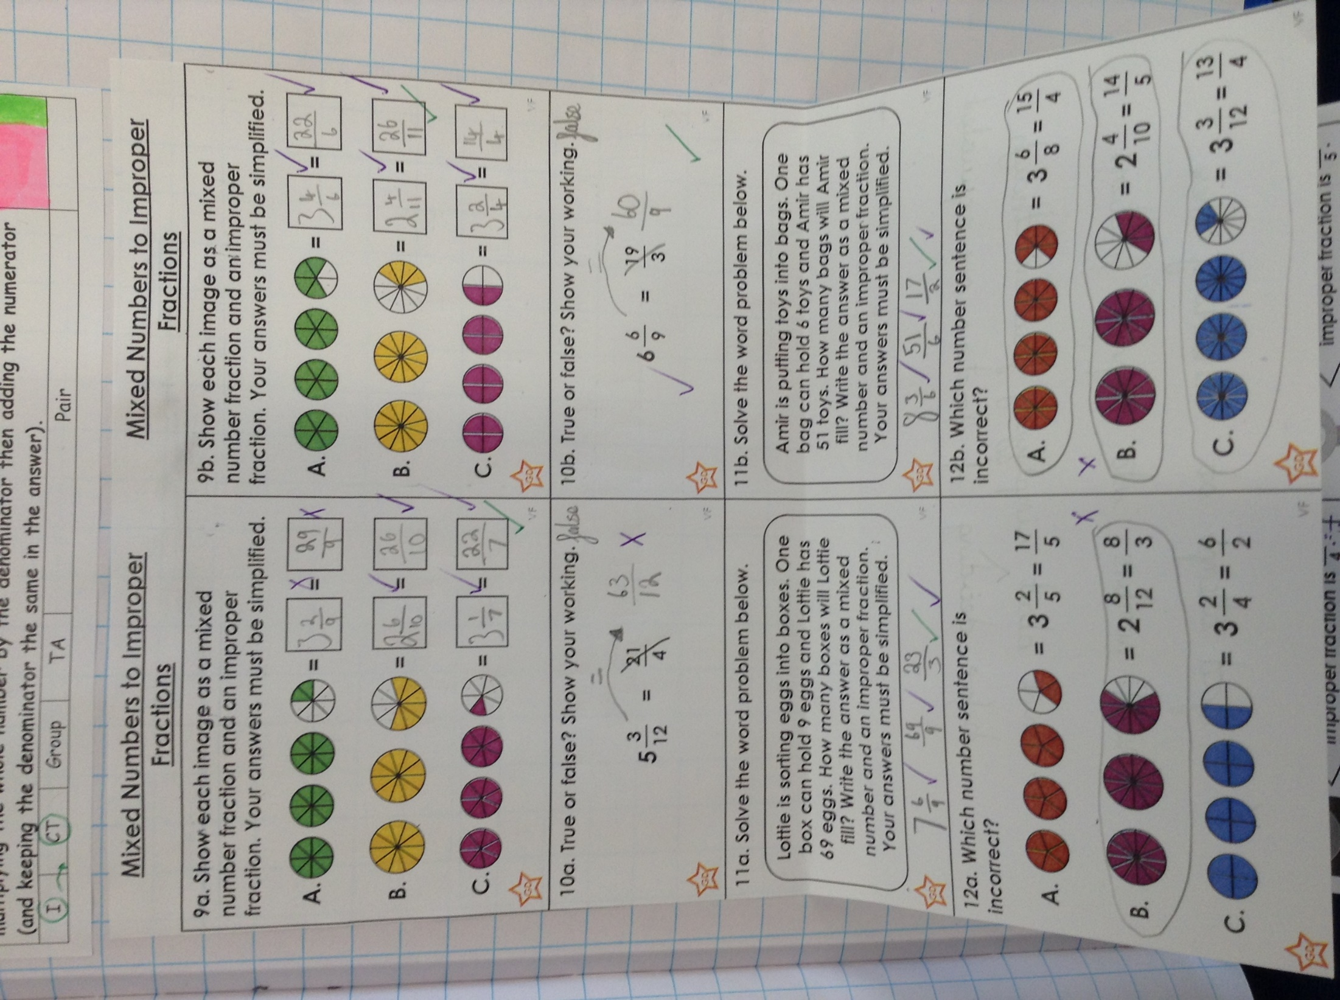
Heidi’s Topic front cover design

Slide 20
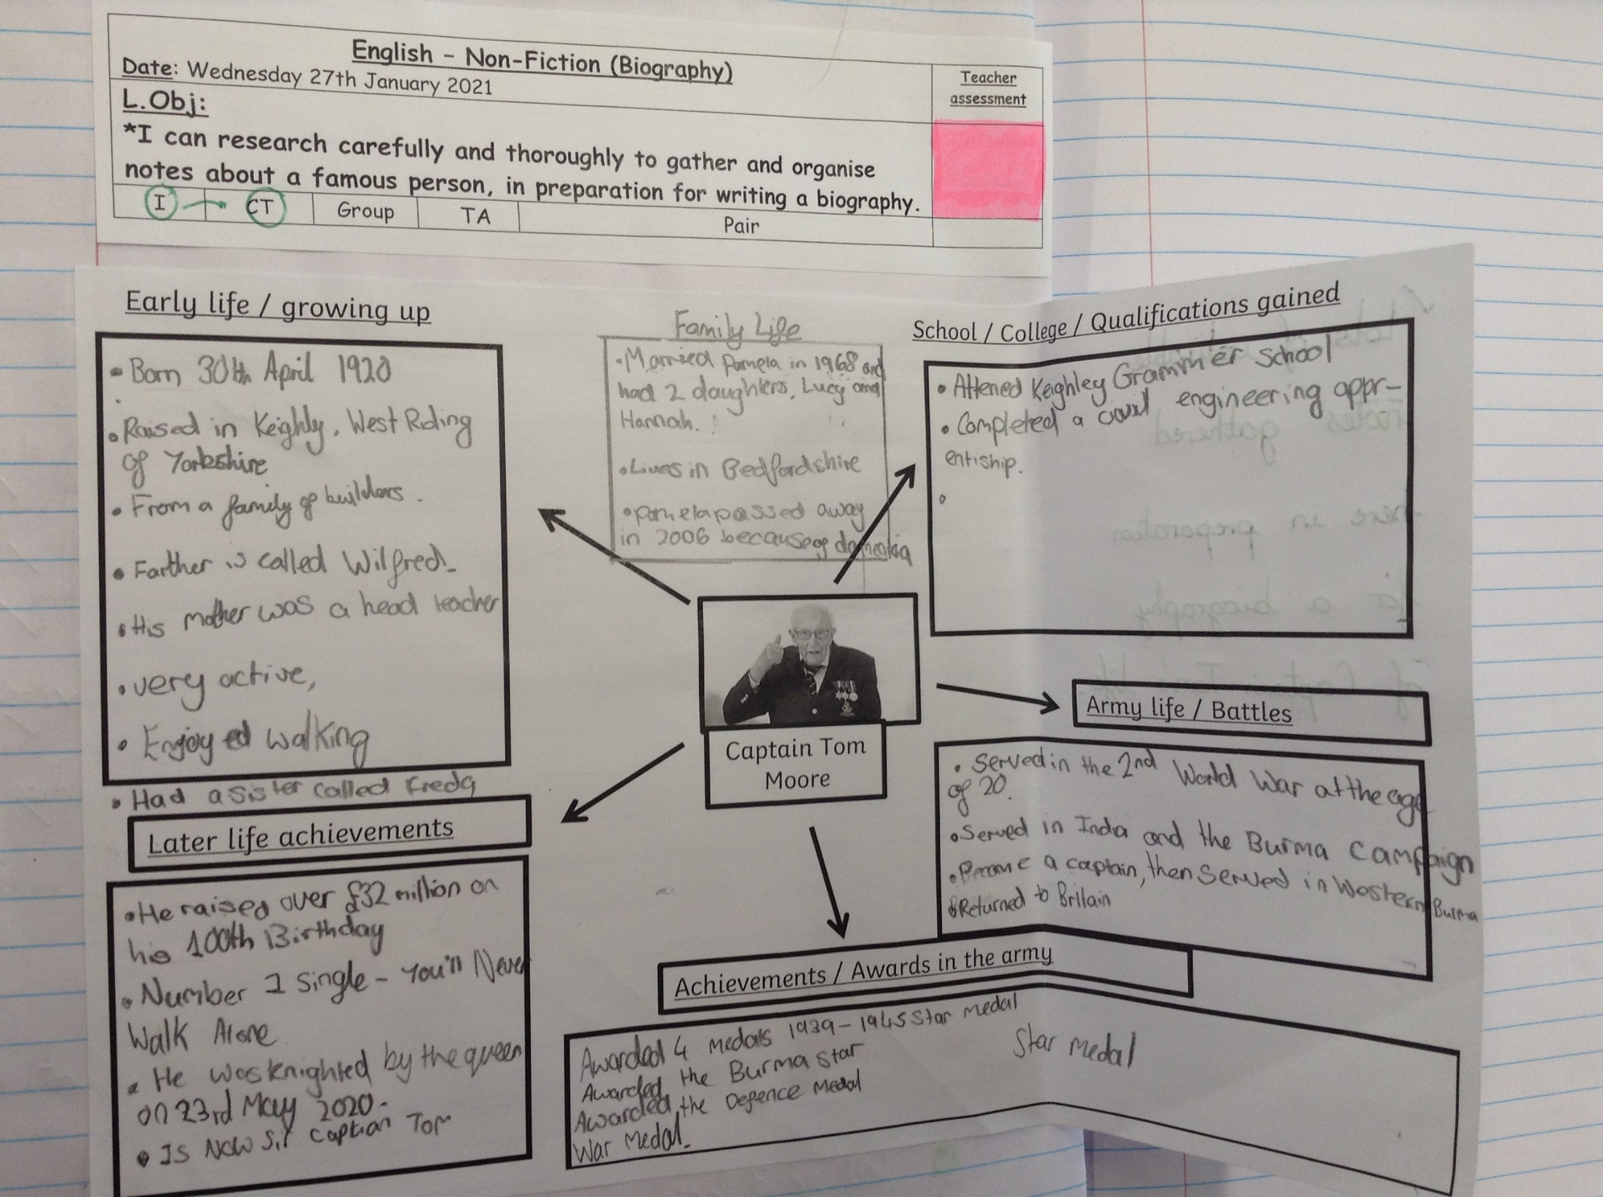
Dylan’s Topic front cover design

Slide 21
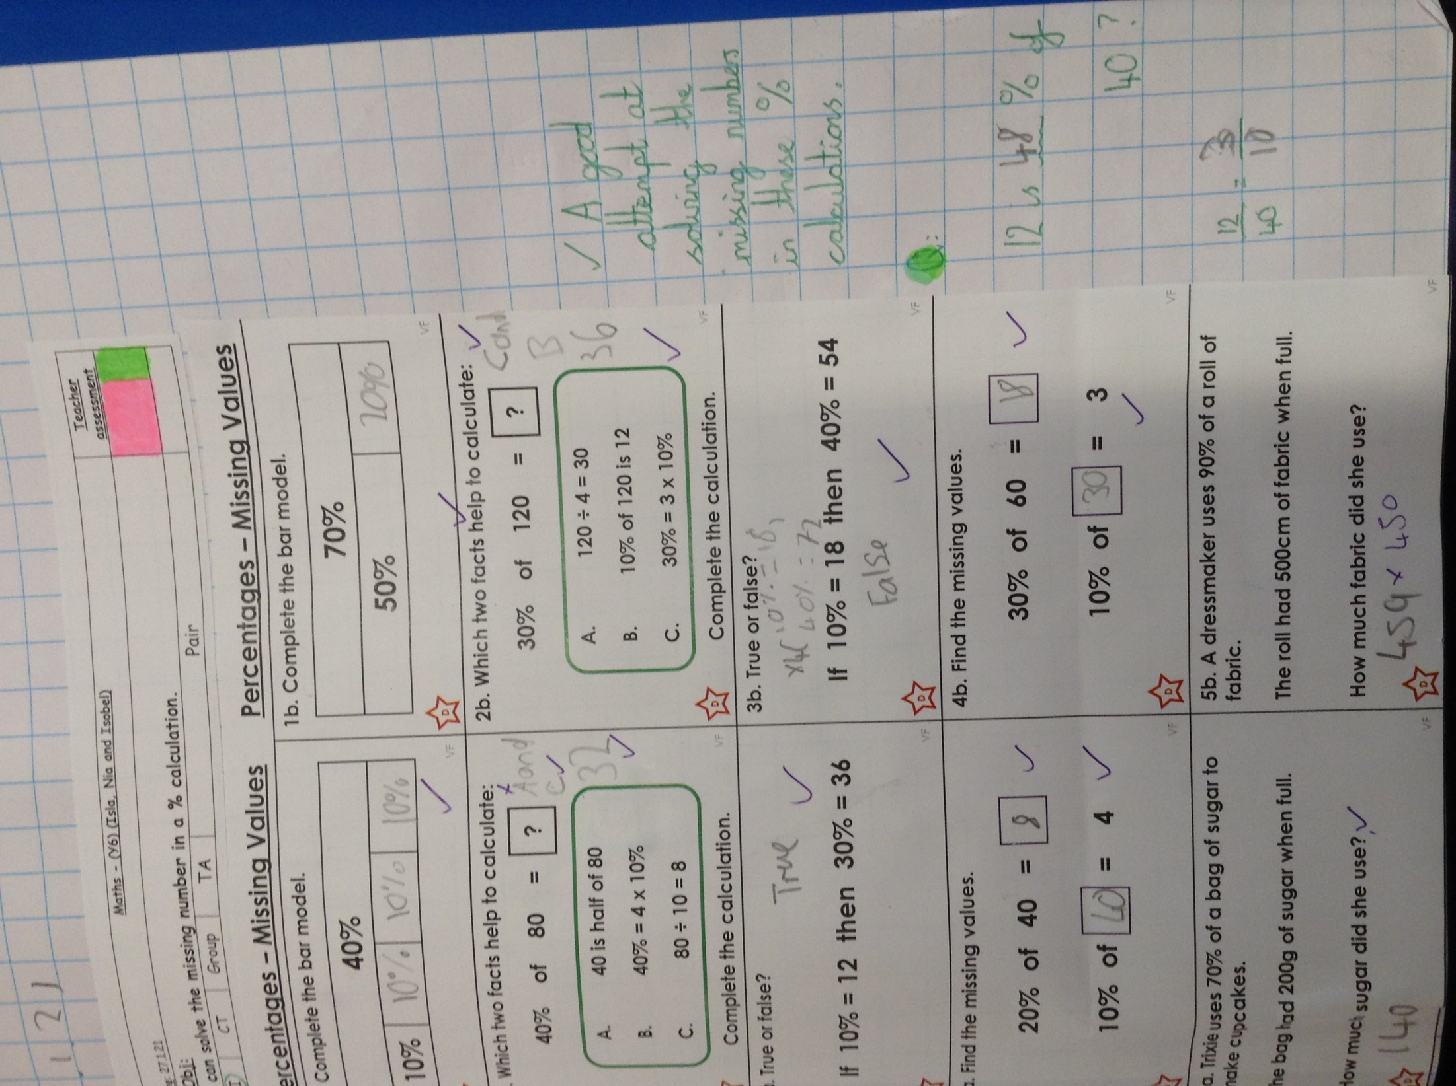
Cameron’s Topic front cover design

Slide 22
Sam’s Topic front cover design

Slide 23
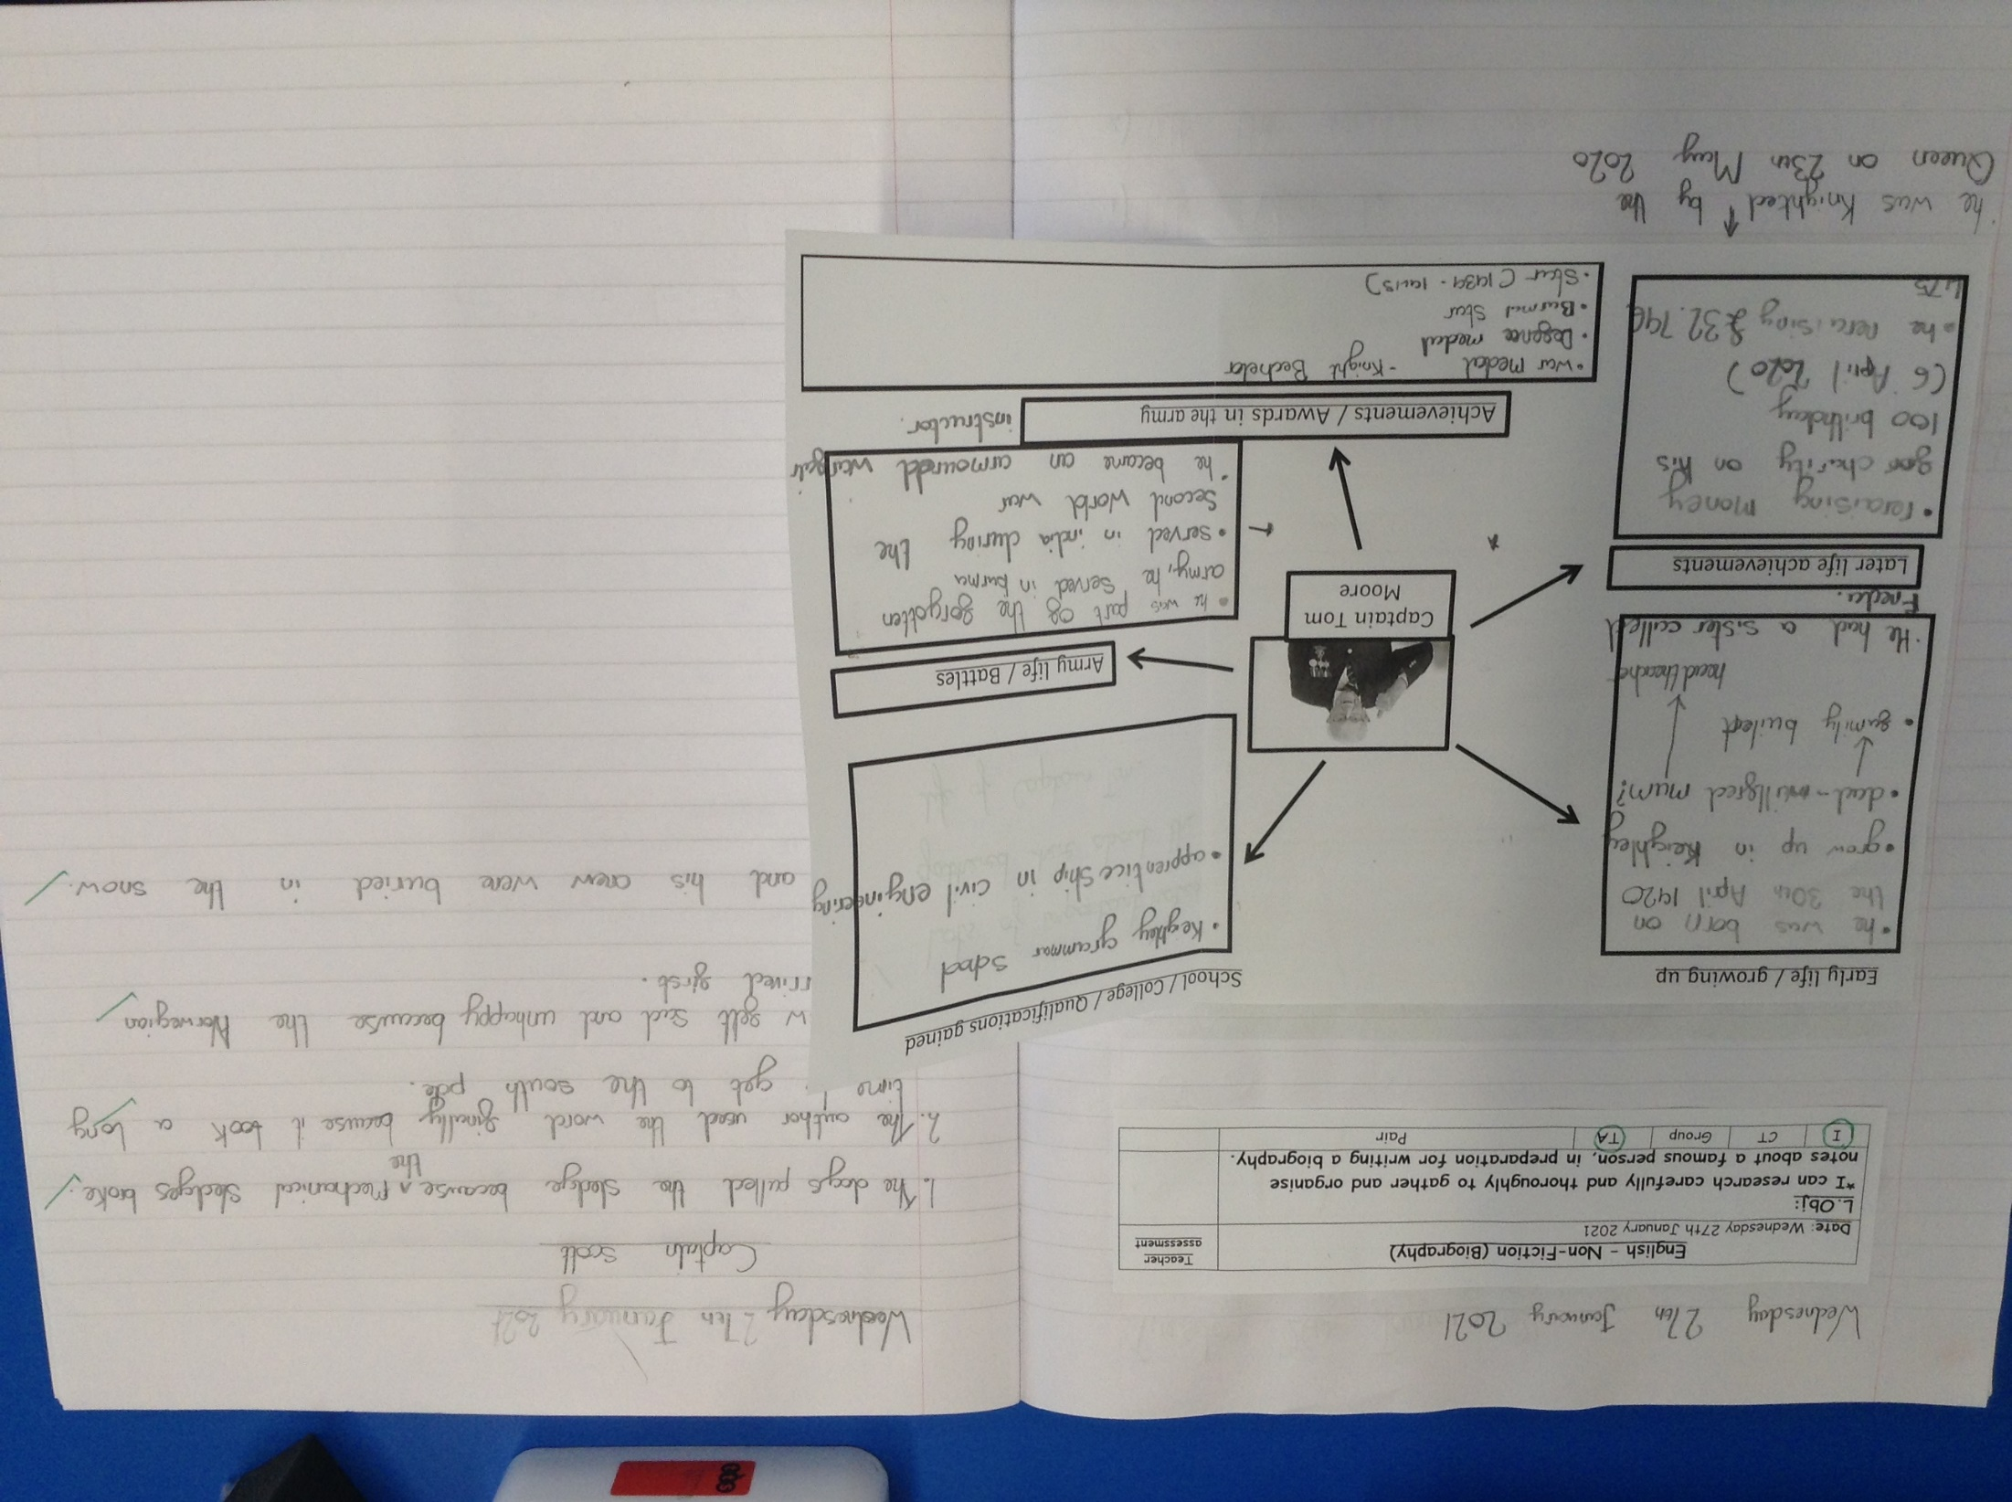
Ollie’s Topic front cover design

Slide 24
Nelly’s Topic front cover design

Slide 25
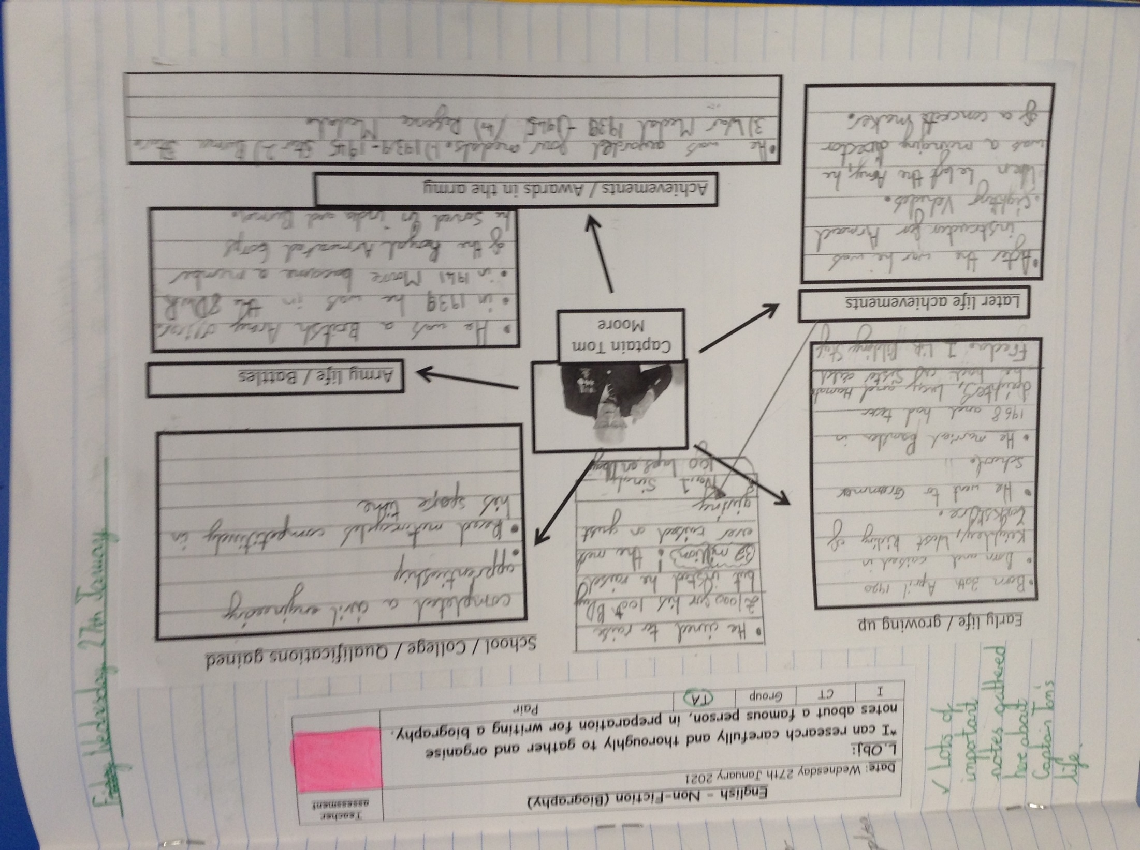
Rhys’ Topic front cover design

Slide 26
Cameron gathered his notes well today.
Captain Tom Moore
Early Life
Born 30th April 1920
Born in the town of Keighley
Father is Wilfred Moore
Born into a building family
Mother is a head teacher
School/ college info
His first school was a Keighley grammar school
In college he trained as a civil engineer
He went to Cranfeild uni
He has an honoury degree of a doctor at Cranfeild uni
His mother was called Pamela
Achievements
He has received the rarest blue peter badge (the gold badge)
He has received knighthood from the queen
He has got three war badges ( defence badge, Burma star and the war medal and the star medal)
Army life
He was in the second world war
He was in the Burma campaign battle of Ramree island
He was in the regiment Royal corps
He was in the Duke of wellington regiment
He was a British army officer
Other
His first wife was called Billie
His children are called Hannah and Lucy
He used to race motorcycles against others
His late wife was called Pamela in 1968 who passed away in 1968
At the moment he lives in Marston Moretaine, Bedfordshire
He raised over 32 million pounds by completing 100 laps right before his 100th birthday
He enjoys spending time outside.

Slide 27
Katie gathered her notes about Captain Tom.

Slide 28
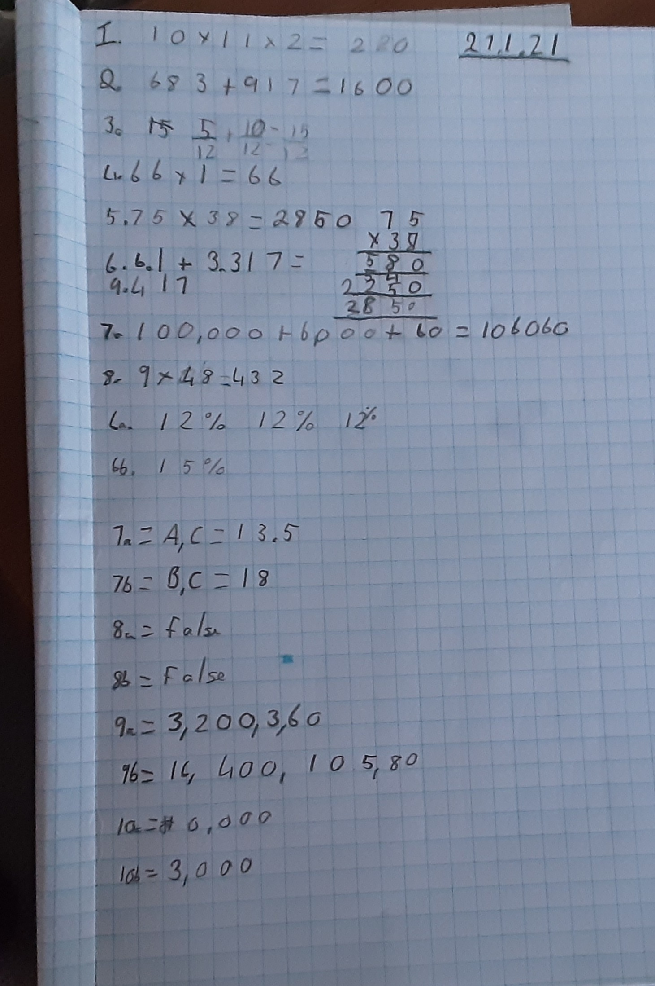
Katie worked hard on calculating the missing number in the % problem.

Slide 29
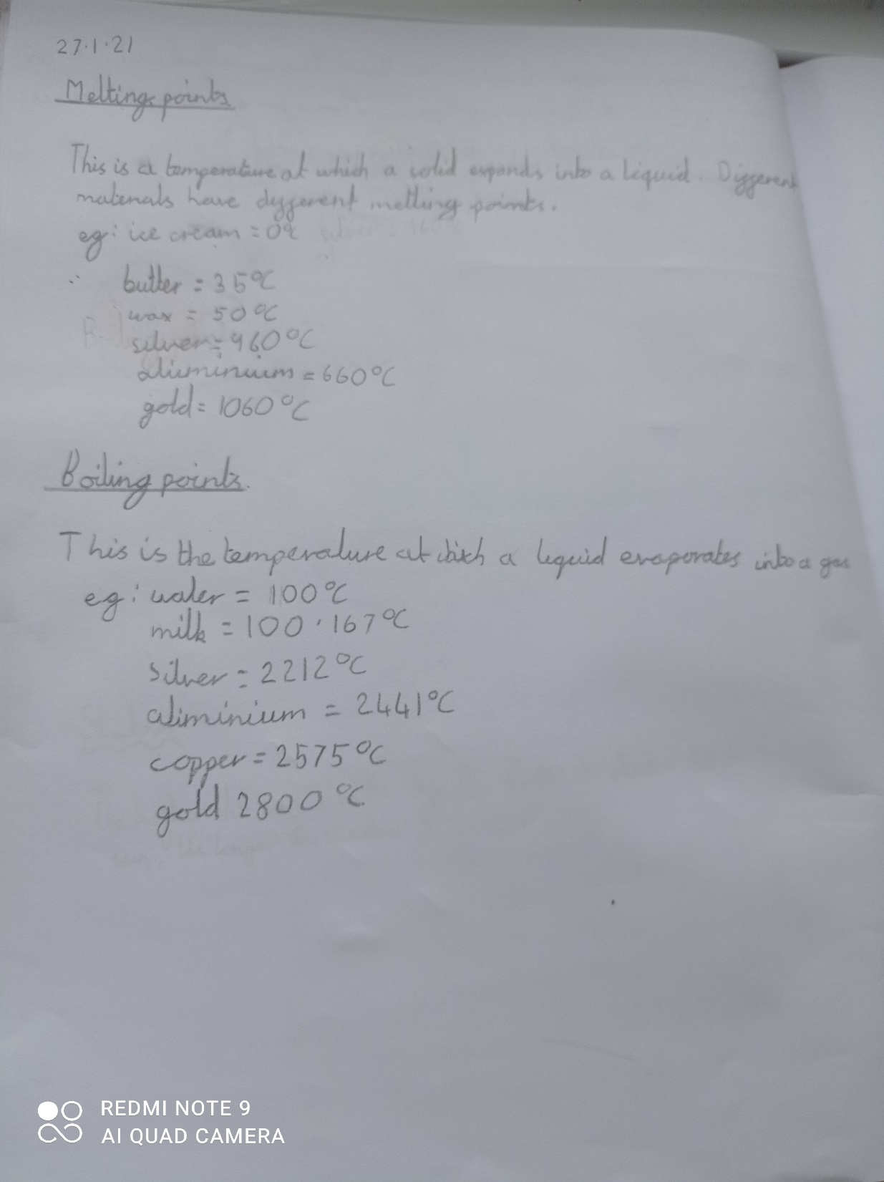
Lucy has shown her understanding of boiling and melting points of water.

Slide 30
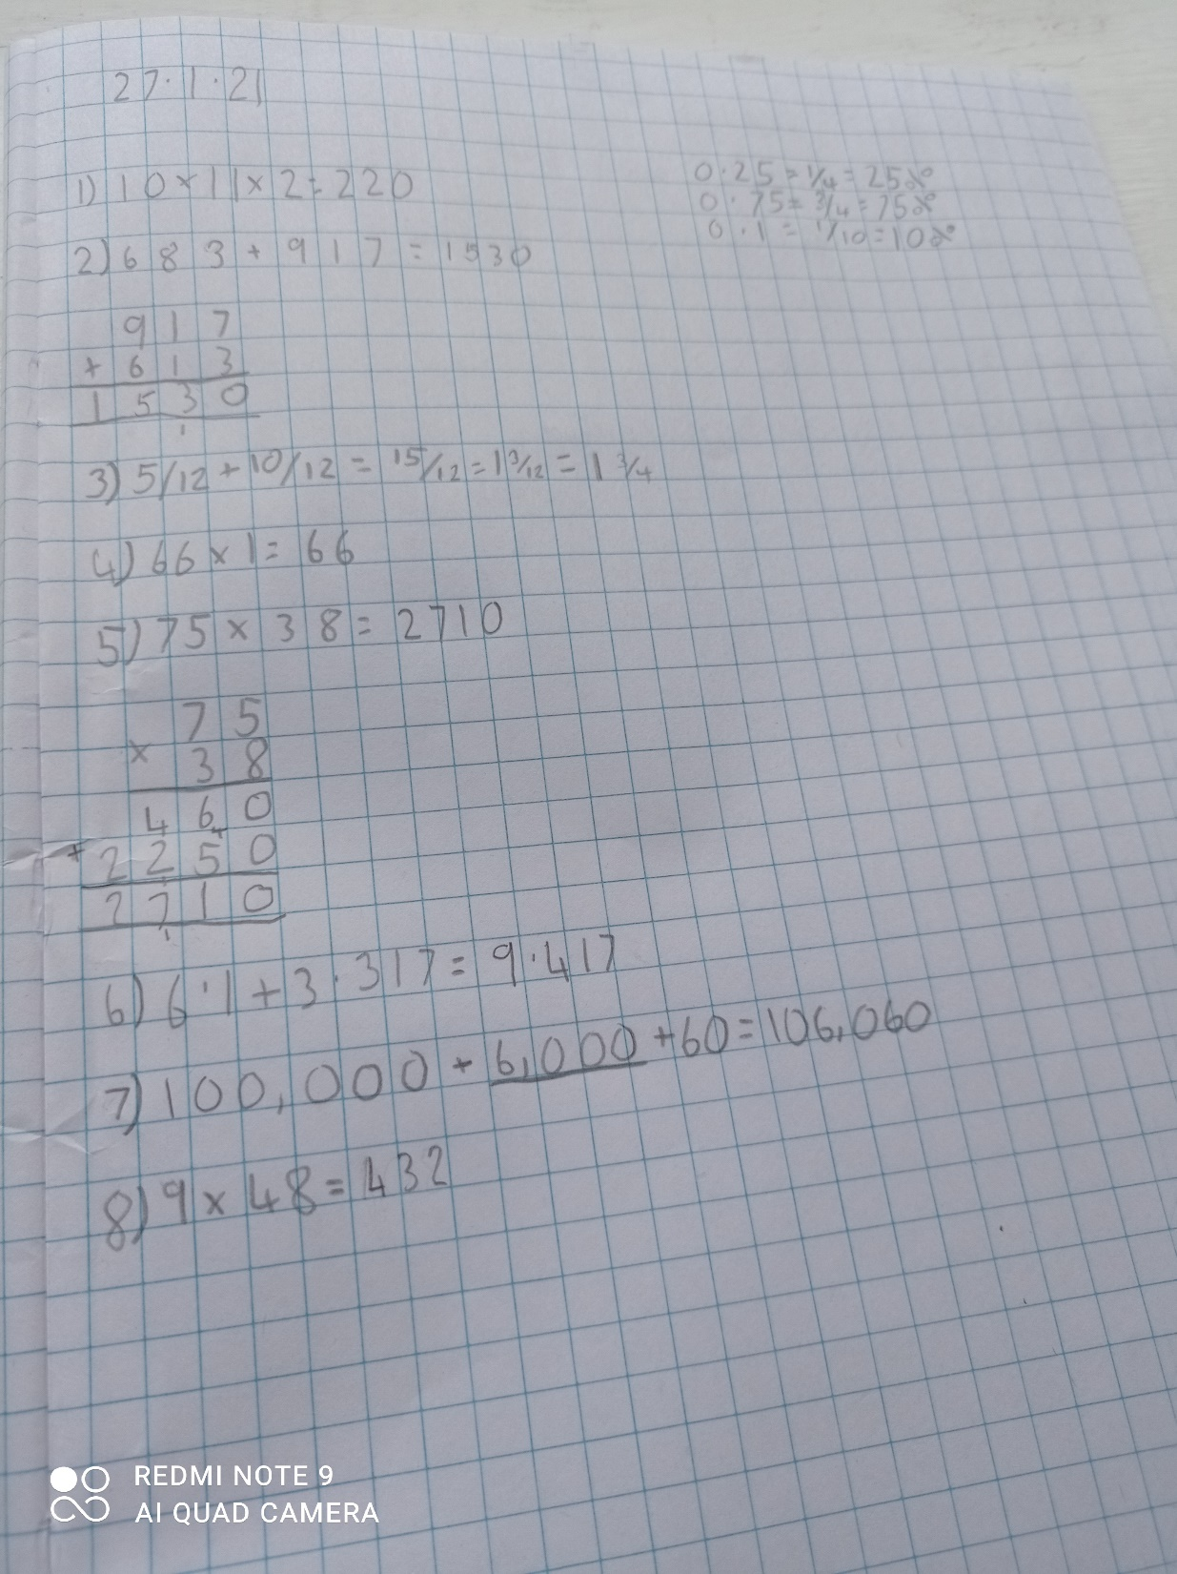
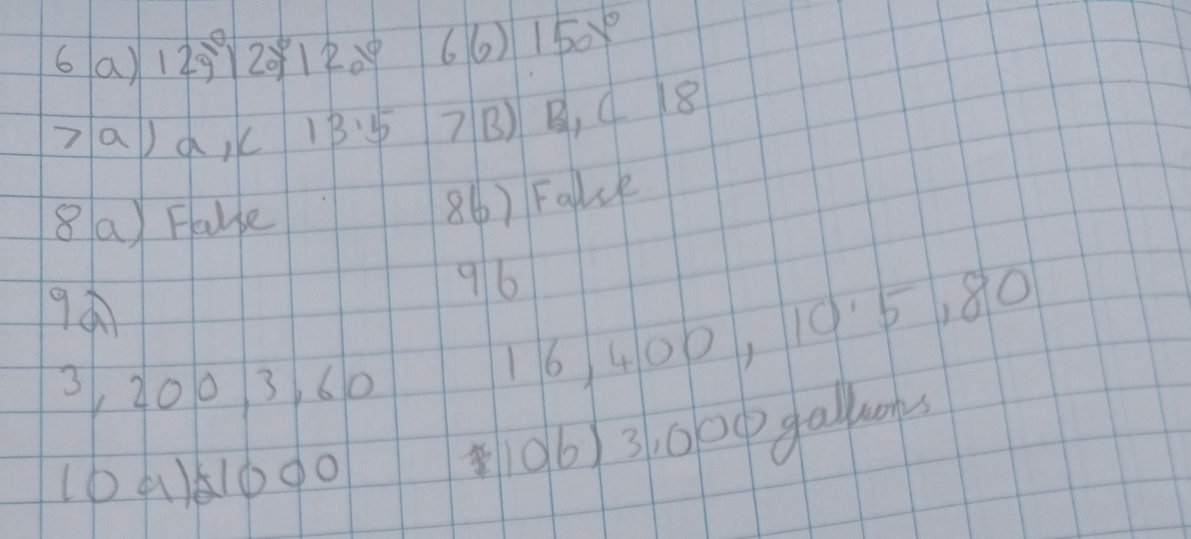
Lucy has been solving the tricky % calculations and problems in maths.

Slide 31
Lucy has researched well about the life of Captain Tom.

Slide 32
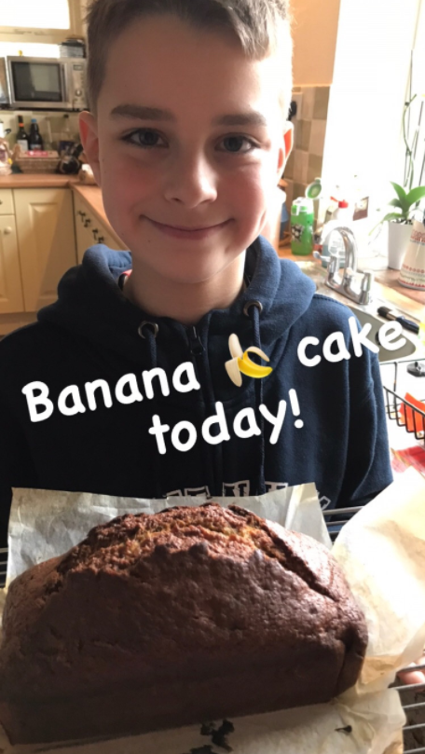
Rhys is BANANAMAN!

Slide 33
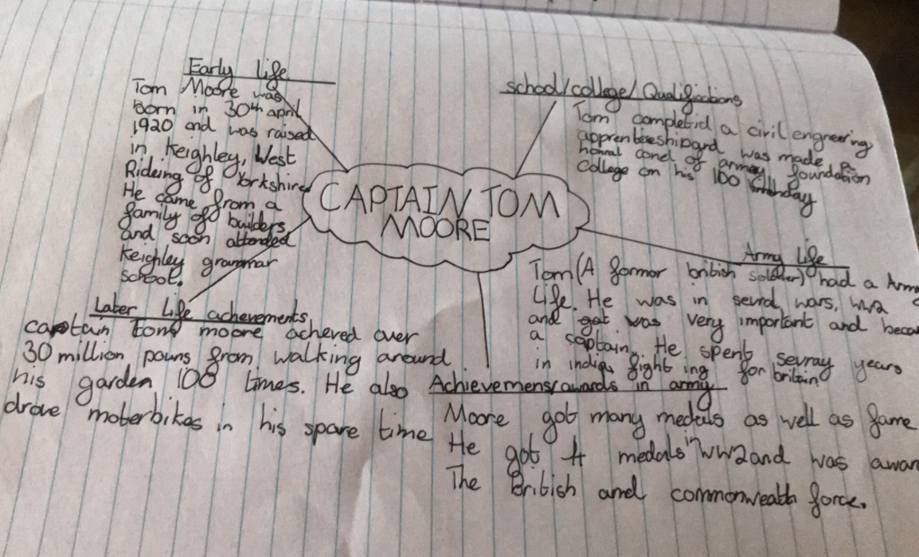
Rhys has researched a lot of information about Captain Tom.

Slide 34
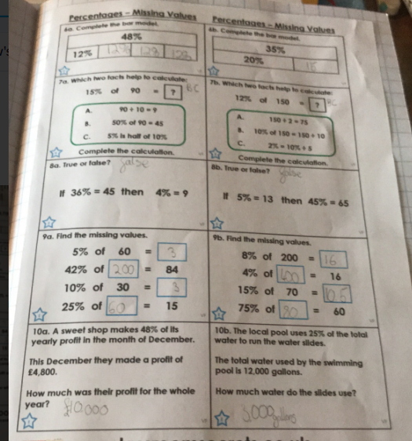
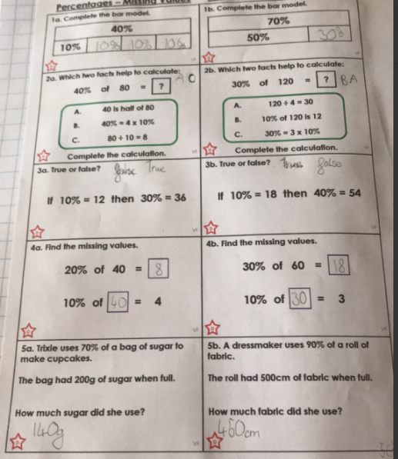
Rhys has worked incredibly hard today to solve these calculations / problems using %.

Slide 35
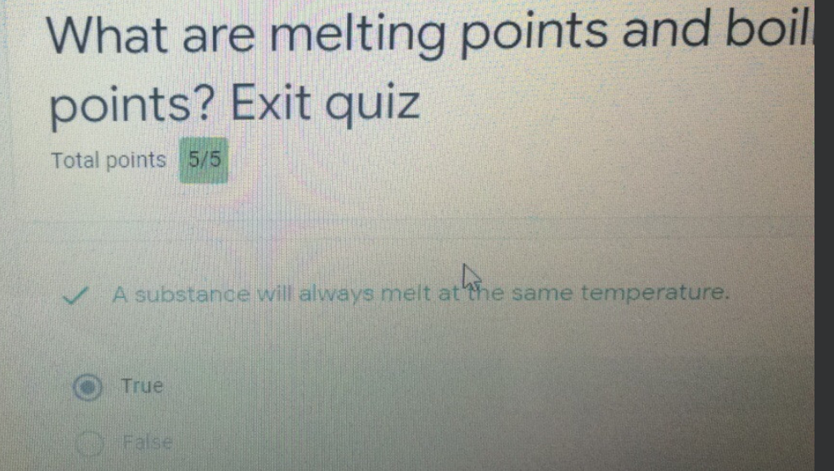
Isla took the Science quiz and scored 5/5.

Slide 36
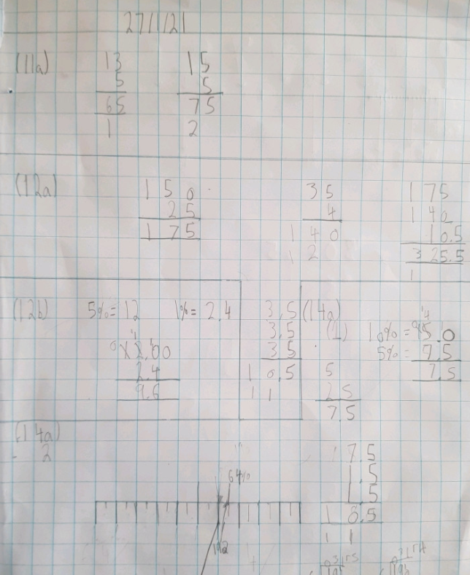
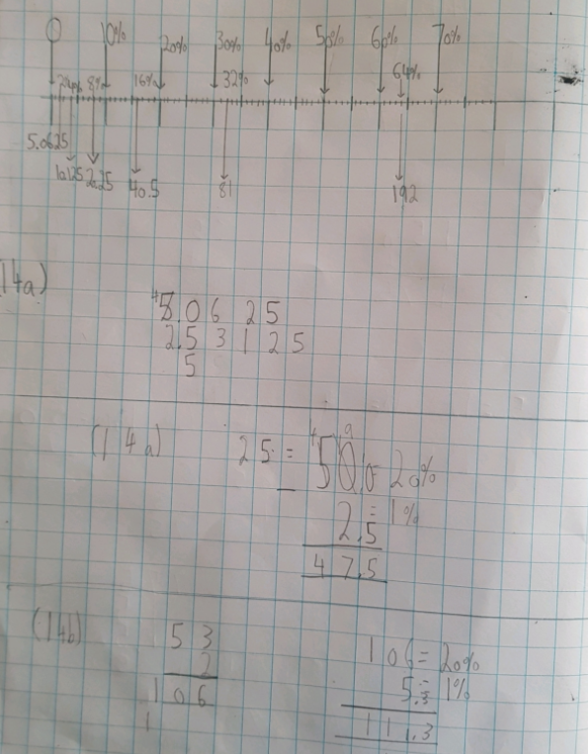
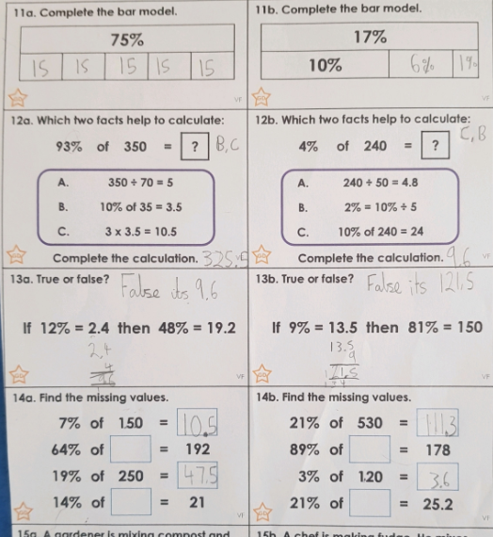
Cameron worked really hard in his maths, showing great workings out in his books to help him.

Slide 37
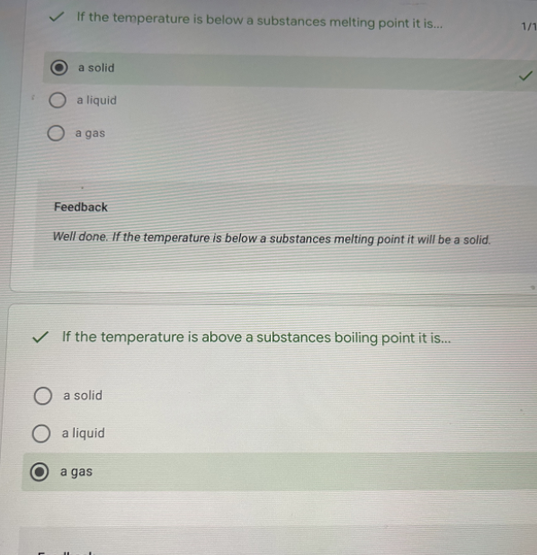
Nelly has focused on her Science today.

Slide 38
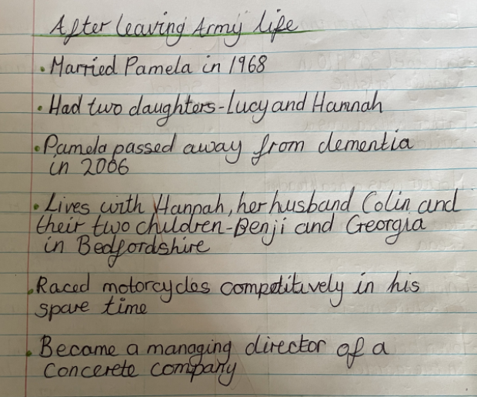
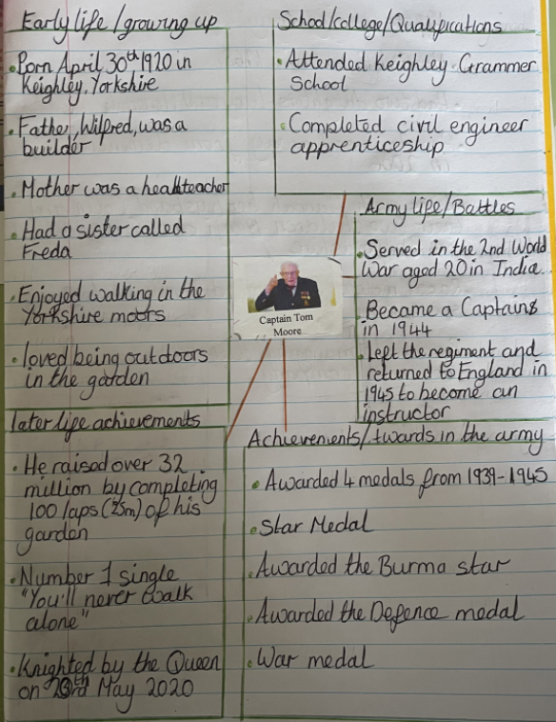
Nelly gathered her research of Captain Tom very well.

Slide 39
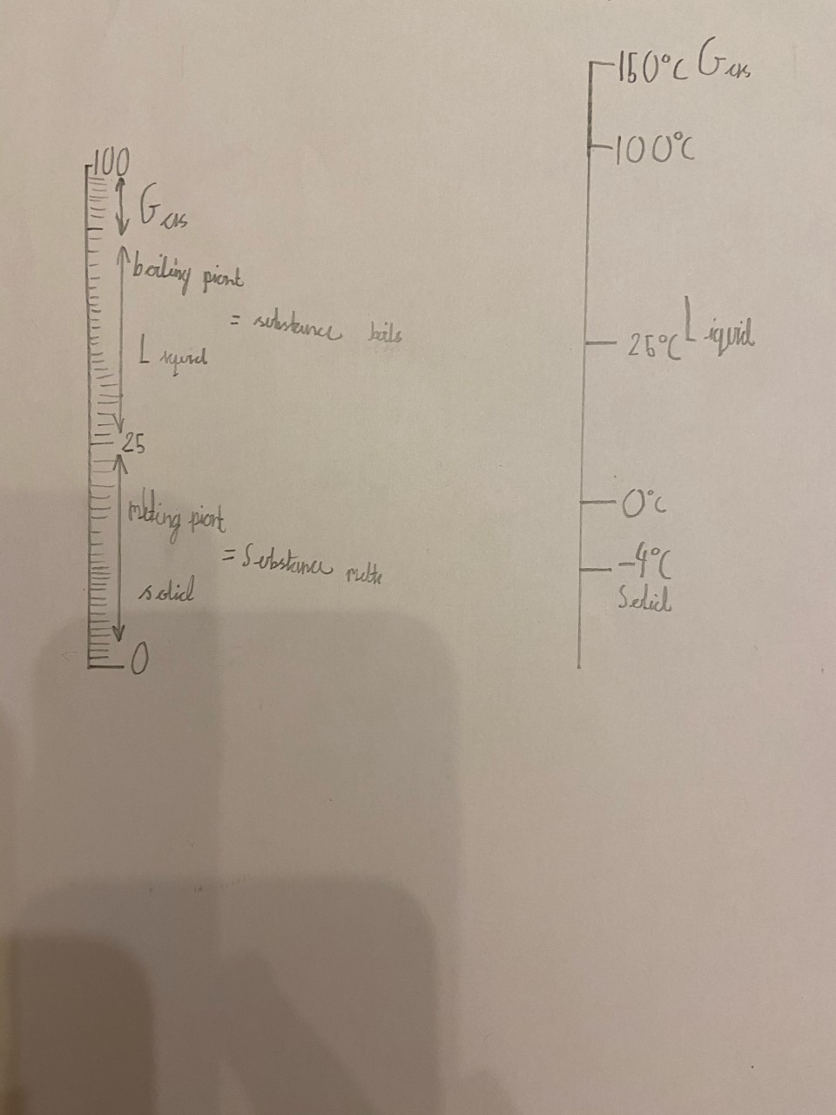
Dylan observed the online Science lesson and then showed his understanding of melting points and boiling points of water.

Slide 40
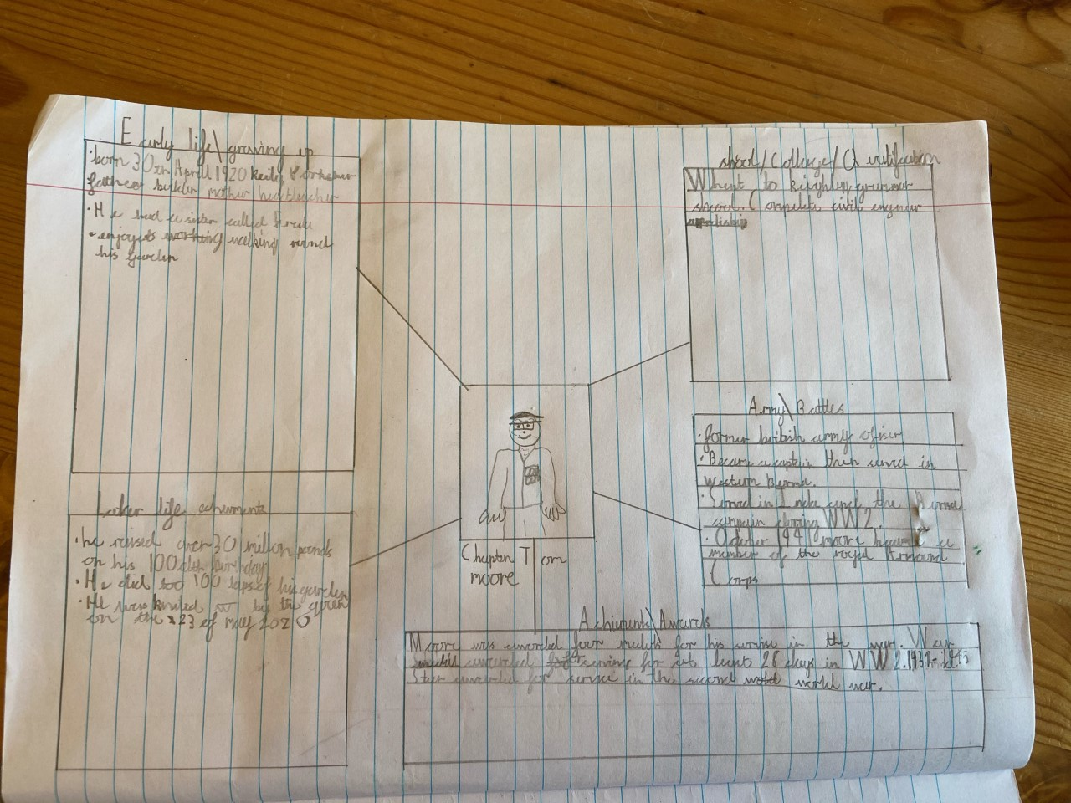
Dylan organised his research of Captain Tom Moore very clearly in preparation for his biography.

Slide 41
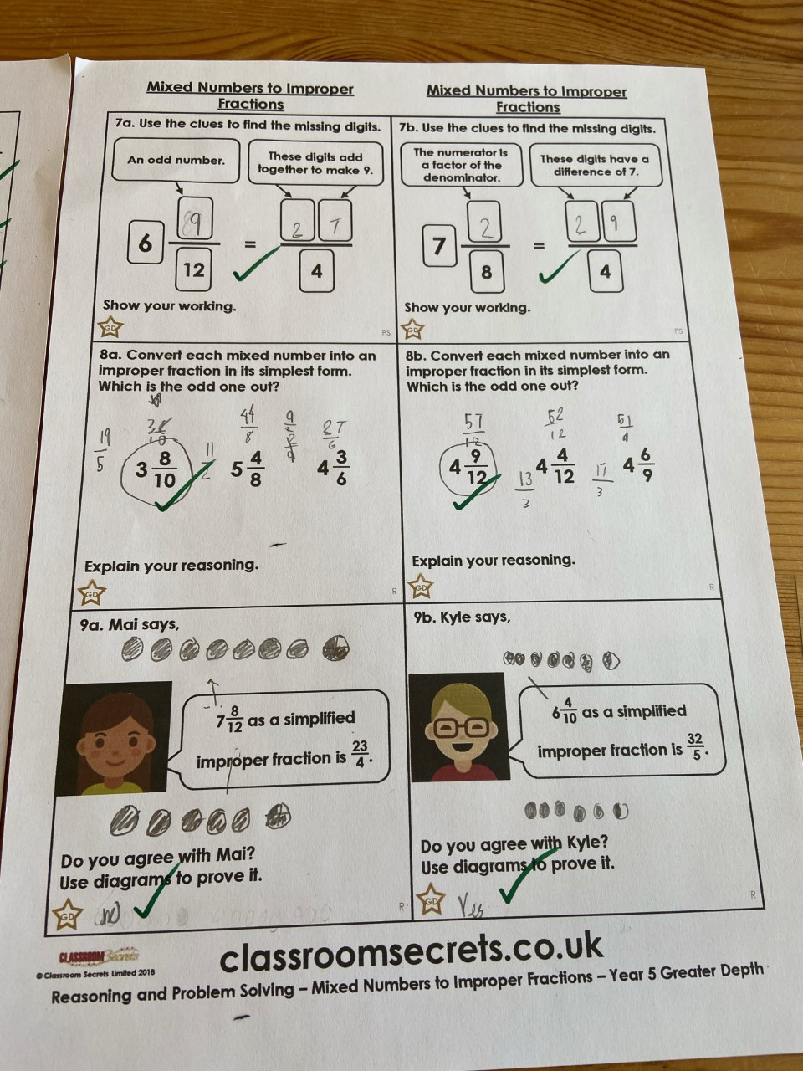
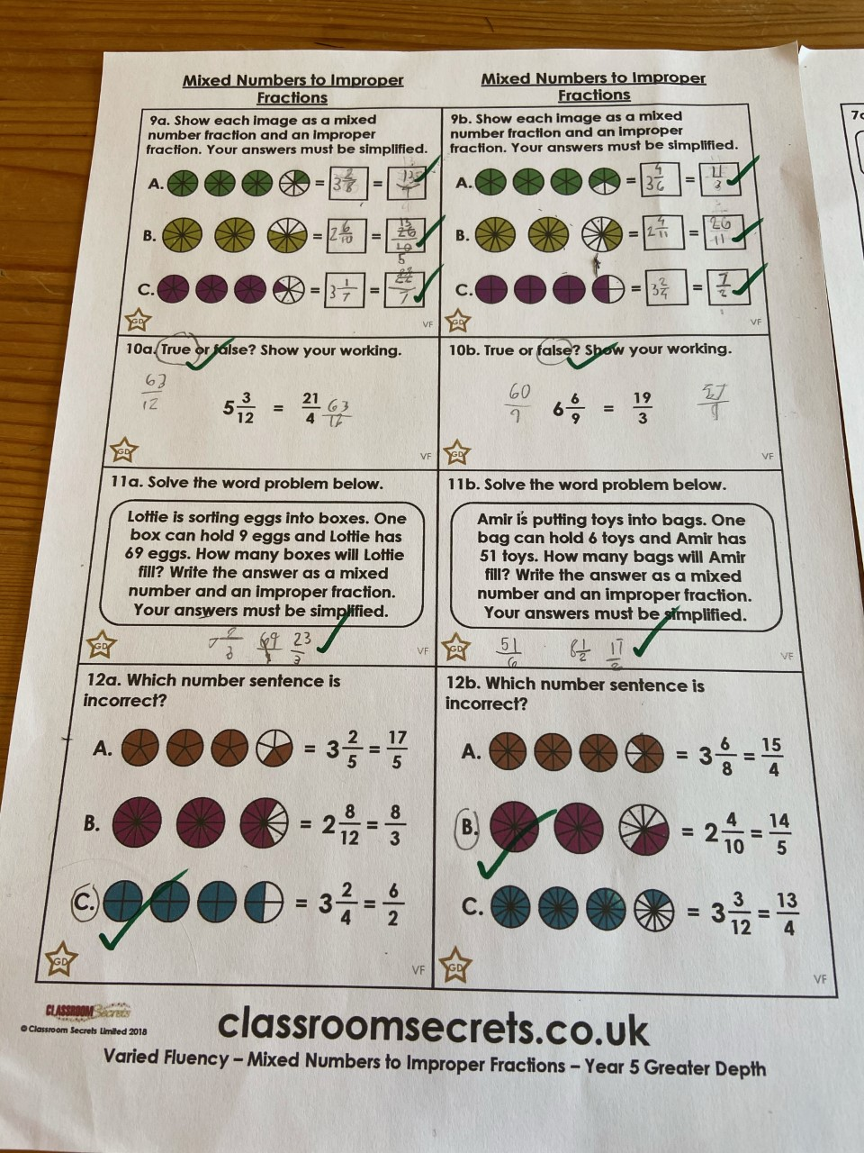
Dylan converted his mixed fractions into improper fractions using great knowledge of his times tables.

Slide 42
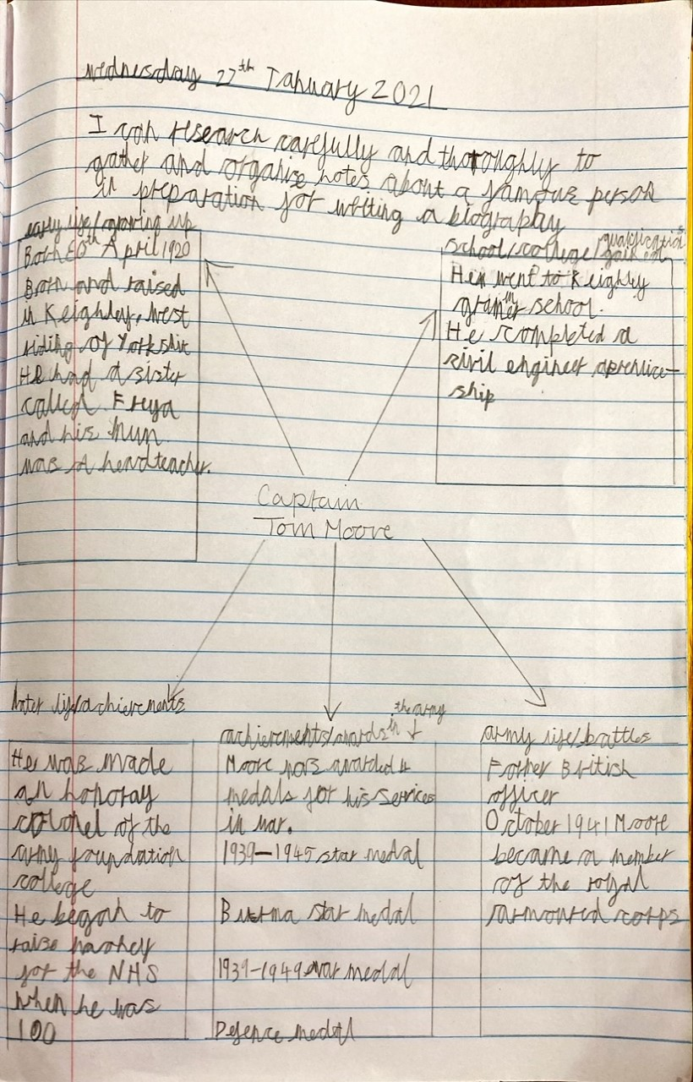
Sam has researched well here to gather all of the information that he could about Captain Tom Moore.

Slide 43
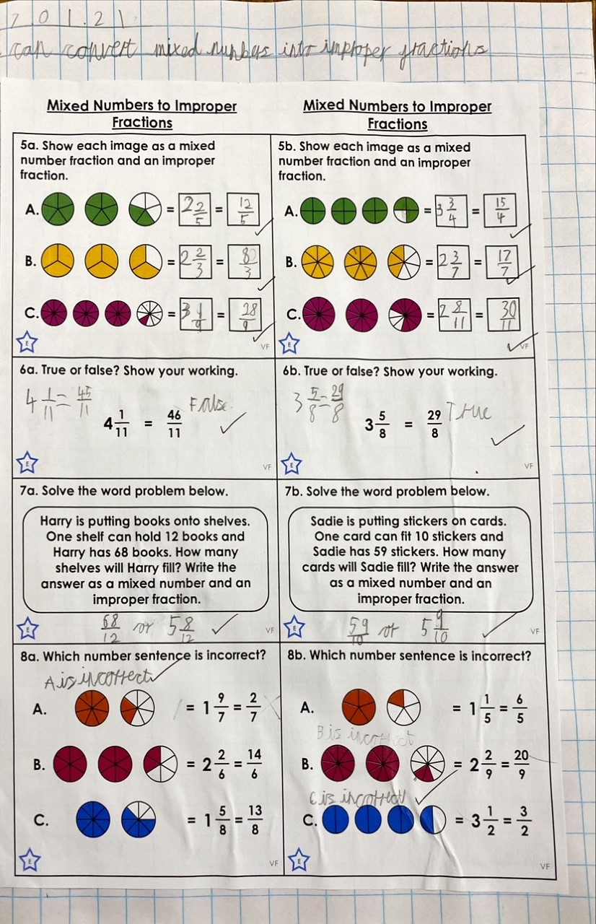
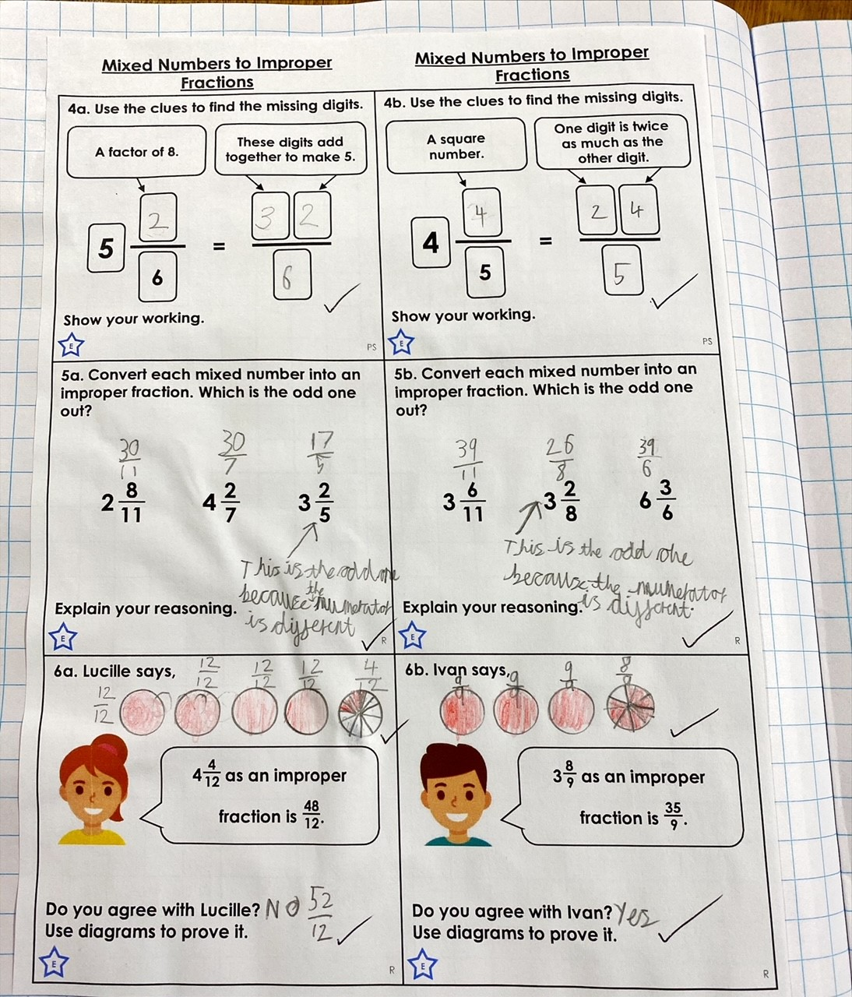
Sam worked well to convert these mixed numbers into improper fractions.

Slide 44
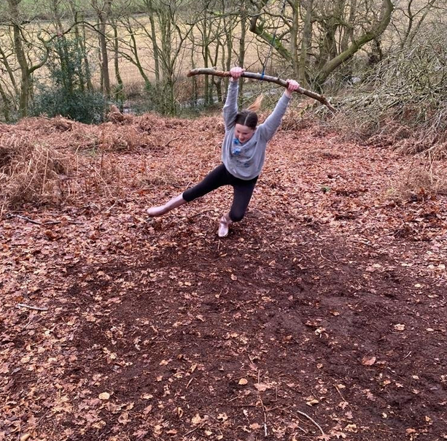
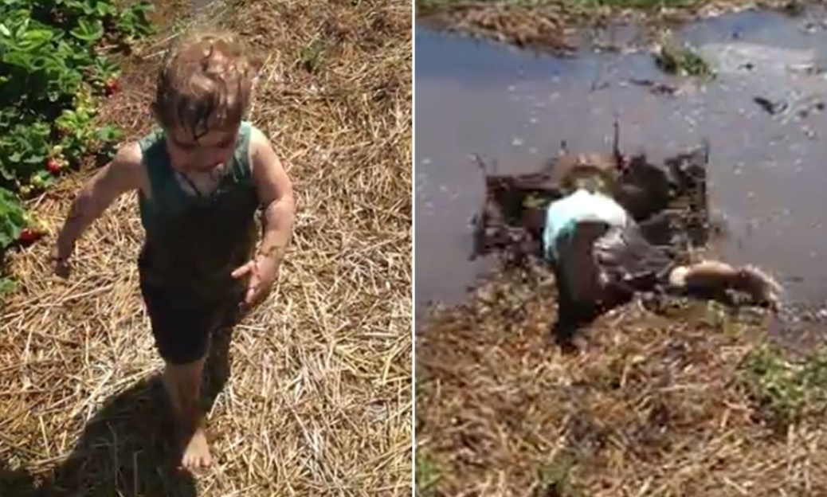
I think this is an accident waiting to happen!

Slide 45
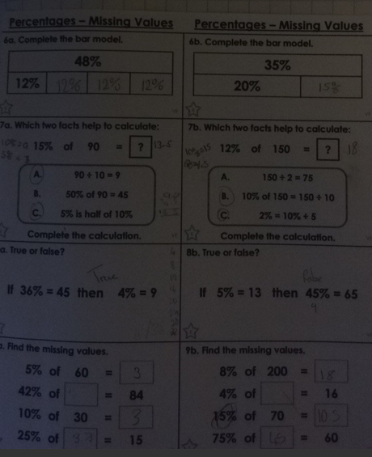
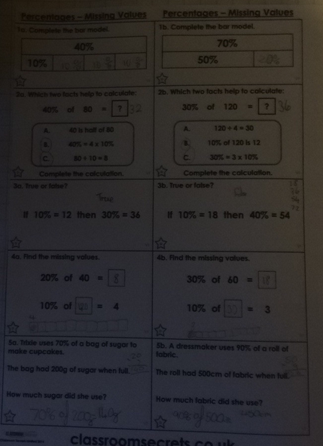
A new challenge for Isla – Maths in the dark!

Slide 46
That’s it Isla – the lights are switched on now for your Captain Tom research.

Slide 47
Now back to Science in the dark!

Slide 48
Esme continued her understanding of the three states in Science.

Slide 49
Esme did some great research and Captain Tom and organised it well.

Slide 50
Esme read her text about Captain Scott to earn more about his exploring. Well answered Esme.

Slide 51
Esme persevered with her maths despite finding it tricky.

Slide 52
Sophie Collins researched some of the main facts of Captain Tom’s life.

Slide 53
Sophie Collins calculated the missing numbers in these % problems today.

Slide 54
Alex used great jottings and workings out in his maths to help him to convert mixed numbers into improper fractions.

