Slide 1
Rooted
Two brightly coloured, feathery birds swung happily through the streaked sky. It was morning and everything was waking up after a long night’s sleep. This was why -after perching on a lone tree to rest- they nearly tumbled out of its branches.
The tree yawned mercilessly. It had been a late night yesterday, watching the fireworks glitter and gleam above the far away city. He stretched his trunk and regretfully watched as a couple of birds fell out of his boughs. All at once the tree noticed a truck parked on the dusty road that wound through his home. Something was shuffling around behind it. Something tall. He leaned sideways to get a better view when the vehicle suddenly pulled away and he was left gawking at the most beautiful blossom tree he had ever seen.
She shyly waved. Pulled a flower from her leaves. Kissed it. Blew it over the road, to him. Day turned to night, turned to day, turned to month, turned to year, as they loved each other- a long distance relationship you may say.
One evening when the two were enjoying the orange sunset, a couple of humans walked together and sat on a bench. Then the male pulled out a small box. The female looked taken aback, she said yes, and wrapped her arms around his they stayed like that for ages.
The trees suddenly got an unquenchable urge to do the same but (as they were on the opposite side of the road to each other) their branches couldn’t quite reach. Two birds snuggled up together on the boughs and doing so a feather dislodged itself and fluttered into the sky.
Years turned into decades as the trees struggled to reach each other their leafy fingers stretched out over the road but always to far away to reach. The human couple kept coming back to the warped, gnarled bench- like they did all those moons ago until eventually the man came alone, then not at all.
Morning came. A thick, swirling mist cloaked the air. The trees awoke to find their aged trunks tattooed with a large red cross. panic surged in realisation of what would happen. They would be cut down. Urgently they strained their branches. Roots cracked. Suddenly they were falling, falling arm in arm with each other, falling into the back of the lumberjack’s van.
Amy has written her short story ‘Two Trees; this morning.

Slide 2
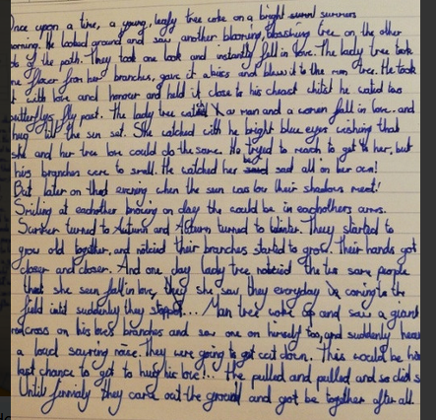
Holly H has written her short story ‘Two Trees; this morning.

Slide 3
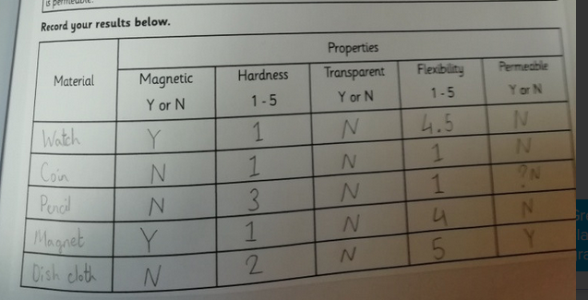
Amy has been testing the properties
of some of the objects in her house in her Science today.

Slide 4
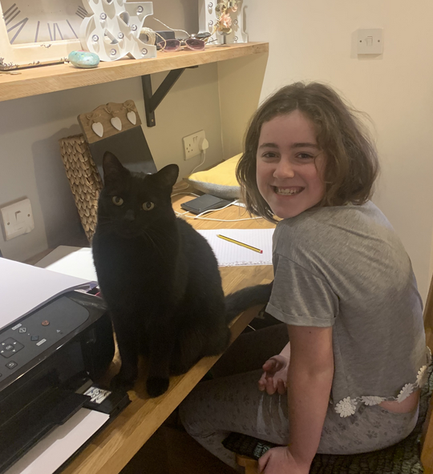
Pugwash has been assisting Holly with her story writing this morning.

Slide 5
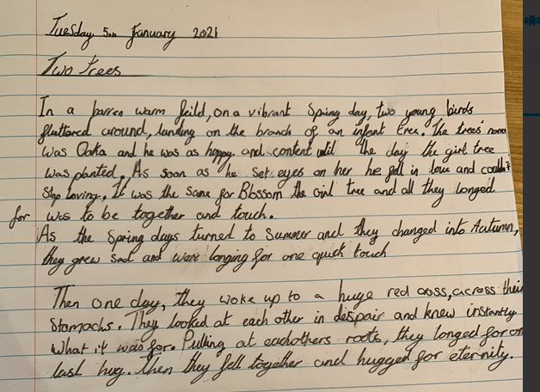
Zoe has written her short story ‘Two Trees; this morning.

Slide 6
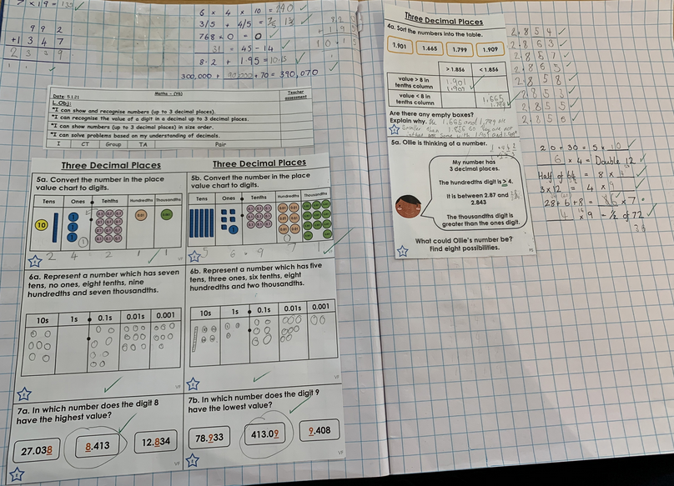
Zoe has been focusing on her understanding of decimals in maths.

Slide 7
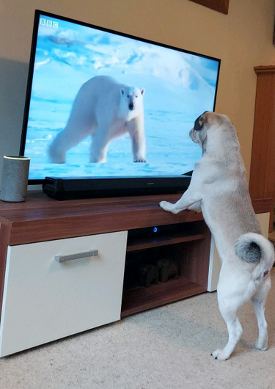
Ollie’s dog is either loving or hating the Frozen Planet topic!

Slide 8
On a sunny day, there was an oak tree who had woken up. When he stretched his arms and yawned, he saw that there was a tree-planting truck. As soon as he saw the tree his heart skipped a beat. It was the most beautiful female tree he had ever seen. She sent him a kiss on the flower by the breeze. As they looked in to the sunset they saw a couple hug and they were sad because they longed to hug. After that each year they grew taller. After many years they could nearly touch. 5 years later he awoke and saw that she had a red cross on her and him too. They knew that they were going to be cut down so they stretched and stretched until their roots snapped and then they could finally hug.
Blake has written his short story ‘Two Trees; this morning.
There once was two trees, one boy, one girl. They lived in a park several metres away from each other. Just because they lived in a park they saw people in love that wanted them to be together. But they could not as they were several metres away but they tried so much to hold hands but no matter how hard they tried they couldn’t. Until... someone graffitied a X on them so they tried harder than they had tried before and BOOM!!! They finally held hands and lived happily ever after.
Lilly has written her short story ‘Two Trees; this morning.

Slide 9
Missing Multiplication
1) 3 x 197 = 591
2) 4 x 325 = 1,300
3) 5 x 489 = 2,445
4) 6 x 198 = 1,188
5) 8 x 697 = 5,576
6) 9 x 1,258 = 11,322
7) 7 x 1,247 = 8,729
Blake has been calculating the missing digits in the multiplication calculations.

