Slide 1
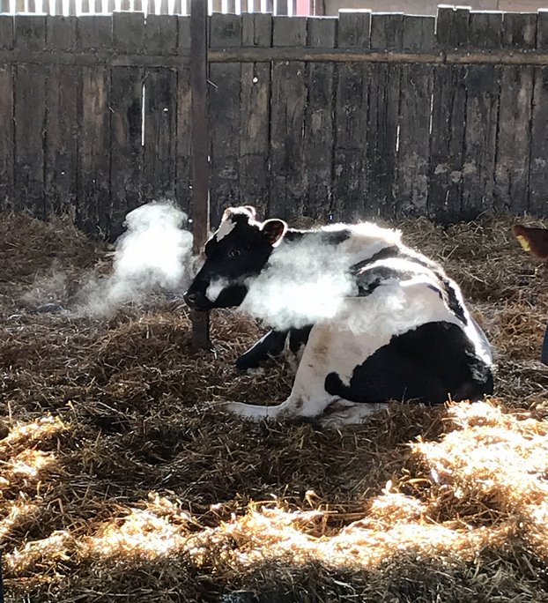
Rhys has been busy on the farm.

Slide 2
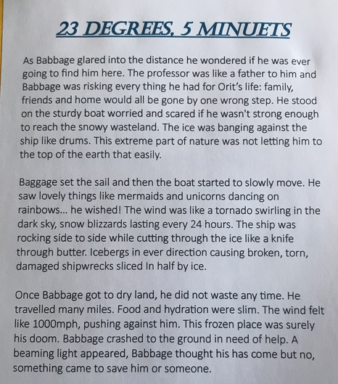
Rhys’ final draft of his story ‘23 Degrees 5 Minutes’

Slide 3
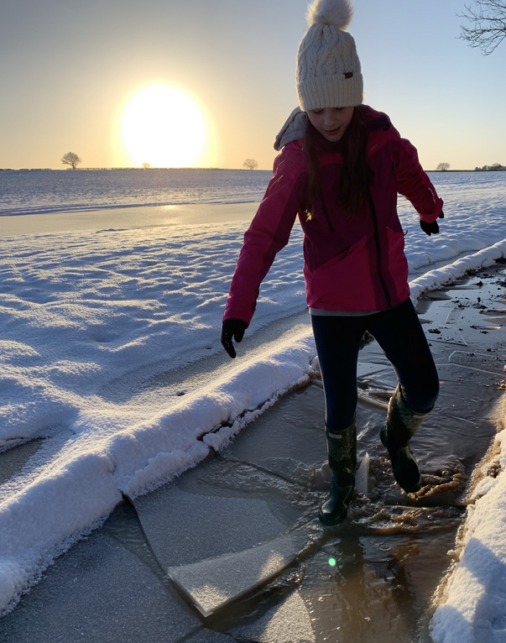
Zoe has been loving the snow.

Slide 4
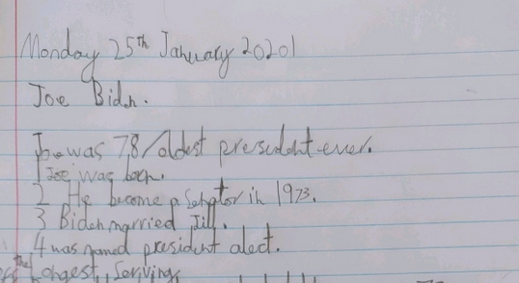
Ollie has learned about the life of Joe Biden today when reading his biography.

Slide 5
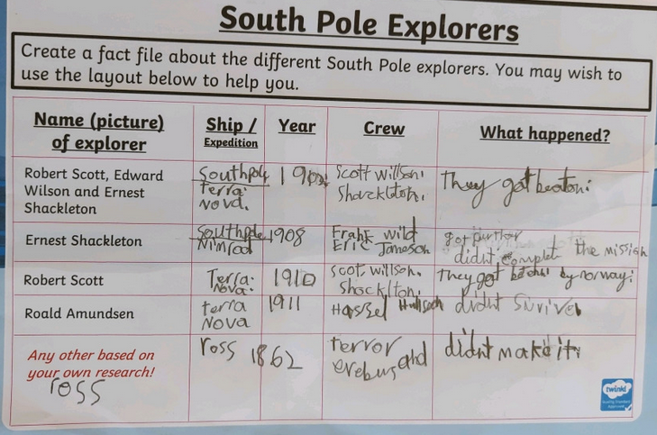
Ollie has been researching the expeditions of these famous polar exploeres today..
Ollie has been researching the expeditions of these famous polar explorers today.

Slide 6
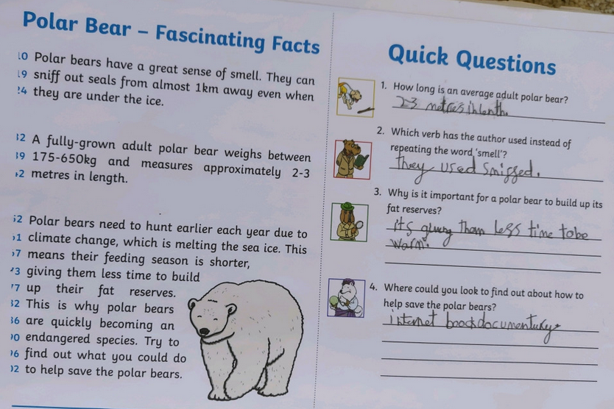
Ollie has been learning about polar bears in his reading today.

Slide 7
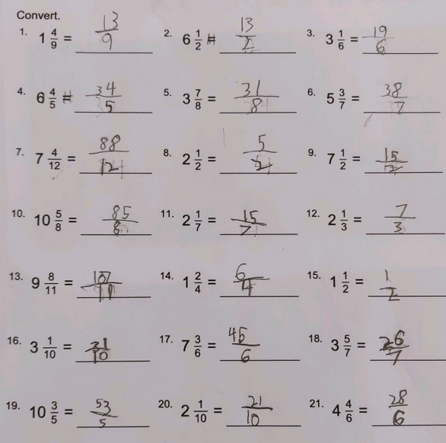
Ollie has been converting mixed numbers into improper fractions correctly today.

Slide 8
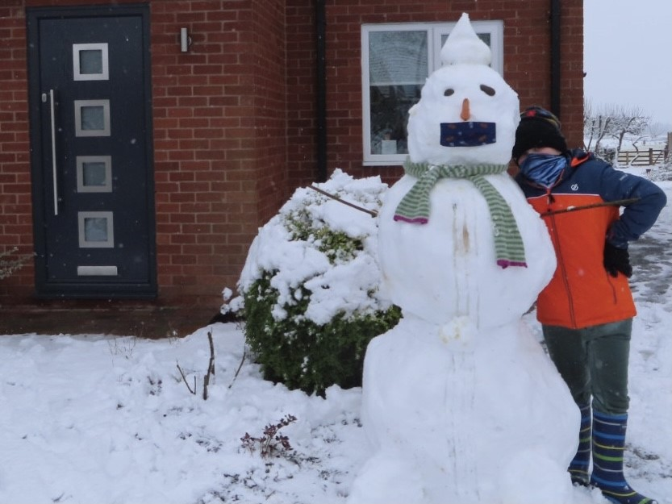
Sam made sure that his snowman was wearing a mask.

Slide 9
Sophie Collins’ final draft of her story extract
One cold winters morning, Babbage set off on his old wooden boat – Darla - to find the Professor.
“I hope I make it” he said to himself as he set sail through the thick ice that covered the sea and past the iceburg’s that surrounded him.
The bitter cold, freezing wind wrapped around him and he was finding it difficult to focus on what he was doing as he steered the ship towards his destination. Even though he was wearing thick clothes and a balaclava, that didn’t stop the cold from attacking his body.
Babbage knew he had to find his beloved Professor who had gone missing 23 years and 5 months ago to the day. He needed answers and this was the only way he would be able to get them.
“What did 23 degrees and 5 minutes mean?” Babbage said to himself. The journey was exhausting but it was the sights Babbage saw that kept him going.
Everywhere he looked there was wildlife. Penguins nestled together upon the shore, sheltering from the constant attack of the freezing winds, the seals perched upon the dotted iceburg’s along the way and he was even lucky enough to catch a glimpse of a lone polar bear on the horizon.
He knew he was getting closer due to the constant checking of his compass and map, however he still was unsure when he would finally reach his destination or what he would actually find when he got there.
It was early morning when Babbage finally arrived at his destination. The icy mist was just beginning to lift as he moored his boat onto a large iceburg; securing it with its heavy anchor. He wrapped himself in another layer of warm clothing to protect him form the cold. Babbage climbed off his boat and onto the slippery snow.
The ice was barely impossible to stand, let alone walk, so Babbage made the final part of his journey on his hands and knees. The struggle became almost to much to continue, and just as he was about to give up he heard a voice above him.
“Who is that?” he said to himself as he looked up into the mist. Could this really be the Professor or was his exhausted mind playing tricks on him?

Slide 10
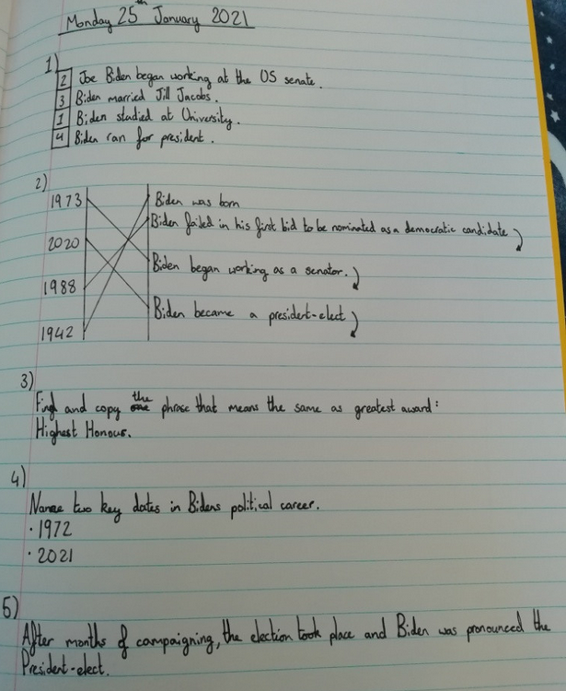
Amy has learned about the life of Joe Biden today when reading a biography.

Slide 11
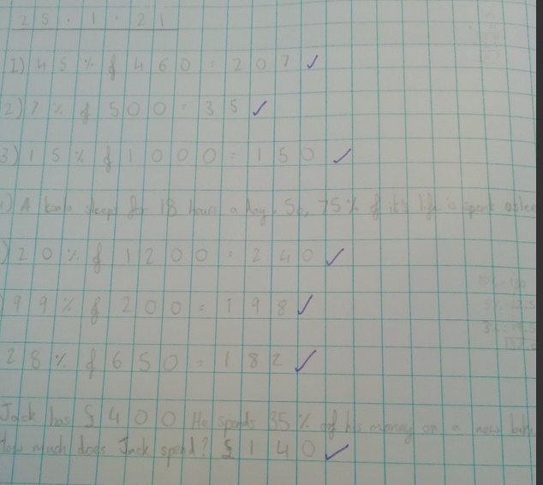
Amy has been calculating these % of amounts.

Slide 12
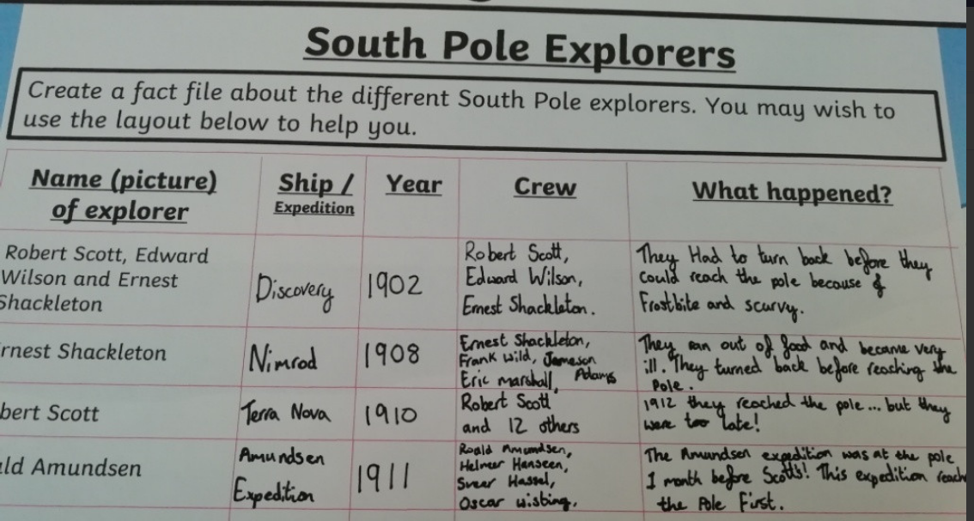
Amy has been researching the expeditions of these famous polar explorers today.

Slide 13
Izzy’s completed story
23 Degrees, 5 minutes
The icy wind blew in the frosty artic. Hulls creaked as old boats shifted out of place. Babbage started to hum a sea shanty to himself. It helped him to forget that there was a massive storm and crashing, tall waves that were damaging his tiny ship. He glanced at the decaying wood in the corner of his ship. Icebergs drifted out of his way, making a trail of blue water for him to follow. He had a cushy balaclava protecting his face from the frigid weather.
“Where are you professor?” Babbage asked himself. He started to think, if he got to the South Pole what would he do if Professor Orit were not there? After all, he was missing for 2 years and 6 months. He stood on the bow of his ship and wondered what awaited him.
As Babbage stood on his wooden deck, he took in the view but, he was still searching for his old friend -Orit- so he could not forget that this was a rescue mission. The ship was tiny and cramped; there was hardly any breathing space. Many tiresome days passed. Babbage checked his chronometer and it read -25 degrees. He was feeling happy for the first time since he left Florida. Even more days passed by then suddenly, he heard a loud “creak” and when he got onto the top deck, he saw land and took his first step on the ice.
The ice was almost impossible to stand/walk on. So, Babbage decided to crawl. He nearly gave up until, he heard a voice above him, it sounded like the professor.
Was it really Professor Orit or was he just hallucinating?

Slide 14
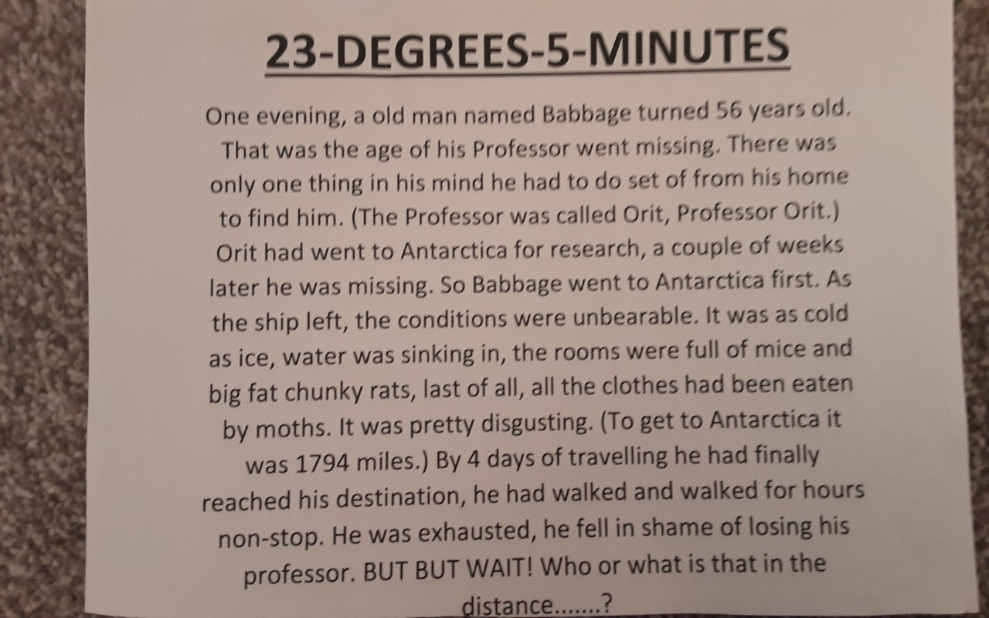
Lilly’s completed story.

Slide 15
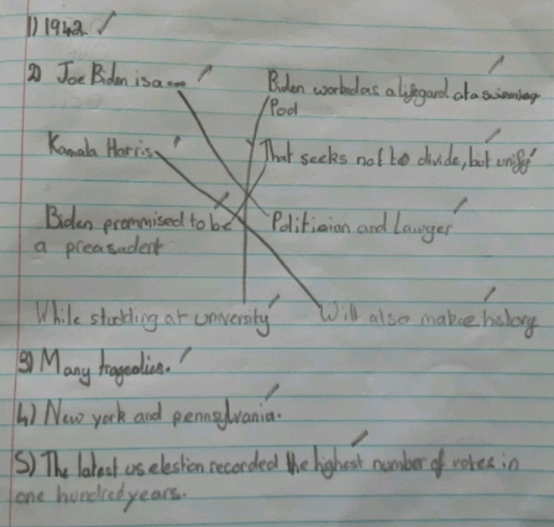
Lilly has shown her understanding of the new president Joe Biden today.

Slide 16
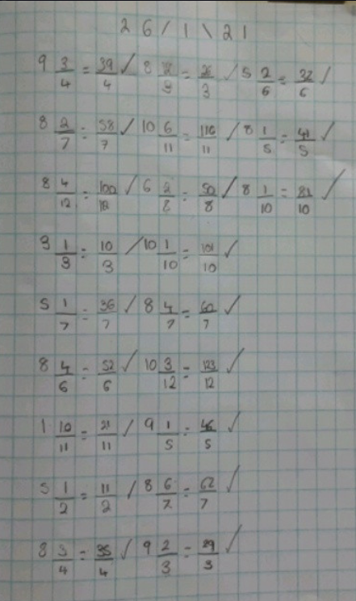
Lilly has converted her mixed numbers into improper fractions really well.

Slide 17
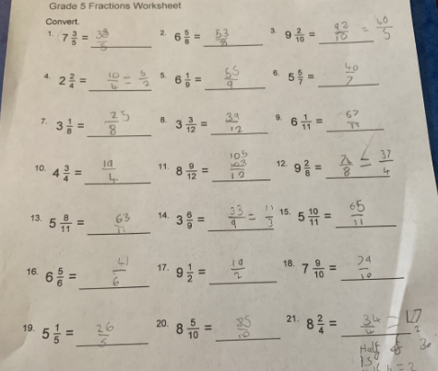
Alex has converted these mixed numbers into improper fractions very well.

Slide 18
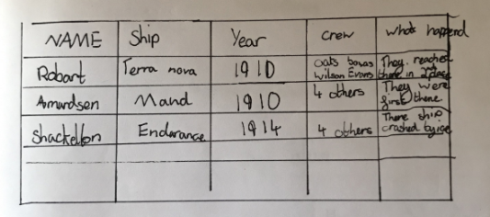
Rhys has researched the expeditions of these famous South Pole explorers.

Slide 19
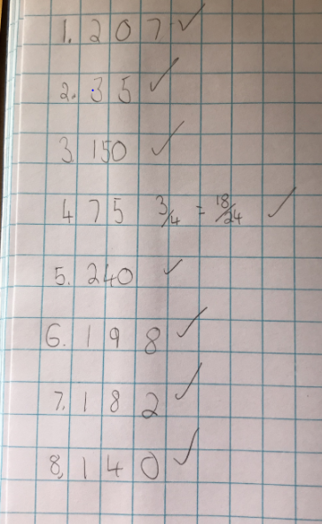
Rhys has calculated these % of amounts today.
Well done Rhys!

Slide 20
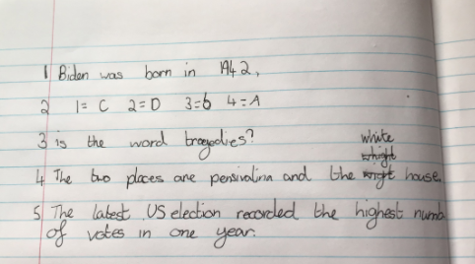
Rhys has read the biography of Joe Biden to learn more about his life to answer the questions about him.

Slide 21
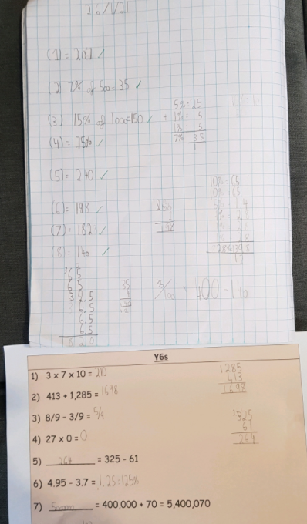
Cameron has calculated these % of amounts very well today.

Slide 22
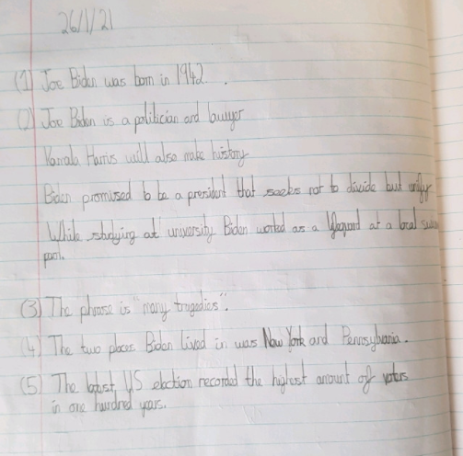
Cameron has read the biography of Joe Biden well to locate these facts about his life.

Slide 23
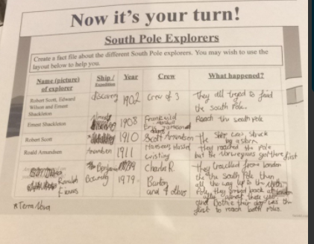
Holly H has been researching the expeditions of some of the most famous explorers.

Slide 24
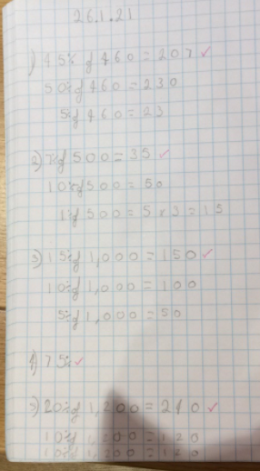
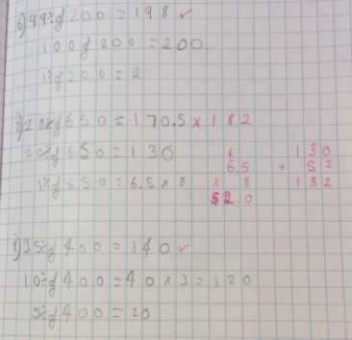
Holly H has been calculating these % of amounts.

Slide 25
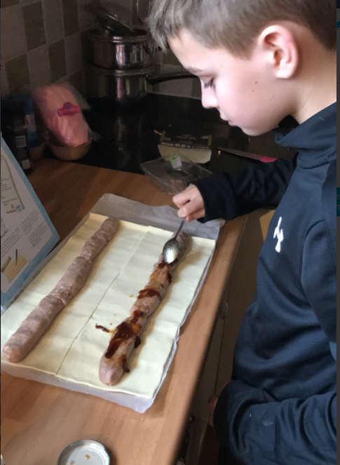
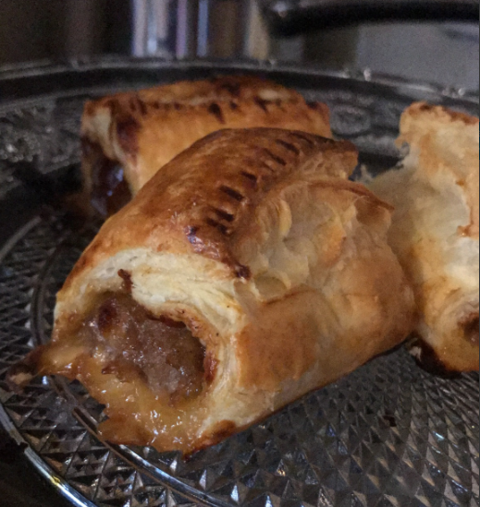
Rhys is making his own home-made sausage rolls for lunch today.

Slide 26
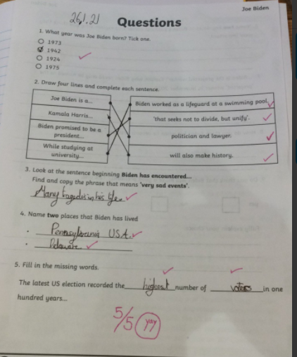
Holly H is pleased with the outcome in her reading today.

Slide 27
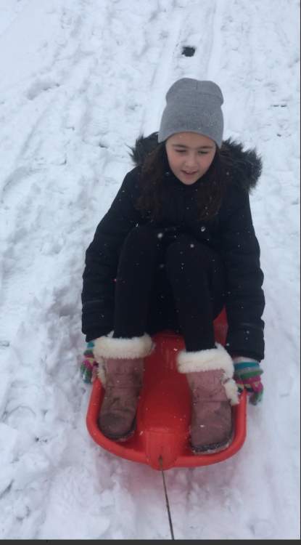
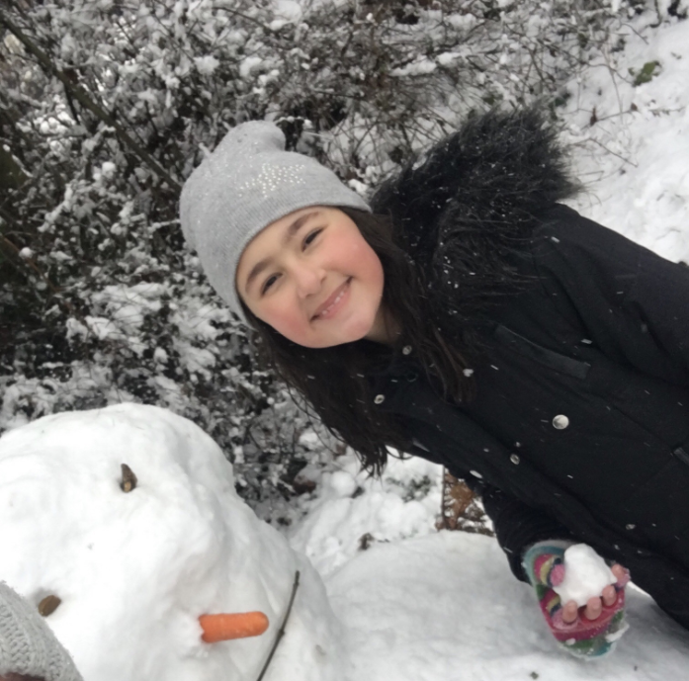
After working hard, Esme found time to have fun in the snow.

Slide 28
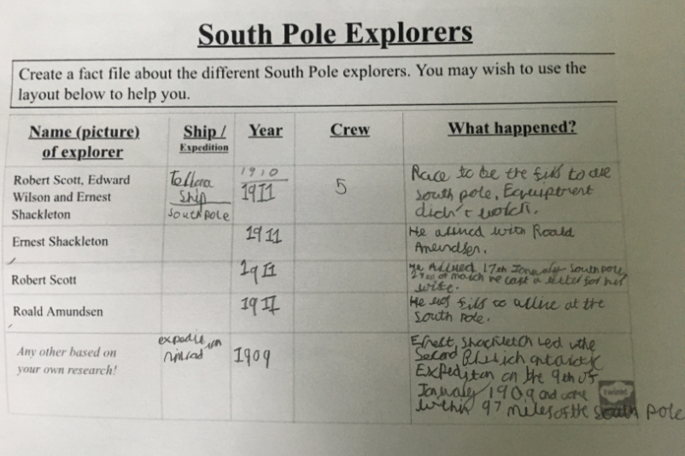
Esme has been learning about the South Pole expeditions

Slide 29
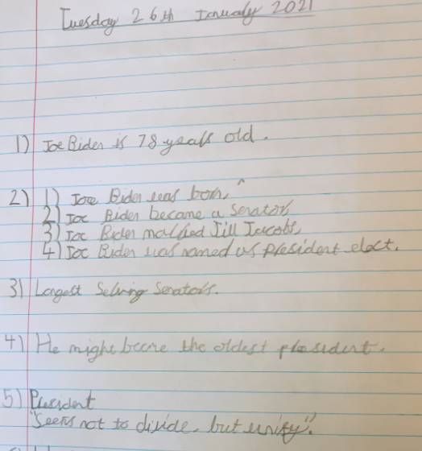
Esme has been reading the biography of Joe Biden

Slide 30
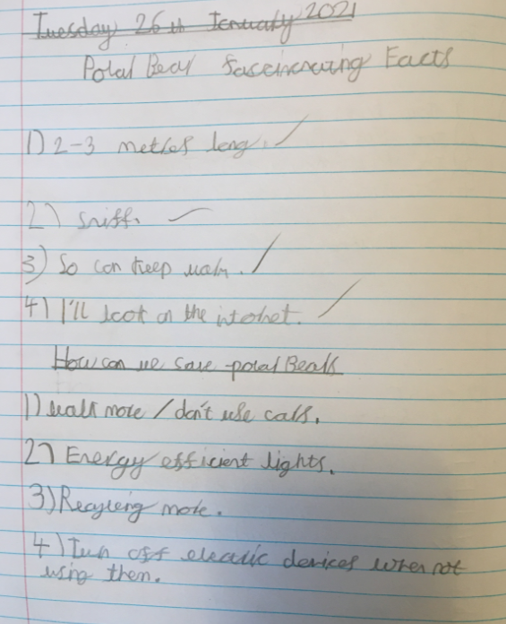
Esme has been learning about polar bears in her reading.

Slide 31
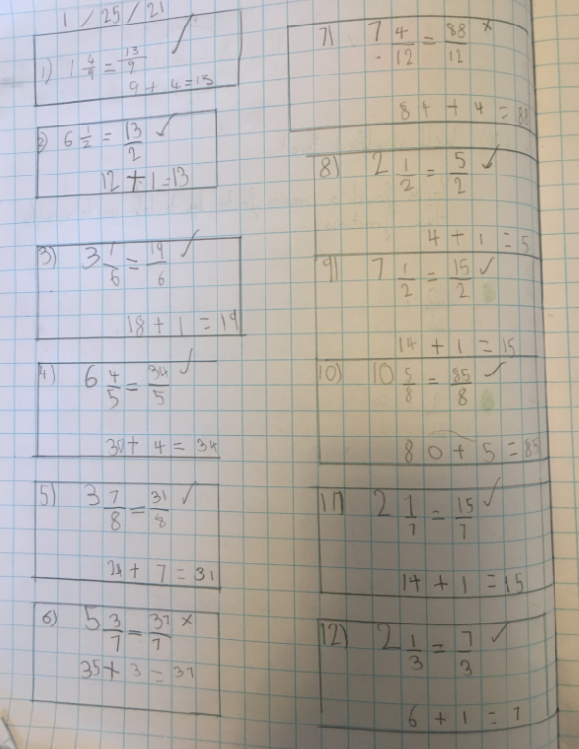
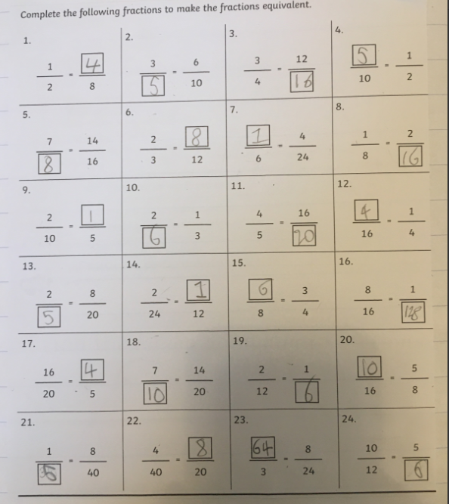
Esme has converted her mixed fractions into improper fractions today.
Esme has completed her maths homework, recognizing equivalent fractions

Slide 32
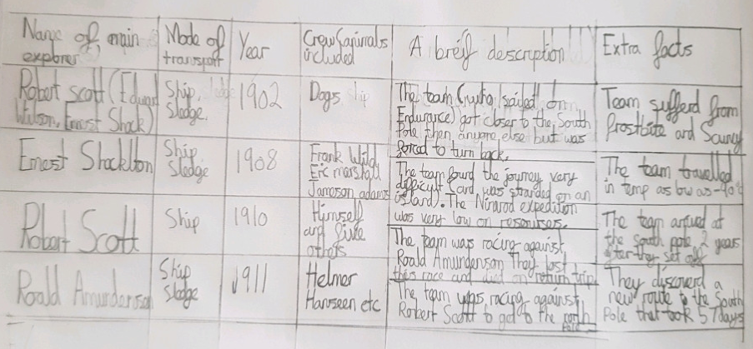
Cameron has gathered information about the expeditions of these famous South Pole explorers.

Slide 33
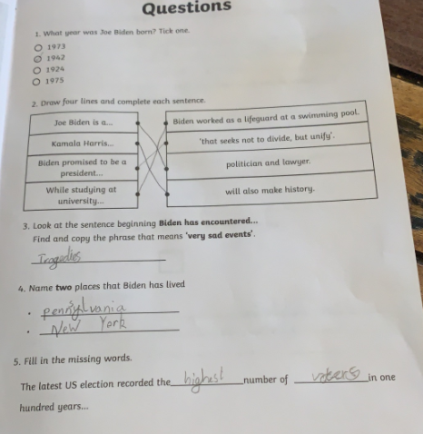
Alex has studied the biography of Joe Biden carefully.

Slide 34
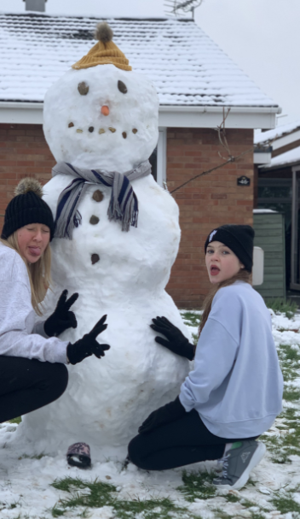
Sophie found some spare time to build a snowman.

Slide 35
Sophie Collins gathered and shared her information about the South Pole explorers.

Slide 36
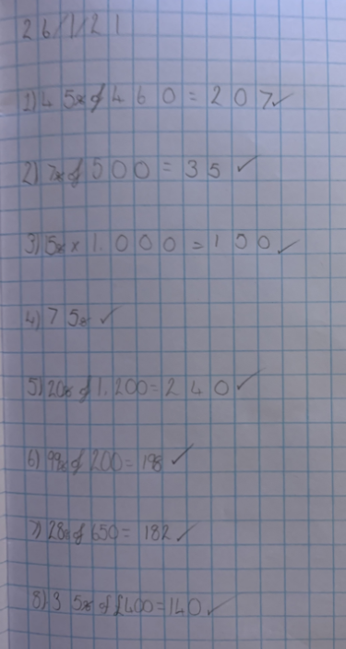
Sophie Collins has calculated the % of these amounts correctly.
Well done Sophie!

Slide 37
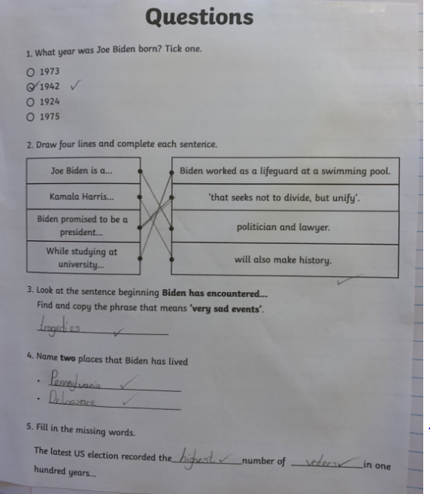
Sophie Collins has read the biography of Joe Biden to show her understanding of his life.

Slide 38
Heidi’s beautifully presented information about the South Pole explorers

Slide 39
Cass has made effective notes about the South Pole explorers so that he can organise them correctly.

Slide 40
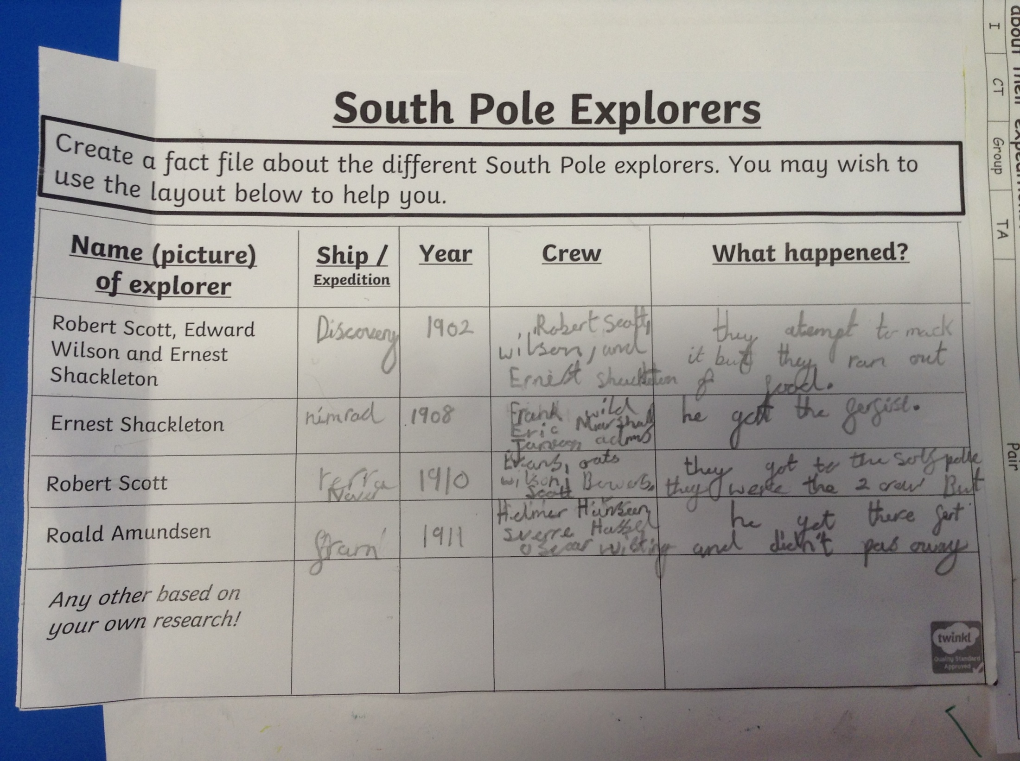
Sophie Carr has shown how and when some of the South Pole explorers went on their expeditions.

Slide 41
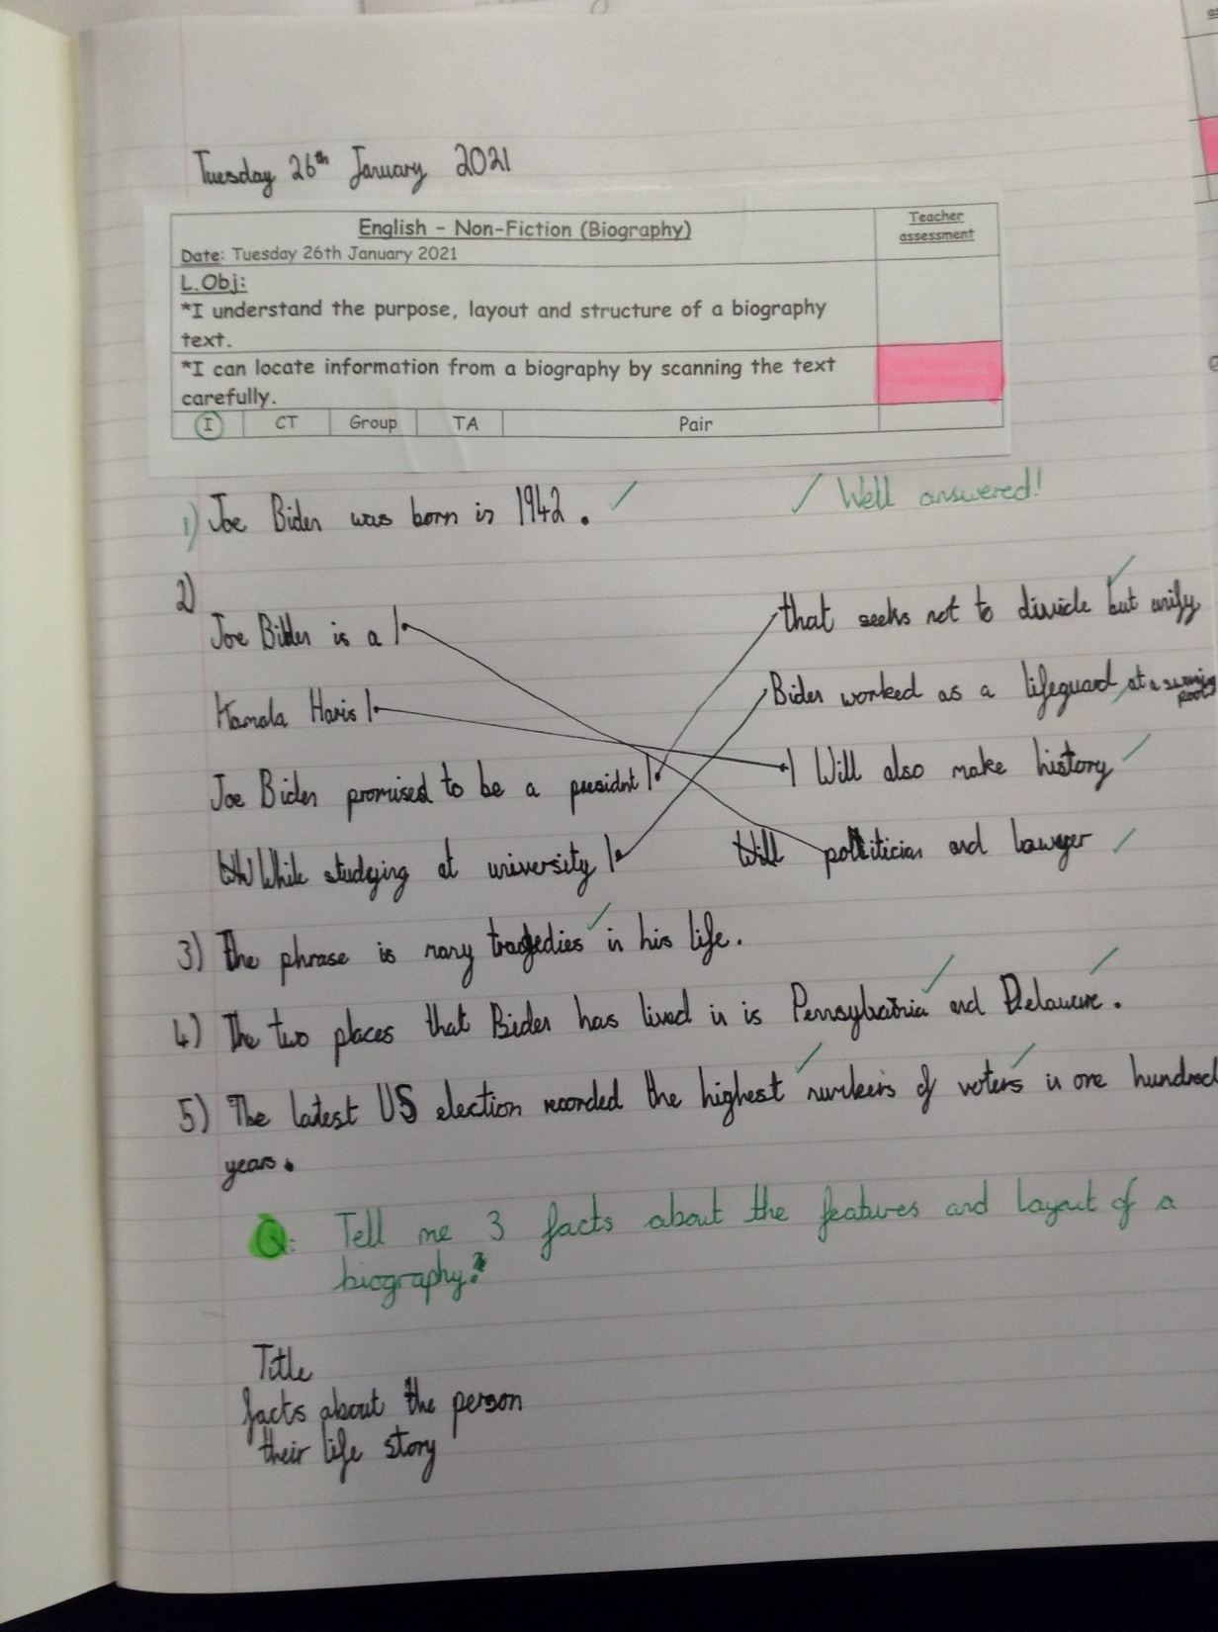
Cass has read his Joe Biden biography well and scanned the text to locate these answers correctly.

Slide 42
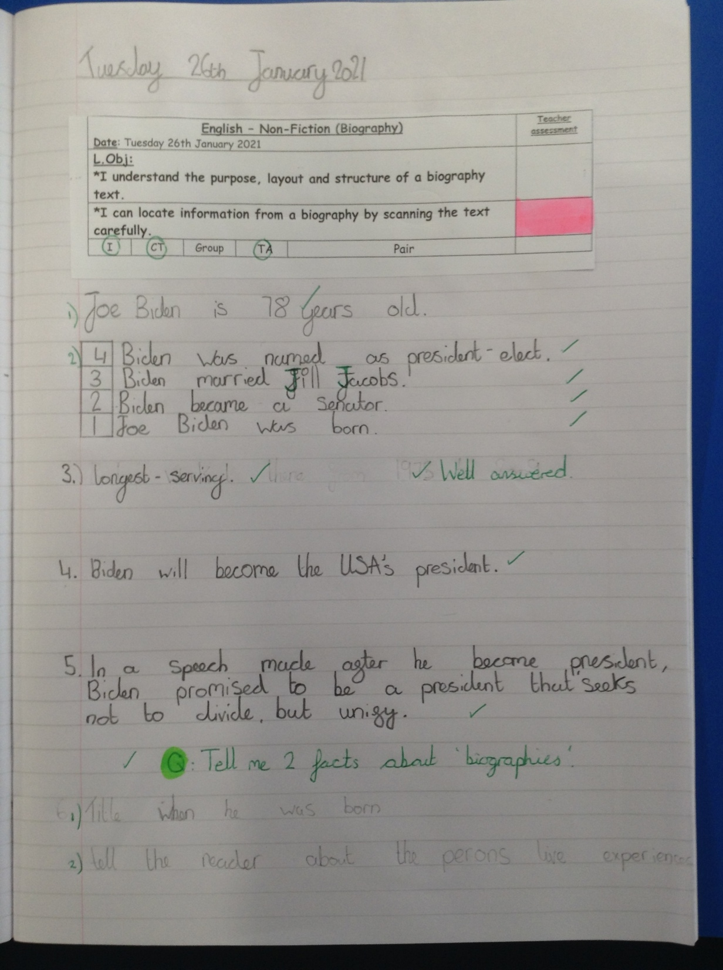
Alfie has scanned his Joe Biden biography text to locate these answers.

Slide 43
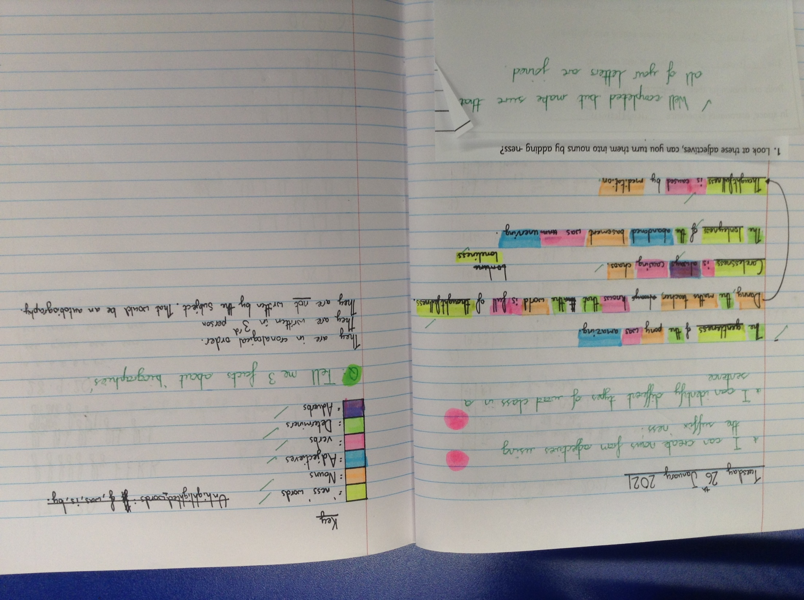
Amy has produced her own sentences using the suffix ‘ness’ to change adjectives into nouns. Then, she’s identified the different types of word class in her sentences.

Slide 44
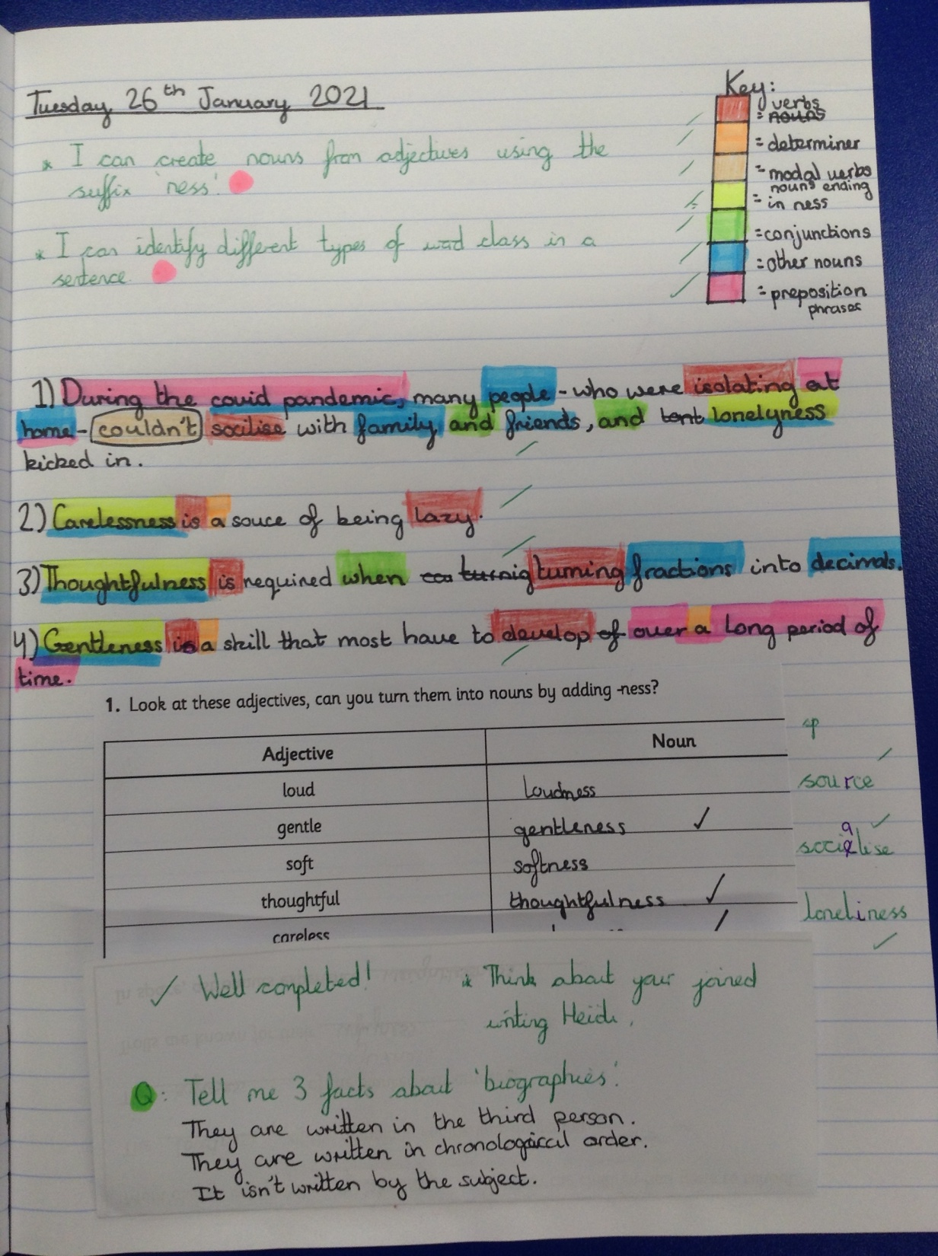
Heidi has created her own sentences using the suffix ‘ness’ to change adjectives into nouns.
Then, she has identified the different types of word class in her sentences.

Slide 45
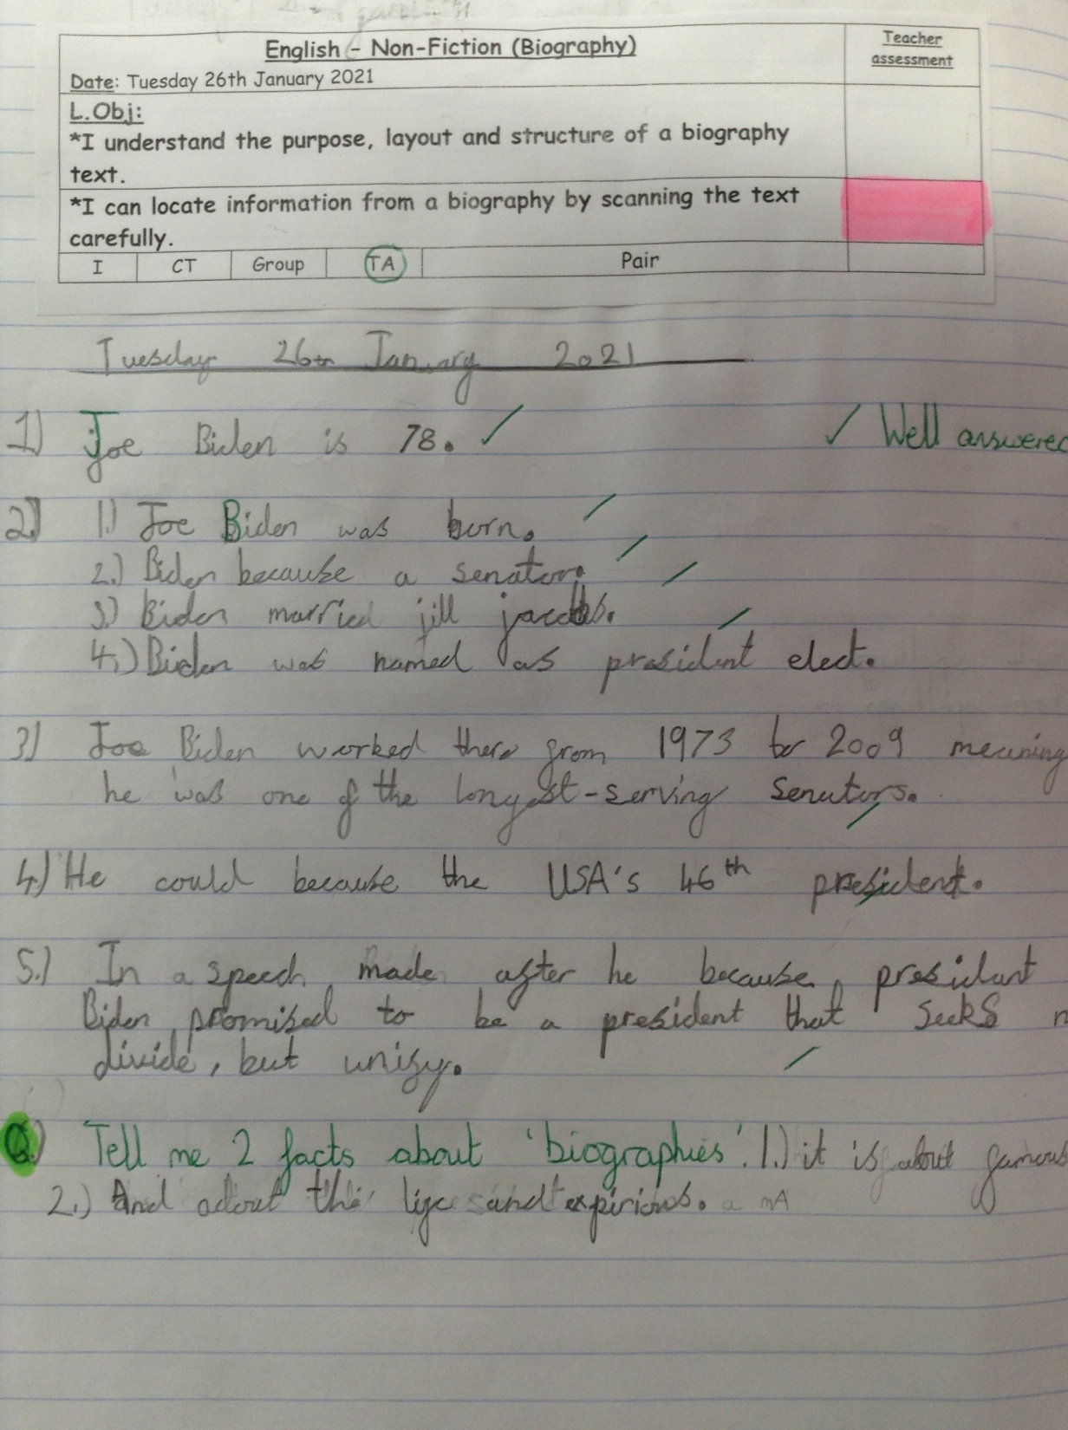
Sophie Carr has scanned her Joe Biden biography text to locate these answers.
Ollie did a ‘real life’ maths challenge with some ‘tuck shop’ money questions.

Slide 46
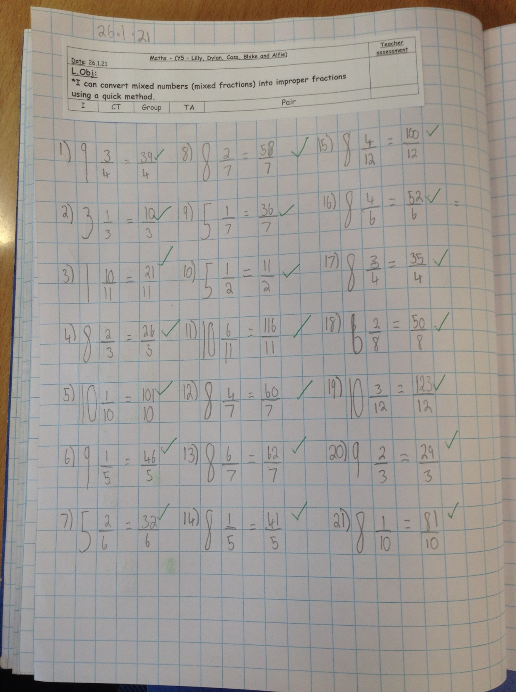
Cass has converted these mixed fractions into improper fractions really well.

Slide 47
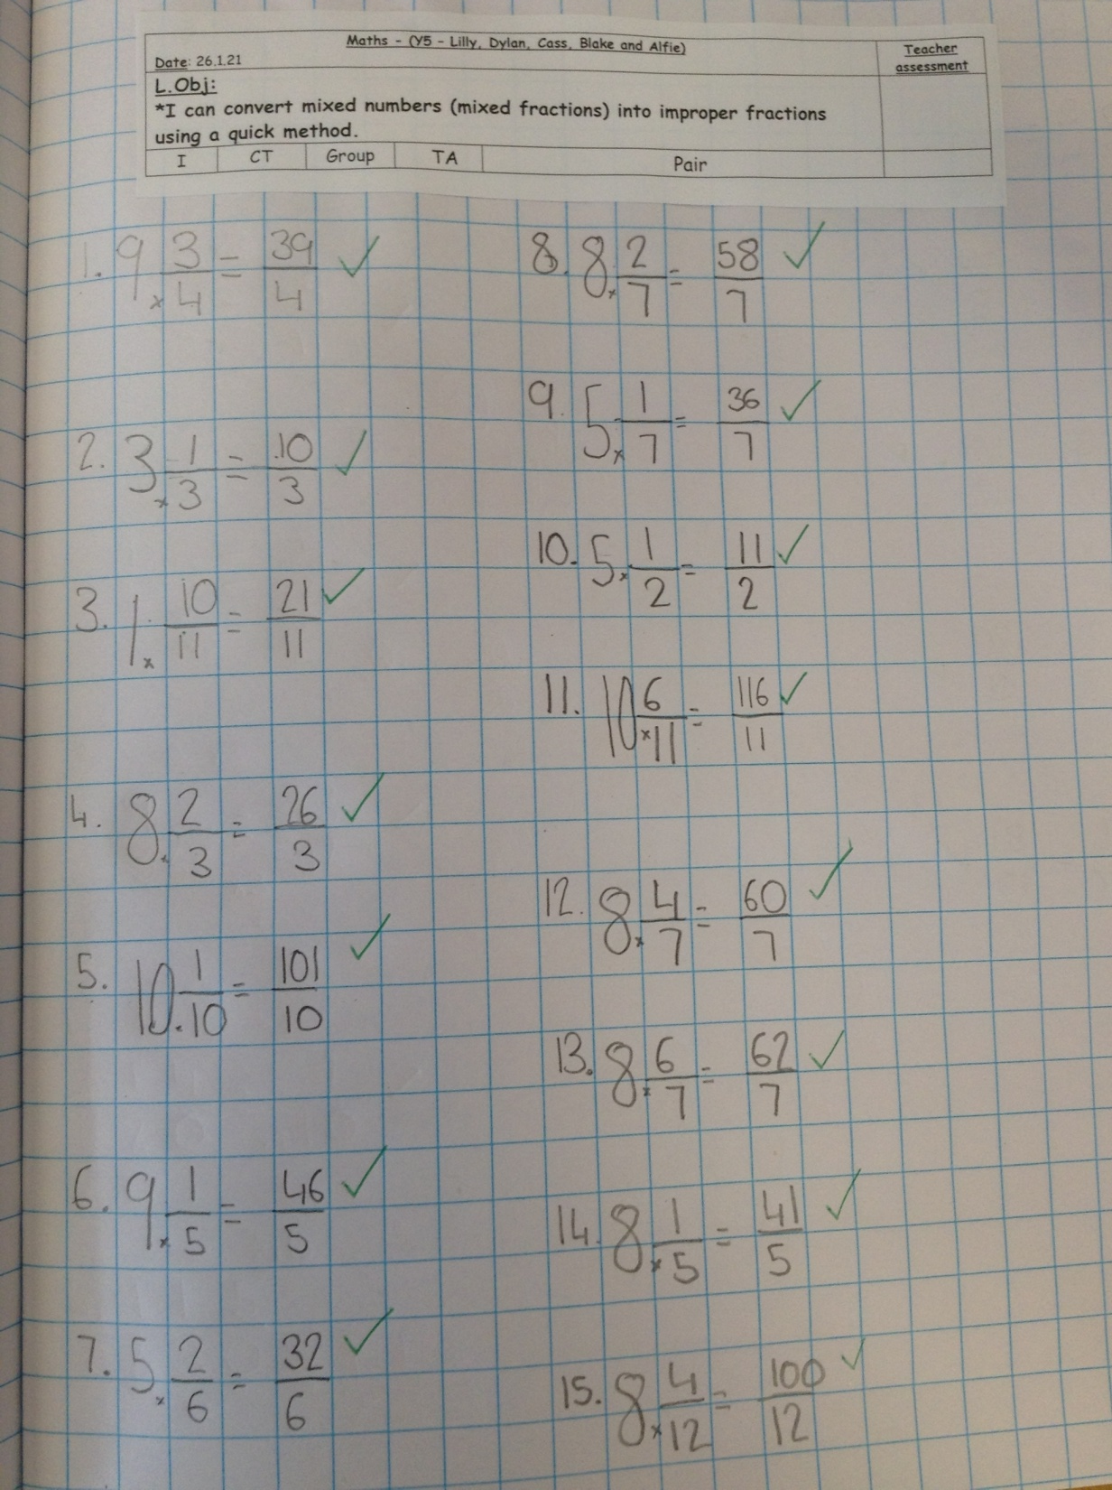
Alfie has converted these mixed fractions into improper fractions really well.

Slide 48
Sophie Carr has converted these mixed fractions into improper fractions really well.

Slide 49
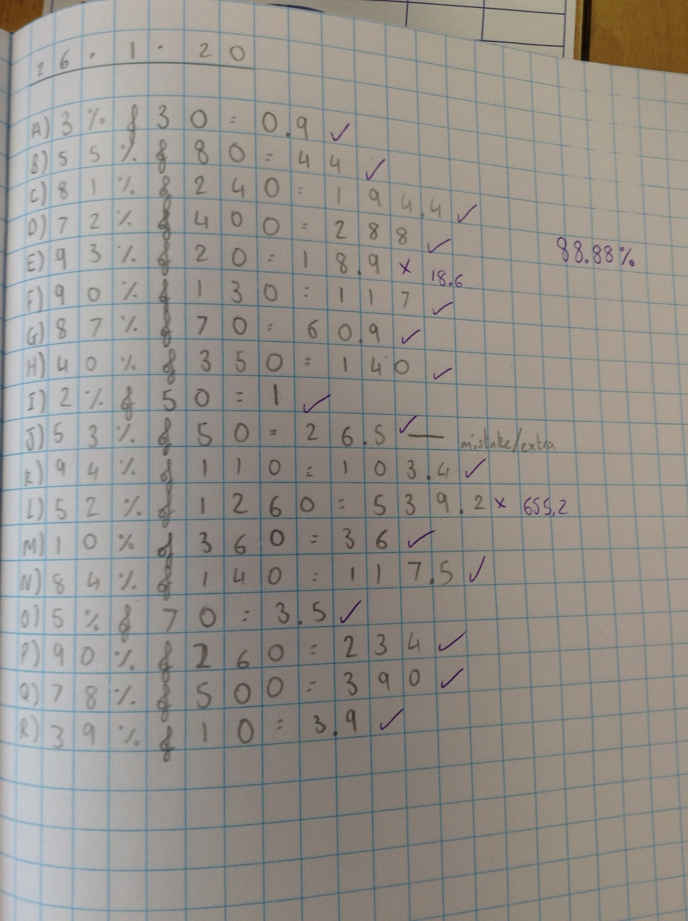
Amy has calculated these % of amounts by creating her own calculations using the online 1-100 spinner.

Slide 50
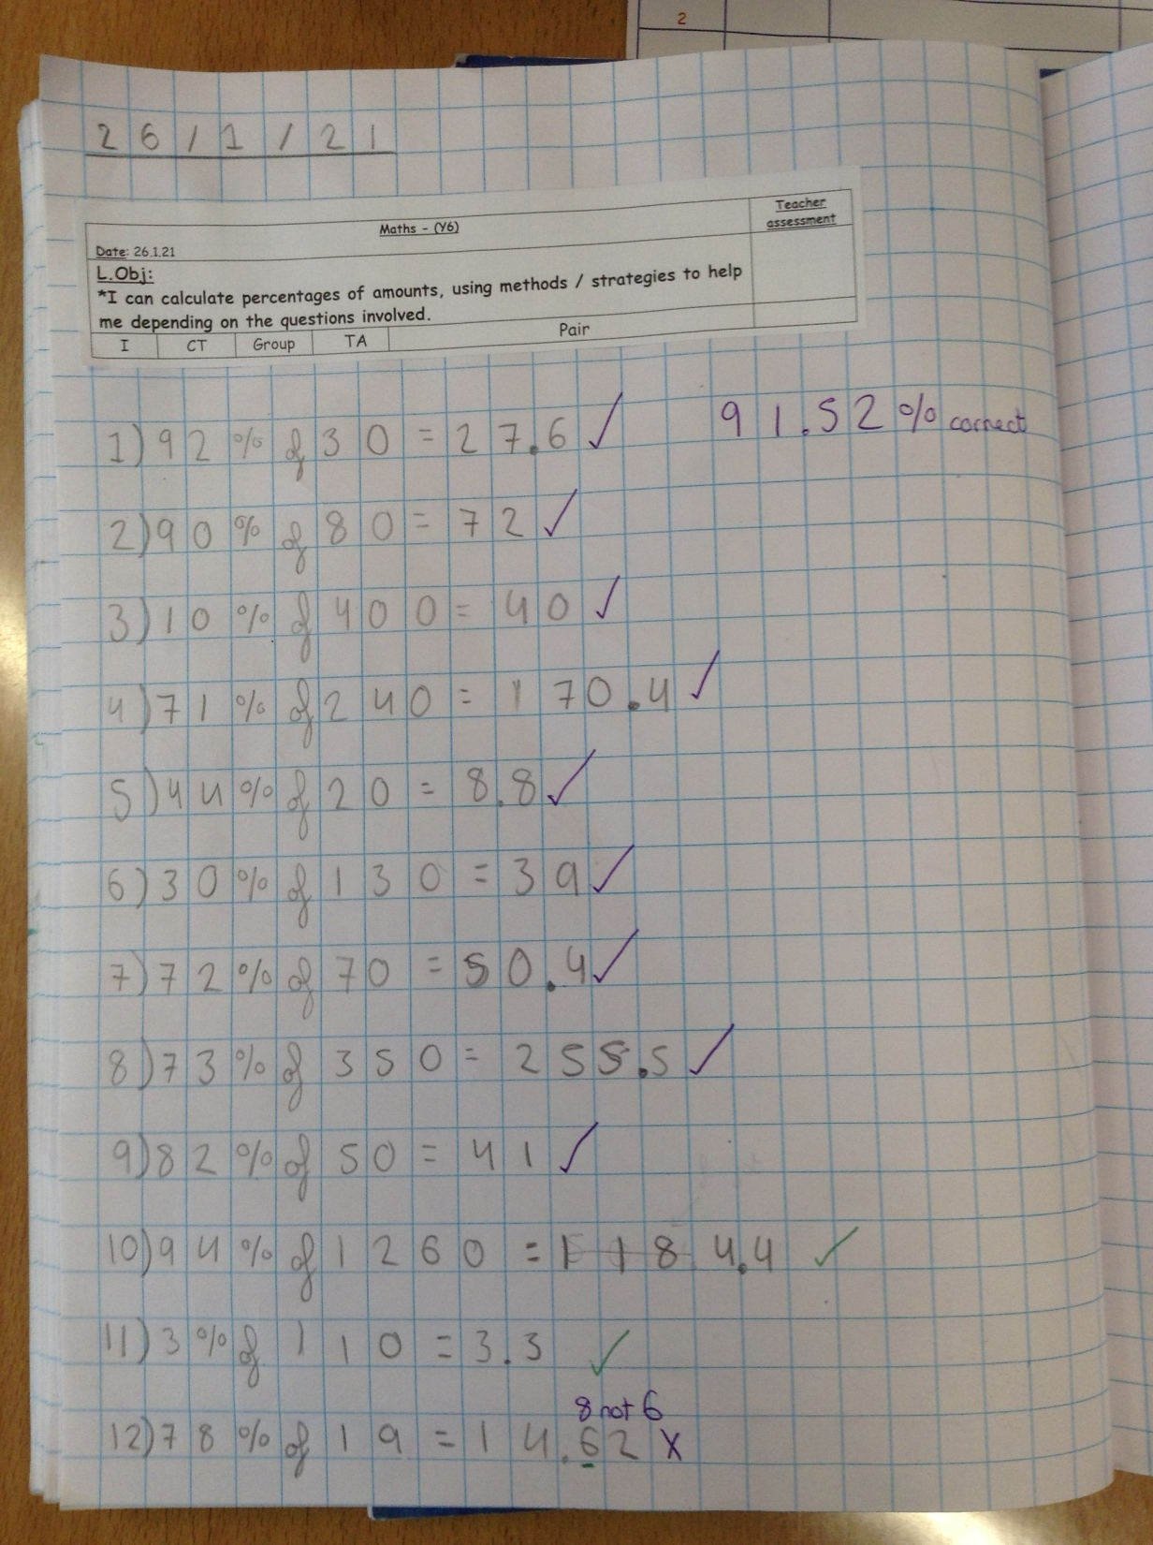
Heidi has calculated these % of amounts by creating her own calculations using the online 1-100 spinner.

Slide 51
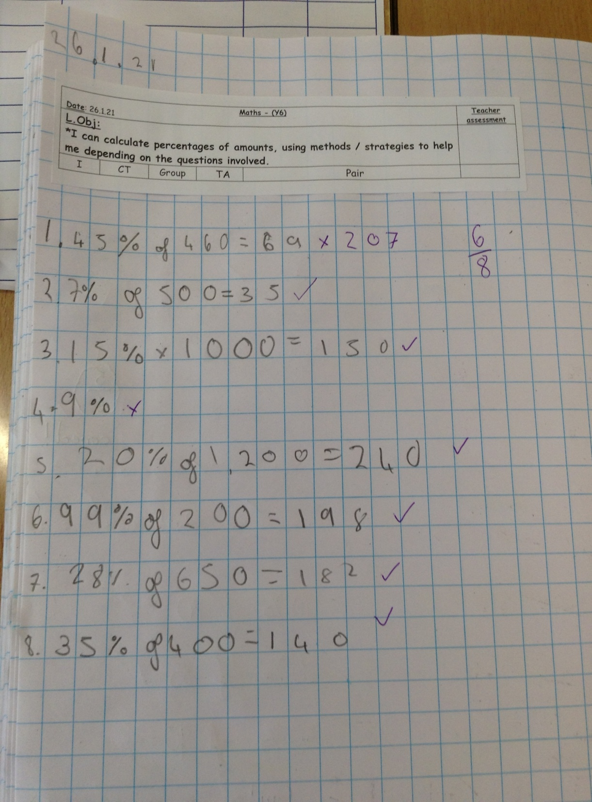
Isobel answered 6 out of 8 correctly.
What % is that Isobel?

Slide 52
Nelly has completed the final draft of her story.
23 Degrees 5 Minutes
After months of preparations the long awaited day had finally arrived. I was embarking on a treacherous expedition to find my dear old friend, Professor Orid. Standing on the eerily quiet dock, anticipation and nerves filled my veins, pumping around my body sending thoughts that flooded my mind.
“Have I got everything?”
“What if I don’t survive?”
“Am I even gonna find the old chap?”
The crashing noise of the sea hitting the rocks snapped me back to reality, the boat was about to dock. I jumped on board eager to get going, but I couldn’t help but notice the ship seemed a bit older than I would’ve liked; rusty metal, frayed rope and split ancient planks of wood, which creaked with every step I made. This was clearly going to be an interesting journey.
As each day led into the other I became intimately familiar with every nook and cranny of my temporary home. The stains on the wall, if you looked at them for long enough you could start to see patterns.
The journey was long and hard and definitely one that I wouldn’t be in a hurry to repeat. Sea sickness had really zapped me of energy. Eventually with a monumental sigh of relief I could see land and ice, lots of it, big chunks that pummelled every inch of the boat. I briefly wondered if the dated ship would withstand such abuse. It did and it wasn’t much later we set ashore.
Stepping onto the crunchy, thick snow I exhaled a deep breath and let my eyes wonder to scan my surroundings. It was cold, bitterly cold, a cold I had never experienced before, a cold that takes your breath away and penetrates deep into your bones. There was nothing much to be seen other than snow- a big fluffy duvet far as the eyes could see.

Slide 53
Nelly has completed the final draft of her story.
Wait! I could see something in the distance. It looked vaguely like a polar bear but was extremely difficult to be sure. Nevertheless it was time to get moving, I had a purpose with no time to waste. I threw my bag on my back and set off in the direction of my map, glaring ahead. I was desperate to see something, anything that would let me know I was going in the right direction. The wind was really getting strong, picking up the snow and swirling it around making visibility near on impossible. I persevered, I wasn’t going to be beaten, I’d come too far. Pushing through the freezing snow, I lost all sense of time. I fought hard to keep going, my mind beginning to drift.
“This is hopeless.”
The weather took a terrifying turn for the worst. Baltic blizzard conditions gripped hold of me and wouldn’t let go, swirling all around me, pulling me down, down, down I fell, hitting the snow, exhaustion had taken over every tiny muscle of my body, pushing me down deeper into the snow, which covered me like a blanket. I lay frozen, delirious and gripped by fear.
“Is this it?”
“Am I gonna die in the desolate place all alone?”
Curling up into a ball I was overcome by emotions, my eyes stinging I was so tired but I was desperate to stay awake, I just had to keep my eyes open. Suddenly, my eyes shot open. Something had startled me. I fought with all my might to focus, my eyes stopping on a hazy figure looking down at me. I frantically rubbed my eyes doing my utmost to visualise what was in front of me.
“Could it be?”

Slide 54
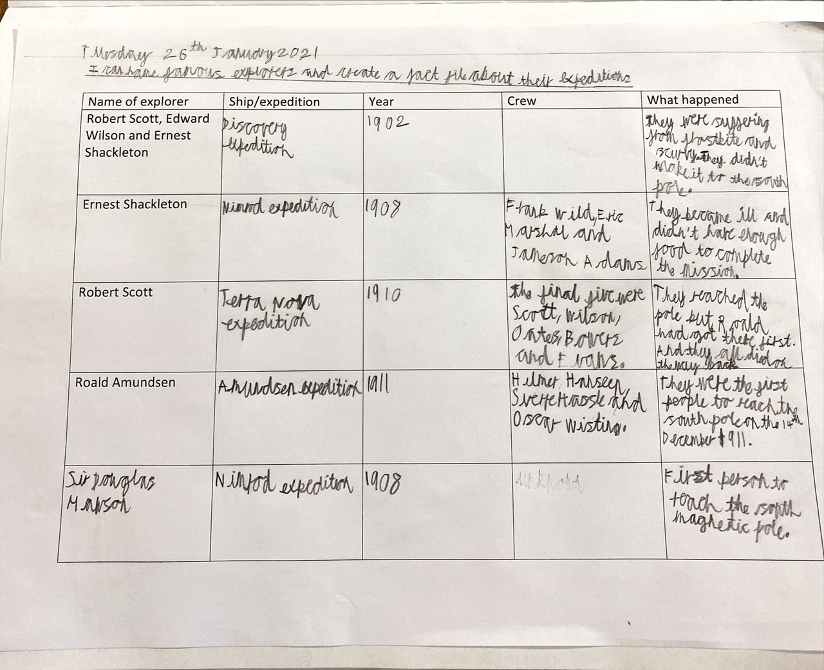
Sam has shown how and when some of the South Pole explorers went on their expeditions.

Slide 55
Sam has converted these mixed fractions into improper fractions really well.

Slide 56
Sam has read his Joe Biden biography well and scanned the text to locate these answers correctly.

Slide 57
Katie and Lucy have shown how and when some of the South Pole explorers went on their expeditions.

Slide 58
Lucy has read her Joe Biden biography well and scanned the text to locate these answers correctly.

Slide 59
Lucy has used great workings out to help her to calculate these % of amounts.

Slide 60
Katie has used great workings out to help her to calculate these % of amounts.

Slide 61
Katie has read her Joe Biden biography well and scanned the text to locate these answers correctly.

