Slide 1
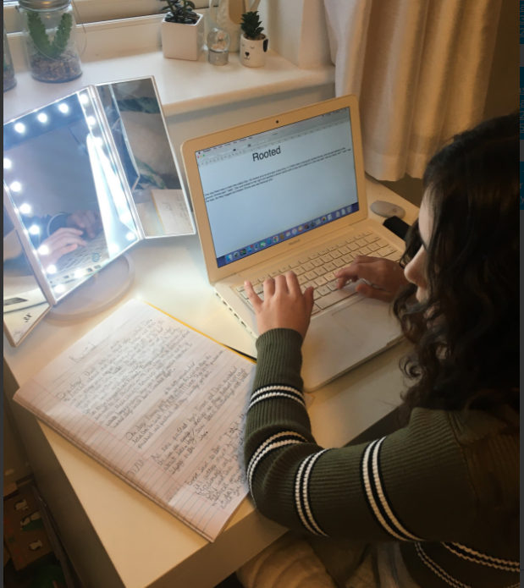
Esme working really hard on her typing skills to complete her final draft of ‘Rooted’.

Slide 2
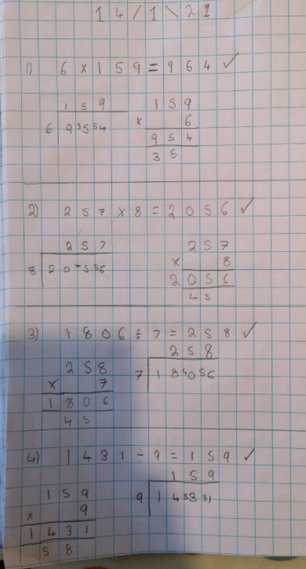
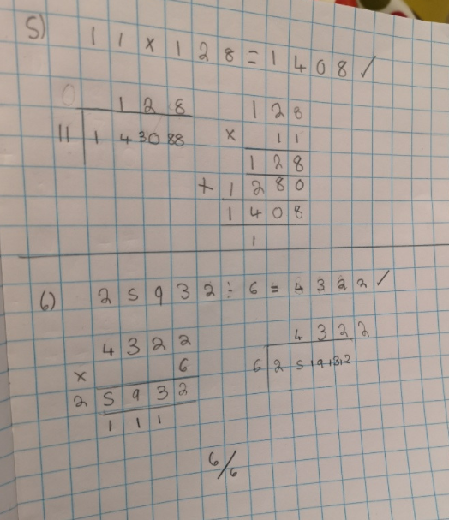
Lilly whizzed through her division and multiplication in maths today.

Slide 3
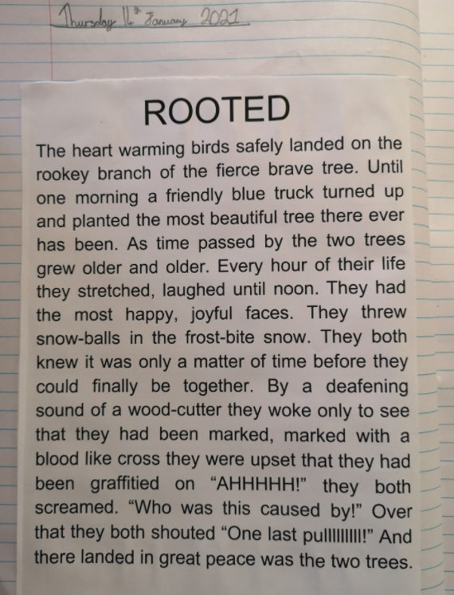
Lilly has been typing the final draft of her story today.
*Remember, start your speech sentences on a new line.

Slide 4
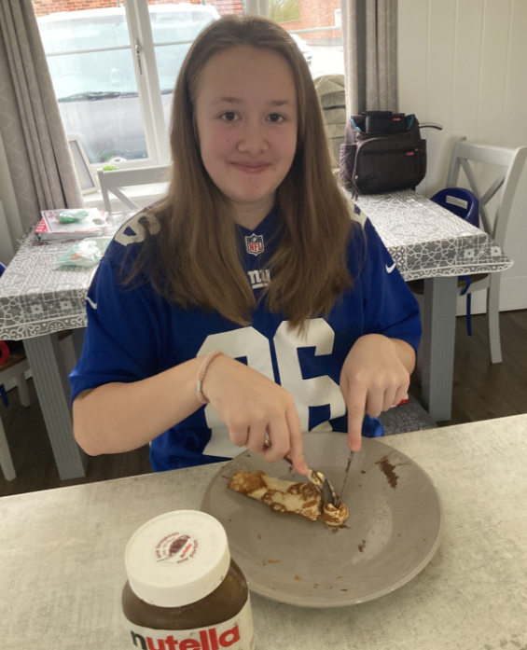
Pancakes to start the day for Isla today, ready for the work ahead.

Slide 5
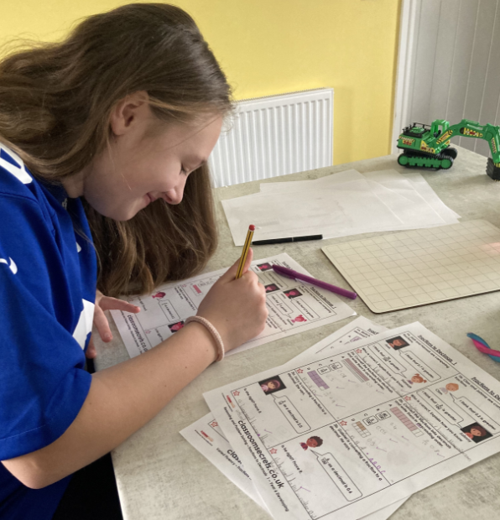
Yes mum, I know you are taking a photograph of me!

Slide 6
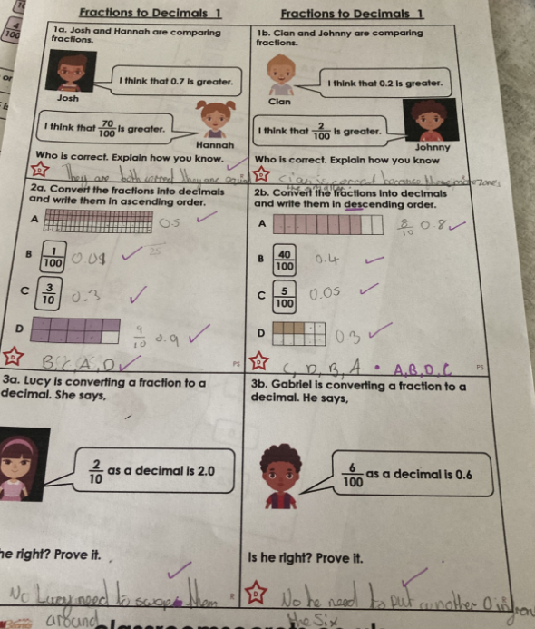
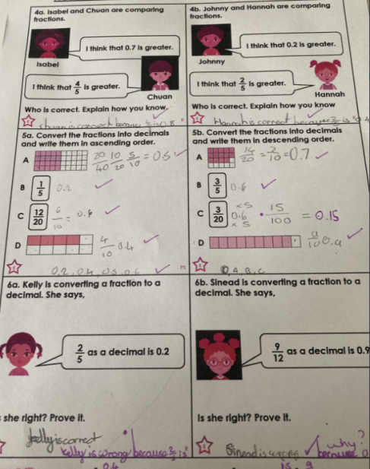
Isla found her maths tricky at first but then persevered and understood by the end.

Slide 7
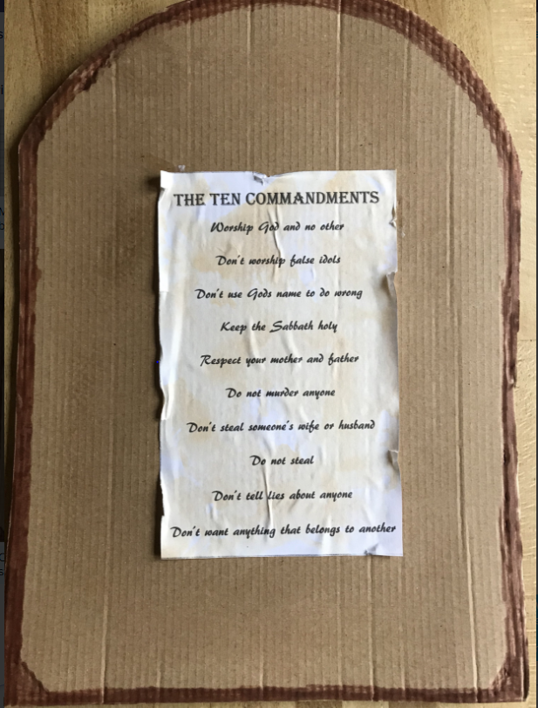
Ariana created a really thoughtful tablet to show off the ten commandments.

Slide 8
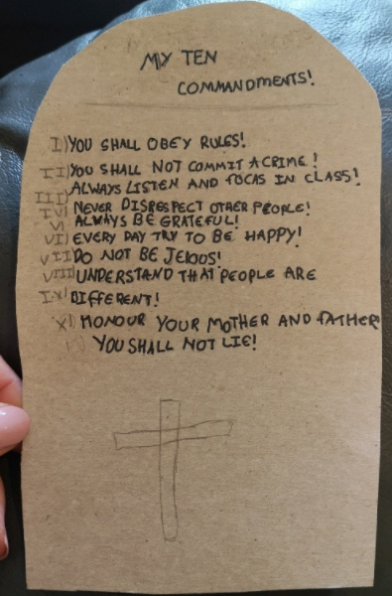
Lilly created her own table to show the ten commandments in RE today.

Slide 9
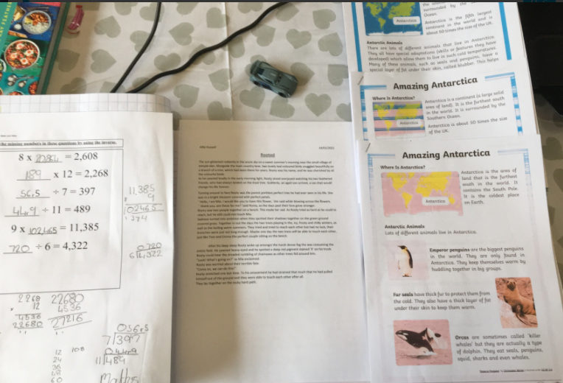
Alfie has worked really hard on his typing, maths and reading today.

Slide 10
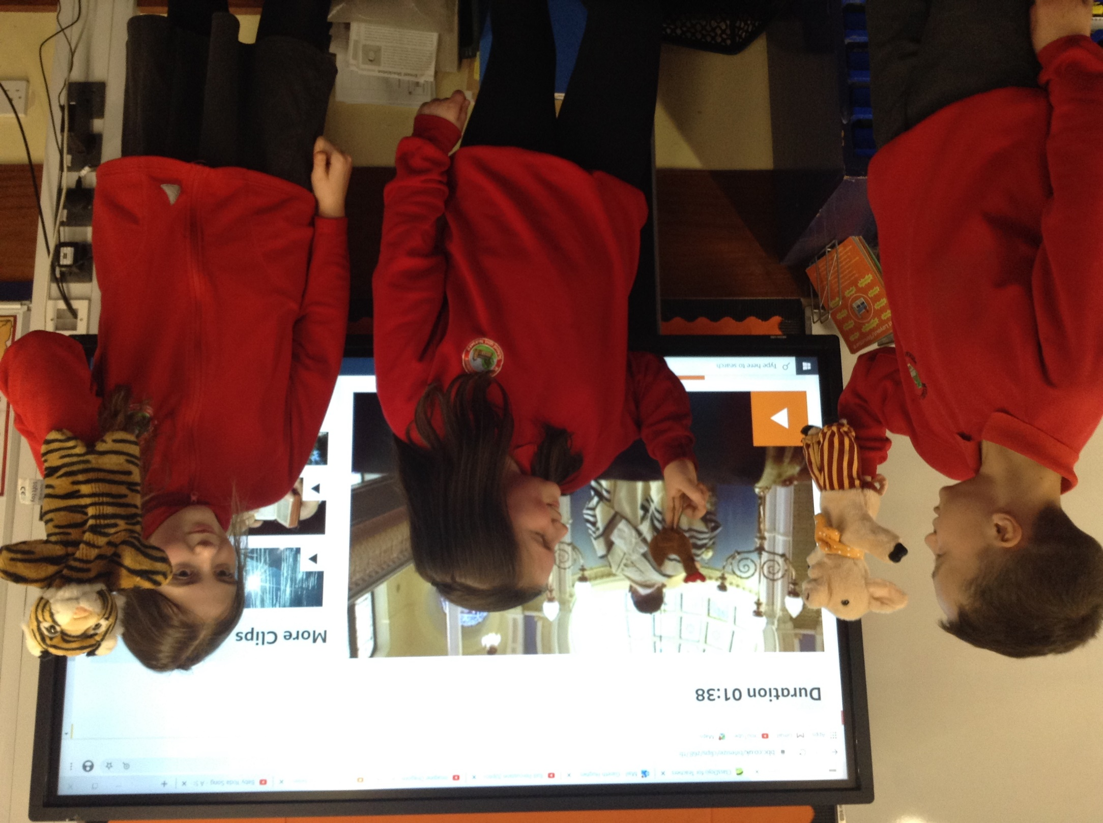
We created a puppet show about the Ten Commandments today.
Click on the link on the website to watch it.

Slide 11
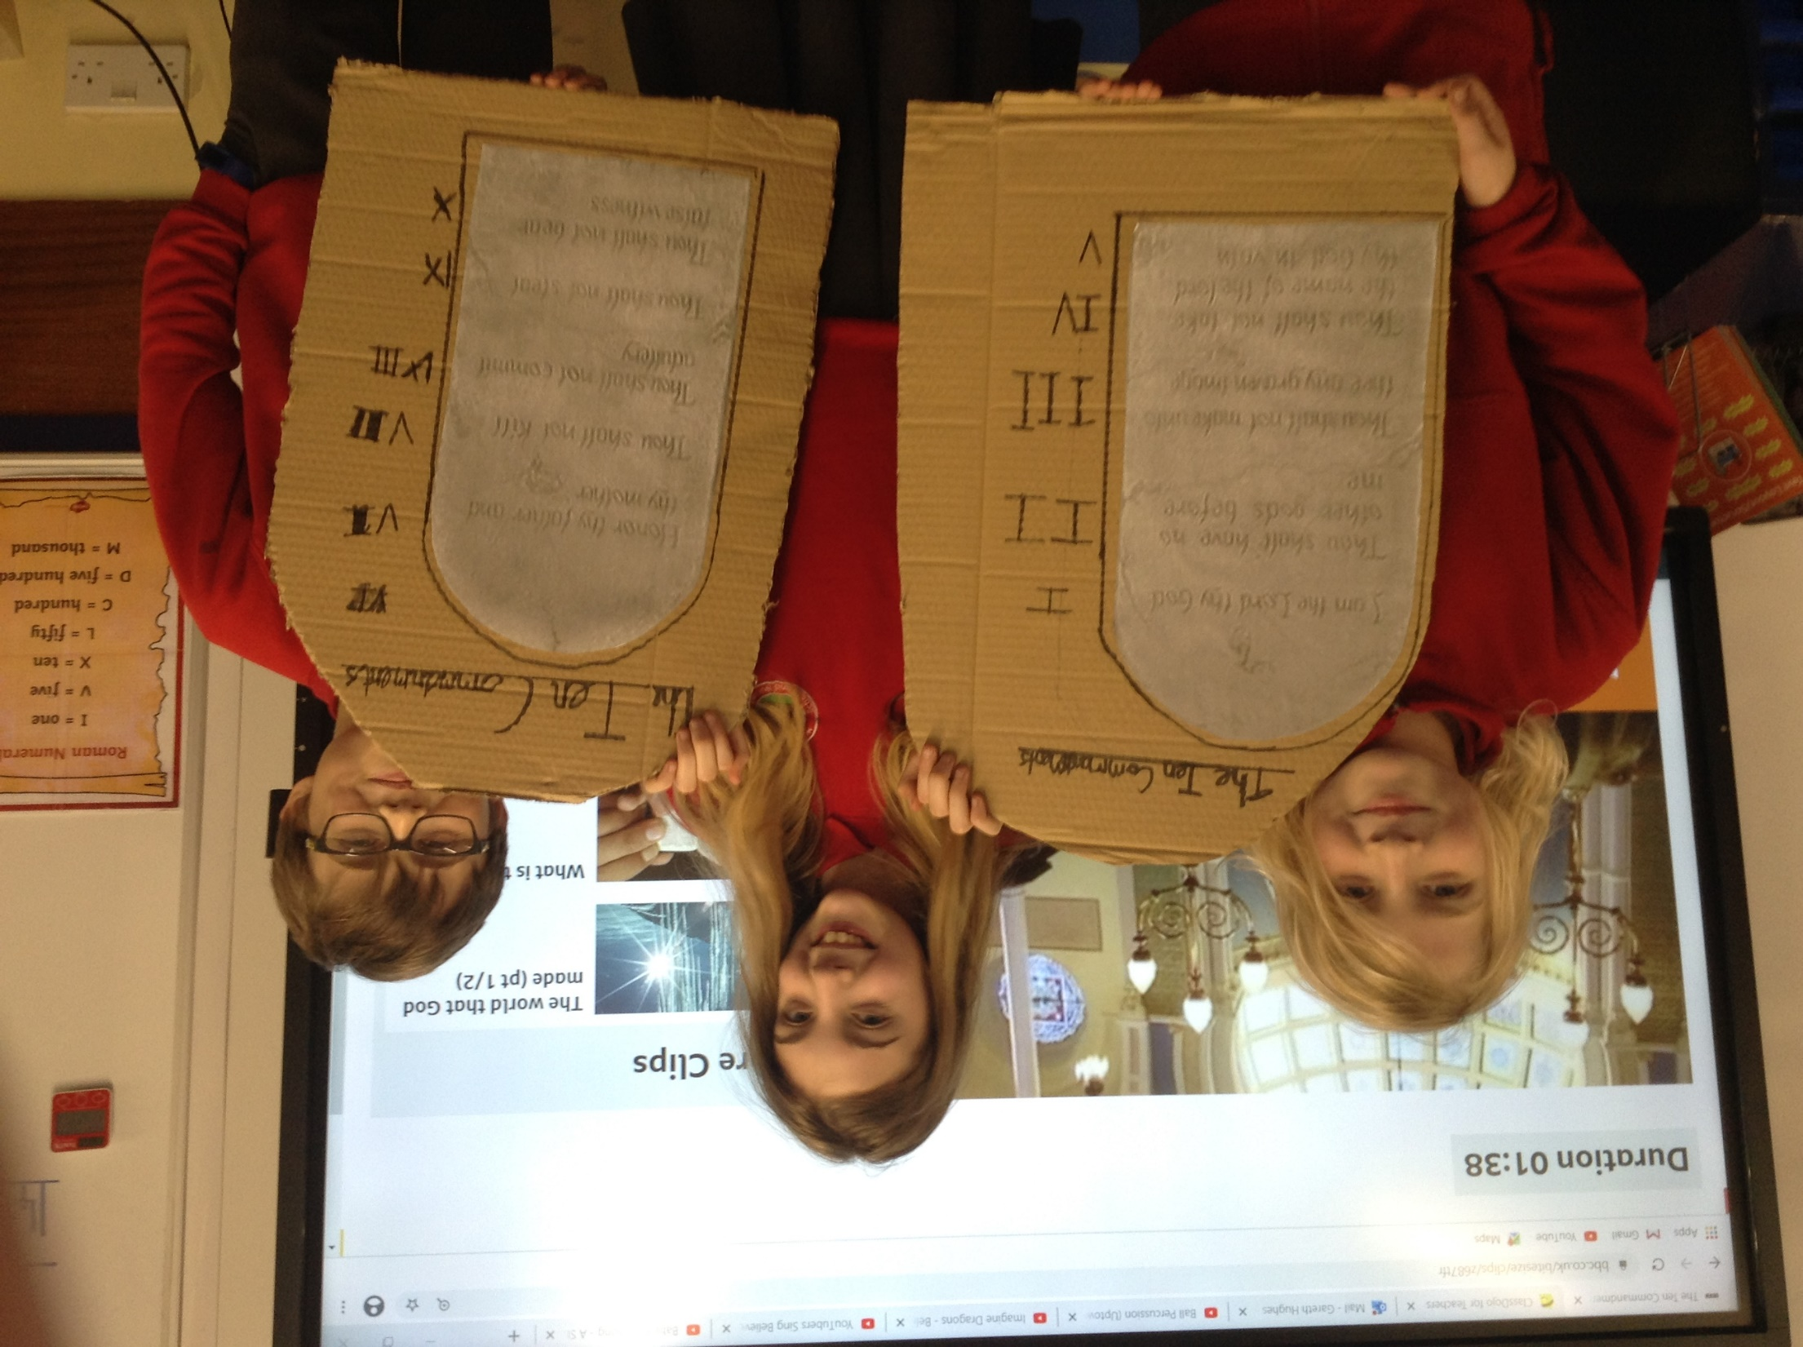
We created the Ten Commandments on our tablets today.

Slide 12
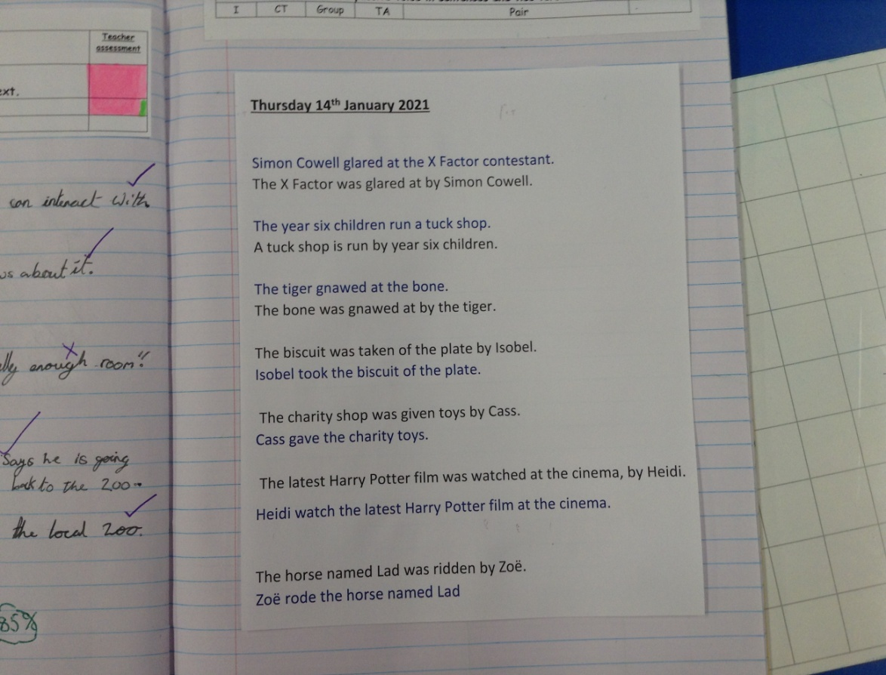
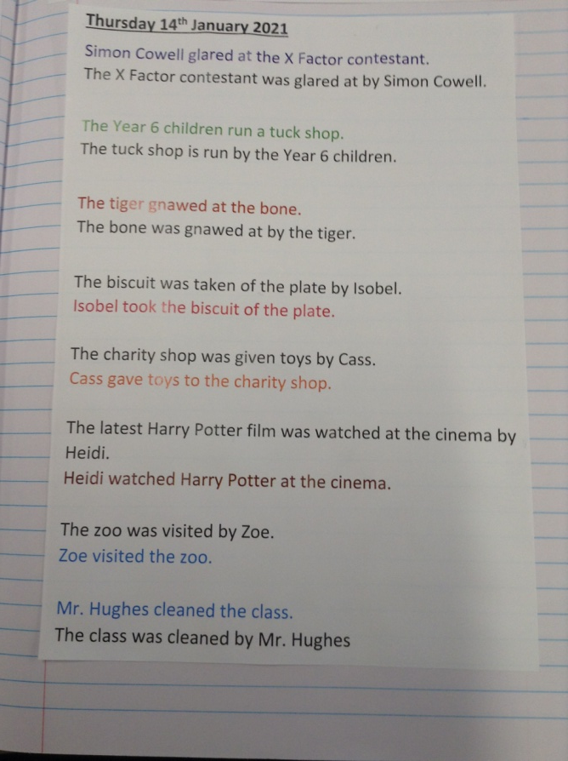
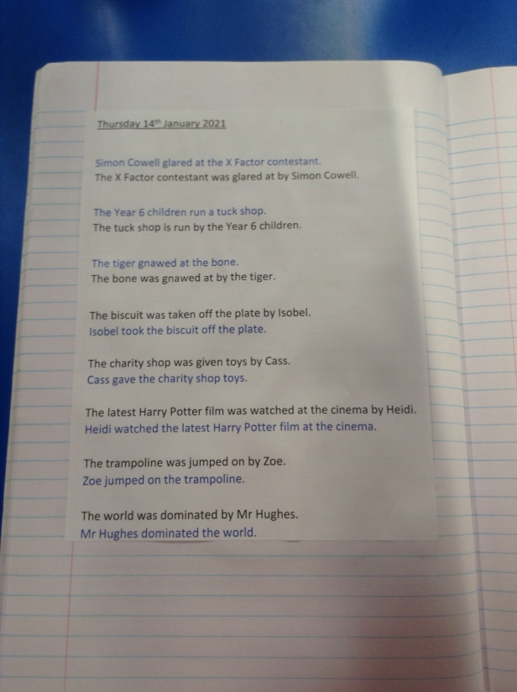
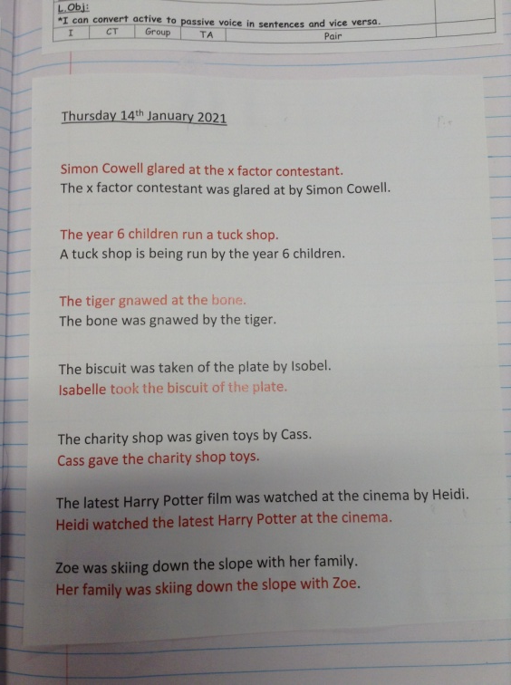
The children in class were converting sentences written in the active and passive voice.

Slide 13
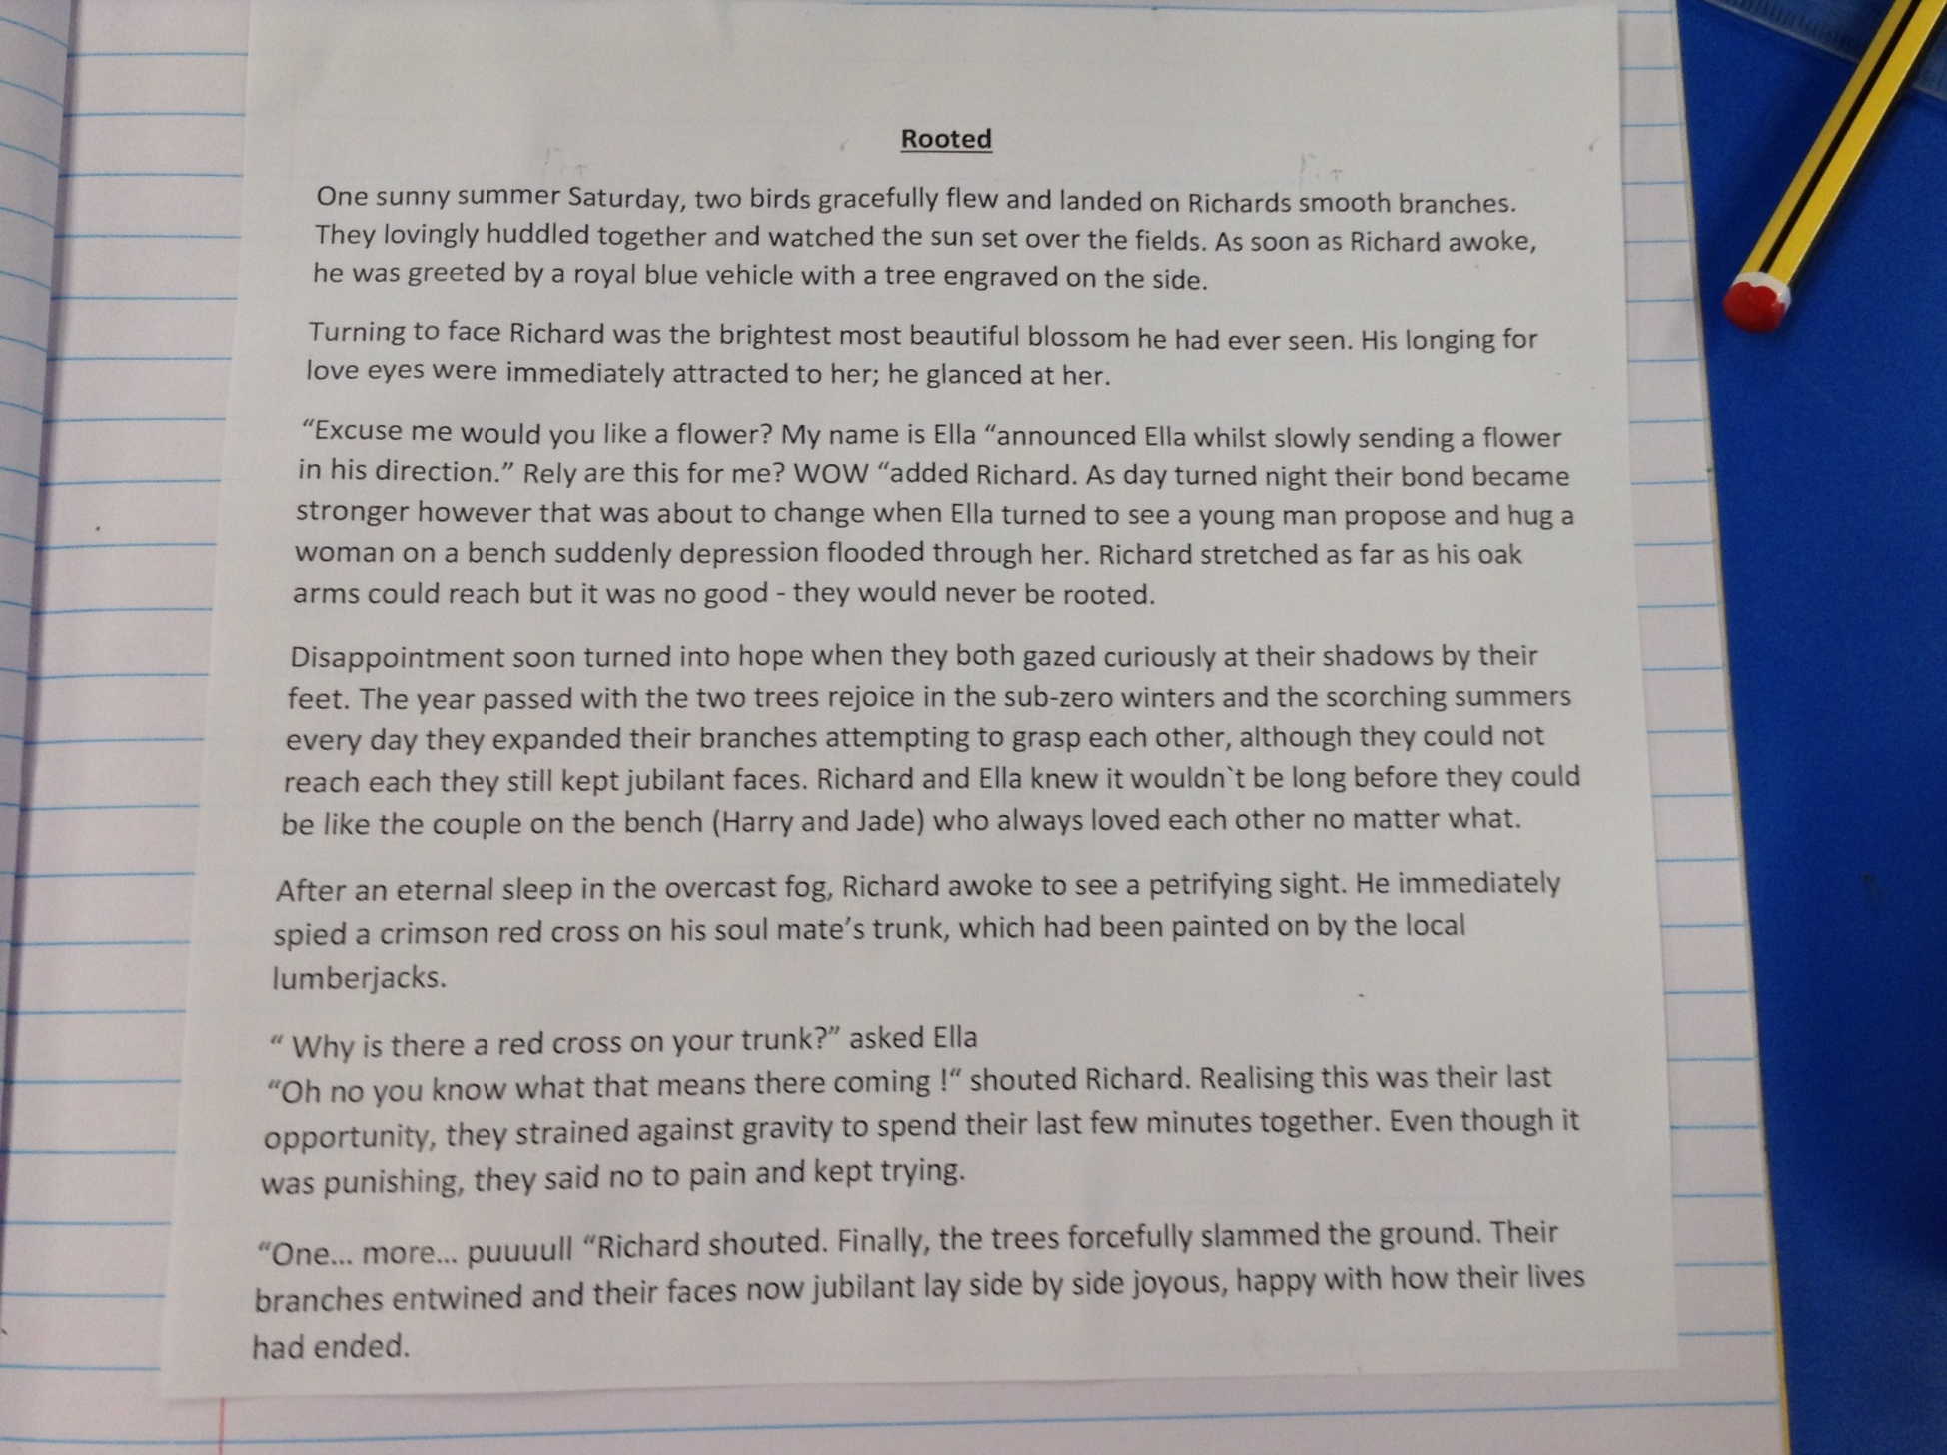
Dylan completed the typing of the final draft of his ‘Rooted’ story.

Slide 14
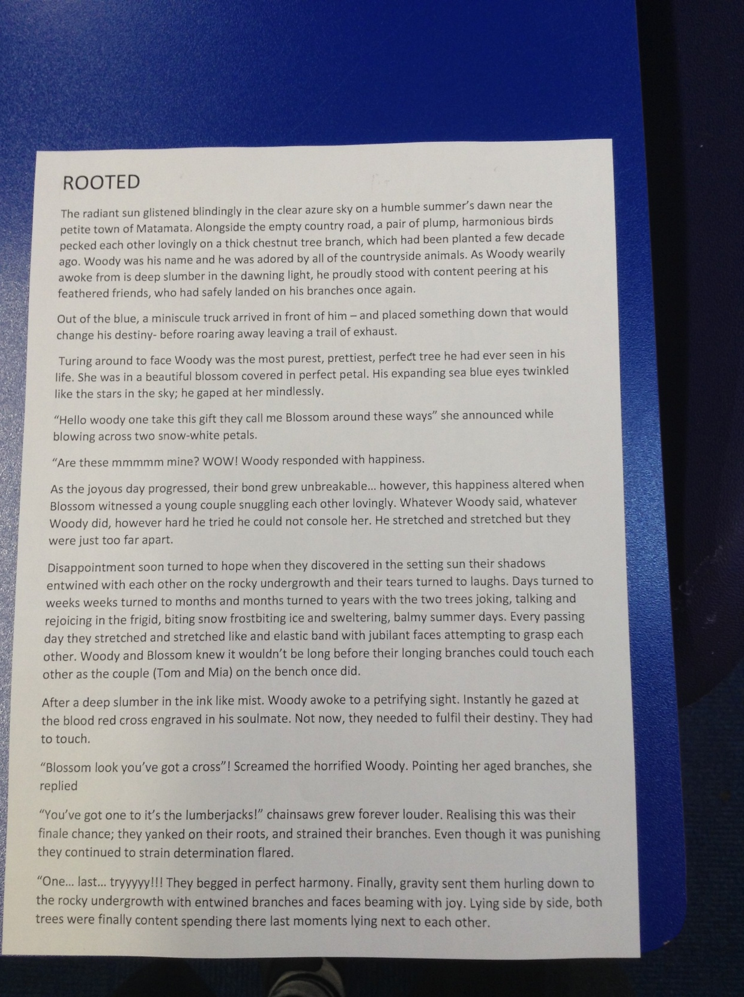
Cameron has been typing out his fantastic ‘Rooted’ story.
You should be proud of the effort and quality in your story Cameron.

Slide 15
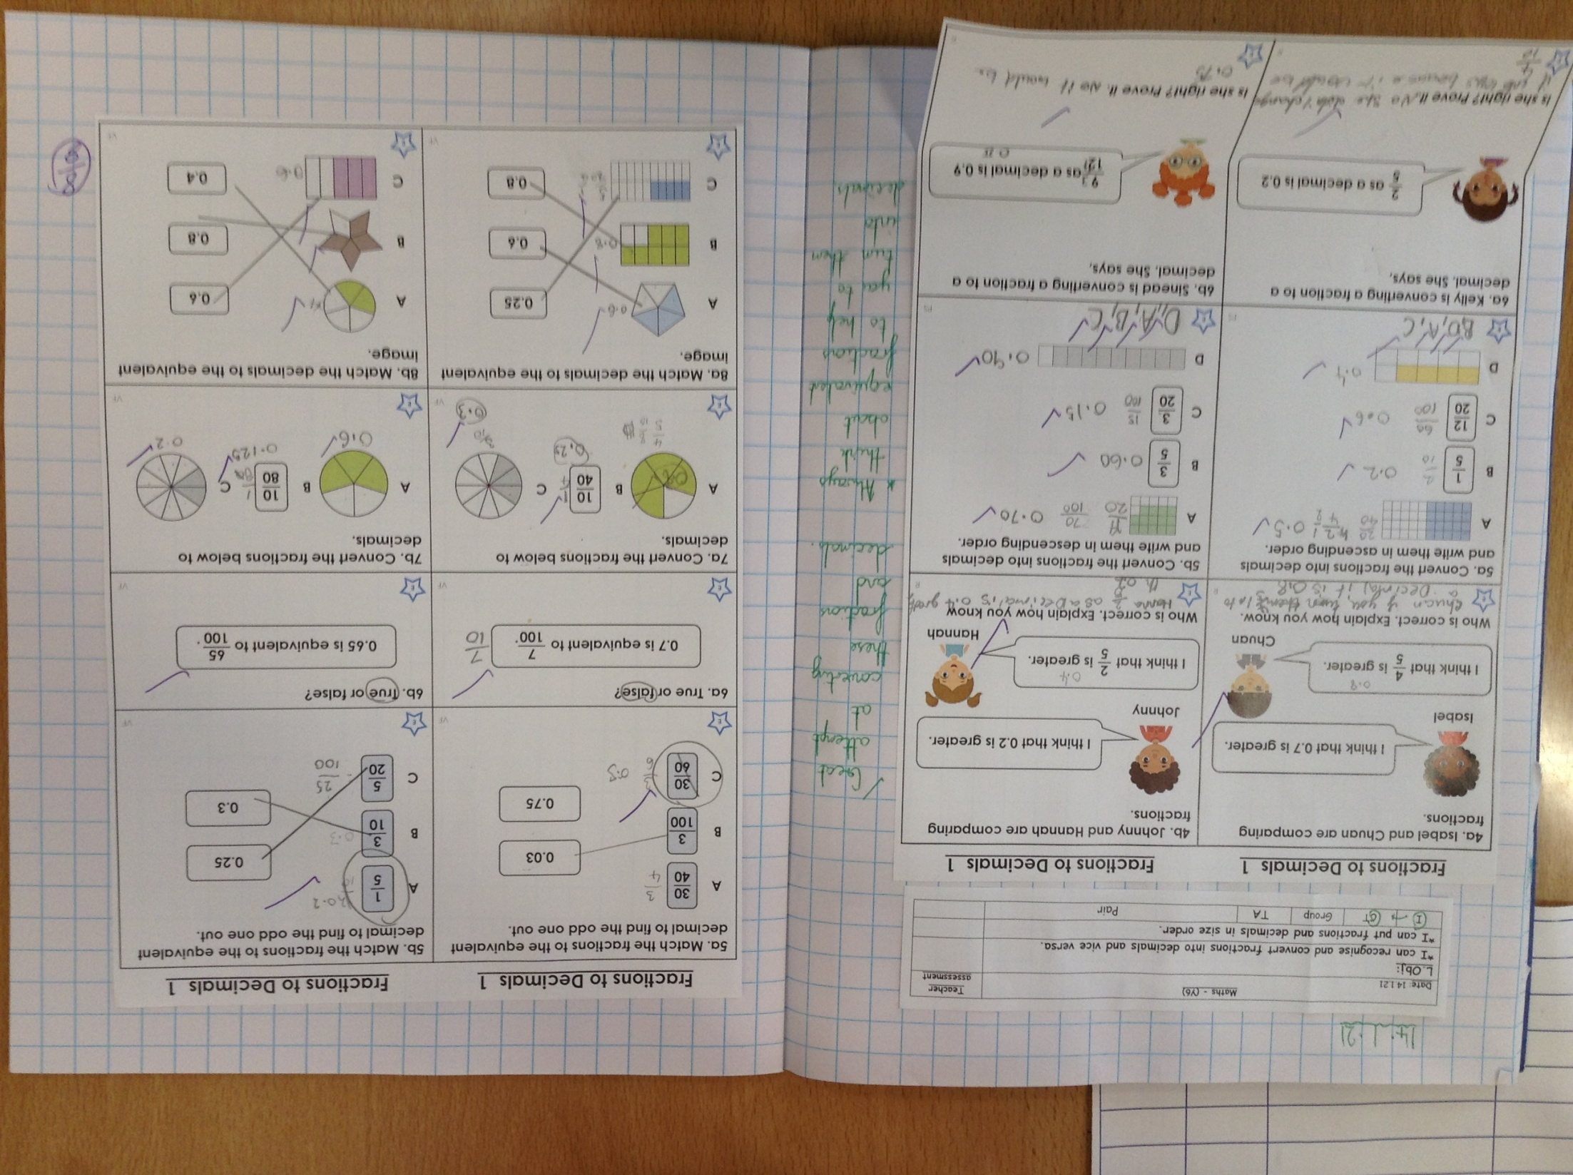
Zoe has converted many of her decimals and fractions correctly.

Slide 16
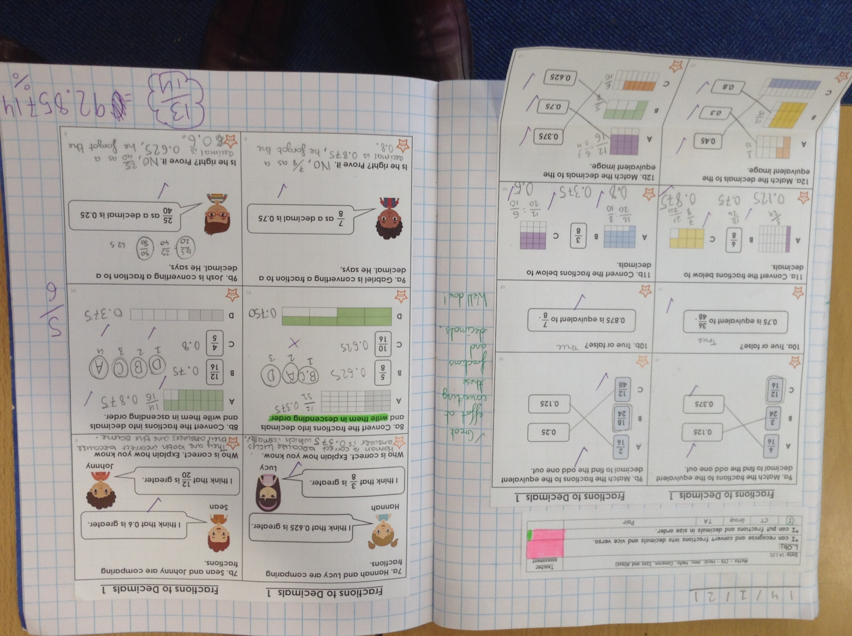
Heidi achieved 93% in her maths today. What’s that as a fraction and decimal Heidi?

Slide 17
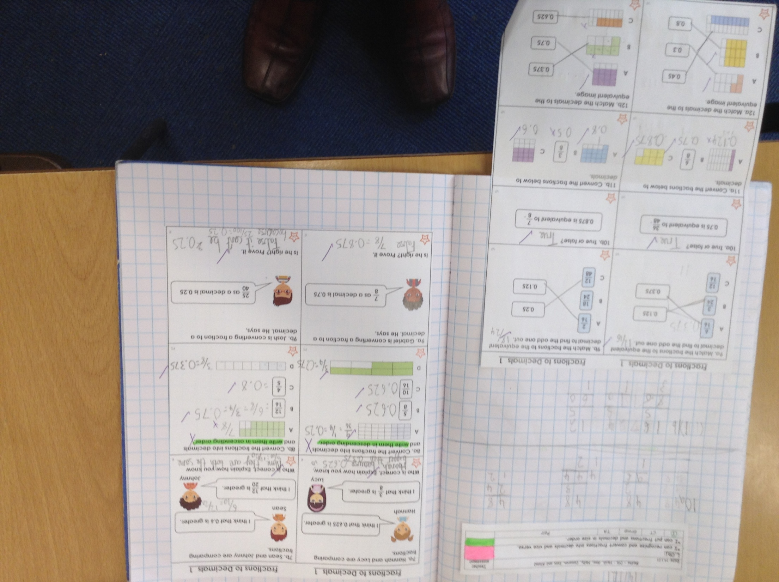
Cameron used his book to jot down his workings out to find these equivalent fractions and decimals.

Slide 18
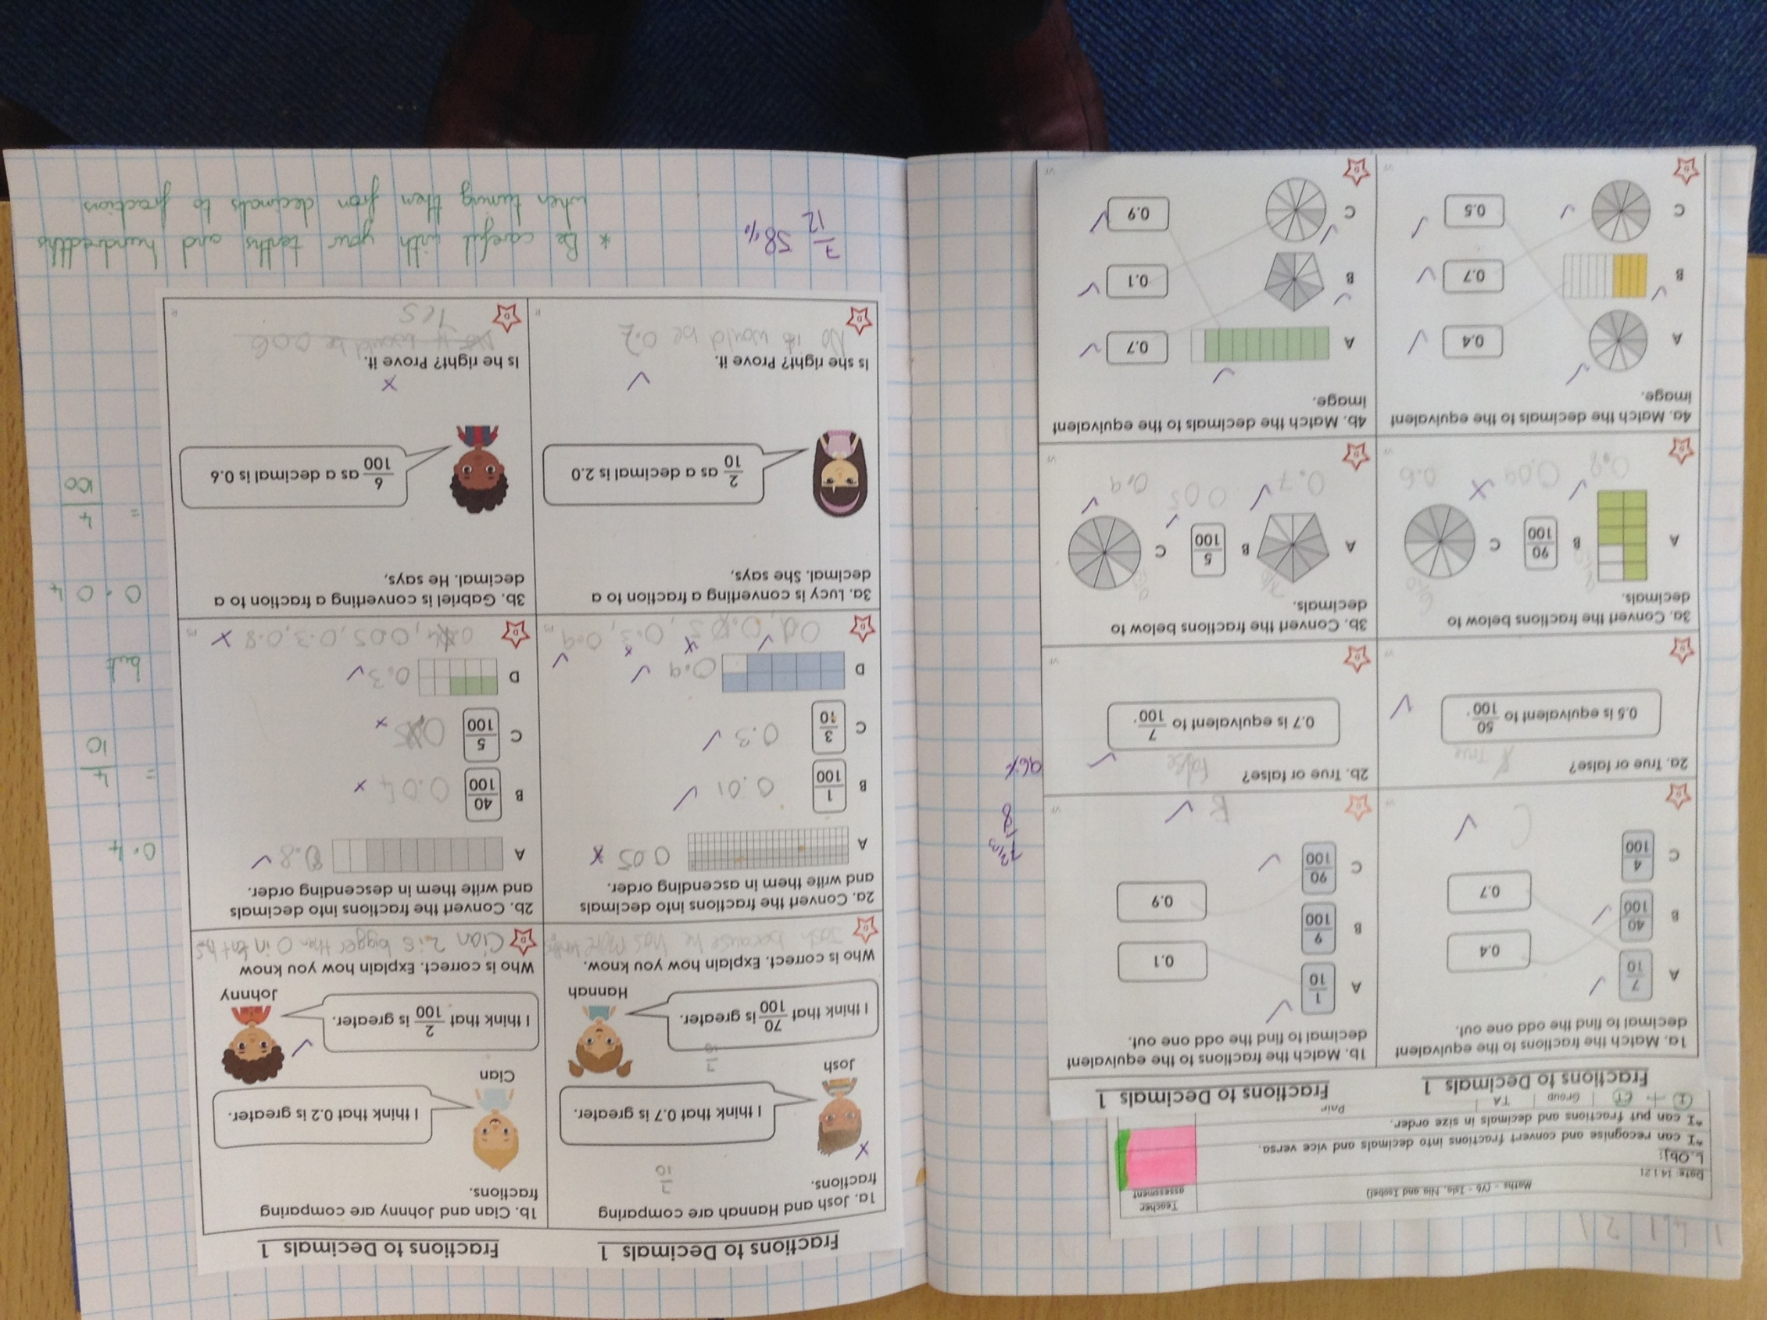
Isobel has converted many of her decimals and fractions correctly.

Slide 19
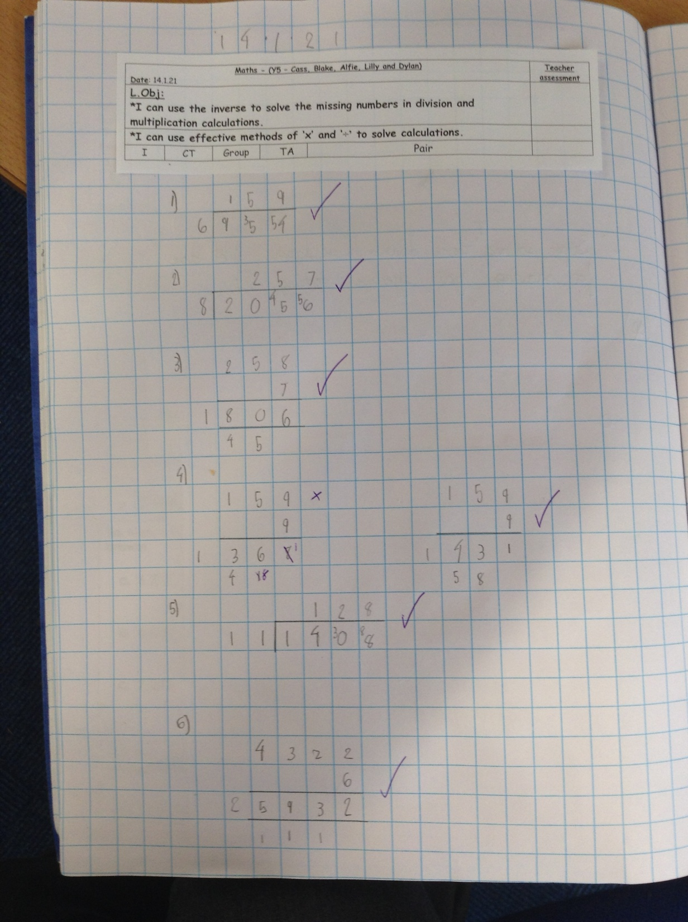
Dylan correctly answered 5 out of 6 and then recognised where he made an error on number 4.

Slide 20
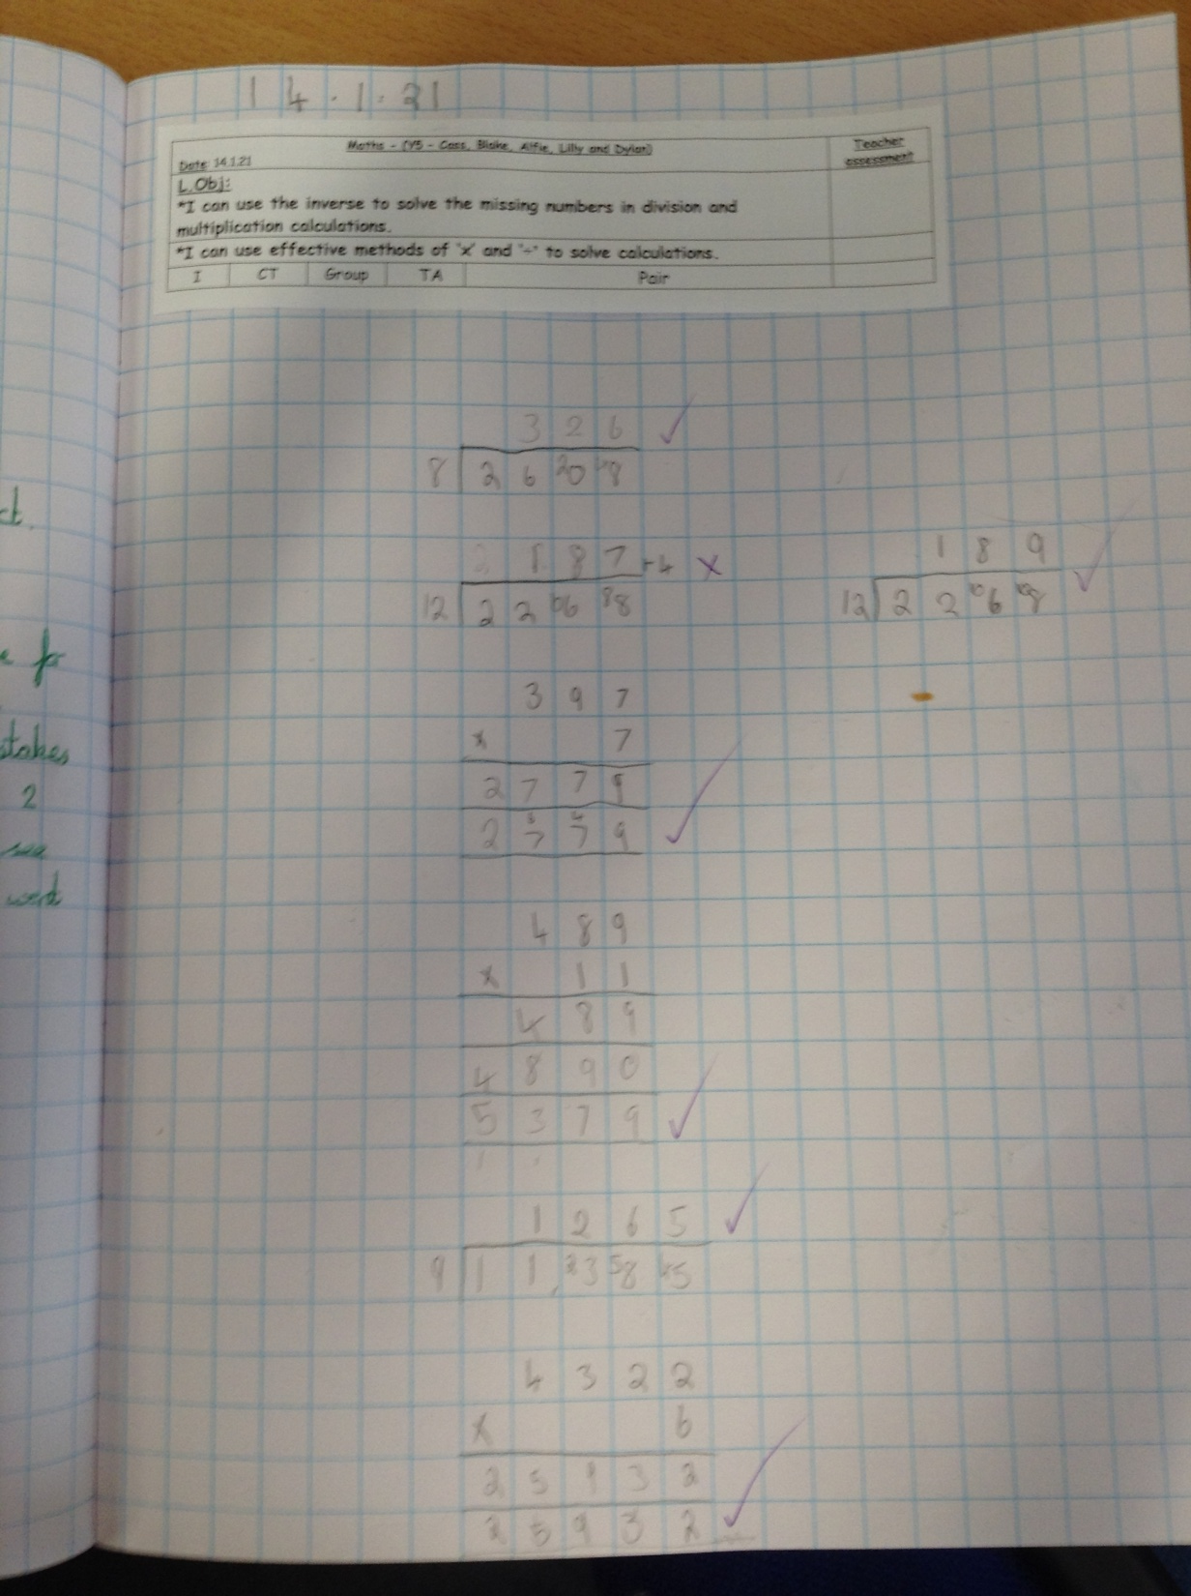
Cass correctly answered 5 out of 6 and then recognised where he made an error on number 2.

Slide 21
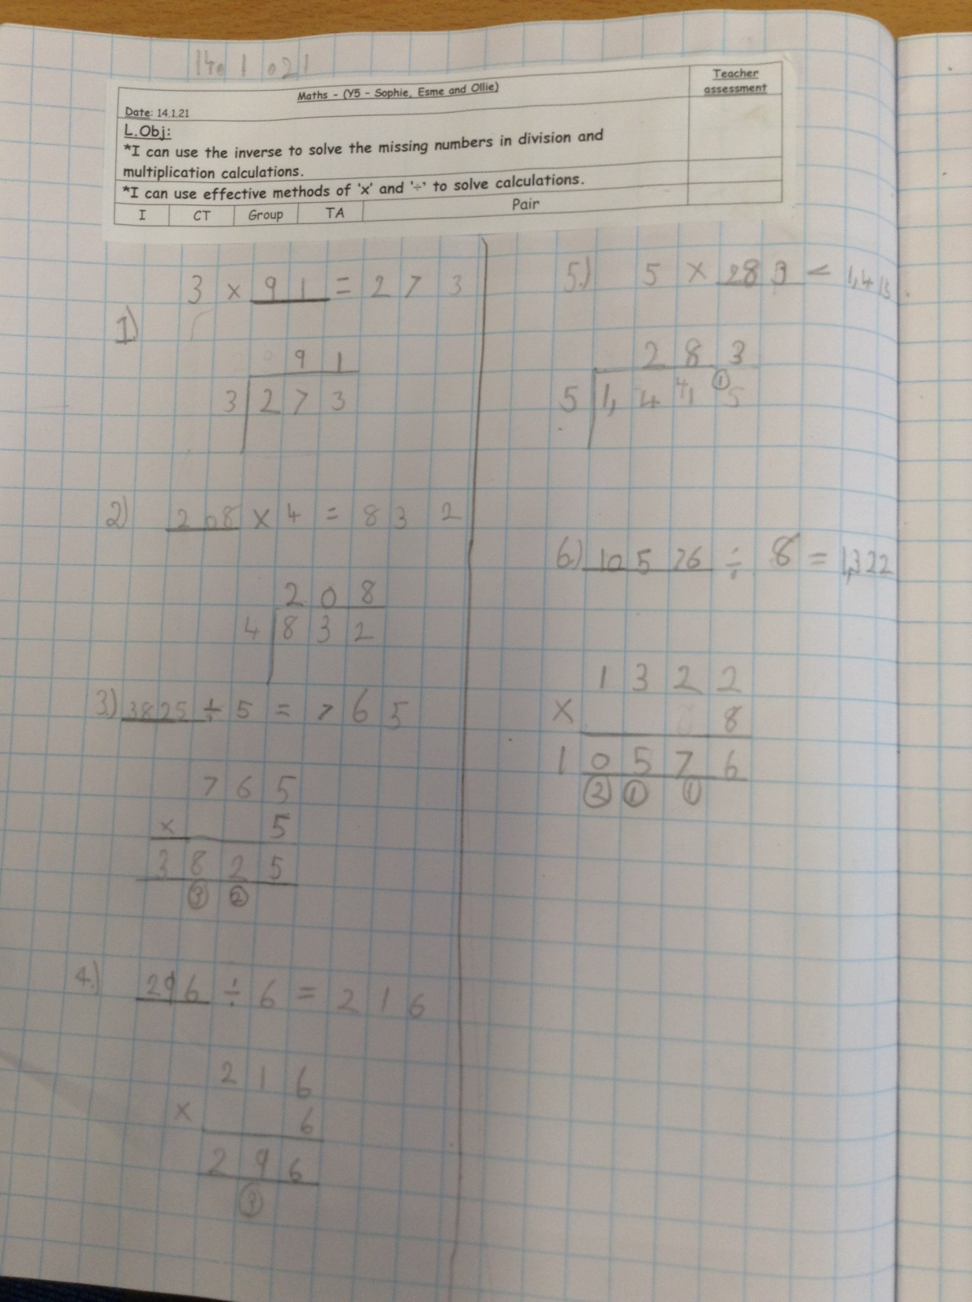
Sophie Carr correctly answered 5 out of 6 and then recognised where she made an error on number 4.

Slide 22
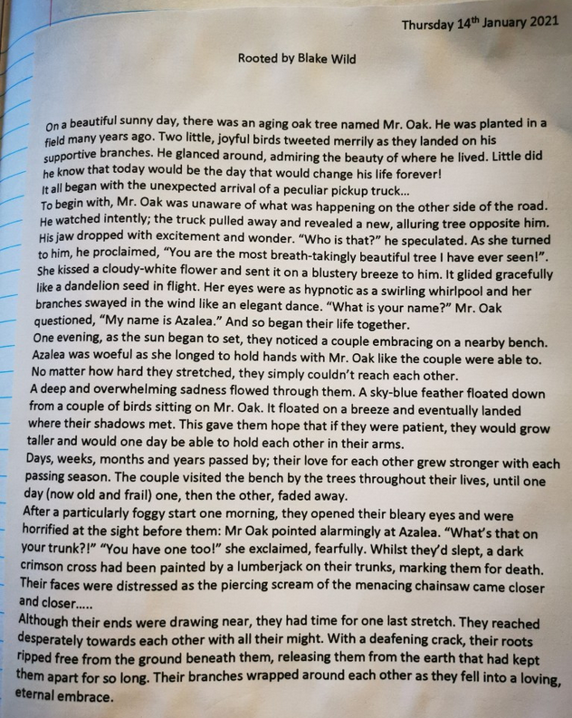
I love the quality sentence structure and grammar that Blake has used in the final typed draft of his story ‘Rooted’.

Slide 23
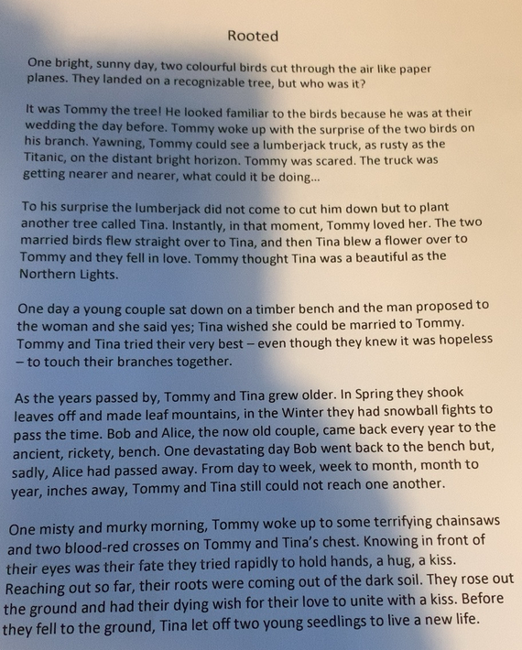
I really like your final two paragraphs the most Alex. Which parts do you think are the most detailed and descriptive?

Slide 24
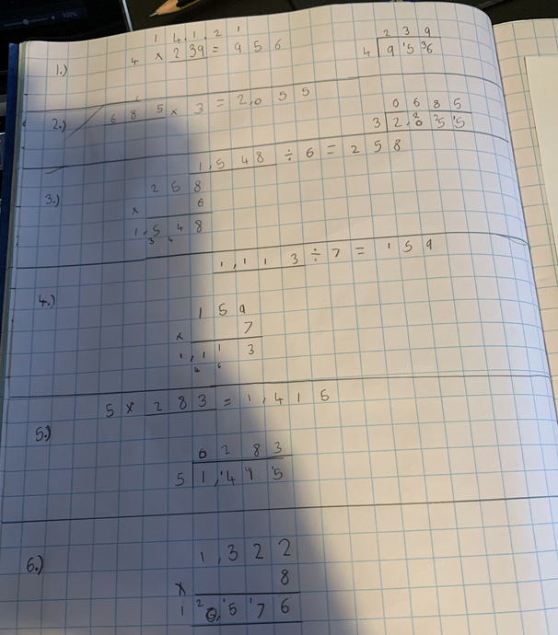
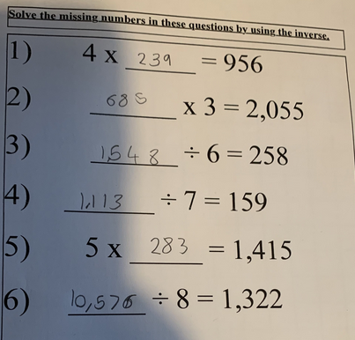
Alex has used the inverse really well to find the missing numbers in the questions.

Slide 25
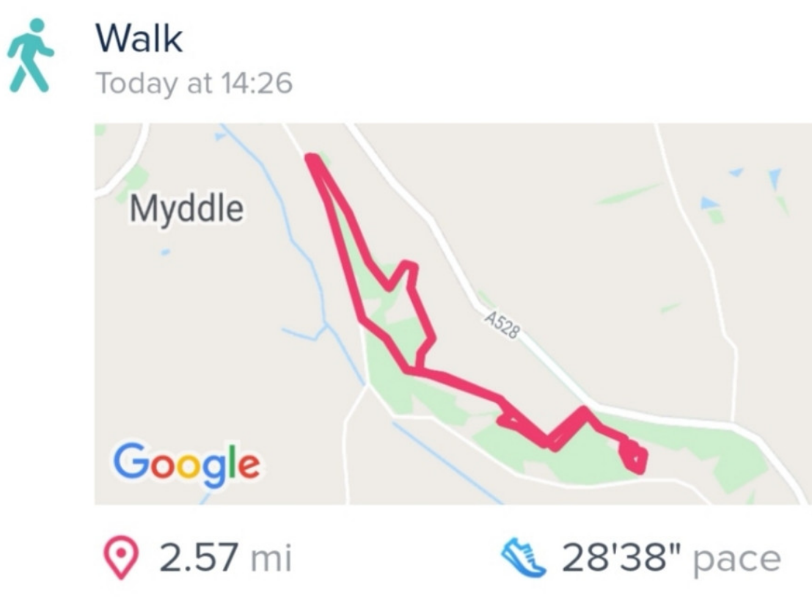
Lilly braved the cold weather to go for a walk. It was ‘as cold as an ice cube’ Lilly told us.

Slide 26
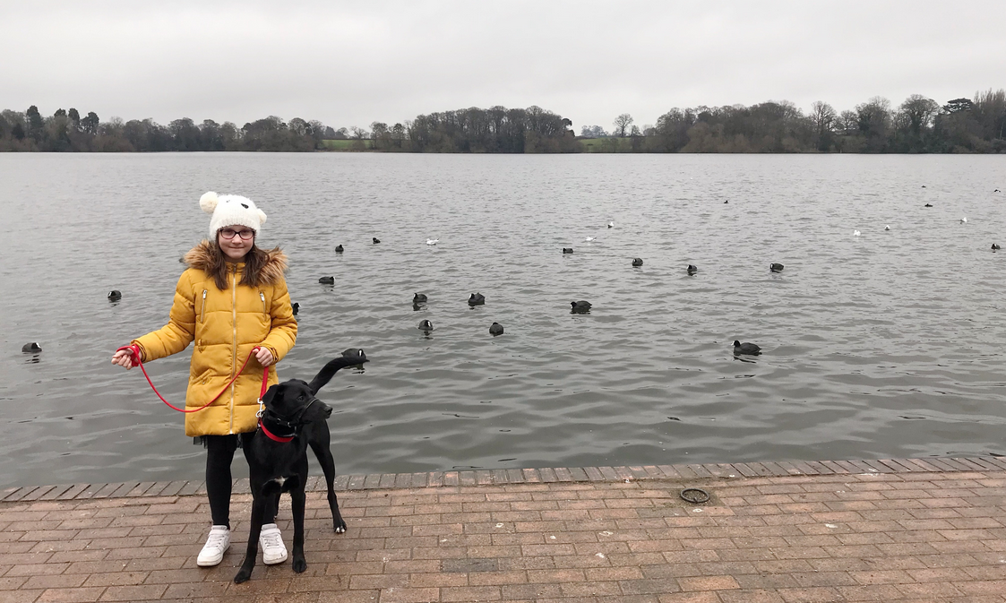
Ariana also enjoyed a lovely walk.
She took Darwin along with her!

Slide 27
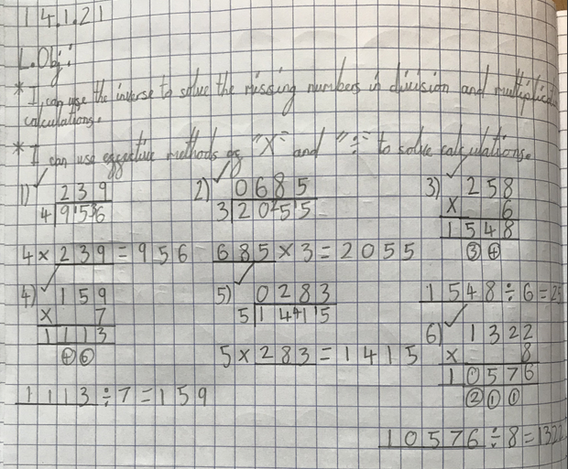
Amazing layout and quality to Ariana’s maths today.

Slide 28
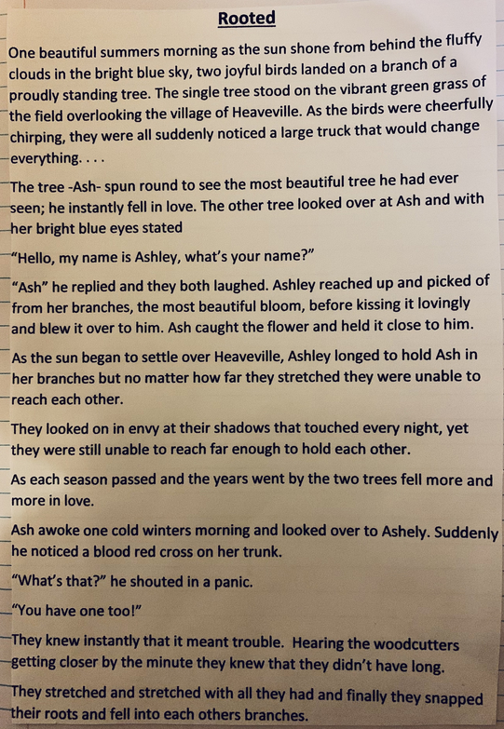
Sophie Collins completed the final, typed draft of her ‘Rooted’ story today.
I love this sentence!

Slide 29
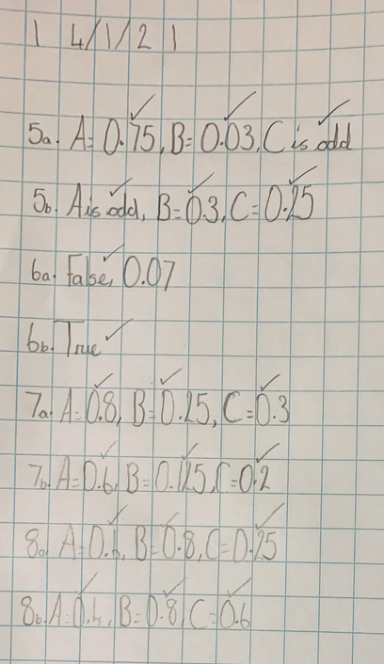
Sophie Collins converted her decimals and fractions really well today to then help her to order them.

Slide 30
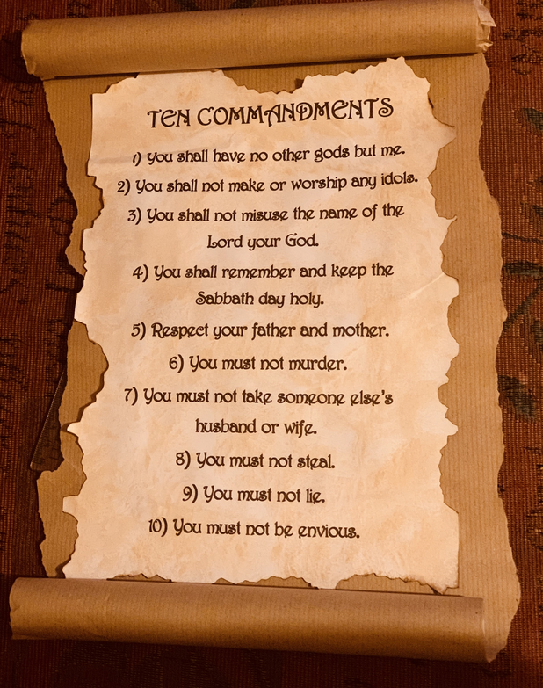
WOW!
What a great scroll to show the Ten Commandments Sophie.

Slide 31
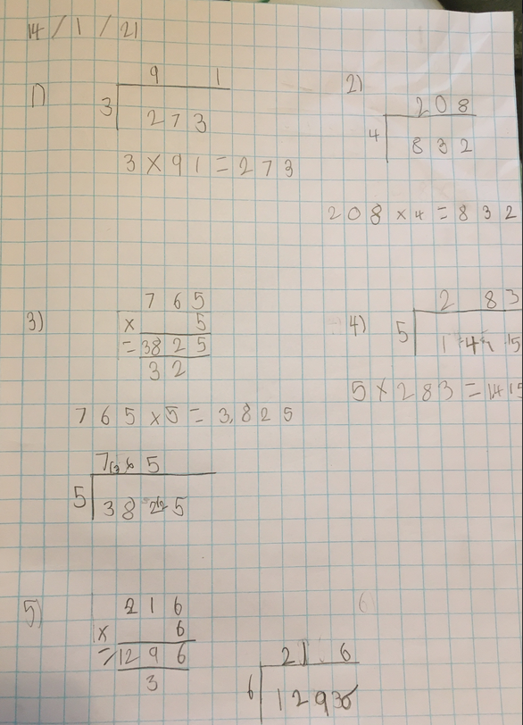
Esme used both multiplication and division methods to help her to solve the missing numbers in the calculations.

Slide 32
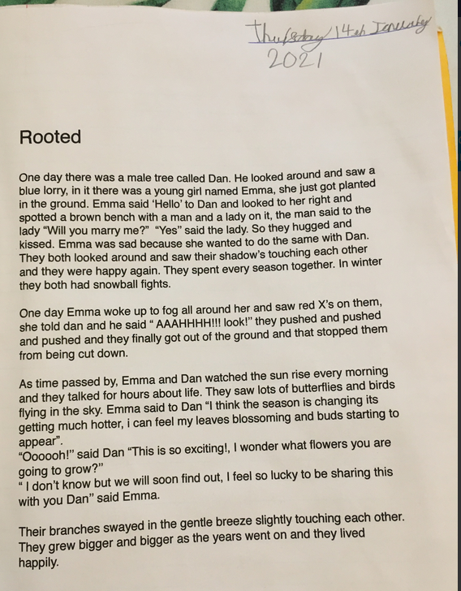
Esme completed the final, typed draft of her ‘Rooted’ story.

Slide 33
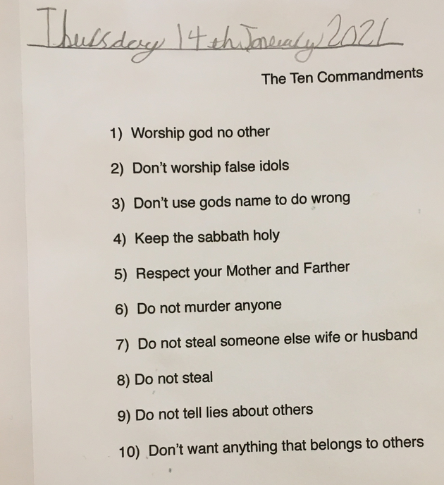
Esme has been typing her little fingers off today – this time with the Ten Commandments.

Slide 34
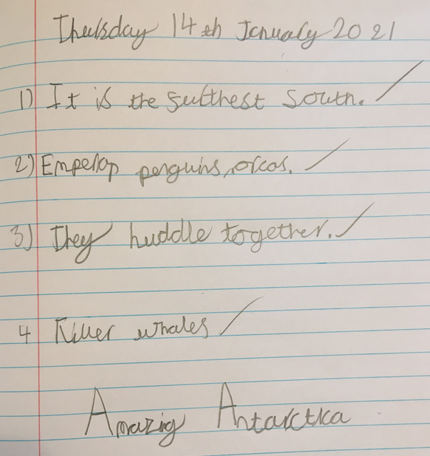
Esme has been learning about Antarctica in her reading.

Slide 35
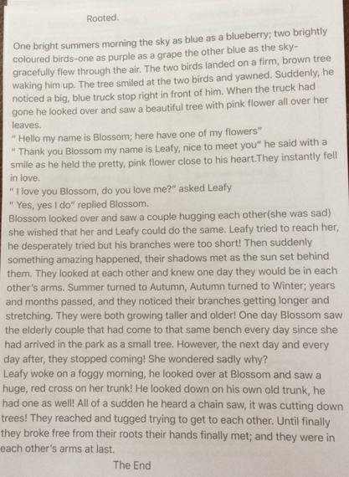
Holly H’s completed ‘Rooted’ story, all typed and ready to be read now.
Well done for using lots of adjectives and adverbs to make it descriptive for the reader.

Slide 36
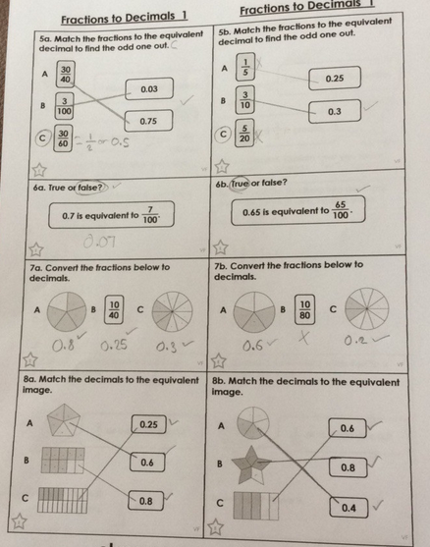
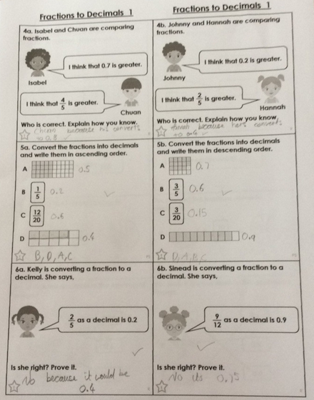
Holly H has matched the decimals and fractions well her today by simplifying some fractions to help her.

Slide 37
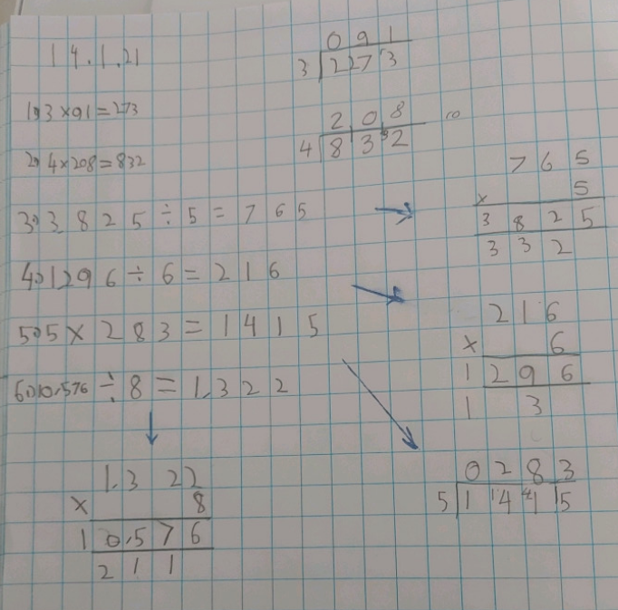
Good use of ‘x’ and ‘÷’ methods her Ollie to solve the missing numbers.

Slide 38
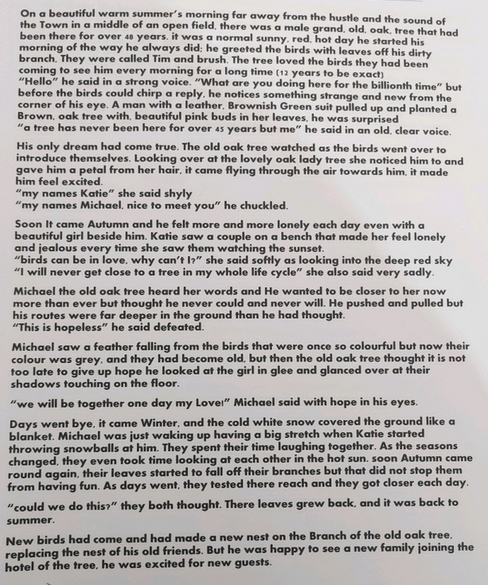
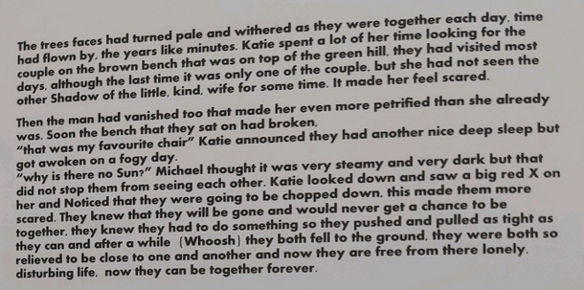
Ollie has clearly put a lot of effort into each part of his ‘Two Trees’ story during the last two weeks.

Slide 39
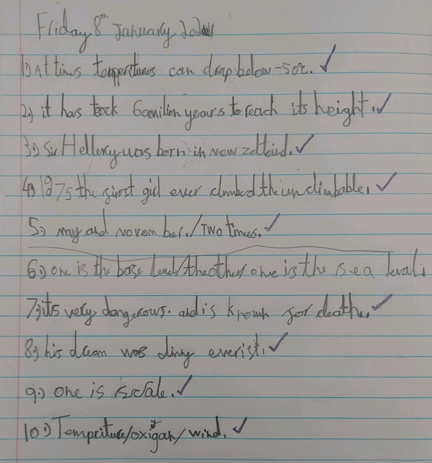
Ollie has been reading information about the polar regions in his comprehension task.

Slide 40
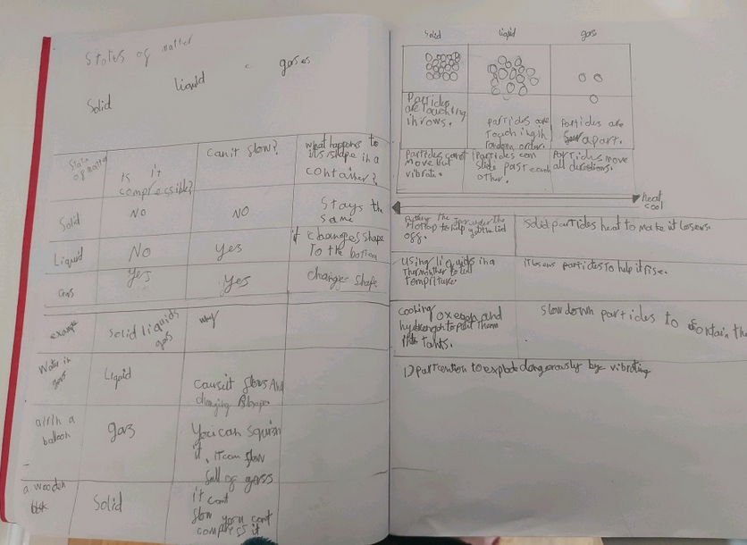
Ollie has showed his understanding of the 3 states in Science.

Slide 41
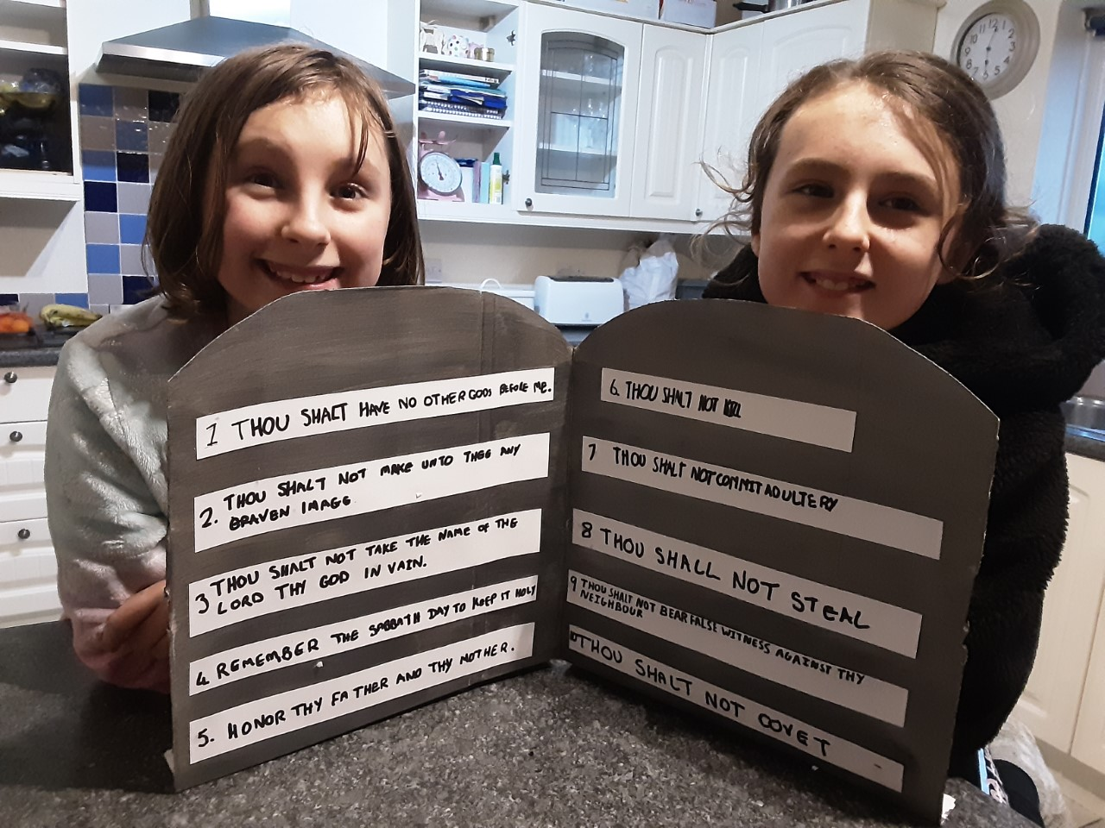
Katie and Lucy showed great teamwork to produce their Ten Commandments on two stone tablets.

Slide 42
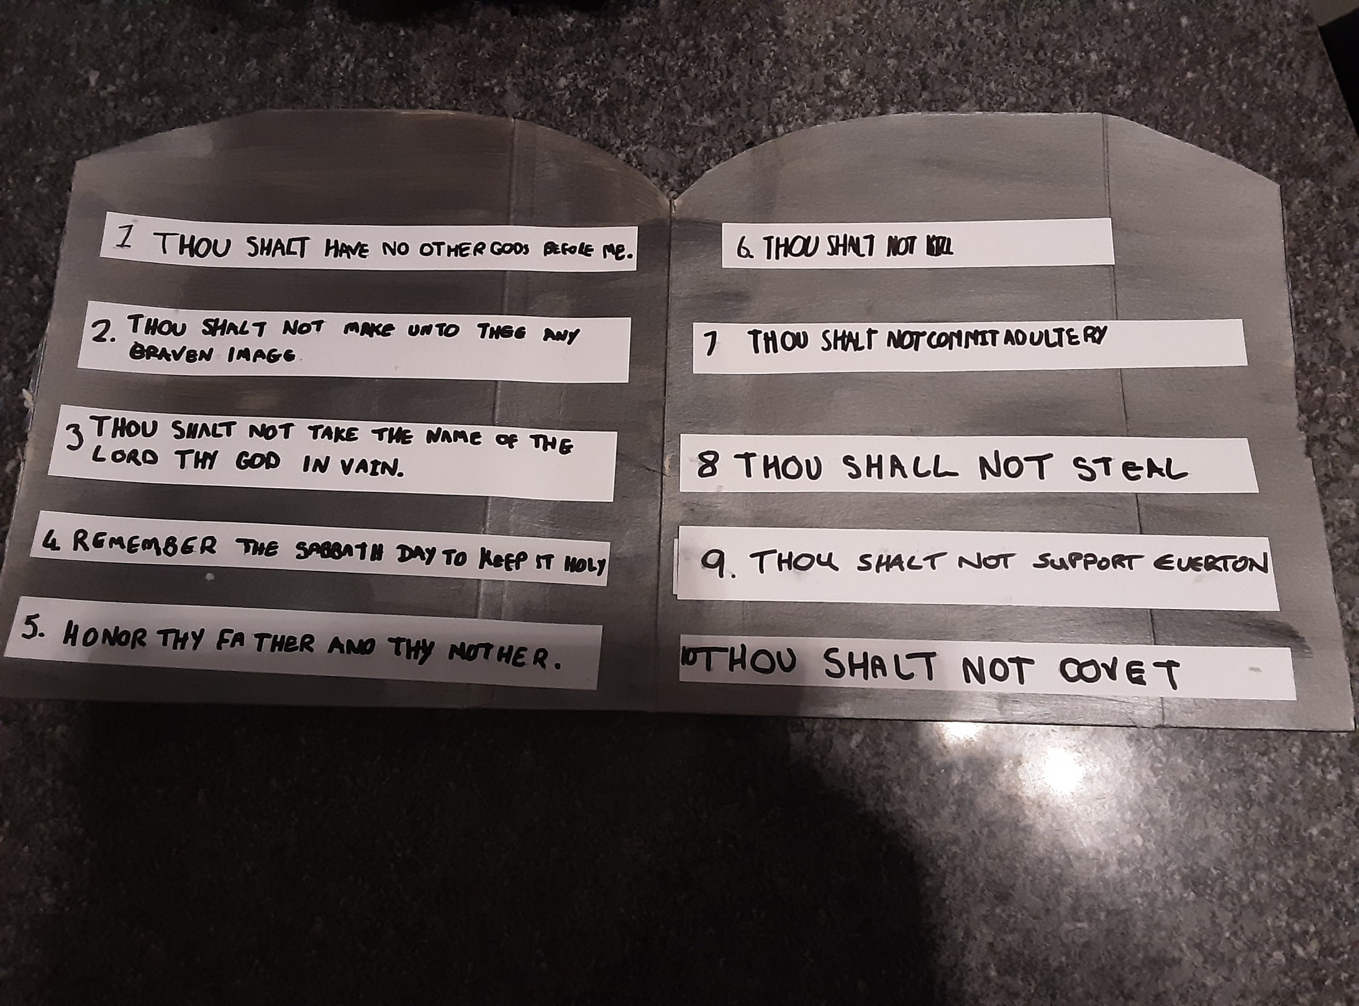
Lucy and Katie’s dad then decided to change number 9.
If only this was true. Maybe I would’ve saved myself lots of heartbreak over the years!

Slide 43
Either Sam is reading a funny part in his book, or he knows that he’s having his photograph taken!

Slide 44
Sam really enjoyed creating the Ten Commandments on his two tablets.
Well done Sam.
Commandment Number 11 –
Thou shall always wear shorts in the Winter.

Slide 45
Sam used his excellent multiplication and division methods to help him to solve the missing numbers in the calculations.

