Slide 1
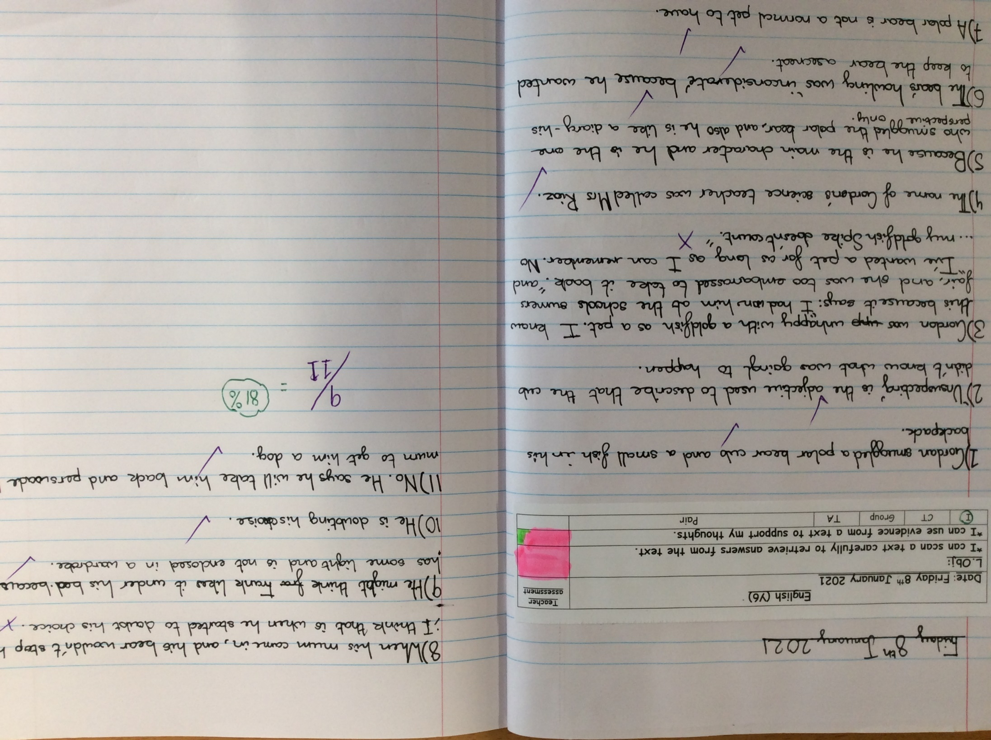
Heidi’s comprehension from today.

Slide 2
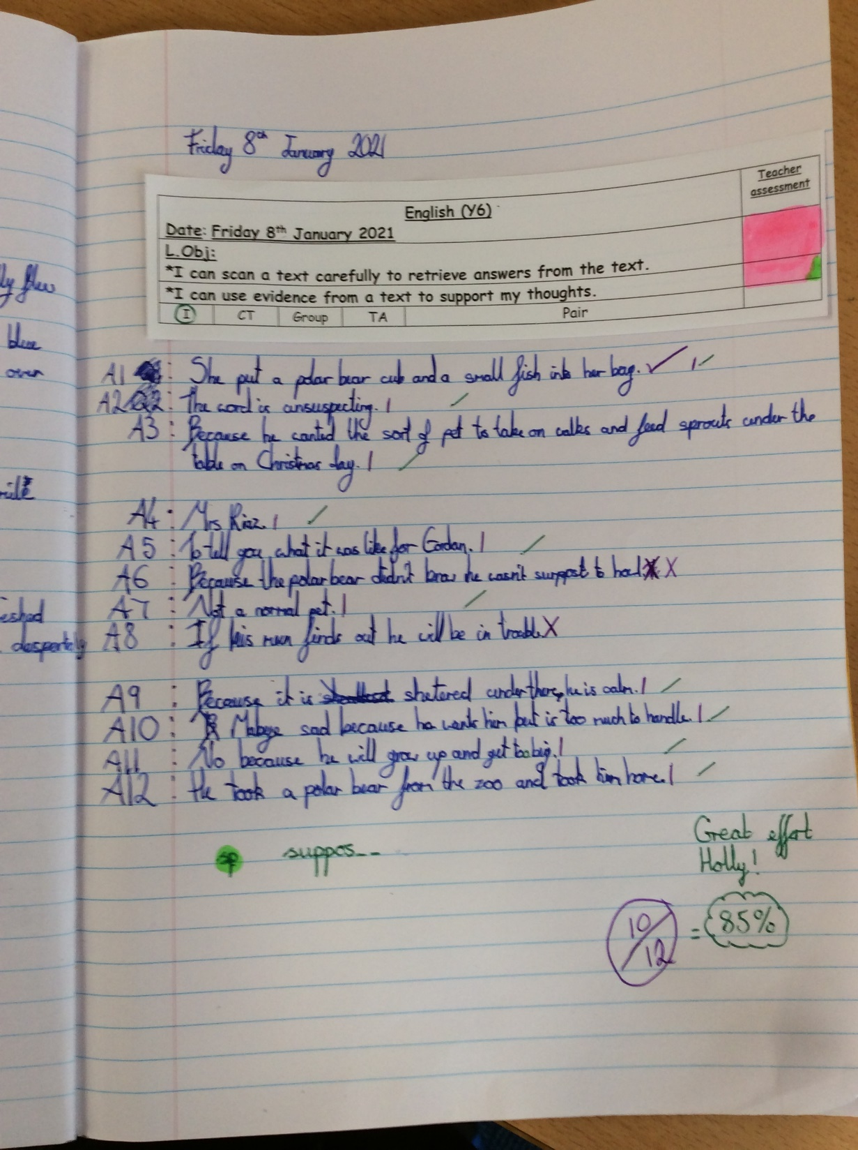
Holly H’s comprehension from today.

Slide 3
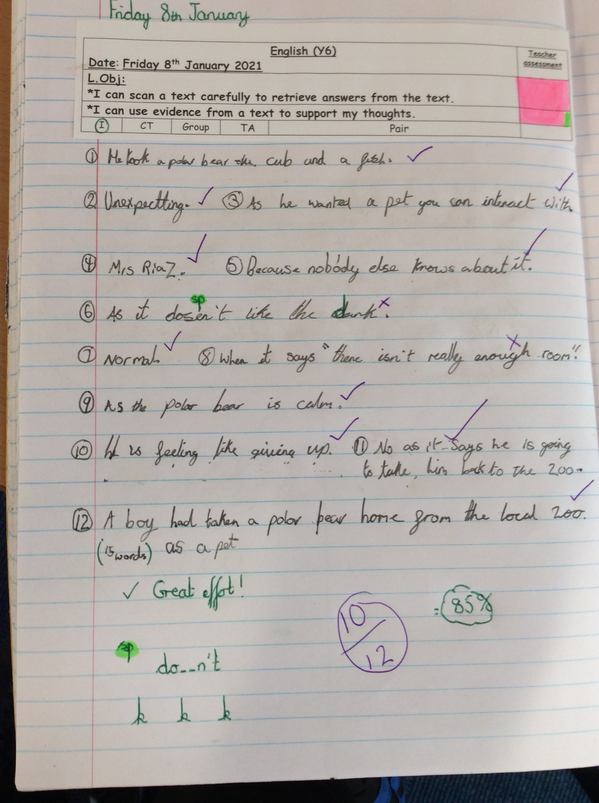
Zoe’s comprehension from today.

Slide 4
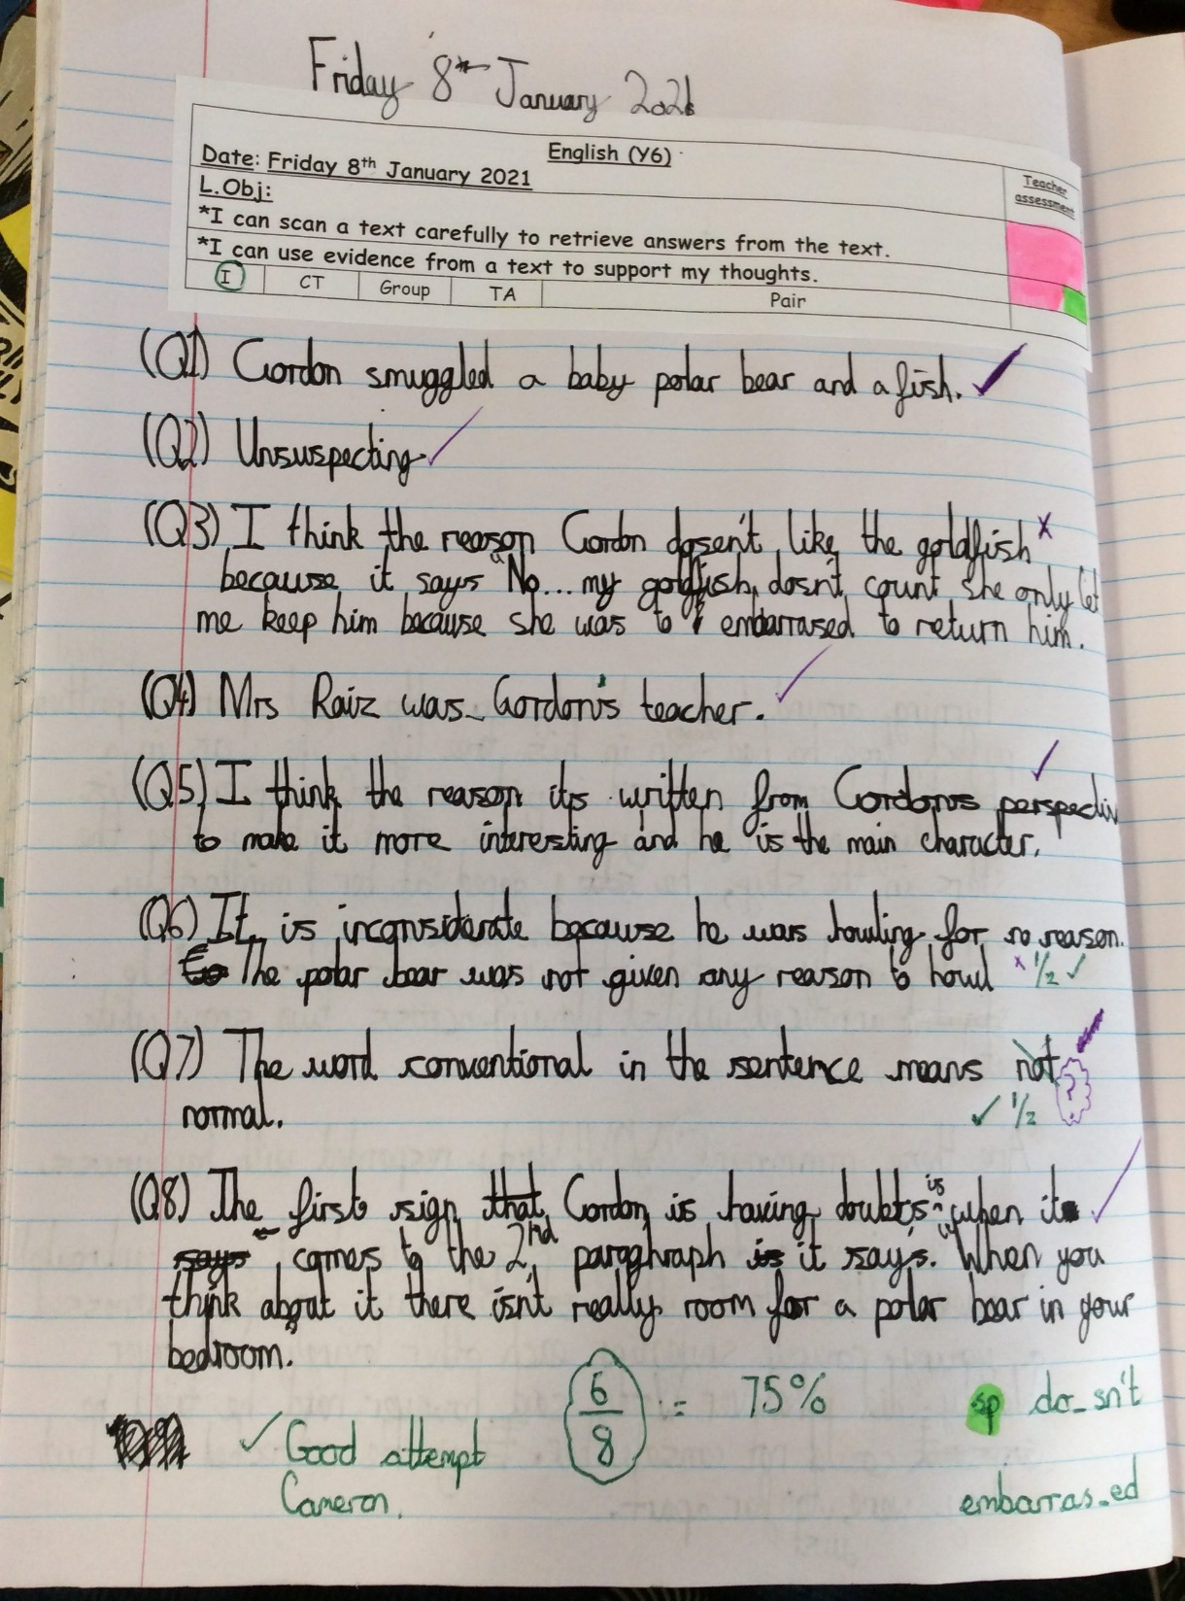
Cameron’s comprehension from today.

Slide 5
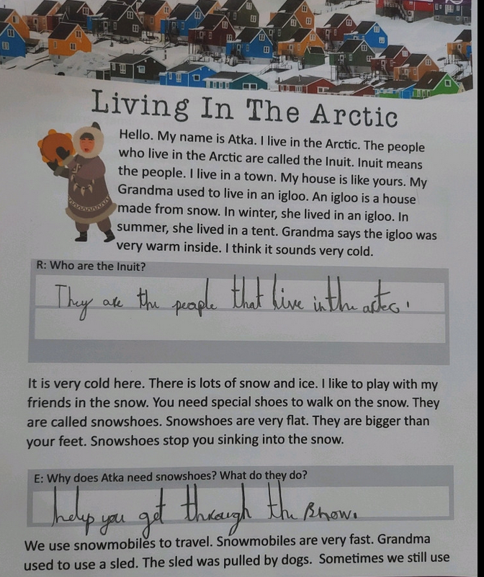
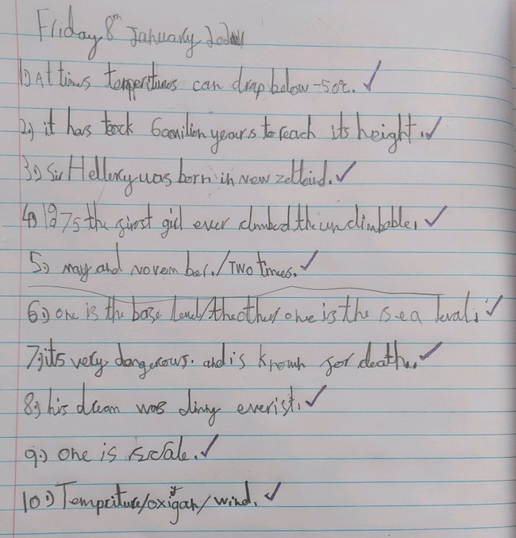
Ollie completed his comprehension task and then challenged himself on the Mount Everest text.

Slide 6
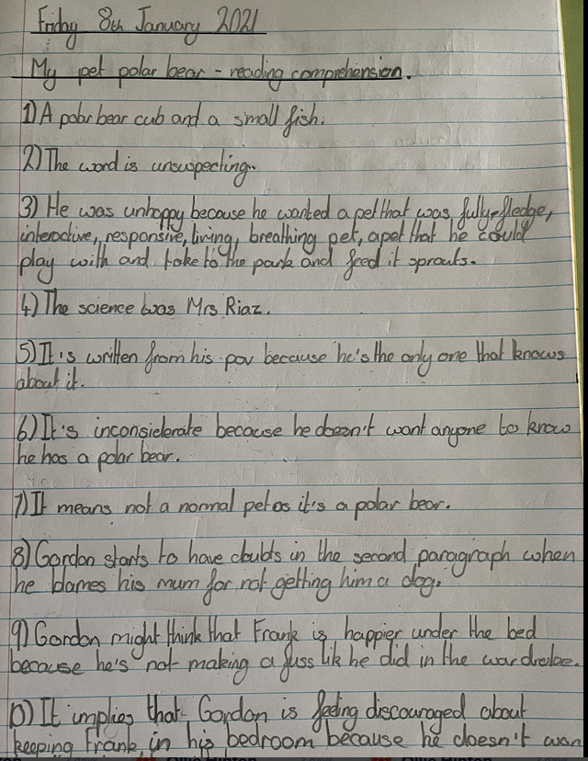
Nelly’s comprehension from today.

Slide 7
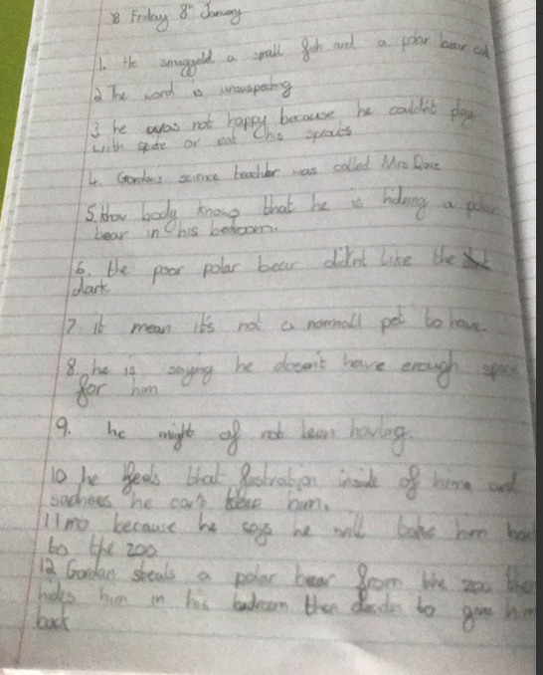
Rhys’ comprehension from today.

Slide 8
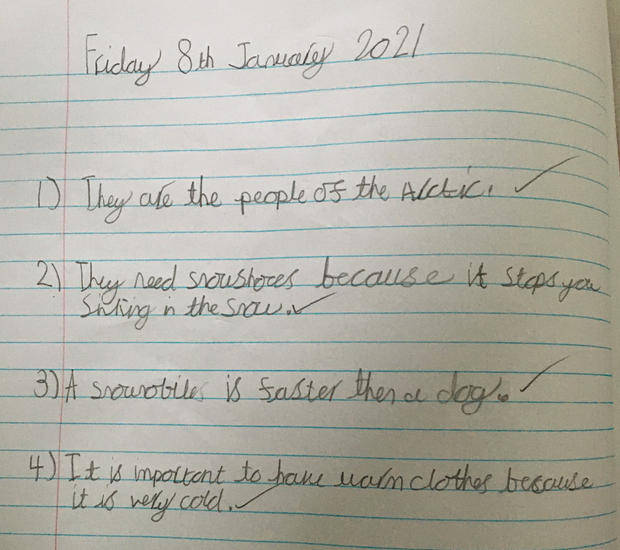
Esme’s comprehension from today.

Slide 9
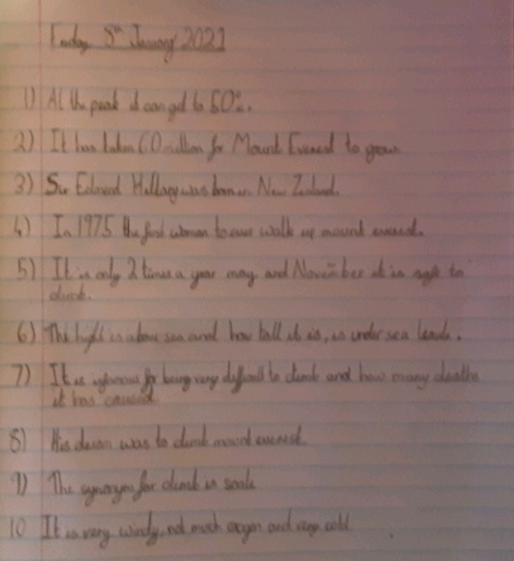
Lilly’s comprehension from today.

Slide 10
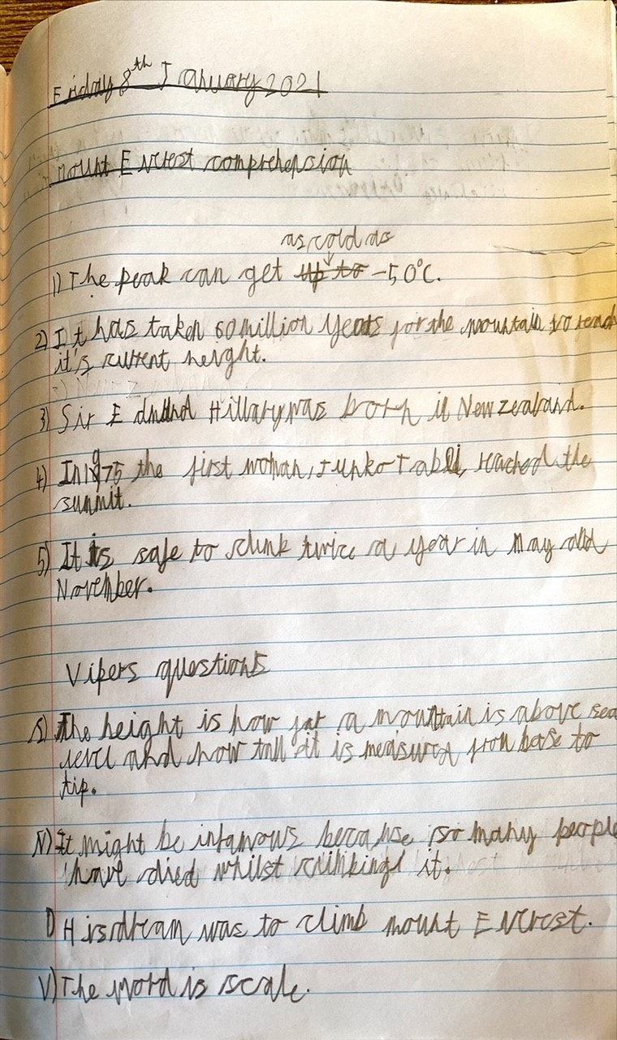
Sam’s comprehension from today.

Slide 11
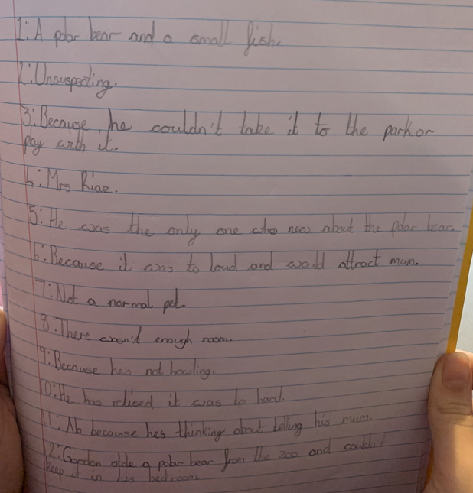
Sophie’s comprehension from today.

Slide 12
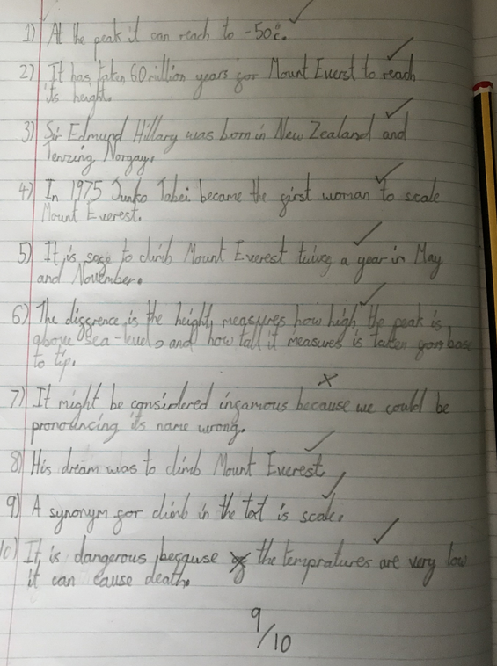
Ariana’s comprehension from today.

Slide 13
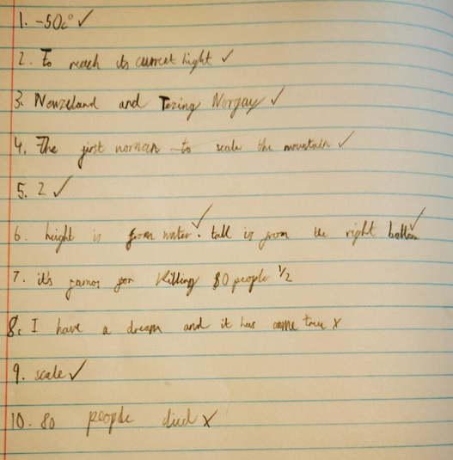
Blake’s comprehension from today.

Slide 14
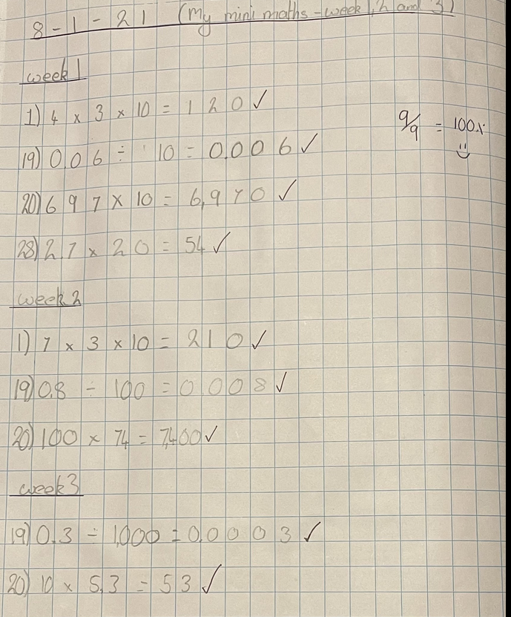
Nelly scored 100% on her maths calculations today.

Slide 15
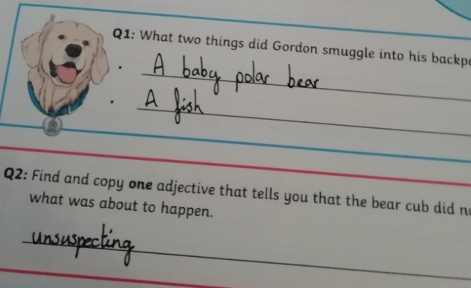
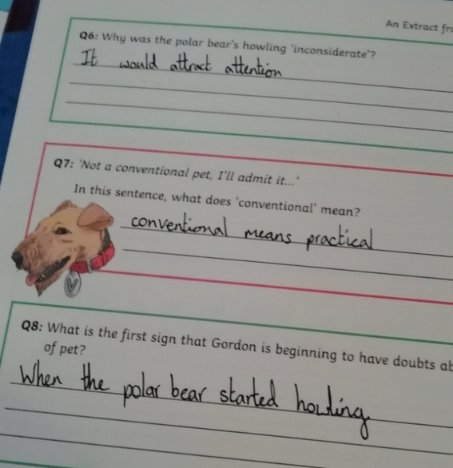
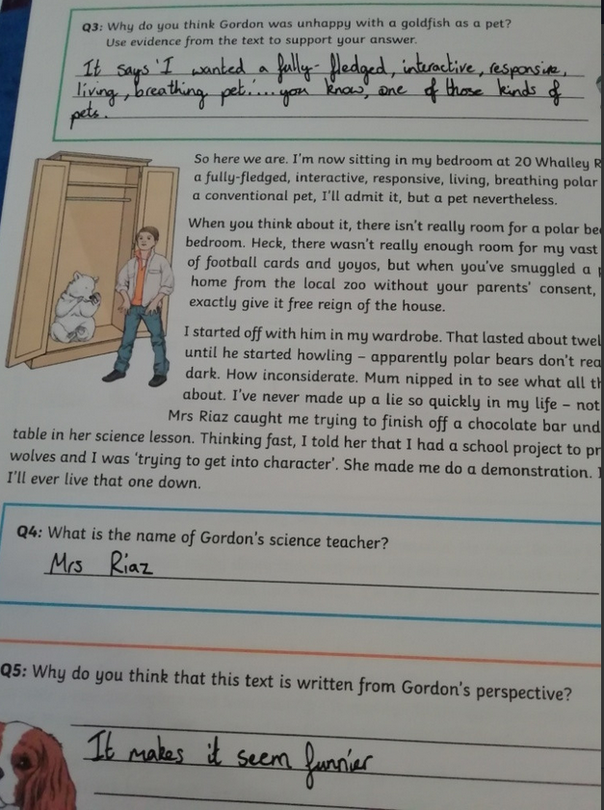
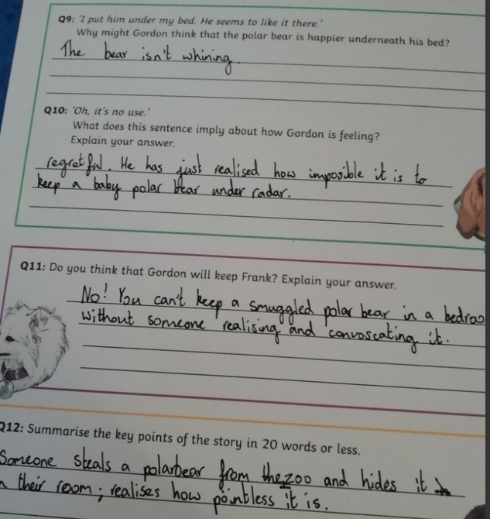
Amy’s comprehension answers today.

Slide 16
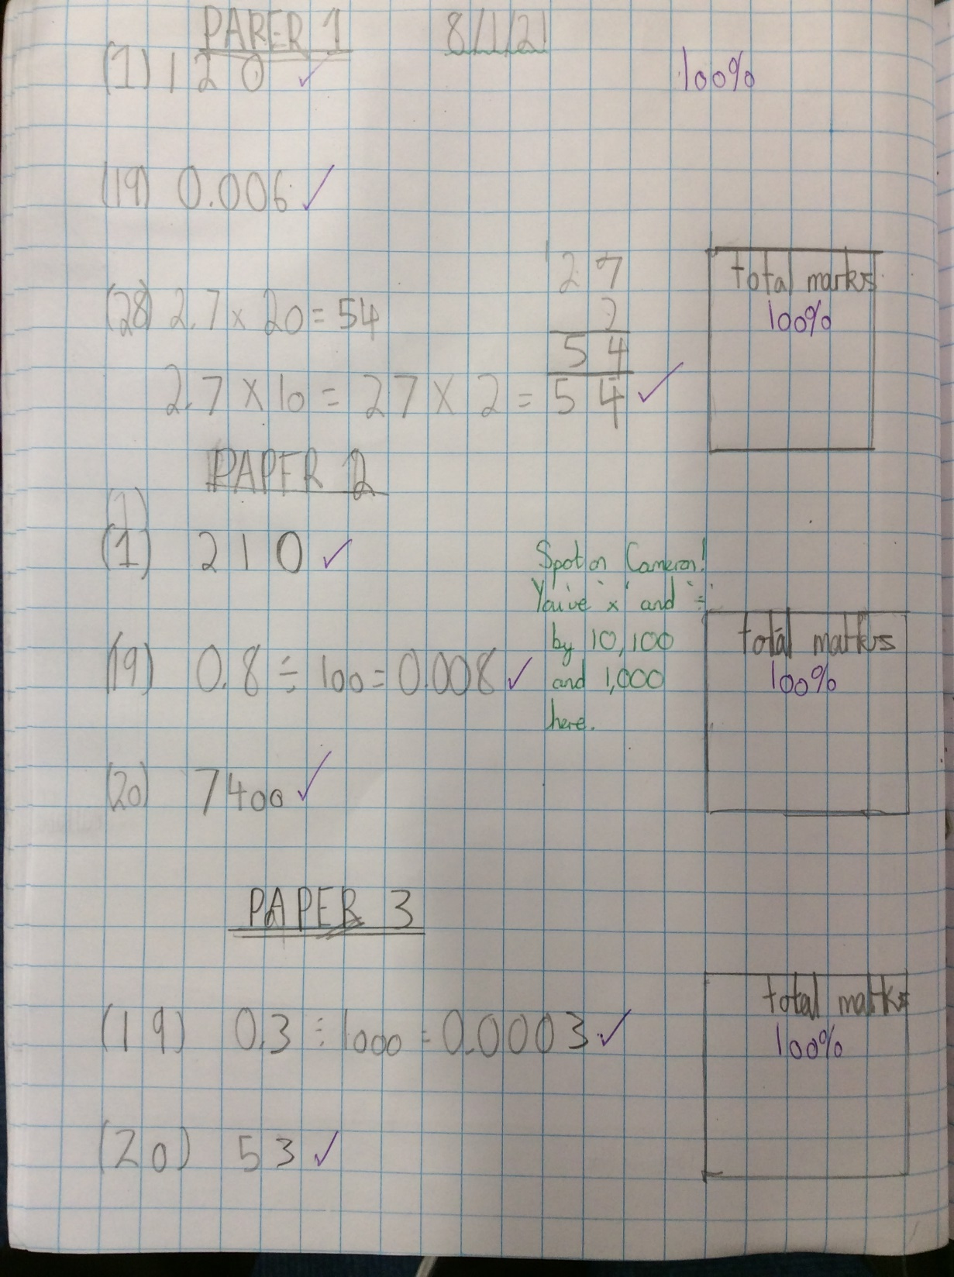
Cameron scored 100% on his maths calculations today.

Slide 17
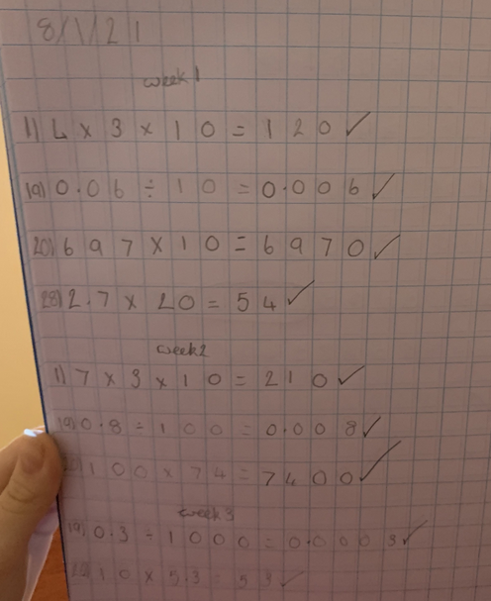
Sophie scored 100% on her maths calculations today.

Slide 18
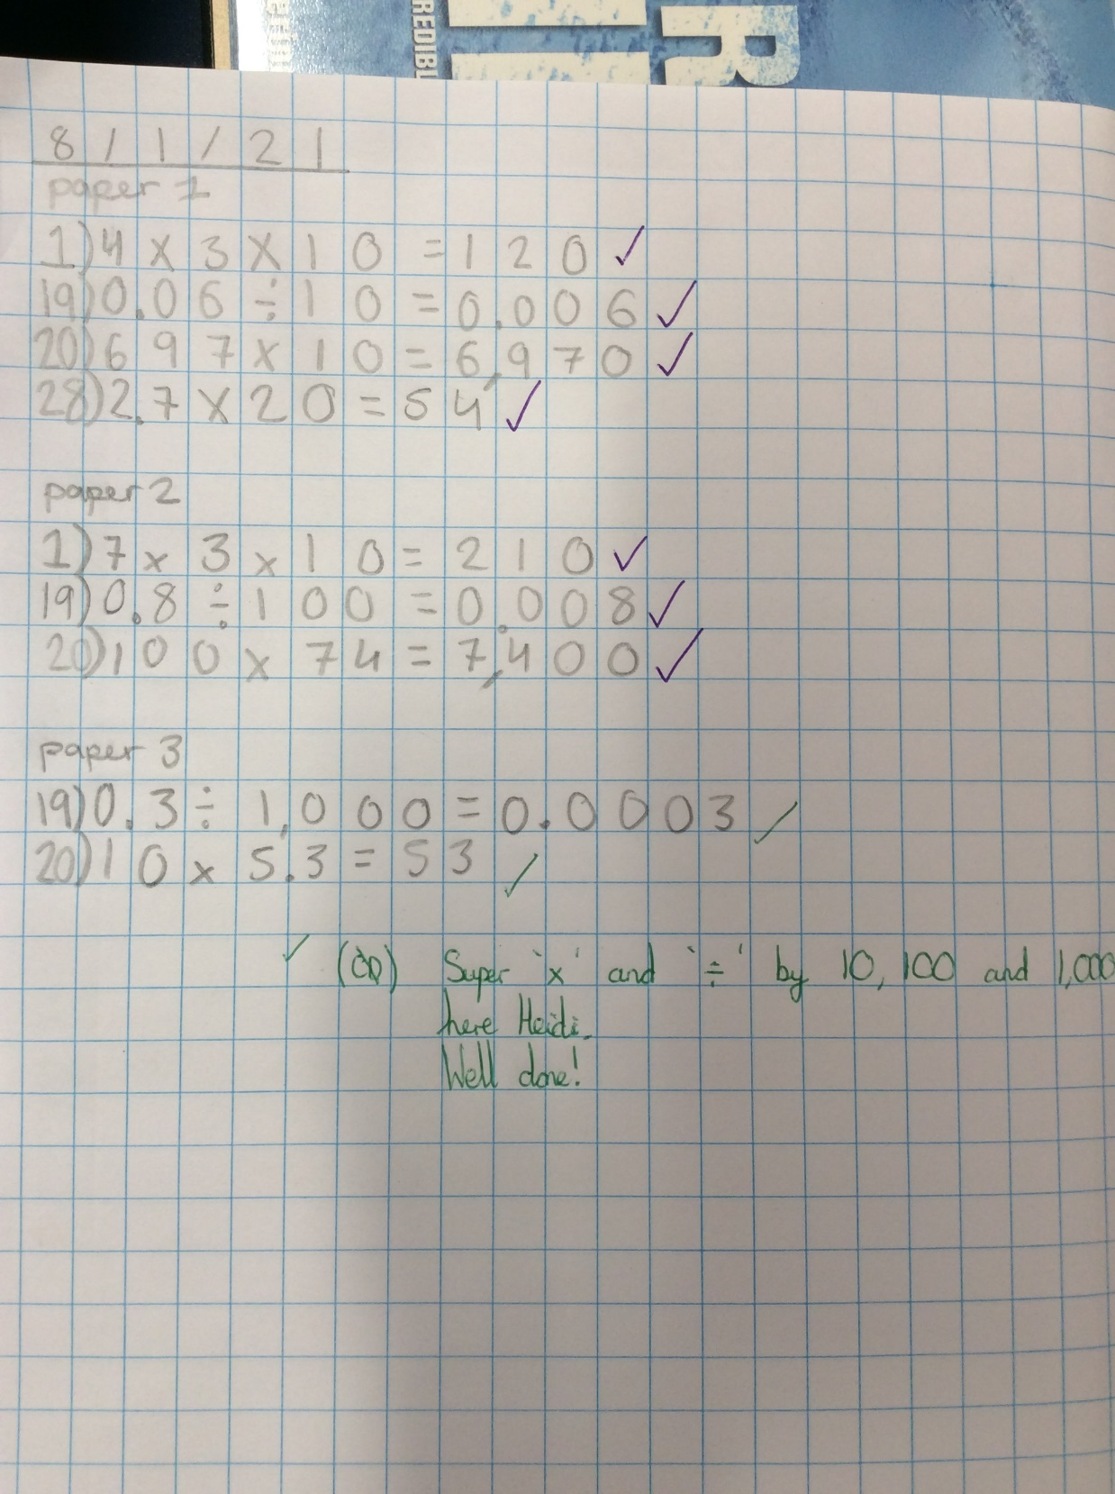
Heidi scored 100% on her multiplying and dividing by 10, 100 and 1,000 calculations today.

Slide 19
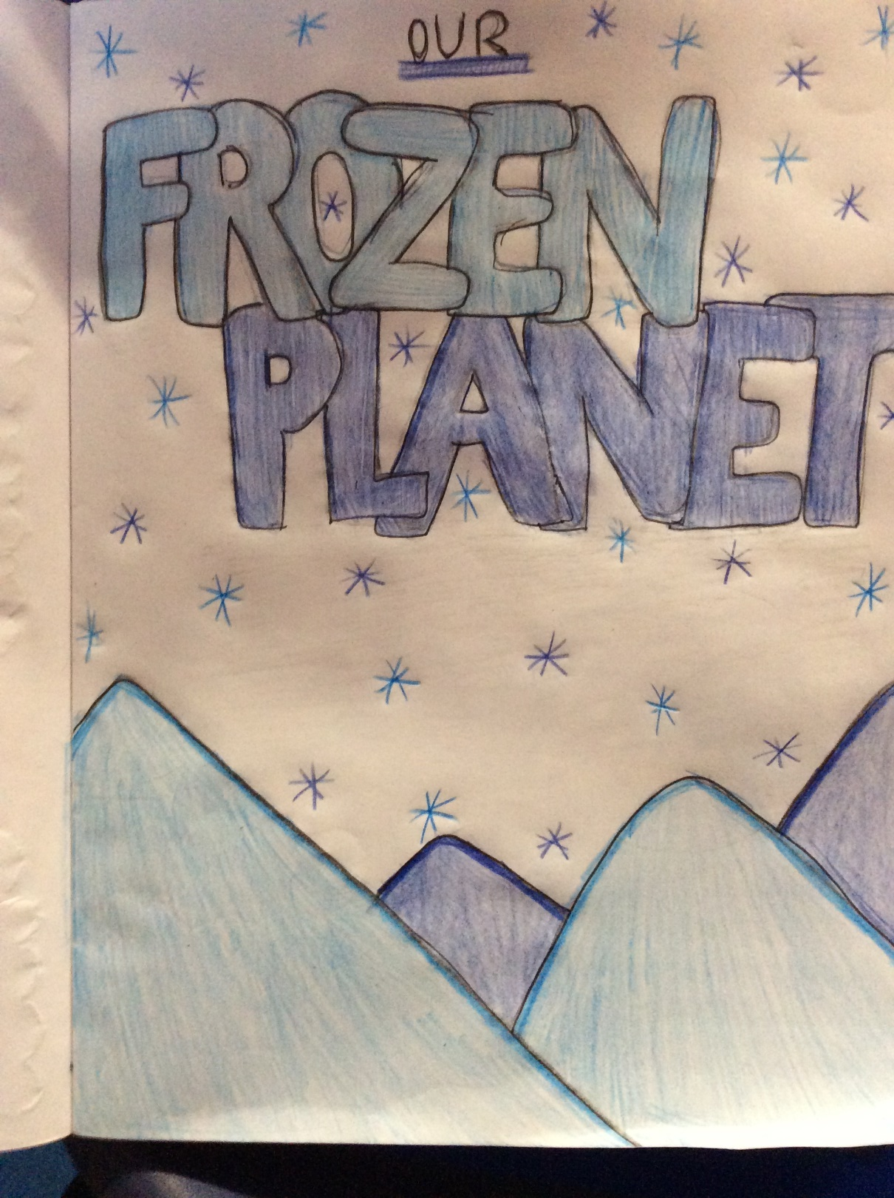
Heidi’s Topic front cover design

Slide 20
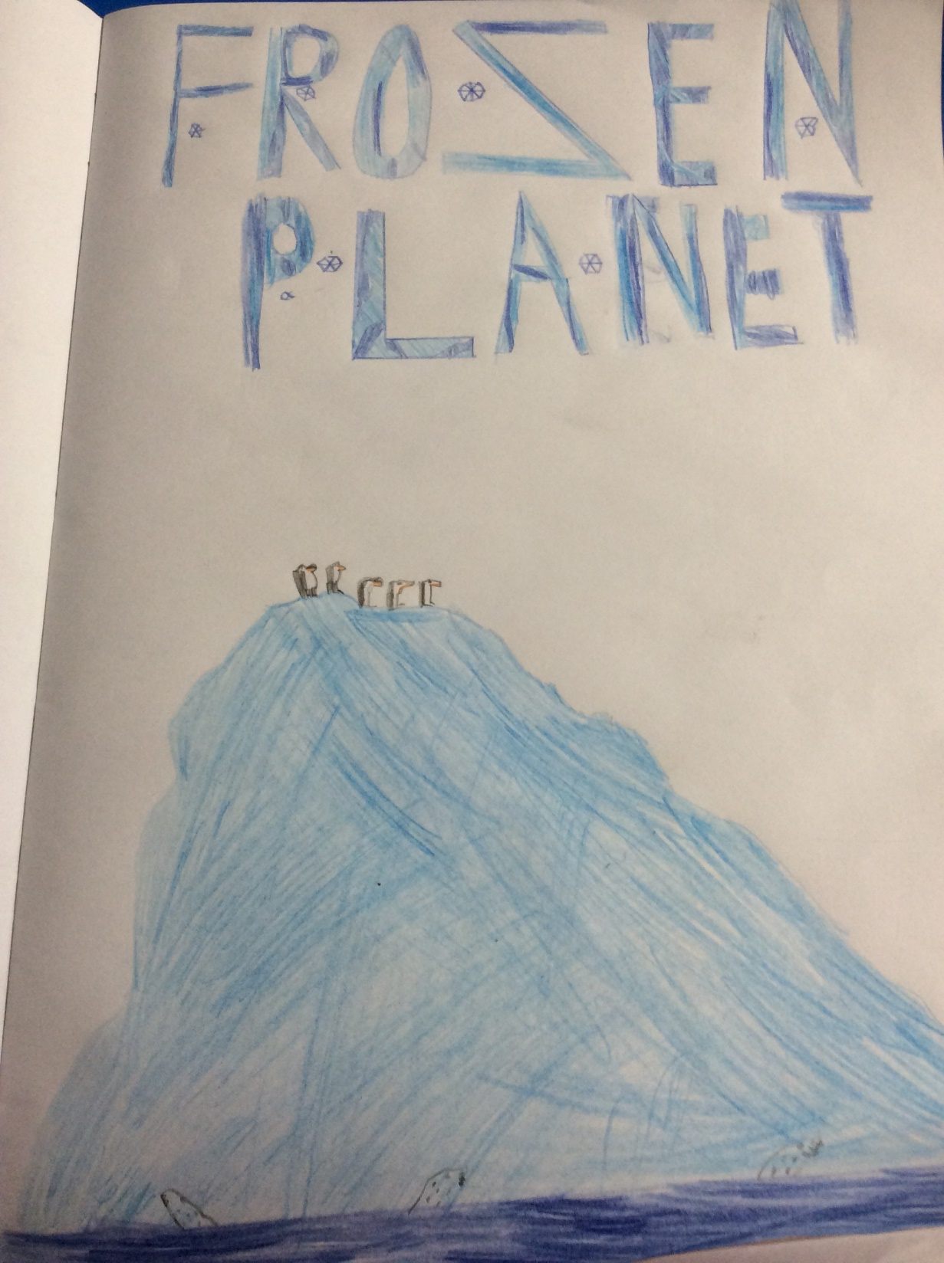
Dylan’s Topic front cover design

Slide 21
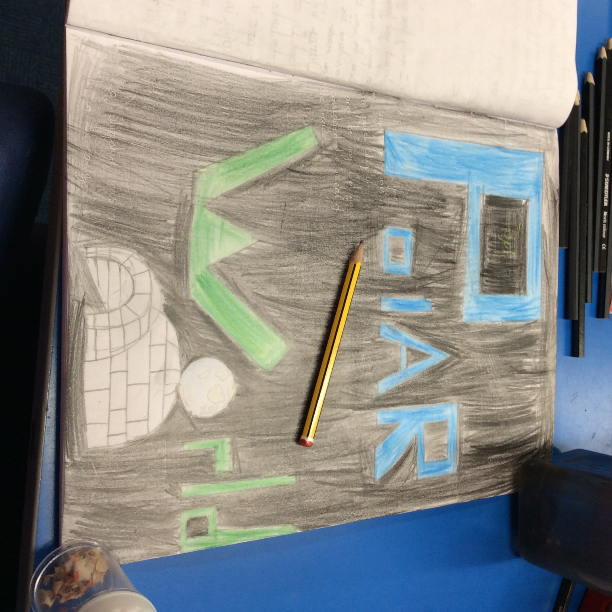
Cameron’s Topic front cover design

Slide 22
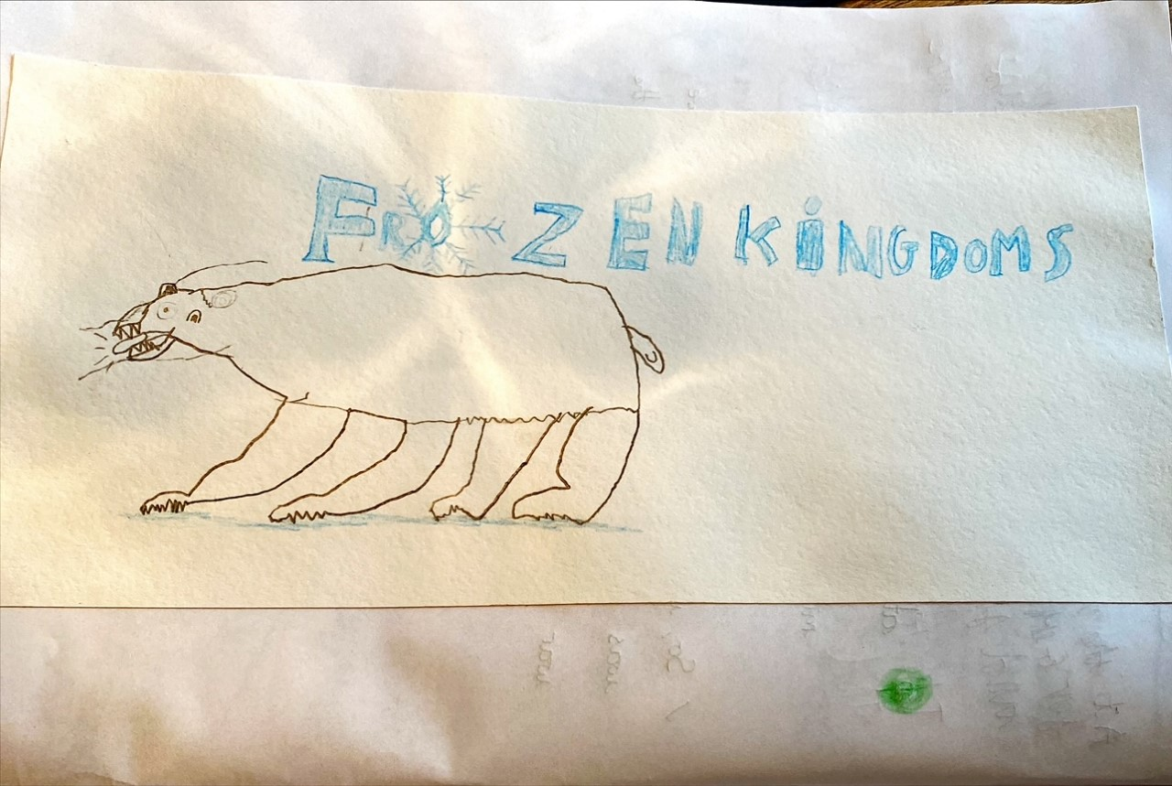
Sam’s Topic front cover design

Slide 23
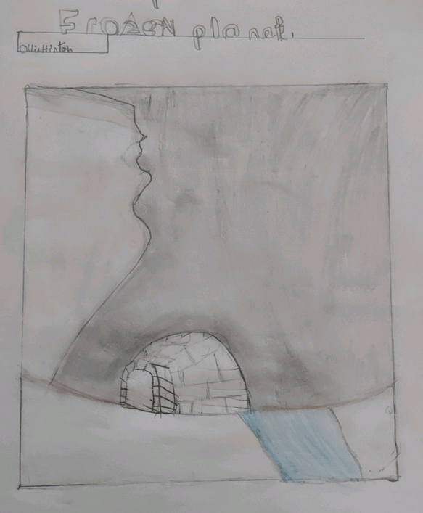
Ollie’s Topic front cover design

Slide 24
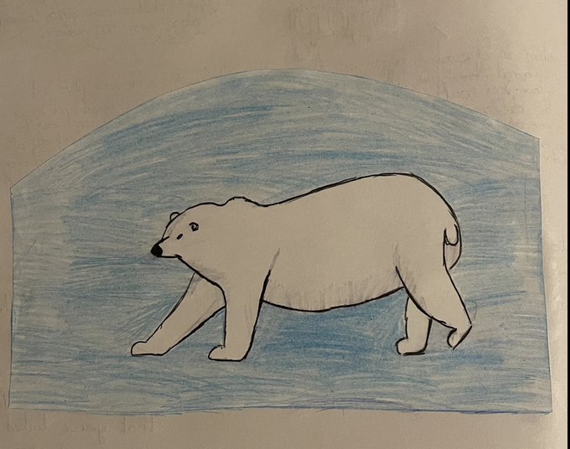
Nelly’s Topic front cover design

Slide 25
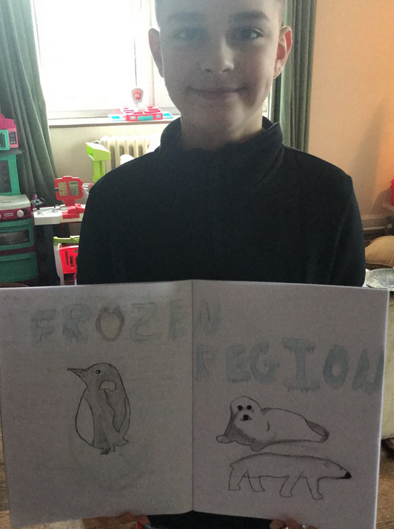
Rhys’ Topic front cover design

Slide 26
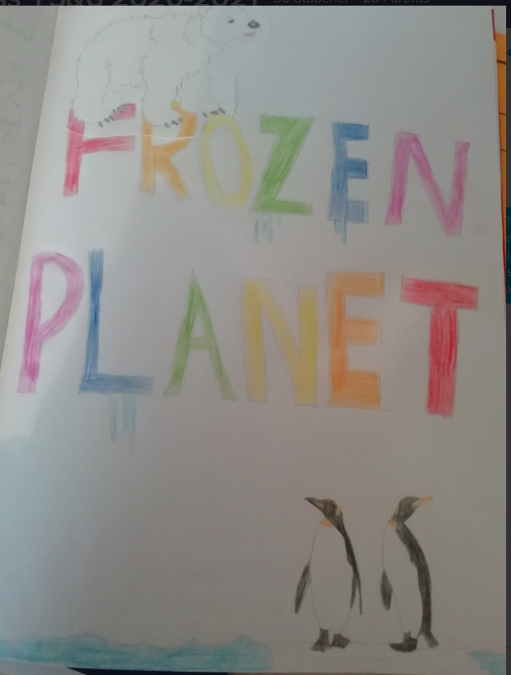
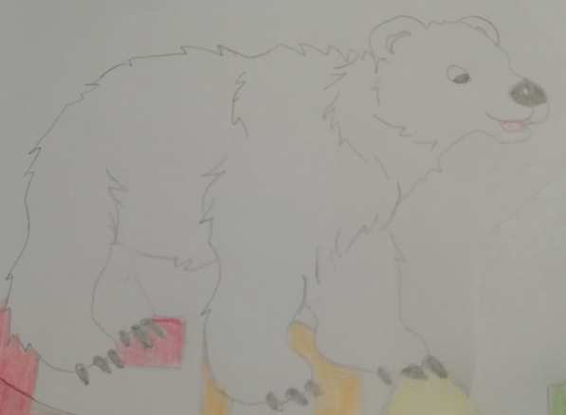
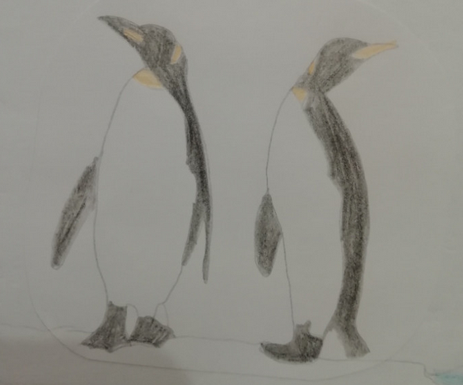
Amy’s Topic front cover design

Slide 27
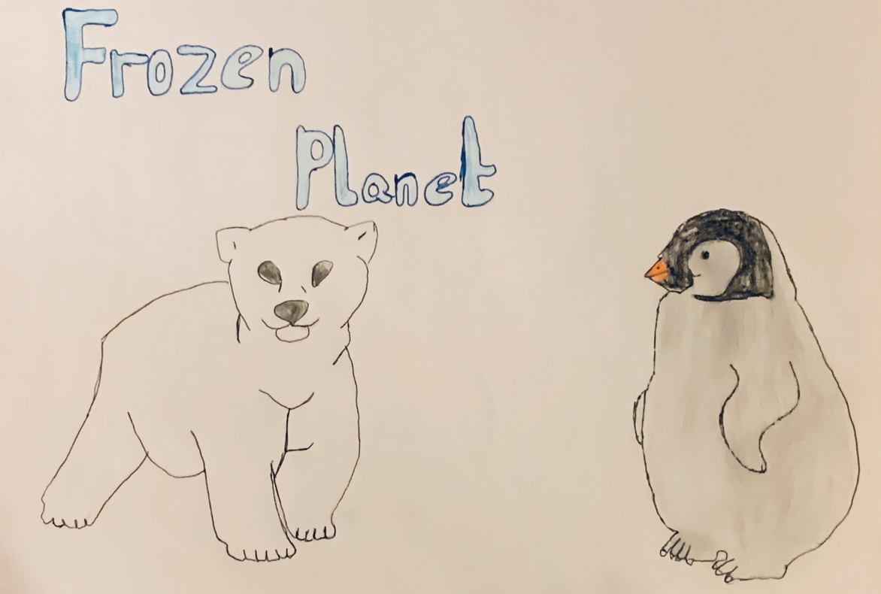
Sophie’s Topic front cover design

Slide 28
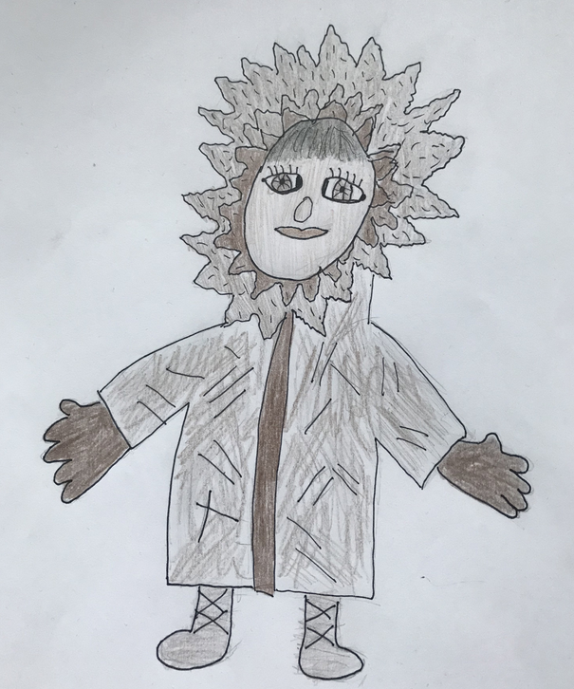
Ariana’s Topic front cover design

Slide 29
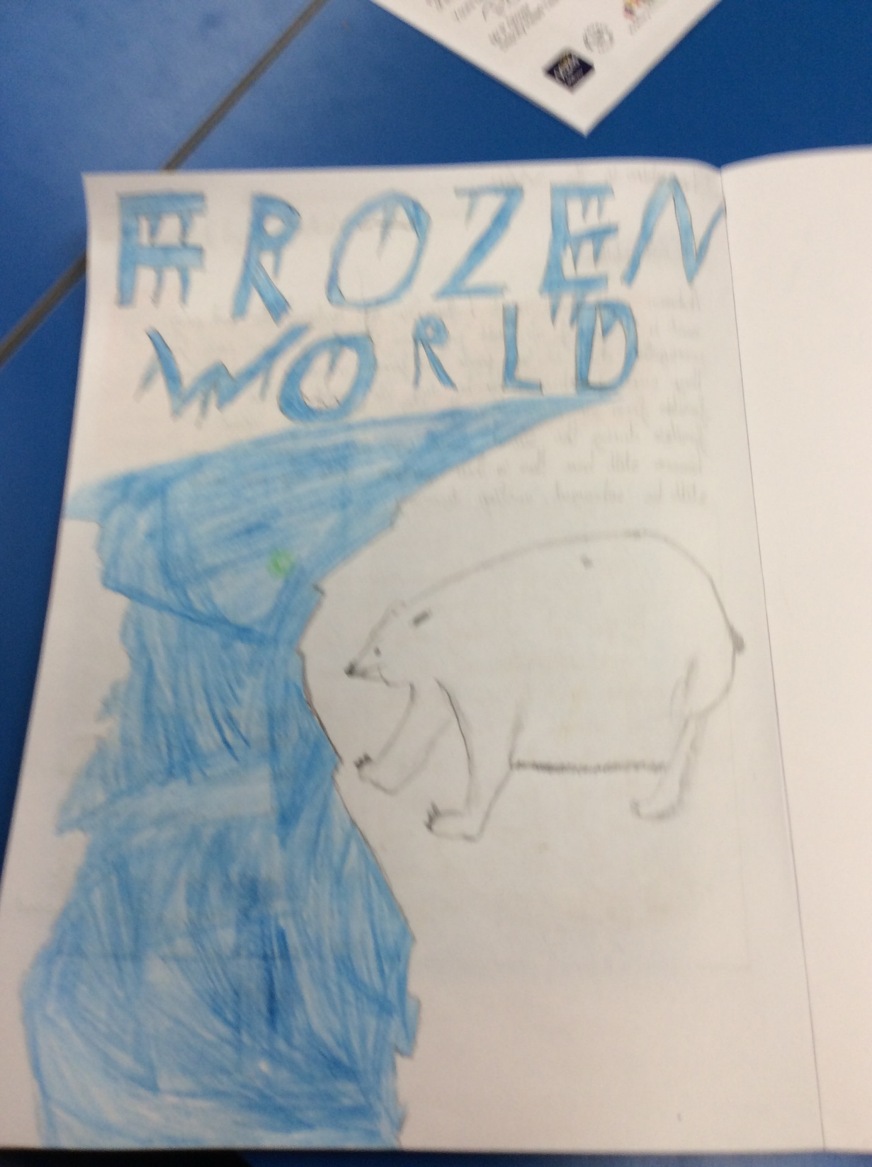
Cass’ Topic front cover design

Slide 30
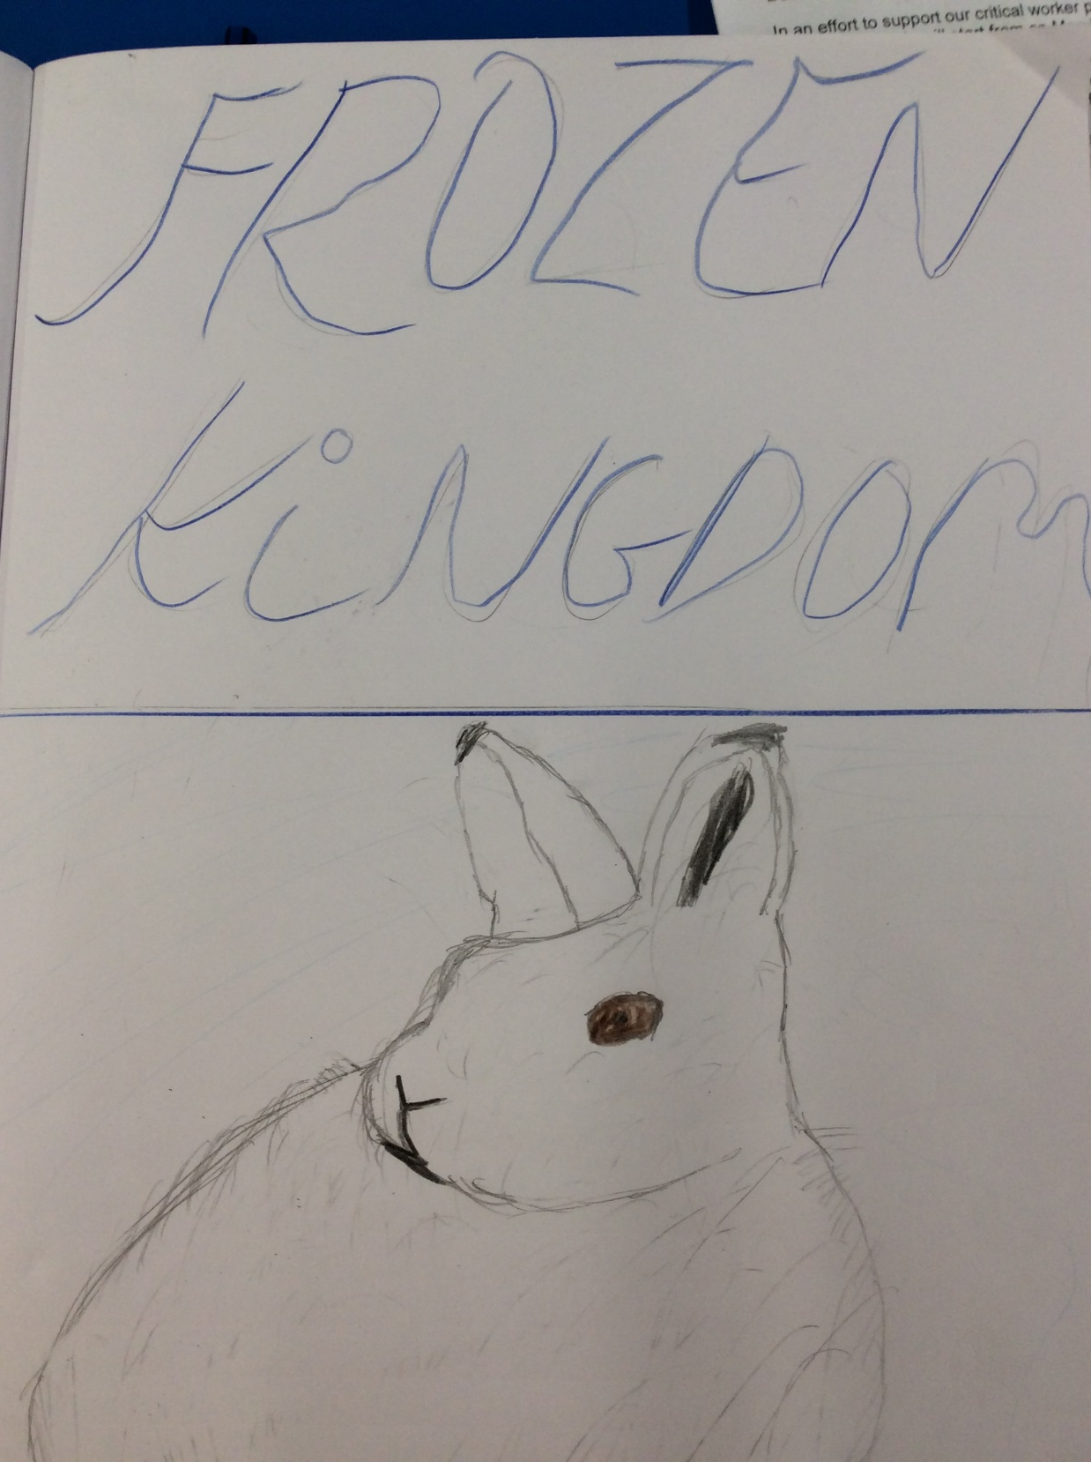
Zoe’s Topic front cover design

Slide 31
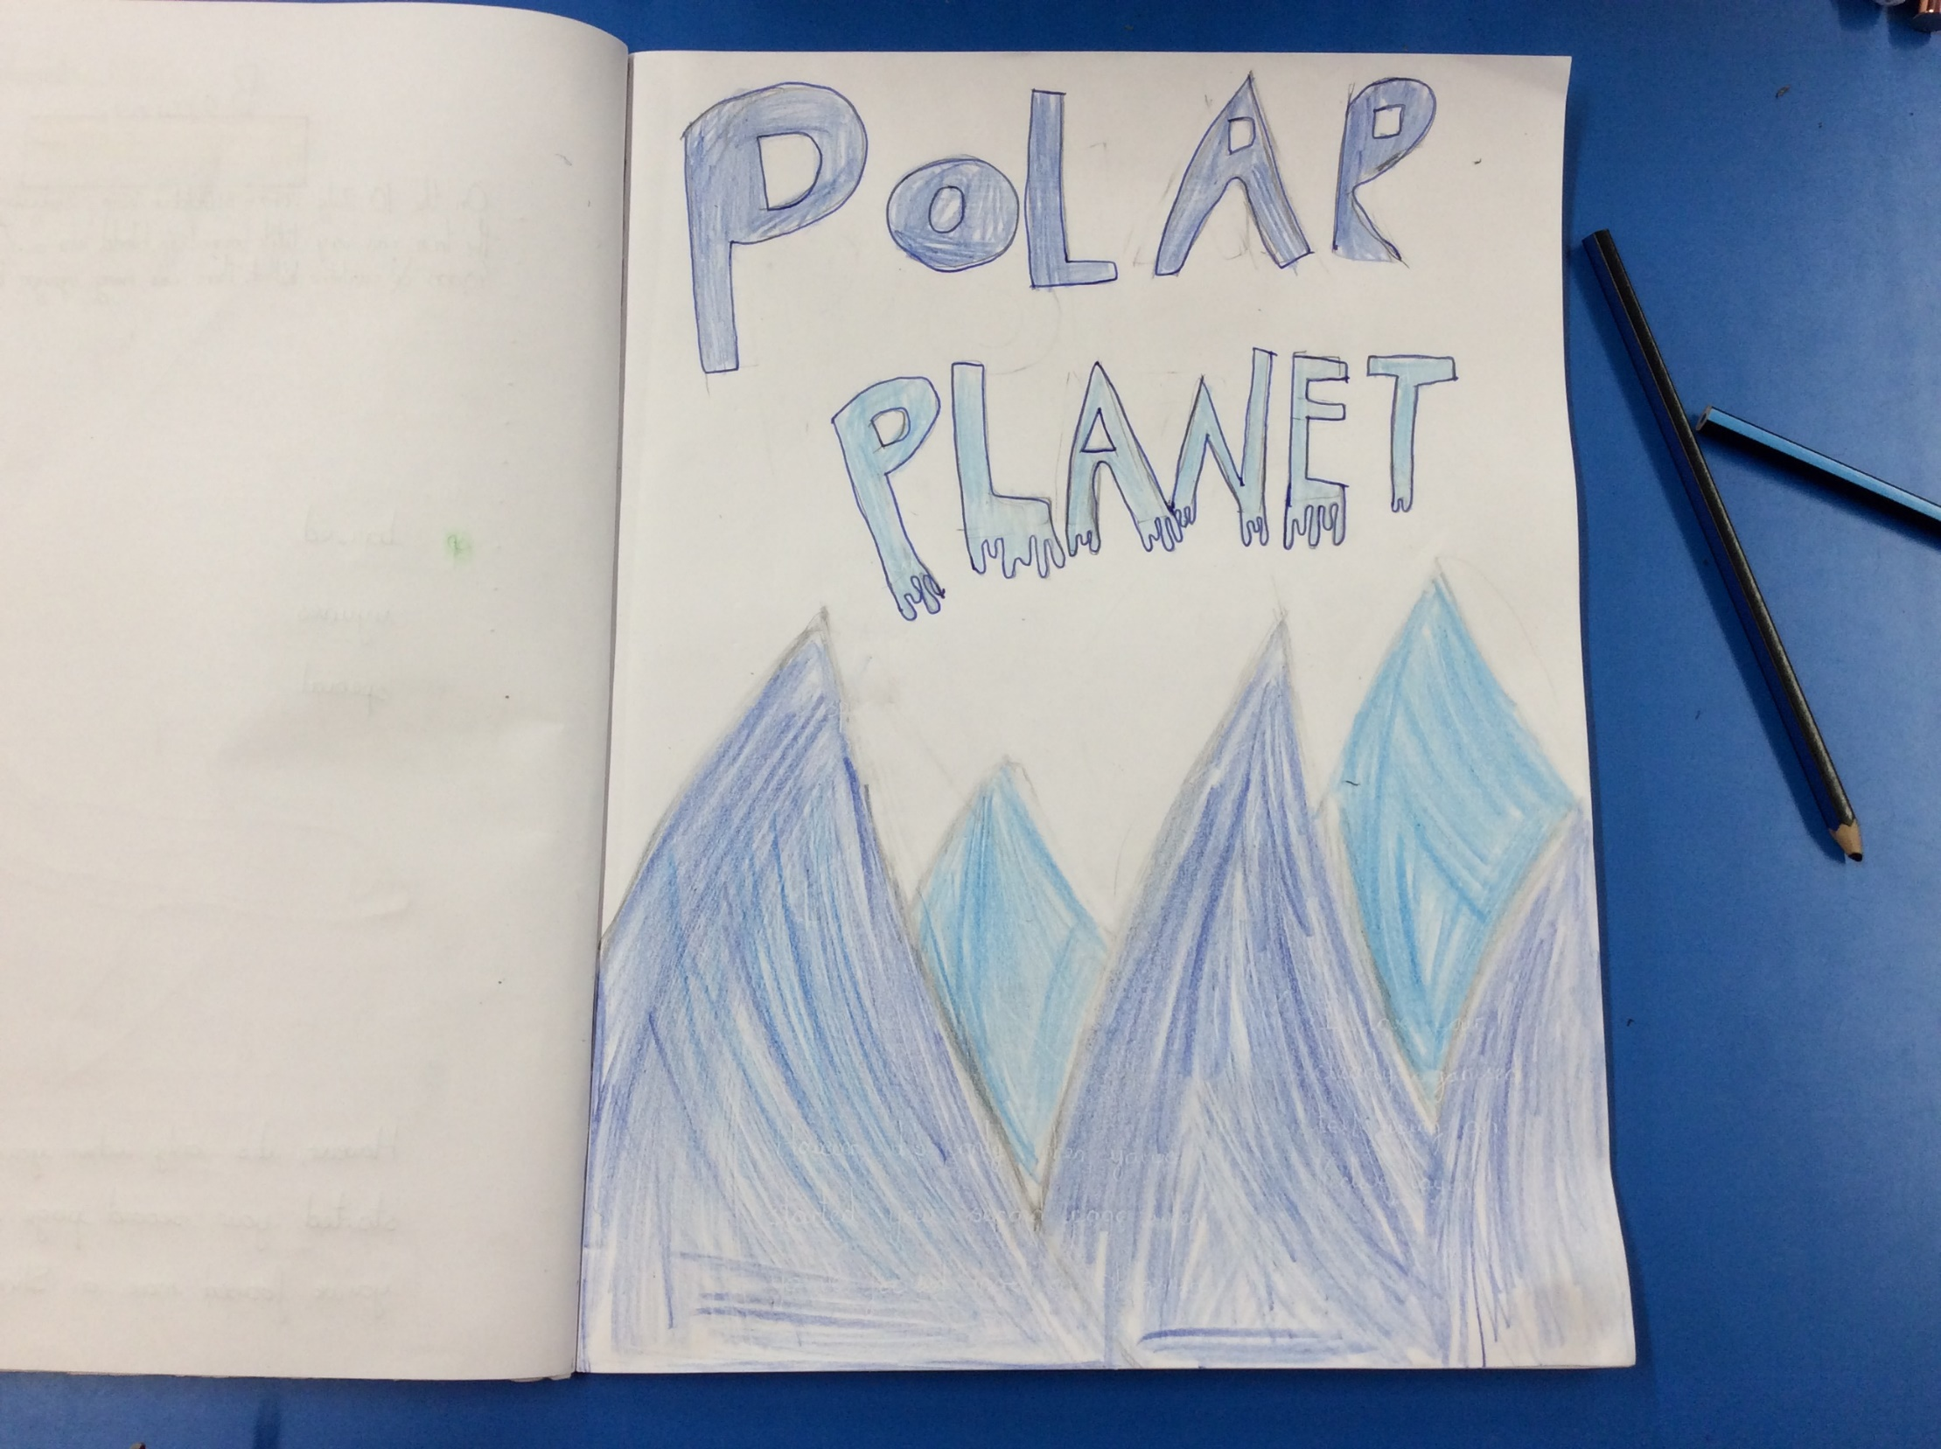
Holly H’s Topic front cover design

Slide 32
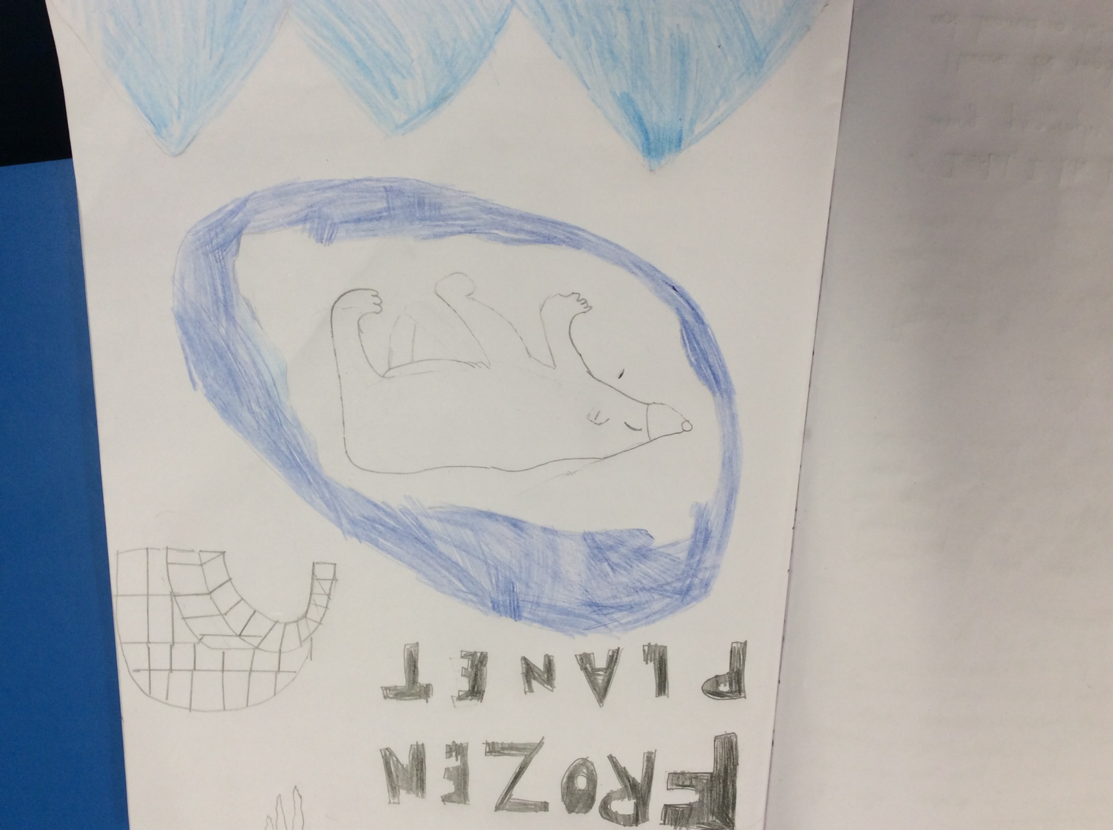
Isobel’s Topic front cover design

Slide 33
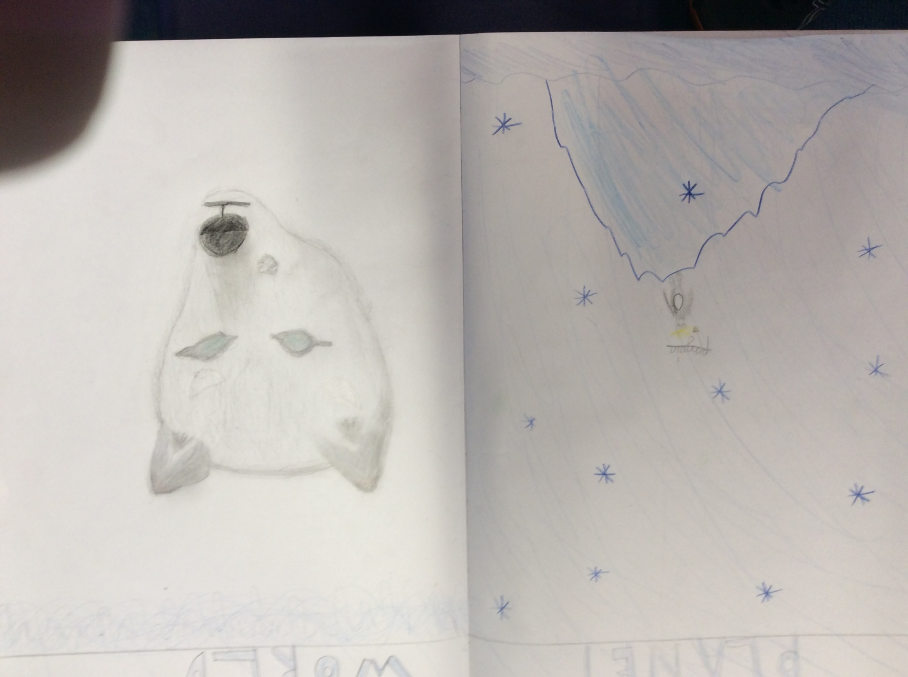
Sophie’s Topic front cover design

Slide 34
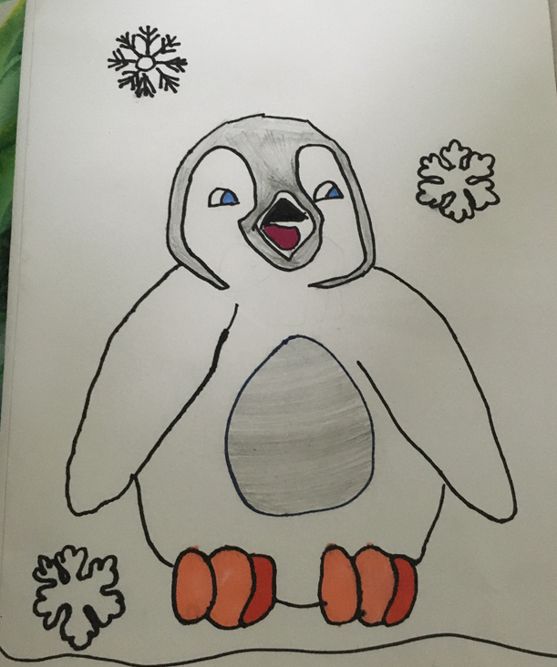
Esme’s Topic front cover design

Slide 35
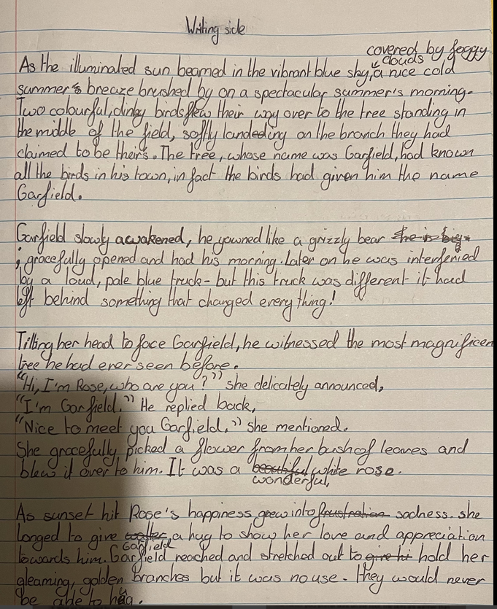
Ollie has been reading and answering questions about ‘Igloos’ today.

Slide 36
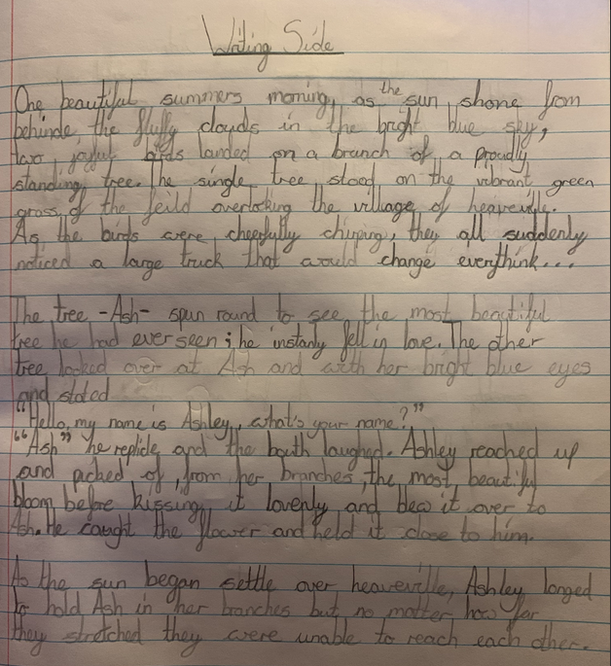
Sophie’s thinking side really helped her with the preparation of her writing this week.

Slide 37
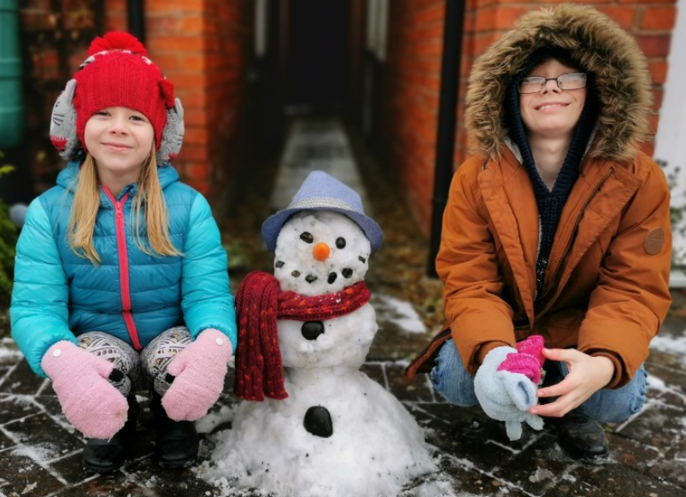
I took the time out this morning to build Snowy McSnowyson.

Slide 38
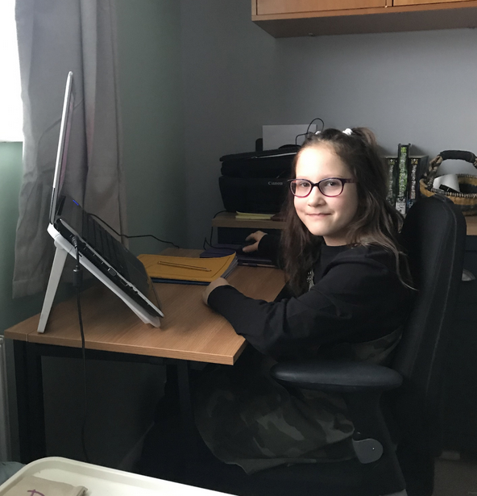
I got the opportunity to work at my mum’s special office chair today!

Slide 39
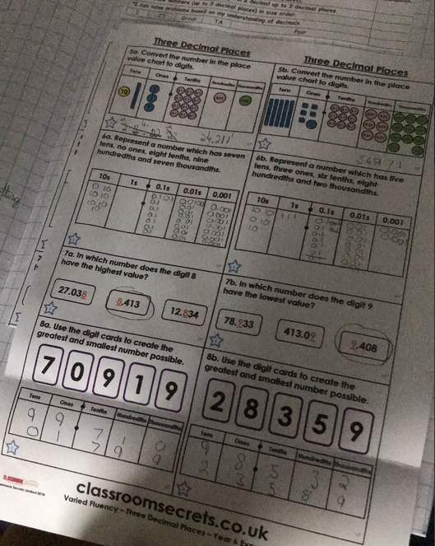
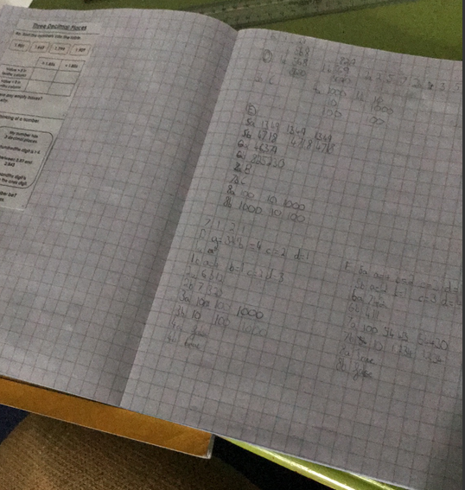
Rhys has been working hard all week in his maths learning from home.

Slide 40
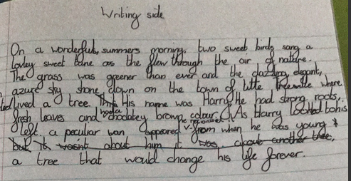
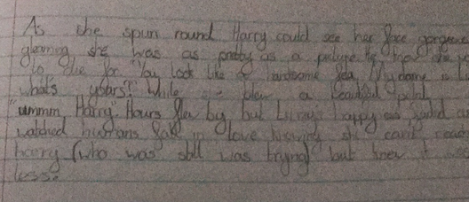
Rhys has used his ‘Thinking side effectively to help with the ideas for his story writing this week.

Slide 41
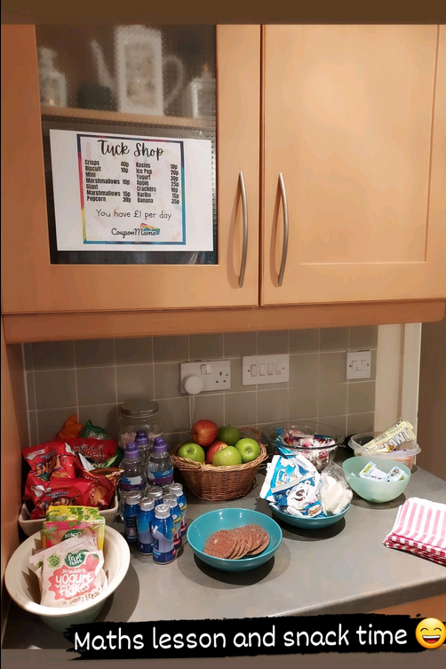
Ollie did a ‘real life’ maths challenge with some ‘tuck shop’ money questions.

Slide 42
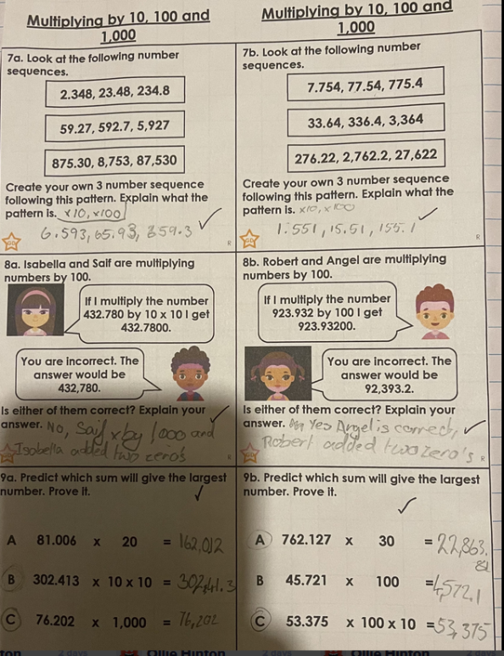
Nelly has been working hard all week in maths on her decimals and multiplying / dividing by 10, 100 and 1,000

Slide 43
Nelly’s guided reading from during the week.

