Slide 1
Holly H’s continuation of her Captain Tom Moore biography
Army Life
When Tom joined the army, he served in WW2 at the age of 20. In October 1941, Moore became a member of the royal armoured corps. He served in India and the Burma campaign during WW2, where he received the Burma star, the defence medal and the war medal! He was enlisted in the 8th battalion Duke of wellington regiment. He became Captain Tom Moore in 1944 for his brave commitment to the war effort. Then he left India in 1945 to return back to England.
After The Army
Tom didn’t return back to the army, instead he became a managing director of a concrete company. In his spare time, Tom raced motor cycles competitively. In 1949, Tom married his first wife called Billie however the married ended 20 years later due to a divorce. In 1968, he married for the second time to a lady called Pamela and had two daughters Hannah and Lucy. Sadly, Pamela passed away in 2006. Hannah gave Tom two grand children named Georgia and Benjie.

Slide 2
Captain Tom Moore
Introduction
One year ago, an elderly gentleman caught the eyes and hearts of the nation, for embarking and fulfilling a remarkable achievement. That man was Captain Tom Moore! But how much do you know about the Captain himself? Read on and find out more about this phenomenal man, and everything he has achieved…
Growing Up and Qualifications
Born in Keighley, Yorkshire on the 30th April 1920 to father (Wilfred, builder and architect) and mother (School Headmistress), Thomas Moore loved the outdoors. He had a sister called Freda, and was a very energetic boy. Safety was not something on Tom’s agenda; he loved making things and had a very creative mind. Tom attended Keighley Grammar school, which is now known as Oakbank school. Later, he completed a civil engineering apprenticeship that was cut short, leaving to join the army to fight in WW2.
Army life / battles
Based in India, Tom served in the Burma Campaign during WW2, receiving many awards and medals such as the 1939 – 1945 star, the War medal, the Burma star and the Defence medal. Becoming a member of the Royal Armoured Corps in 1941, he later became Captain in 1944. After the war, he returned to England, taking up another career.
After the Army
Becoming a managing director of a concrete business, Tom had more time on his hands. He was very keen on motorcycles, and competitively raced them as a hobby. He married Billie at age 29, ending in divorce almost 20 years later. He married for the second time to a woman named Pamela in 1968, having two children (Hannah and Lucy). Pamela sadly passed away in 2006 from dementia and health issues. Tom has two grandchildren – Benji and Georgia.
Heidi’s continuation of her Captain Tom Moore biography

Slide 3
Captain Tom Moore
Introduction
One year ago, an elderly gentleman caught the eyes and hearts of the nation, for embarking on and fulfilling a remarkable achievement. That man was Tom Moore! But how much do you know about the man himself? Read through this fascinating Biography to uncover the many secrets of the Captain himself.
Growing Up and Qualifications
The legend of Thomas Moore was born on the 30th of April 1920 in the town Keighley, Yorkshire. The Captain was born into a very privileged family. His mother was a head teacher at a local school while the father (Wilfred Moore) worked in the tough trade of building. Him and his sister –Freda- attended the local Keighley Grammar school , which is now known as Beck field Oak bank . Safety didn’t come first for Thomas Moore (now more widely known as the popularly Sir Captain Tom Moore) as he enjoyed building items with wood and nail in his pastimes. While at the Cranfield university the young Tom trained as a civil engineer and received the honouree degree of a doctor. While working in his aprentiship war broke out (ww2) ; he was called out to join the British army.
Army life
At the troublesome age of 20, the soon to be captain was called up to join his country's army to fight against the Axis in the bloodshed battle of WW2 (world war two). Whilst serving his nations army, Tom worked his way up to the hounoray rank of Captain in the Indian war base. Captain Thomas Moore earned medals in his lengthy time in the army. These are the medals Mr Moore earned during his life
Burma star
Defence badge
Star medal
War medal
Golden blue peter badge (not earned because of his commitment to the war)
After leaving the Army
After leaving India in order to return to his home country (Britain), Mr Thomas Moore began a new life. As he had more available time he raced motor cycles competivaly. To ensure money was within his grasp, Tom joined a concrete making factory. Tom became the manager soon after joining the company. After leaving, he married a woman named Billie. However Tom divorced a few years later in order to remarry. Pamela, who was his 2nd wife, tragically died in 2006. With her, he had two children named Lucy and Hannah.
Cameron’s continuation of his Captain Tom Moore biography

Slide 4
Captain Tom Moore
Introduction
One year ago, an elderly gentleman caught the eyes and hearts of the nation, for embarking on and fulfilling a remarkable achievement. That man was Tom Moore! But how much do you know about the man himself? If you want to find out about Sir Tom and his fascinating life, read on.
Growing up and qualifications
Thomas Moore, now known as Sir Captain Tom Moore, grew up in Keighley, Yorkshire after being born on April 30th 1920. He lived with his father Wilfred (who was a builder), his mother who was a head teacher and his sister Freda. As a child Tom was very active and loved being out side in his garden; he would also prefer to have wood and nails than any other toy. He attended Keighley Grammar School which is now known as Oak Bank School. Later he completed a civil engineering apprenticeship before joining the war effort in WW2.
Army life/ Battles
While at war, he was based in India at the age of twenty on 1939 and worked his way up to becoming a captain in 1944. He received many medals such as, Star medal, Burma star and the War medal. He received all of the medals between 1939 and 1945. He then left in 1945 once the war had ended and became an instructor for a short while.
After leaving the Army Life
After returning home, he became a managing director of a concrete company and eventually found the love of his life Pamela and married in 1968 but before that he was married to Billie in 1949, which ended twenty years later. During these years Tom also raced motorcycles competitively in his spare time. He had two daughters named Lucy and Hannah. Sadly in 2006, Pamela died from dementia. Hannah married and had two children named Benji and Georgia who are Tom’s grandchildren.
Zoe’s continuation of her Captain Tom Moore biography

Slide 5
Captain Tom Moore
Introduction
One year ago, an elderly gentleman caught the eyes and hearts of the nation, for embarking on and fulfilling a remarkable achievement. That man was Tom Moore! But how much do you know about the man himself? Read through this biography to find out about this amazing man.
Growing Up and Qualifications
Captain Thomas Moore was born on the 30th of April 1920 in Keighley, Yorkshire, whilst growing up with a sister, Freda. His father, Wilfred, was a builder, whilst his mother was a head teacher. As a child he loved being outdoors in the garden, enjoyed walking in the Yorkshire moors and was very active. Safety never came first for Tom, as his usual toys were nails and hammers. He attended Keighley Grammar School, which is now known as Beckfoot Oakbank School. After finishing school, he moved onto college and completed a civil engineer apprenticeship. But that time in college was cut short because he was called into the army.
Army Life and Battles
Whilst being pulled out of college, he entered the war. He served in the 2nd World War in India, even though he was only 20 years of age. During this time, he became a captain in 1944. Not just that, but he achieved many other awards such as, 4 medals from 1939-1945, including the star medal, Burma star, Defence medal and a war medal. After many years of fighting, he finally returned back to England in 1945, to become an instructor and didn’t return to the regiment.
Finally Returning
After coming back to his home town of Keighley, he became a managing director of a concrete company. When he had spare time, he enjoyed racing motorcycles competitively. He married his first wife Billie in 1949 but it ended 20 years later. In 1968, he married Pamela, who he had 2 daughters with (Lucy and Hannah). Unfortunately, Pamela passed away in 2006 from dementia. He also had 2 grandchildren called Benji and Georgia.
Isobel’s continuation of his Captain Tom Moore biography

Slide 6
Captain Tom Moore
Introduction
One year ago, an elderly gentleman caught the eyes and hearts of the nation, for embarking on and fulfilling a remarkable achievement. That man was Tom Moore! But how much do you know about the man himself? Read on to learn some exciting facts and so much more…
Growing Up and Qualifications
Thomas Moore was born on the 30th of April 1920 in Keighley, West Riding, Yorkshire. He had one sibling named Freda. Thomas was the son of a builder, Wilfred, and his mother was a head teacher. While growing up he was very active and enjoyed being outdoors and walking around the Yorkshire Moors.
Thomas went to Keighley Grammar School, a mixed secondary and sixth form. He began an apprenticeship in civil engineering before enlisting in the army in WW2 where he rose to captain.
Army Life
Tom was an officer in the British army and in May 1940, he was recruited into the 8DWR (8th Battalion) regiment, where he was selected for officer training. In 1941 Moore became a member of the royal army corps. Later that year he was transferred to India, to the 9DWR (9th Battalion) regiment, where he set up a training program for motorcyclists in the army.
Tom was awarded four medals, during his time serving in the war. The first medal he was awarded was the (1939-1945) Star II, which every officer got for serving in the Second World War. Tom also achieved a medal for fighting in the Burma campaign from 1941 to 1945, called the Burma Star. Moore was then awarded the War Medal, also achieving the Defence Medal, a couple of years later. On the 20th May 2020, he was awarded the Knight Bachelor at Windsor Castle.
After The Army
After the army, Moore married his first wife, Billie in 1949. The marriage ended after twenty years. Tom then married his second wife, Pamela in 1968, who he had two daughters with, Hannah and Lucy. Pamela passed away in 2006 from dementia. Moore has lived with Hannah, her husband and two grandchildren since 2008 in Bedfordshire. He became the managing director of a concrete company. In his spare time he enjoys racing motorcycles.
Sophie Carr’s continuation of his Captain Tom Moore biography

Slide 7
Captain Tom Moore
Introduction
One year ago, an elderly gentleman caught the eyes and hearts of the nation, for embarking on and fulfilling a remarkable achievement. That man was Captain Tom Moore! But how much do you know about the man himself? Here you’ll find all your answers to your questions in this fascinating insight into his life.
Growing up and Qualifications
Thomas Moore, now known as Sir Captain Tom, was born in 30th April 1920 in Keighley, West Riding of Yorkshire. His father (Wilfred Moore) was a builder whilst his mother was the head teacher of Keighley Grammar school, which is now known as Beckfoot, Oakbank school. He and his sister Freda went to that same place. Safety wasn’t for Tom. What he had for toys was nails and wood. if he got hurt though he wouldn’t do it again. Loving playing in the Yorkshire moors he would run around all day. Later in his life, he trained in a civil engineering apprenticeship but was called out because of the army.
Army Life
Whilst in the army, he served in the 2nd world war in India, even though he was 20. In 1944, he became a captain and was given many medals such as; the star medal, the Burma star, the defence medal and the war medal which are very special to him. After many years of fighting, he returned to England in 1945 to become an instructor and did not go back to the regiment.
Returning Home
After coming back from the war, he became a managing director of a concreate company. When he had spare time, he liked to race motorcycles competitively. He married his first wife Billie in 1949 however this ended in divorce. Pamela, who he married 20 years after, gave him two daughters ( Lucy and Hannah). Hannah had two children of her own - Benji and Georgia. His wife tragically died in 2006 because of dementia.
Cass’ continuation of his Captain Tom Moore biography

Slide 8
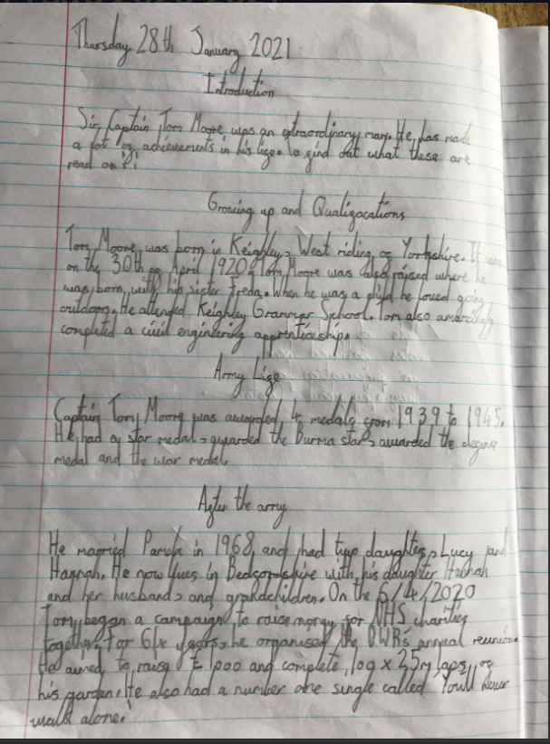
Ariana’s continuation of her Captain Tom Moore biography

Slide 9
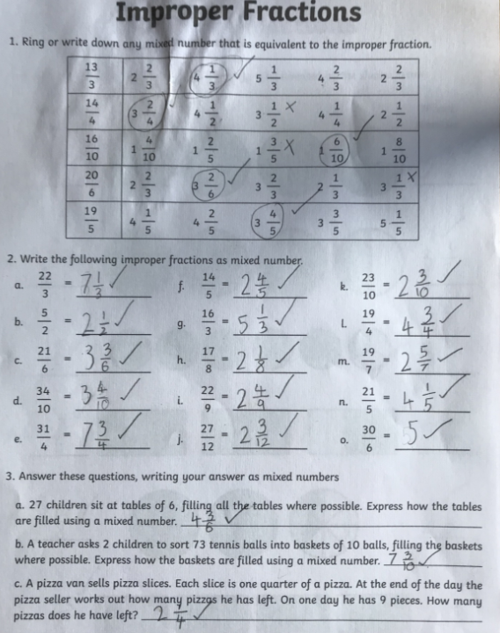
Ariana has been converting her improper fractions into mixed numbers correctly.

Slide 10
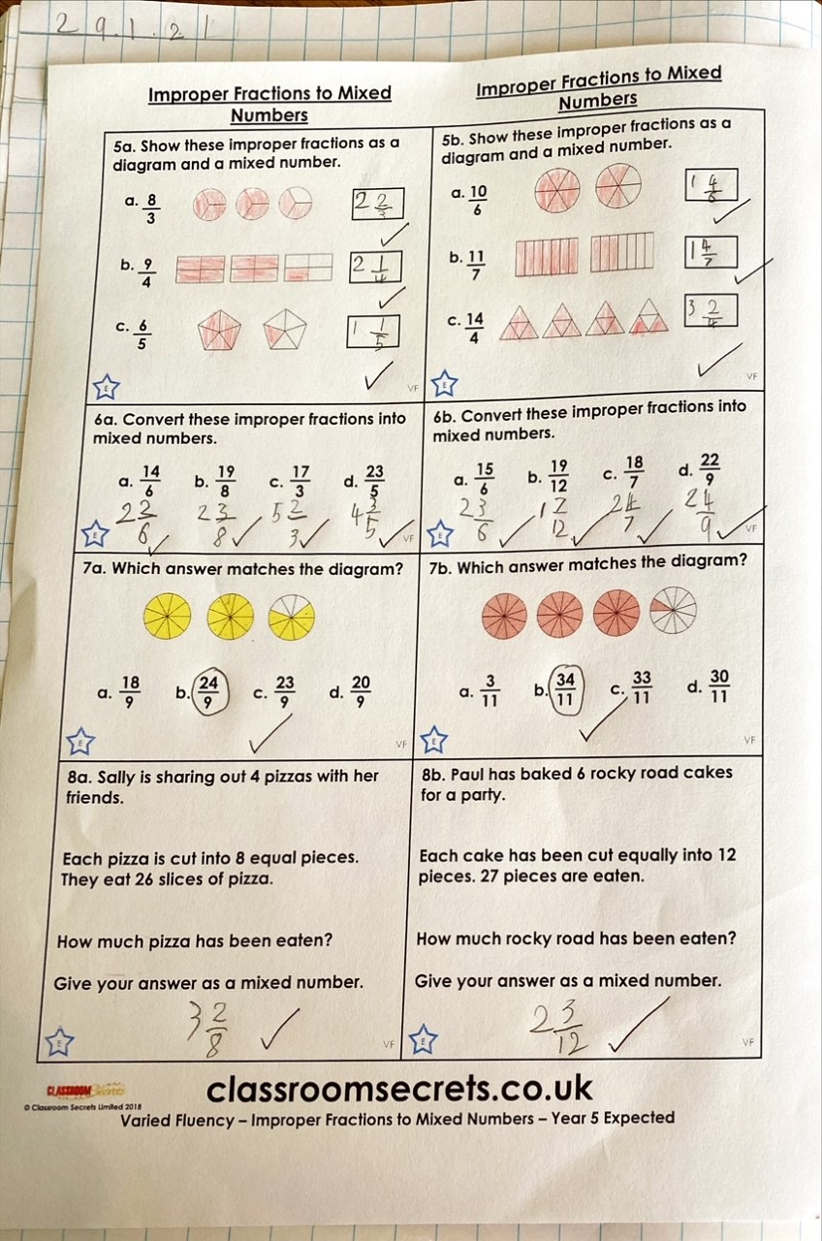
Sam confidently converted improper fractions to mixed fractions.

Slide 11
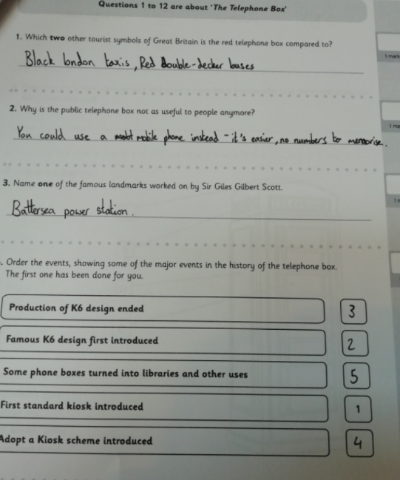
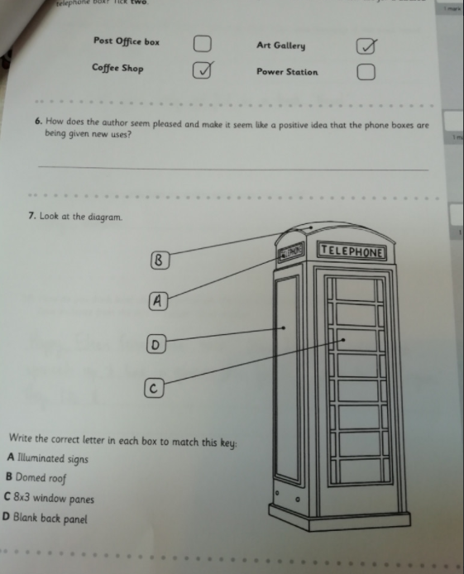
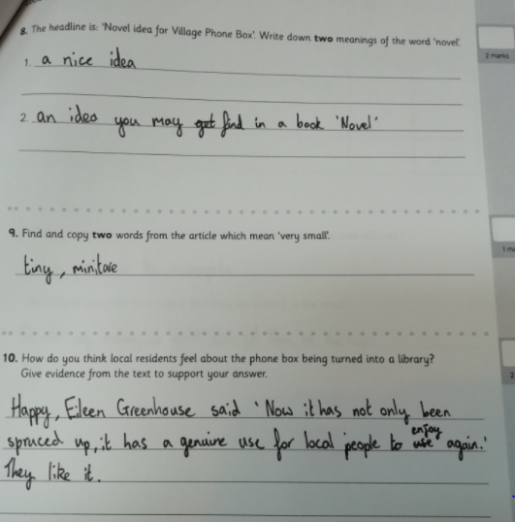
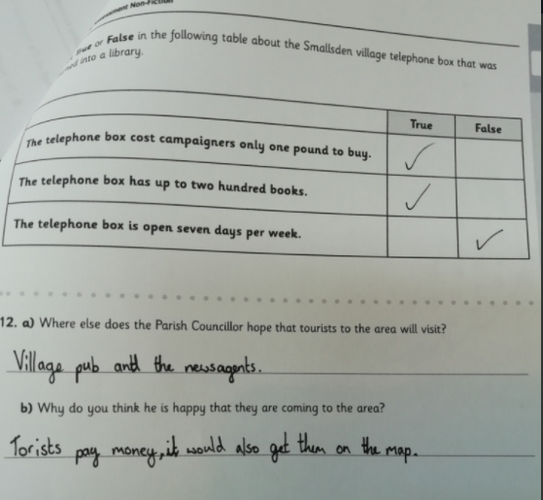
Amy read her ‘Telephone Box’ text carefully to answer these questions well.

Slide 12
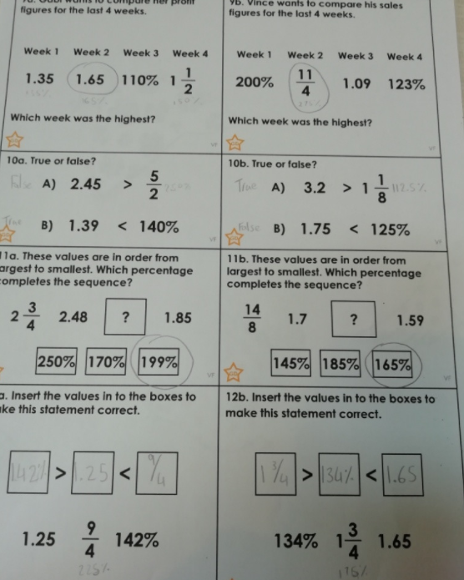
Amy flew through her maths today, ordering the fractions, decimals and % correctly.

Slide 13
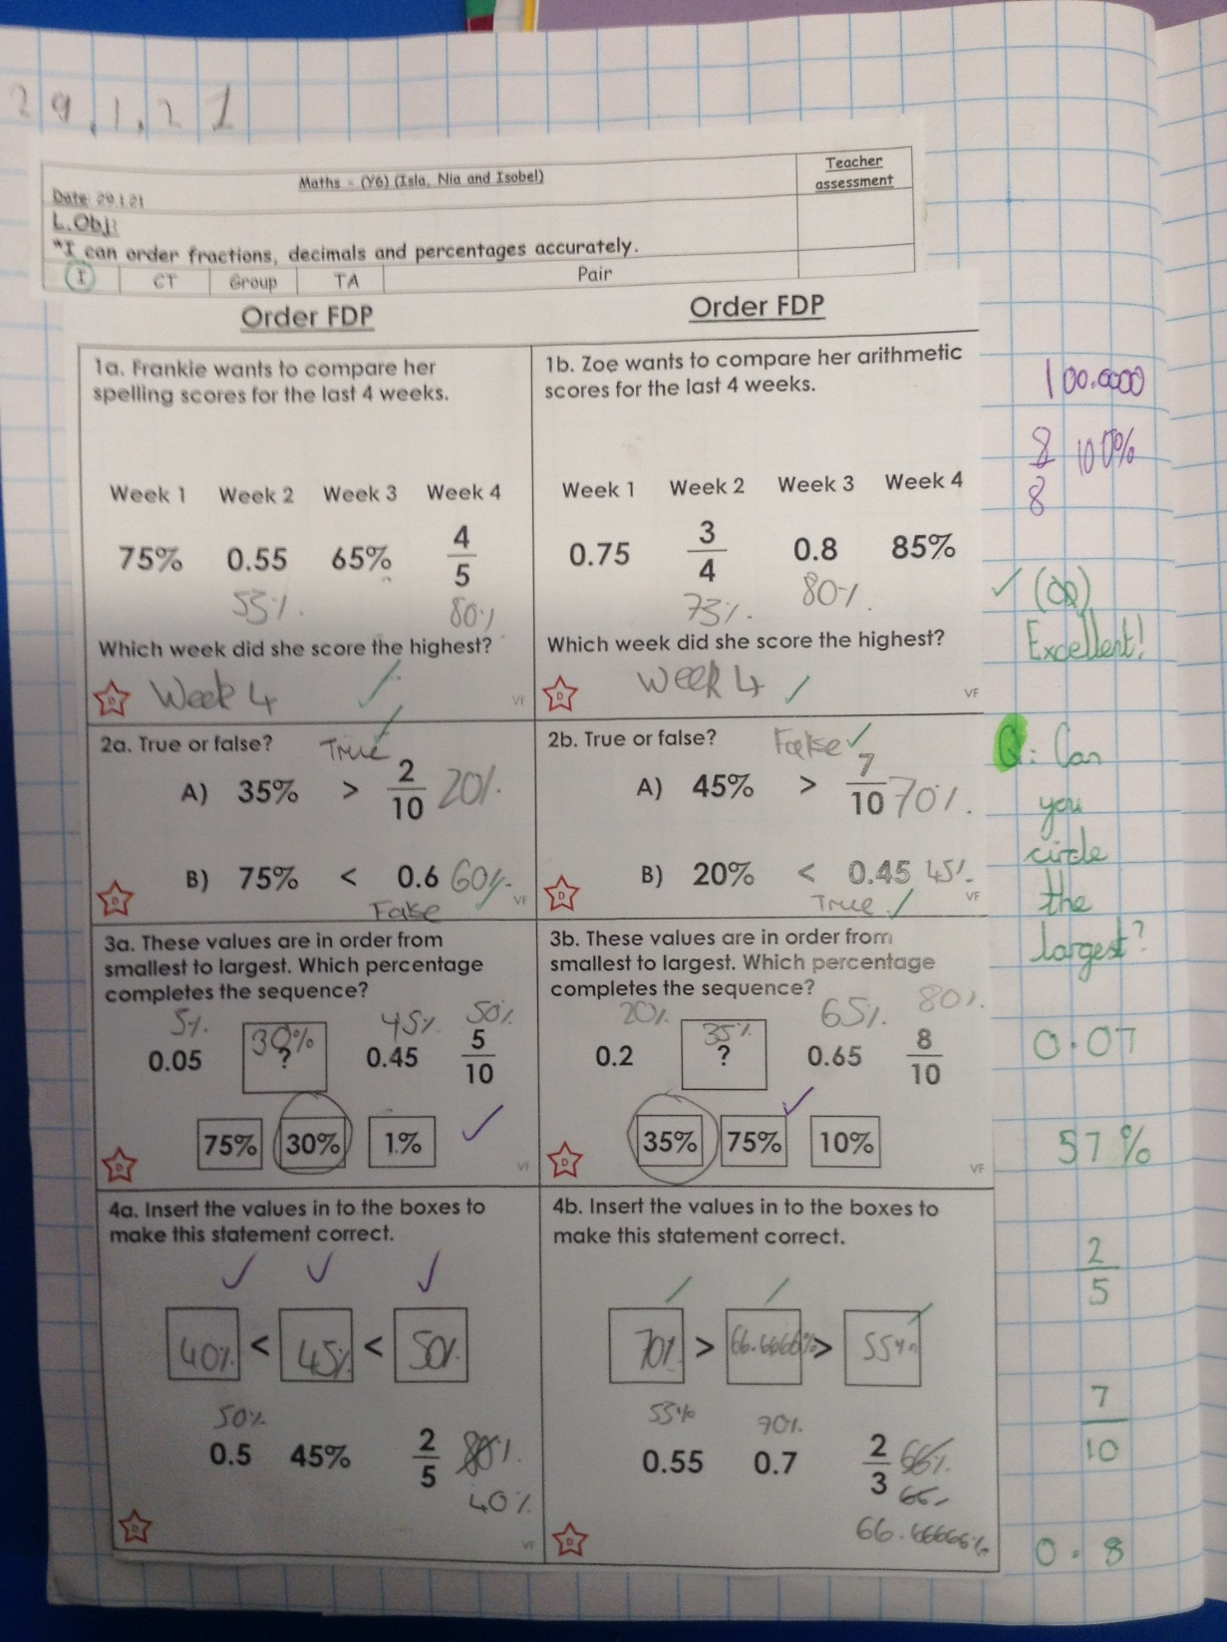
Isobel confidently ordered these fractions, decimals and percentages in maths today.

Slide 14
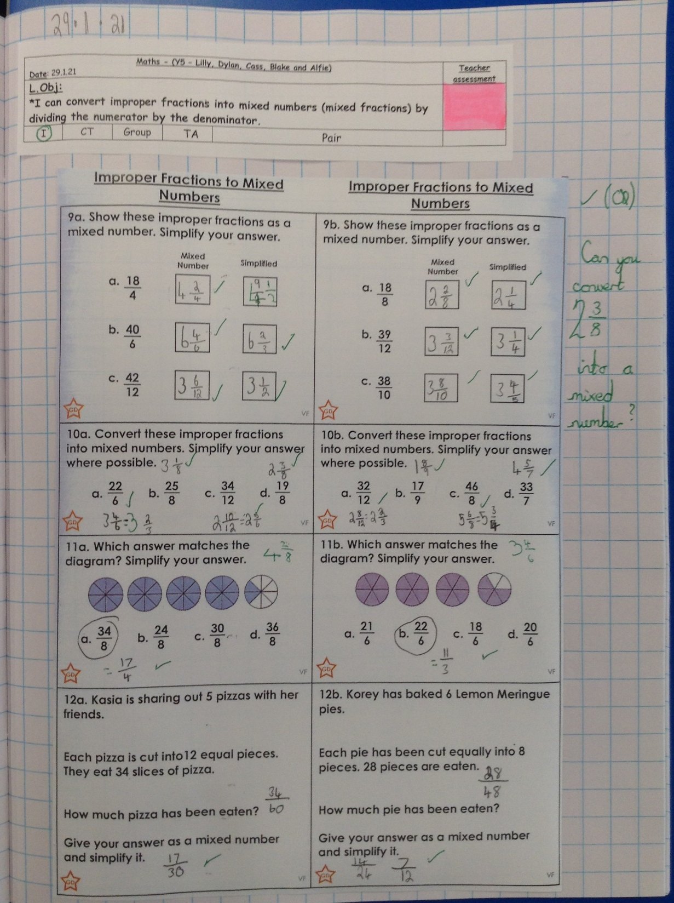
Cass converted these improper fractions really well into mixed numbers and then simplified them correctly.

Slide 15
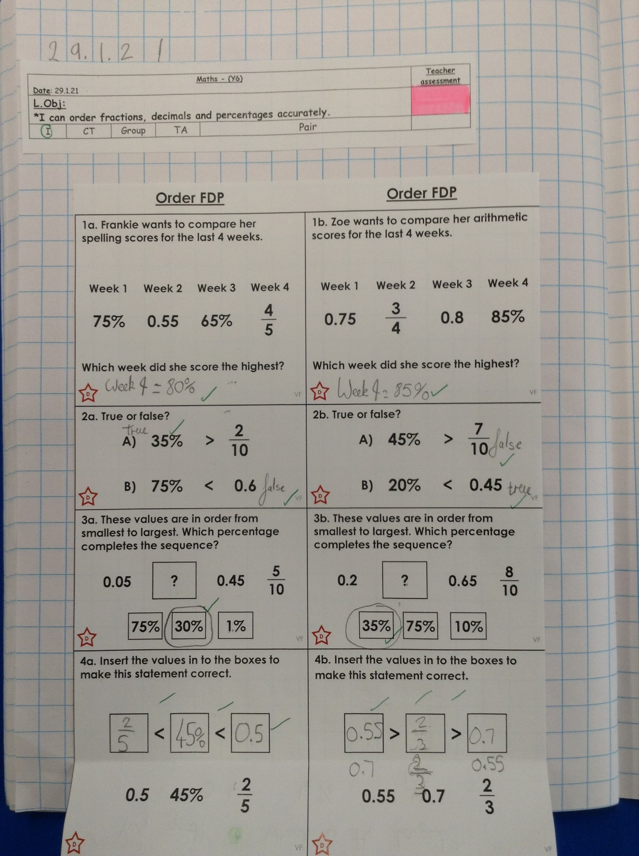
Holly H turned all of these into percentages today to help her to put these fractions, decimals and percentages in size order.

Slide 16
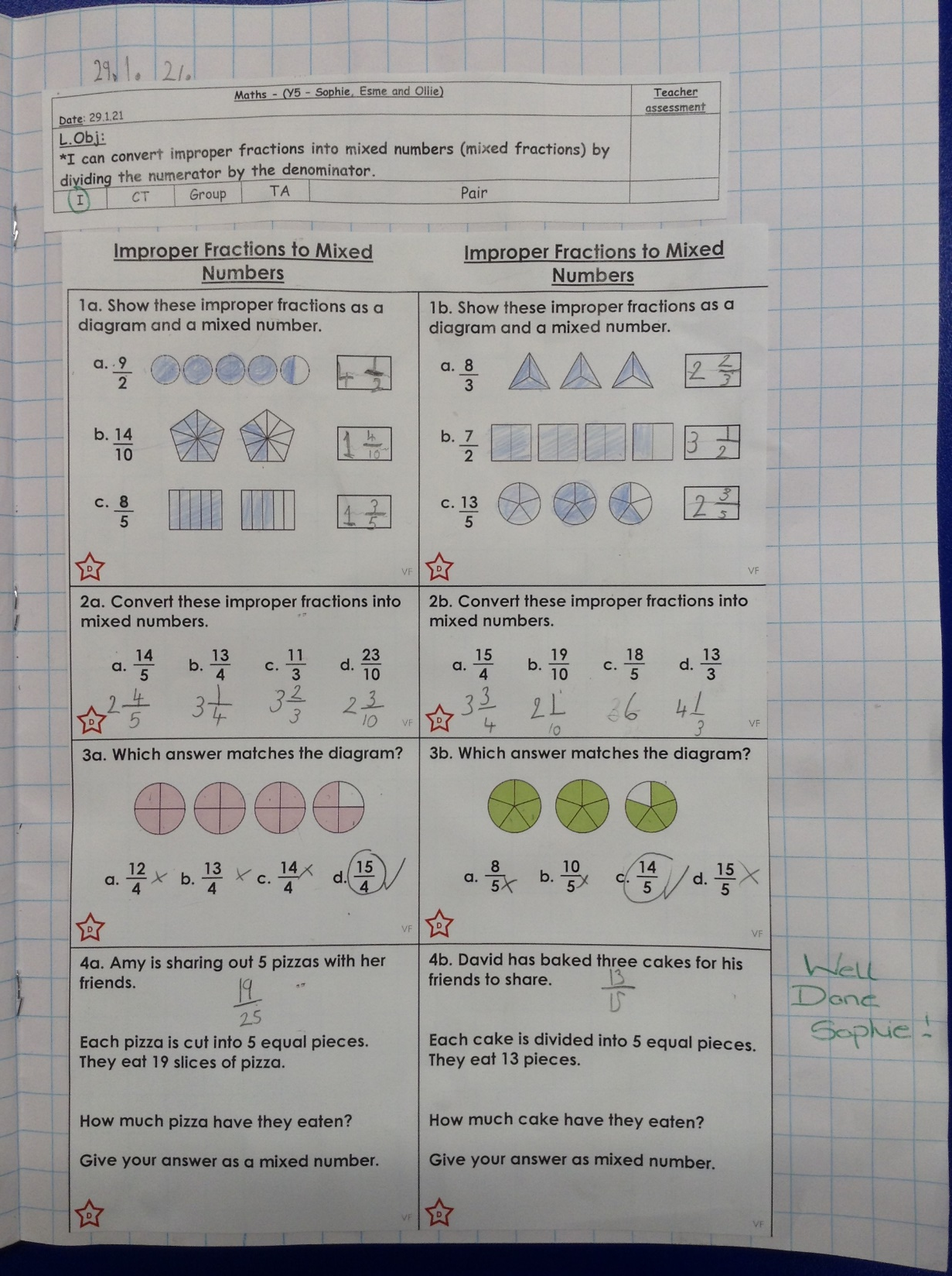
Sophie Carr converted these improper fractions into mixed numbers correctly.

Slide 17
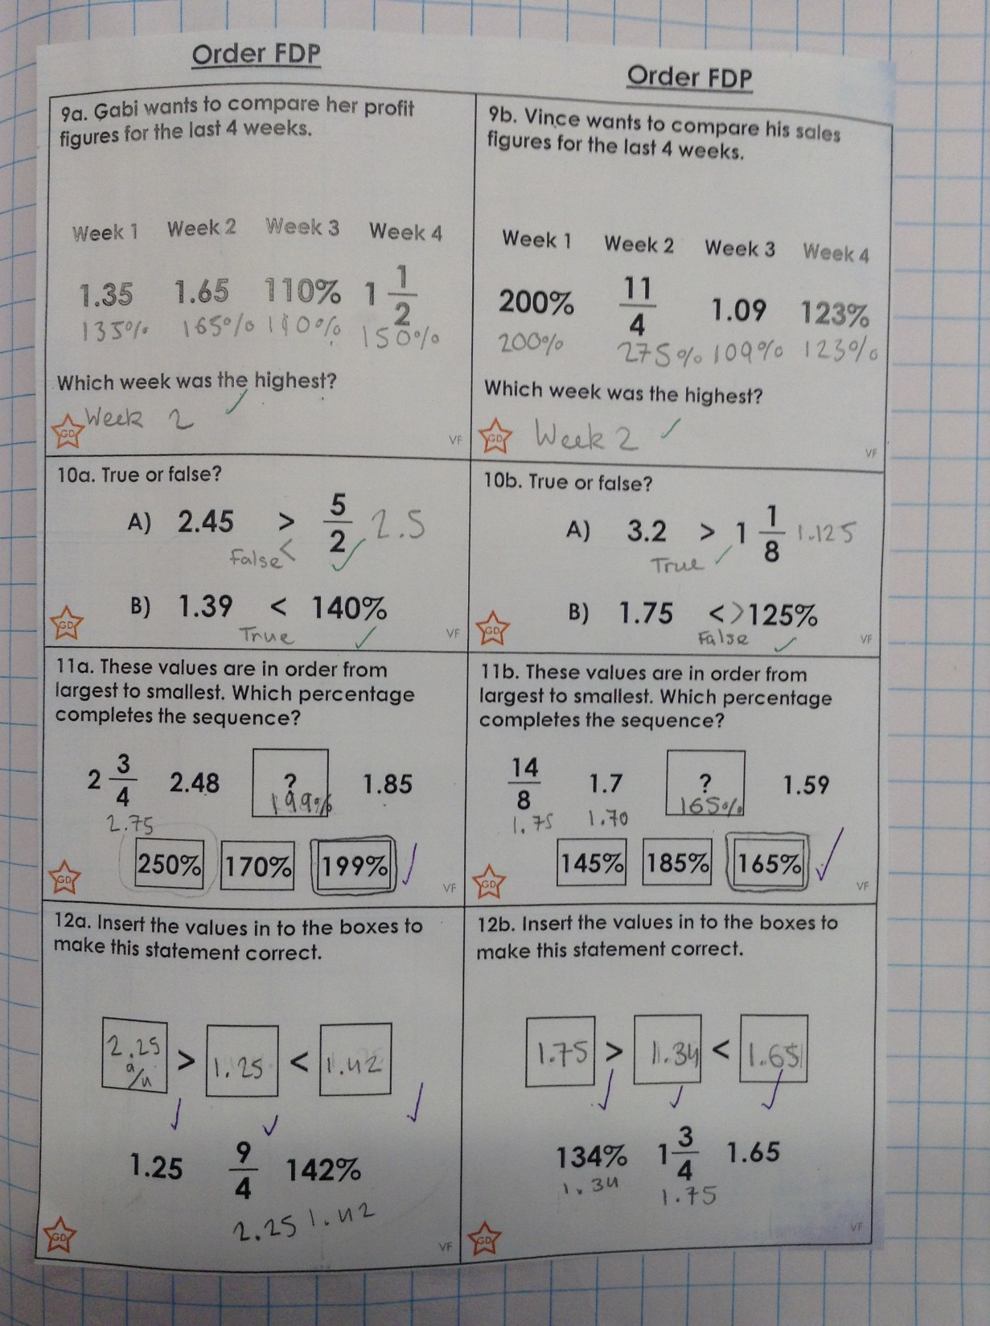
Heidi has converted these all into percentages to help her to put them into size order.

Slide 18
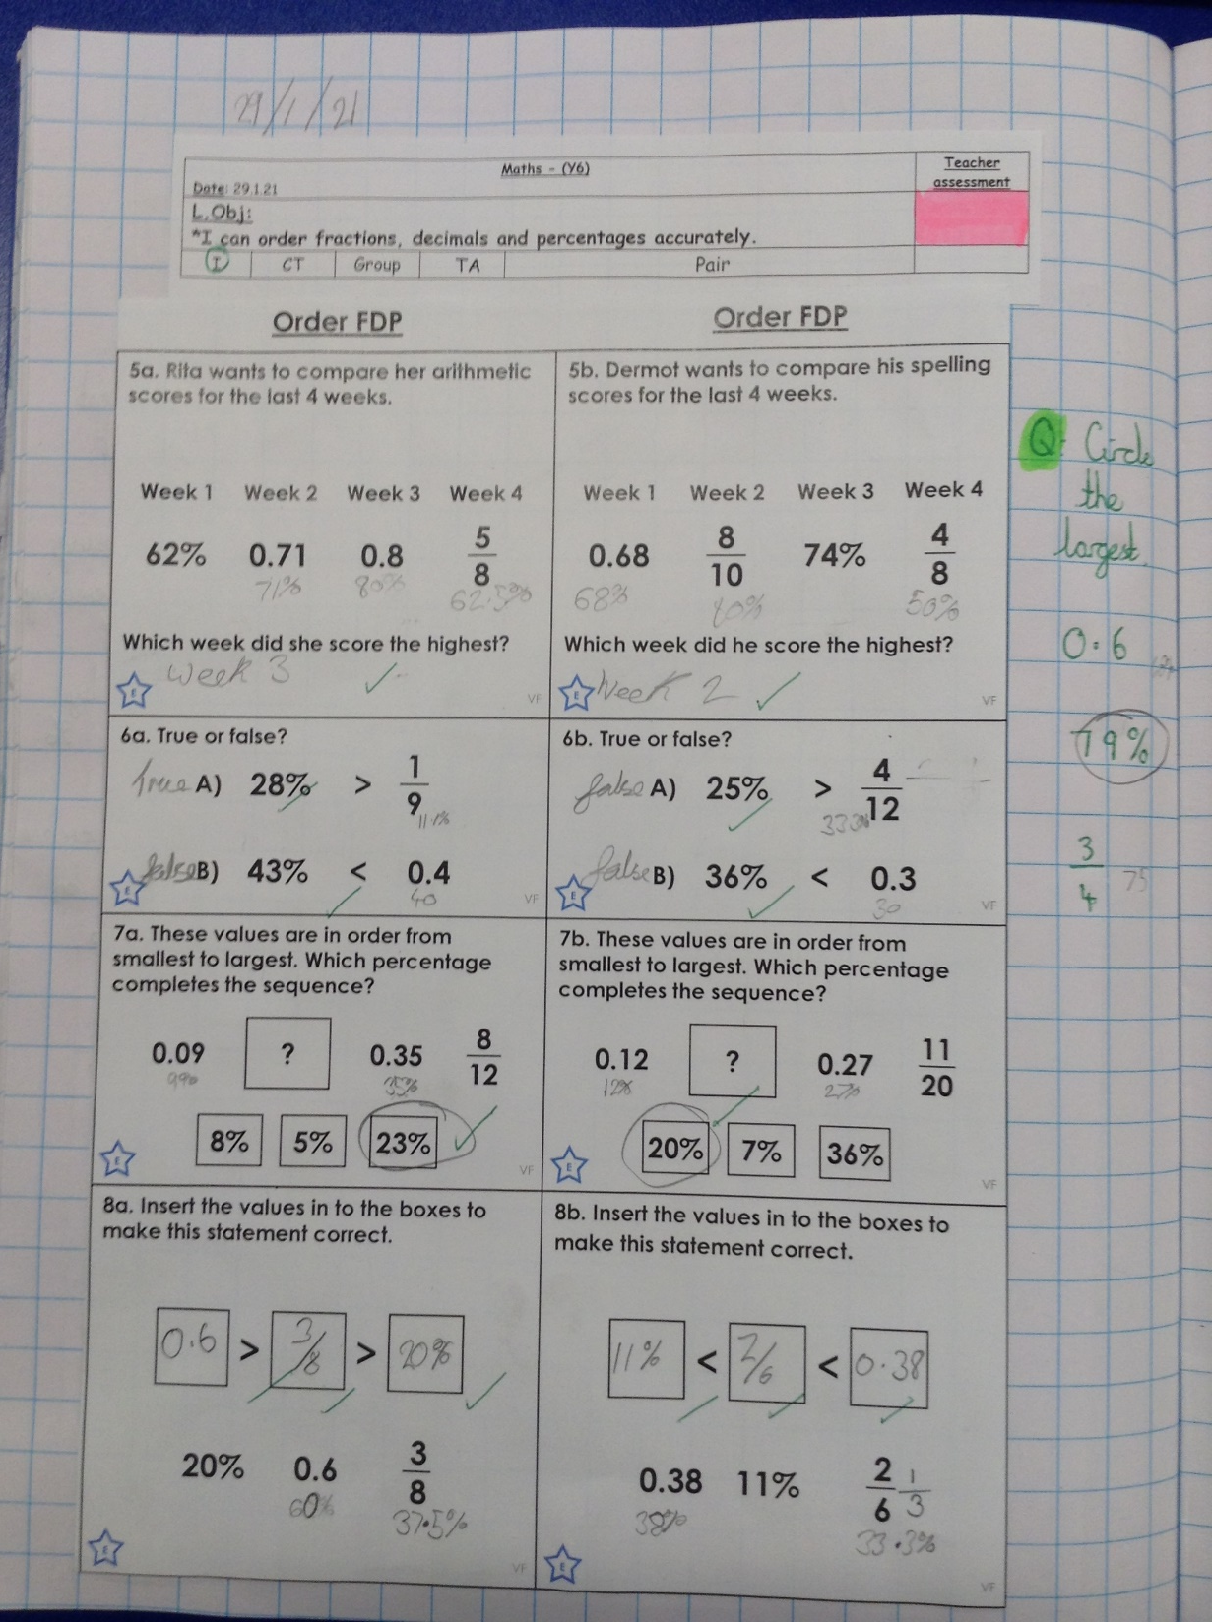
Cameron has ordered these fractions, decimals and percentages well by converting them all into percentages.

Slide 19
Amy’s continuation of her biography of the life of Captain Tom Moore.
Army life
In May 1940, Moore joined the 8th Battalion, Duke of Wellington's Regiment (8 DWR) stationed in Cornwall, eight months after the beginning of the Second World War when he was just twenty years old. After one year of service, Tom became a member of the Royal Armoured Corps where he helped the war effort greatly. Later that year another promotion was offered, Tom moved to the 9th battalion- posted in Bombay (Mumbai) then Calcutta (Kolkata) in India. He was promoted to a lieutenant in October 1942 and to a temporary captain on 11 October 1944. Captain Tom became part of the Fourteenth Army, and he served in Abakan, western Burma (now Myanmar) – where he survived Dengue fever. Moore returned to the UK in February 1945, to take a training course on Churchill tanks, learning to become an instructor. He did not return to the regiment, remaining as an instructor and the Technical Adjutant of the Armoured Vehicle Fighting School in Bovington Camp, Dorset, until he was demobilised in early 1946.
After the Army
Captain Tom returned home to Yorkshire, he worked as a sales manager for a roofing materials company, and later as managing director of a Fens-based company manufacturing concrete- Cawood Concrete Products Ltd, which was renamed March Concrete Products Ltd. As well as this, Moore competitively raced motorcycles in his spare time.
Did you Know?
Captain Tom was a contestant in the Christmas day 1983 BBC edition of Blankety Blank?

Slide 20
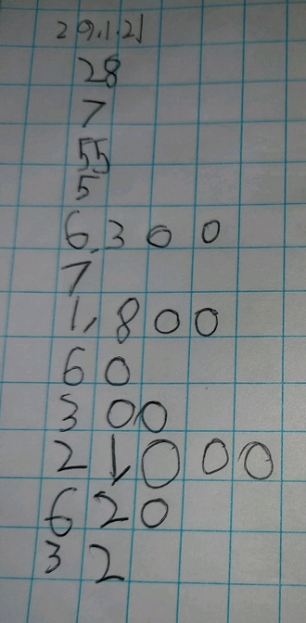
Ollie started his maths today with some mental maths calculations.

Slide 21
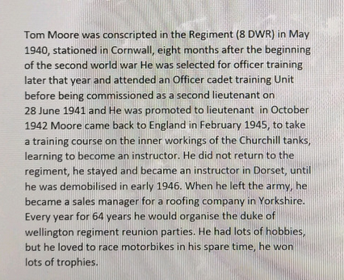
Here’s Ollie’s biography writing from today.

Slide 22
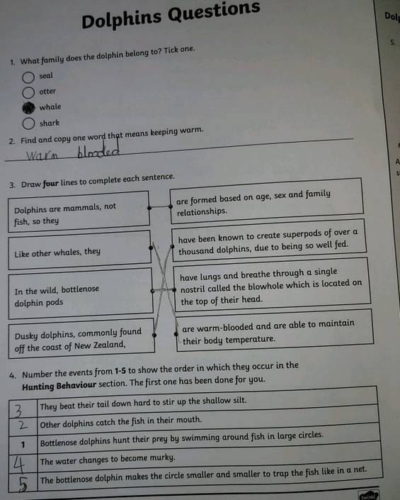
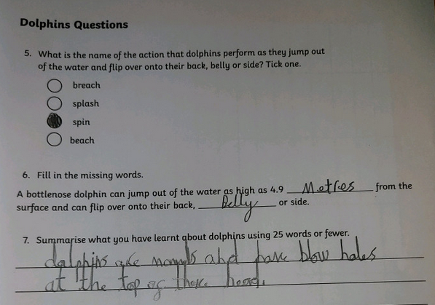
Ollie has been learning about dolphins in his reading today.

