Slide 1
23 Degrees 5 Minutes – Final draft - Sam
Babbage was freezing despite all of the gear he was wearing but he was not surprised as he was in the Arctic. He was in protective goggles and furry mittens as well as steel braced boots.
He was there to find his old professor Orid who had gone missing 23 years and 5 months ago, in mysterious circumstances - no-one knew where he had gone except Babbage. That’s how he ended up boarding the boat named Sapphire travelling to the Arctic. The docks were cold and icy and glaciers filled the surrounding area with only a small channel for them to pass through. The snow swirled like leaves in a hurricane. Barrels of provisions were piled high and a rusty, mysterious trawler ship was nearby.
As the ship set sail over glassy waves, Babbage stood on the deck, his beard was as cold as ice. He looked forwards and wondered what adventures awaited him.
A few days later, Babbage was still on the Sapphire sailing to the Arctic. It was cold and dark, everywhere he looked there was snow or ice. He felt as though he was going to freeze to death, he thought about Ireland, the home he had left behind, the university, the children whom he was teaching, what if he never came back...
He thought of the task ahead, he was with a surprisingly small crew of 3 people, well 4 if you counted Babbage. One of them was named Ruffnuck, he enjoyed the thrill of adventures and was willing to do anything for his friends. The second one was named Throk, he sounded all strong but he normally kept himself to himself and enjoyed maths and navigation problems. Finally the last member of the crew, Sven, he was the ship’s mechanic/engineer he was the one who built the Sapphire. And finally Babbage, although you already know all about him.
The crew kept asking him, “what are we doing in this place?” And, “Yeah it’s freezing why would we come here?” Babbage was forced to tell them a little bit about Orid,
“So you see I am looking for my old professor Orid, he disappeared 25 years and 5 months ago.”The crew were intrigued but cautious,
“And why is this professor Orid so important?” they asked.
Babbage spoke and said, “well some things you just miss so much.”
The conditions were quite good although it was always cold but you couldn’t be surprised - they were on the way to one of the coldest places on Earth. Babbage was chilled to the bone, but he got used to it in time.
Babbage got off the ship and on to dry land, finally the ship could go no further, he had to walk the rest of the way. He wanted to go alone; he thought this was his own search. The rest of the crew shouldn’t get involved he told himself, but there was a nagging suspicion that he should have had them come with him.
It was freezing. He thought that he was going to die in this inhospitable place. Babbage’s pack was heavy which slowed him down. To start with he wasn’t bothered but he would soon regret it. You see last few nights on board the Sapphire, he had been going to sleep at 1 am because he had offered to do the night watch. After several days of walking with all of that weight on him and exhaustion, he fell to the ground and fainted. A few minutes later he awoke with a start and looked up and could not believe what he saw - a mysterious shape coming towards him...

Slide 2
23 Degrees 5 Minutes – Final draft – Alfie
One icy day I went looking for my boss. He was lost. I had to get ready to go, it was freezing. I had my thick gigantic jumper on and my warm gloves and goggles on. The rope was hard as hell. I was going fa, far from the deck. The sea which was like a dark blue carpet opened the ice. I could see the broken ship from here that we had left behind. He looked at the ice and said “woah... this ice is sharp; this boat could break.’’ It started to snow; the snow was so hard.
I went to go to work at 7.49am, I got stuck in a storm; a snowy storm. It was hard to turn the ship. I went inside of the ship; it took half an hour for the storm to stop. So, I went back up and it had stopped. When I was looking at the sea, I saw a seal in the water. A large glitzing grey seal. I saw the seal and then he popped his head back underneath, as I turned the storm started again. The ice broke it came to the ship and it bumped the hull. Then the ship went out of control it crashed into the icebergs. A polar was on top of it fast asleep with her baby. An hour later I was asleep inside the ship, then I woken to a loud bang, I checked but it was nothing, I was sooo hungry for food, but there was nothing to eat. I got my fishing rod out, and tried to catch something to eat, I caught a big fish! After my fish dinner I felt seasick. The captain said, “come on it has only been an hour!”.
We got to the mountains, then the storm started again got lost I was so tired I fell to the ground; I was so puffed out. Then I finally found my boss in the snowy storm, he looked like Santa then he disappeared. My friends came to help me.

Slide 3
23 Degrees 5 Minutes – Final draft - Ariana
As Babbage stood on the messy docks he took in the slight because today he going to the North Pole. He leaped on the ship and thought how he would do it. Babbage needed to find the Professor there. The man adjusted his warm snood. All the passengers glanced at the small icebergs bobbing along. He was also wearing dark goggles and held a strong walking stick.
Babbage attempted to calculate his findings as he ploughed faithfully across the deck. Like an animal catching prey, he walked to the front to look at the ice. As he stated “It’s freezing”. Babbage shivered slightly. The journey which was very hard rocked the ship and made him feel sea sick. From far away he could see the land.
Babbage sighed in relief. He saw many other things like polar bears and artic foxes. The ice was almost blue and looked beautiful. He saw that some animals (including narwhals) loved the chilly water. Whilst Babbage admired the magnificent animals the weather turned on them. As the sea battered the ship, people shook in fear. After a while it got back to normal and settled down. Everybody slowly calmed down, also Babbage worried how they could reach the North Pole safely, but they did.
Babbage stepped out on to the crunchy, deep snow. He needed to find the Professor, so he got his stick and battled through the icy storm. As his face began to freeze Babbage started feeling dizzy, he was exhausted. He attempted to take another step but he fell into the treacherous snow. It took Babbage a while to finally lift his head. As he did he saw a shadow standing in front of him. You will never guess who it was….

Slide 4
23 Degrees 5 Minutes – Final draft - Ollie
It was a cold and icy morning, and Babbage was about to set sale on his ship called Phillips ready for his scary and dangerous jurney. He stood there on the edge of the ship scared, worried, petrified whilst people started shouting “Bye” all of a sudden, he noticed that his beard started to freeze. He thought “How am going to survive when I'm not even there and my beard is already starting to freeze?”. Now it is time to set off on his dangerous embarking jurney. “Do I have everything I need? Will I be coming back?” he quietly thought “Will something happen?” Babbage looked into the distance Antartica so far ahead of him, the excitement took over!
It took him over 3 months on the cold icy water to get there. Babbage saw lots of wide, sharp icebergs and unusual sea creatures he had not seen before. He was freezing cold and he felt more scared when he crashed into a (4 metre) iceberg, he was stuck for hours but until the Sailer found a way past it safely. He finally made it to land and grabs all his heavy equipment, ready to start the long tiresome walk up the torcher mountain. Babbage didn’t know it could be that cold, he had walked for so long but before he reached the part to start climbing up the mountain, he fell to the ground slowly his body had given up. Laying there in the snow so close to death when he saw his professor that made the man chuckle, he couldn’t believe his eyes it was actually him.

Slide 5
23 Degrees 5 Minutes – Final draft - Alex
Knowing his beloved professor was missing somewhere, Babbage set off on an epic journey. After a few weeks of preparing Babbage set sail on a wooden ship, where he would sleep, to go to the North Pole.
On the way there, Babbage noticed some beautiful seals bobbing in and out of the ice-cold, deathly water. He saw many igloos, glaciers and icebergs. Babbage felt anxious, scared and excited, “I’ll either die or live out here.” Babbage announced.
Finally, arriving onto the icy plains, Babbage began the quest to find his professor. After hours upon hours of searching Babbage fell to the ground because of exhaustion. The bitter blizzards suddenly stopped. There was a faint figure standing in front of Babbage, but who could it be…?

Slide 6
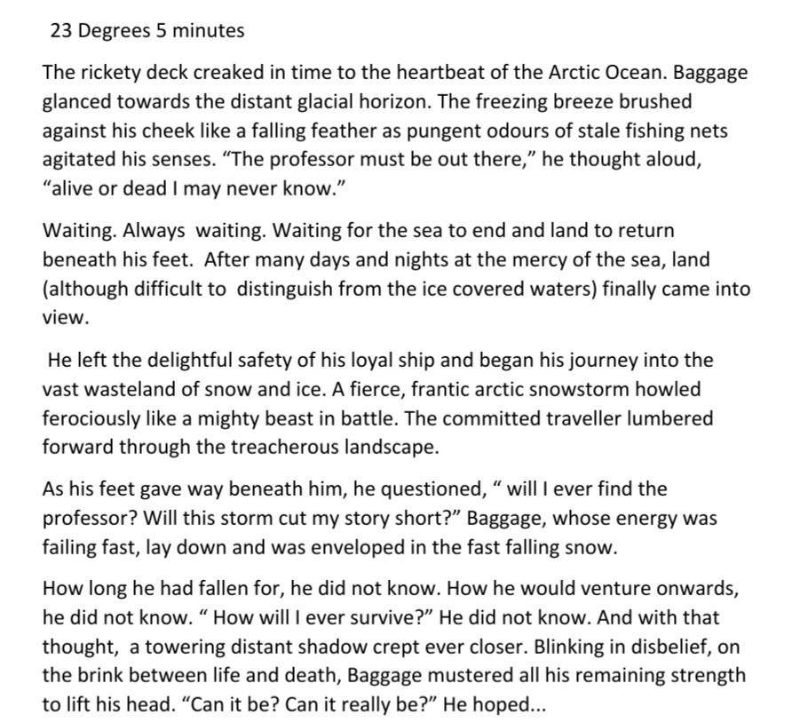
23 Degrees 5 Minutes – Final draft - Lucy

Slide 7
23 Degrees 5 Minutes – Final draft - Isla
23 Degrees 5 Minutes
By Isla
Babbage was so interested about what lay ahead although he was frightened. Leaving the dock, looking back, sort of regretting it. All these dreadful thoughts going through his head “oh no we all might crash, what if I fall in? I could even be seasick oh well ill be able to survive.” Babbage was trying to stay positive. He was as cold as a frozen ice cube but that did not stop him from having the fear of not being able to find any clues or professor Orit in the North Pole.
He had now been on the boat for at least 5 hours standing on the boat feeling quite anxious of what might happen. Babbage had now got butterflies. His beard looked like it had now turned to ice. Really wanting to find the 23 degrees and 5 minutes. Snow and ice was all around him he was shivering like crazy. Trying not to stand up, he saw something in the distance; it was a collosal sized ice burg. Running like a tiger to catch its pray, to the captain warning him but luckily the captain (Harnold) already knew. Babbage was speaking to his explorer friends telling them about what he was going to do and this journey and asking what they were all going to do when they got there. Throughout the voyage he was trying not to be sick but there was one really important thing that he had to do which was preparing all of his science equipment for his search.
Now that Babbage had arrived on dry land he had no time to waste. An hour into this once in a life time journey he had fainted into the thick, deep freezing snow but then all of a sudden in the area he heard this really deep voice, he didn’t see anything though. His head just flopped back into the snow then he heard it again this time he saw it .There it was.

Slide 8
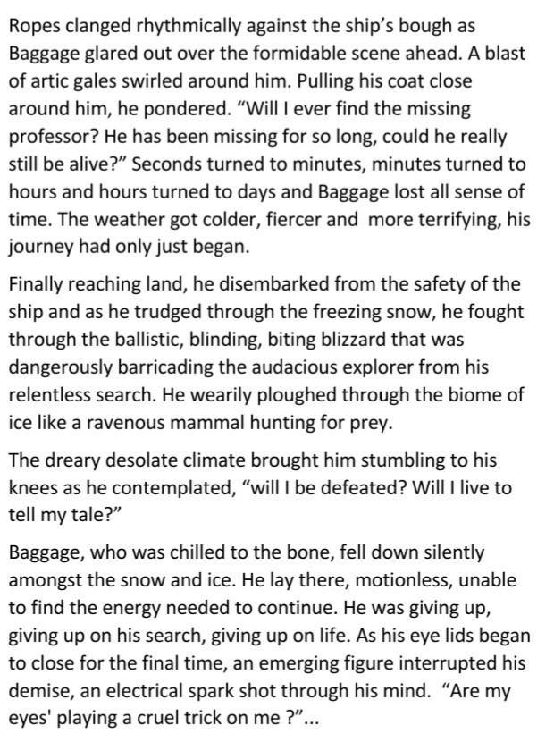
23 Degrees 5 Minutes – Final draft - Katie

Slide 9
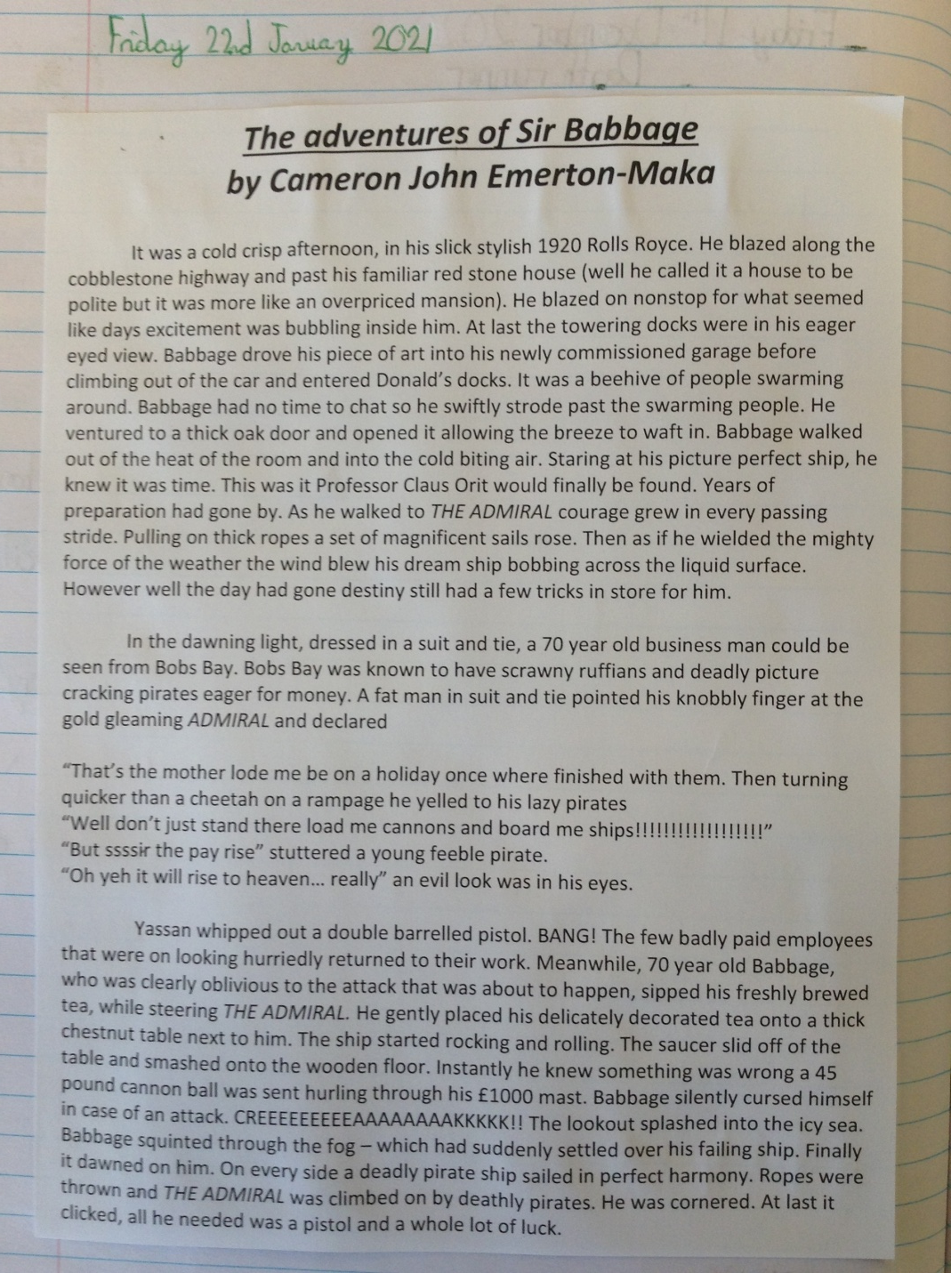
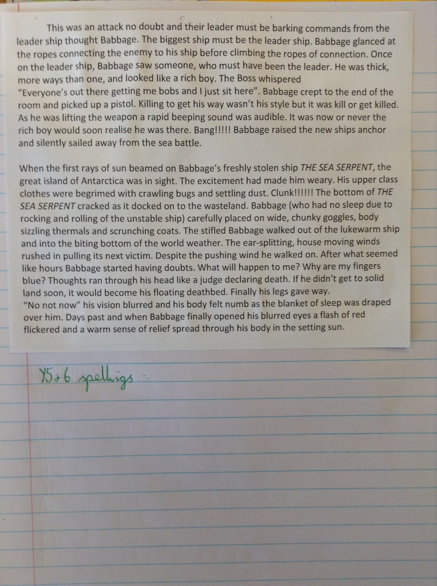
23 Degrees 5 Minutes – Final draft - Cameron

Slide 10
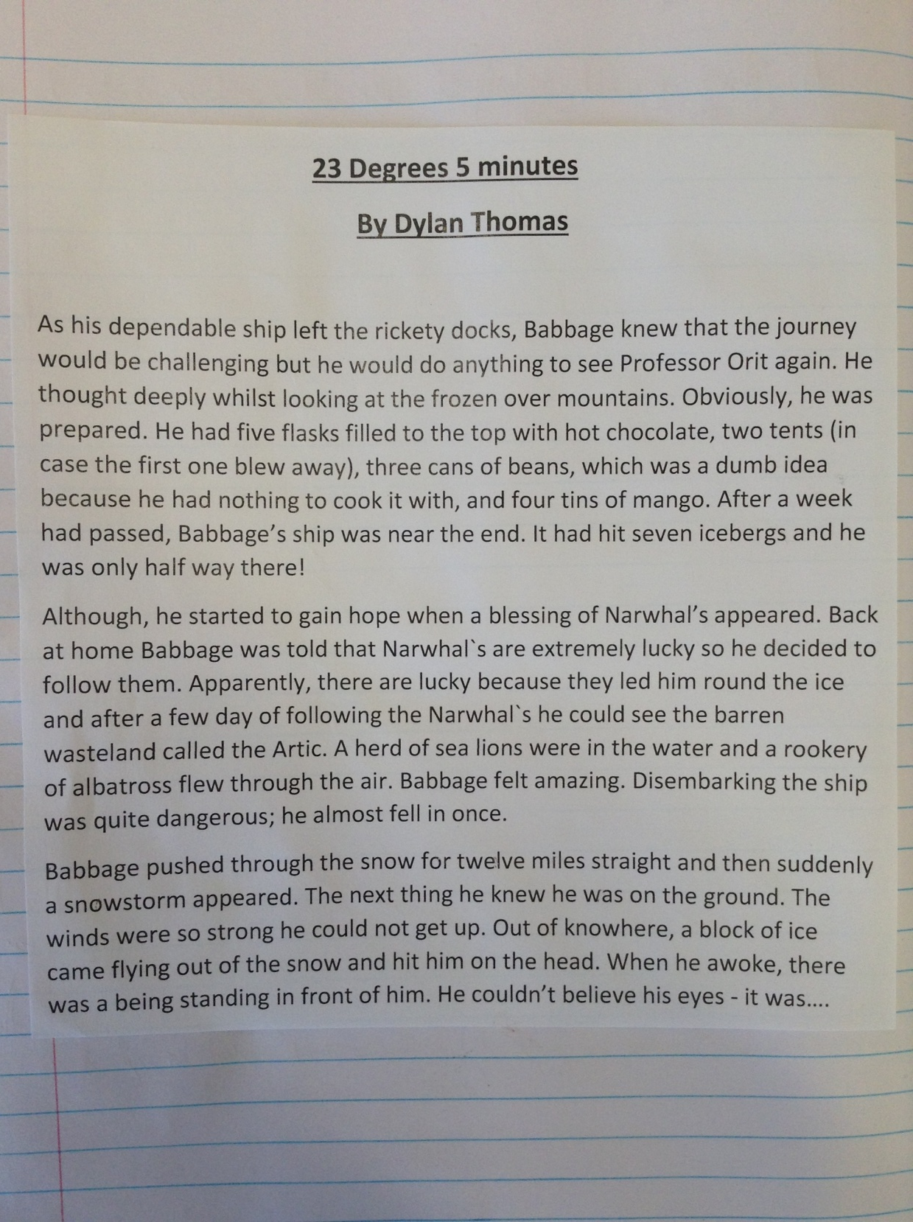
23 Degrees 5 Minutes – Final draft - Dylan

Slide 11
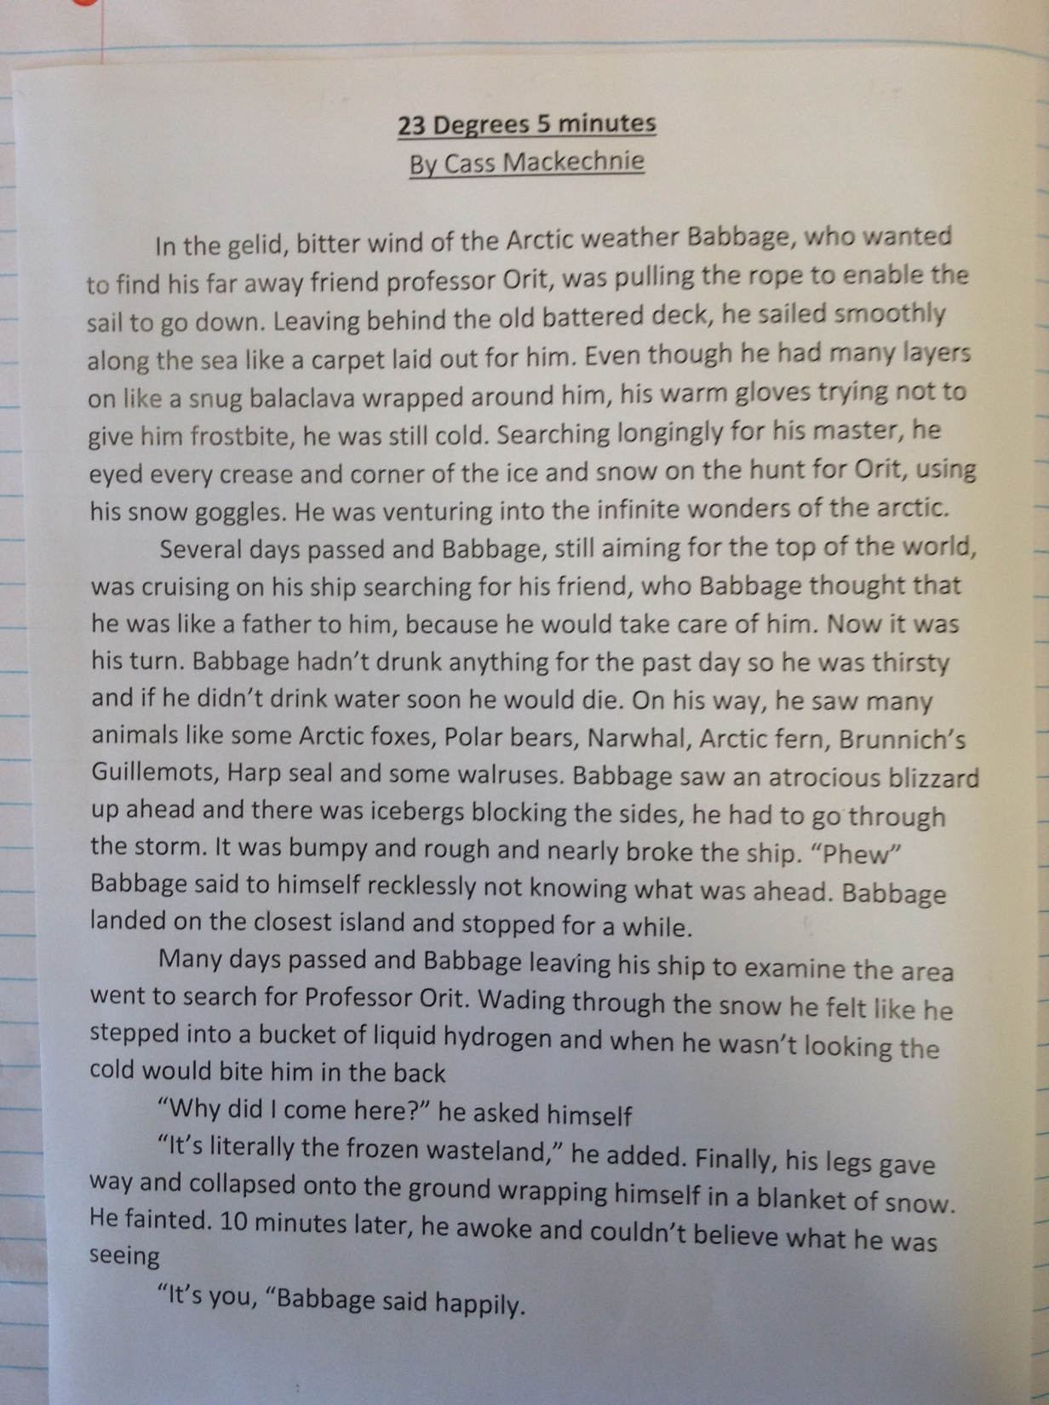
23 Degrees 5 Minutes – Final draft - Cass

Slide 12
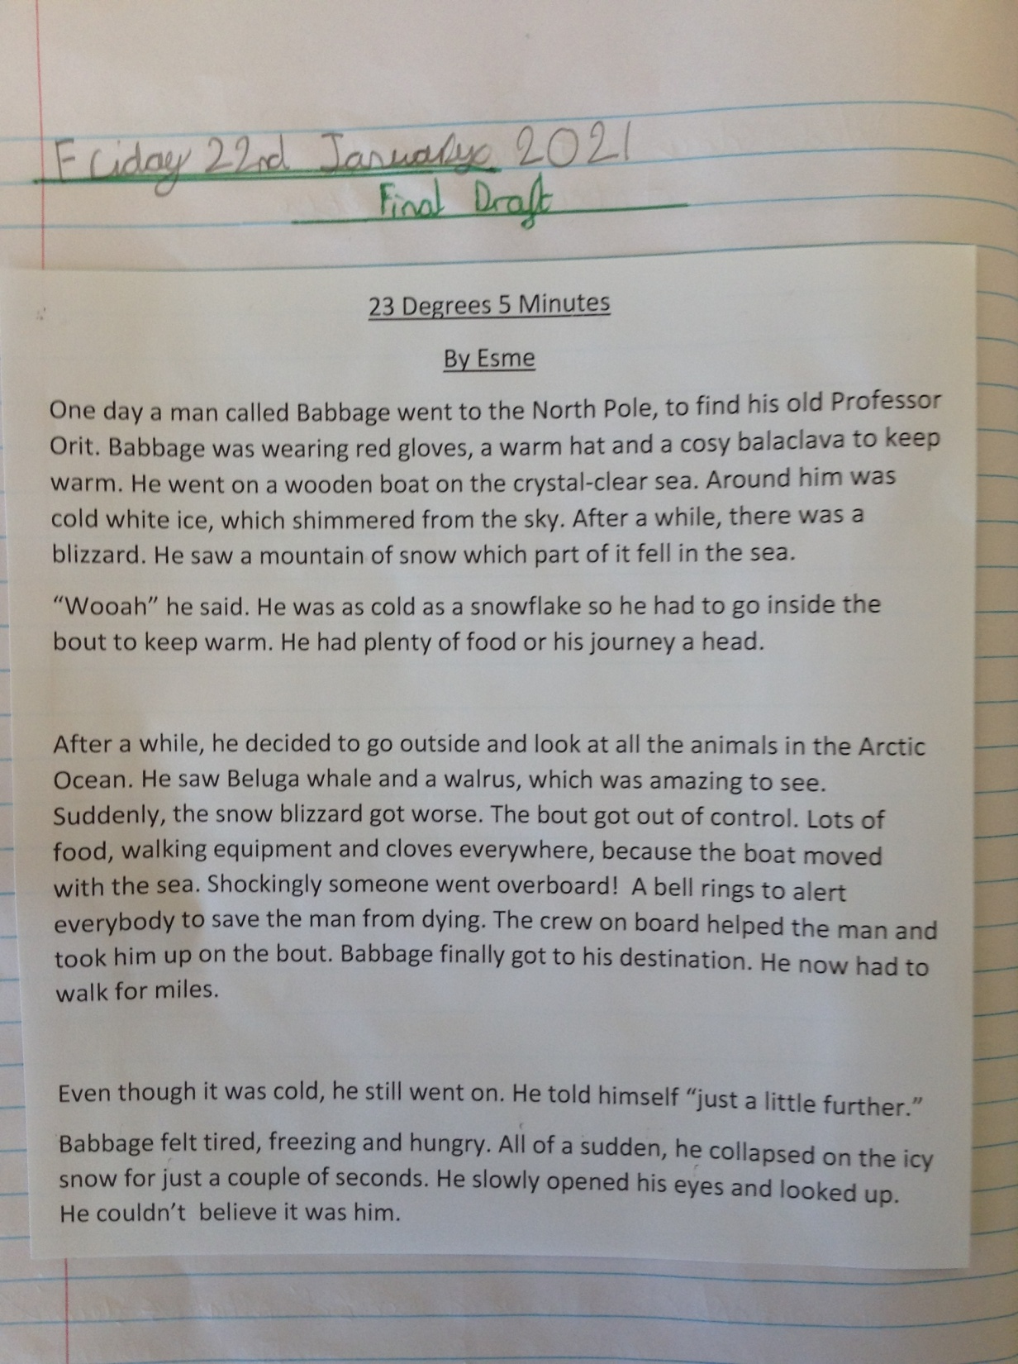
23 Degrees 5 Minutes – Final draft - Esme

Slide 13
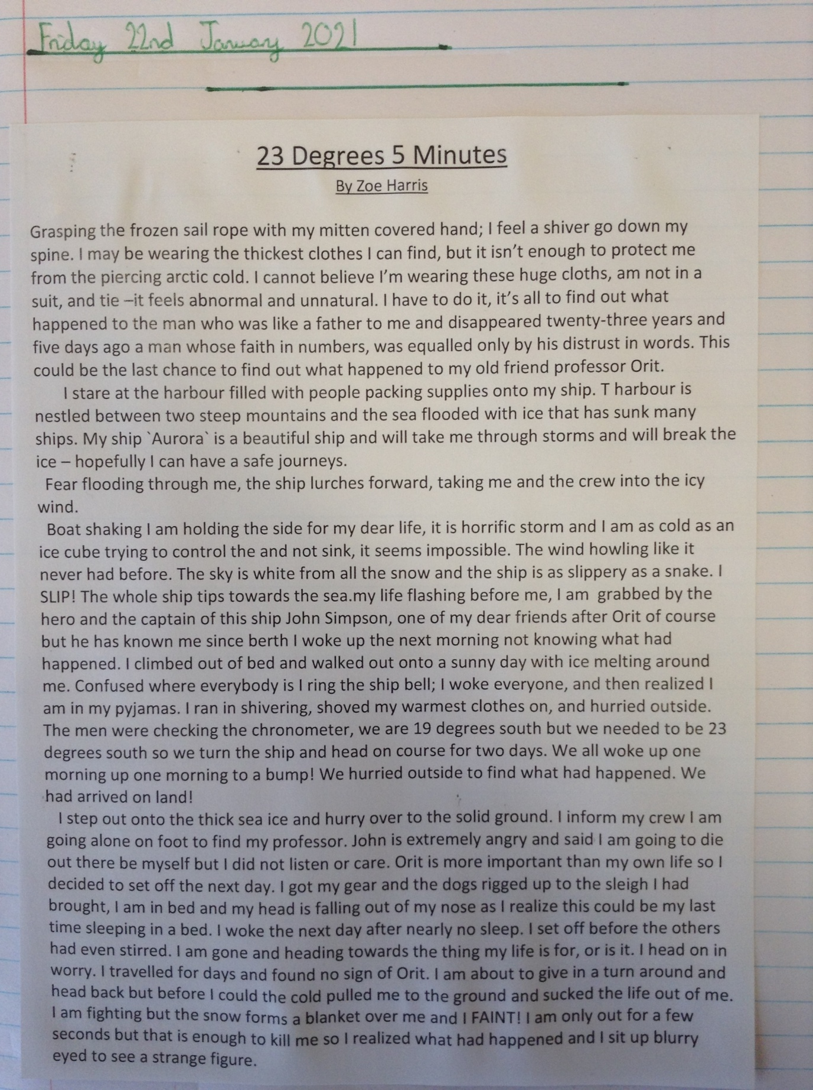
23 Degrees 5 Minutes – Final draft - Zoe

Slide 14
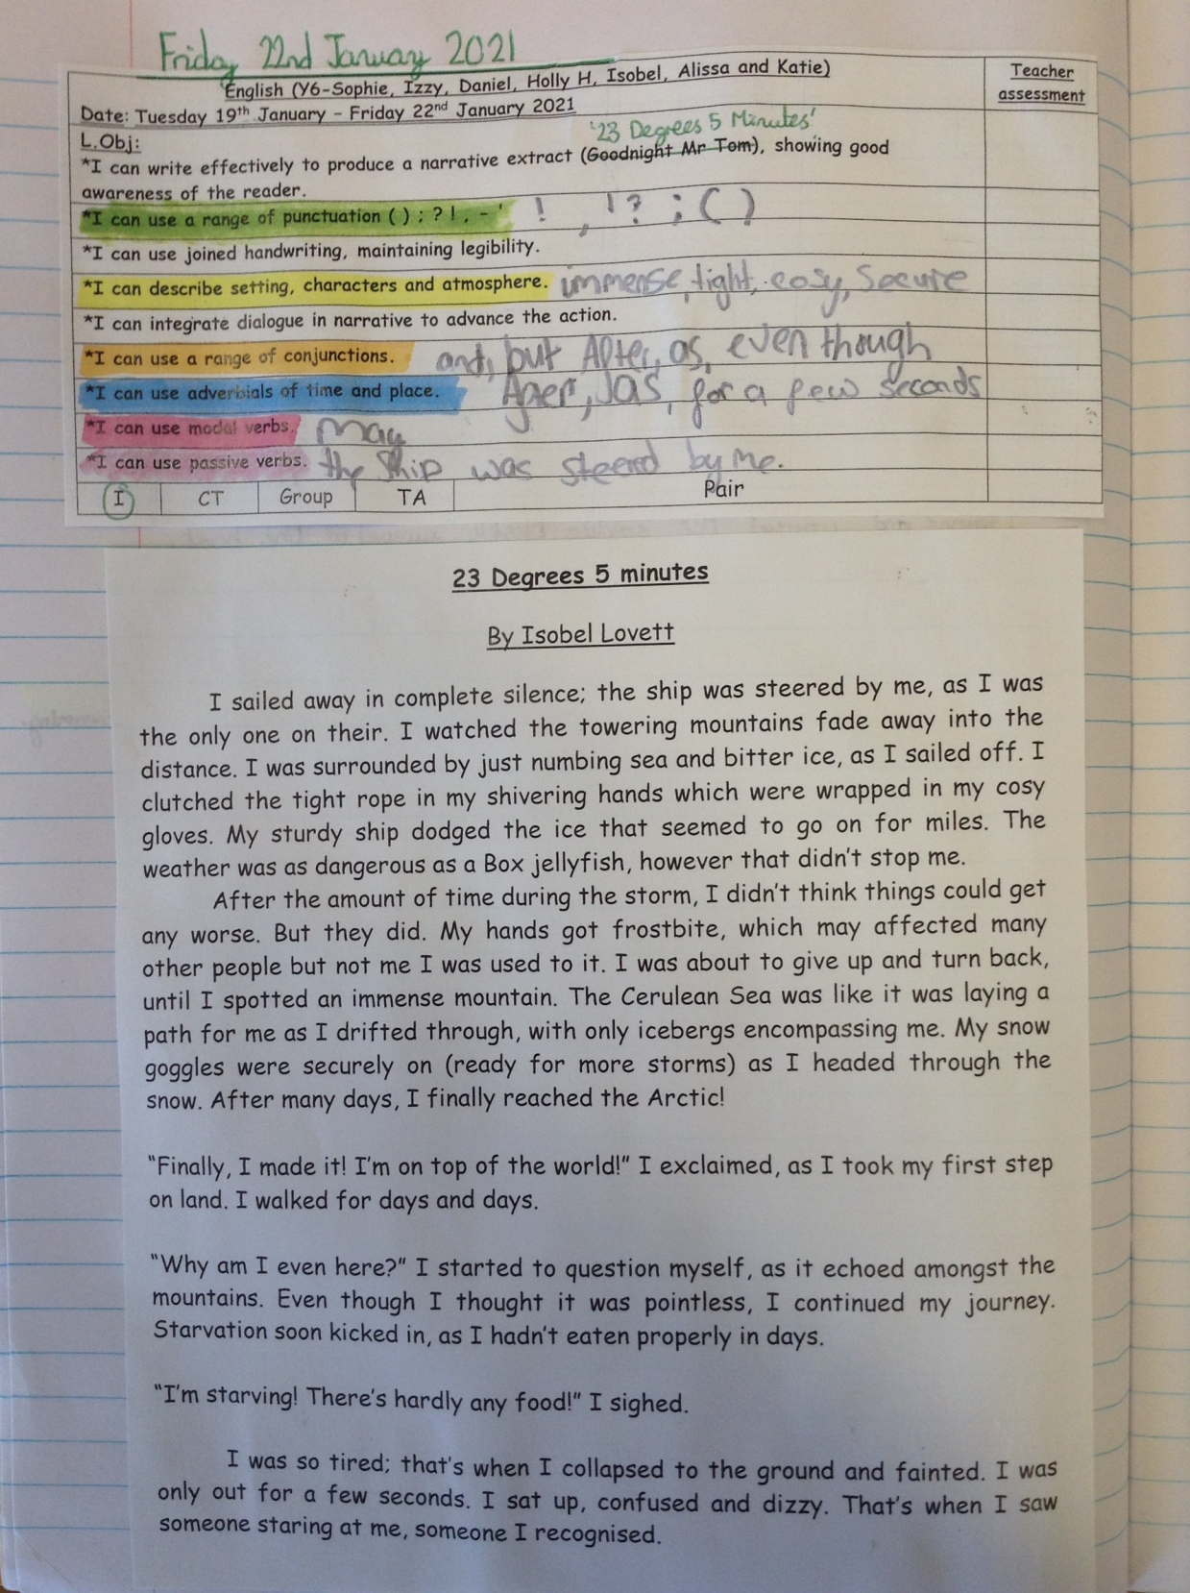
23 Degrees 5 Minutes – Final draft - Isobel

Slide 15
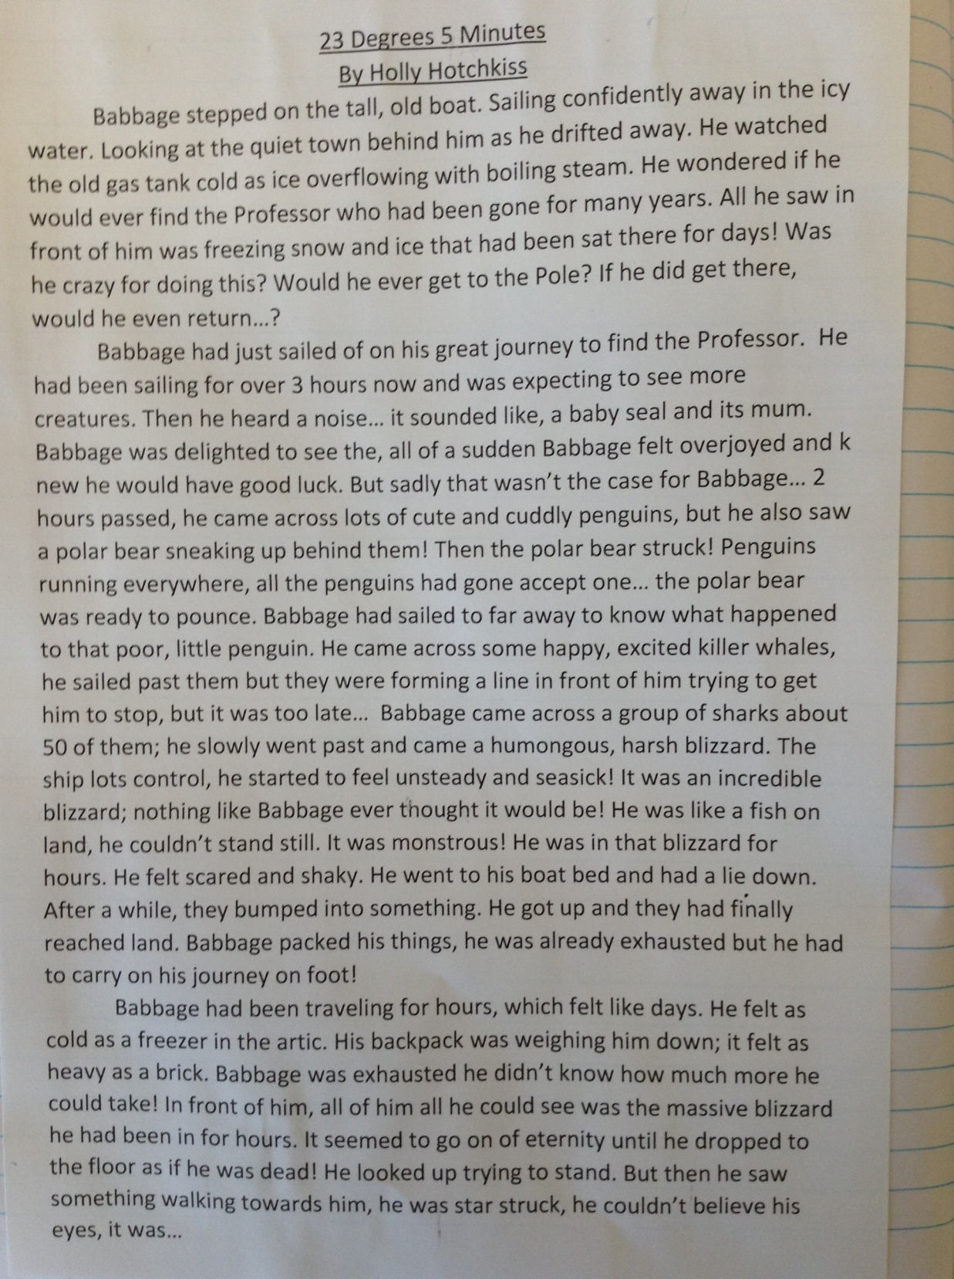
23 Degrees 5 Minutes – Final draft – Holly H

Slide 16
23 Degrees 5 Minutes – Final draft - Amy
23 Degrees, 5 Minutes
The icy wind blew bitterly on the rusty, disused fishing village of Nord. Hulls and sterns creaked as old boats shifted, singing a mournful shanty about their catching days. Babbage listened to this. It helped him deal with the unforgiving storm that threatened to blow his tiny ship – Duration – away. He mercifully started at some rotting timbers and wondered whether he’d end up like that, alone and forgotten. Snug balaclavas were strung around Babbage’s neck making it difficult to whisper:
“I’ll find you professor.” Without strangling himself. His sails picked up, jolting him forward like a child being pushed and instantly tightening the mainsheet in his gloved hand. University talks with Professor Orit (the man he dedicated himself to find) seemed a lifetime ago, a warm lifetime ago, it became clear to him. He walked into the cabin.
A sharp cracking sound awoke him. Babbage’s weary eyes fluttered open. His dreams had been so full of snow and ice, frostbite and scurvy – Nightmares. The varnished wood ceiling in his cabin was chipped. He uncurled himself from a nest of blankets and staggered onto the bleached deck. The distracting disaster laid out in front of him made him groan; ‘Trusty’ Duration had crashed into an iceberg…
“Of course. What else could go wrong? Will I stay stuck? Why does this have to happen to me?’ he thought. Curses flew at speed through Babbage’s frozen mind. He yanked the steering wheel sharply left and was answered by more creaking, straining noises. He slumped down to the floor, beaten by a berg. Depression overwhelmed him like a polar bears beaty. Polar Bear? Eyes bursting open, heart thumping wildly, he realised that he wasn’t alone on the boat.
Babbage quickly scanned the area. A lone bear was staring intently at him, black, beady pupils peered, strong powerful muscles poised; ready to attack and massacre if needed. It was hungry, starving, deprived of food for weeks. Not merciful. Babbage had a plan.

Slide 17
23 Degrees 5 Minutes – Final draft - Amy
Half an hour later he was prepared. Attached to the mast was a cold corned beef sandwich with a trap underneath. Hopefully, the bear would move towards the lunch, get trapped and end up upside down hanging from the boom helplessly. That was the idea.
Minutes later a munching sound came from the trap. Babbage peeked over the rim of his empty tank barricade and was shocked. The polar bear and sandwich had disappeared. Where had it gone? Looking to his optimistic side, he said “Well at least it’s vanished.” He walked over to the empty net and accidently stumbled on a loose rope. Babbage fell, head over heels, into his own trap.
“Help!” he whimpered knowing that no-one would come. Blood rushed to his head as he attempted to swing from side to side, trying to reach a small penknife in case of an emergency. Babbage nearly had it in his grasp when THUD! Duration lurched violently backwards, the knife skittered into a heap of boxes and became out of reach. He viciously cursed to the sallow snow and acrimonious ice. First the iceberg, next the polar bear and now this. The boat juddered again bouncing him up and down like a yoyo, he glanced up sharply and noticed the rope snapping.
It took another three movements to dislodge the rope, Babbage crashed noisily into a heap. His head throbbed, and he landed on a weird angle, everywhere hurt. But he wasn’t giving up. The Professors words echoed around his head ‘You work for it, you get it’ Babbage staggered to the side of the boat and gasped. He was looking into the malicious eyes of a pod of orcas.
Six sleek heads glanced up at him, each one as pure as the other, they menacingly opened their mouths and displayed their sharp teeth. Each was as sharp as a dagger blade, all 48 of them.

Slide 18
23 Degrees 5 Minutes – Final draft - Amy
Shaking in terror, Babbage feared the worst – they were here to eat him. He wondered if anyone would search for his mangled body, know who he was. How had everything gone so wrong? The orcas shut their mouths and prepared to leap at him. Babbage had another plan… better than the last one. Probably.
He raced toward the imprisoning iceberg at top speed and threw himself onto it. “Hey!” he cried “I’m over here, you big brainless dolphins!” That got their attention. They swerved away from Duration and started to bombard the big ice cube with tail hits, thumping and whacking. The boat groaned its captor moving around in the water dragging it along.
“Hang on old girl.” Babbage orated, trying to stay on top of the floating ice. He had realised that if the orcas hit the berg with enough force the boat would be dislodged and would sail away to the Arctic ice. Duration moaned again; the hull was punctured; she was sinking. Babbage groaned as loud of his ship; luck had completely disappeared. He dived back onto his ship and grabbed the vitals – some matches, his penknife, food, a couple of blankets, a compass, and a thermal bag to keep them in. Grabbing a wooden lifeboat from it’s hold, he pushed it into the calm water and leaped in rowing away from the carnage behind him.
Minutes turned to hours turned to days as Babbage lived and battled the waves on the small boat, heading north. He was at the mercy of the elements, snowstorms, hailstorms and sleet storms battered him to the bone and many times he felt like his fingers were being bitten off. Day 12 of the voyage – land in sight. Babbage nearly jumped off the rocking boat in joy. It took another three hours to reach the ice mass and by the time his weary feet set foot on land, he felt ready to give up. His arms ached from rowing, and his stomach felt seasick. “What was I thinking? Going to this frozen wasteland at the top of the world.” He questioned himself.

Slide 19
23 Degrees 5 Minutes – Final draft - Amy
Miles upon miles of snow stretched out as far as the eye could see, a strange stillness hung in the cold air. Babbage shivered; he’d never seen anything so barren. He discarded the boat and trekked on, the horizon seeming further and further away the more he walked. Blasting breezes whipped the knee-high snow into a panicked frenzy, creating a swarming blizzard. Through the icy landscape Babbage walked, never stopping but occasionally resting for moments. The hours dragged on until he collapsed out of pure exhaustion. “Would I really find him here?” he asked the enveloping snow. Doubt ran rife through his head.
Out of the deep blue, Babbage lifted his face out the snow “Good God!” he gasped. Someone was standing in front of him.

Slide 20
23 Degrees 5 Minutes – Final draft - Blake
23 Degrees 5 Minutes
While he gazed into the horizon, pensively, he pondered, “Will I ever find him?”. The treacherous journey ahead of him was long and dangerous and he didn’t know what to expect. He found himself worrying if he’d ever see his home again. He thought anxiously to himself, “What if I succumb to hypothermia?”. He ensured that he packed all the vital equipment and the warmest clothes possible to fend off the bitter ice-cold weather. Even though Babbage felt prepared he was nervous and apprehensive about what lay ahead. Standing on the deck of the boat, he watched his home shrink into the distance and readied himself for the adventure of a lifetime. Little did he know that he would have to overcome numerous obstacles in order to reach his goal.
During his first few hours on board, he began to feel nauseous. The gentle swaying of the boat made his head spin causing him to vomit over the side of the deck into the ocean. A few days passed by and he eventually found his ‘sea legs’ so he didn’t feel sick anymore. Even though Babbage was feeling physically better, he still worried if he and his crew would ever reach their destination in one piece.
Most days the weather was pleasant but the further they ventured, the more vicious the weather became. One gloomy night, there was a massive storm raging outside their ship; fears rushed into his head, “Would the boat capsize?” and if it did “Would we survive long enough to be rescued?”. The heavy rain thrashed and the destructive waves crashed into them. When the storm died down, they were amazed to see a pod of whales next to their boat.
The whole crew didn’t think things could get any better but they suddenly realised they’d already arrived at their destination (they had not noticed how far they had travelled during the storm due to obscured vision). Their happiness only lasted a short time because the next day an icy blizzard struck their camp.
It was as cold as liquid nitrogen and because of the poor visibility, Babbage became separated from the rest of the group. As he blindly wandered through solid, compacted snow, the weight of his exhaustion and his wet, heavy clothes pulled him down to the ground. He thought despairingly, “Is this the end of the road for me?”. He was so fatigued and weary that he was tempted to give in to the inevitable death that awaited him. He didn’t know how long her was unconscious for but when he awoke, he noticed that the blizzard had lifted. He saw a mysterious shadow in the snow beside him. He squinted upwards and was awe-struck by the sight before him….

Slide 21
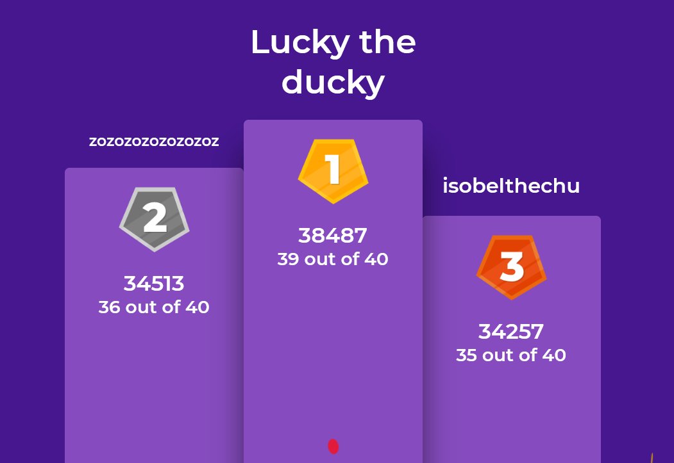
Well done to the Kahoot Maths Champions!

Slide 22
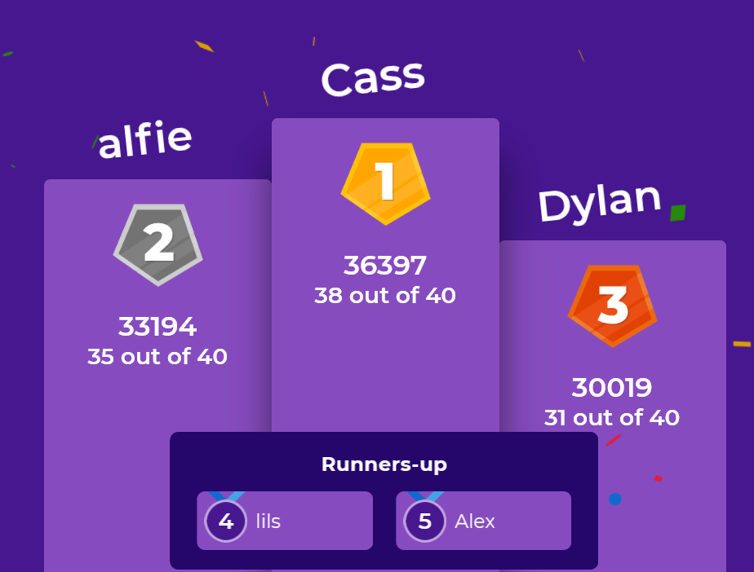
Well done to the Kahoot Maths Champions!

Slide 23
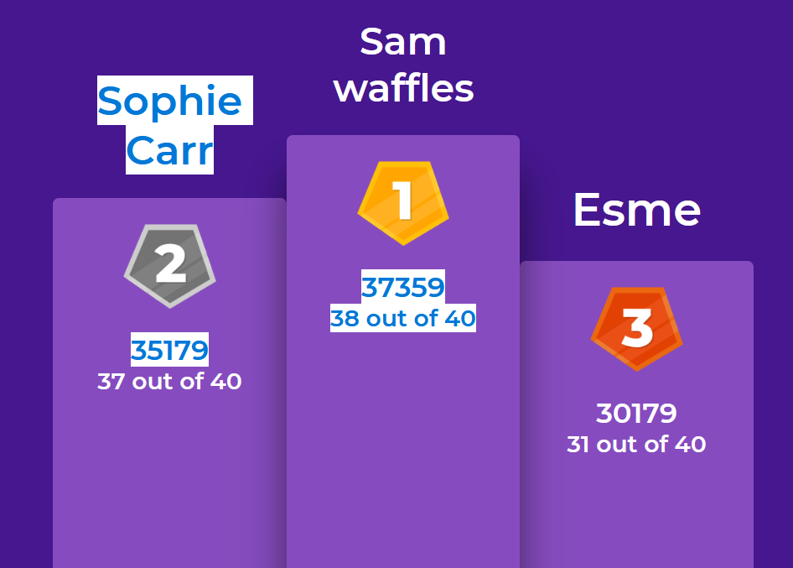
Well done to the Kahoot Maths Champions!

Slide 24
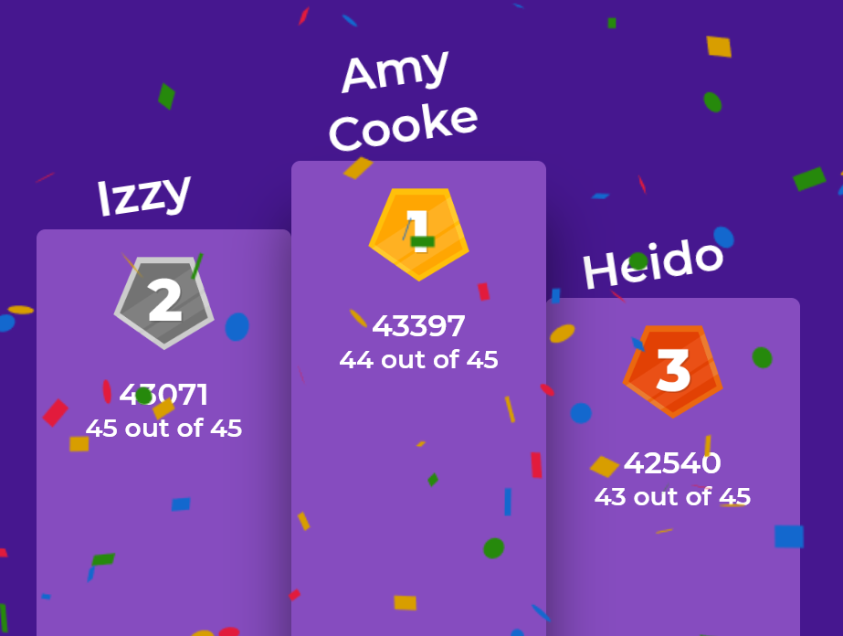
Well done to the Kahoot Maths Champions!

Slide 25
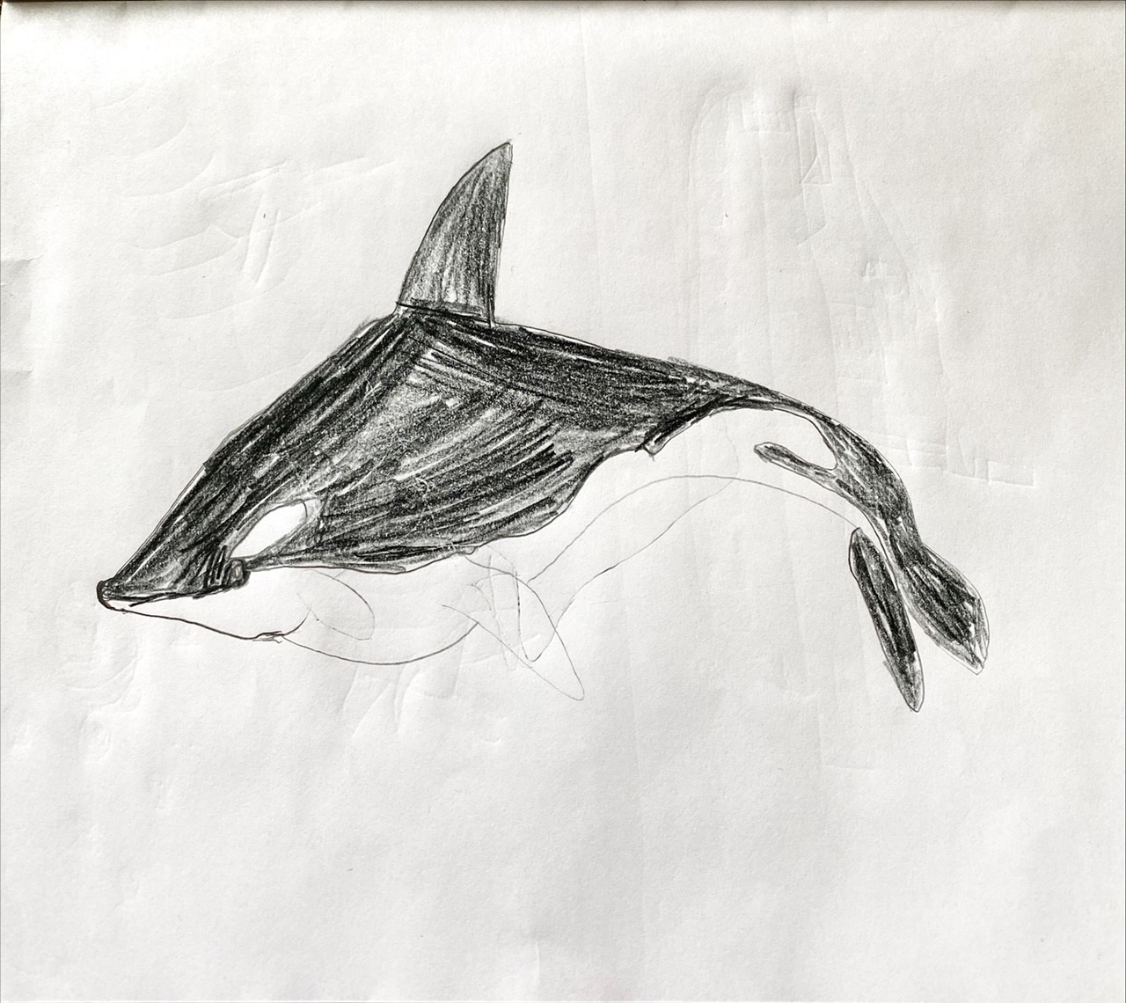
Sam enjoyed producing his killer whale (orca) illustration.

Slide 26
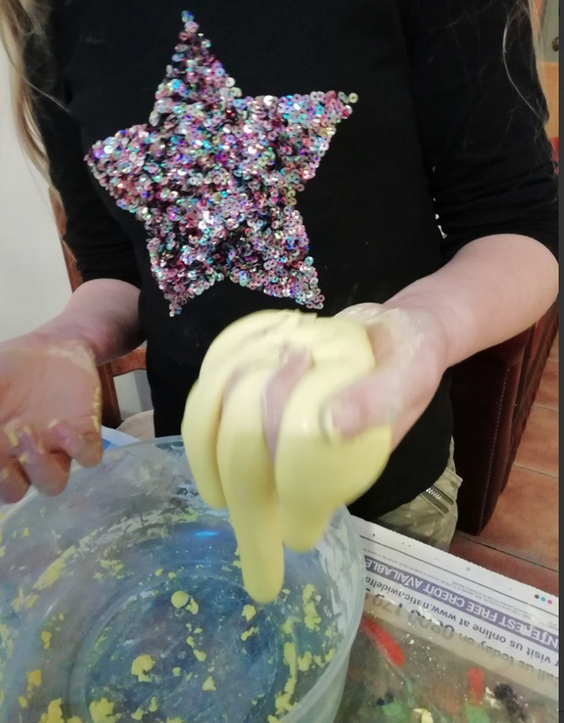
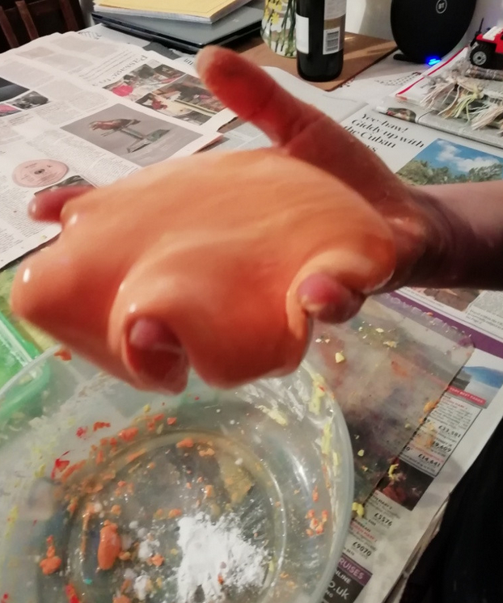
Amy has been making ‘oobleck’ this afternoon.

Slide 27
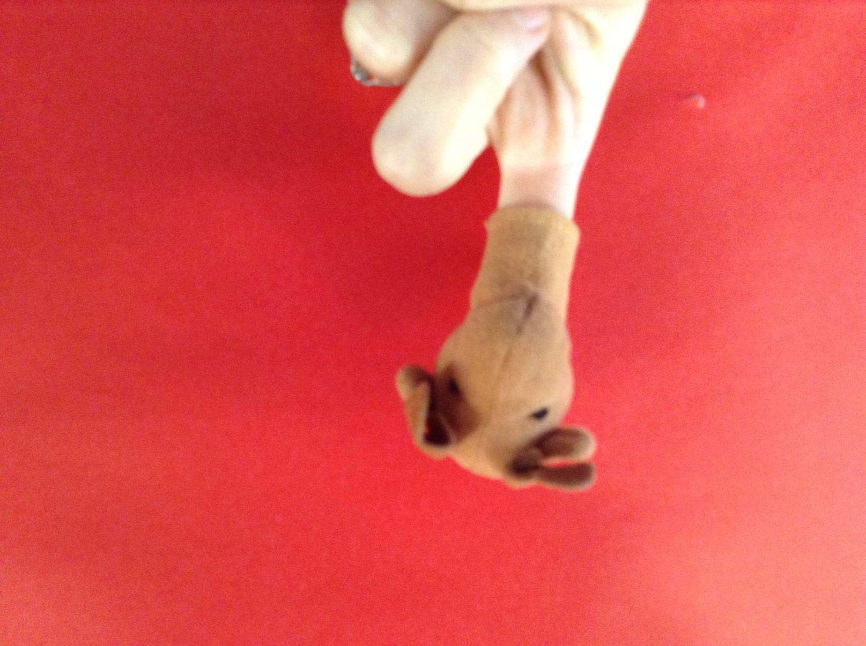
Sadly we said ‘Goodbye’ to Moose today in The Masked Finger, who turned out to be Cass.
The Masked Finger

