Slide 1
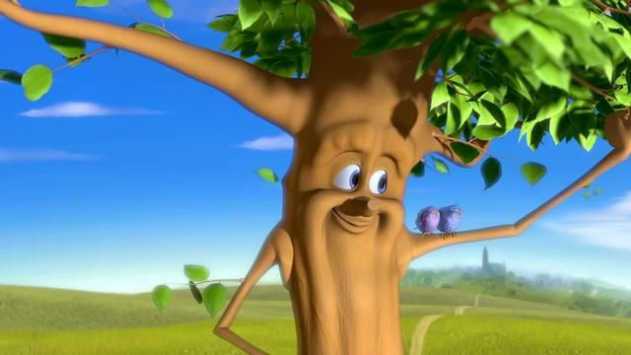
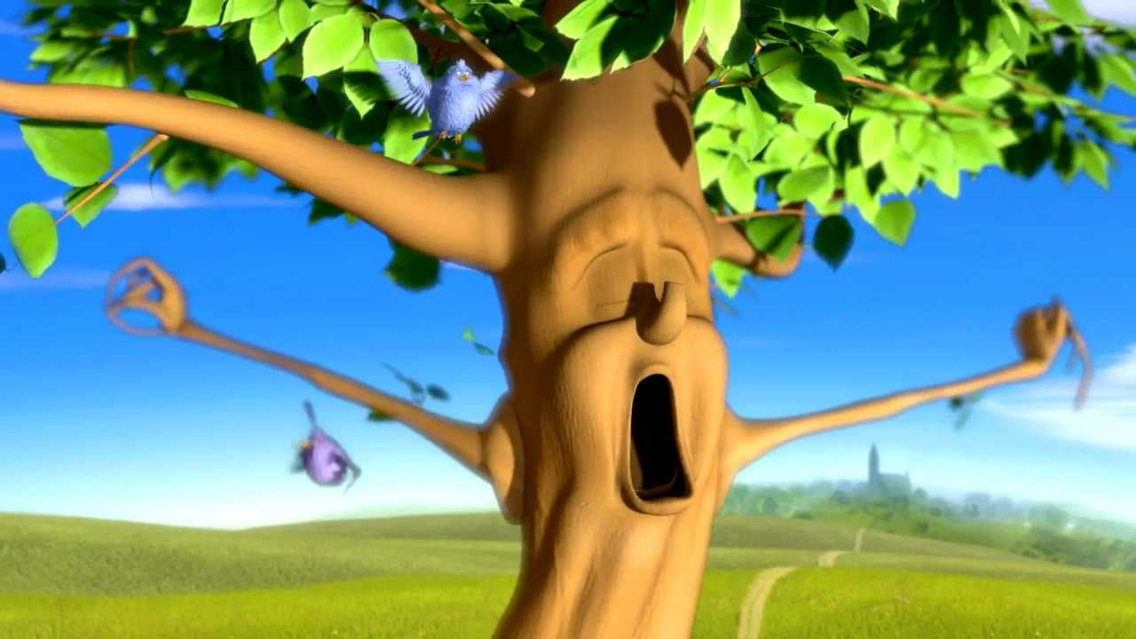
What I’m learning in English today
English – Cold write Date: Tuesday 5th January 2021
*I can recognise and explain the difference between a ‘statement’, ‘question’ and ‘command’ sentence.
*I can write my own short story based on a video clip ‘Two Trees’.

Slide 2
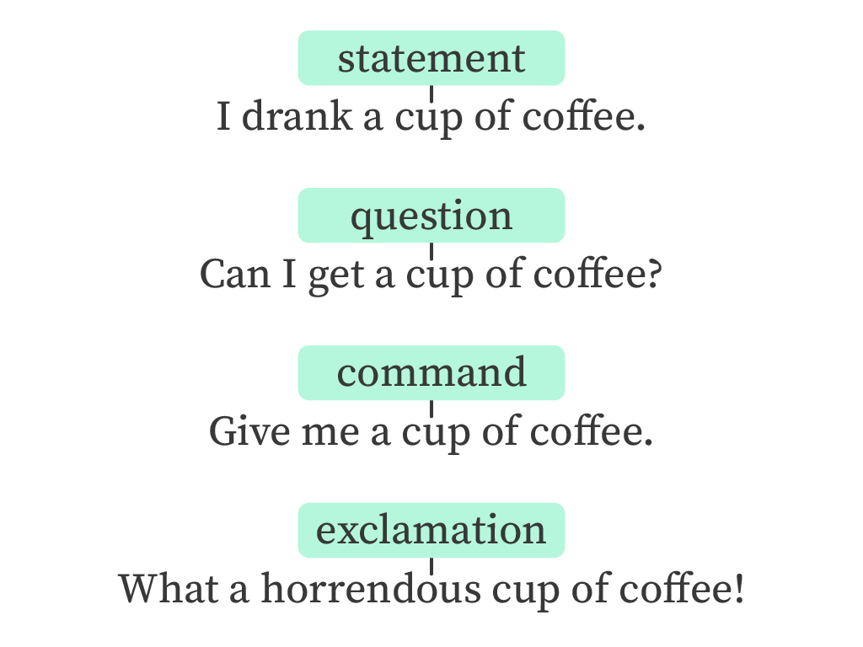
SPaG Starter –
Command, Statement or Question?

Slide 3
I’m so hungry.
Statement:
Gives information without
the need for a response.
Get me some food.
!
Begins with an imperative verb.
Command:
If it is a forceful command, it may end in an exclamation mark.
Can I have something to eat?
Question:
Ends with a question mark.

Slide 7
Can you think of your own example of a statement, question and command?

Slide 8
Two Trees
Click on the link on the school website to watch the short story ‘Rooted’ (Two Trees).

Slide 9
Two Trees
Today, in class, your writing task is a ‘cold’ write.
Write a short story, explaining the events from what you have watched.
You have 1 hour!
(It’s a short story!)
*You can type or write.

