Slide 1
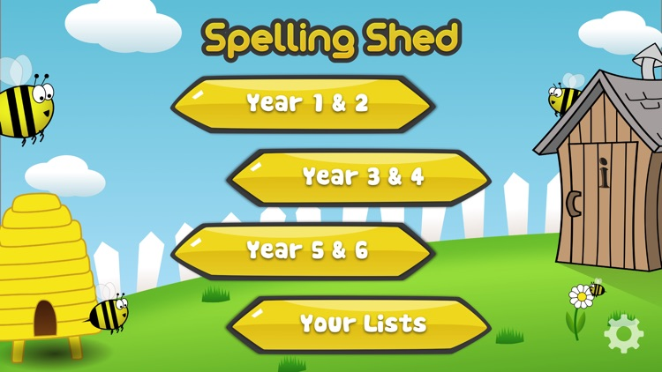
Y5&6 TOP SPELLERS TODAY
1st = Jack 29 points
2nd = Cassie 17 points
3rd = Holly H 10 points
4th = Harvey 8 points
5th = Rhys 8 points
6th = points
7th = points
8th –points
9th = point
These are the amount of dojos you have received for your efforts today!
Everybody else earns 1 dojo for practising their spellings today!

Slide 2
What have the Y5&6s been
studying today at home?

Slide 3
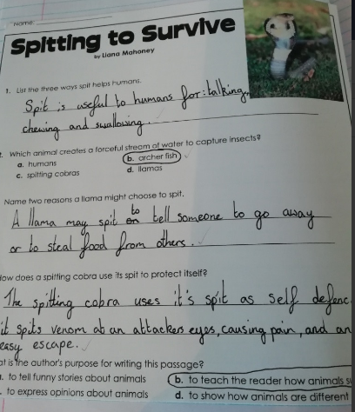
Here’s what Y5&6 have been focusing on at home today
Amy has read the text carefully to answer the questions.

Slide 4
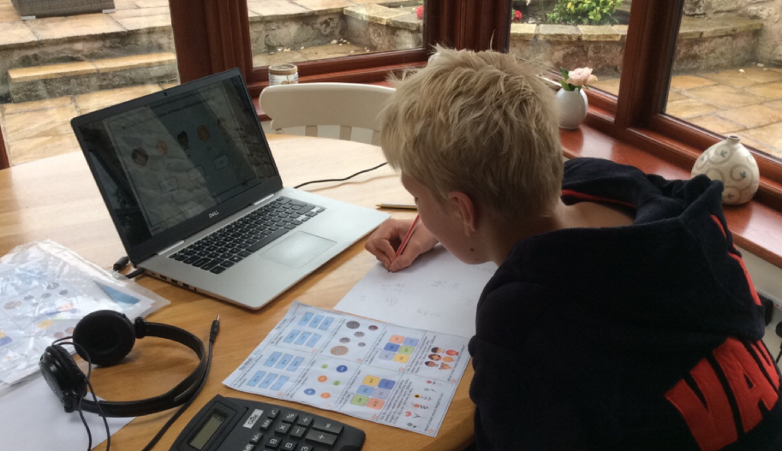
Here’s what Y5&6 have been focusing on at home today
I’m busy this morning.

Slide 5
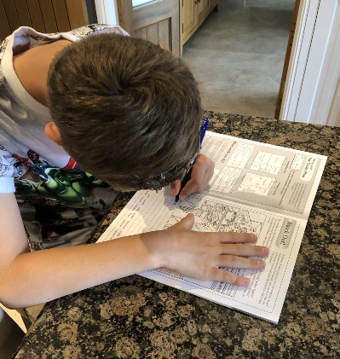
Here’s what Y5&6 have been focusing on at home today
Harvey is enjoying completing his Crucial Crew work.

Slide 6
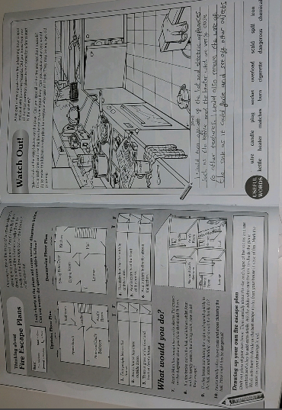
Here’s what Y5&6 have been focusing on at home today
Dante is enjoying completing his Crucial Crew work.

Slide 7
Here’s what Y5&6 have been
focusing on at home today.

Slide 8
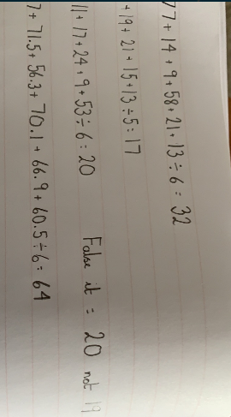
Here’s what Y5&6 have been
focusing on at home today.
Cassie has been using addition and division to calculate the mean.

Slide 9
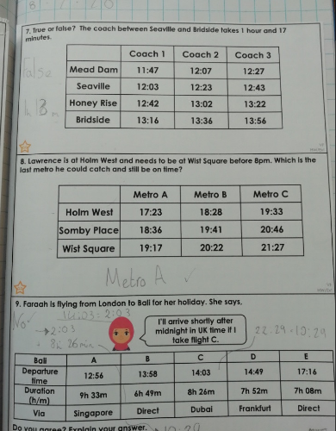
Here’s what Y5&6 have been
focusing on at home today.
Amy has solved the timetable problems

Slide 10
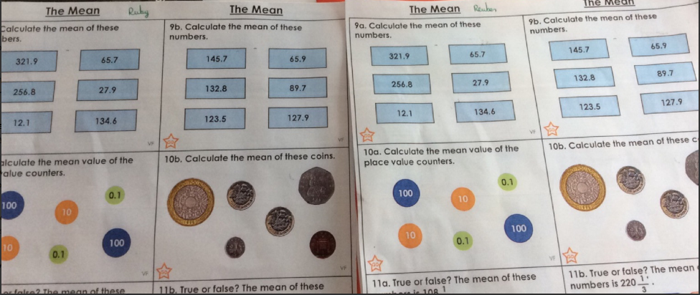
Here’s what Y5&6 have been
focusing on at home today.
Reuben has been using addition and division to calculate the mean.
He’s also chosen to complete Ruby’s too!

Slide 11
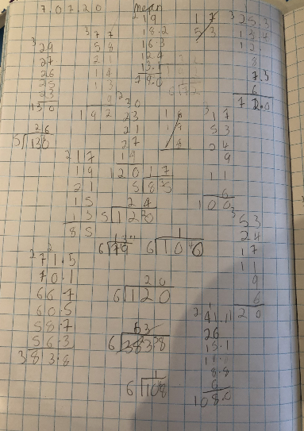
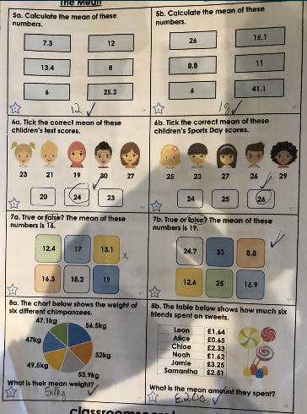
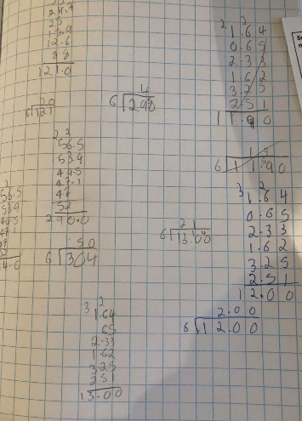
Here’s what Y5&6 have been
focusing on at home today.
Harvey’s workings out to solve the ‘mean’.

Slide 12
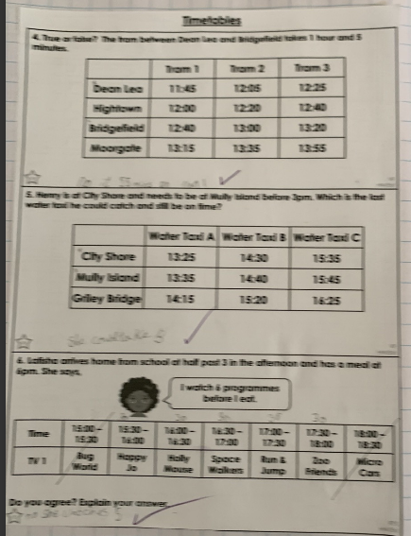
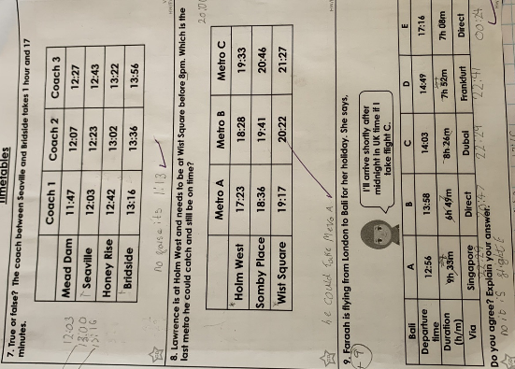
Here’s what Y5&6 have been
focusing on at home today.
Zoe has solved the timetable problems.

Slide 13
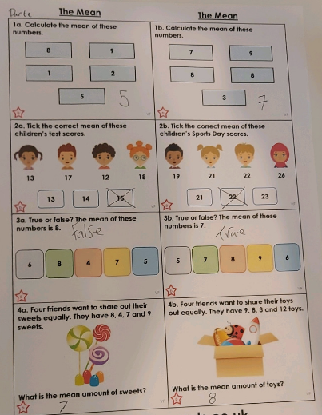
Here’s what Y5&6 have been
focusing on at home today.
Dante has been using addition and division to calculate the mean.

Slide 14
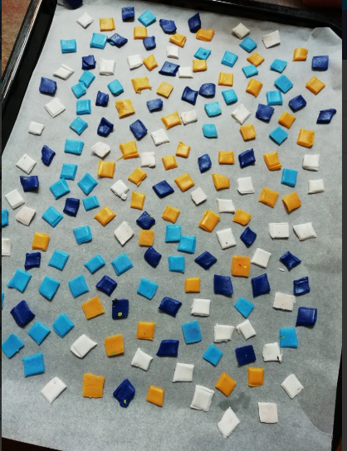
What else have we been doing at home?
Hmmmm wonder what this is going to be?
Baking polymer clay tiles....

Slide 15
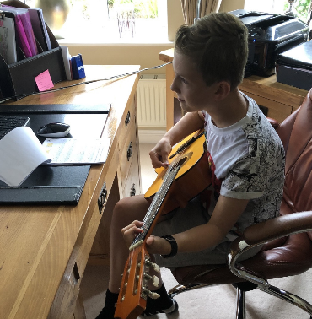
What else have we been doing at home?
I’ve had another guitar lesson this afternoon.

