Slide 1
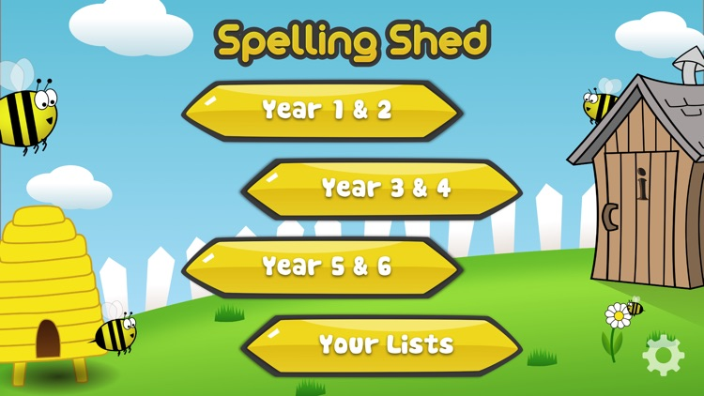
Y5&6 TOP SPELLERS TODAY
1st = Amy and Nelly 21 points
1st = Holly H 18 points
3rd = Katie 14 points
2nd = Cassie 13 points
3rd = Henry 12 points
5th = Lucy 11 points
4th = Jack 10 points
5th = Lily 7 points
6th = Bethany and Chloe 6 points
These are the amount of dojos you have received for your efforts today!
Everybody else earns 1 dojo for practising their spellings today!

Slide 2
What have the Y5/6s been
studying today at home today?

Slide 3
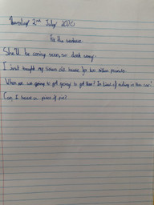
Here’s what the Y5s & Y6s have been focusing on at home today in English.
Harvey has been correcting and improving the sentences with punctuation and spelling mistakes in.

Slide 4
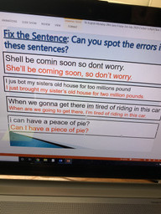
Here’s what the Y5s & Y6s have been focusing on at home today in English.
Henry has been correcting and improving the sentences with punctuation and spelling mistakes in.

Slide 5
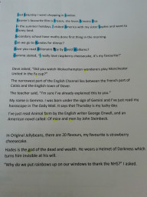
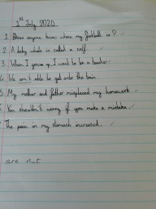
Here’s what the Y5s & Y6s have been focusing on at home today in English.
Amy has been correcting and improving the sentences with punctuation and spelling mistakes in.

Slide 6
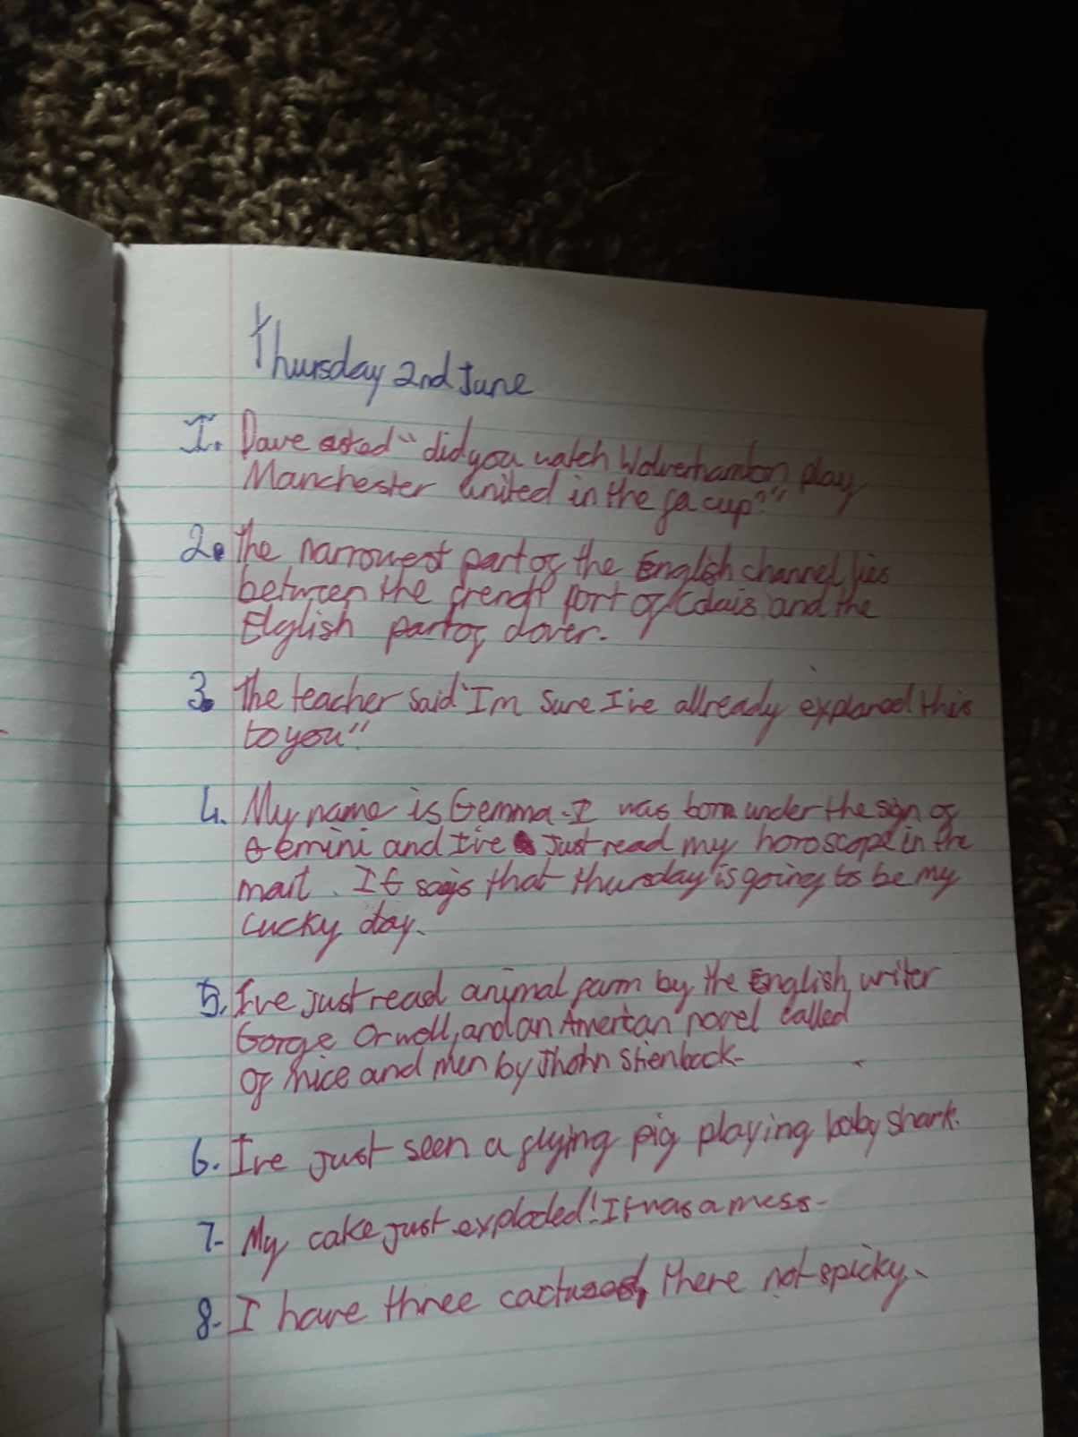
Here’s what the Y5s & Y6s have been focusing on at home today in English.
Katie has been attempting to make the corrections to the capital letters in these sentences.

Slide 7
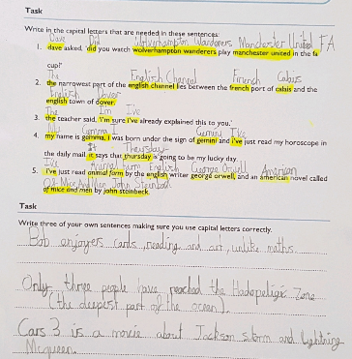
Here’s what the Y5s & Y6s have been focusing on at home today in English.
Cameron has been making the corrections to the capital letters in these sentences.

Slide 8
Here’s what Y5&6 have been
focusing on at home today.

Slide 9
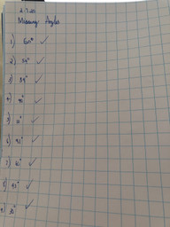
Here’s what Y5&6 have been
focusing on at home today.
Harvey has been solving the missing angles inside the triangles.

Slide 10
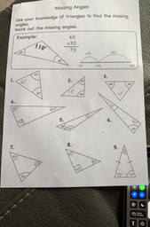
Here’s what Y5&6 have been
focusing on at home today.
Cassie has been solving the missing angles inside the triangles.

Slide 11
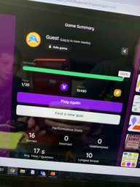
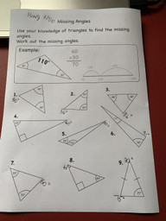
Here’s what Y5&6 have been
focusing on at home today.
Henry has been solving the missing angles inside the triangles as well as playing the quadrilaterals quiz.

Slide 12
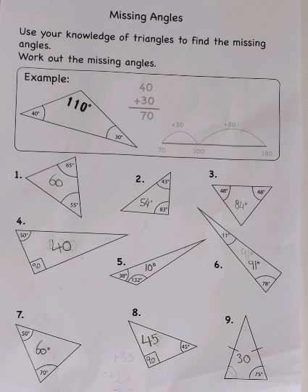
Here’s what Y5&6 have been
focusing on at home today.
Dante has been solving the missing angles inside the triangles.

Slide 13
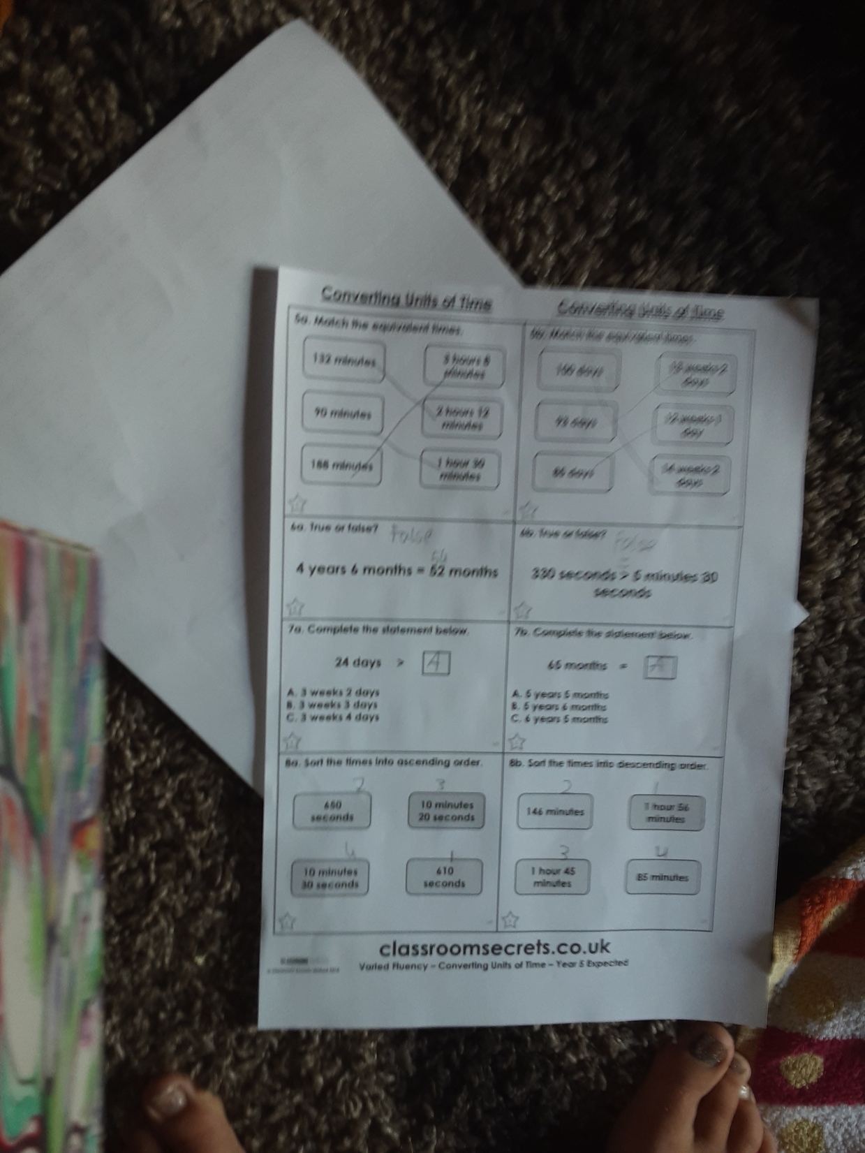
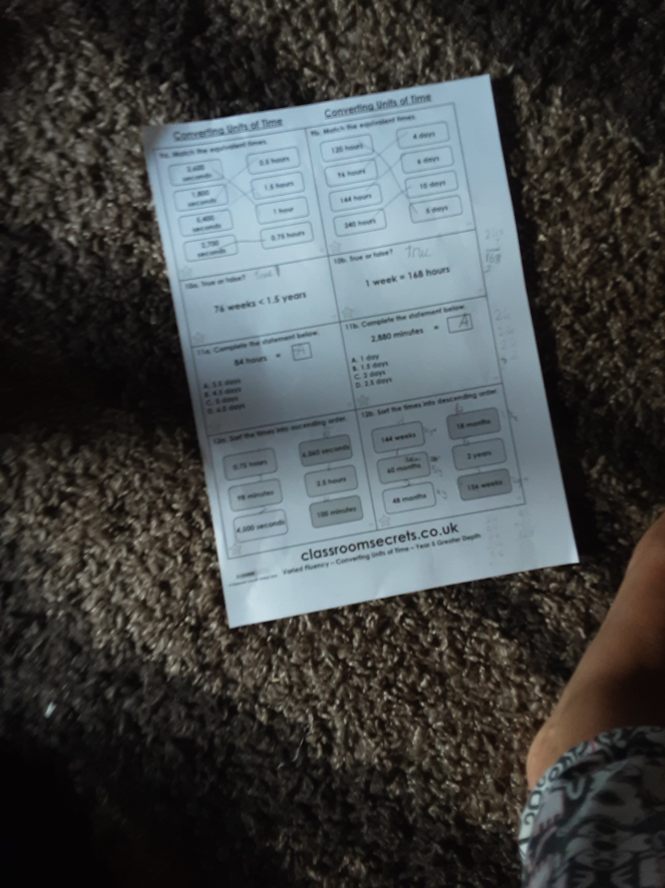
Here’s what Y5&6 have been
focusing on at home today.
Katie has been showing her understanding of ‘time’ to help her to make the conversions or solve the problems.

Slide 14
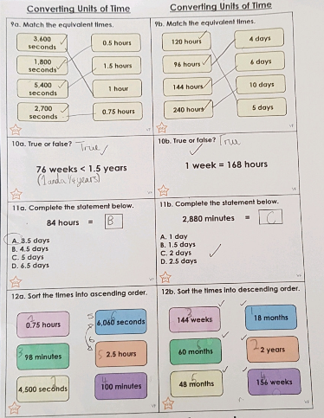
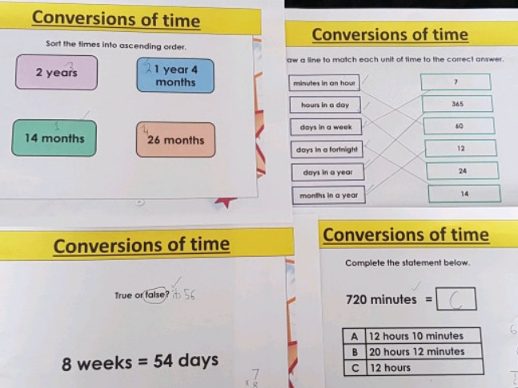
Here’s what Y5&6 have been
focusing on at home today.
Cameron has been showing his understanding of ‘time’ to help his to make the conversions or solve the problems.

Slide 15
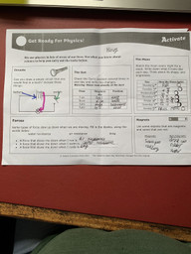
What else have I been doing at home today?
Henry has now completed his Science transition activity ready to be delivered to his new Science teachers at the Corbet School.

