Slide 1
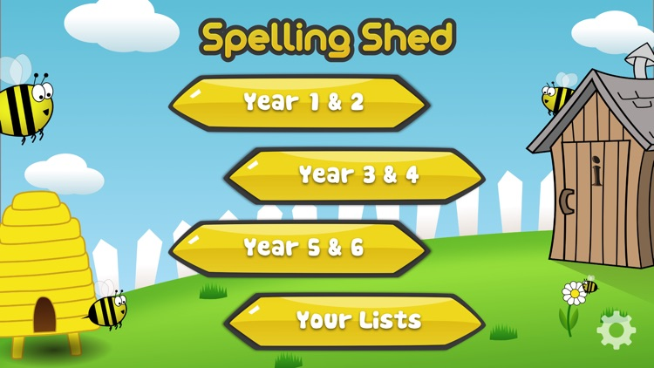
Y5&6 TOP SPELLERS TODAY
1st = Henry 23 points
2nd = Jack 17 points
3rd = Nia 13 points
4th = Ruby 6 points
5th = Bethany 5 points
6th = Chloe, Megan Reuben and Harvey 4 points
7th = Elizabeth, Lily and Holly H 3 points
8th = Zac 1 point
9th = points
These are the amount of dojos you have received for your efforts today!
Everybody else earns 1 dojo for practising their spellings today!

Slide 2
What have the Y5s been
studying today at home?

Slide 3
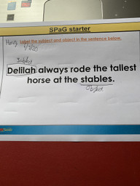
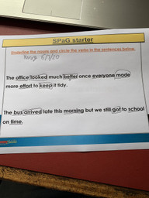
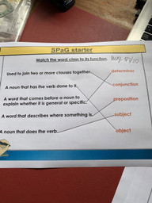
Here’s what Y5 have been focusing on at home today
Henry has been locating the different types of word classes in these sentences.

Slide 4
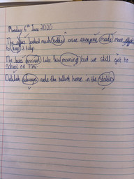
Here’s what Y5 have been focusing on at home today
Harvey has been locating the different types of word classes in these sentences.

Slide 5
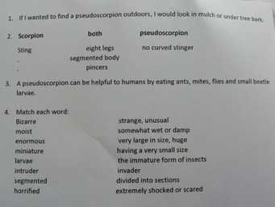
Here’s what Y5 have been focusing on at home today
Amy has been reading the text carefully to show her understanding.

Slide 6
Here’s what Y5&6 have been
focusing on at home today.

Slide 7
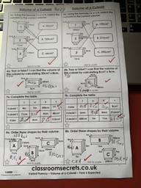
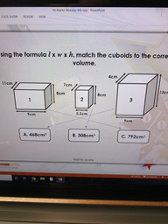
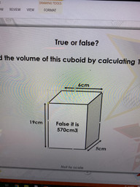
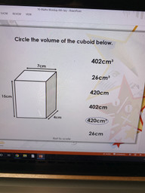
Here’s what Y5&6 have been focusing on at home today.
Henry has been attempting to solve these ‘volume’ based problems and calculations using ‘length x width x height’ as his method.

Slide 8
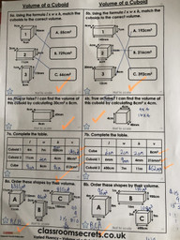
Here’s what Y5&6 have been focusing on at home today.
Harvey has been attempting to solve these ‘volume’ based problems and calculations using ‘length x width x height’ as his method.

Slide 9
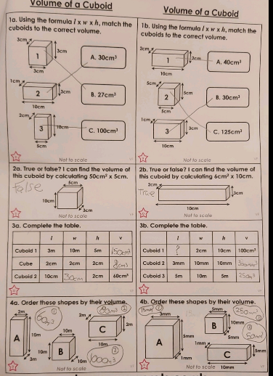
Here’s what Y5&6 have been focusing on at home today.
Dante has been attempting to solve these ‘volume’ based problems and calculations using ‘length x width x height’ as his method.

Slide 10
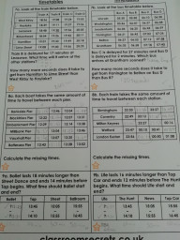
Here’s what Y5&6 have been focusing on at home today.
Amy has been interpreting the layout and meaning of the timetables to solve the problems.

Slide 11
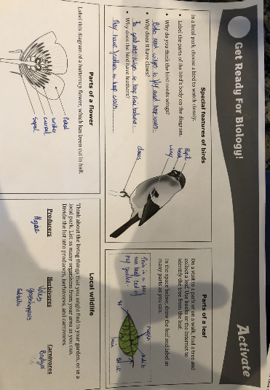
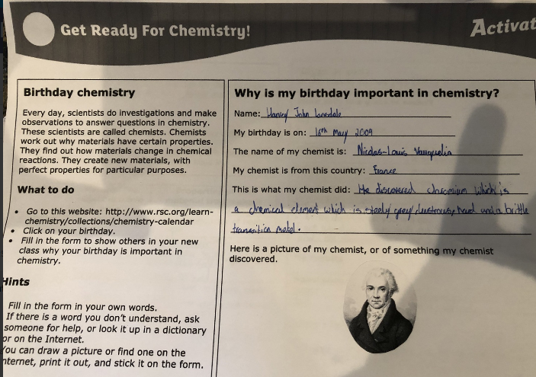
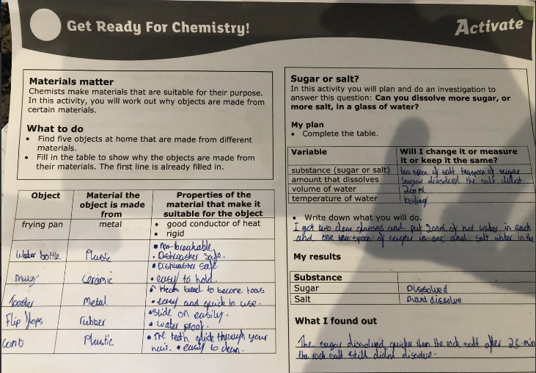
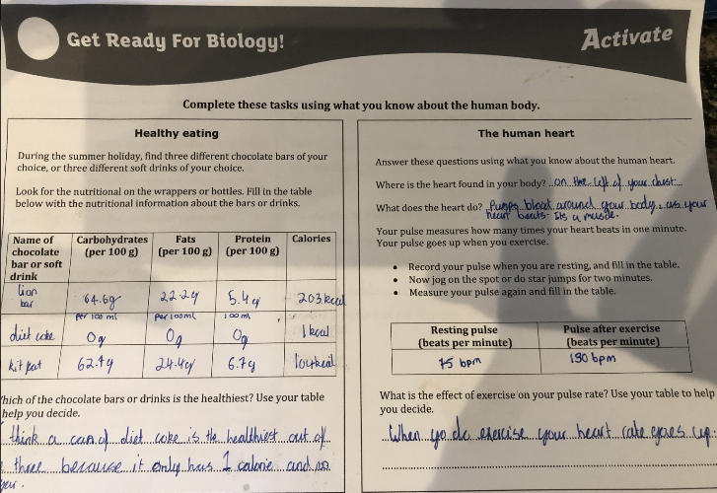
What else have we been doing recently?
Harvey’s completed Corbet Science task

Slide 12
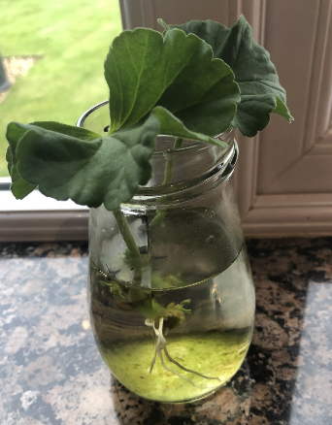
What else have we been doing recently?
Harvey’s geranium plant is finally growing roots.
How is everybody else’s plant getting on?

Slide 13
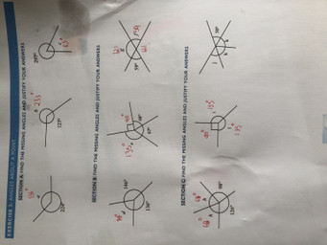
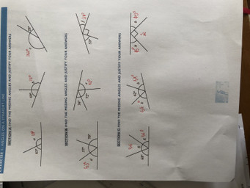
What else have we been doing recently?
Harvey’s been solving the missing angles on a straight line and around a point.

