Slide 1
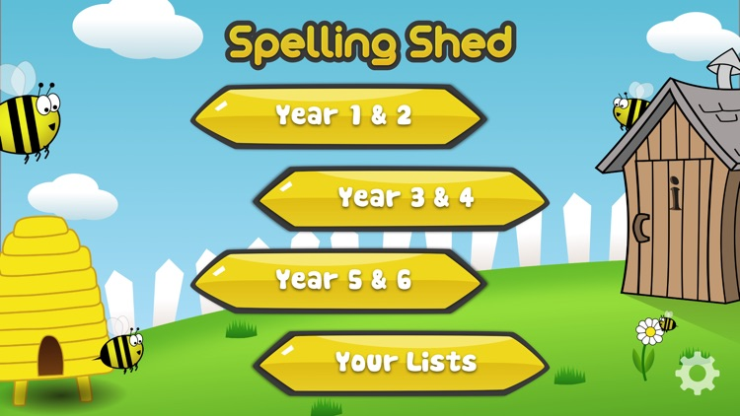
Y5&6 TOP SPELLERS TODAY
1st = Henry 16 points
2nd = Jack 14 points
3rd = Chloe 13 points
4th = Bethany and Dante 3 points
5th = Elizabeth, Reuben, Megan, Lily and Ruby 2 points
6th = Holly H and Harvey 1 points
7th =
8th =
9th =
These are the amount of dojos you have received for your efforts today!
Everybody else earns 1 dojo for practising their spellings today!

Slide 2
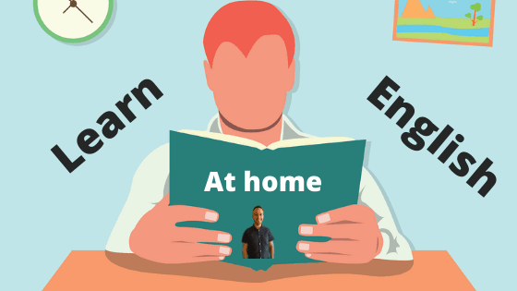
What have the Y5&6s been
studying today at home?

Slide 3
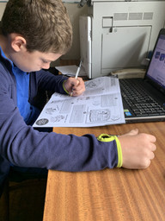
Here’s what Y5&6 have been focusing on at home today
I’m busy studying my Crucial Crew booklet.

Slide 4
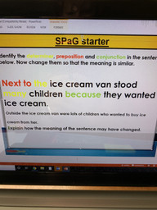
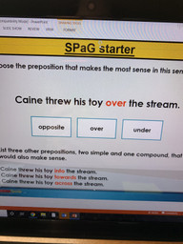
Here’s what Y5&6 have been focusing on at home today
Henry identified the different types of grammar in the sentence.

Slide 5
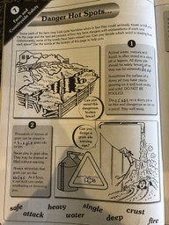
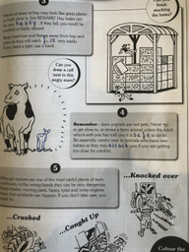
Here’s what Y5&6 have been focusing on at home today
Harvey has been studying his Crucial Crew booklet today.

Slide 6
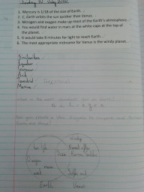
Here’s what Y5&6 have been focusing on at home today
Amy has been reading the text carefully to answer the questions accurately.

Slide 7
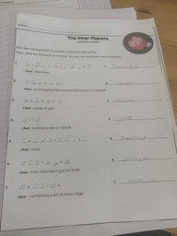
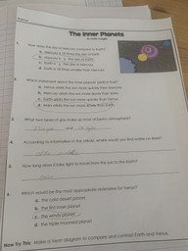
Here’s what Y5&6 have been focusing on at home today
Zoe has been reading the text carefully to answer the questions accurately.

Slide 8
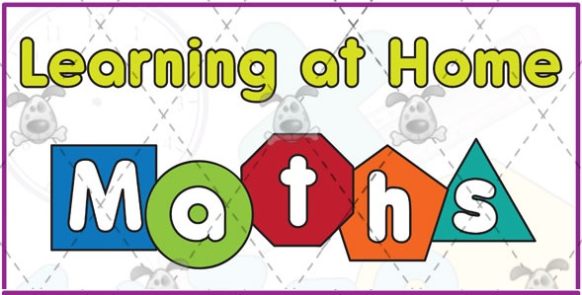
Here’s what Y5&6 have been
focusing on at home today.

Slide 9
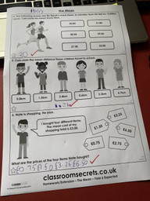
Here’s what Y5&6 have been
focusing on at home today.
Henry has been solving the ‘mean’ in his maths work today.

Slide 10
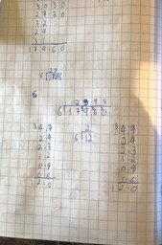
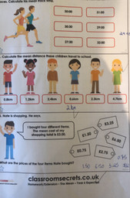
Here’s what Y5&6 have been
focusing on at home today.
Harvey has been solving the ‘mean’ in his maths work today.

Slide 11
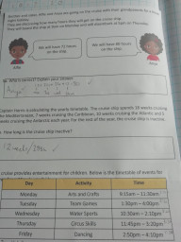
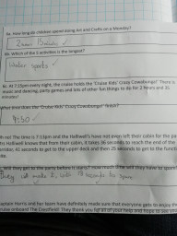
Here’s what Y5&6 have been
focusing on at home today.
Amy has solved the problems well today in maths.

Slide 12
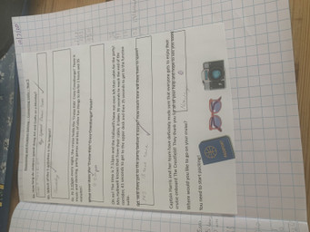
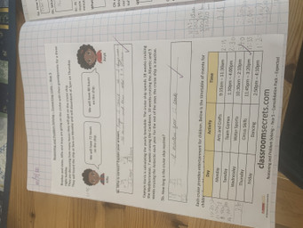
Here’s what Y5&6 have been
focusing on at home today.
Zoe has solved the problems well today in maths.

Slide 13
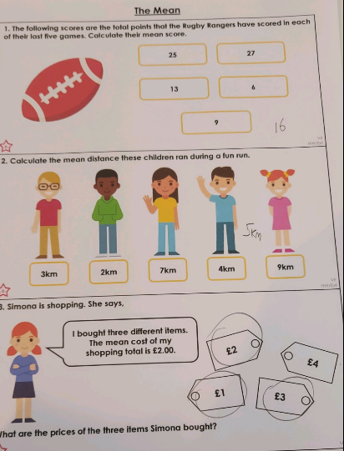
Here’s what Y5&6 have been
focusing on at home today.
Dante has solved the ‘mean’ (average) here in his maths work.

Slide 14
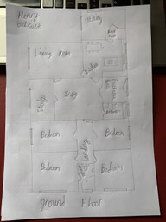
What else have we been doing at home?
Henry created a floor plan of his house.

Slide 15
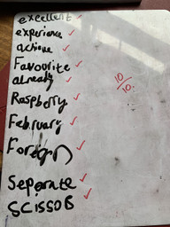
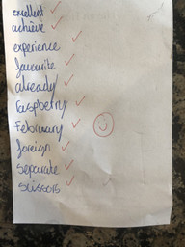
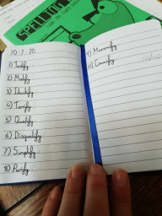
What else have we been doing at home?
Henry, Amy and Harvey scored 10/10 in their spellings. Also scoring 100% were Reuben, Ruby and Jack.

Slide 16
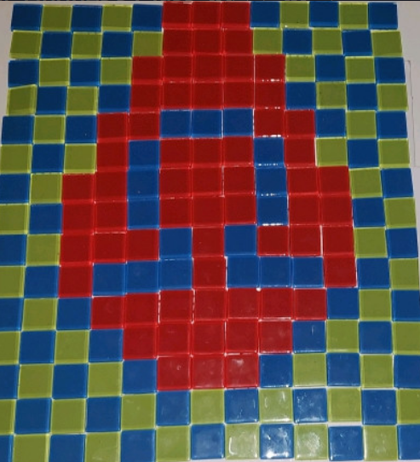
What else have we been doing at home?
Dante created an Omega symbol with mosaic tiles, as a vase.

Slide 17
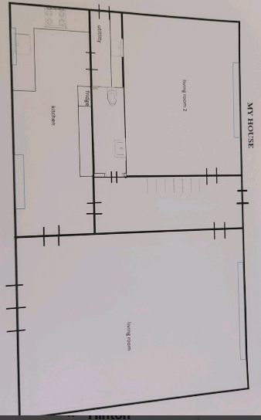
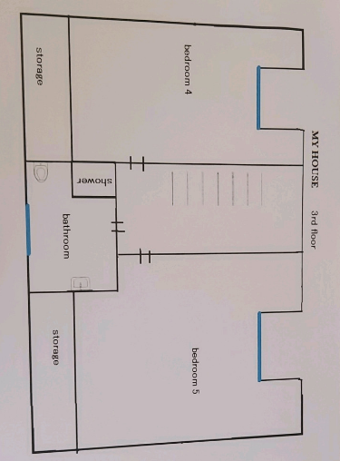
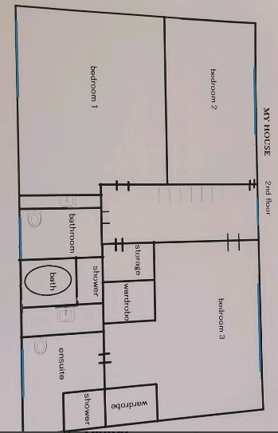
What else have we been doing at home?
Dante has produced a floor plan of the different levels of his house.

