Slide 1
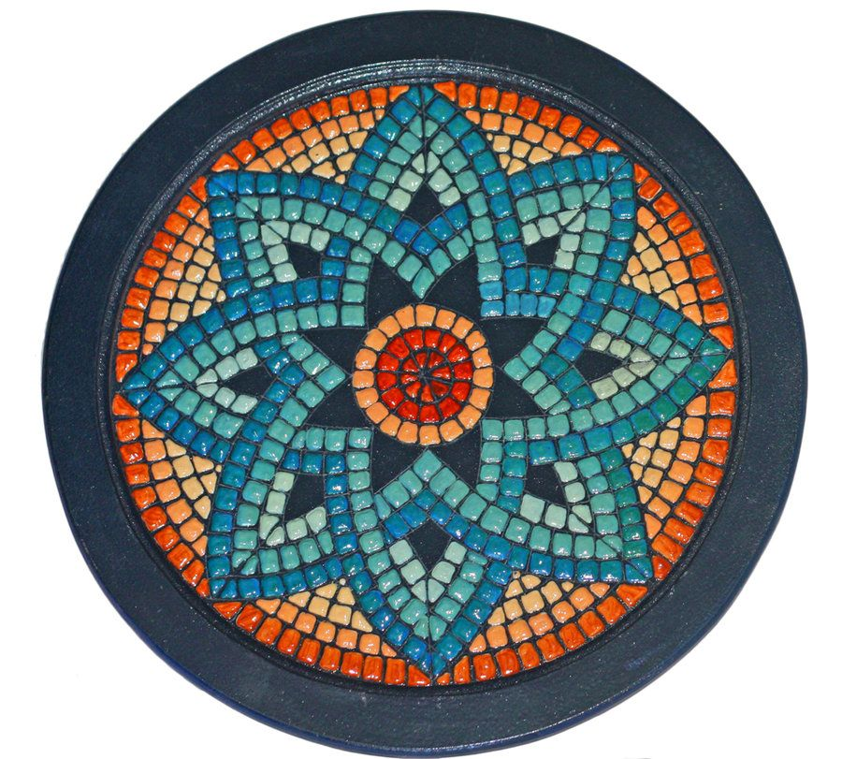
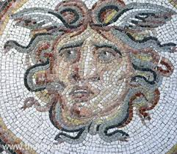
Ancient Greek
Mosaic Art
Watch the first 3 minutes of the video on the link below to understand more about Ancient Greek Art.
https://www.youtube.com/watch?v=oD0czn_aA4k

Slide 2
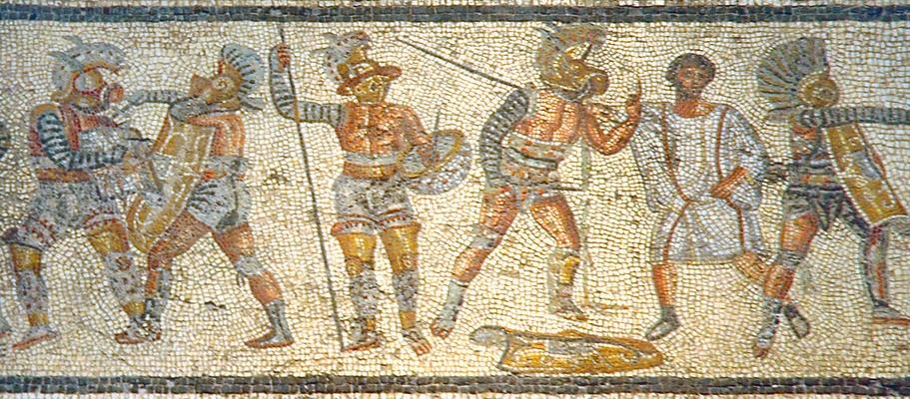
Greek Mosaics, which can be found in parts of Greece and modern-day Macedonia are believed to be the earliest form of the art still in existence today.

Slide 3
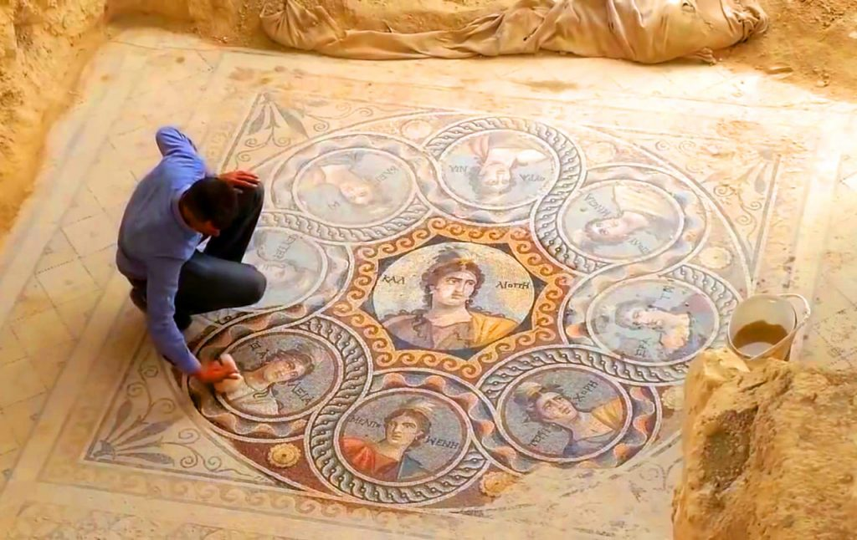
The most common use of mosaic design in the Greek world were floor mosaics. These large designs were favoured as they are much less vulnerable when buildings collapse.

Slide 4
Ancient Greek
Mosaic Art Challenge
Your challenge during the next two weeks is to produce your own example of ancient Greek mosaic art.
How you produce it, what you use and what ancient Greek image it depicts is entirely up to you.
Good luck!

Slide 5
