Slide 1
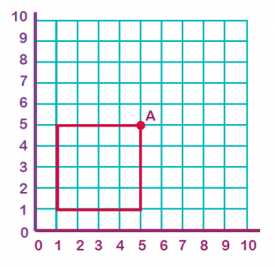
What I’m learning in Maths today
Maths – Y5 (translating shapes) Date: 3.6.20
L.Obj: *I can translate shapes on a grid to it’s new position.
*I can explain the movement and direction of shapes when translated to it’s new position.

Slide 2
Heidi, Amy, Alissa, Izzy, Cameron, Lucy & Nelly -
What is……………..?
Daniel, Jacob, Zoe, Holly H, Isobel, Sophie, Katie & Holly T– What is ………………?
Nia, Isla and Rhys – Maths Starter –
What is……..?
Finding fractions of numbers/amounts
(Divide by the denominator, then multiply by the numerator)
2/7 of 77 =
3/5 of 45 =
8/9 of 81 =
3/10 of 120 =
5/8 of 96 =
3/4 of 36 =
1/12 of 60 =
2/7 of 56 =
3/5 of 35 =
8/9 of 63 =
3/10 of 100 =
5/8 of 72 =
3/4 of 28 =
1/12 of 48 =
2/7 of 28 =
3/5 of 30 =
8/9 of 54 =
3/10 of 80=
5/8 of 48 =
3/4 of 24 =
1/12 of 24 =

Slide 3
Heidi, Amy, Alissa, Izzy, Cameron, Lucy & Nelly -
What is……………..?
Daniel, Jacob, Zoe, Holly H, Isobel, Sophie, Katie & Holly T– What is ………………?
Nia, Isla and Rhys – Maths Starter –
What is……..?
Finding fractions of numbers/amounts
(Divide by the denominator, then multiply by the numerator)
2/7 of 77 = 22
3/5 of 45 = 27
8/9 of 81 = 72
3/10 of 120 = 36
5/8 of 96 = 60
3/4 of 36 = 27
1/12 of 60 = 5
2/7 of 56 = 16
3/5 of 35 = 21
8/9 of 63 = 56
3/10 of 100 = 30
5/8 of 72 = 45
3/4 of 28 = 21
1/12 of 48 = 4
2/7 of 28 = 8
3/5 of 30 = 18
8/9 of 54 = 48
3/10 of 80= 24
5/8 of 48 = 30
3/4 of 24 = 18
1/12 of 24 = 2

Slide 4
Tick the translation from shape A to shape B.
A
 | 5 right, 3 down
 | 5 right, 2 down
B
© Classroom Secrets Limited 2018

Slide 5
Tick the translation from shape A to shape B.
A
 | 5 right, 3 down
 | 5 right, 2 down
B
© Classroom Secrets Limited 2018

Slide 6
Translate shape A 1 right, 4 up.
Then translate shape A 4 right, 1 up.
A
© Classroom Secrets Limited 2018

Slide 7
Translate shape A 1 right, 4 up.
Then translate shape A 4 right, 1 up.
1
2
A
© Classroom Secrets Limited 2018

Slide 8
True or false?
Shape A has been translated 4 right, 1 down.
A
© Classroom Secrets Limited 2018

Slide 9
True or false?
Shape A has been translated 4 right, 1 down.
False, it has been translated 4 left and 1 up.
A
© Classroom Secrets Limited 2018

Slide 10
NOW IT’S YOUR TURN!
Isla, Nia, Rhys and Holly H
(D) Activity questions 1a, 1b, 2a, 2b, 3a and 3b
Lucy, Katie, Holly T, Jacob, Sophie, Zoe, Isobel, Cameron, Daniel, Alissa and Izzy
(E) Activity questions 4a, 4b, 5a, 5b, 6a and 6b
Nelly, Amy and Heidi
(GD) Activity questions 7a, 7b, 8a, 8b, 9a and 9b

