Slide 1
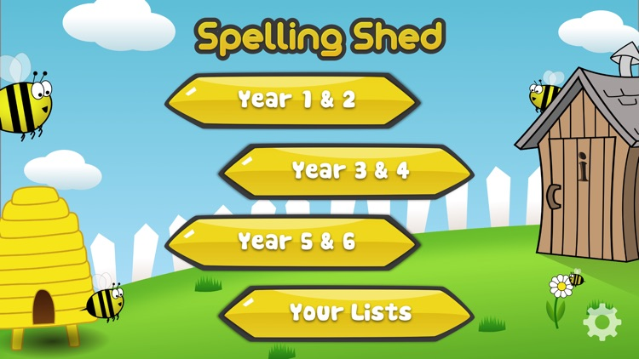
Y5&6 TOP SPELLERS TODAY
1st = Henry 25 points
2nd = Zoe 15 points
3rd = Nia 12 points
4th= Nelly 11 points
5th = Katie 7 points
6th = Reuben, Amy and Lucy 5 points
7th =Chloe and Izzy 3 points
8th = Heidi and Megan 2 points
9th = Jack 1 points
These are the amount of dojos you have received for your efforts today!
Everybody else earns 1 dojo for practising their spellings today!

Slide 2
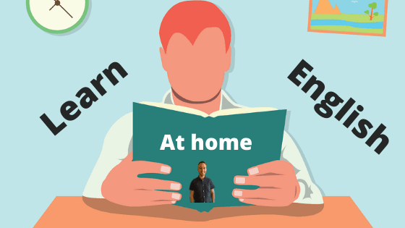
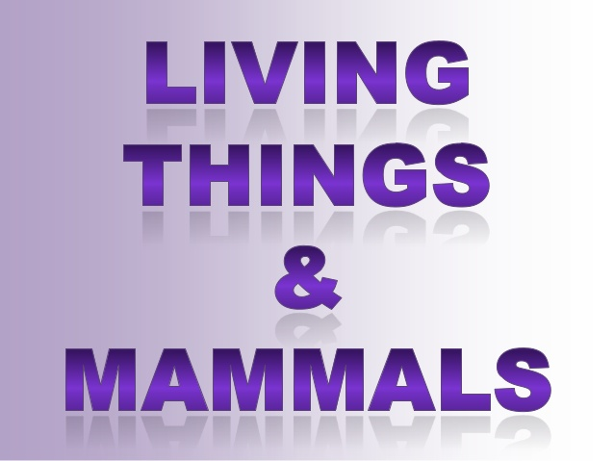
What have we been
studying today in English / Science at home?

Slide 3
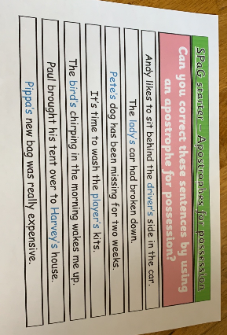
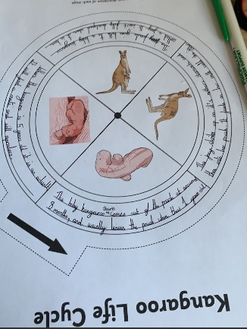
Here’s what Y5&6 have been focusing on at home today
Cassie has studied the life cycle of mammals, including humans, after using apostrophes for possession.

Slide 4
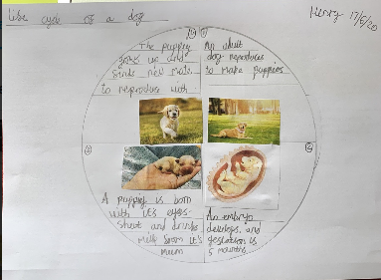
Here’s what Y5&6 have been focusing on at home today
Henry has studied dogs for his life cycle wheel.

Slide 5
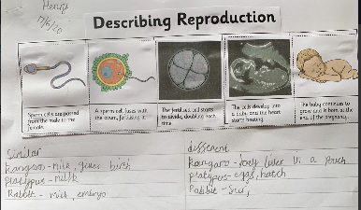
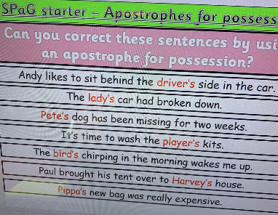
Here’s what Y5&6 have been focusing on at home today
Henry has studied the life cycle of mammals, including humans, after using apostrophes for possession.

Slide 6
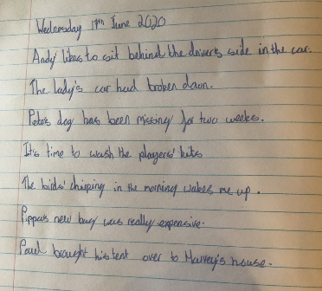
Here’s what Y5&6 have been focusing on at home today
Harvey has studied the life cycle of mammals, including humans, after using apostrophes for possession.

Slide 7
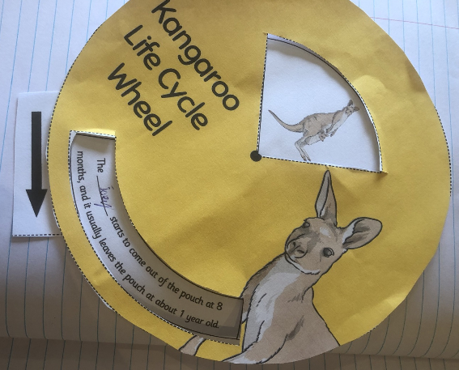
Here’s what Y5&6 have been focusing on at home today
Harvey has studied the life cycle of mammals by producing a life cycle wheel.

Slide 8
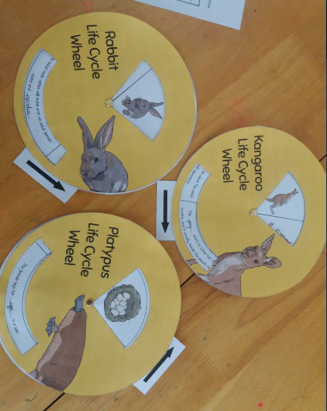
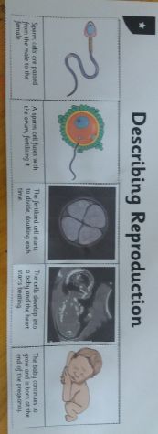
Here’s what Y5&6 have been focusing on at home today
Jack has studied the life cycle of mammals by producing life cycle wheels.

Slide 9
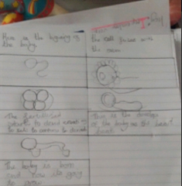
Here’s what Y5&6 have been focusing on at home today
Chloe has studied the life cycle of a human.

Slide 10
Here’s what Y5&6 have been focusing on at home today
Amy has studied the life cycle of mammals, including humans, creating her own life cycle wheel.

Slide 11
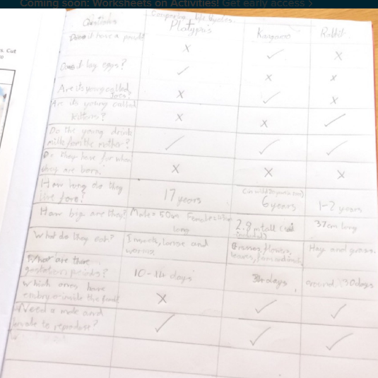
Here’s what Y5&6 have been focusing on at home today
Reuben used a layout of his own choice to compare the similarities and differences between these mammals.

Slide 12
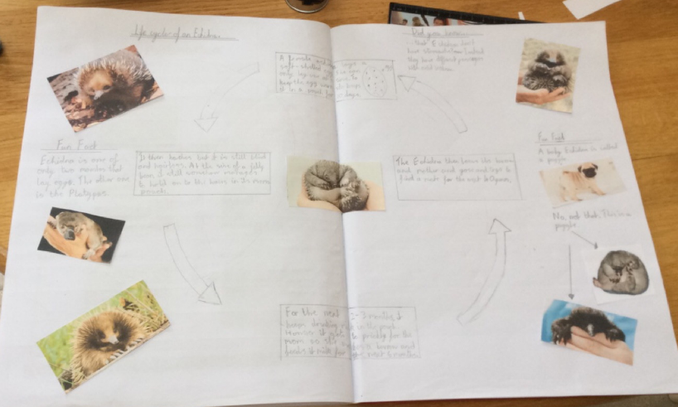
Here’s what Y5&6 have been focusing on at home today
Reuben has chosen to focus on the life cycle of an echidna (spiny anteater)

Slide 13
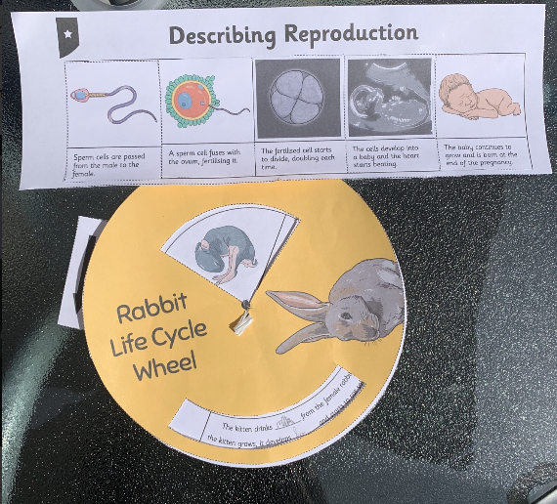
Here’s what Y5&6 have been focusing on at home today
Sophie has studied the life cycle of mammals, including humans, creating her own life cycle wheel.

Slide 14
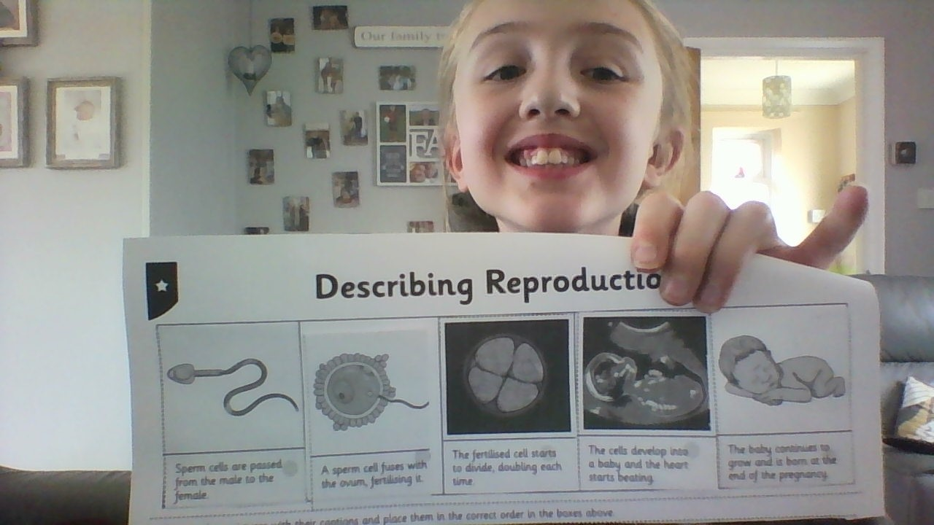
Here’s what Y5&6 have been focusing on at home today
I’ve put these events in order for the growth of a baby.

Slide 15
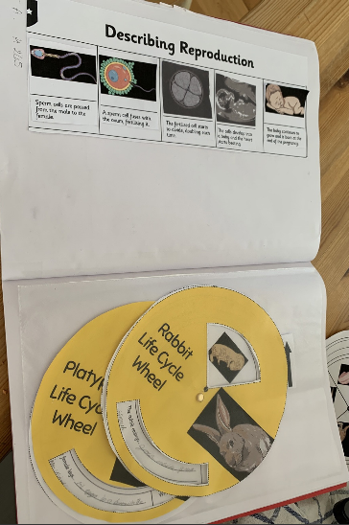
Here’s what Y5&6 have been focusing on at home today
Zoe has studied the life cycle of mammals, including humans, creating her own life cycle wheel.

Slide 16
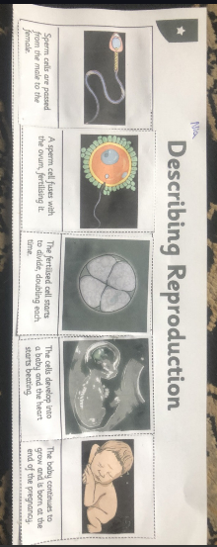
Here’s what Y5&6 have been focusing on at home today
I’ve put these events in order for the growth of a baby.

Slide 17
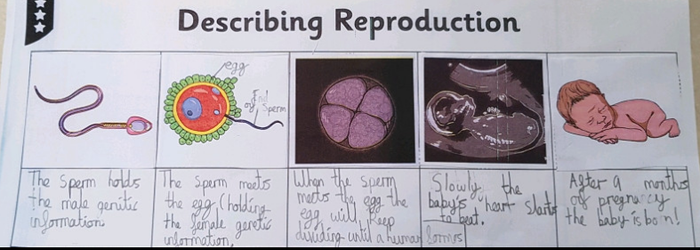
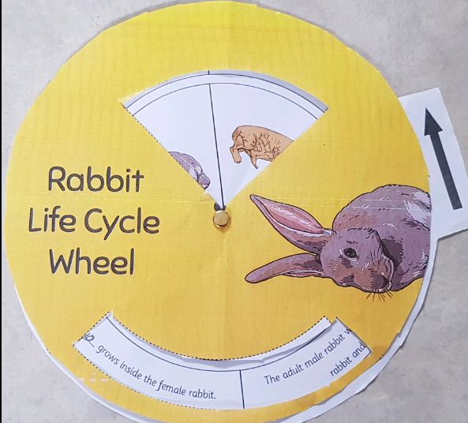
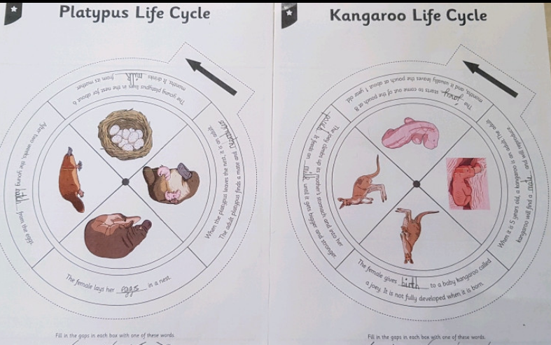
Here’s what Y5&6 have been focusing on at home today
Cameron has studied the life cycle of mammals, including humans.

Slide 18
Here’s what Y5&6 have been
focusing on at home today.

Slide 19
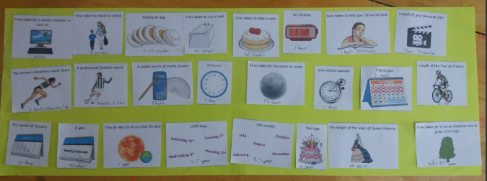
Here’s what Y5&6 have been
focusing on at home today.
Jack has ordered the ‘length of time’ events having done some research for some of these events.

Slide 20
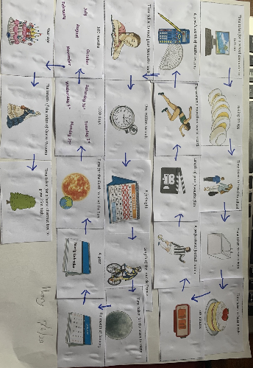
Here’s what Y5&6 have been
focusing on at home today.
Henry has ordered the ‘length of time’ events having done some research for some of these events.

Slide 21
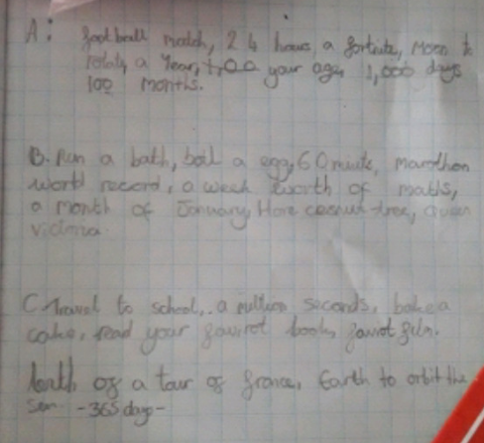
Here’s what Y5&6 have been
focusing on at home today.
Chloe has ordered the ‘length of time’ events having done some research for some of these events.

Slide 22
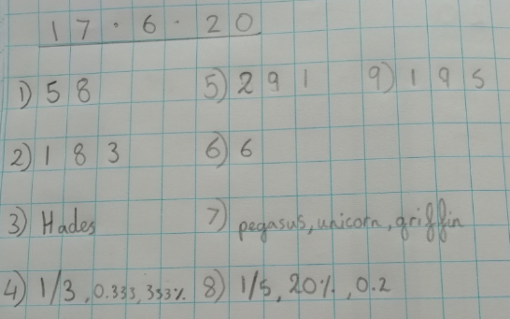
Here’s what Y5&6 have been
focusing on at home today.
Amy has studied the Ancient Greece Top Trumps cards to answer these maths problems about them.

Slide 23
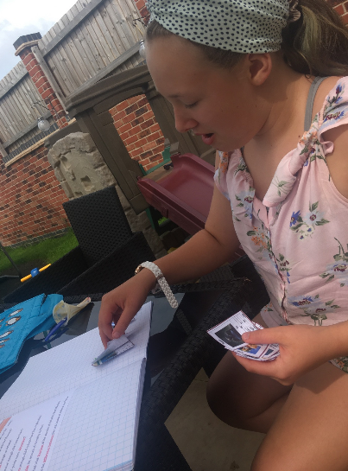
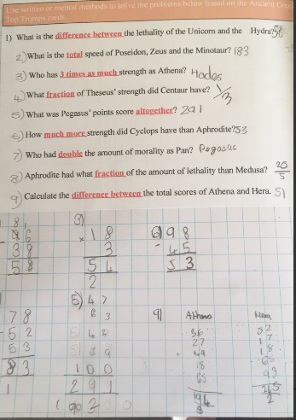
Here’s what Y5&6 have been
focusing on at home today.
I’ve studied and played the Ancient Greece Top Trumps cards to answer these maths problems.

Slide 24
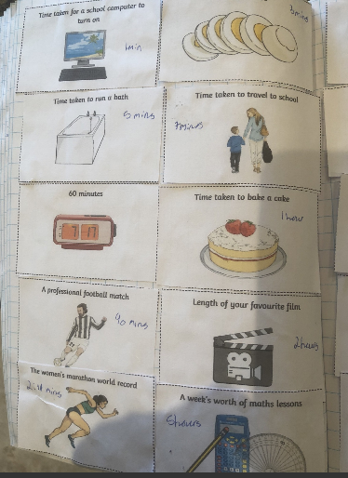
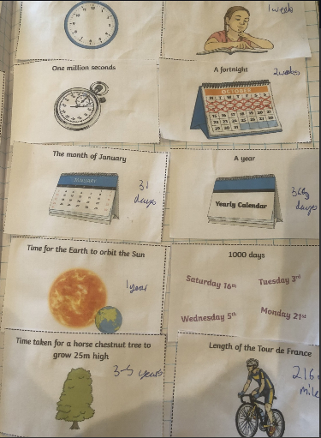
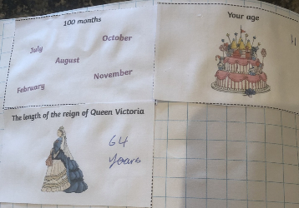
Here’s what Y5&6 have been
focusing on at home today.
Harvey has ordered the ‘length of time’ events having done some research for some of these events.

Slide 25
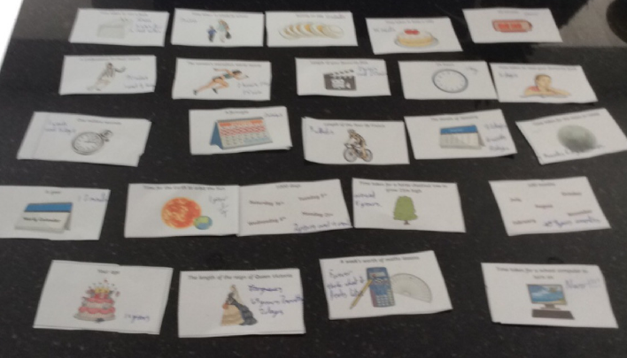
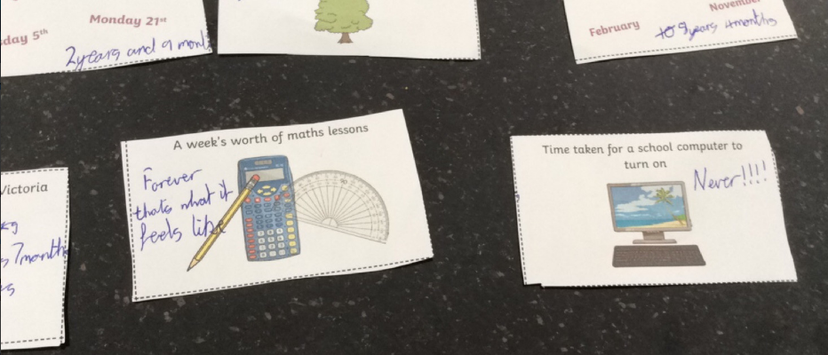
Here’s what Y5&6 have been
focusing on at home today.
Reuben has put these events in ‘length of time’ order and clearly has an issue with the school computers and maths lessons!

Slide 26
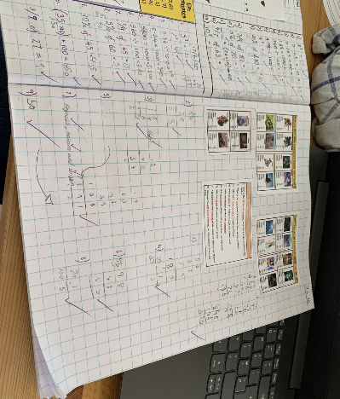
Here’s what Y5&6 have been
focusing on at home today.
Zoe has studied the Ancient Greece Top Trumps cards to answer these maths problems about them.

Slide 27
Cameron has studied the Ancient Greece Top Trumps cards to answer these maths problems about them.

Slide 28
Here’s some more of the work at home that’s just been handed in…….

Slide 29
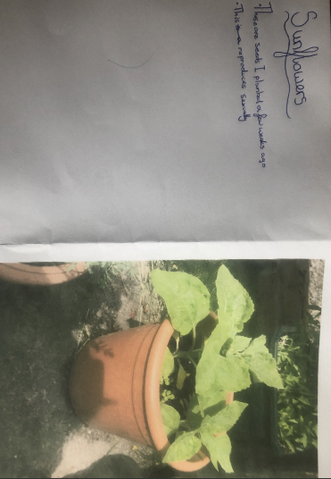
What else have we been doing at home?
This is the outcome of some sunflower seeds that Nia planted a few weeks ago.

Slide 30
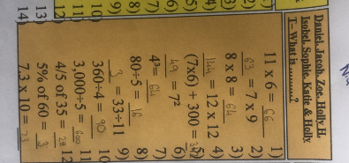
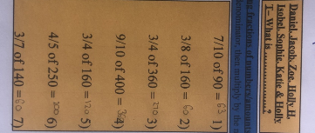
What else have we been doing at home?
Nia has been practising her fractions of numbers and other calculations.

Slide 31
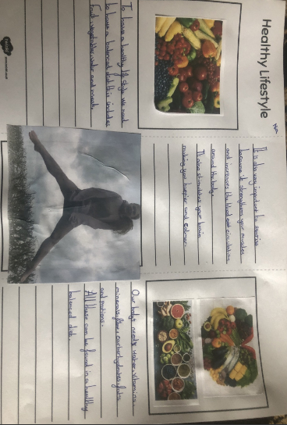
What else have we been doing at home?
Nia wanted to advise others on how to stay healthy.

Slide 32
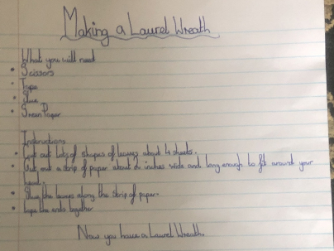
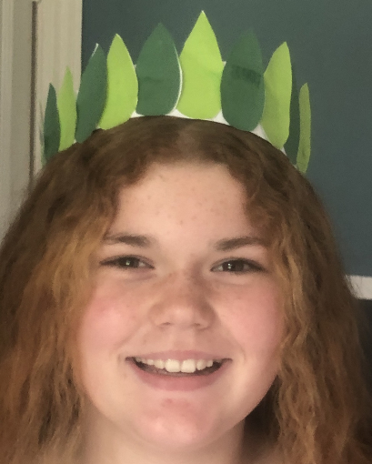
What else have we been doing at home?
I wrote the instructions for my laurel wreath and then made one myself.

Slide 33
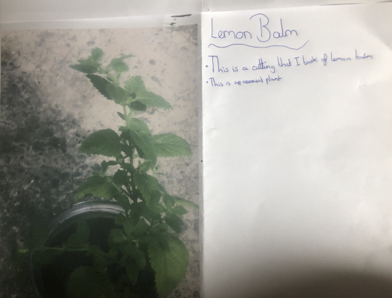
What else have we been doing at home?
Here’s the cutting that I took off the lemon balm.

Slide 34
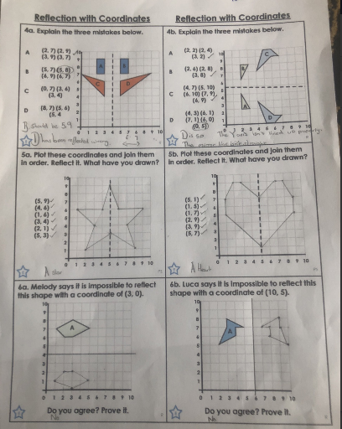
What else have we been doing at home?
Nia has been reflecting the shapes in the y-axis and x-axis and identifying the co-ordinates.

Slide 35
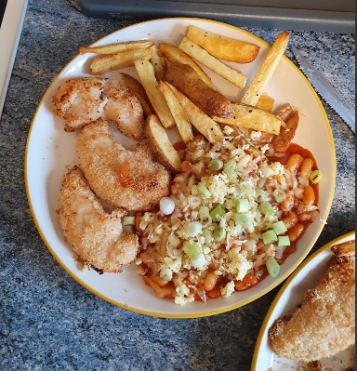
What else have we been doing at home?
Bethany helped in the kitchen to make home chicken, goujons, chips and cheesy beans.

Slide 36
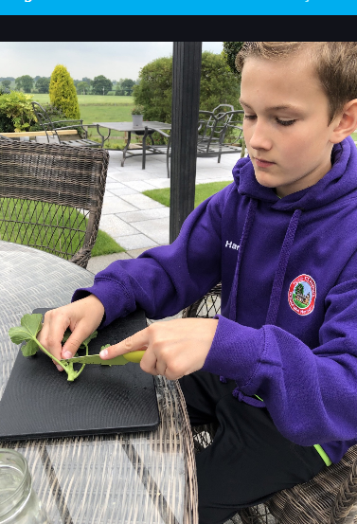
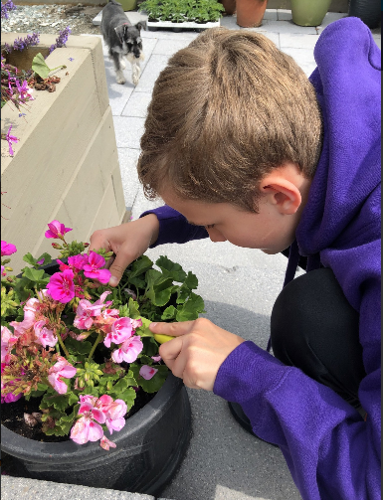
What else have we been doing at home?
I’ve taken my geranium cutting……..

Slide 37
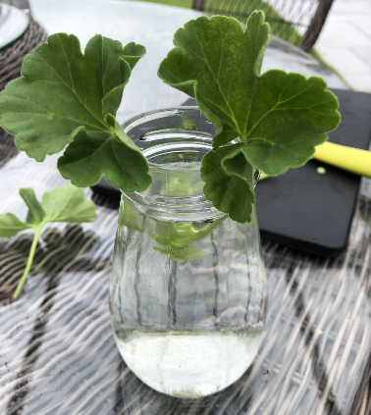
What else have we been doing at home?
…….and I’m hoping for asexual reproduction.

Slide 38
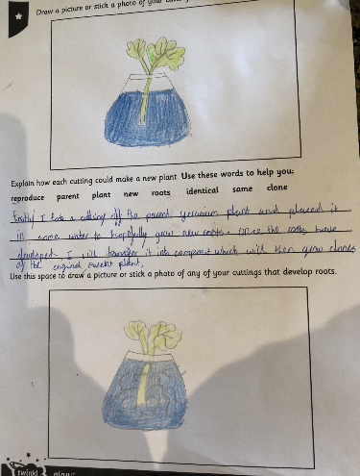
What else have we been doing at home?
Harvey has planned and drawn his science plant testing.

Slide 39
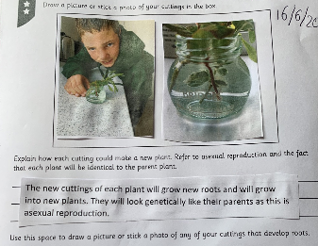
What else have we been doing at home?
Henry is hoping to see his new plant grow.

Slide 40
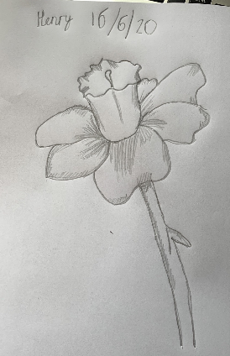
What else have we been doing at home?
Henry has produced a wonderful sketch of his flower.

Slide 41
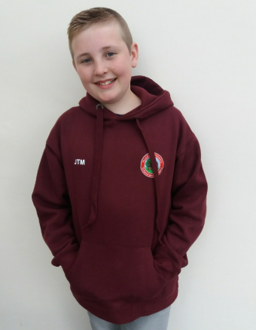
What else have we been doing at home?
Just like in a
‘Next’ catalogue, Jack is modelling his
new hoodie.

Slide 42
What else have we been doing at home?
Jack has identified the advantages and disadvantages of asexual / sexual reproduction.

Slide 43
What else have we been doing at home?
Jack has produced a wonderful sketch of his flower.

Slide 44
What else have we been doing at home?
Sophie is aiming to reach Cameron’s Level 25!

Slide 45
What else have we been doing at home?
Sophie is hoping that her plant regrows to demonstrate asexual reproduction in plants.

Slide 46
What else have we been doing at home?
I found some Shropshire rocks on a walk in Nesscliffe today.

Slide 47
What else have we been doing at home?
Isla has been taking cuttings to attempt to show asexual reproduction of a geranium plant.

Slide 48
What else have we been doing at home?
We went to Cardingmill Valley for an evening picnic.

Slide 49
What else have we been doing at home?
I’ve been learning about the different ways that a plant can reproduce.

Slide 50
What else have we been doing at home?
Cameron has been working through some additional maths whilst he’s been in school today.
I’m surprised he had time to breathe!

