Slide 1
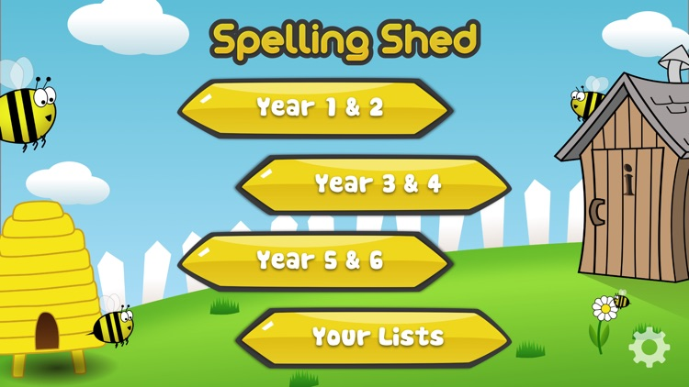
Y5&6 TOP SPELLERS TODAY
1st = Nia 21 points
2nd = Jack and Amy 15 points
3rd = Henry 13 points
4th = Cameron, Katie and Izzy 9 points
5th = Heidi, Lucy and Zoe 6 points
6th = Ruby 5 points
7th = Reuben 4 points
8th = Harvey and Isobel 3 points
9th = Zac 2 points
These are the amount of dojos you have received for your efforts today!
Everybody else earns 1 dojo for practising their spellings today!

Slide 2
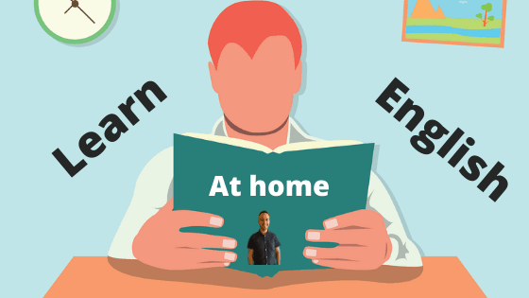
What have we been
studying today at home in my English / History work?

Slide 3
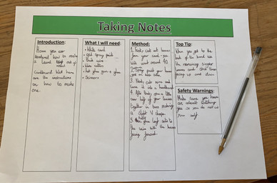
Here’s what Y5&6 have been focusing on at home today
Cassie has planned out her instructions on how to make a laurel wreath.

Slide 4
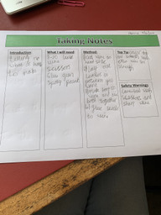
Here’s what Y5&6 have been focusing on at home today
Henry has planned out his instructions on how to make a laurel wreath.

Slide 5
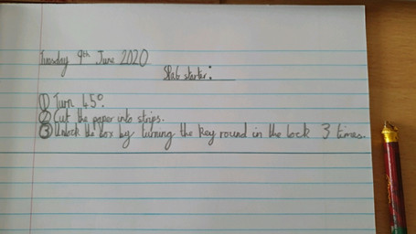
Here’s what Y5&6 have been focusing on at home today
Bethany has used her imperative verbs ‘turn’, ‘cut’ and ‘unlock’ in her own instructions.

Slide 6
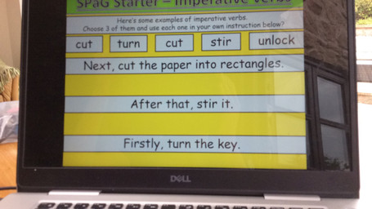
Here’s what Y5&6 have been focusing on at home today
Reuben has used his imperative verbs ‘turn’, ‘cut’ and ‘stir’ in his own instructions.

Slide 7
SPaG Starter – Imperative verbs
Here’s what Y5&6 have been focusing on at home today
Here’s some examples of imperative verbs.
Choose 3 of them and use each one in your own instruction below?
turn
cut
stir
unlock
Cut the bread with the knife.
cut
Turn the lever with your hand.
Unlock the house door with the key.
Cameron has used his imperative verbs ‘turn’, ‘cut’ and ‘unlock’ in his own instructions.

Slide 8
Taking Notes
Here’s what Y5&6 have been focusing on at home today
Introduction:
Have you been wanting a wreath just like the Greeks had? Now you can just follow these simple instructions, then in no time you will be wearing that wreath around your head just like the Greeks.
What I will need:
8-10 olive leaves
Gold wires or silver wire (if silver wire was chosen you will need gold spray paint)
Scissors
Hot glue gun or extra gold wire
Method:
Cut the wire to the diameter of your head.
Lay out your leaves so there are four to the right and four to the left ( five to the left and right if you are using 10 leaves) while leaving space at the top and bottom.
Find the end of your gold or silver wire then make a loop while using the other end to go through that loop and make another one to secure it safely.
If silver wire was picked use the gold spray paint to paint it then wait for it to dry.
If you have a hot glue gun cut off the stems of the leaves to glue it on.
If you don’t have a hot glue gun DON’T cut off the stems use the extra gold wire to wrap the stems of the leaf to the circle of gold wire in the position you laid them out.
Looking at the gap at the top and bottom wrap more extra gold wire around it until it is secure and tight.
Top Tip:
Use green spray paint to make it look like it was made in the time of Greeks.
Safety Warnings:
Don’t Use a hot glue gun without parent supervision. Be careful of sharp pieces of wire.
Cameron has planned out his instructions on how to make a laurel wreath.

Slide 9
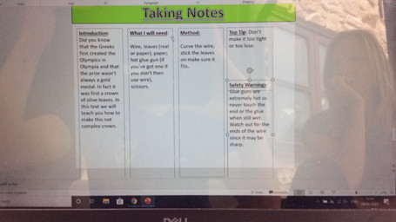
Here’s what Y5&6 have been focusing on at home today
Reuben has planned out his instructions on how to make a laurel wreath, which he will develop when writing his final draft.

Slide 10
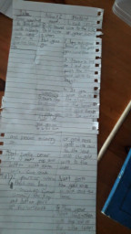
Here’s what Y5&6 have been focusing on at home today
Chloe has planned out her instructions on how to make a laurel wreath, which she will organise clearly when writing her final draft.

Slide 11
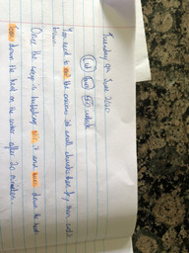
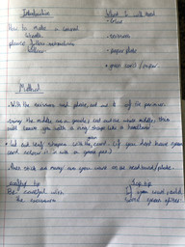
Here’s what Y5&6 have been focusing on at home today
Harvey has planned out his instructions on how to make a laurel wreath, which he will organise clearly when writing his final draft.

Slide 12
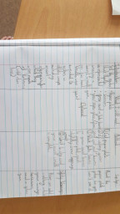
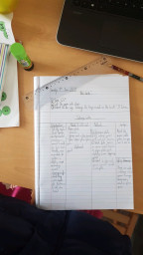
Here’s what Y5&6 have been focusing on at home today
Bethany has planned out her instructions on how to make a laurel wreath, which she will organise clearly when writing her final draft.

Slide 13
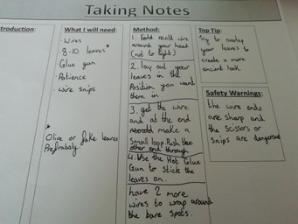
Amy has planned out her instructions on how to make a laurel wreath, which she will organise clearly when writing her final draft.

Slide 14
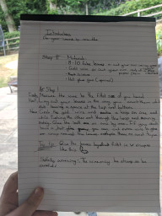
Here’s what Y5&6 have been focusing on at home today
Heidi has planned out her instructions on how to make a laurel wreath, which she will organise clearly when writing her final draft.

Slide 15
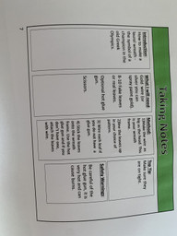
Here’s what Y5&6 have been focusing on at home today
Zoe has planned out her instructions on how to make a laurel wreath, which she will organise clearly when writing her final draft.

Slide 16
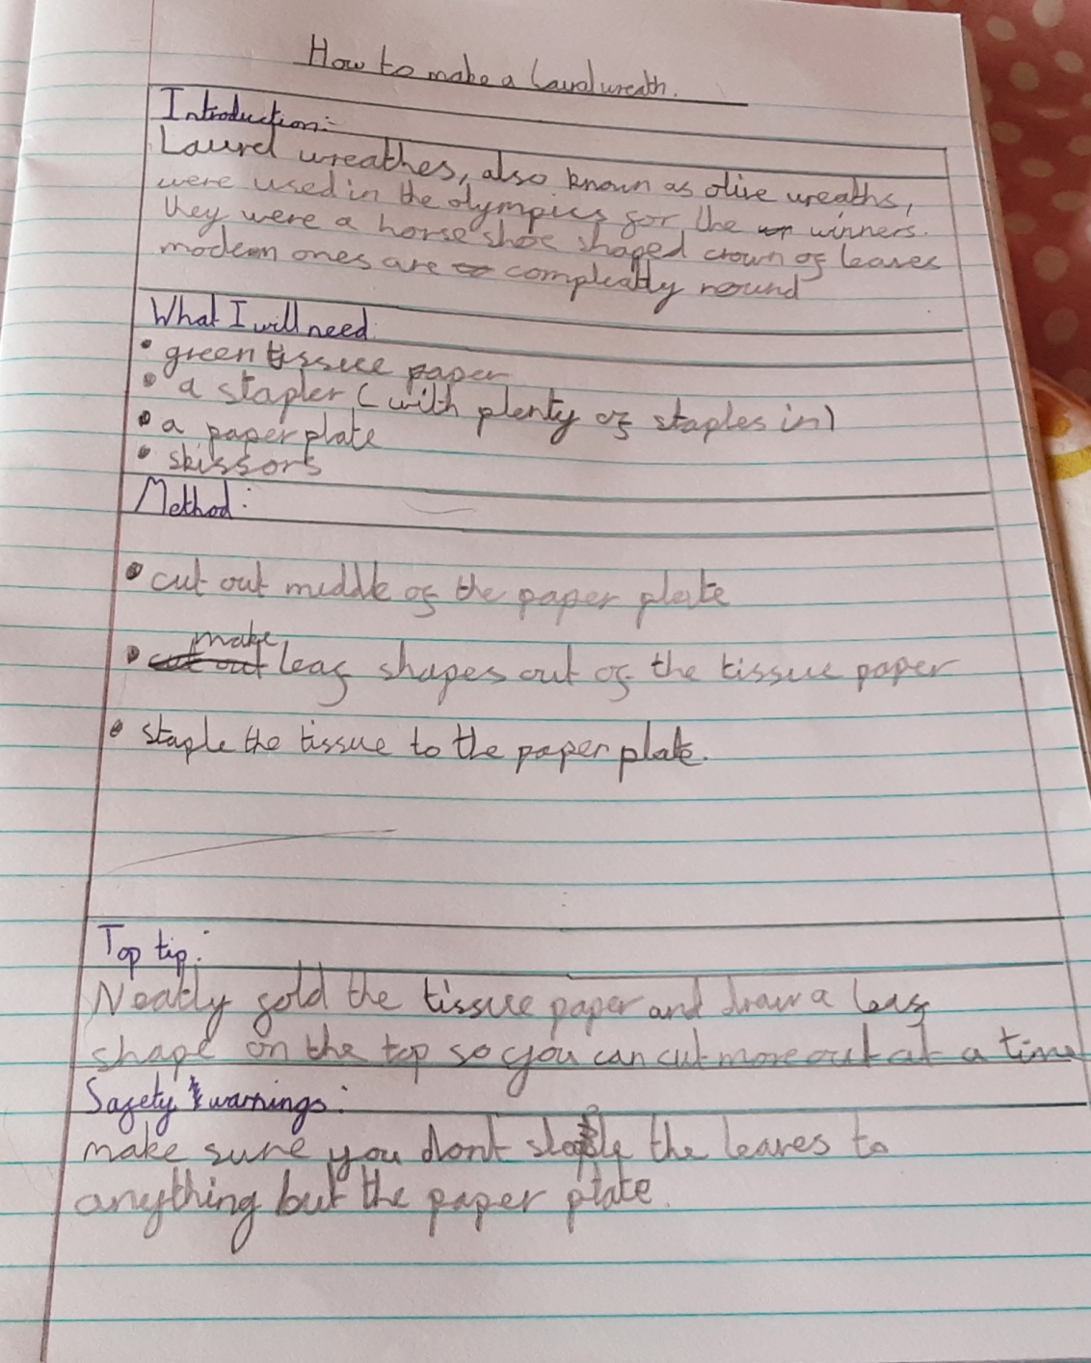
Here’s what Y5&6 have been focusing on at home today

Slide 17
Here’s what Y5&6 have been
focusing on at home today.

Slide 18
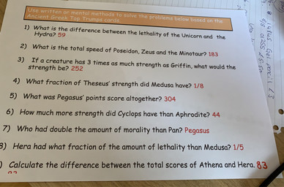
Here’s what Y5&6 have been
focusing on at home today.
Cassie has used the Top Trump cards to solve these calculations/questions correctly.

Slide 19
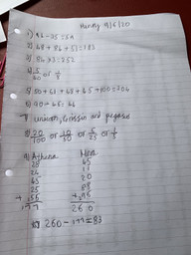
Here’s what Y5&6 have been
focusing on at home today.
Cassie has used the Top Trump cards to solve these calculations / questions correctly.

Slide 20
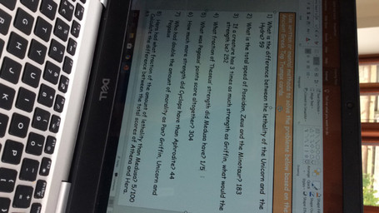
Here’s what Y5&6 have been
focusing on at home today.
Reuben has used the Top Trump cards to solve these calculations / questions correctly.

Slide 21
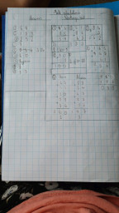
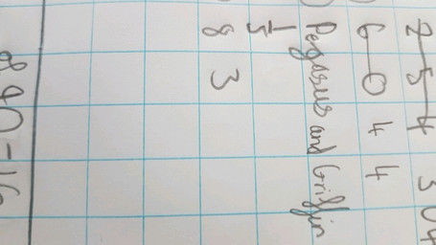
Here’s what Y5&6 have been
focusing on at home today.
Bethany has used the Top Trump cards to solve these calculations, plus any corrections that she made.

Slide 22
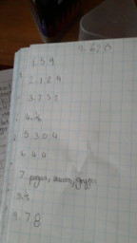
Here’s what Y5&6 have been
focusing on at home today.
Chloe has used the Top Trump cards to attempt to solve these calculations.

Slide 23
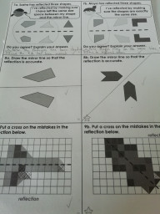
Here’s what Y5&6 have been
focusing on at home today.
Amy has been identifying any errors in the reflections on the grids.

Slide 24
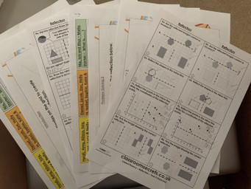
Here’s what Y5&6 have been
focusing on at home today.
Sophie has been working hard on her reflections in maths.

Slide 25
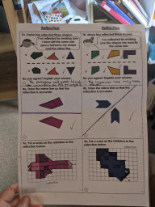
Here’s what Y5&6 have been
focusing on at home today.
Heidi has been identifying the errors and correct reflections, as well as drawing in the accurate mirror lines.

Slide 26
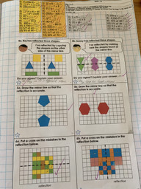
Here’s what Y5&6 have been
focusing on at home today.
Zoe has been identifying the errors in reflection, as well as spotting the missing mirror lines.

Slide 27
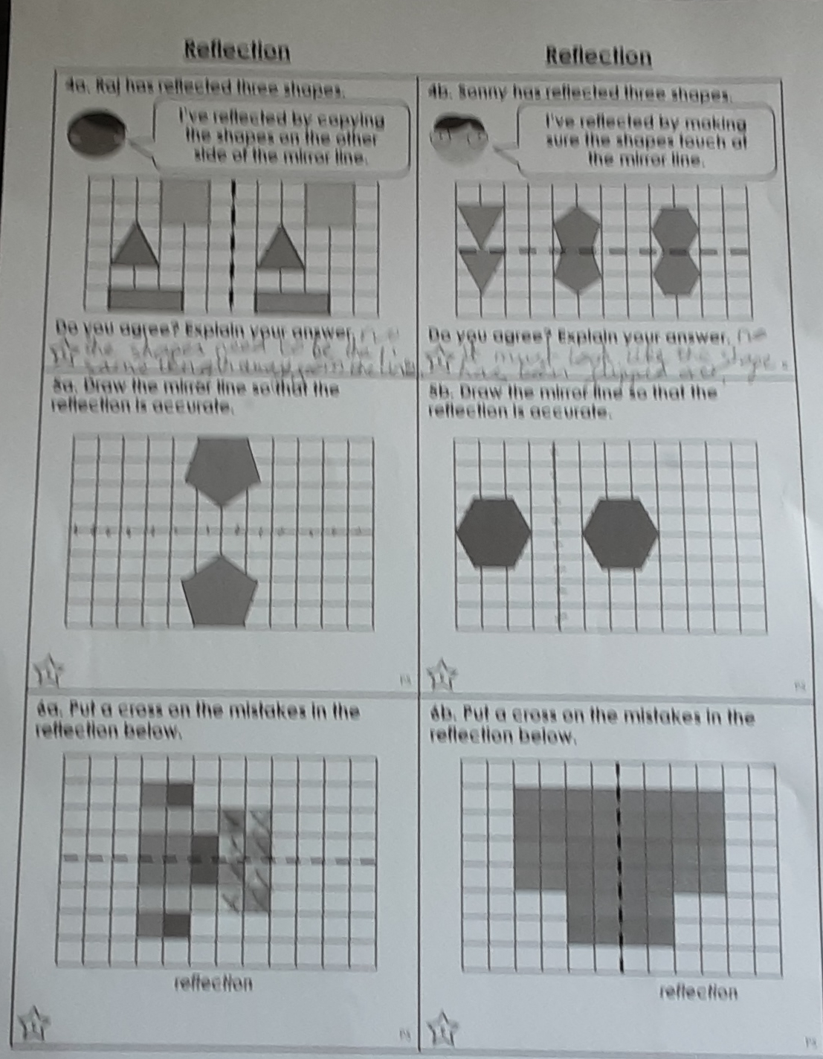
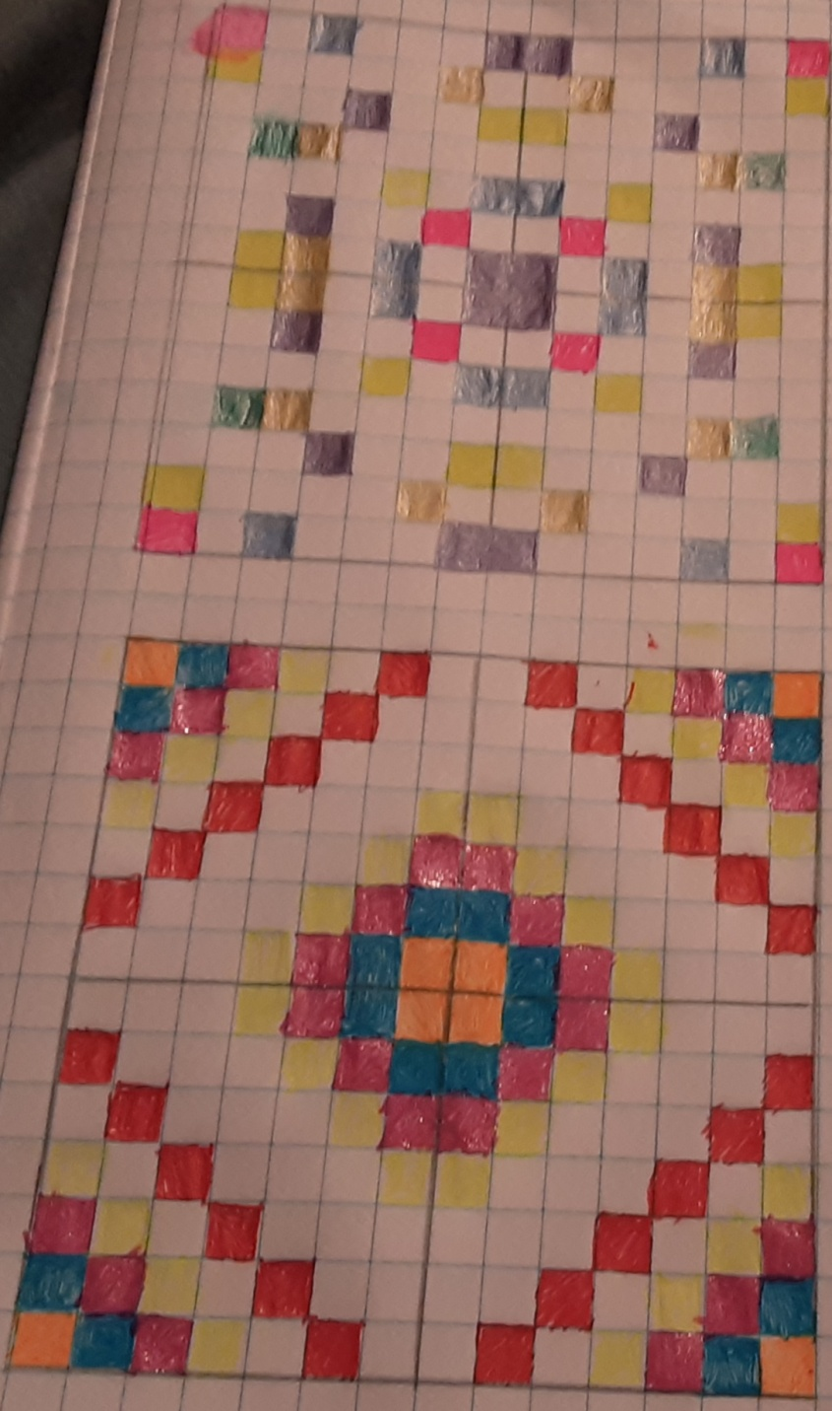
Here’s what Y5&6 have been
focusing on at home today.
Lucy has been working well on her reflections in maths.

Slide 28
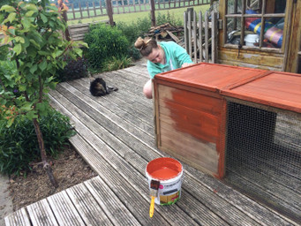
What else have we been doing at home today?
Megan has been painting the guinea pig cage.

Slide 29
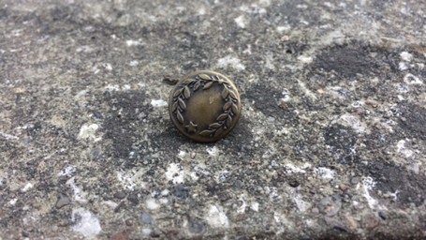
What else have we been doing at home today?
Megan found a button with a laurel wreath on it.

Slide 30
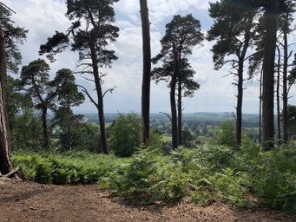
What else have we been doing at home today?
Sophie enjoyed a 4 mile walk around Grinshill.

Slide 31
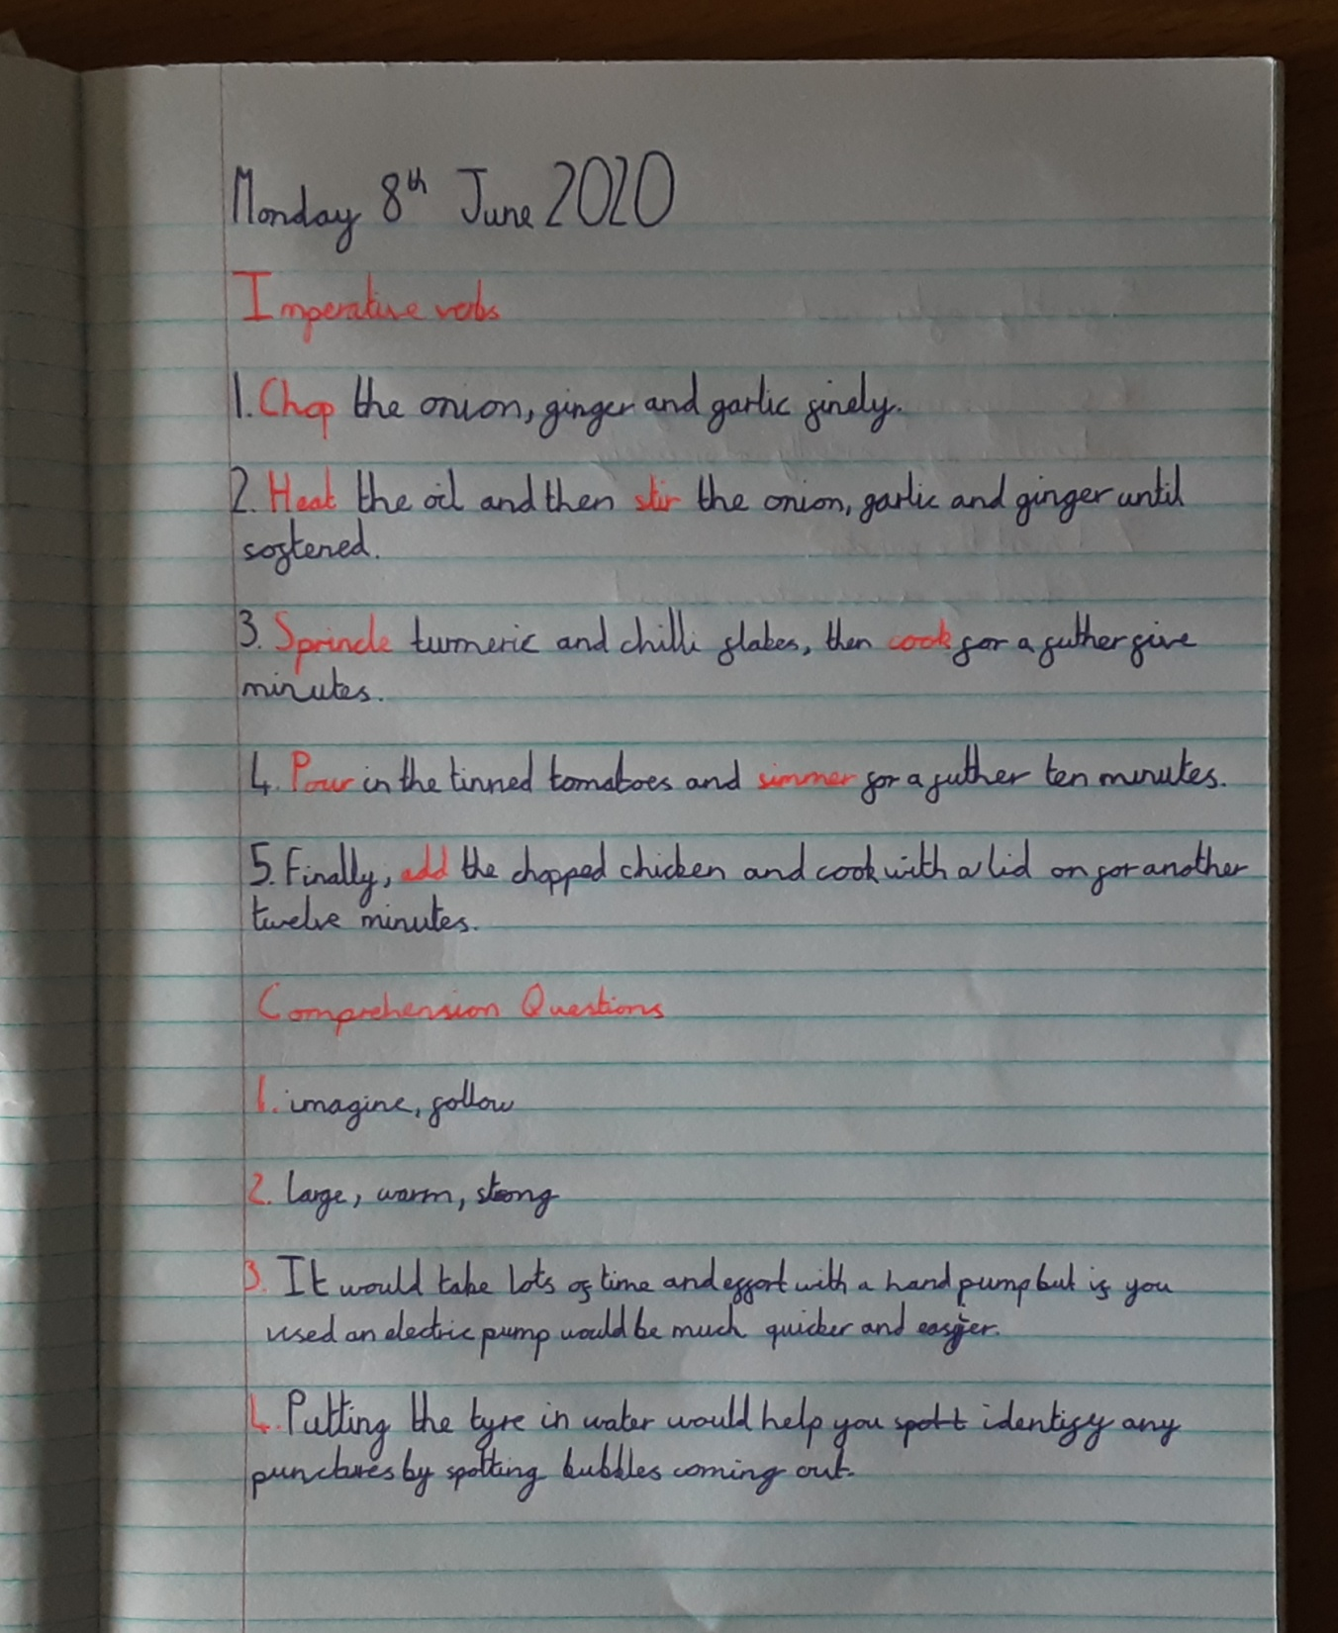
What else have we been doing at home today?
Lucy read the instruction text really carefully yesterday.

Slide 32
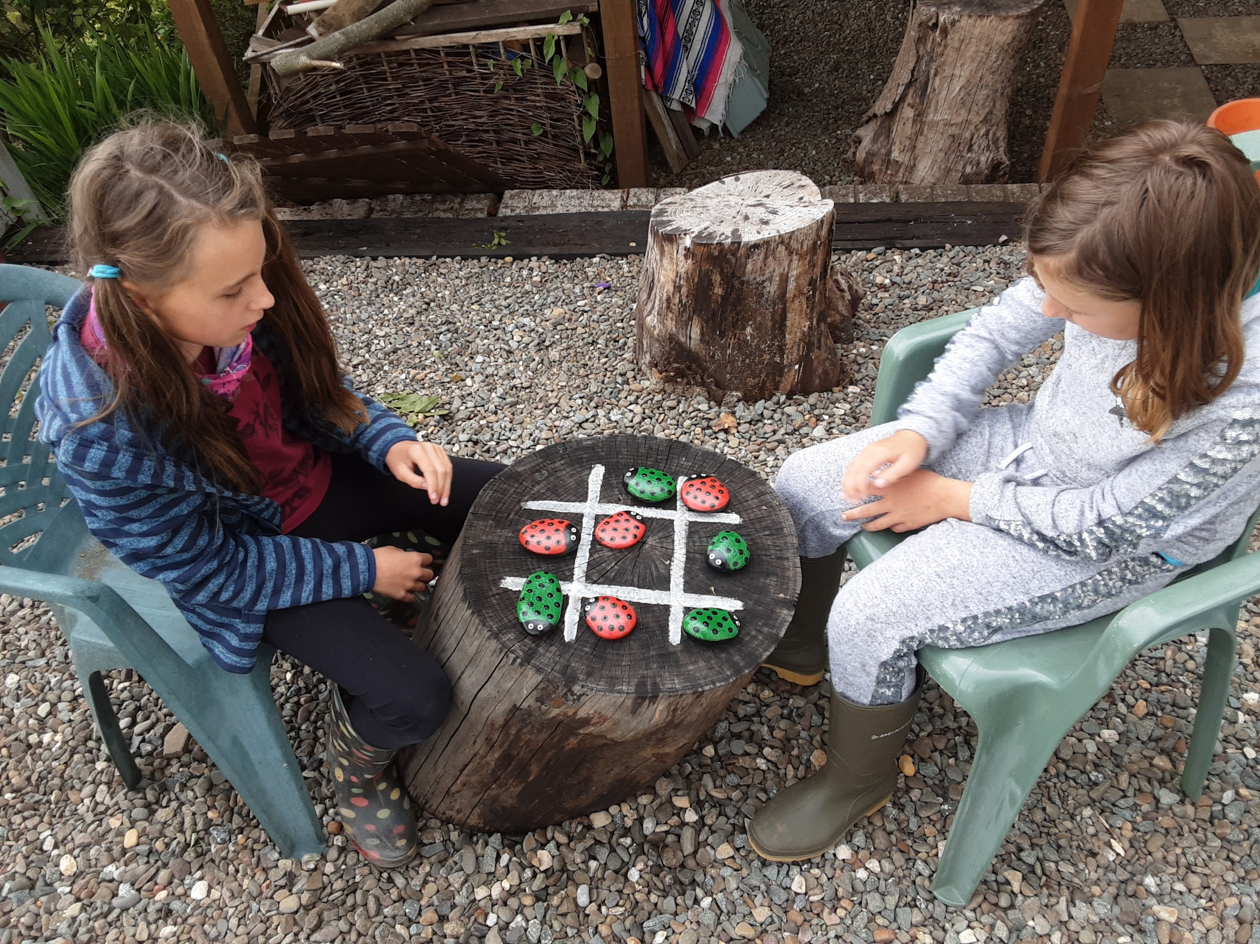
What else have we been doing at home today?
We enjoyed a game of noughts and crosses (well, kind of)

