Slide 1
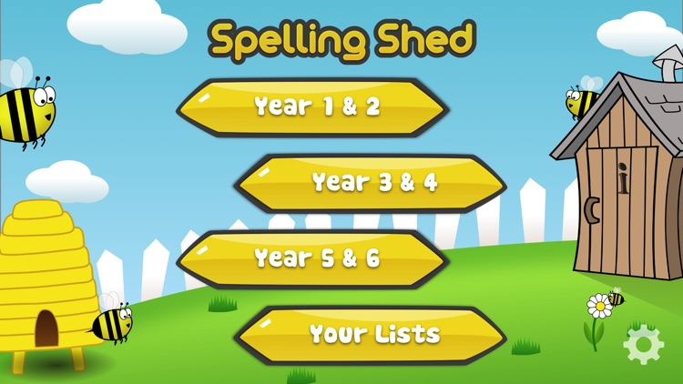

Y5&6 TOP SPELLERS YESTERDAY
1st = Dante 34 points
2nd = Chloe 21 points
3rd = Henry 18 points
4th = Jack 14 points
5th = Nelly 12 points
6th= Bethany 11 points
7th = Nia and Lucy 9 points
8th = Reuben and Lily points
9th = Elizabeth and Katie 6 points
These are the amount of dojos you have received for your efforts today!
Everybody else earns 1 dojo for practising their spellings today!

Slide 2
Y5&6 TOP SPELLERS TODAY
1st = Nia 17 points
2nd = Jack 9 points
3rd = Chloe and Reuben 8 points
4th = Dante 6 points
5th = Megan 5 points
^{6th} = Amy and Bethany 4 points
7th = Elizabeth, Zac and Ruby 3 points
8th = Lily and Henry 2 points
9th = Rhys and Harvey 1 point
These are the amount of dojos you have received for your efforts today!
Everybody else earns 1 dojo for practising their spellings today!

Slide 3
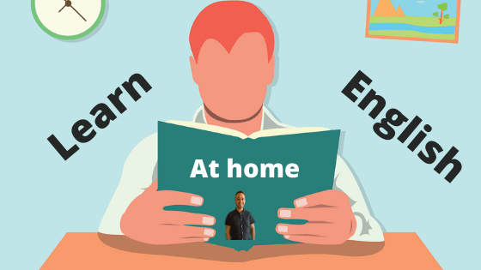
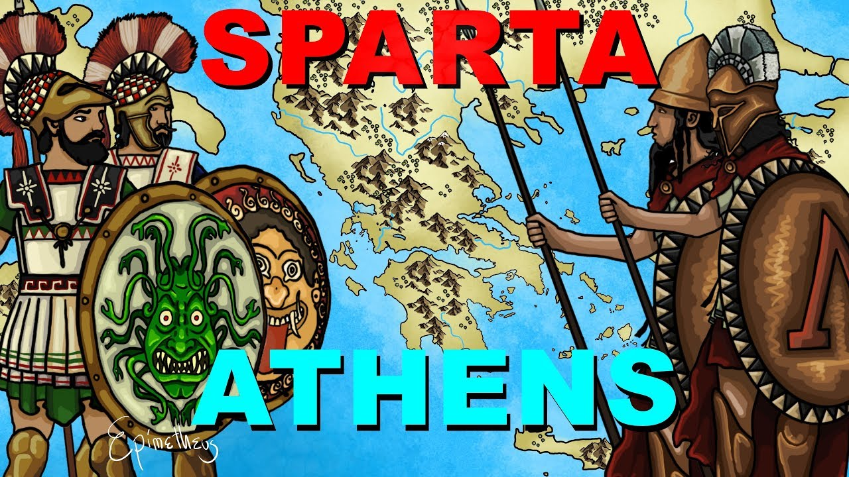
What have we been
studying today in English (History) at home and at school?

Slide 4

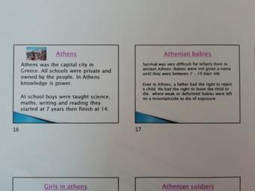
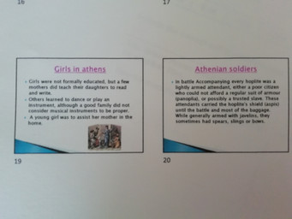
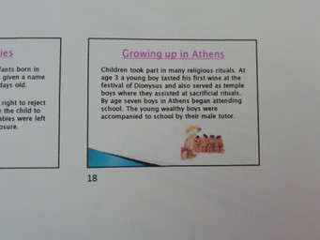
Here’s what Y5&6 have been focusing on at home and at school today
Amy has been gathering her researching for what life was like for the young Athenian children at school and growing up in Ancient Greece.

Slide 5
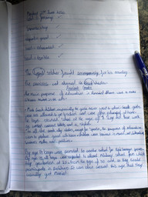
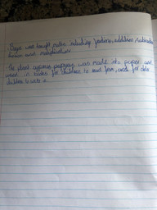
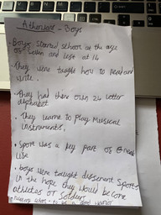
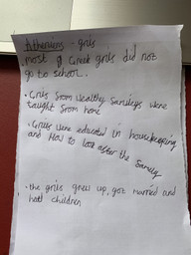
Here’s what Y5&6 have been focusing on at home and at school today
Harvey and Henry have been gathering her researching for what life was like for the young Athenian children at school and growing up in Ancient Greece.

Slide 6
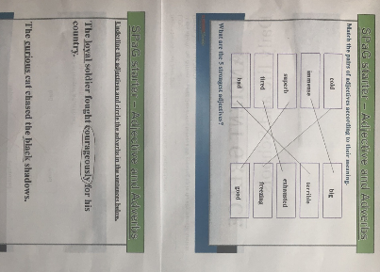
Here’s what Y5&6 have been focusing on at home and at school today
Nia has been matching and finding adjectives and adverbs.

Slide 7
School life for Athenian girls
As girls didn’t attend school, they were taught (at home) by their mother or private tutor. While they were there, they were educated on being a good mother and how to do the housework. How would you like to have been a Athenian girl in Ancient Greece?
Bethany has been learning about the Athenian children at school.

Slide 8
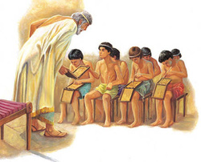
School life for Athenian Boys
Boys were taught at home until around the age of 6; then they went to school where they learned how to read and write.
They also learned: the poetry of Homer, how to debate, how to give a persuasive speech, math, science and how to play a musical instrument (usually the flute or the lyre.) The boys had physical education where they learned sports and gymnastics. They ended school at 14. After high school, boys attended military school where they learned to be good warriors.
Bethany has been learning about the Athenian children at school.

Slide 9
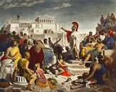
Jobs of Athenian boys and girls
When they left school most boys went into politics and may have gone to war. Girls stayed at home doing housework and looking after children.
Bethany has been learning about the Athenian children at school.

Slide 10
Athens
Elizabeth has been learning about the Athenian children at school.
Girls education
As girls didn’t attend school, they were taught (at home) by their mothers or private tutor on music, art, English, maths poetry and reading. While they were there they were educated on being a good mother and how to do the house-work. How would you deal with being an Athenian girl at home? When the girls grow up they don’t do much but stay inside and be an isolated mum.

Slide 11
Athens
Elizabeth has been learning about the Athenian children at school.
Boys education
Up to the age of 7 years old boys were taught at home . When they were ready boys would go to school until they were 14 (7 years) and in that time they were taught: music, art, English , science, math, politics, poetry and reading. When boys grew up they would become soldiers, philosopher, politician, play righter, teacher, musician and farmer.

Slide 12
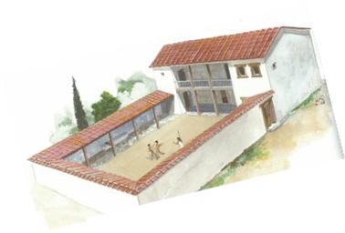
Athens
Education for boys
Unlike the girls, boys went to school (σχολείο in Greek) to be educated in Maths, literature, reading, poetry, music and politics. However, even though an education was very important for boys, they still only stayed in school until they were 14.
They also took a slave with them; if they broke the rules then they were there to punish them by whipping or beating.
Reuben has been learning about the Athenian children at school.

Slide 13
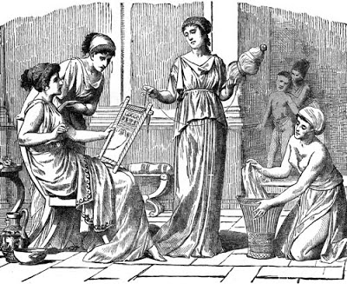
Education for girls
As girls didn’t attend school, they were taught (at home) by their mother or private tutor. While they were there, they were educated on being a good mother and how to look after the house.
Only very lucky girls had a tutor who would teach them Maths, reading, writing, poetry and music.
Would you like to be a girl in ancient Athens?
Reuben has been learning about the Athenian children at school.

Slide 14
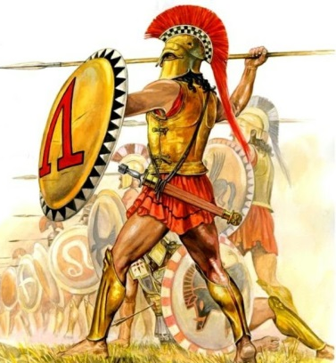
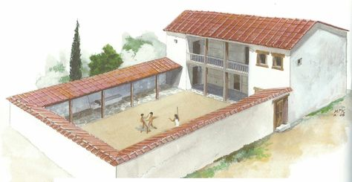
Jobs in Athens
Men could have many jobs including: farmer, fisherman, soldier, teacher, government worker, craftsman, philosopher or actor.
On the other hand, girls didn’t really get a job; instead they did bought up the children, cooked the meals and cleaned.
Reuben has been learning about the Athenian children at school.

Slide 15
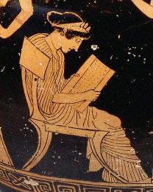
Education for girls
As girls didn’t attend school, they were taught by their mother as a private tutor. While they were there, they were educated on being a good mother or wife and how to do the homework.
Lily has been learning about the Athenian children at school.

Slide 16
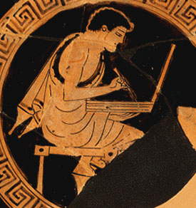
School life for boys
Unlike girls, boys went to school and learnt music, art, literature, science, maths and politics. They started school at the age of 6 and ended when they were 14.
Lily has been learning about the Athenian children at school.

Slide 17
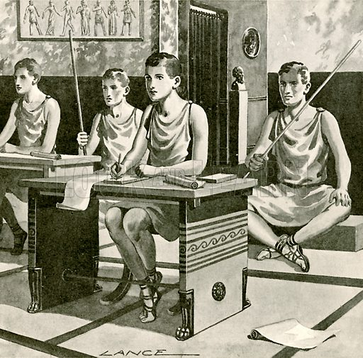
Athens
School For Boys
For boys, school was immensely important. At first, they would be educated at home - -- like girls - but afterwards, they would finally attend. When they did come to school, they would learn: reading, writing, music, art, science, maths, poetry and politics. When they graduated from education at the age of 20, they would be expected to have jobs such as: politicians, actors, poets, philosophers and mathematicians. The reason they had these jobs was because the Athenian people were very cultural and liked these kinds of subjects. They loved all variety of entertainment including sports and performances. Would you have liked to have had these jobs after you left school in Athens?
Jack has been learning about the Athenian children at school.

Slide 18
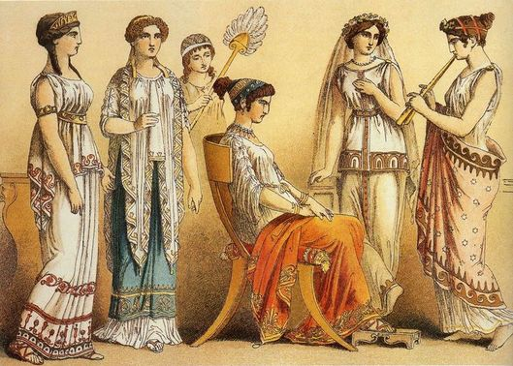
Athens
School For Girls
As girls didn’t attend school, they were taught by their mothers or by a private tutor (at home). While they were there, they would be educated on being a good mother and how to do the housework. Only girls with rich parents would have a tutor to teach them reading, writing and art. How would you have felt if you were stuck at home doing housework in Athens everyday?
Jack has been learning about the Athenian children at school.

Slide 19
GIRLS
As girls didn’t attend school ,they were taught (at home) by their mother or private tutors.
While they were there, they were educated on being a good mother and how to do the house work. How would you feel as a girl no going to school?
Chloe has been learning about the Athenian children at school.

Slide 20
BOYS
When boys turned the age of 6 they went to school .They didn’t learn how to look after a baby or how to do the cooking . Instead they were taught, music, art, literature, science, maths and politics however they weren't educated for long. At the age of 14 they left to either go to work or just staying at home and going out with friends.
Chloe has been learning about the Athenian children at school.

Slide 21
School life for boys and girls
Boys
They went to school at age 5 and left at age 14.They were taught maths, reading and writing, economy, art and poetry.
Girls
They didn’t actually go to school. they were taught at home by there mothers or a tutor if they were wealthy .
Zac has been learning about the Athenian children at school.

Slide 22
Jobs
There were many jobs for men in Ancient Greece including farmer, fisherman, soldier, teacher, government worker, and craftsman.
The women however, raised the children and cooked the meals.
Zac has been learning about the Athenian children at school.

Slide 23
Girls life
As girls didn’t attend school. they were taught by their mothers (at home) or a privet tutor. While they were there they were educated on house keeping and how to be a great mother. How do you think you would feel having to learn how to be a mother at the age of 5?
Megan has been learning about the Athenian children at school.

Slide 24
Boys life
Schools for boys was actually aloud. At first their mothers would tutor them until the age of 6, then at the age of 7 they would start attending a school or σχολείο (that’s how the Greek spell school) and would stay until 14.The child was trained in: music, art, literature, science, maths and politics; they were lucky to have learned all of that.
Megan has been learning about the Athenian children at school.

Slide 25
Education for girls
As girls didn’t attend school, they were taught (at home) by there mothers or private tutor if rich. While they were there, they were educated how to do the housework and how to be a good mother just like they had been taught. If they were really lucky, there private tutor would occasionally teach them reading and writing. Would you like to be an Athenian girl and have to do all the housework and not be appreciated?
Ruby has been learning about the Athenian children at school.

Slide 26
Education for boys
On the other hand, school was very important so the boys had to attend. Until the age of six, boys were educated just like the girls….. at home by their mother! When they were 7, they attended school. The teacher at the school would always be a male. They studied: Art, Music, Literature, Maths, Science, Politics and Physical Education. If the boys were badly behaved, the tutor ( the one they brought with them) would bring a stick that they used for whipping and beating. Even though school was important for the boys, they left school at 14. When the boys are 16, their basic education was complete. The boys who didn’t work studied all of the sciences and Philosophy.
Ruby has been learning about the Athenian children at school.

Slide 27
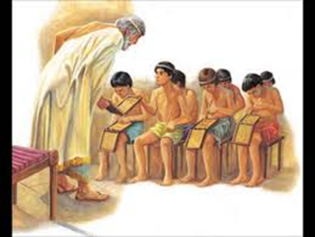
Here’s what Y5&6 have been focusing on at home and at school today
Athenians – How They Were Educated
Henry has been learning about the Athenian children at school.

Slide 28
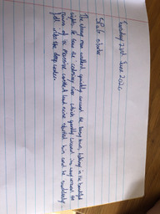
Here’s what Y5&6 have been focusing on at home and at school today
Harvey has been revising his use of adjectives and adverbs in sentences today.

Slide 29
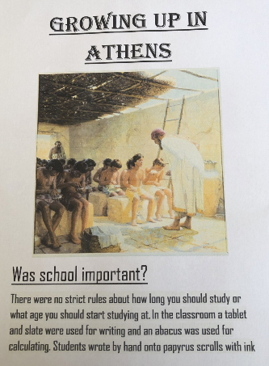
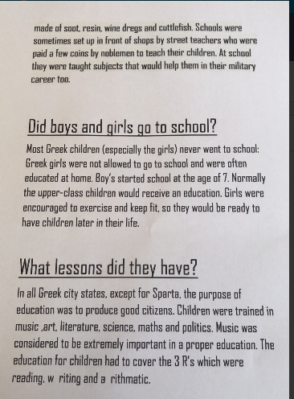
Here’s what Y5&6 have been focusing on at home and at school today

Slide 30
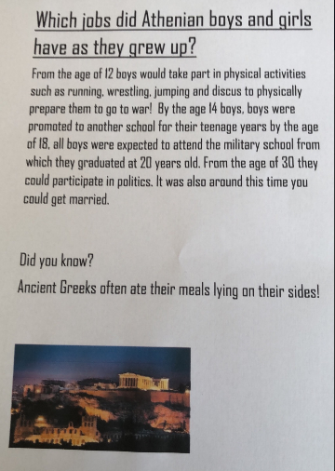
Here’s what Y5&6 have been focusing on at home and at school today
Harvey’s been learning about the life of ancient Athenians at school.

Slide 31
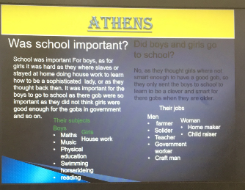
Here’s what Y5&6 have been focusing on at home and at school today
Zoe’s been learning about the life of ancient Athenians at school.

Slide 32
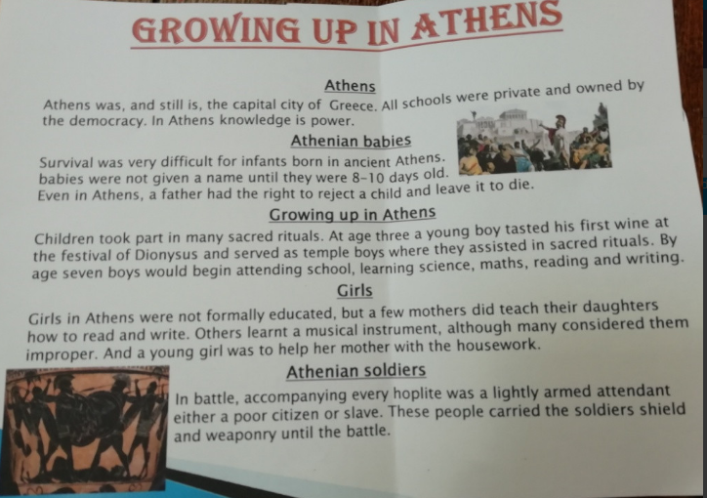
Here’s what Y5&6 have been focusing on at home and at school today
Amy’s been learning about the life of ancient Athenians at school.

Slide 33
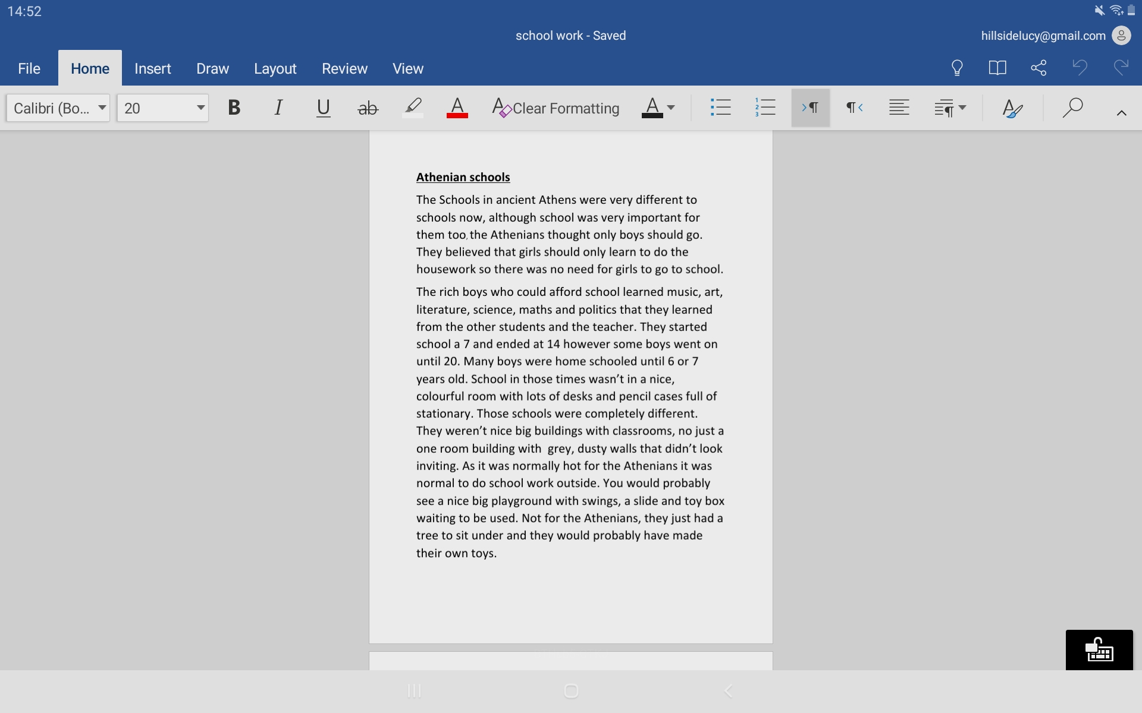
Here’s what Y5&6 have been focusing on at home and at school today
Lucy’s been learning about the life of ancient Athenians at school.

Slide 34
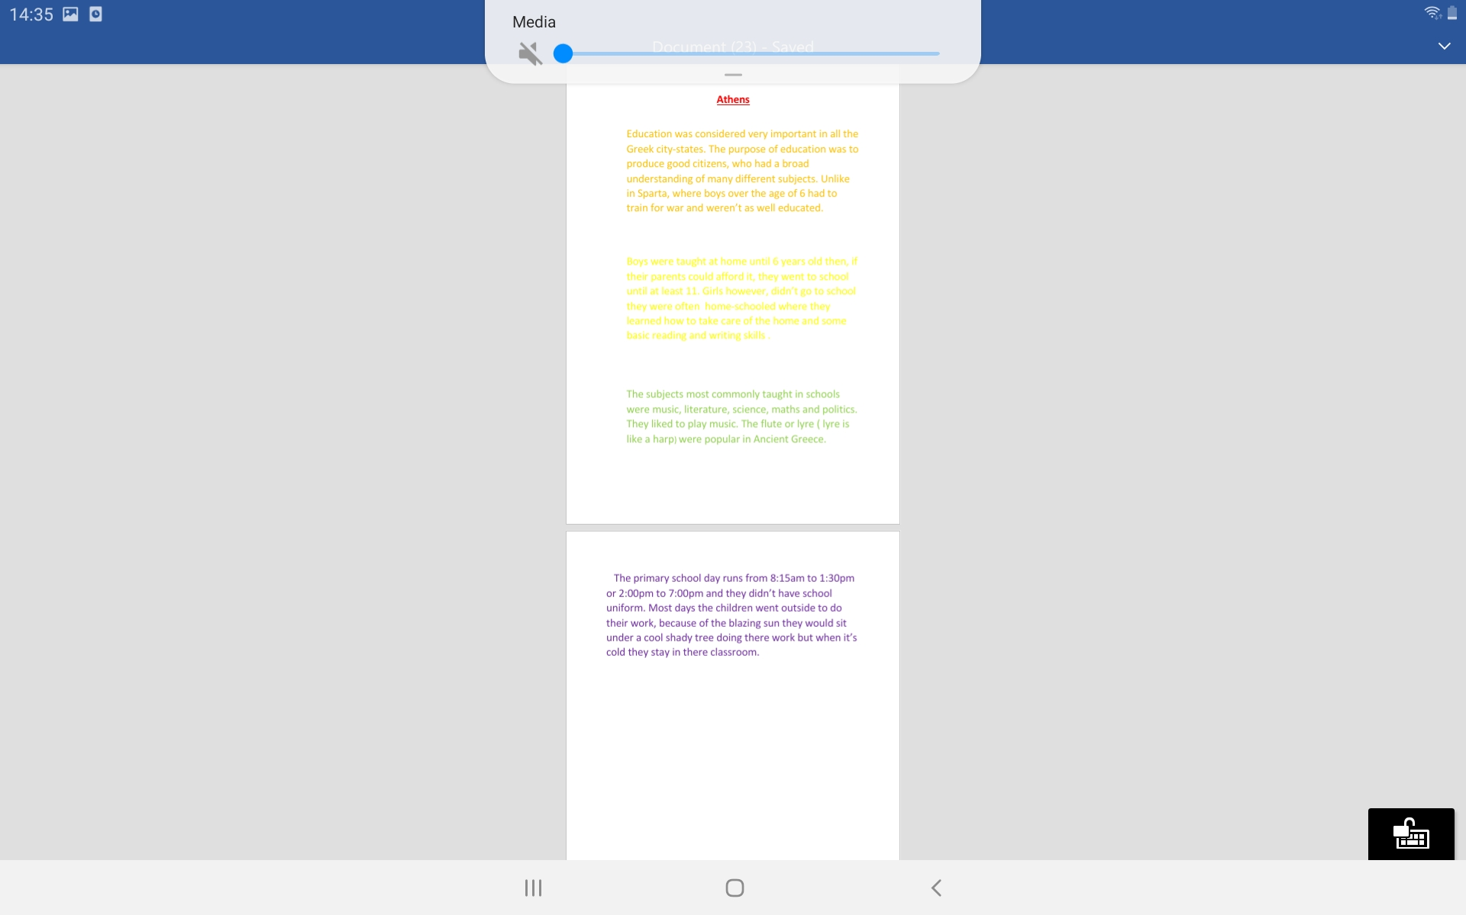
Here’s what Y5&6 have been focusing on at home and at school today
Katie’s been learning about the life of ancient Athenians at school.

Slide 35

Athens
Life for men
Boys age 6 would be tutored then would be off to primary only leaving once reaching the age of fourteen. In ancient Greek, Athens was the main place for learning as it was the intellectual center of Greece. At school in Athens you would learn music, Grammata (like English) and physical education. The boys would then do jobs until their 16th , when they would’ve had the choice to either learn science and philosophy or do more jobs. Two years later all men their age would have to take military training then join the army.
Life for women
Girls had a very simple life and, as children they very rarely left their home. They would be tutored by their mother in order to encourage them to do the same with their children. The reason girls were tutored and didn’t often leave their home was, to make them a better house cleaner when they grew up.
Would you have liked to live a Athean life? You would have a controlled life but would you sacrifice that to see the first democracy and some of the most beautiful buildings in the world its your choice…
Life for women
Girls had a very simple life and, as children they very rarely left their home. They would be tutored by their mother in order to encourage them to do the same with their children. The reason girls were tutored and didn’t often leave their home was, to make them a better house cleaner when they grew up.
Would you have liked to live an Athenian life? You would have a controlled life but would you sacrifice that to see the first democracy and some of the most beautiful buildings in the world its your choice…
Cameron’s been learning about the life of ancient Athenians at school.

Slide 36
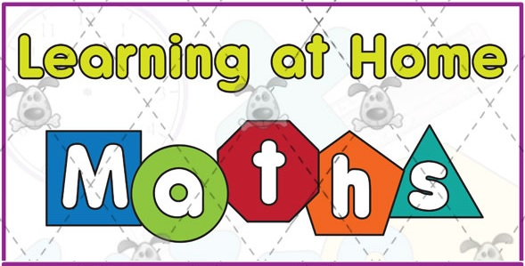
Here’s what Y5&6 have been
focusing on at home today.

Slide 37
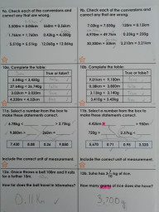
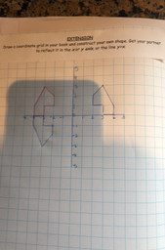
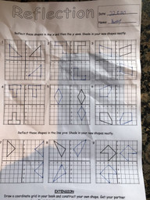
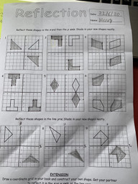
Here’s what Y5&6 have been focusing on at home today.
Henry has been working hard on his reflections of shapes in the x-axis and y-axis.
Harvey has been working hard on his reflections of shapes in the x-axis and y-axis.
Amy has been working hard on her understanding of kg/g and km/m today.

Slide 38
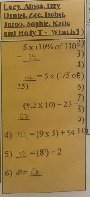
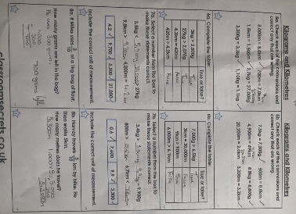
Here’s what Y5&6 have been focusing on at home today.
Nia has been practising her calculations and then working on her understanding of kg/g and km/m.

Slide 39
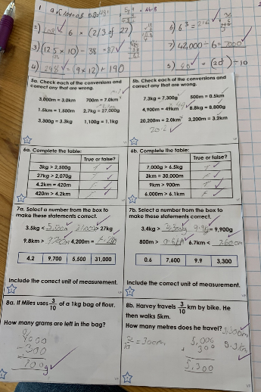
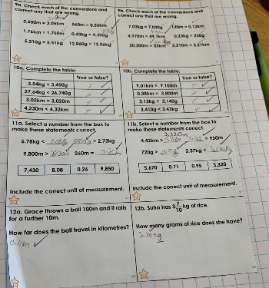
Here’s what Y5&6 have been focusing on at home today.
Zoe has been practising her calculations and then working on her understanding of kg/g and km/m.

Slide 40
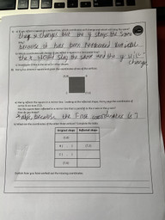
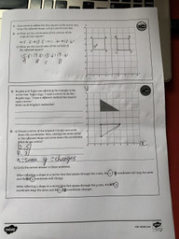
Here’s what Y5&6 have been focusing on at home today.
Henry has been thinking about the meaning of the co-ordinates and whether the x-axis or y-axis changes after reflection.

Slide 41
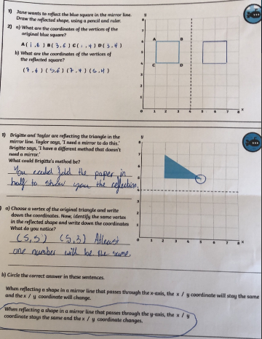
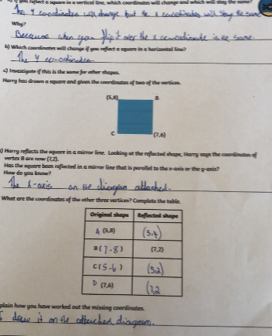
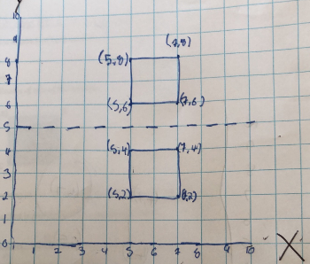
Here’s what Y5&6 have been focusing on at home today.
Harvey has been thinking about the meaning of the co-ordinates and whether the x-axis or y-axis changes after reflection.

Slide 42
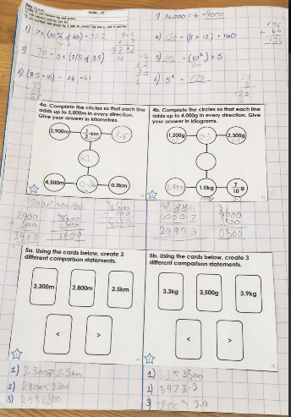
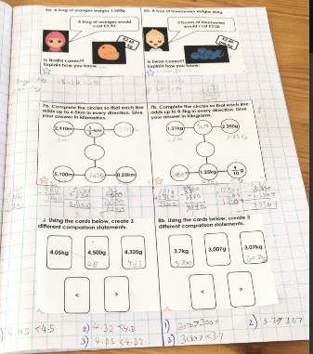
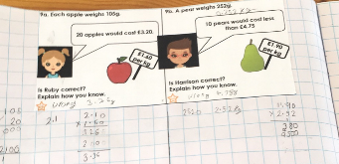
Here’s what Y5&6 have been focusing on at home today.
Zoe has continued to develop her understanding of kg/g and km/m.

Slide 43
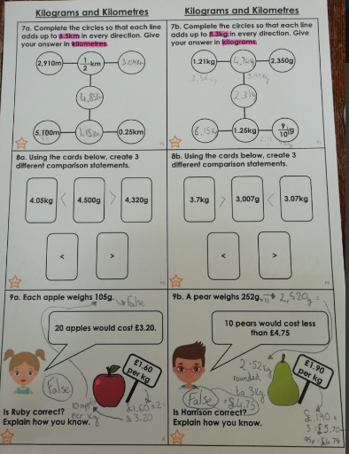
Here’s what Y5&6 have been focusing on at home today.
Amy has continued to develop her understanding of kg/g and km/m.

Slide 44
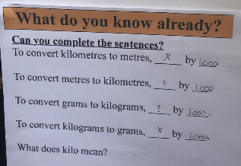
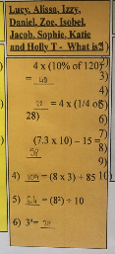



Here’s what Y5&6 have been focusing on at home today.
Nia has continued to develop her understanding of kg/g and km/m, as well as practising and showing excellent progress in her calculations.

Slide 45





Here’s what Y5&6 have been focusing on at home today.
Cameron has (once again,) worked really hard on his maths today.

Slide 46

Here’s what Y5&6 have been focusing on at home today.
Lucy has (once again,) worked really hard on her maths today.

Slide 47


Here’s what Y5&6 have been focusing on at home today.
Katie has (once again,) worked really hard on her maths today.

Slide 48

Here’s some of last week’s work that has been produced recently at home.

Slide 49

What else have we been doing recently?
Nia has been learning about the work of Jane Goodall and her experiences with chimpanzees in Tanzania.

Slide 50



What else have we been doing recently?
Nia has been working on her reflecting and recognising coordinates skills.

Slide 51

What else have we been doing recently?
Nia has been working really hard creating her mammal life cycles.

Slide 52

What else have we been doing recently?
Lucy has been working really hard creating her maths this week.

Slide 53

What else have we been doing recently?
Lucy has researched some excellent information about Athenian school children.

Slide 54



What else have we been doing recently?
Katie has researched some excellent information about Athenian school children.

Slide 55

What else have we been doing recently?
Toby has been attempting to reflect his shapes in either the x-axis or the y-axis.
Has the final shape been translated or reflected?

Slide 56

What else have we been doing recently?
I went for a lovely, afternoon walk up Haughmond Hill today.

Slide 57

What else have we been doing recently?
I’m being an instructor for my brother.

Slide 58

What else have we been doing recently?
Henry has been playing cricket in the back garden with his dad.

Slide 59

What else have we been doing recently?
Heidi has produced a superb piece of art work with her Spartan soldier.

Slide 60


What else have we been doing recently?
Amy says her soldier is Achilles, as his armour was all gold because his original one broke so Hephestus gave him some solid gold armour.

Slide 61

What else have we been doing recently?
Dante has also produced a very good piece of art work with his Spartan soldier.

