Slide 1
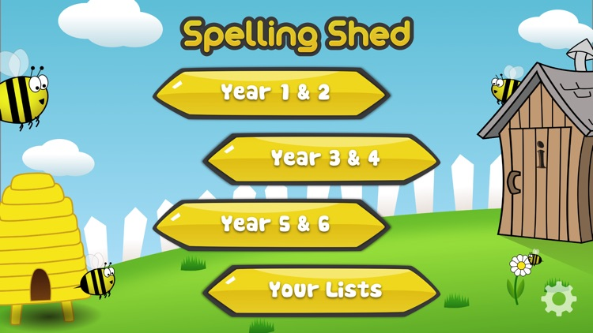
Y5&6 TOP SPELLERS TODAY
1st = Chloe 10 points
2nd = Amy 9 points
3rd = Rhys 8 points
4th = Ruby, Lucy and Lily 7 points
5t^{h} = Jacob 6 points
6th = Cassie and Nia 5 points
7th= Bethany, Holly H and Jack 4 points
8th = Reuben, Harvey and Megan 3points
9th = Elizabeth, Isobel, Cameron and Henry 2 points
These are the amount of dojos you have received for your efforts today!
Everybody else earns 1 dojo for practising their spellings today!

Slide 2
What have the Y5s been
studying today at home today?

Slide 3
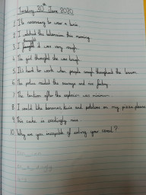
Here’s what the Y5s have been focusing on at home today in English.
Amy has been editing and amending the sentences provided.

Slide 4
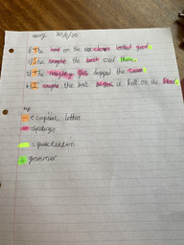
Here’s what the Y5s have been focusing on at home today in English.
Henry has been editing and amending the sentences provided.

Slide 5
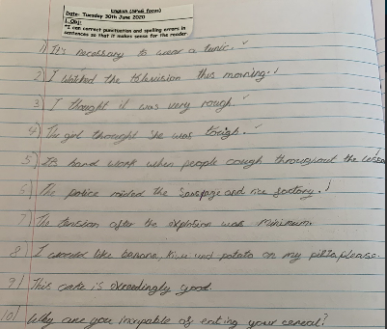
Here’s what the Y5s have been focusing on at home today in English.
Zoe has been editing and amending the sentences provided.

Slide 6
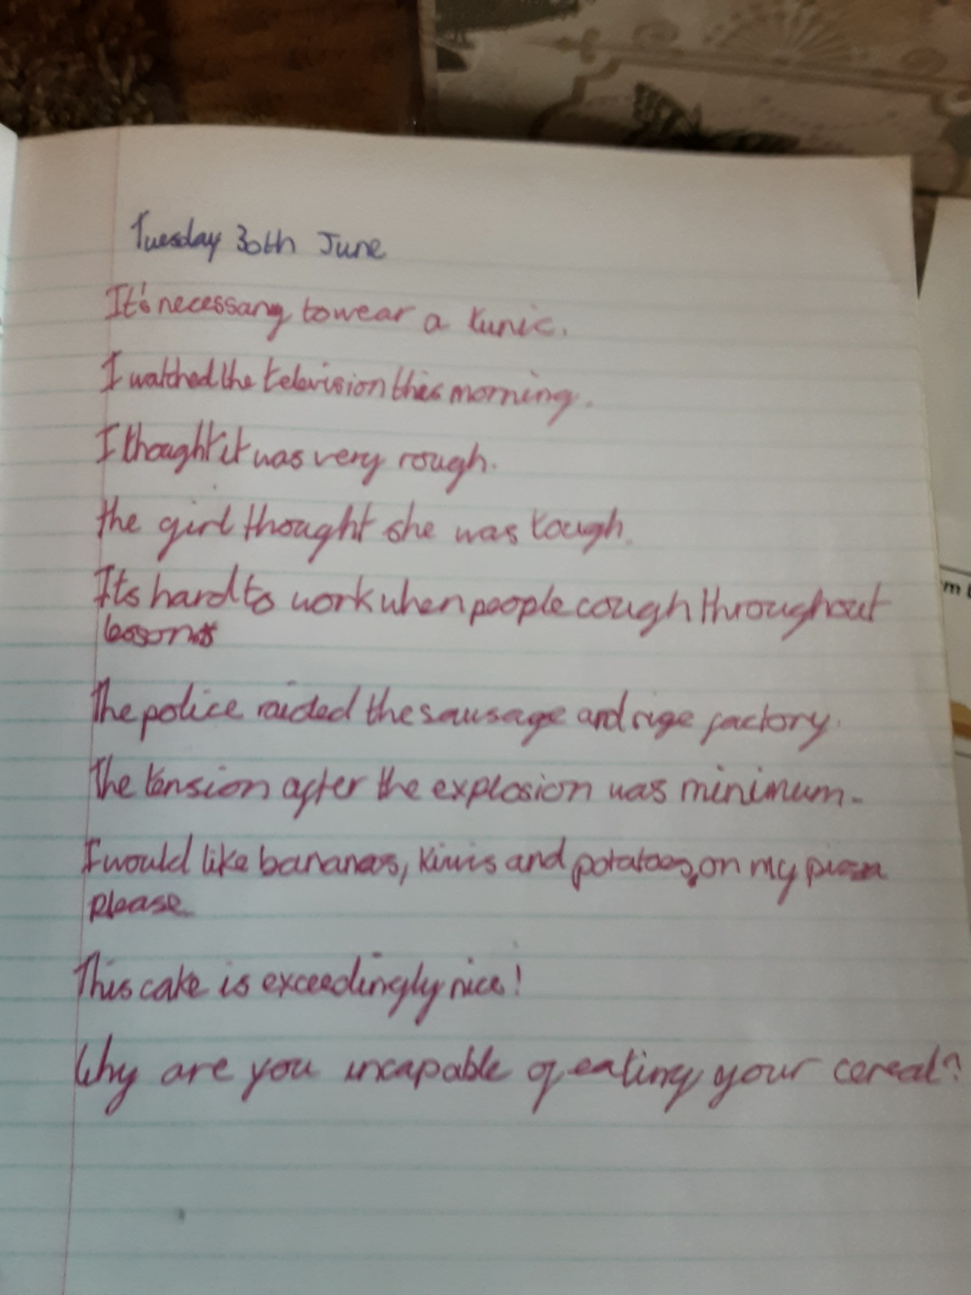
Here’s what the Y5s have been focusing on at home today in English.
Katie has been editing and amending the sentences provided.

Slide 7
Here’s what Y5&6 have been
focusing on at home today.

Slide 8
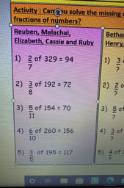
Here’s what Y5&6 have been focusing on at home today.
Cassie has been solving the missing DENOMINATORS in the fractions of numbers using a specific method.

Slide 9
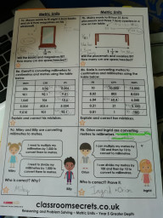
Here’s what Y5&6 have been focusing on at home today.
Amy has been using her knowledge of metres, centimetres and millimetres.

Slide 10
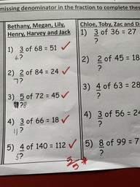
Here’s what Y5&6 have been focusing on at home today.
Henry has been solving the missing DENOMINATOR in these fractions of numbers

Slide 11
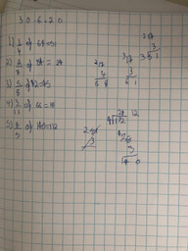
Here’s what Y5&6 have been focusing on at home today.
Harvey has been solving the missing DENOMINATORS in the fractions of numbers using a specific method.

Slide 12
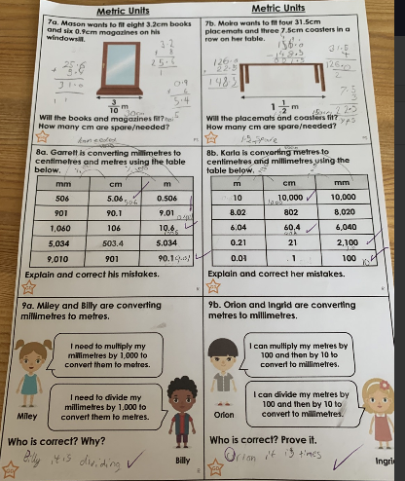
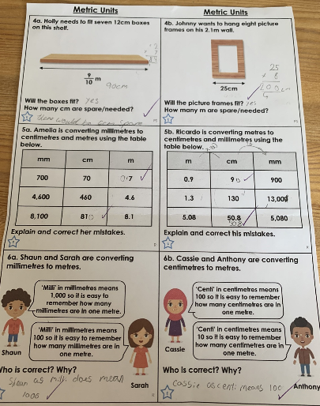
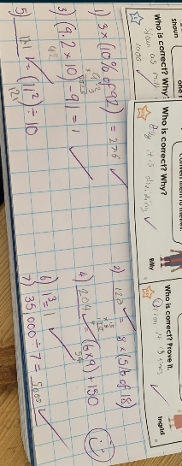
Here’s what Y5&6 have been focusing on at home today.
Zoe has been using her knowledge of metres, centimetres and millimetres.

Slide 13
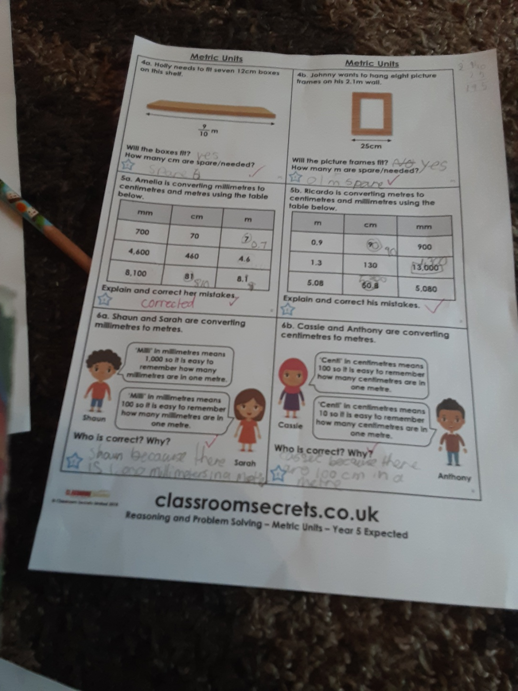
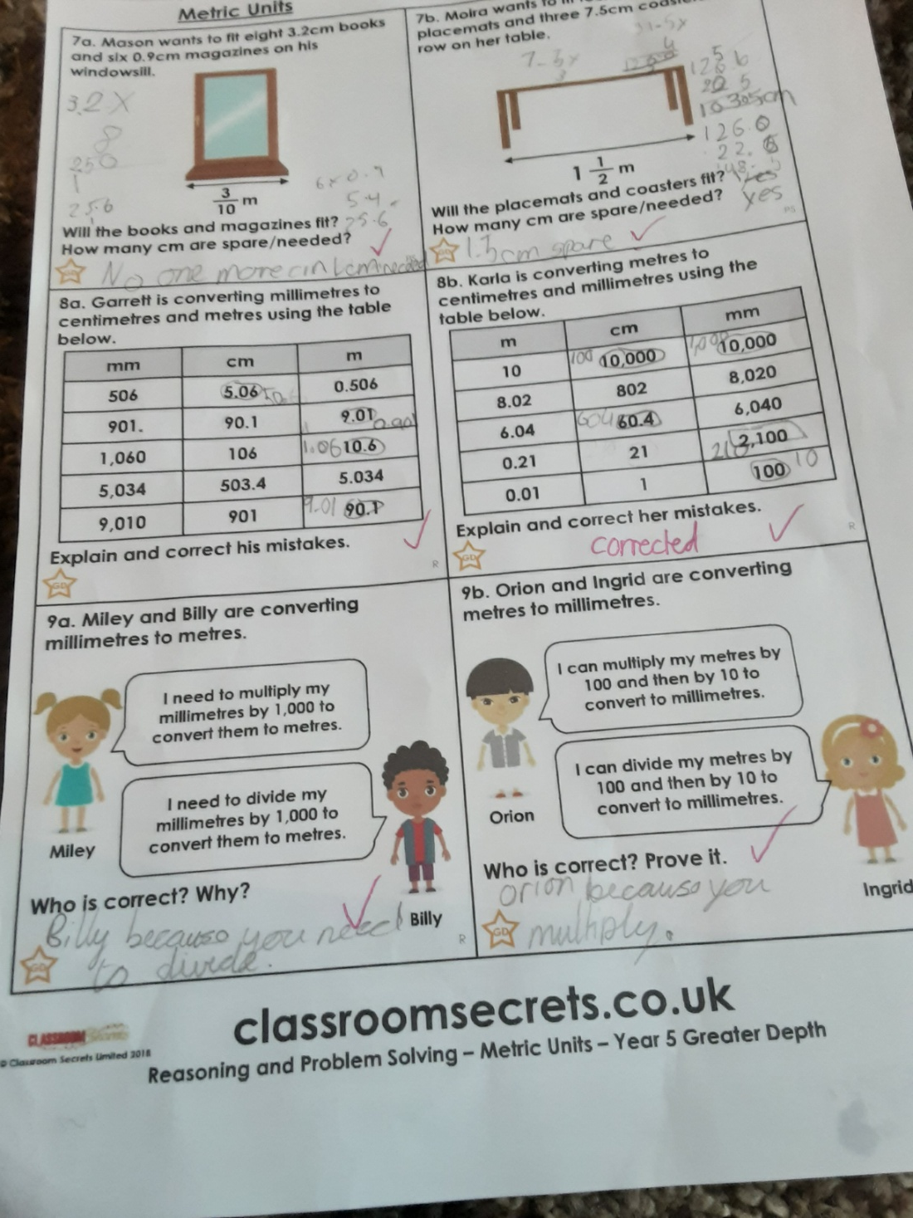
Here’s what Y5&6 have been focusing on at home today.
Katie has been using her knowledge of metres, centimetres and millimetres.

Slide 14
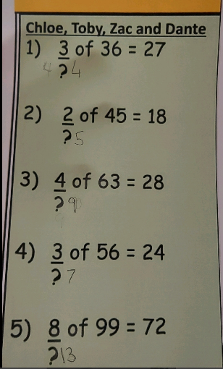
Here’s what Y5&6 have been focusing on at home today.
Dante has been attempting to solve the missing DENOMINATORS in the fractions of numbers using a specific method.

Slide 15
Here’s some of last week’s work that has been produced recently at home.

Slide 16
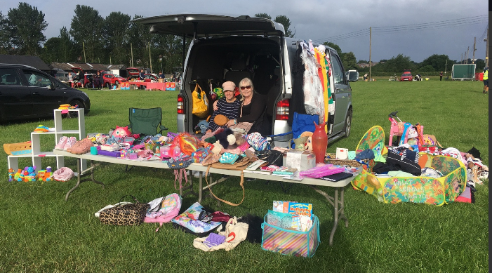
What else have we been doing recently?
I’ve had a car boot sale and raised enough money for me to redecorate my bedroom.

Slide 17
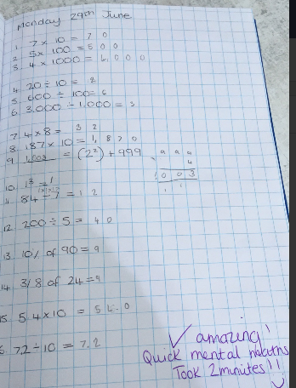
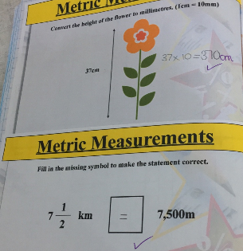
What else have we been doing recently?
Isla has been using her mental skills to solve these calculations and problems.

Slide 18
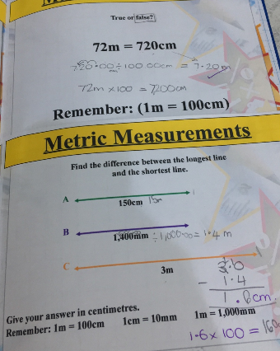
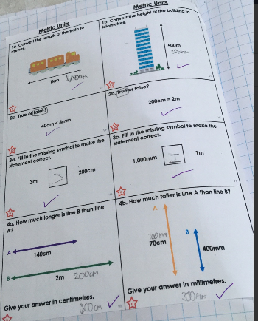
What else have we been doing recently?
More maths from Isla

Slide 19
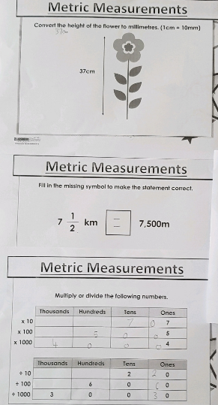
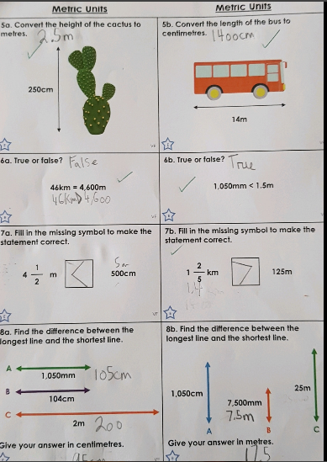
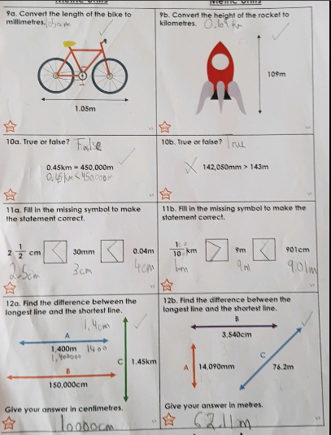
What else have we been doing recently?
Cameron has been thinking hard on his metric measurements in maths.

Slide 20
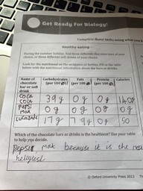
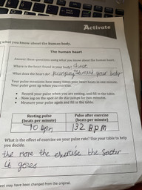
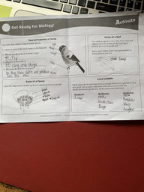
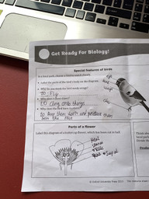
What else have we been doing recently?
Henry has been showing his biology understanding in preparation for Corbet School.

Slide 21
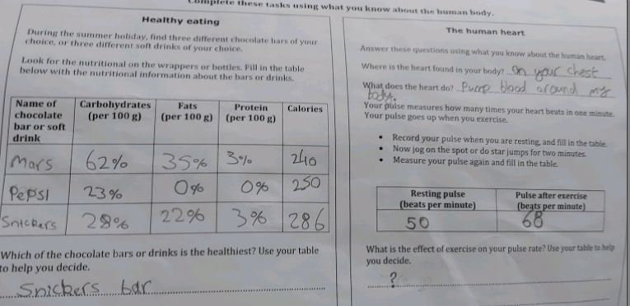
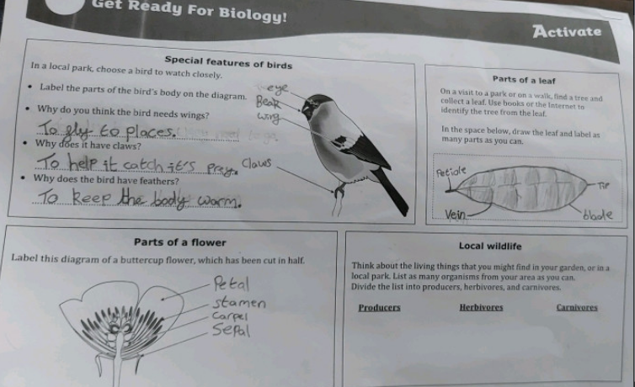
What else have we been doing recently?
Dante has been showing his biology understanding in preparation for Corbet School.

