Slide 1
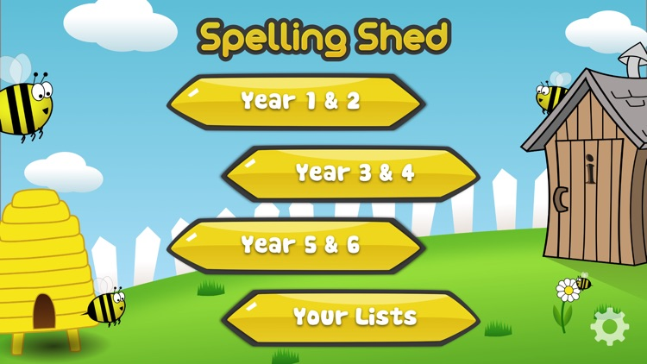
Y5&6 TOP SPELLERS TODAY
1st = Izzy 58 points
2nd = Lucy 50 points
3rd = Nelly 42 points
4th = Jack 32 points
5th = Katie 19 points
6th = Nia 13 points
7th = Isobel and Henry 10 points
8th = Amy 9 points
9th = Lily 5 points
These are the amount of dojos you have received for your efforts today!
Everybody else earns 1 dojo for practising their spellings today!

Slide 2
What have we been
studying today at home in my English / History work?

Slide 3
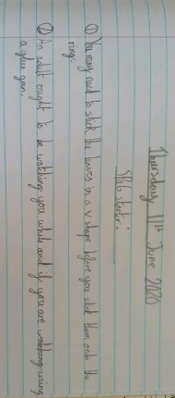
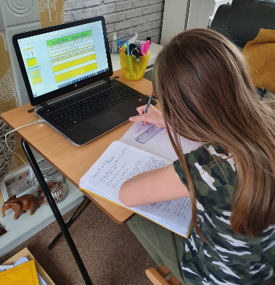
Here’s what Y5&6 have been focusing on at home today
Bethany is on task straight away with her imperative verbs.

Slide 4
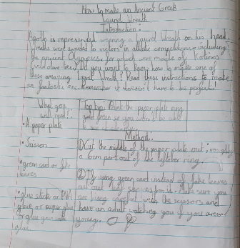
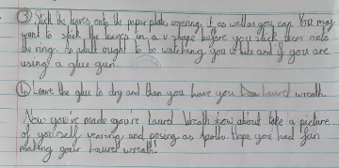
Here’s what Y5&6 have been focusing on at home today
Bethany’s superb, clearly-written instruction text, using a variety of quality English grammar and punctuation.

Slide 5
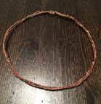
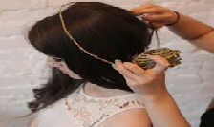
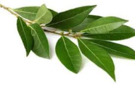
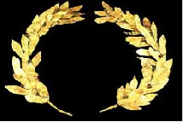
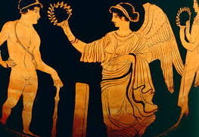
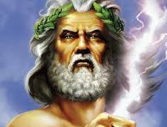
Here’s what Y5&6 have been focusing on at home today
How To Make A Laurel Wreath
You will need:
Wire
8-10 Laurel Leaves
Scissors
Glue Gun
Spray paint(Optional)
Introduction
Today you are going to learn how to make a Laurel Wreath that was used back in the Ancient Greek Olympics (776 BC).
Method
1) Firstly you need to cut the wire to the size of your head. You should make sure it is not to big or to small.
2) Next you need to make a loop on one end of the wire and a hook on the other end and join together to make a circle that fits your head securely! (An adult could help with this part.)
3) Then you need to lay out the Laurel leaves the way that you would like them to look each side. These can then be attached to the wire using the glue gun, (You must be careful when using the hot glue)
4) Finally you must wait for the glue to dry and make sure the laurel leaves are securely in place, you can spray the wreath any colour you wish. I would recommend gold.
Conclusion
Henry’s superb completed instruction text.
So finally you will have a replica wreath that the Greeks would have been proud of. Have fun making this ☺
Safety Tip
Be careful with the glue gun.
Be careful with sharp scissors.
The wire may also be sharp.

Slide 6
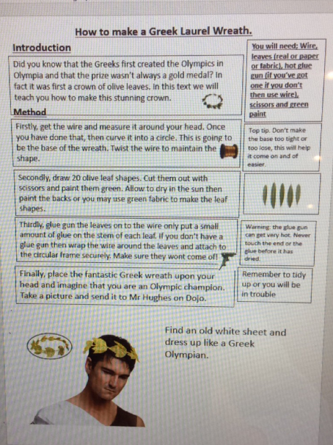
Here’s what Y5&6 have been focusing on at home today
Reuben’s completed instruction text using all of the key features

Slide 7
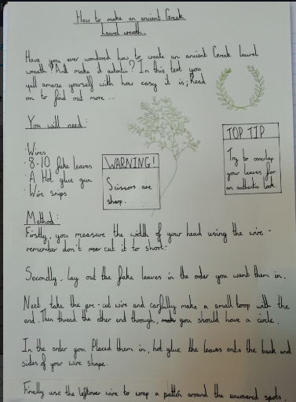
Here’s what Y5&6 have been focusing on at home today
Amy has completed her instruction text with a well-organised layout

Slide 8
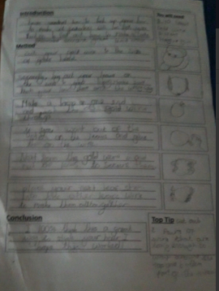
Here’s what Y5&6 have been focusing on at home today
Chloe has completed her instruction text today.

Slide 9
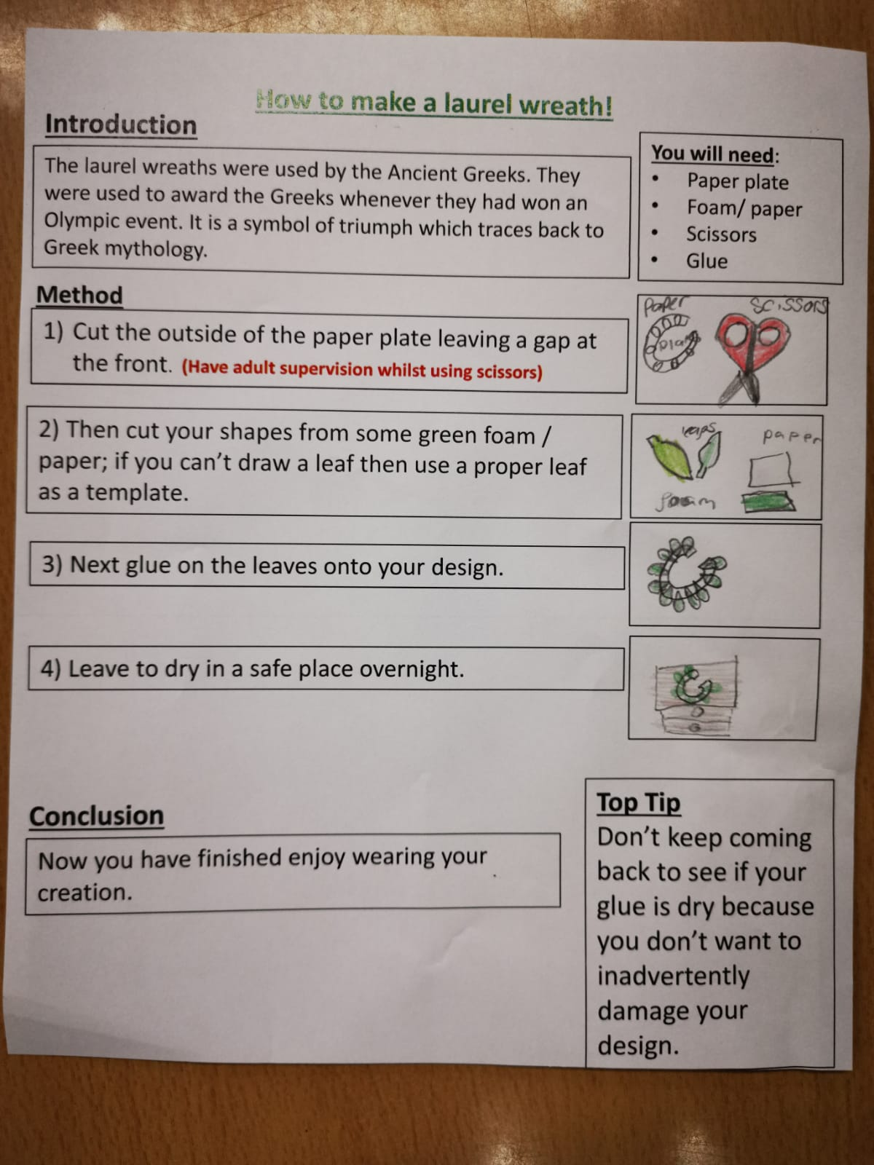
Here’s what Y5&6 have been focusing on at home today
Isobel has completed her instruction text.

Slide 10
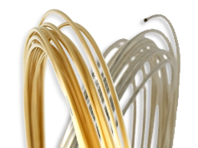
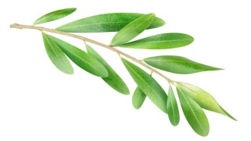
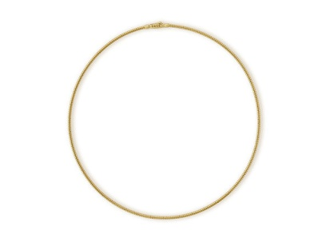
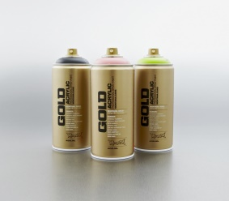
Here’s what Y5&6 have been focusing on at home today
How to make a laurel wreath
Introduction
Have you seen Greek wreaths and have been dreaming of wearing one? Just follow these simple steps; in no time you will be wearing a fashionable wreath just like the Greeks.
You will need:
Gold or silver wire (if silver wire was chosen you will need gold spray paint)
8-10 olive leaves.
Scissors
A hot glue gun (if you don’t have a hot glue gun get extra gold wire).
Method
With the help a sensible adult, cut your gold or silver wire to the diameter of your head.
Lay out your leaves so there are four to the left and four to the right leaving space at the top and bottom (five to the left and five to the right if you are using 10 leaves).
Find the end of your gold or silver wire then tie a loop. While doing this grab your other end and push it through the other loop and secure it safely (be careful of sharp pieces of wire).
If you picked silver wire now is the time to use the gold spray paint to make it gleam gold then wait for it to dry.
If a hot glue gun is at hand (don’t use without adult supervision) cut off the stems of the leaves and glue them on the way you laid them out.
If you don’t have a hot glue gun DON’T cut off the stems use the extra gold wire to wrap the stems of the leaf to the circle of gold wire in the position you laid them out in.
Conclusion Do you like your ancient Greek wreath? Now all you need to do is to hold a competition and award the winner with your new wreath.
Top Tip: Use green spray paint to make it look like its from the time of the Greeks.
Cameron has completed his instruction text.

Slide 11
Here’s what Y5&6 have been focusing on at home today
How to make an Ancient Greek Laurel Wreath
Have you ever sat in your room staring at the ceiling trying to think of something to do to pass the time as it was raining outside? Well I have the solution to all your problems! With this easy to follow instruction text, the rain will never leave you bored again. Read on to find out how to make the Ancient Greek Laurel Wreath…
What you will need:
8-10 olive leaves
Gold wires ( you can always spray paint them gold if you don’t have gold wire.)
Scissors. Ask a grown-up to help you if you are struggling.
A Hot glue gun is optional!
Method
1) First, you will need to cut your gold wire so that it will fit around your head. ( You don’t want to make it super loose or super tight as you want it to fit your head perfectly.) If you decided to spray paint your wire, make sure that you put newspaper underneath it!
2) Lay out your leaves over your base wire in the position you want. If I was you, I would lay them out so that there are 4 olive leaves on each side facing inwards; remembering to leave a gap at the top and bottom of the wreath.
3) Make a loop over one end while pushing the other end through the same loop and tighten securely.
4) Place the olive leaf somewhere away from the closing loops then cut a piece of gold wire (wherever you get the wire from) and place under the base wire. Then with the leaf (you placed onto the main wreath) get another piece of wire and tie it around the bottom of the leaf.
5) Go over the stem, then under the base wire; take it over the stem and this creates a loop. ( You don’t need the loop over the top of the leaf but personally it does look good!)
6) After that, you place it as a loop going over and under each leaf. When you get to the top of the leaf, you need to make sure it is secure by wrapping it round the end of the leaf. Beware! The main wire is very flammable so keep away from fire!
7) So then you grab another olive leaf and flip over your base wire. Then place it under the loop at the top of the previous leaf. And then do the exact same as step 7 until you have used all of your leaves.
8) The top and bottom of the wreath is very thin, so what you are going to do is cover the top and bottom part of the wreath with extra wire.
9) Cut out 2 pairs of wire that are long enough to wrap around the top and bottom of the wreath. (This is so it makes the wreath tighter.)
10) Then you are going to go over and under at the top and bottom of the base wire until you get a secure finish.
11) Finally, cut out smaller pieces of gold wire and secure the loose places on the wreath as well as pushing down loose wires that may injure your head. And there you have it! The Ancient Greek Laurel Wreath.
Ruby has completed her instruction text

Slide 12
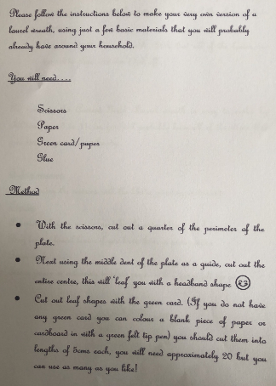
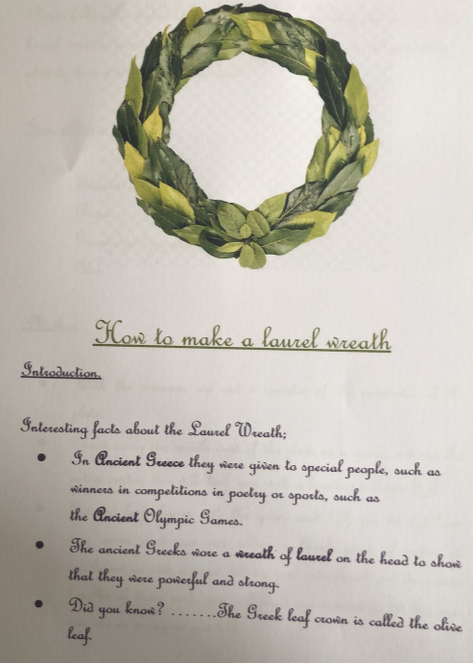
Here’s what Y5&6 have been focusing on at home today

Slide 13
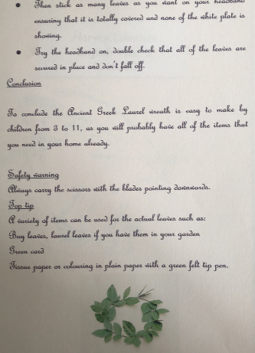
Here’s what Y5&6 have been focusing on at home today
Harvey has produced a wonderful, clear, effective instruction text.

Slide 14
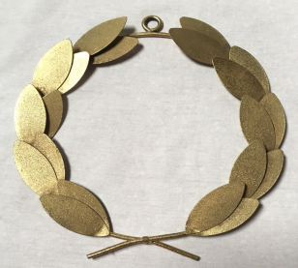
Here’s what Y5&6 have been focusing on at home today
Introduction
HOW TO MAKE AN ANCIENT GREEK LAUREL WREATH
Megan has produced a wonderful, clear, effective instruction text.
In ancient Greek times, when someone won an event at the Olympics, instead of getting a medal they would be presented with a laurel wreath. It’s really easy to make one for yourself!
Method
You will need:
Gold wire
8 plastic leaves
A hot glue gun (or Sellotape)
Wire cutters/scissors
Gold spray paint
glitter
First, measure the gold wire round your head so it is the perfect size to wear; then using your hot glue gun stick the ends of the wire together. (If you don’t have a hot glue gun use a bit of Sellotape.)
Then, get four of the plastic leaves and stick them onto one side of the circle, do the same with the other side-you must make sure they are facing the front.
Next, twist more wire round the parts of the wreath that don’t have leaves on it to make it a bit thicker.
SAFETY TIP!
Make sure an adult helps you with the hot glue gun.
Want to make your wreath look extra special? Spray the leaves with gold paint, then sprinkle with glitter! Leave to dry before your presentation ceremony!
Top Tip
Remember to use some news paper so your work surface doesn’t get gold spray paint on it.
Conclusion
I hope you’ve enjoyed making this headpiece. Make sure you strut around the house proudly wearing it like the true champion you are!

Slide 15
Here’s what Y5&6 have been
focusing on at home today.

Slide 16
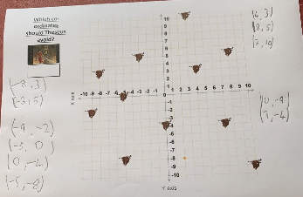
Here’s what Y5&6 have been
focusing on at home today.
Henry has been reflecting the minotaur’s co-ordinates correctly in both the x-axis (horizontal mirror line) and y-axis (vertical mirror line)

Slide 17
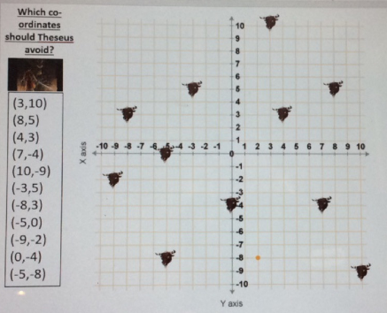
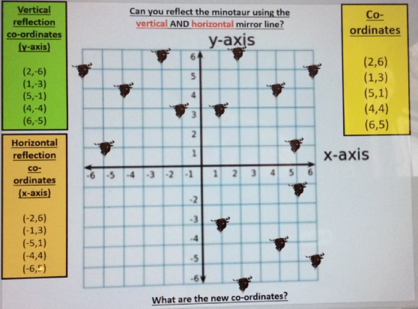
Here’s what Y5&6 have been
focusing on at home today.
Reuben has been reflecting the minotaur’s co-ordinates correctly in both the x-axis (horizontal mirror line) and y-axis (vertical mirror line)

Slide 18
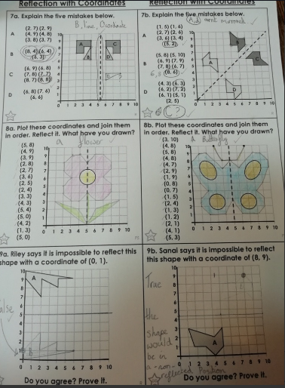
Here’s what Y5&6 have been
focusing on at home today.
Amy has reflected these shapes really well using the co-ordinates of each vertex to help her.

Slide 19
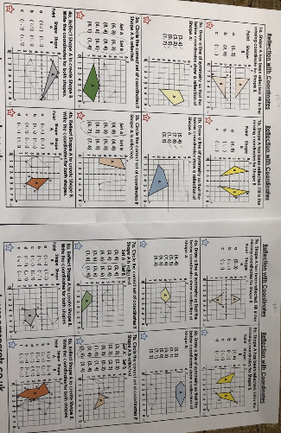
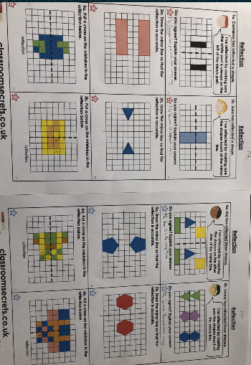
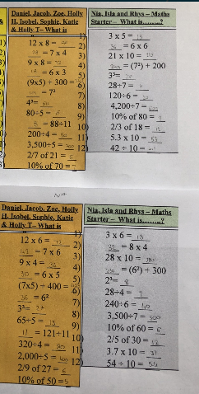
Here’s what Y5&6 have been
focusing on at home today.
Nia has reflected these shapes really well and been practising her calculations too.

Slide 20
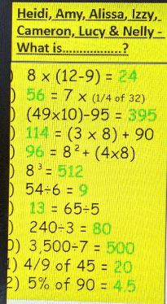
Here’s what Y5&6 have been
focusing on at home today.
Heidi has been practising her calculations.

Slide 21
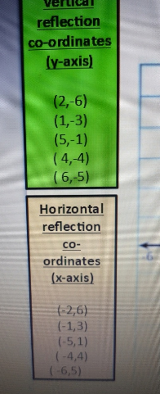
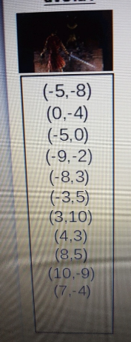
Here’s what Y5&6 have been
focusing on at home today.
Bethany has been identifying the new co-ordinates.

Slide 22
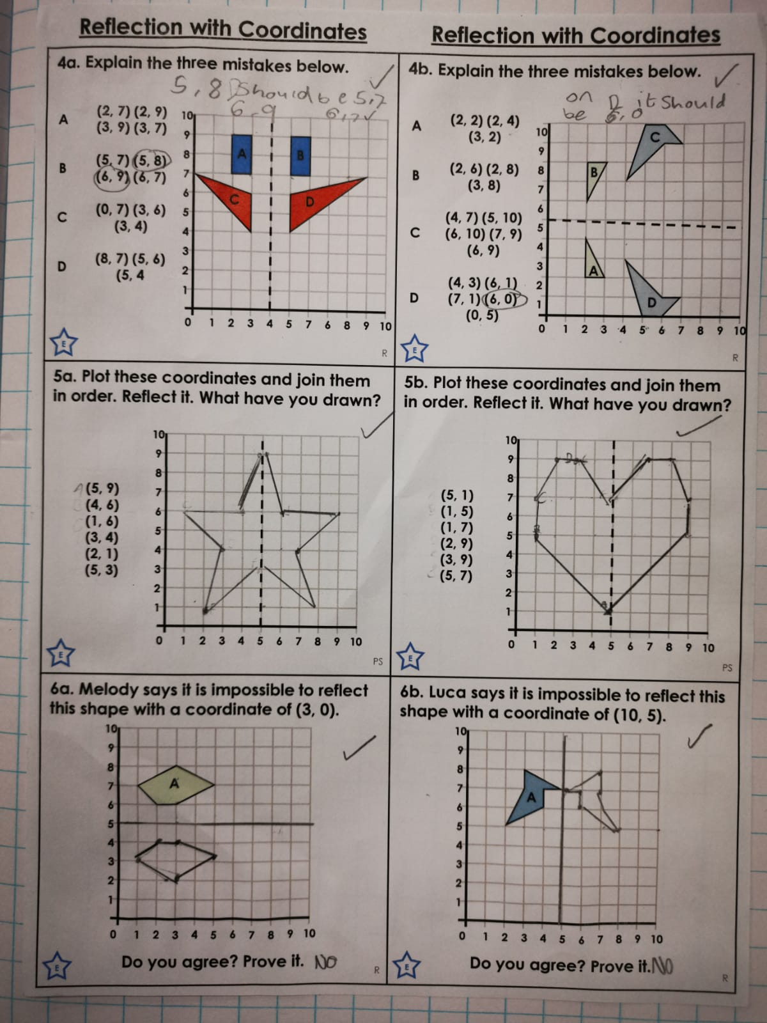
Here’s what Y5&6 have been
focusing on at home today.
Isobel has been reflecting her shapes correctly in the x and y axis.

Slide 23
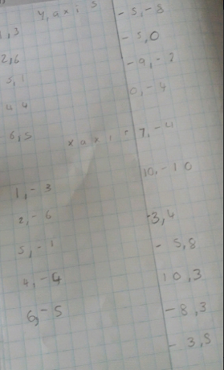
Here’s what Y5&6 have been
focusing on at home today.
Chloe has been identifying the co-ordinates of some of the minotaur’s locations.

Slide 24
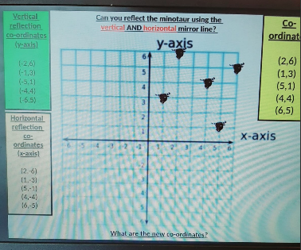
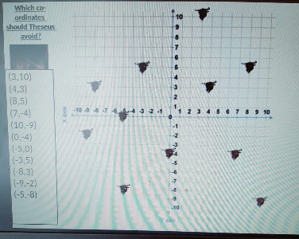
Here’s what Y5&6 have been
focusing on at home today.
Ruby has been reflecting the minotaur’s co-ordinates correctly in both the x-axis (horizontal mirror line) and y-axis (vertical mirror line)

Slide 25
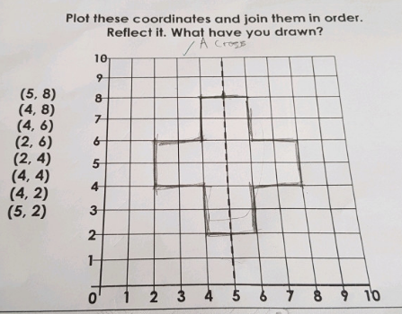
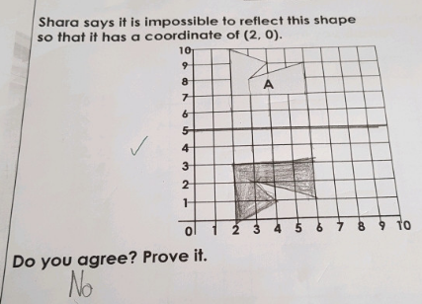
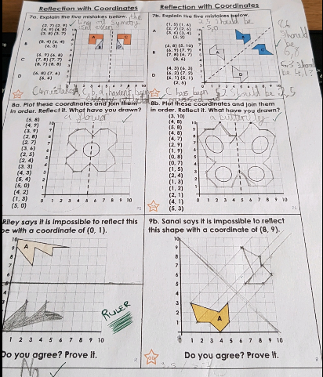
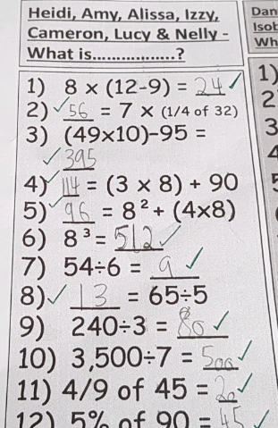
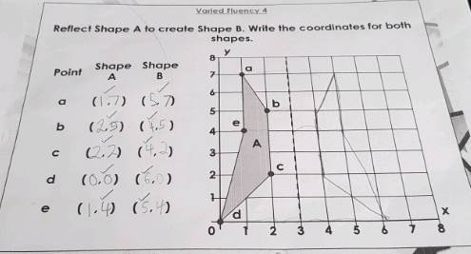
Here’s what Y5&6 have been
focusing on at home today.
Cameron has reflected these shapes accurately using the co-ordinates of each vertex to help him.

Slide 26
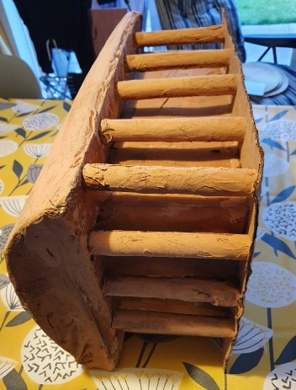
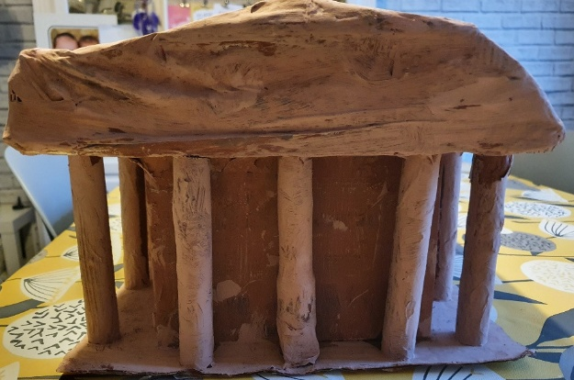
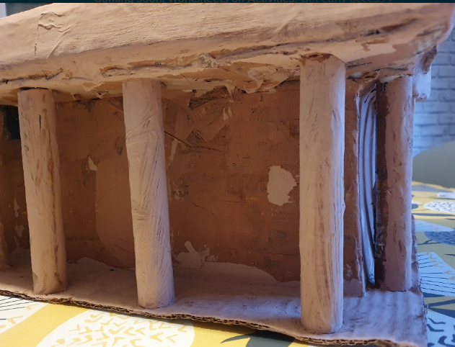
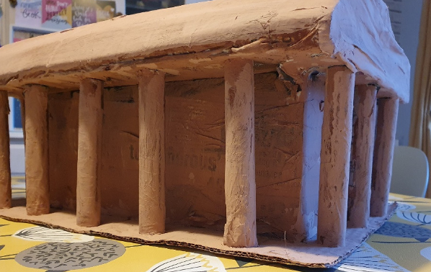
What else have I been doing at home today?
Close up views of Bethany’s Parthenon model

Slide 27
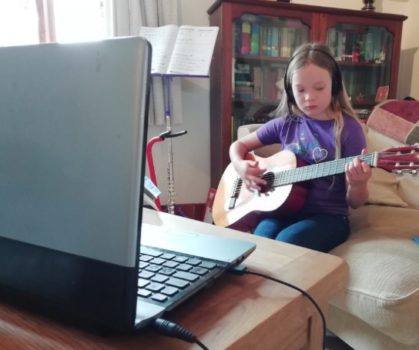
What else have I been doing at home today?
I’ve had a Zoom guitar lesson today.

Slide 28
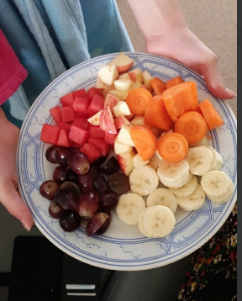
What else have I been doing at home today?
Bethany has been slicing her own fruit and vegetables today.

Slide 29
Here’s some more of the work at home that’s just been handed in…….

Slide 30
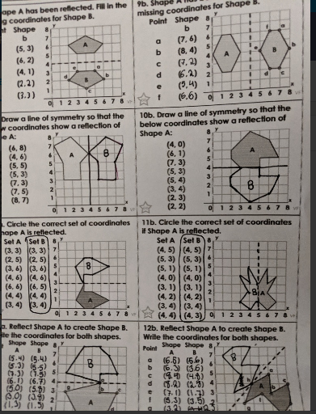
What else have I been doing recently?
Heidi’s reflections and understanding of co-ordinates from yesterday.

Slide 31
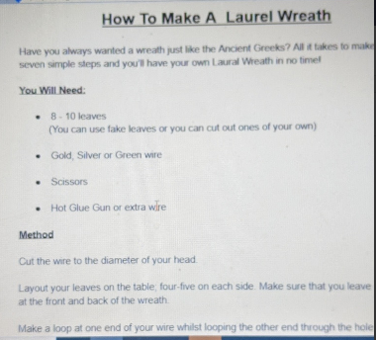
What else have I been doing recently?
Heidi’s start to her instruction text from yesterday.

Slide 32
What else have I been doing recently?
We used our feet for our rainbow for the window.

