Slide 1
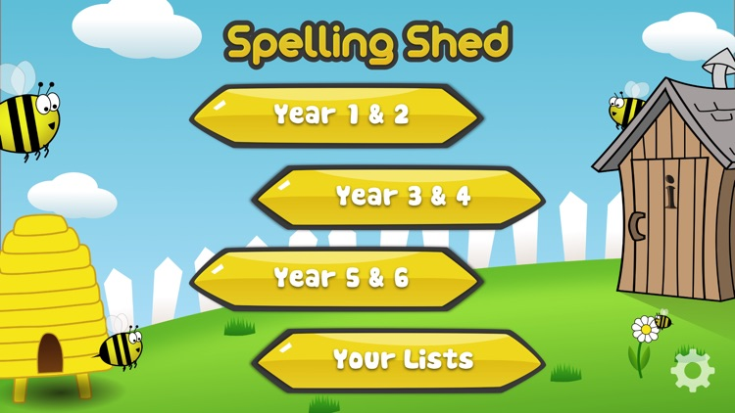
Y5&6 TOP SPELLERS TODAY
1st = Henry 38 points
2nd = Jack 16 points
3rd = Ruby and Reuben 9 points
4th = Rhys 8 points
5th = Nia and Zoe 6 points
6th = Isobel 5 points
7th = Alissa, Toby and Megan 4 points
8th = Zac and Heidi 3 points
9th = Harvey 1 points
These are the amount of dojos you have received for your efforts today!
Everybody else earns 1 dojo for practising their spellings today!

Slide 2
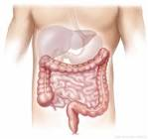
What have we been
studying today in English / Science at home?

Slide 3
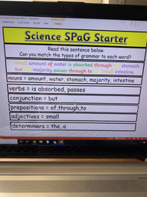
Here’s what Y5&6 have been focusing on at home today
Henry has identified the different types of grammar in the sentence.

Slide 4
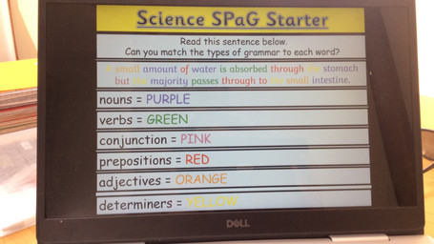
Here’s what Y5&6 have been focusing on at home today
Reuben has identified the different types of grammar in the sentence.

Slide 5
Science SPaG Starter
Isobel has identified the different types of grammar in the sentence.
A small amount of water is absorbed through the stomach but the majority passes through to the small intestine.
nouns = amount, water, majority, stomach, intestine
verbs = is absorbed, passes
conjunction = but
prepositions = of, through, through to
adjectives = small
determiners = A, the

Slide 6
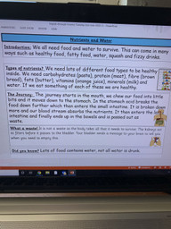
Here’s what Y5&6 have been focusing on at home today
Henry has produced his information text about the journey of nutrients through the digestive system.

Slide 7
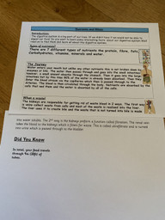
Here’s what Y5&6 have been focusing on at home today
Cassie has produced her information text about the journey of nutrients through the digestive system.

Slide 8
Here’s what Y5&6 have been focusing on at home today
Nutrients and water
Have you ever wondered what happens to the food and drinks you inhale into your body? Well, listen up as this information text will tell you all the secrets there is to know about what happens to everything you take into your body.
The different types of Nutrients
There are 7 different types of nutrients: carbohydrates, proteins, fibres, fats, vitamins, minerals and water. These nutrients are very important to the human body and all should be consumed (but obviously not too much because that wouldn’t be healthy for the body!) Many of you might know that protein helps the body to grow and repair itself if it gets damaged whereas Carbohydrates gives the body energy and insulates it from the cold. Fibres help keep food moving through the colon and intestines and fats also gives the body energy so that we can be active. Vitamins are an important part to the human body as they keep us healthy. That’s why your parents nag at you to eat apples, oranges and any other fruits!
The journey
Nutrients and water are then absorbed in the stomach or the large and small intestines. From there, the nutrients and water make their way into the bloodstream by the capillaries where they are then transported through the arteries. The nutrients and water are then circulated around the body via the circulatory system. After that, nutrients are absorbed by cells that need nutrients to survive whereas, water is absorbed by all cells as they can’t survive without water. And that’s why you parents also nag at you to drink at least 2 cups full of water so next time they nag at you, now you know why they do it!
What a waste!
After it has been absorbed and already reached the stomach, the kidneys are responsible for getting rid of the waste that your body makes from blood in two ways. The first way is the veins collect waste from the cells and most of the waste is released into the liver. The liver then uses it to create something called bile. This then goes down into the duodenum which breaks down the food into something called chyme. The rest of the waste that was made into bile was then made into water soluble which means to dissolve in water and then goes down into your kidneys. The second way is the kidneys performed a function called filtration. The renal vein delivers blood to the kidneys which it filters for all the waste that goes into the kidneys. The scientific word for all of this is ultrafiltrate which is then turned into urine (wee) which gets passed through to the bladder. The bladder has the same function as the rectum as they both send important signals to the brain. It sends signals to the brain which tells you that the urine needs to be expelled. When you need to go to the toilet, it is the inside of your body that is sending signals to your brain telling you that you need the toilet. I know it's amazing! Urine, which is also known as wee, is then released through the urethra.
Did you know?
Did you know that Carbohydrase enzymes break down starch (in carbohydrates) into sugars?
Ruby has produced her information text about the journey of nutrients through the digestive system.

Slide 9
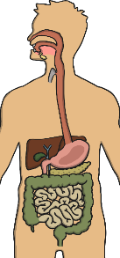
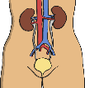
Nutrients and Water
Here’s what Y5&6 have been focusing on at home today
Isobel has produced her information text about the journey of nutrients through the digestive system.
Introduction: Humans get their nutrients from the food that they eat. It is very important that we get our nutrients because they keep us alive and healthy. You will learn some interesting facts if you read on.
Types of nutrients? The type of nutrients are: carbohydrate, protein, fibre, fats,
vitamins, minerals and water. We can find these different varieties of nutrients in our
food. They each have an important job to do to maintain our body.
The Journey: When we eat our food, it travels through the mouth, then into the
Oesophagus before it enters the stomach, waiting for the food to be broken down by acid.
Next it passes into the pancreas, then into the small intestine before entering the large intestine.
What a waste! The rectum stores stools and signals to the brain that there are stools
that need releasing out from the anus.
Did you know? Fibre is important for the digestive system because it helps food to move through the digestive track and certain types of fibre can help you maintain regularity.

Slide 10
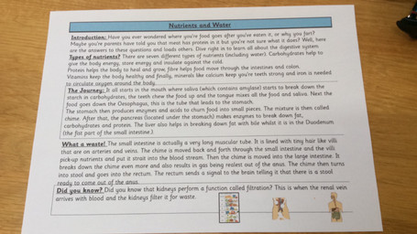
Here’s what Y5&6 have been focusing on at home today
Reuben has produced his information text about the journey of nutrients through the digestive system.

Slide 11
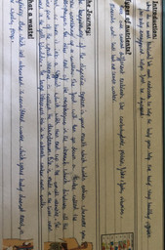
Here’s what Y5&6 have been focusing on at home today
Harvey has produced his information text about the journey of nutrients through the digestive system.

Slide 12
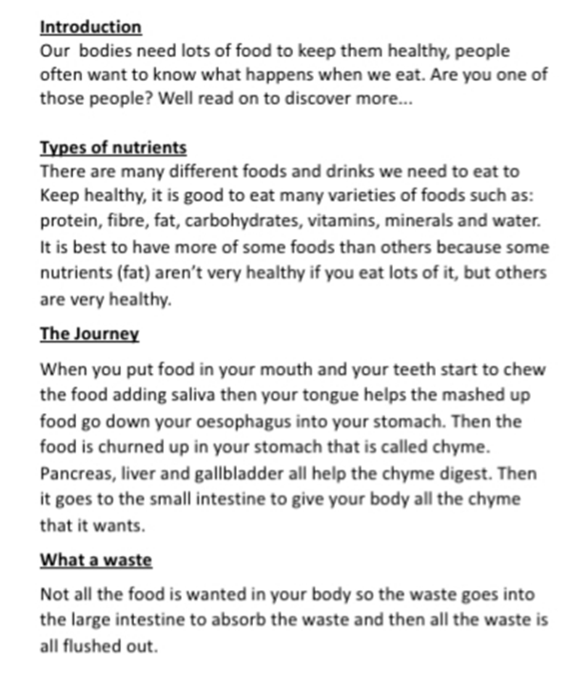
Here’s what Y5&6 have been focusing on at home today
Lucy has produced her information text about the journey of nutrients through the digestive system.

Slide 13
Nutrients and Water
Introduction: Have you ever wondered where your food goes? Did you ever wonder where your poo comes from? If so, read on and find out step by step about our digestive system.
Types of nutrients? There are several types of nutrients, they include carbohydrates, protein, fibre, fats, vitamins, minerals & water and they all help in different ways. They go though your body and turn into different things, for example - fat turns into glycerol molecules but carbohydrates turn in to sugar molecules. These all start to make their way around your body, giving the body vital nutrients and to stay alive.
The Journey:
Food: The journey of your digestive system starts at the mouth. In the mouth, we chew food with our teeth and our tongue mixes it with saliva (saliva has an enzyme called amylase). Food is then swallowed down the Oesophagus. It then lands in the stomach, where it gets broken down by acids and made into smaller pieces called chyme. It then gets pushed down into the Duodenum which is the first part of the small intestine. In the small intestine, the chyme is moved back and forth, the nutrients pass through the villi and are absorbed into the blood vessels. The journey then continues to the large intestine.
Water: Water enters through the mouth but unlike food, it is not broken down by enzymes or bile. The stomach absorbs a small amount of the water but the rest passes through the small intestines. The water is then absorbed in the small intestine just like food. Water then passes to the large intestine, where already, 90% of the water has already been absorbed.
What a waste!
Spare nutrients then move onto the first part of the large intestine (called the cecum),, this is where remaining water is absorbed and turns the waste into stools (poo). It then moves into the rectum, where the stools are held until it sends a single to the brain to release it into the anus, to then be released out of the body (hopefully in a toilet).
Zoe has produced her information text about the journey of nutrients through the digestive system.
Did you know?
In the small intestine it is lined with villi, they are like tiny hairs (the large intestine has no villi).
The large intestine is also known as the colon.

Slide 14
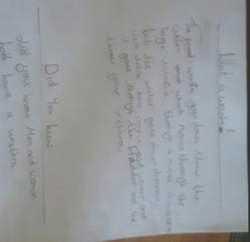
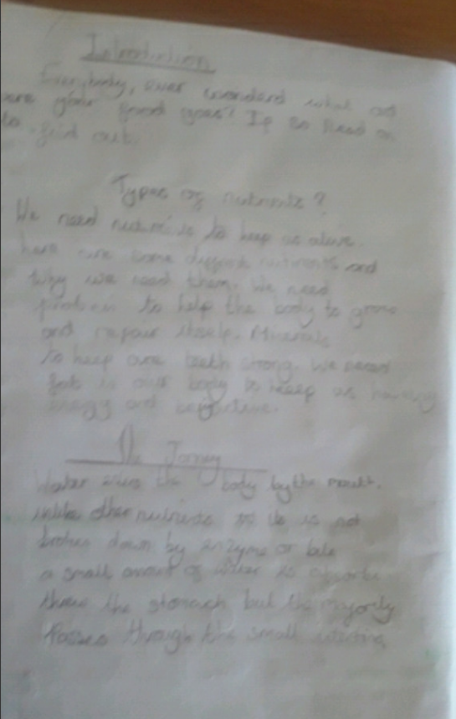
Here’s what Y5&6 have been focusing on at home today
Chloe has produced her information text about the journey of nutrients through the digestive system.

Slide 15
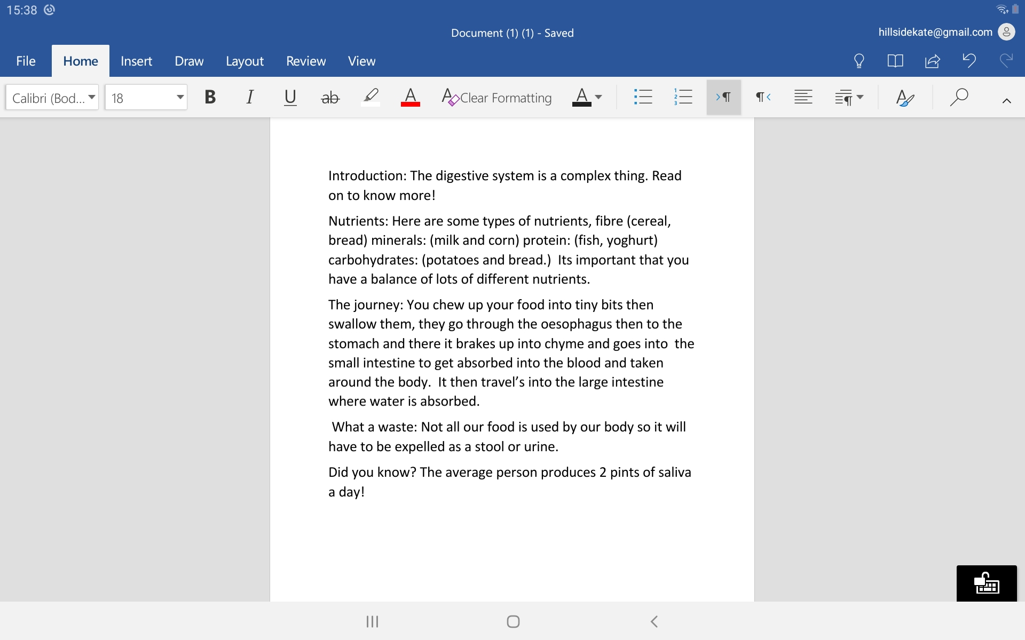
Here’s what Y5&6 have been
focusing on at home today.
Katie has produced her information text about the journey of nutrients through the digestive system.

Slide 16
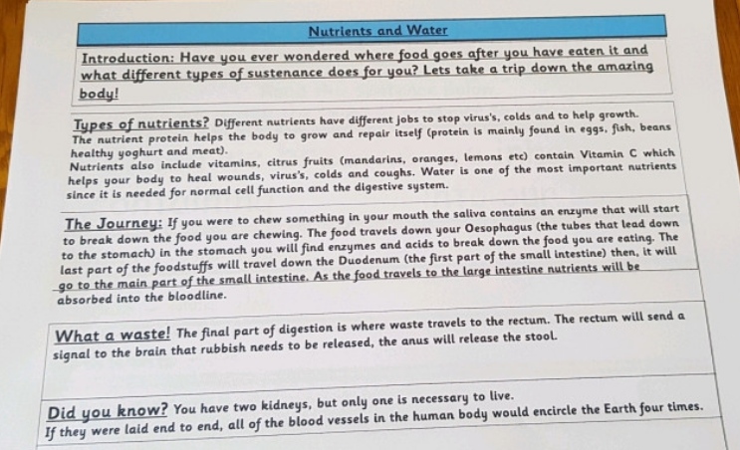
Here’s what Y5&6 have been focusing on at home today
Cameron has produced his information text about the digestive system.

Slide 17
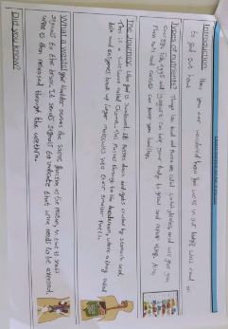
Here’s what Y5&6 have been focusing on at home today
Dante has produced his information text about the digestive system.

Slide 18
Here’s what Y5&6 have been
focusing on at home today.

Slide 19
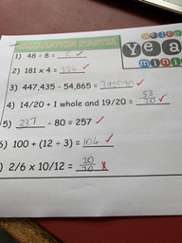
Here’s what Y5&6 have been
focusing on at home today.
Henry has continued to practise his calculation skills.

Slide 20
Here’s what Y5&6 have been
focusing on at home today.
Henry’s maths questions for Harvey to solve
Question 1) What is the difference between Cookie Monsters and Ruby Rebels?
Question 2) What is the total of all the teams from both nights?
Question 3) What is the total sum of Demon Donners and Ring of Fire?
Question 4) What is the altogether score of the Saturday night quiz?
Question 5) What is the total of the Friday night quiz?
Question 6) What is the difference between the Friday and Saturday night quiz?

Slide 21
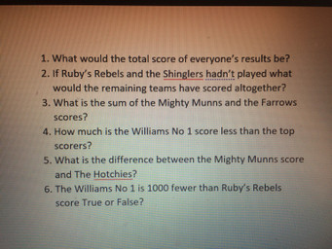
Here’s what Y5&6 have been
focusing on at home today.
Megan’s questions for Jack to solve

Slide 22
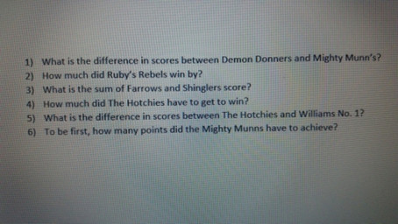
Here’s what Y5&6 have been
focusing on at home today.
Jack’s maths questions for Megan to solve

Slide 23
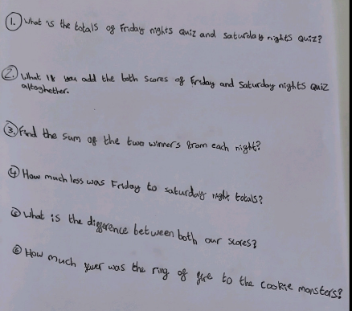
Here’s what Y5&6 have been
focusing on at home today.
Dante’s maths questions for Chloe to solve

Slide 24
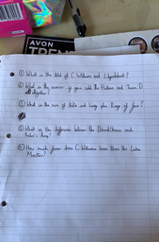
Here’s what Y5&6 have been
focusing on at home today.
Cassie’s maths questions for Reuben to solve

Slide 25
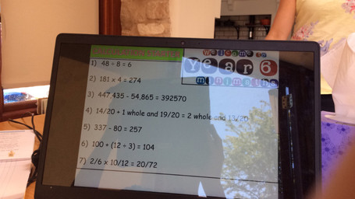
Here’s what Y5&6 have been
focusing on at home today.
Reuben has continued to practise his calculation skills.

Slide 26
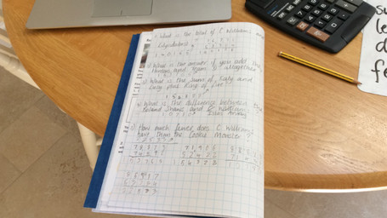
Here’s what Y5&6 have been
focusing on at home today.
Reuben has solved the questions that Cassie has written for him.

Slide 27
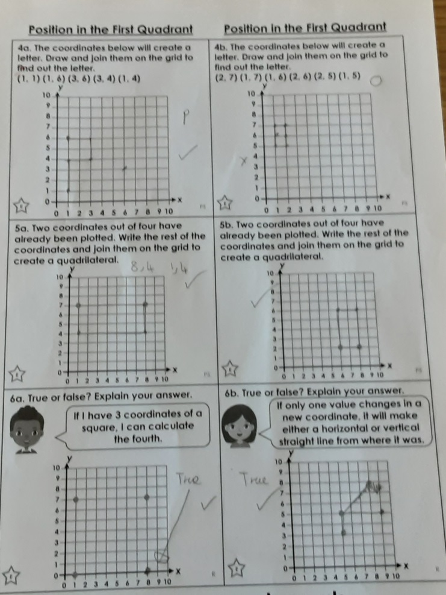
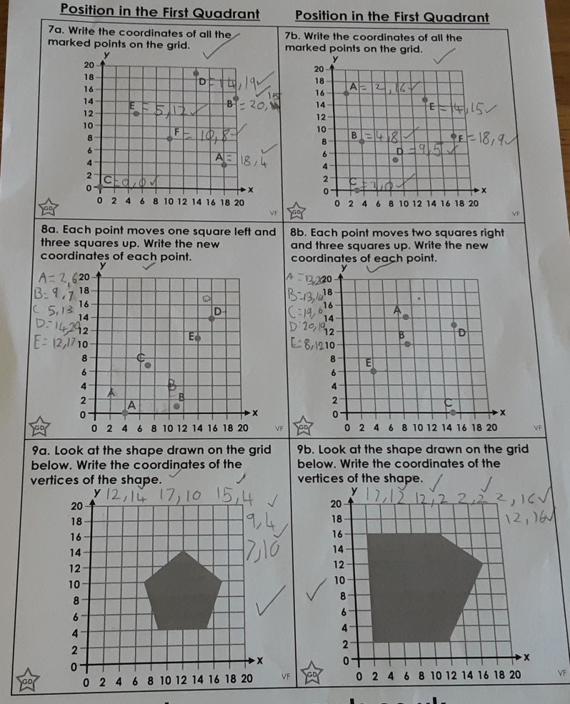
Here’s what Y5&6 have been
focusing on at home today.
Lucy has plotted the co-ordinates correctly on these grids.

Slide 28
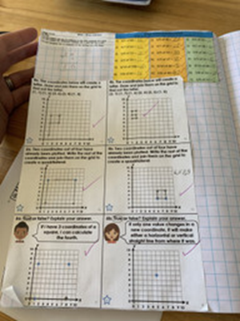
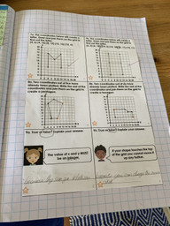
Here’s what Y5&6 have been
focusing on at home today.
Zoe has plotted the co-ordinates correctly on these grids.

Slide 29
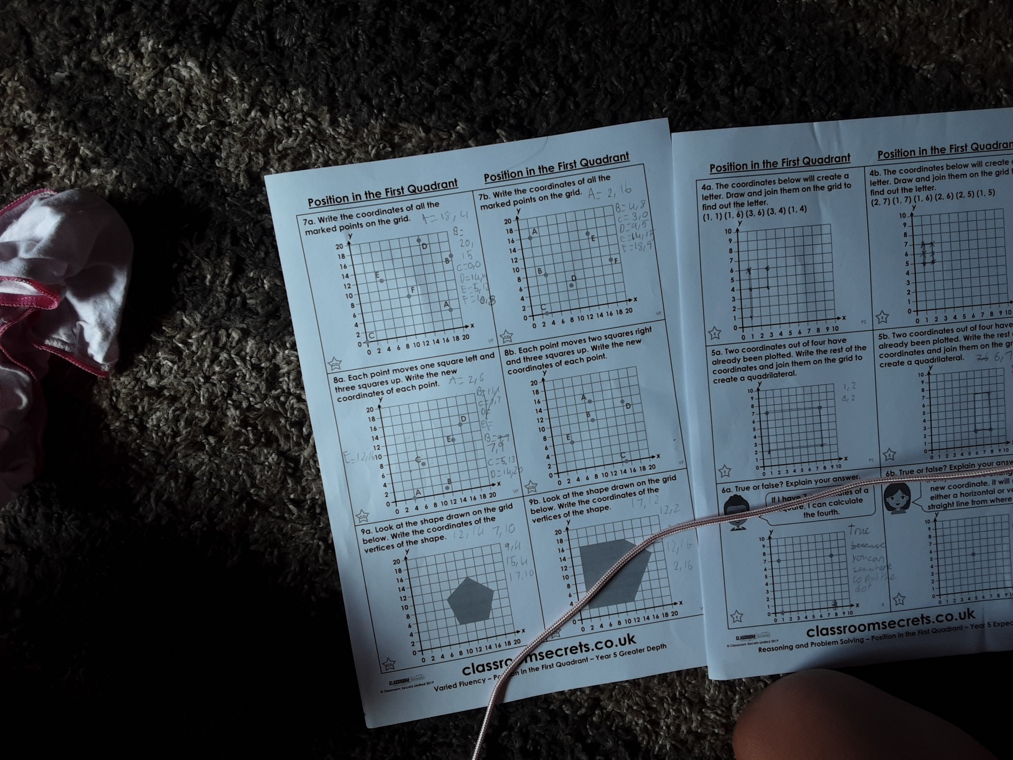
Here’s what Y5&6 have been
focusing on at home today.
Katie has plotted the co-ordinates correctly on these grids.

Slide 30
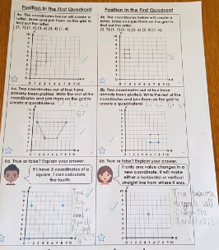
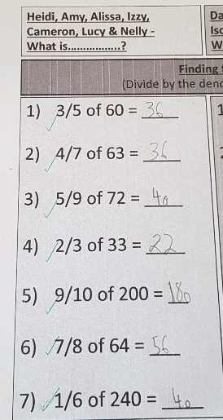
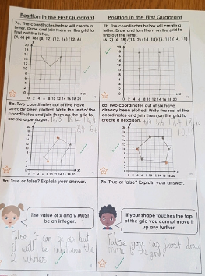
Here’s what Y5&6 have been
focusing on at home today.
Cameron has plotted the co-ordinates correctly on these grids as well as finding fractions of numbers as a mental maths starter.

Slide 31
Here’s some of what we missed viewing yesterday.

Slide 32
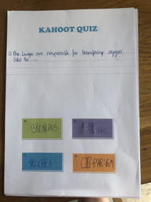
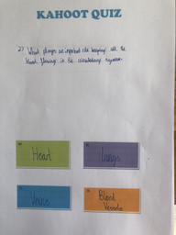
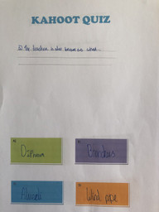
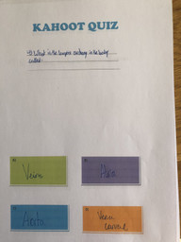
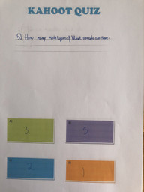
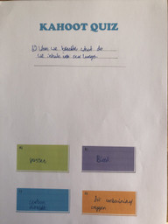
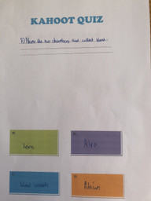
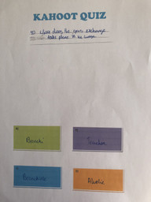
What else did we do at home yesterday?
Harvey’s Science Kahoot Quiz from yesterday

Slide 33
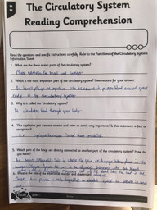
What else did we do at home yesterday?
Harvey read the information carefully about the circulatory system to help him to answer the questions.

Slide 34
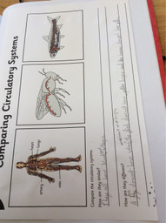
What else have I worked on at home today?
Reuben has been comparing the circulatory system of humans and other animals.

Slide 35
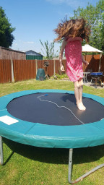
What else have I done at home today?
Chloe has been speed bouncing on her trampoline.

Slide 36
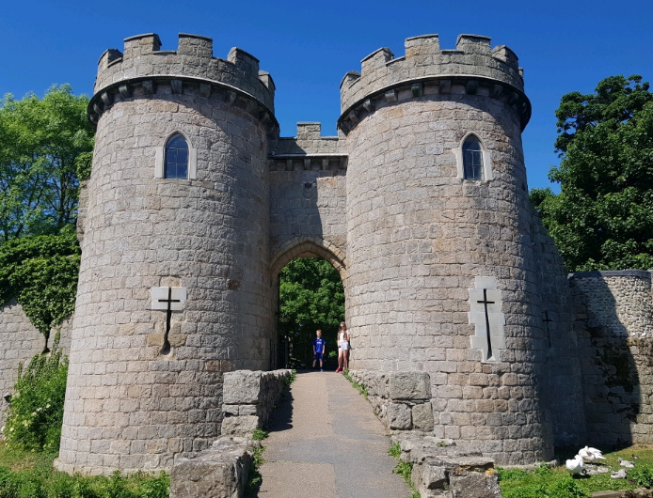
What else have been doing today?
Elizabeth took a tour of Whittington Castle

Slide 37
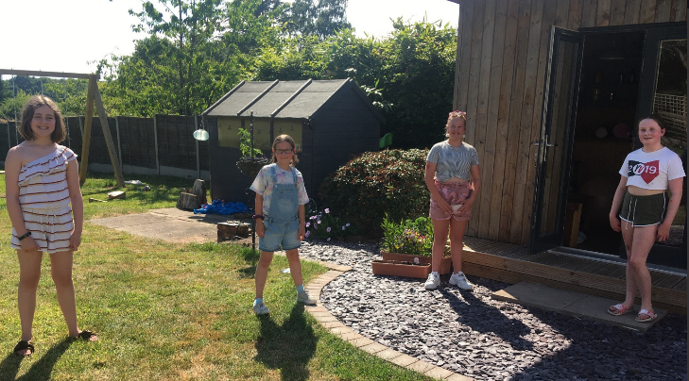
What else have we been doing today?
A 2 metre distanced catch up with friends!

