Slide 1
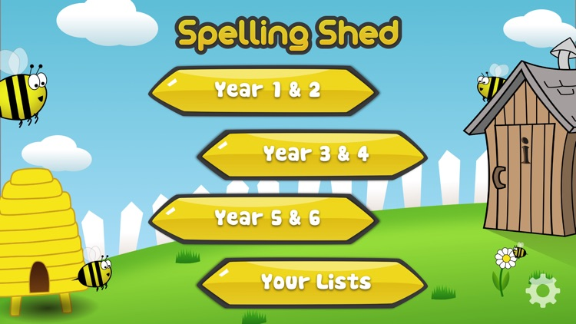
Y5&6 TOP SPELLERS TODAY
1st = Jack 184 points
2nd = Elizabeth 55 points
3rd = Rhys 45 points
4th = Chloe 44 points
5th = Henry and Reuben 14 points
6th = Dante 12 points
7th = Harvey 9 points
8th= Bethany 8 points
9th = Amy, Zoe and Cameron 6 points
These are the amount of dojos you have received for your efforts today!
Everybody else earns 1 dojo for practising their spellings today!

Slide 2
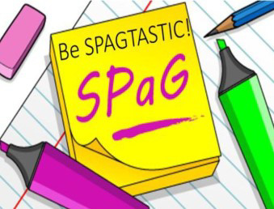
What have the Y5s been
studying today at home today?

Slide 3
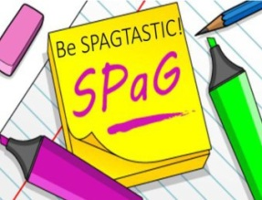
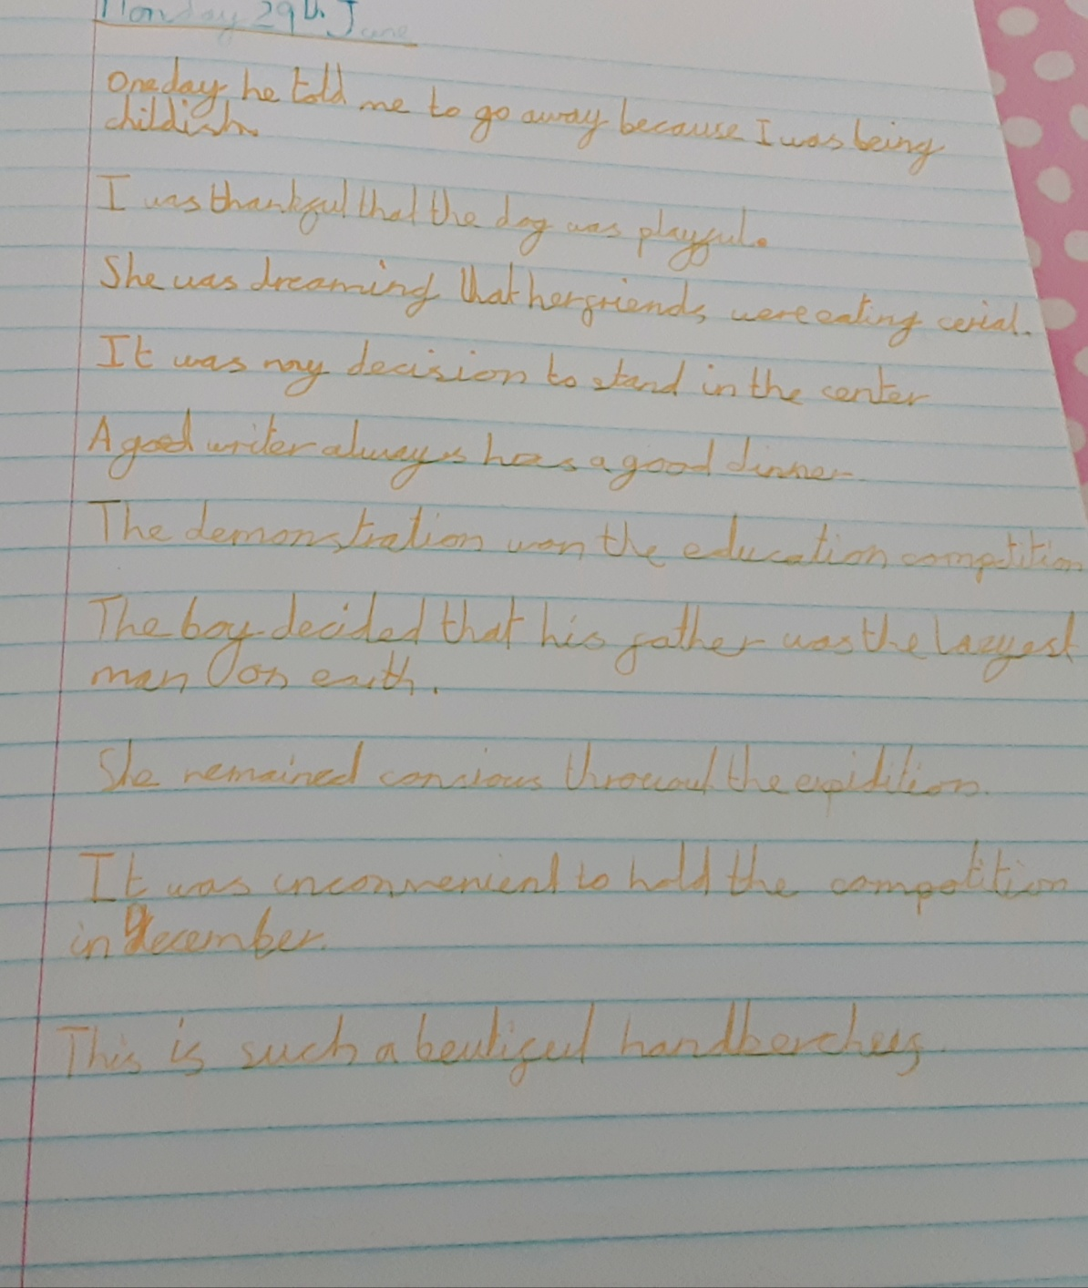
Here’s what the Y5s have been focusing on at home today in English.
Lucy has been attempting to correct the errors in the punctuation and spellings on her sentences today.

Slide 4
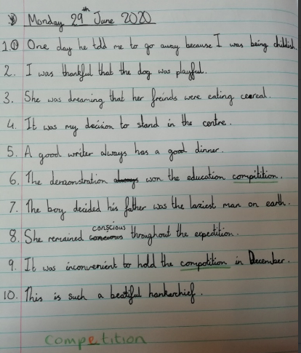
Here’s what the Y5s have been focusing on at home today in English.
Amy has been attempting to correct the errors in the punctuation and spellings on her sentences today.

Slide 5
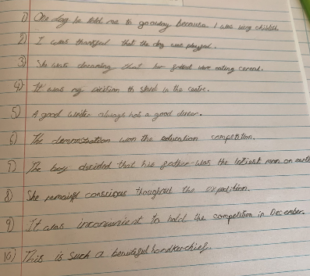
Here’s what the Y5s have been focusing on at home today in English.
Zoe has been attempting to correct the errors in the punctuation and spellings on her sentences today.

Slide 6
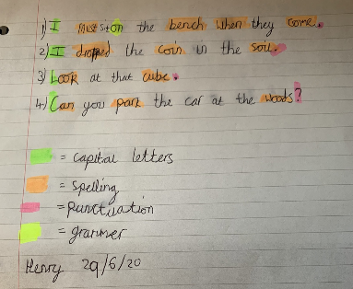
Here’s what the Y5s have been focusing on at home today in English.
Henry has been attempting to correct the errors in the punctuation and spellings on his sentences today.

Slide 7
Here’s what Y5&6 have been
focusing on at home today.

Slide 8
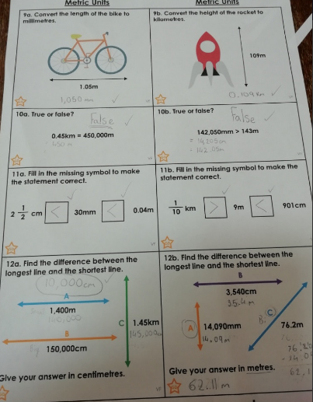
Here’s what Y5&6 have been focusing on at home today.
Amy has been comparing m, cm and mm today, using conversions to solve the problems.

Slide 9
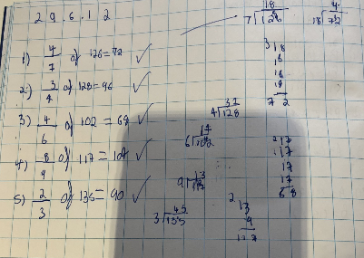
Here’s what Y5&6 have been focusing on at home today.
Harvey has been solving the missing numerator in the fraction of numbers using a specific method to help him.

Slide 10
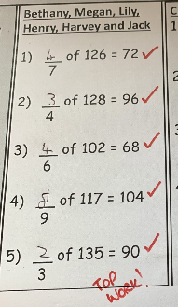
Here’s what Y5&6 have been focusing on at home today.
Henry has been solving the missing numerator in the fraction of numbers using a specific method to help him.

Slide 11
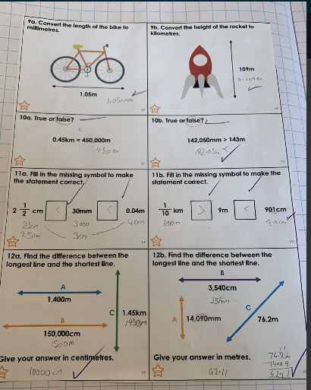
Here’s what Y5&6 have been focusing on at home today.
Zoe has been comparing m, cm and mm today, using conversions to solve the problems.

Slide 12
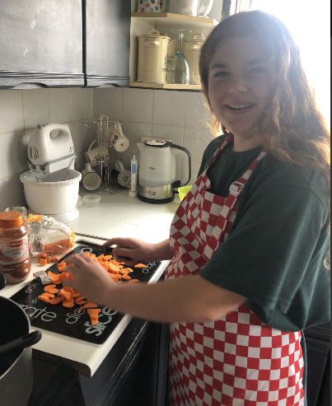
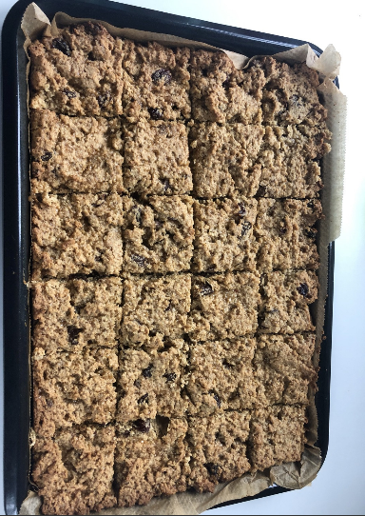
What else have we been doing today?
I’ve been helping to make soup and flapjacks today.
I shall be wanting Mrs Russell’s job soon!

