Slide 1
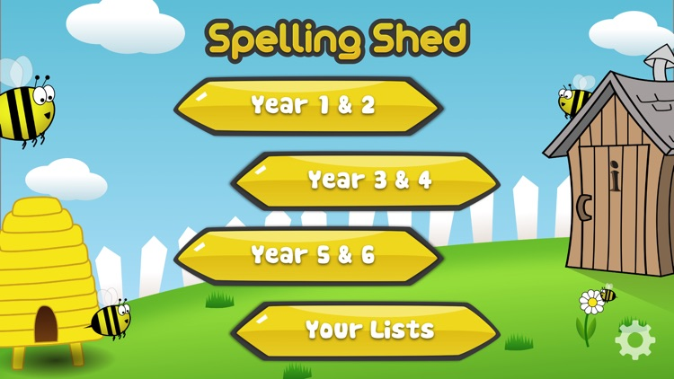
Y5&6 TOP SPELLERS TODAY
1st = Jack 46 points
2nd = Nia 18 points
3rd = Heidi 16 points
4th = Izzy 14 points
5th = Henry 13 points
6th = Lily 11 points
7th = Reuben and Megan 8 points
8th = Zoe and Isobel 7 points
9th = Amy 6 points
These are the amount of dojos you have received for your efforts today!
Everybody else earns 1 dojo for practising their spellings today!

Slide 2
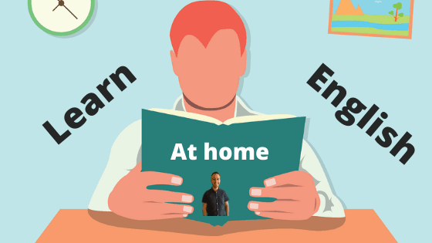
What have we been
studying today at home?

Slide 3
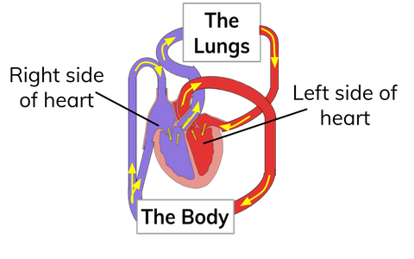
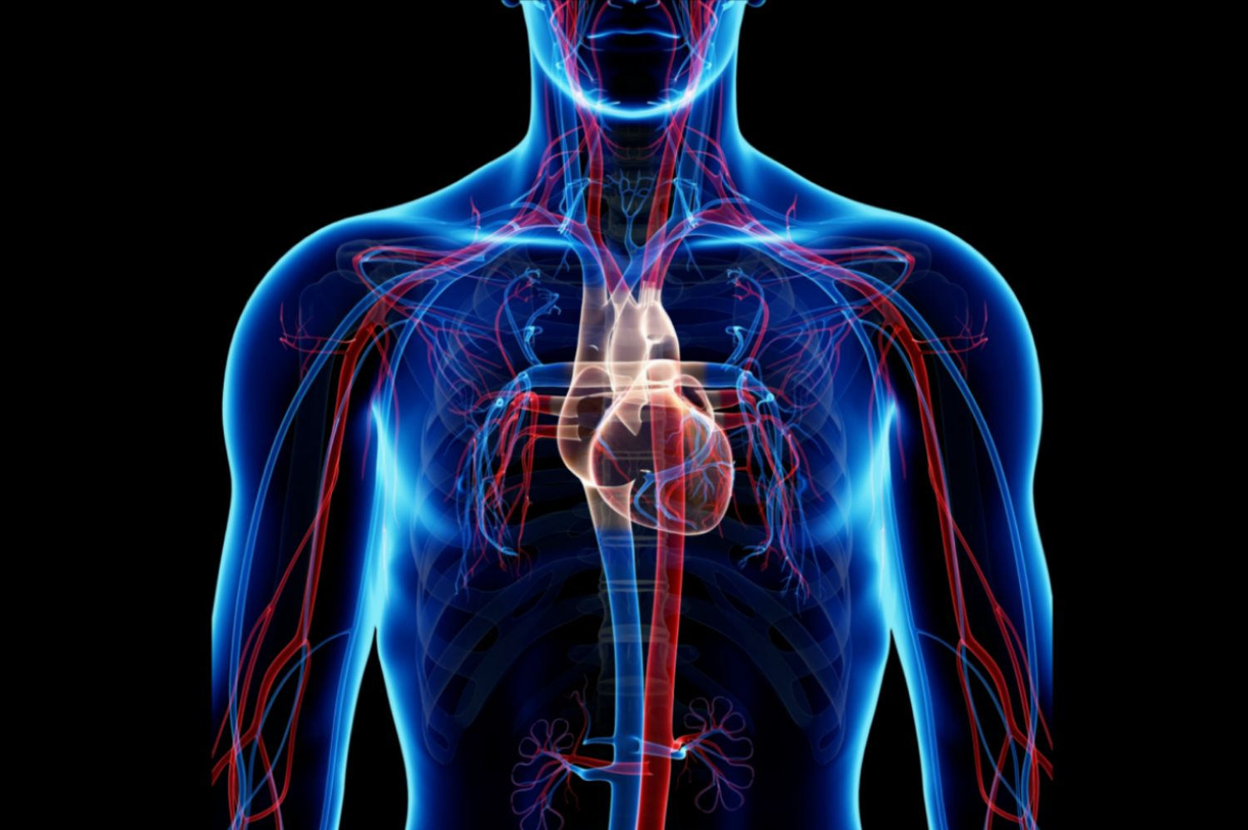

Slide 4
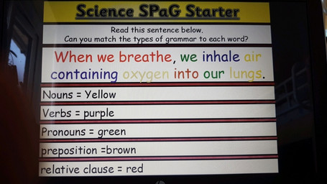
Here’s what Y5&6 have been focusing on at home today
Bethany has been matching the types of grammar to the words

Slide 5
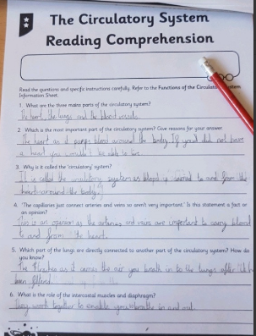
Here’s what Y5&6 have been focusing on at home today
Bethany has read the information about the circulatory system carefully.

Slide 6
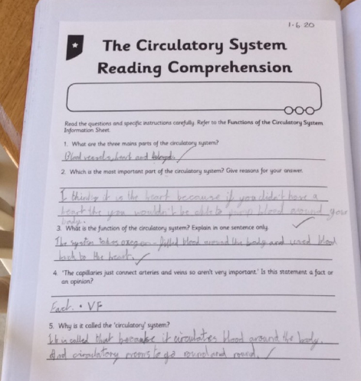
Here’s what Y5&6 have been focusing on at home today
Reuben has read the information about the circulatory system carefully.

Slide 7
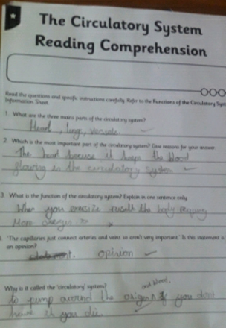
Here’s what Y5&6 have been focusing on at home today
Chloe has read the information about the circulatory system carefully.

Slide 8
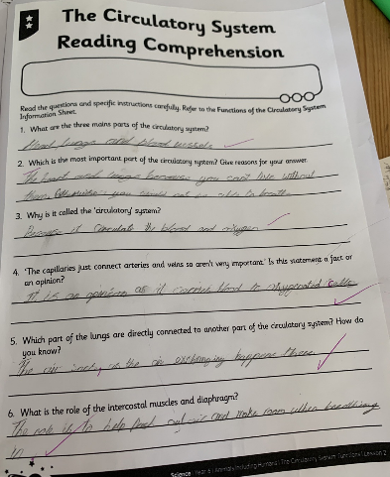
Here’s what Y5&6 have been focusing on at home today
Zoe has read the information about the circulatory system carefully.

Slide 9
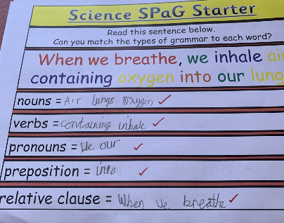
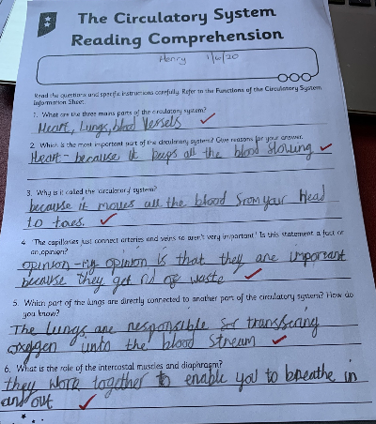
Here’s what Y5&6 have been focusing on at home today
Henry has read the information about the circulatory system carefully.

Slide 10
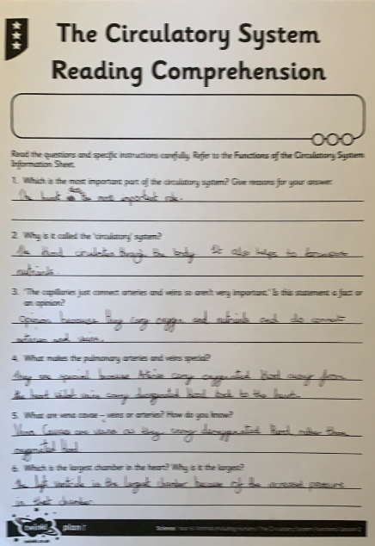
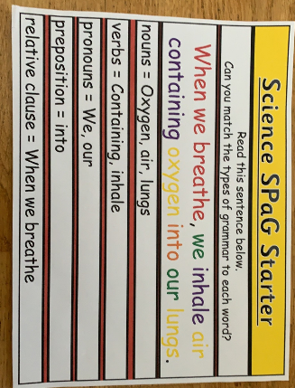
Here’s what Y5&6 have been focusing on at home today
Cassie has read the information about the circulatory system carefully.

Slide 11
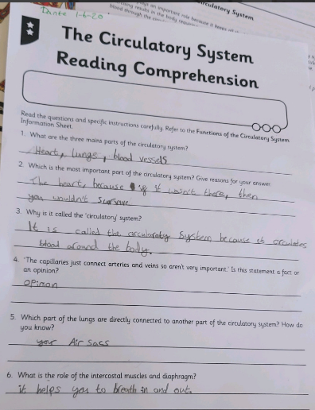
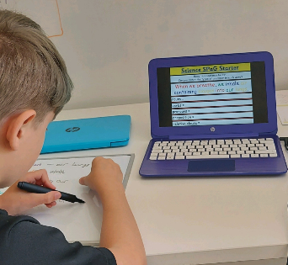
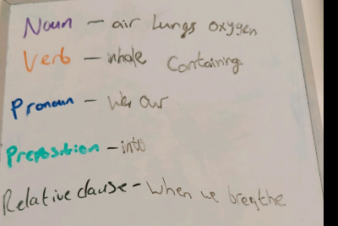
Here’s what Y5&6 have been focusing on at home today
Dante has read the information about the circulatory system carefully.

Slide 12
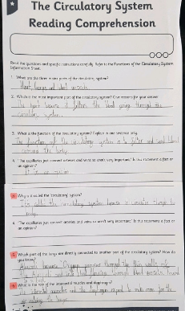
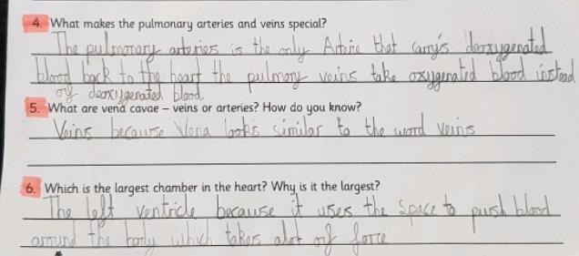
Here’s what Y5&6 have been focusing on at home today
Cameron has read the information about the circulatory system carefully.

Slide 13
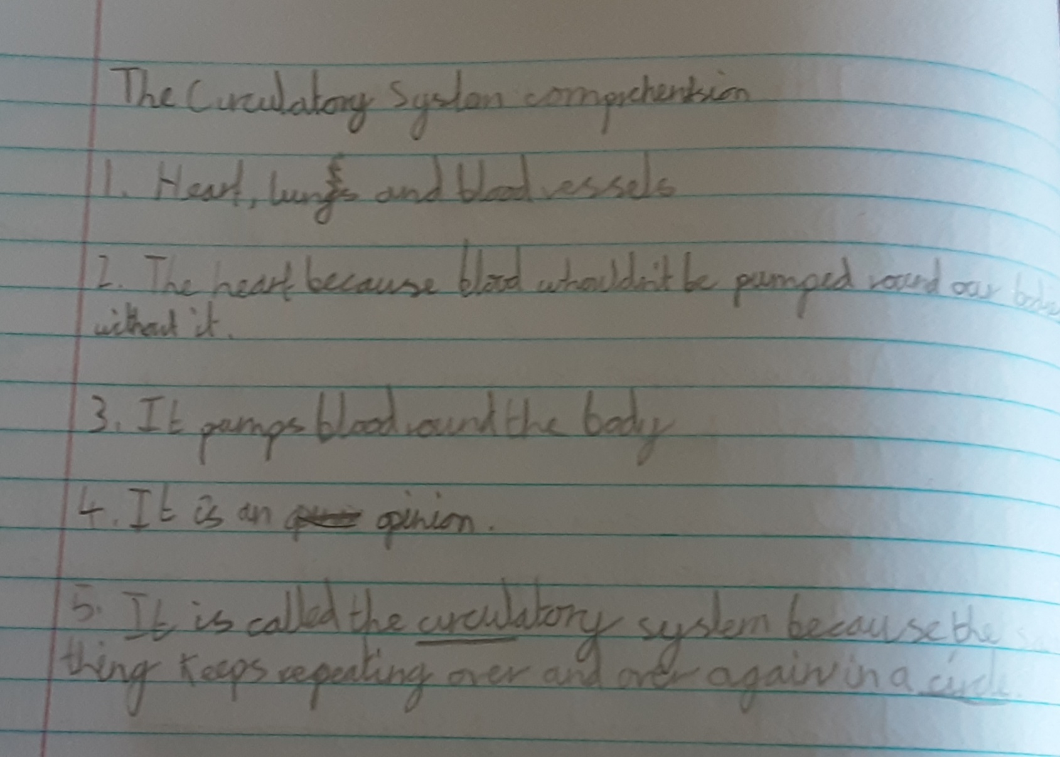
Here’s what Y5&6 have been focusing on at home today
Lucy has read the information about the circulatory system carefully.

Slide 14
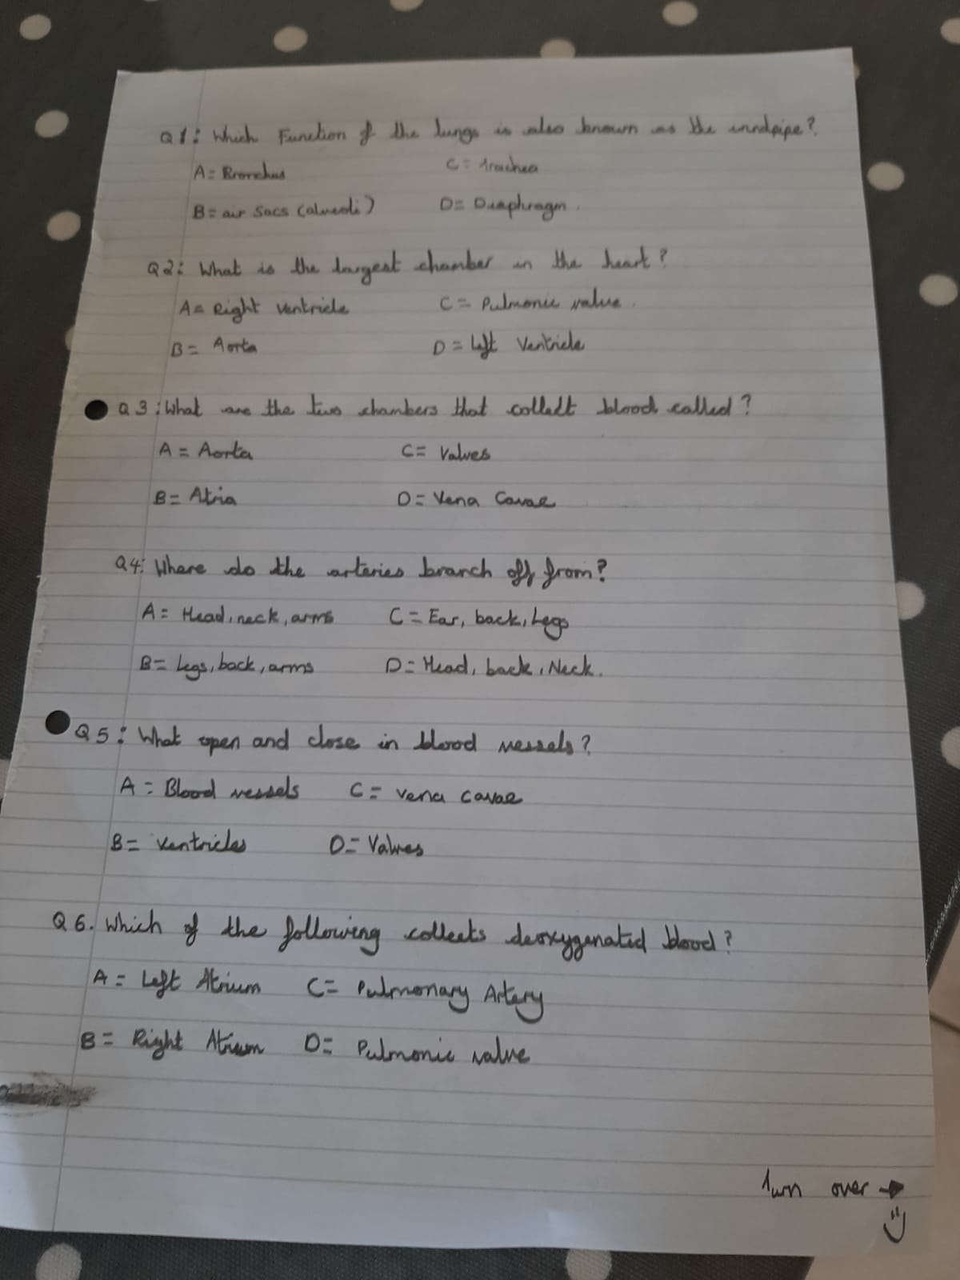
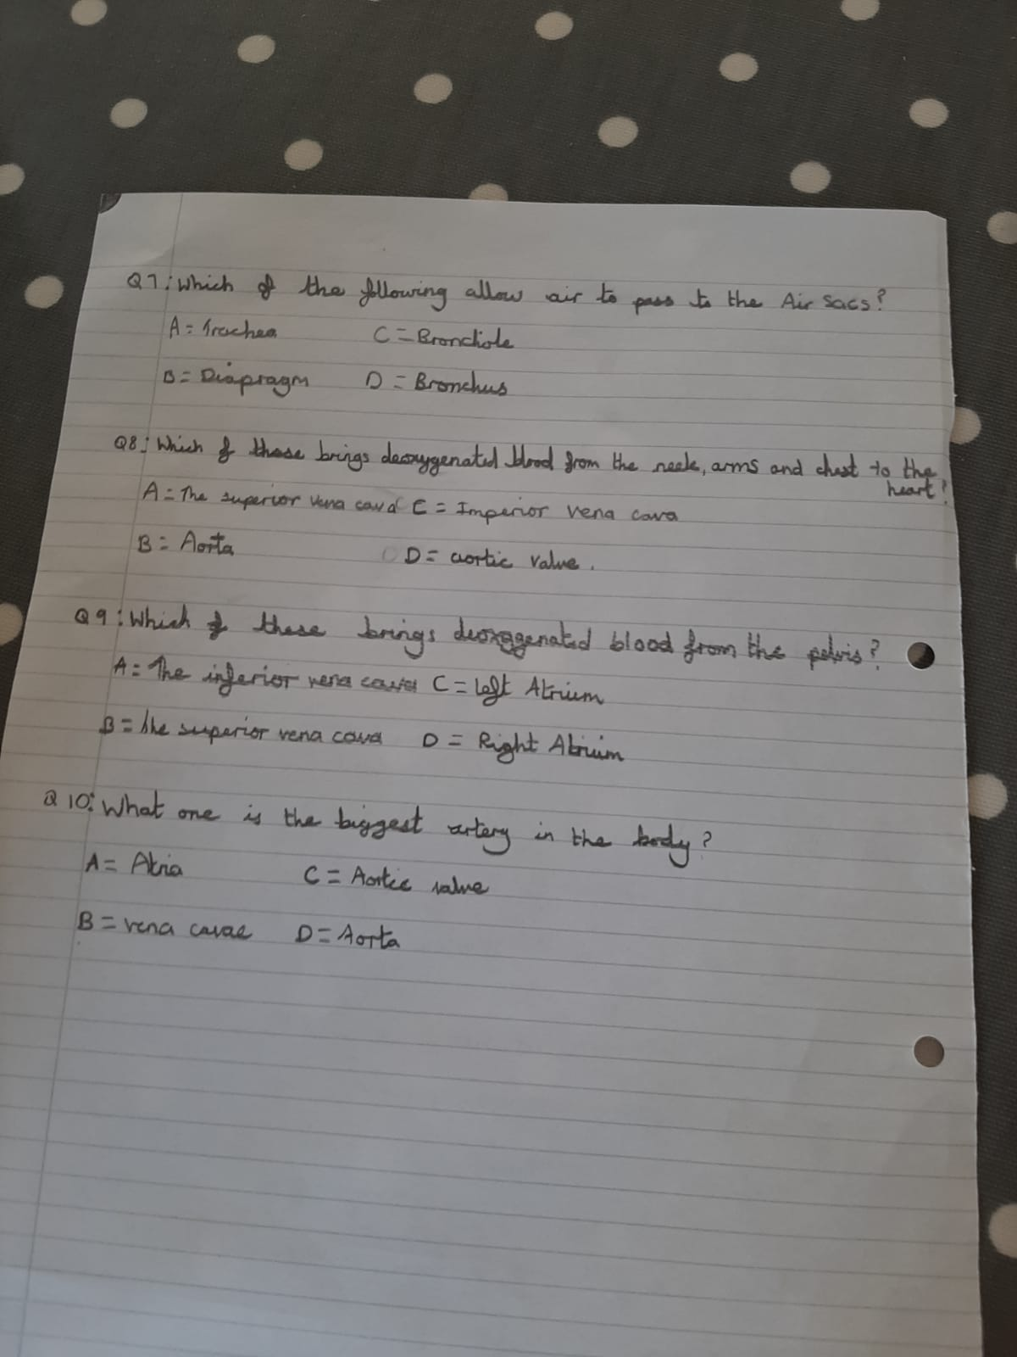
Here’s what Y5&6 have been focusing on at home today
Ruby’s quiz questions!

Slide 15
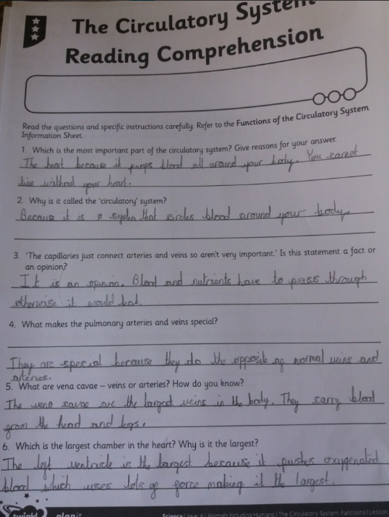
Here’s what Y5&6 have been focusing on at home today
Jack has read the information about the circulatory system carefully.

Slide 16
Here’s what Y5&6 have been
focusing on at home today.

Slide 17
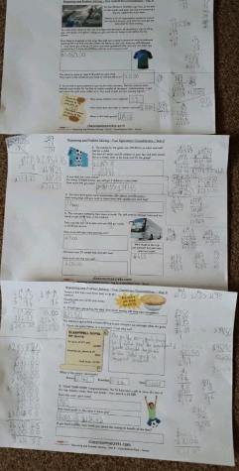
Here’s what Y5&6 have been focusing on at home today.
Bethany has worked hard to solve the maths ‘football’ problems.

Slide 18
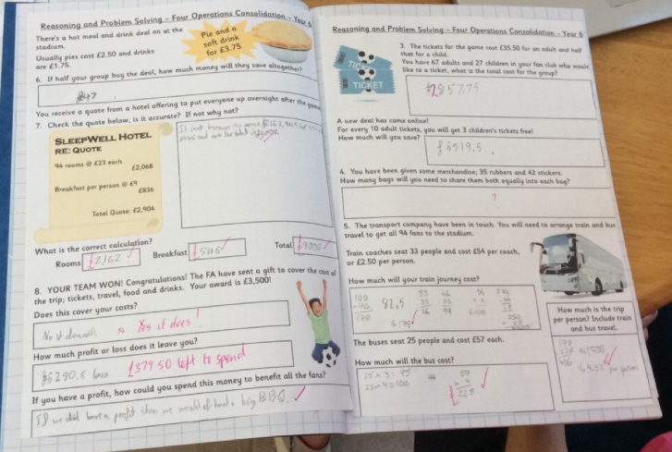
Here’s what Y5&6 have been focusing on at home today.
Reuben has worked hard to solve the maths ‘football’ problems.

Slide 19
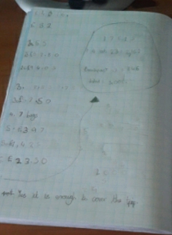
Here’s what Y5&6 have been focusing on at home today.
Chloe has worked hard to solve the maths ‘football’ problems.

Slide 20
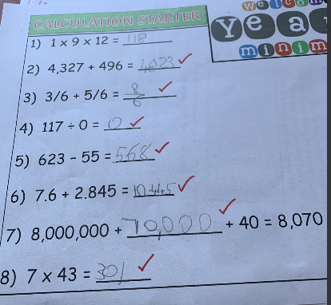
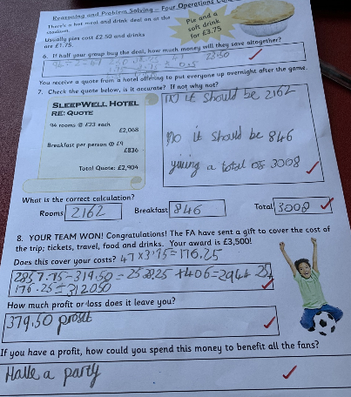
Here’s what Y5&6 have been focusing on at home today.
Henry has worked hard to solve the maths ‘football’ problems.

Slide 21
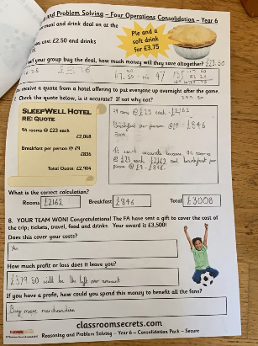
Here’s what Y5&6 have been focusing on at home today.
Cassie has worked hard to solve the maths ‘football’ problems.

Slide 22
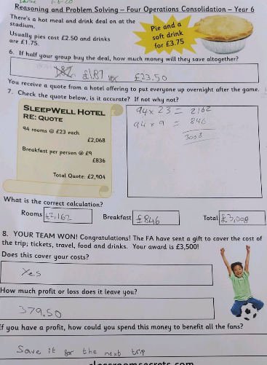
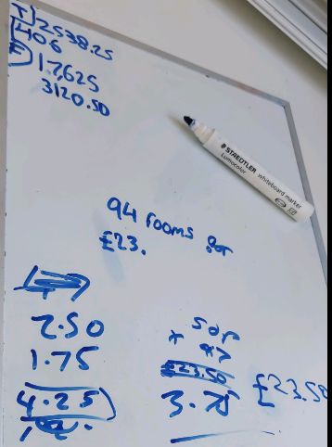
Here’s what Y5&6 have been focusing on at home today.
Dante has worked hard to solve the maths ‘football’ problems.

Slide 23
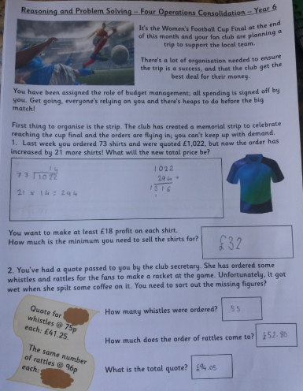
Here’s what Y5&6 have been focusing on at home today.
Jack has worked hard to solve the maths ‘football’ problems.

Slide 24
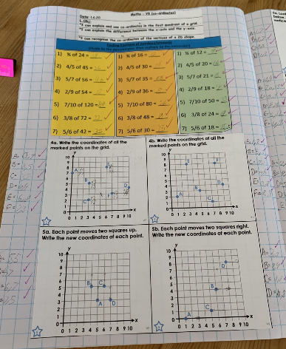
Here’s what Y5&6 have been focusing on at home today.
Zoe has plotted and recognised the co-ordinates well on the grid.

Slide 25
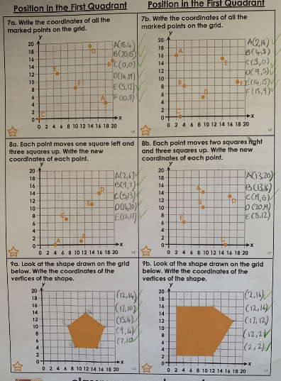
Here’s what Y5&6 have been focusing on at home today.
Nelly has plotted and recognised the co-ordinates well on the grid.

Slide 26
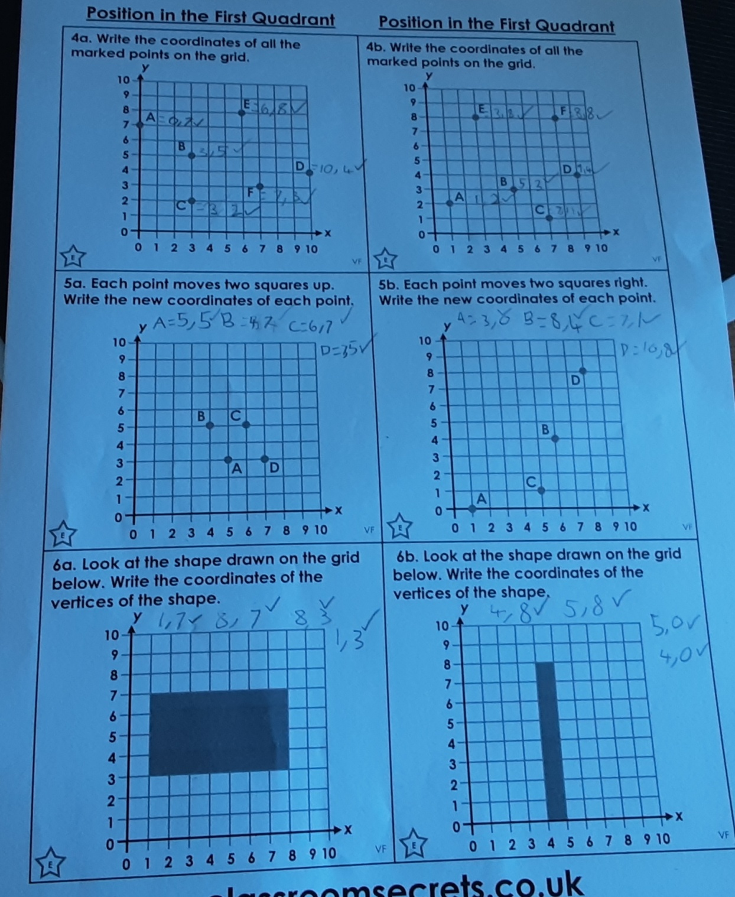
Here’s what Y5&6 have been focusing on at home today.
Lucy has plotted and recognised the co-ordinates well on the grid.

Slide 27
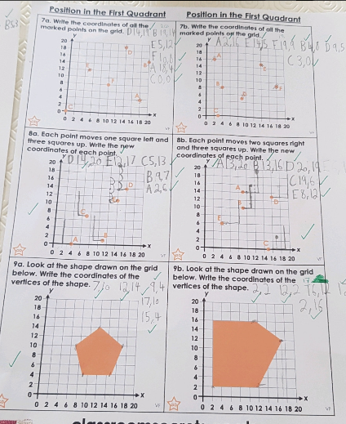
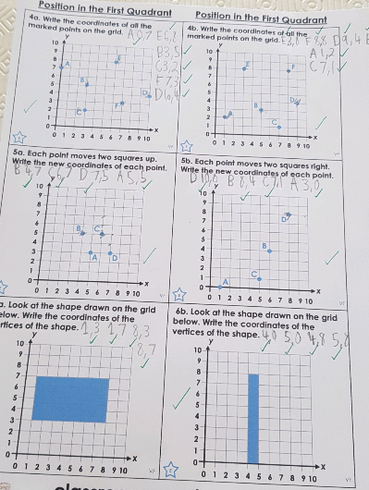
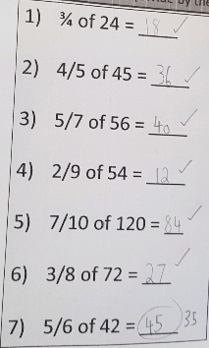
Here’s what Y5&6 have been focusing on at home today.
Cameron has plotted and recognised the co-ordinates well on the grid.

Slide 28
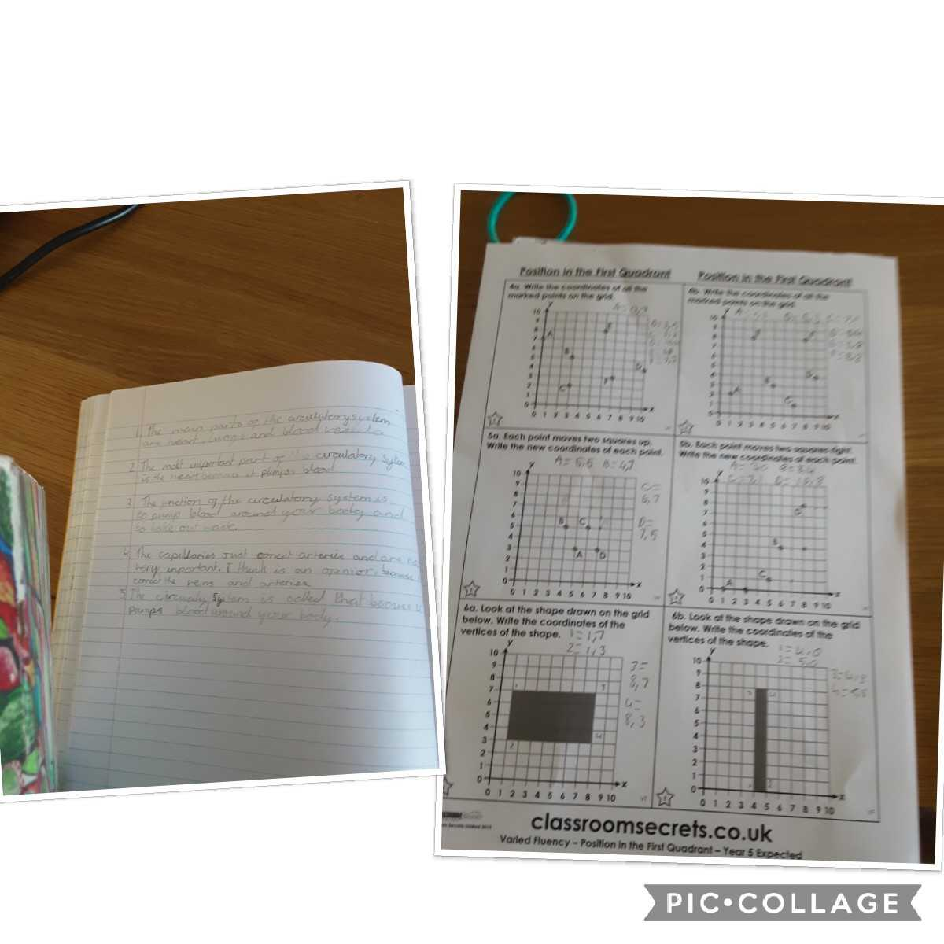
Here’s what Y5&6 have been focusing on at home today.
Katie has plotted and recognised the co-ordinates well on the grid, as well as reading her Science information carefully about the heart.

Slide 29
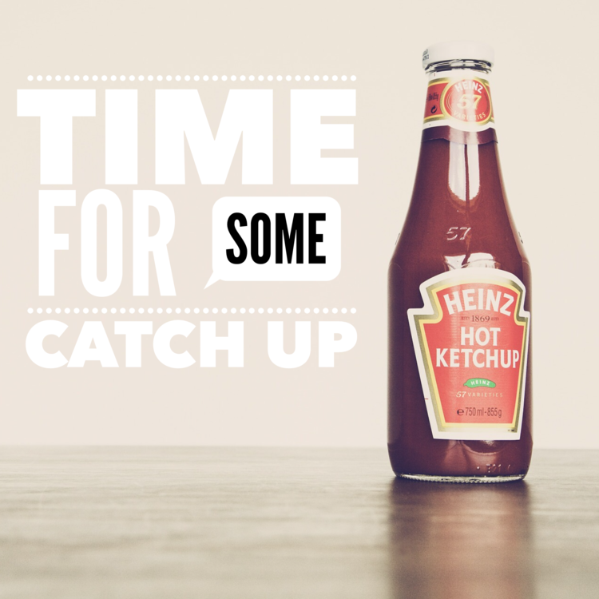
Here’s some of last week’s work that has been produced recently at home.

Slide 30
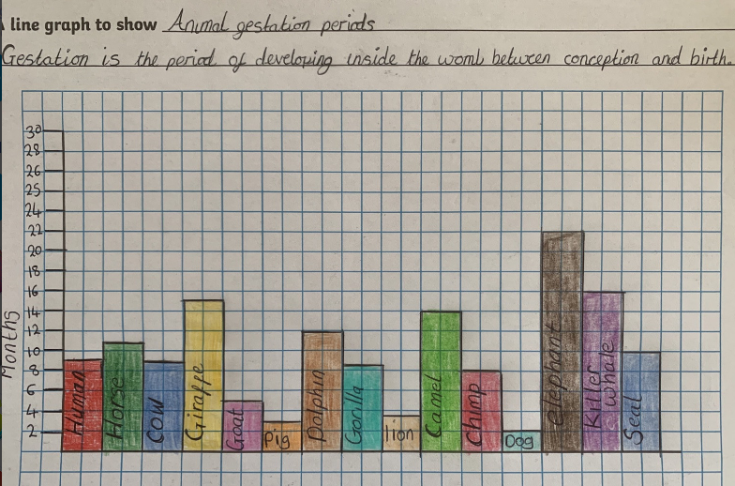
What else have we been doing during the half term holidays?
Nelly produced a perfect chart to show the gestation period of animals

Slide 31
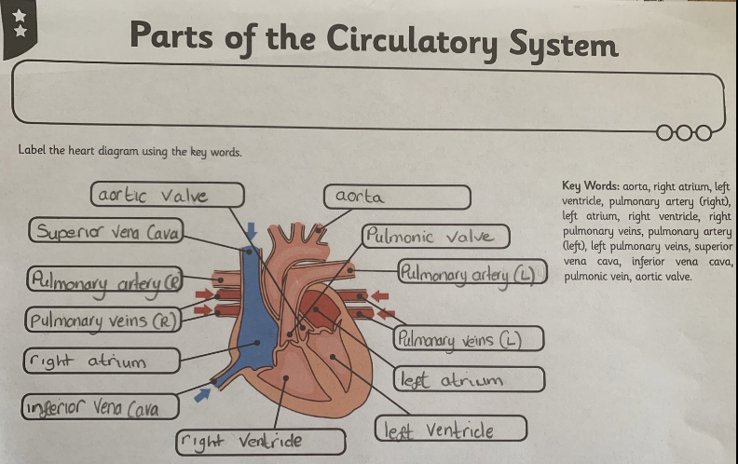
What else have we been doing during the half term holidays?
Nelly has been studying the parts of the heart

Slide 32
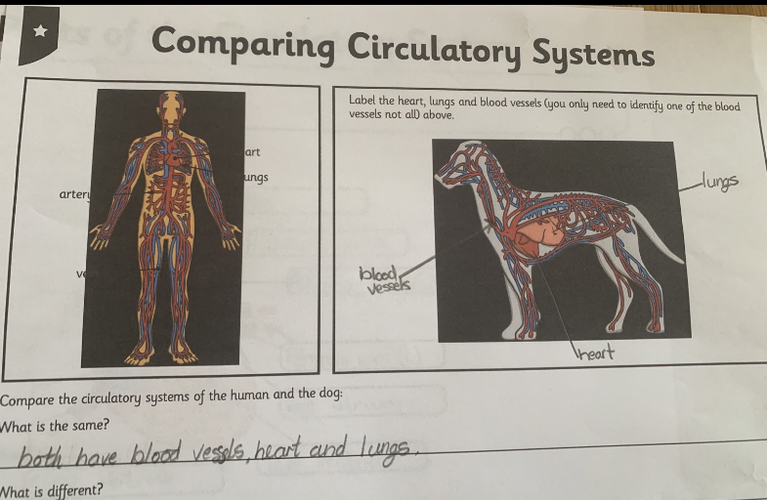
What else have we been doing during the half term holidays?
Nelly compared the human and animal circulatory system?

Slide 33
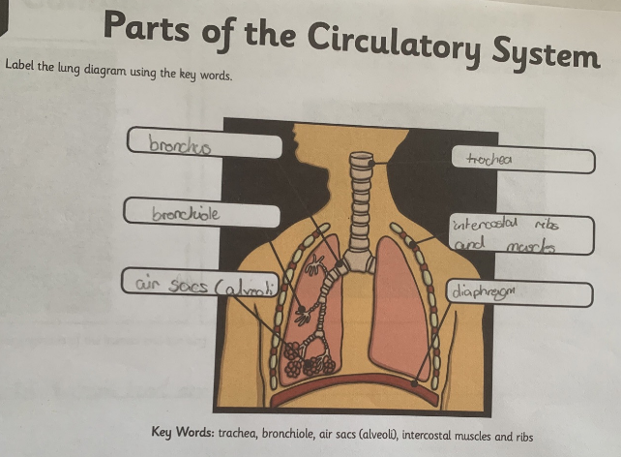
What else have we been doing during the half term holidays?
Nelly identified the parts of the lungs

Slide 34
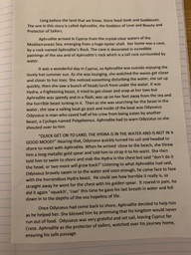
What else have we been doing during the half term holidays?
Zoe completed her Ancient Greek myth story

Slide 35
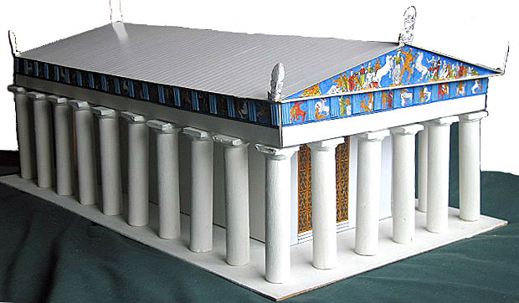
Ancient Greek Project
‘Parthenon’

Slide 36
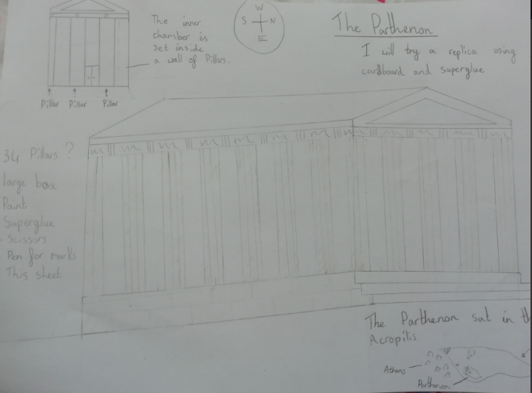
Amy

Slide 37
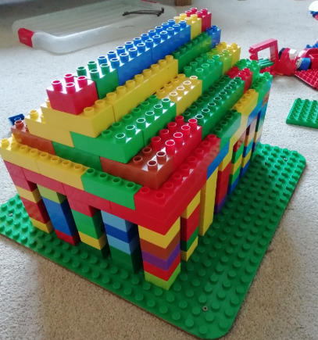
Amy

Slide 38
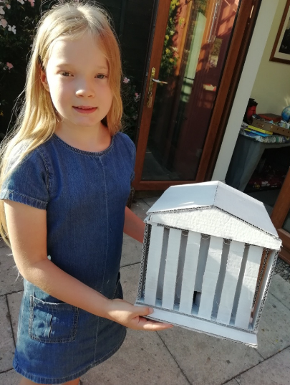
What else have we been doing recently?

Slide 39
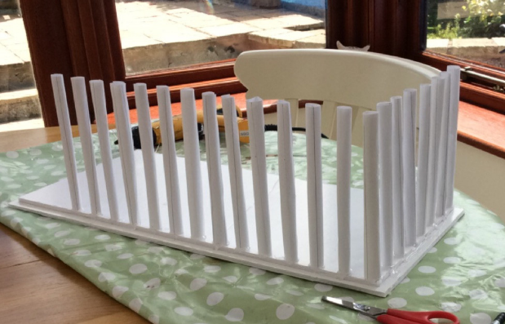
Reuben

Slide 40
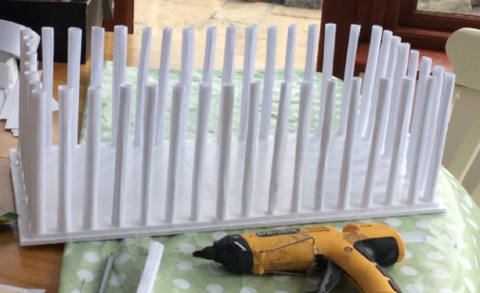
Reuben

Slide 41
Reuben

Slide 42
Reuben

Slide 44
Reuben

Slide 46
Cassie

Slide 48
Cassie

Slide 49
Cameron

Slide 50
Cameron

Slide 51
Cameron

Slide 52
Henry

Slide 55
The Parthenon
in ruins

Slide 56
Bethany

Slide 57
Bethany

Slide 58
Heidi

Slide 59
Heidi

Slide 60
Zoe

Slide 61
What else have we been doing recently?
Jack

Slide 62
What else have we been doing recently?
Nia

Slide 63
What else have we been doing recently?
I’ve made a model ‘Lightning F-35’

Slide 64
What else have we been doing recently?
Nia is proud of her achievements in her spelling practise.

Slide 65
What else have we been doing recently?
I’ve been enjoying some trampoline time.

