Slide 1
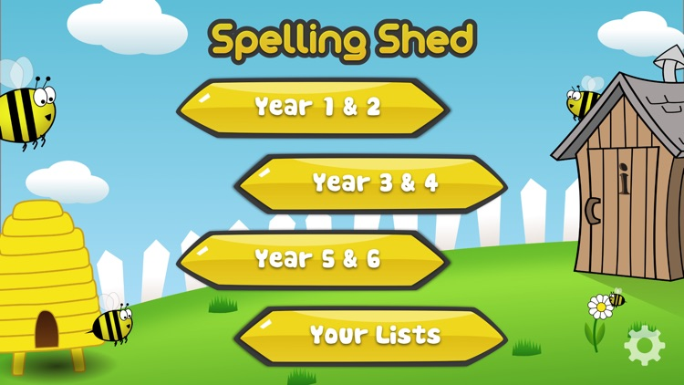
Y5&6 TOP SPELLERS TODAY
1st = Nia 28 points
2nd = Chloe 10 points
3rd = Lucy 9 points
4th = Jack and Harvey 7 points
5th = Henry and Ruby 5 points
6th = Megan 4 points
7th = Bethany and Lily 3 points
8th = Elizabeth and Reuben 2 points
9th = Zac 1 point
These are the amount of dojos you have received for your efforts today!
Everybody else earns 1 dojo for practising their spellings today!

Slide 2
What have we been
studying today at home?

Slide 3
Here’s what Y5&6 have been focusing on today
Use the information above to answer the following questions:
1. Why was theatre so important to the ancient Greeks?
It was like a festival
2. What is a satire play? – They were comedy plays.
3. How many people would attend ancient Greek plays? – 15,000 people
4. Why were theatres built on the hillsides? – so everybody could see what was going on below.
5. Which God were plays dedicated to? -Dionysys
6. Who was the most famous Greek playwright? - Aeschylus, Sophocles and Euripides
7. The stage was raised within the circle, why was it built this way? – So everyone could see and hear the sounds.
8. What would the audience throw if they weren’t happy with the play? – food and stones.
Henry has been reading the Ancient Greek Theatres text to answer the questions about it.

Slide 4
Here’s what Y5&6 have been focusing on today
Use the information above to answer the following questions:
1. Why was theatre so important to the ancient Greeks?
The theatre was important to originally celebrate the God Dionysus though many other gods got in the act. CORRECT
2. What is a satire play?
A satire were plays that made fun of real people and mortal legend’s. CORRECT
3. How many people would attend ancient Greek plays?
15,000 people would gather to see the plays. CORRECT
4. Why were theatres built on the hillsides?
Theatres were built on hillsides to accommodate the the large number of people that attended and it allowed the audience to see what was going on in the orchestra pit. CORRECT
5. Which God were plays dedicated to?
The plays were dedicated to the God Dionysus. CORRECT
6. Who was the most famous Greek playwright?
The most famous Greek playwright was Sophocles. CORRECT
7. The stage was raised within the circle, why was it built this way?
The stage was raised to make sure all the audience could see and it also helped amplify the sound.
CORRECT
8. What would the audience throw if they weren’t happy with the play?
They would throw food and a stone if they did not like the play.
CORRECT
Bethany has been reading the Ancient Greek Theatres text to answer the questions about it.

Slide 5
Here’s what Y5&6 have been focusing on today
Use the information above to answer the following questions:
1. Why was theatre so important to the ancient Greeks?
Theatre was so important because it was in honour of the god, Dionysus. CORRECT
2. What is a satire play?
A satyr play was a play that made fun of Greek legends and was very opinionated. CORRECT
3. How many people would attend ancient Greek plays?
Over 18,000. CORRECT
4. Why were theatres built on the hillsides?
Because they were large and needed to fit 18,000 viewers in. ½ CORRECT
5. Which God were plays dedicated to?
They were dedicated to the god Dionysus. CORRECT
6. Who was the most famous Greek playwright?
The most famous playwrights were: Aeschylus, Sophocles, Euripides and Aristophanes. CORRECT
7. The stage was raised within the circle, why was it built this way?
So that the audience could see and so that the sound was amplified. CORRECT
8. What would the audience throw if they weren’t happy with the play?
They would throw food and stone. CORRECT
Jack has been reading the Ancient Greek Theatres text to answer the questions about it.

Slide 6
Here’s what Y5&6 have been focusing on today
Use the information above to answer the following questions:
1. Why was theatre so important to the ancient Greeks? To honour the god Dionysus CORRECT
2. What is a satire play? They were plays that mocked mortal legends CORRECT
3. How many people would attend ancient Greek plays? 15,000 CORRECT
4. Why were theatres built on the hillsides? It allowed the audience to see what was going on in the play. CORRECT
5. Which God were plays dedicated to? Dionysus CORRECT
6. Who was the most famous Greek playwright? Sophocles CORRECT
7. The stage was raised within the circle, why was it built this way? So the audience could hear them better CORRECT
8. What would the audience throw if they weren’t happy with the play? Food or stones CORRECT
Lily has been reading the Ancient Greek Theatres text to answer the questions about it.

Slide 7
Here’s what Y5&6 have been focusing on today
1. Why was theatre so important to the ancient Greeks? It was important because of the aspect of the society even prisons would be released to see the play.
Who did they honour?
2. What is a satire play? It is a play that made fun of mortal legends and of real people. CORRECT
3. How many people would attend ancient Greek plays? Crowds of 15,000 people. CORRECT
4. Why were theatres built on the hillsides? To accommodate the large number of people that attended they were also on the hill because it allowed the audience to see what’s going on in the orchestra pit. CORRECT
Which God were plays dedicated to? God Dionysus CORRECT
6. Who was the most famous Greek playwright? Sophocles was the Greek playwright he wrote 120 plays. CORRECT
7. The stage was raised within the circle, why was it built this way? The shape made sure all the audience could see and helped amplify the sound. CORRECT
8. What would the audience throw if they weren’t happy with the play? If they didn’t like the play they would throw food and a stone. CORRECT
Chloe has been reading the Ancient Greek Theatres text to answer the questions about it.

Slide 8
Here’s what Y5&6 have been focusing on today
1. Why was theatre so important to the ancient Greeks? It was important to them because in some of their plays the gods were added so it shows how much the appreciate them. CORRECT
What is a satire play? A satire plays that made fun of mortal legends and real people in ancient Greece you did not make fun of the gods not in real life or ever, but you could make fun of your leaders. CORRECT
3. How many people would attend ancient Greek plays?15-18,000 CORRECT
4. Why were theatres built on the hillsides? It allowed the audience to see and hear everything that’s going on. CORRECT
5. Which God were plays dedicated to? They were dedicated to Dionysus. CORRECT
6. Who was the most famous Greek playwright? Sophocles CORRECT
7. The stage was raised within the circle, why was it built this way? It made sure the audience could see and it helped amplify the sound. CORRECT
8. What would the audience throw if they weren’t happy with the play? Rocks and food. CORRECT
Megan has been reading the Ancient Greek Theatres text to answer the questions about it.

Slide 9
Here’s what Y5&6 have been focusing on today
Use the information above to answer the following questions:
1. Why was theatre so important to the ancient Greeks? It was so important because it was an aspect of society. Even Greeks in goal (Greek prison) were released to go and watch the play.
Who was it used to honour?
2. What is a satire play? A satire play is a rude comedy. It was also quiet political.
CORRECT
3. How many people would attend ancient Greek plays?15,000 CORRECT
4. Why were theatres built on the hillsides? They were built on a hill side because it allowed the audience to see what was going on in the orchestra pit. CORRECT
5. Which God were plays dedicated to? Dionysus. CORRECT
6. Who was the most famous Greek playwright? Aeschylus, Sophocles, Euripides and Aristophanes CORRECT
7. The stage was raised within the circle, why was it built this way? So that all the audience could see and so that the voices of the actors was projected. CORRECT
8. What would the audience throw if they weren’t happy with the play? They would throw food and stones if they were not happy. CORRECT
Reuben has been reading the Ancient Greek Theatres text to answer the questions about it.

Slide 10
Here’s what Y5&6 have been focusing on today
Use the information above to answer the following questions:
1. Why was theatre so important to the ancient Greeks? Because it was an aspect of society and it was a huge competition between towns.
Who were they performed to honour?
2. What is a satire play? They made fun of mortal legends and real people but not the gods. CORRECT
3. How many people would attend ancient Greek plays? 15,000 people. CORRECT
4. Why were theatres built on the hillsides? To accommodate the large amount of people that watched them and so that the audience could see the actors clearly and hear them. CORRECT
5. Which God were plays dedicated to? Dionysus the god of wine. CORRECT
6. Who was the most famous Greek playwright? Sophocles he wrote 120 plays. CORRECT
7. The stage was raised within the circle, why was it built this way? To amplify sound and give people a better way to see. CORRECT
8. What would the audience throw if they weren’t happy with the play? Food and stone if they weren’t happy. CORRECT
Elizabeth has been reading the Ancient Greek Theatres text to answer the questions about it.

Slide 11
Here’s what Y5&6 have been focusing on today
Use this information above to answer the following questions:
Why was theatre so important to the ancient Greeks?
What is a satire play? Satire plays were plays that made fun of mortal legends and of real people. CORRECT
How many people would attend ancient Greek plays?
Crowds of 15,000 people would attend ancient Greek plays and because they were so important to the ancient Greeks that prisoners would be released from gaol temporarily so that they could attend. CORRECT
Why were theatres built on the hillsides?
Theatres were built on hillsides because it allowed the audience to see what was going on in the orchestra pit-the stage area. CORRECT
Which God were plays dedicated to? The ancient Greek plays were purely dedicated to Dionysus. CORRECT
Who was the most famous Greek playwright? The most famous Greek playwright was Sophocles. CORRECT
The stage was raised within the circle, why was it built this way?
What would the audience throw if they weren’t happy with the play?
If the audience wasn’t happy or satisfied with the play they would throw stone or food onto the orchestra pit. CORRECT
Ruby has been reading the Ancient Greek Theatres text to answer the questions about it.

Slide 12
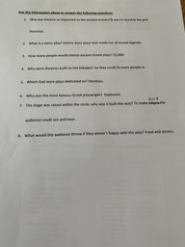
Here’s what Y5&6 have been focusing on today
Zoe has been reading the Ancient Greek Theatres text to answer the questions about it.

Slide 13
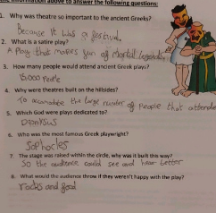
Here’s what Y5&6 have been focusing on today
Dante has been reading the Ancient Greek Theatres text to answer the questions about it.

Slide 14
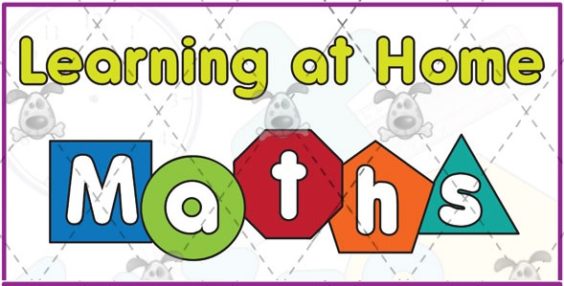
Here’s what Y5&6 have been
focusing on at home today.

Slide 15
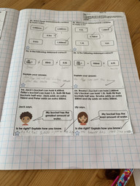
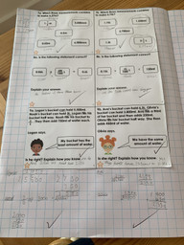
Here’s what Y5&6 have been
focusing on at home today.
Zoe has been solving the measurement problems in maths.

Slide 16
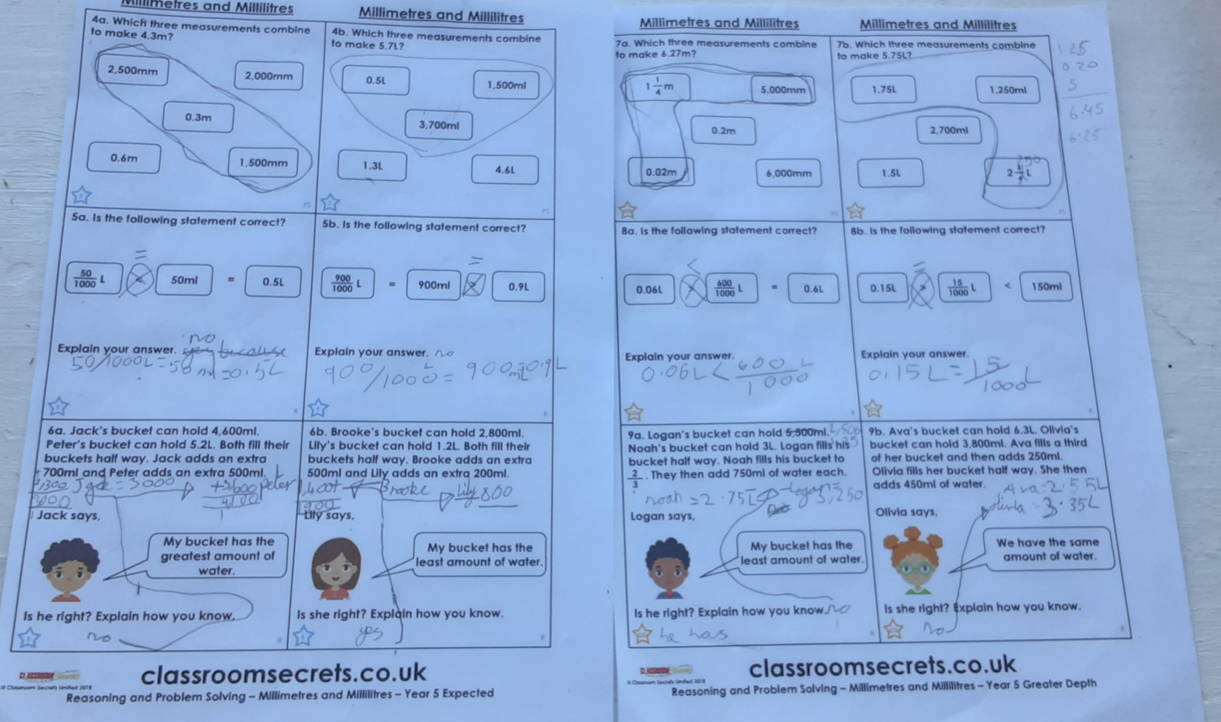
Here’s what Y5&6 have been
focusing on at home today.
Lucy has been solving the measurement problems in maths.

Slide 17
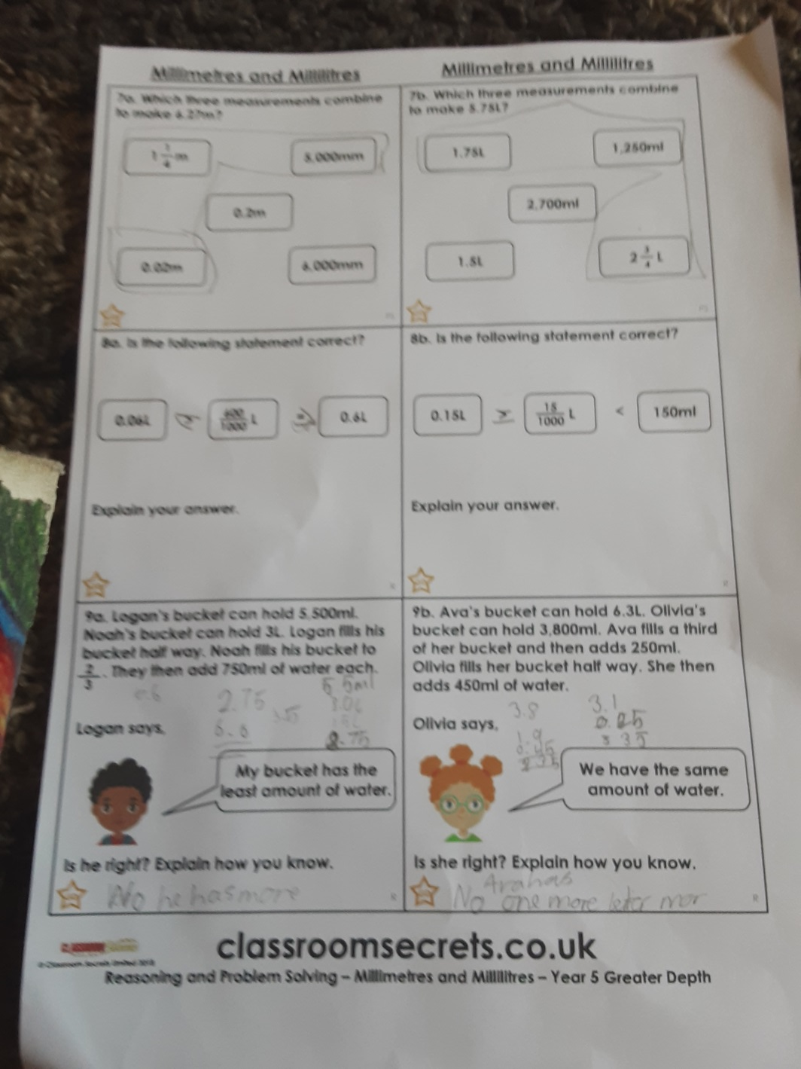
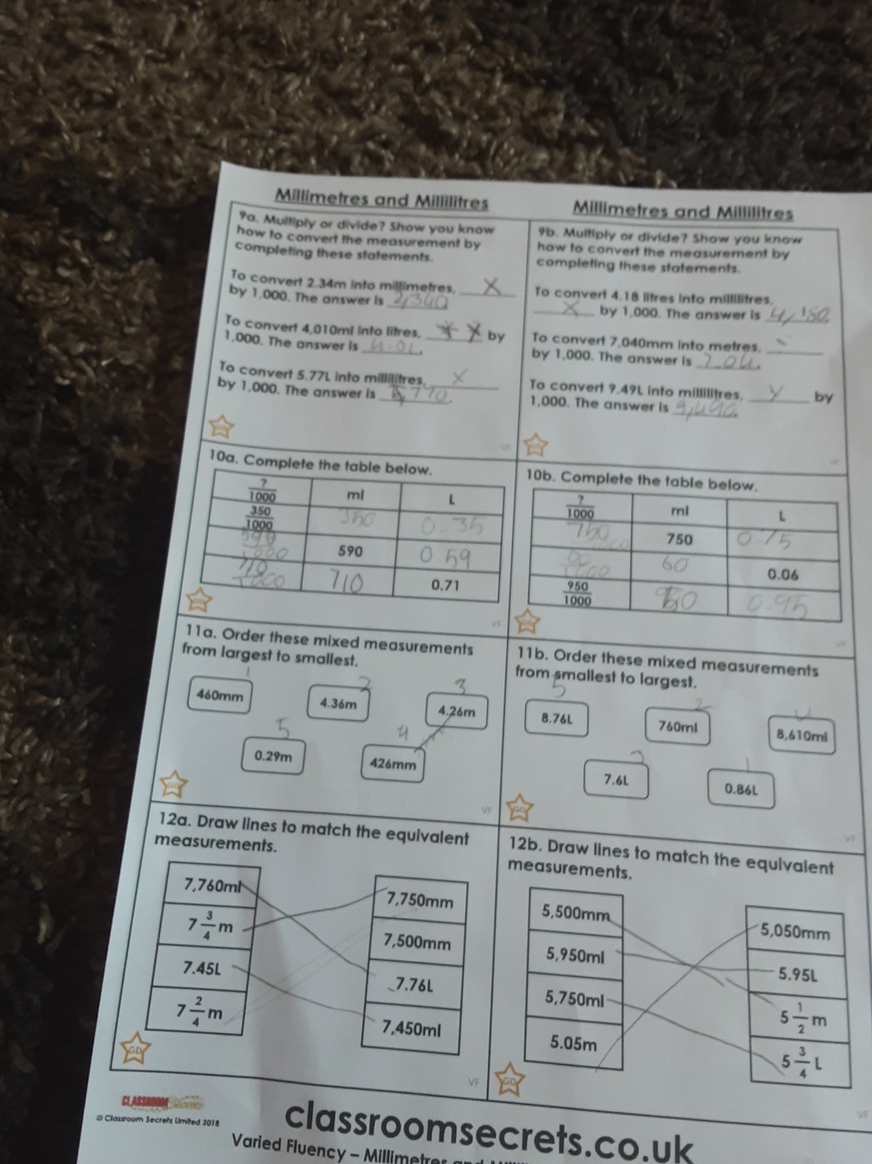
Here’s what Y5&6 have been
focusing on at home today.
Katie has been solving the measurement problems in maths.

Slide 18
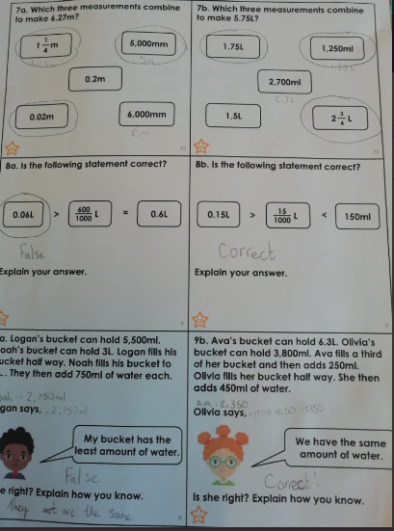
Here’s what Y5&6 have been
focusing on at home today.
Amy has been solving the measurement problems in maths.

Slide 19
Here’s some more of the work at home that’s just been handed in…….

Slide 20
9th October 431bc
Dear dairy
Today was another endless day of learning in our small country school. It all began when I heard a series of slams on my wooden door then I realized I had slept in, once again. Feeling slightly annoyed, I opened the door to see my very annoying sister, Temisee (Ti-mise-e), I simply pushed her out of the way. Leaving my room entering the kitchen I got hit by a wave of dread it was the first day of school after the holidays. Inside our eating section mother had already prepared a wonderful breakfast of buns and bread followed by a jug of wine and another for water. Looking back Breakfast and lunch were my favorite meals that day. After a few hours the whole family (all except for father who was fighting in the army) was ready for the day set for us.
Walking on the dusty, dirty road I was very thankful that father had gifted us with war style sandals. A few minutes later we were in front of my school, Brillgate road. Saying goodbye to mother I entered my first class, Grammata. The reason Grammata is the first class for my year is the teachers believe that sitting down, writing, revising and listening will get us in the school mood. Halfway into the lesson our kind teacher Forsidon (for-si-don) announced that music is coming up next, my heart dropped music was my least favorite subject. “Once you have finished writing down this sum take your instrument and go to your lesson with Mclyre to learn how to play the lyre” Forsidon chuckled to himself. I almost didn’t want the Grammata lesson to end (almost, because the lesson after that is Physical Education and it is my favorite subject and today we are focusing on mortal combat). Heading to my music lesson I could see Alexandros gathering protection armor and small wooden swords. There isn’t much to describe about in the music lesson unless you want to hear my song, 1000 melodies of life (its more like 2000 melodies of death). I forgot it was
Cameron’s diary from the perspective of an ancient Greek child.

Slide 21
lunchtime next. My lunch had fish, (caught and gutted, then cooked myself) bread (also made myself) a bun (brought from neighbor Nefeli) and a selection of olives. Lunch went fast, probably because I spent as long as possible eating my lovely bun. Going to Physical education class the dreadful notes played on my lyre could still be heard ringing in my ears. As I said before there isn’t much to hear about because I won every fighting match by far. “Well done Alterone”, congratulated my teacher, gathering the wooden swords and armour. Looking back I had the most fun in that lesson.
A few minutes later I was walking back to my house. Today was like most days, I hope tomorrow something interesting will happen, wait didn’t Forsidon say he had something planned, oh I remember it was…
Cameron’s diary from the perspective of an ancient Greek child.

Slide 22
Lucy’s diary from the perspective of an ancient Greek child.

Slide 23
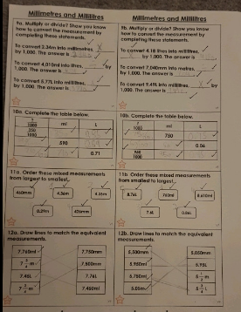
I’ve got more to show you
Cameron’s matched and recognising of the conversions between mm and m / ml and litres.

Slide 24
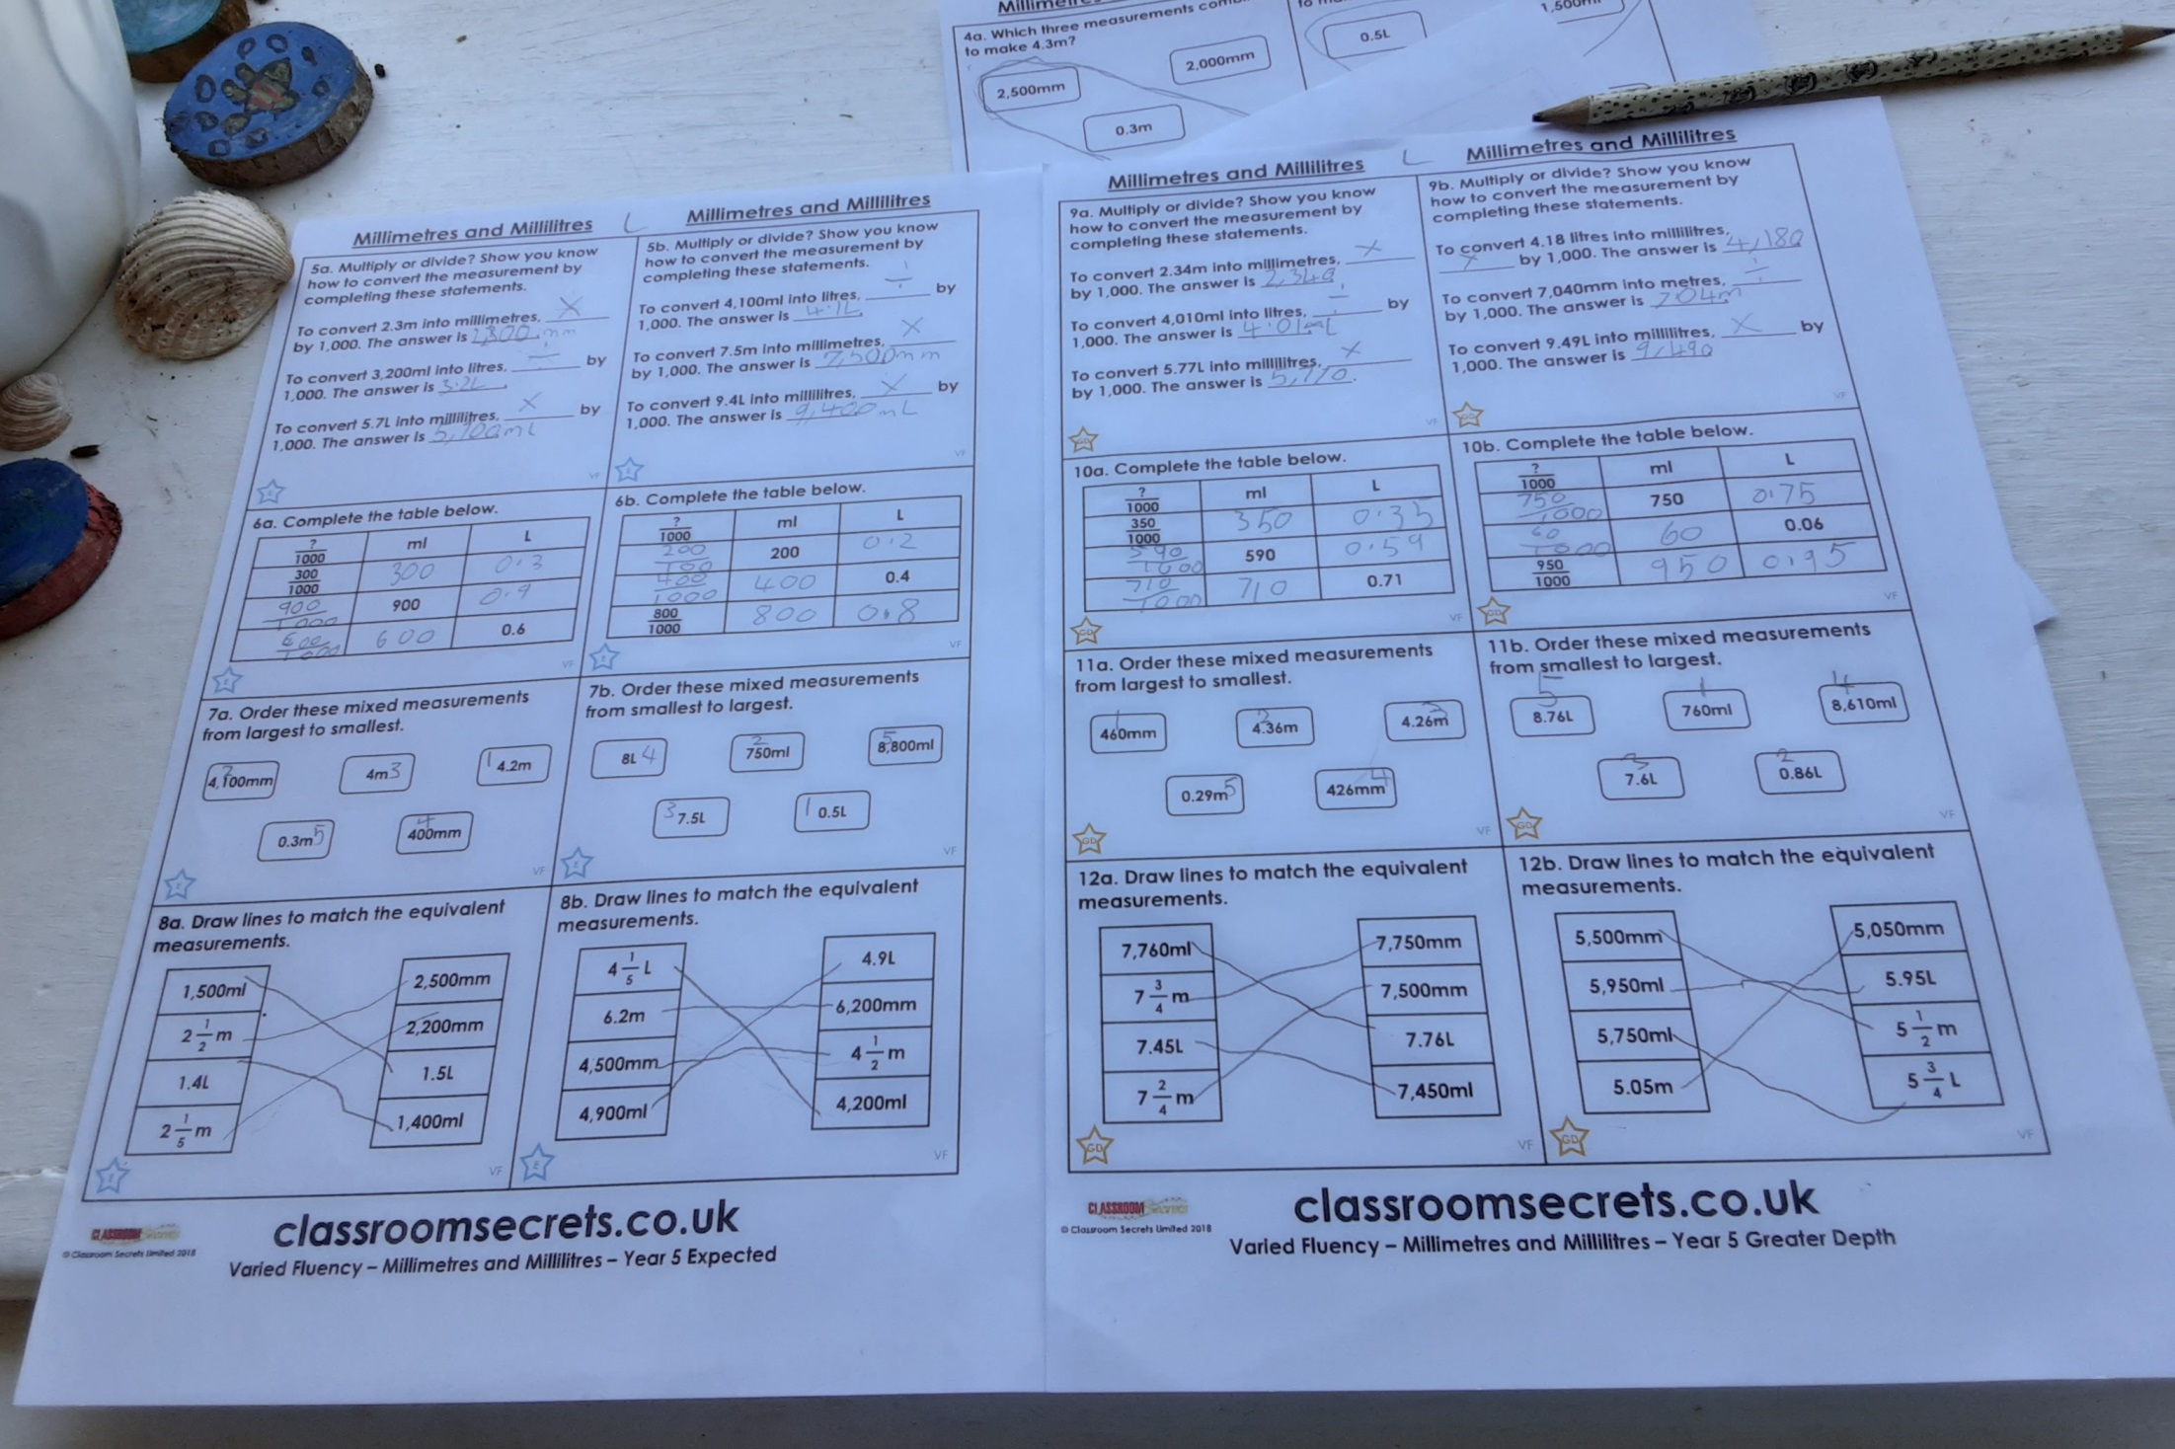
I’ve got more to show you
Lucy’s matched and recognising of the conversions between mm and m / ml and litres.

Slide 25
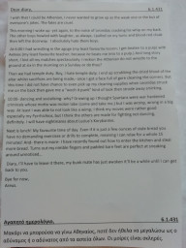
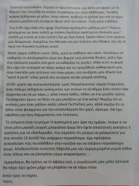
I’ve got more to show you
Amy’s diary from the perspective of an ancient Greek child, which was then translated into Greek!

Slide 26
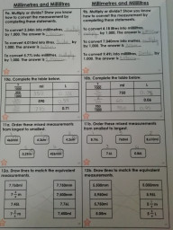
I’ve got more to show you
Amy’s matched and recognising of the conversions between mm and m / ml and litres.

Slide 27
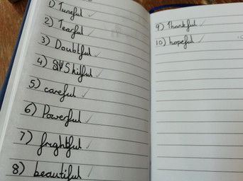
I’ve got more to show you
Amy scored 10/10 in her spelling score.

Slide 28
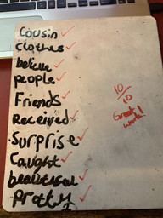
I’ve got more to show you
Henry scored 10/10 in his spelling score.

Slide 29
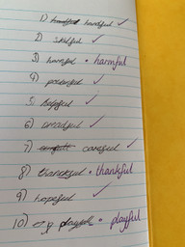
I’ve got more to show you
Zoe scored 7/10 in her spelling score.

Slide 30
I’ve got more to show you
Ruby scored 10/10
Reuben scored 10/10
Elizabeth scored 7/10
Zac scored 5/10
Lily scored 9/10
Megan scored 9/10
Chloe scored 8/10
Bethany scored 10/10
Jack scored 10/10

Slide 31
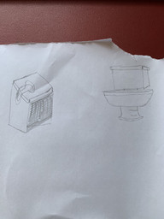
I’ve got more to show you
Henry has sketched a modern day and ancient Greek toilet to make comparisons.

Slide 32
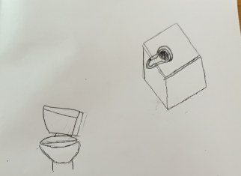
I’ve got more to show you
Zoe has sketched a modern day and ancient Greek toilet to make comparisons.

Slide 33
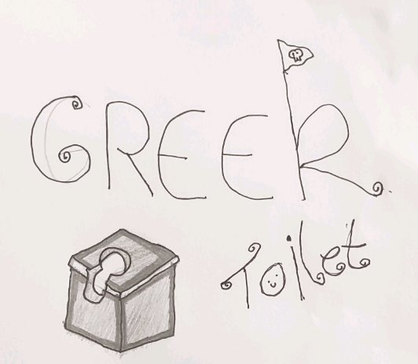
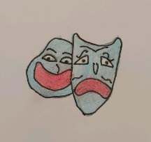
I’ve got more to show you
Dante has sketched an ancient Greek toilet as well as some other art work today.

