Slide 1
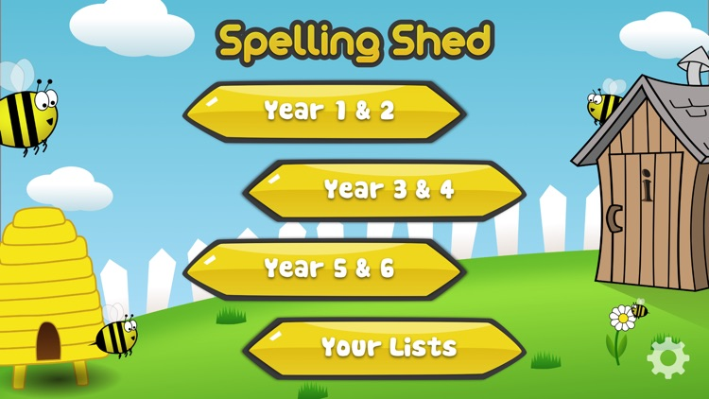
Y5&6 TOP SPELLERS TODAY
1st = Katie 66 points
2nd = Nia 29 points
3rd = Lucy 19 points
4th = Isobel 8 points
5th = Holly H 6 points
6th = Ruby 5 points
7th = Rhys and Toby 3 points
8th = Megan 2 points
9th = Jack, Reuben, Henry and Harvey 1 points
These are the amount of dojos you have received for your efforts today!
Everybody else earns 1 dojo for practising their spellings today!

Slide 2
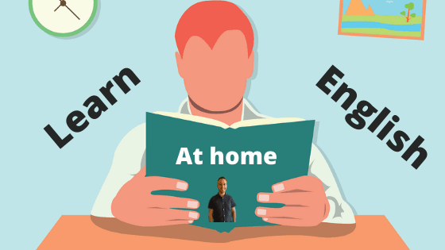
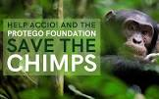
What have we been
studying today at home in our English / Science work?

Slide 3
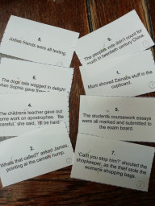
Here’s what Y5&6 have been focusing on at home today
Amy has been practising her use of apostrophes

Slide 4
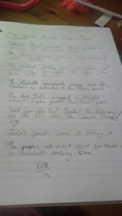
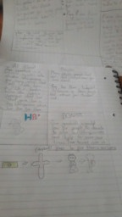
Here’s what Y5&6 have been focusing on at home today
Chloe has been practising her use of apostrophes
Then, she has produced her advert.

Slide 5
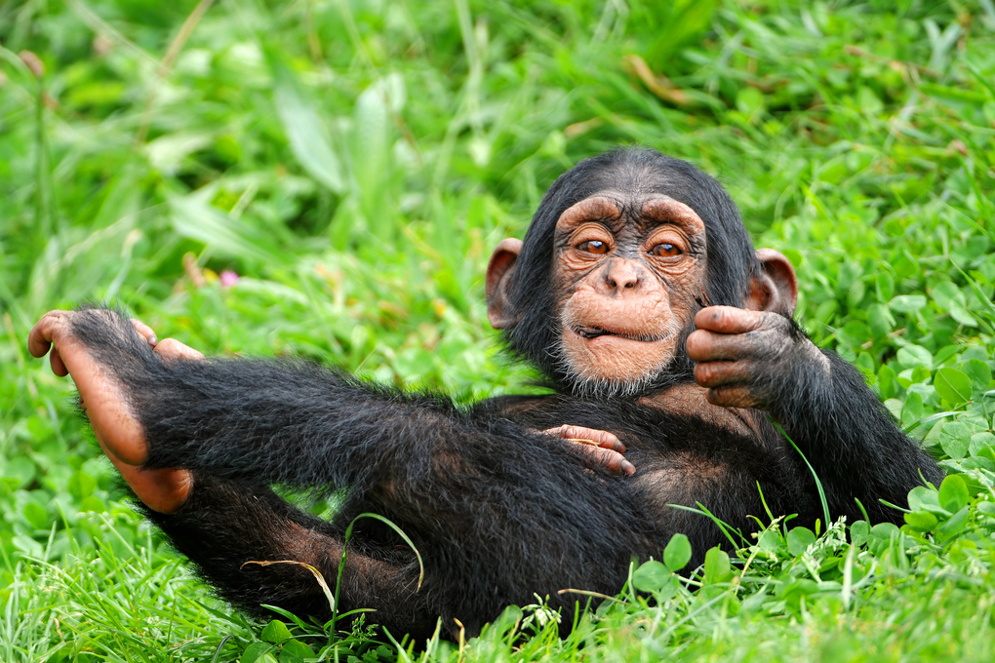
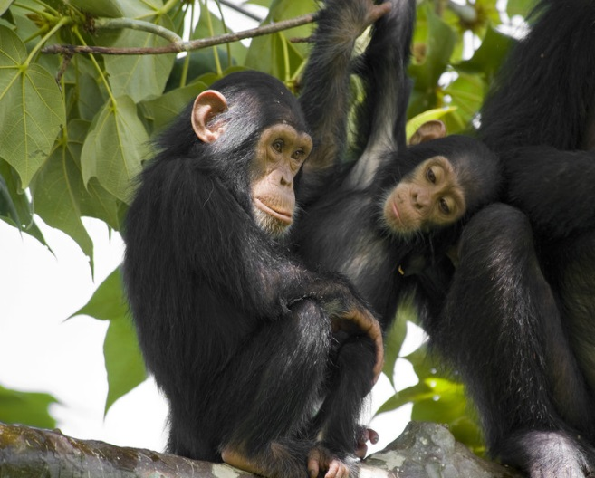
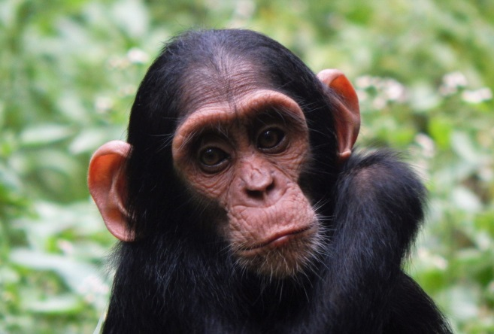
Save The Chimpanzees!!!
Here’s what Y5&6 have been focusing on at home today
Jack has trying to persuade others to consider the needs of the chimpanzees

Slide 6
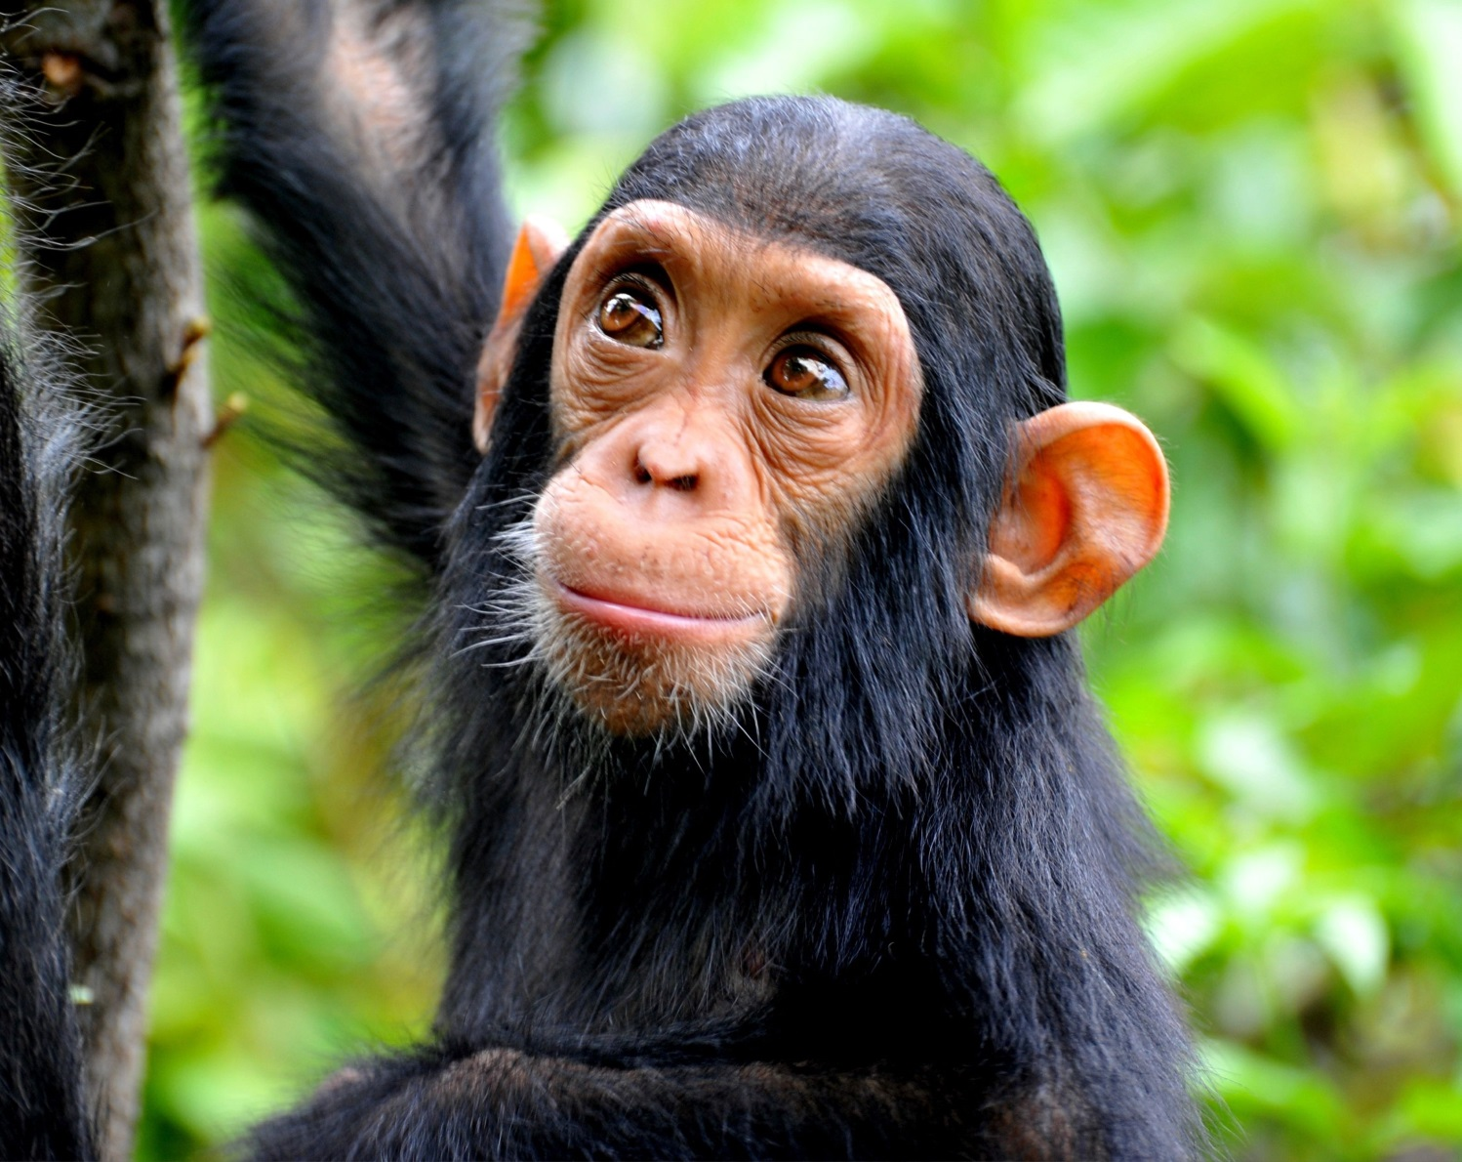
Here’s what Y5&6 have been focusing on at home today
Jack has trying to persuade others to consider the needs of the chimpanzees
Chimps are very unique creatures. They are extremely cute and playful. However, over 100 years ago there were over 1,000,000 chimps out in the wild but due to their loss of homes and illegal trades, there are only 170,000-300,000 left on our planet. That is why we need to save them.

Slide 7
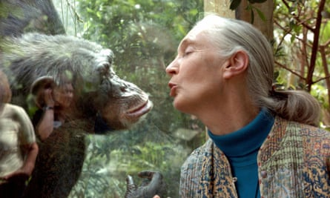
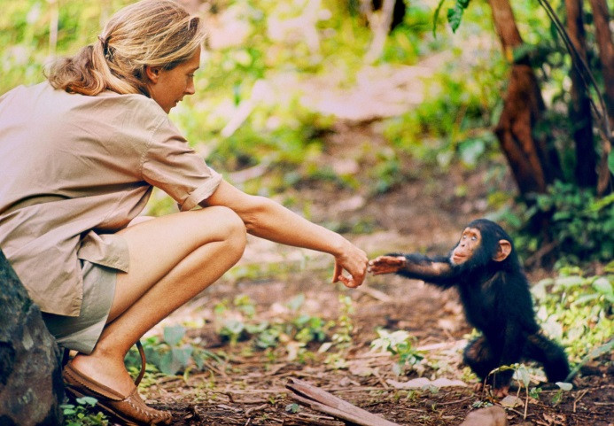
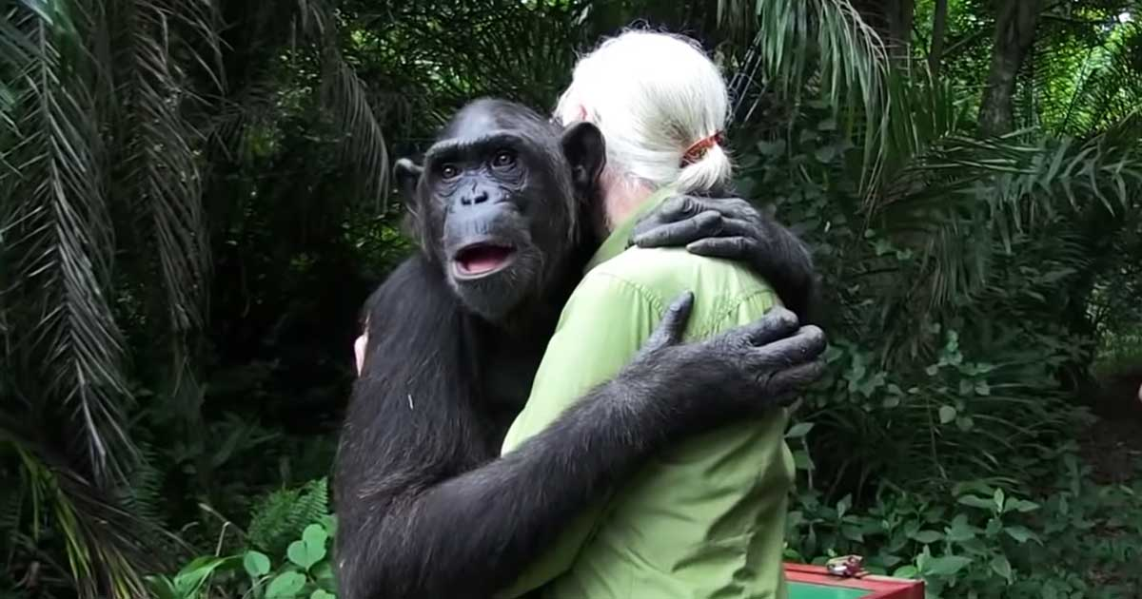
Here’s what Y5&6 have been focusing on at home today
Jack has trying to persuade others to consider the needs of the chimpanzees
Dr. Jane Goodall
Dr. Jane Goodall is a British scientist who has been studying Chimpanzees for many years. She was born in 1934 in London. When she was a child her father gave her a toy chimpanzee and since then she has had a love for animals, especially chimps. In 1960 she was appointed a chimpanzee researcher by a famous archaeologist named Louis Leaky who also sent her to Tanzania National Park to study a troop of chimps. Goodall mostly studied them in parts of Africa. She observed the behaviour of the chimps over a number of years and gained their trust. She found out that they had unbreakable family bonds which would stay through there whole life and saw their life cycle in reality.

Slide 8
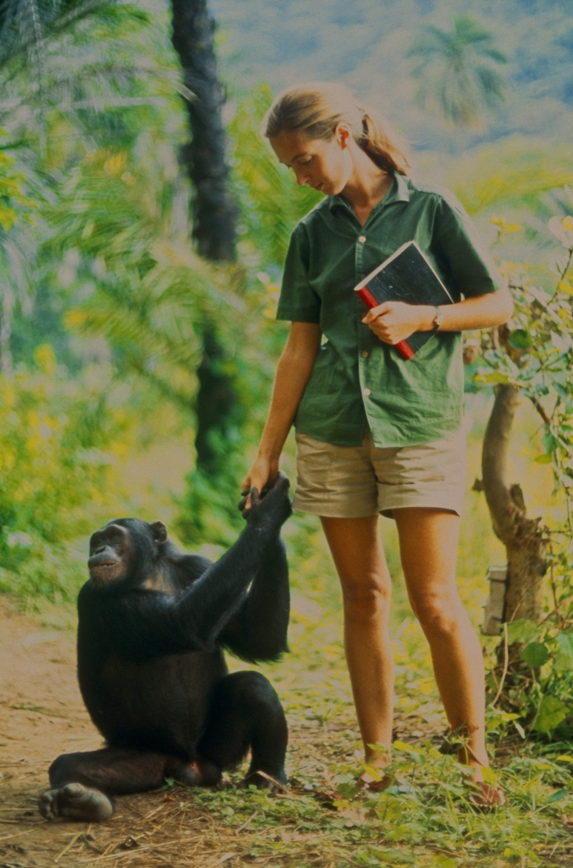
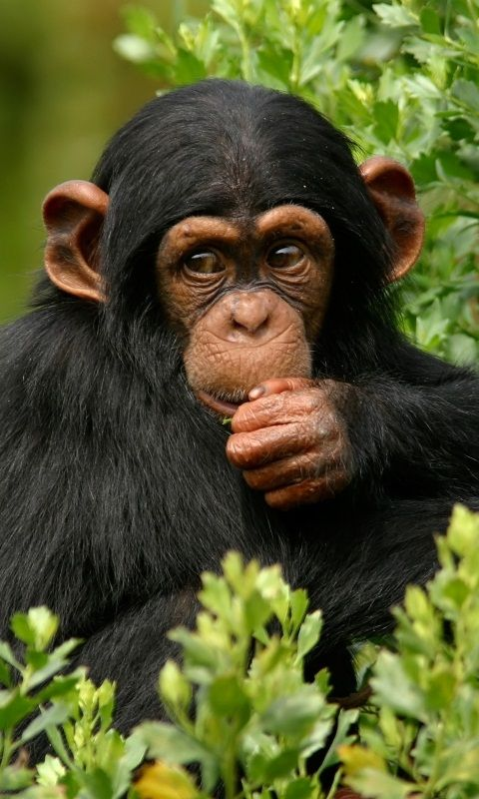
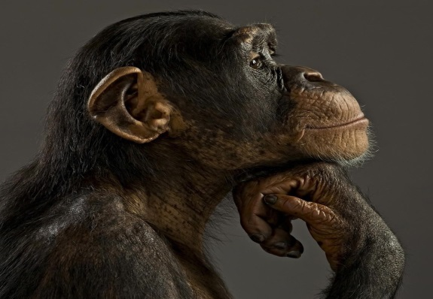
Here’s what Y5&6 have been focusing on at home today
Jack has trying to persuade others to consider the needs of the chimpanzees
If we want these unique creatures to live then we have to stop deforestation and stop destroying their habitats. They deserve a life like ours.
SAVE THE CHIMPS!!

Slide 9
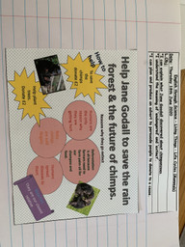
Here’s what Y5&6 have been focusing on at home today
Zoe has been trying to persuade others to consider the needs of the chimpanzees

Slide 10
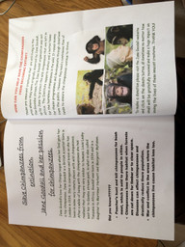
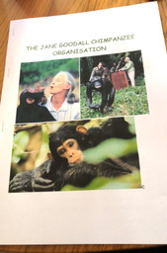
Here’s what Y5&6 have been focusing on at home today
Harvey has been trying to persuade others to consider the plight of the chimpanzees

Slide 11
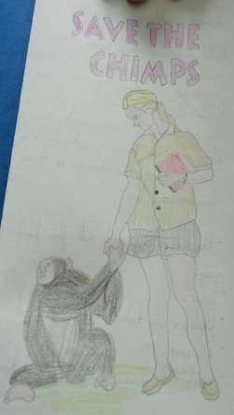
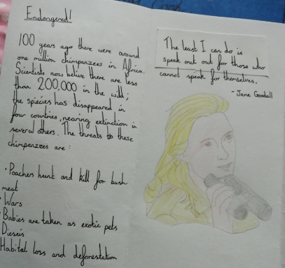
Here’s what Y5&6 have been focusing on at home today
Amy’s superb leaflet about the work of Jane Goodall to help to save the chimpanzees.

Slide 12
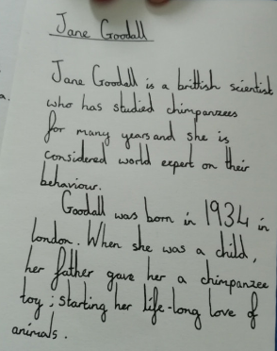
Here’s what Y5&6 have been focusing on at home today
…….a continuation of Amy’s leaflet.

Slide 13
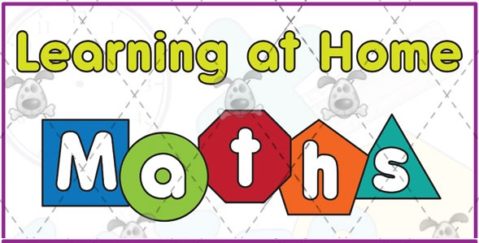
Here’s what Y5&6 have been
focusing on at home today.

Slide 14
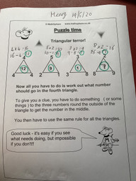
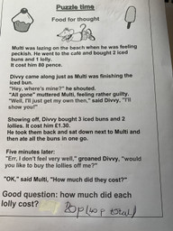
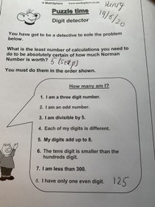
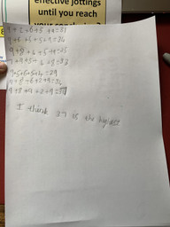
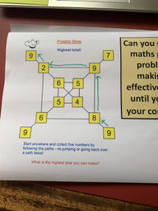
Here’s what Y5&6 have been
focusing on at home today.
Henry has been working hard on and being successful in his maths puzzles today.

Slide 15
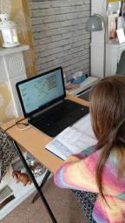
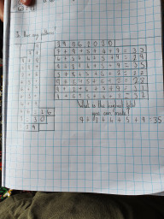
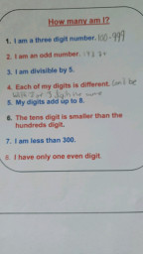
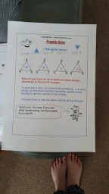
Here’s what Y5&6 have been
focusing on at home today.
Bethany has started her maths puzzles solving.

Slide 16
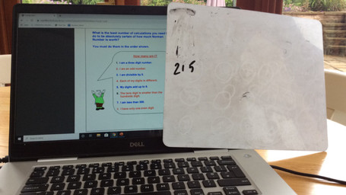
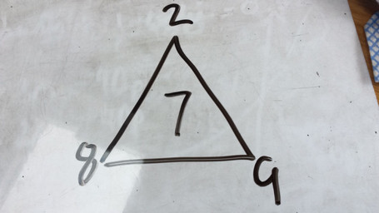
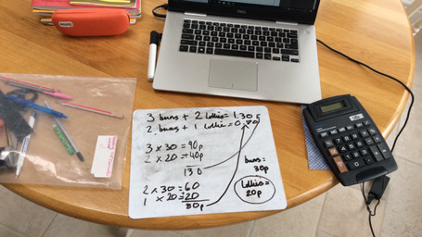
Here’s what Y5&6 have been
focusing on at home today.
Reuben has been working on his maths puzzles.

Slide 17
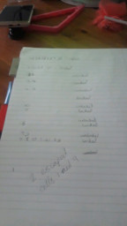
Here’s what Y5&6 have been
focusing on at home today.
Chloe has been working on her maths puzzles.

Slide 18
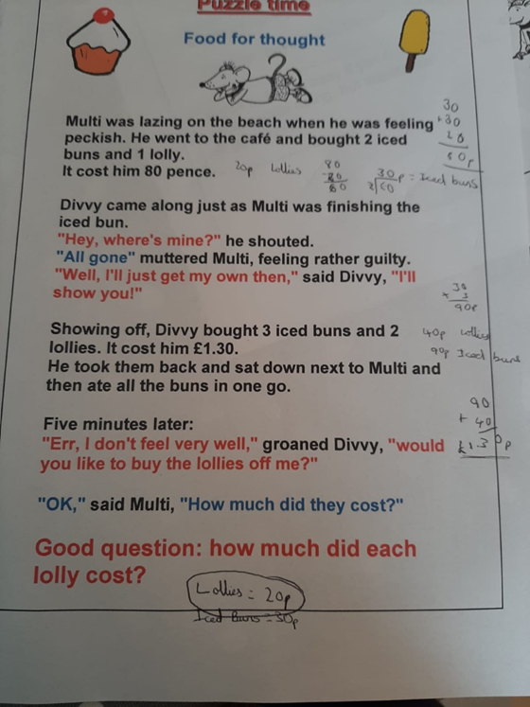
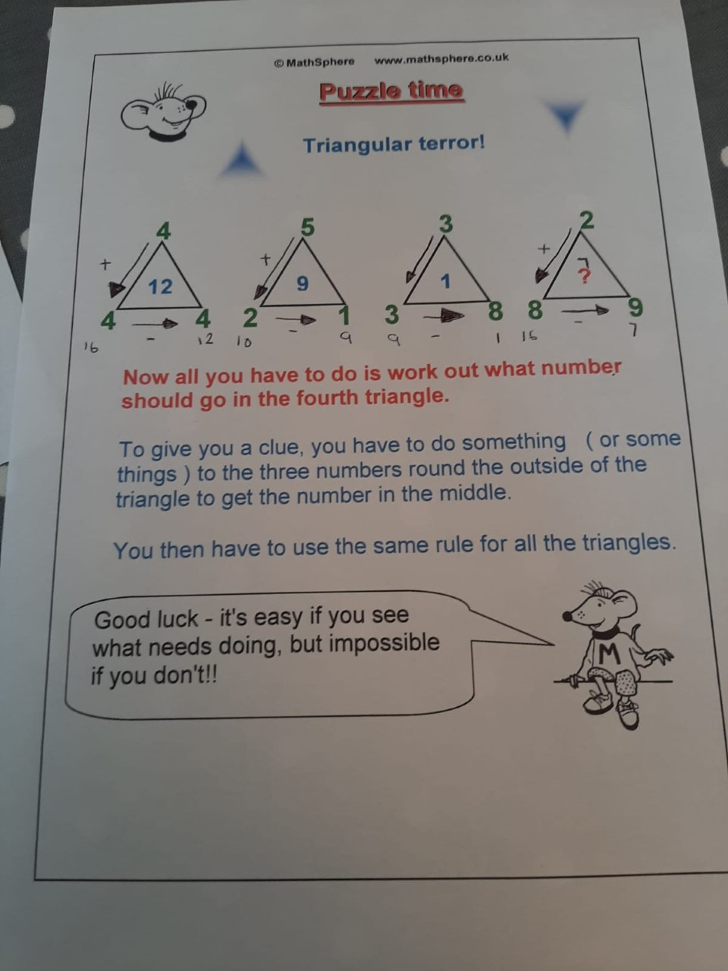
Here’s what Y5&6 have been
focusing on at home today.
Ruby has been working on her maths puzzles.

Slide 19
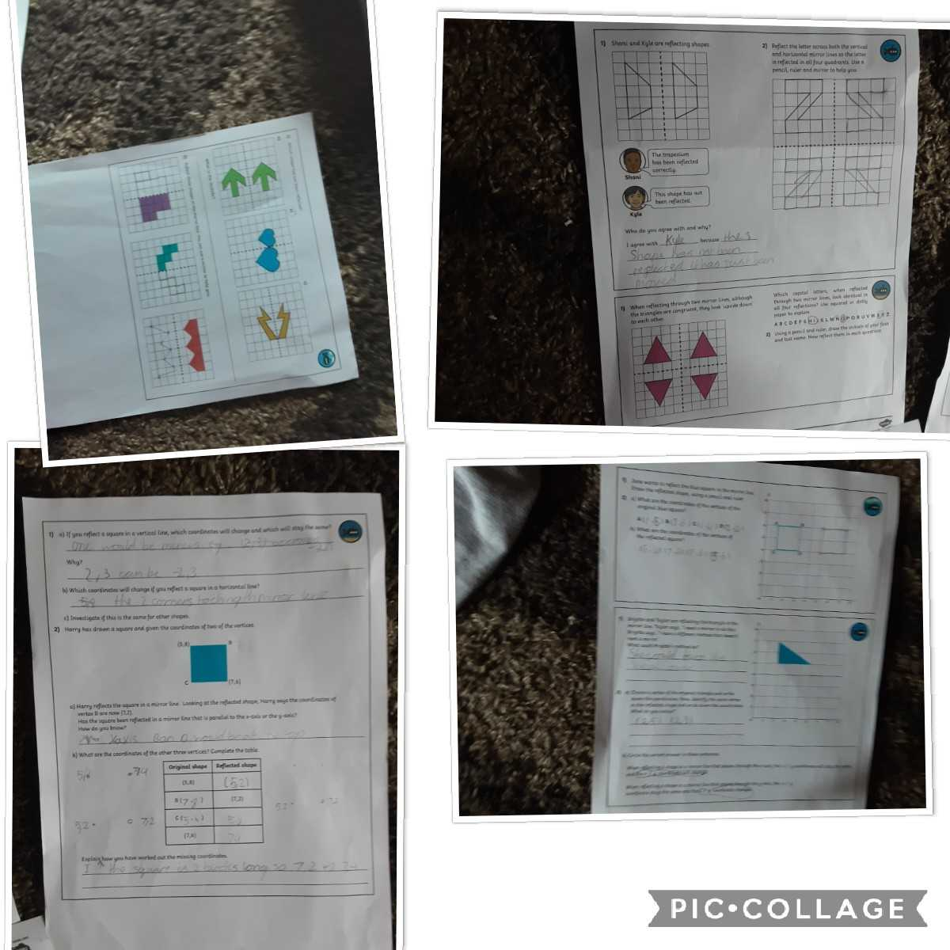
Here’s what Y5&6 have been
focusing on at home today.
Katie has been reflecting her shapes well and then identifying the co-ordinates.

Slide 20
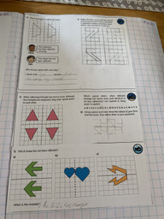
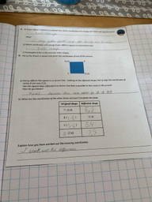
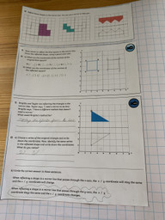
Here’s what Y5&6 have been
focusing on at home today.
Zoe has been reflecting her shapes well and then identifying the co-ordinates.

Slide 21
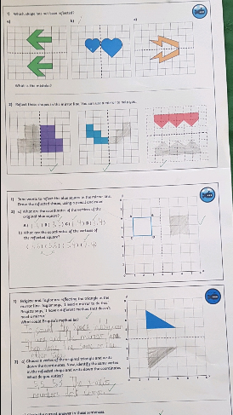
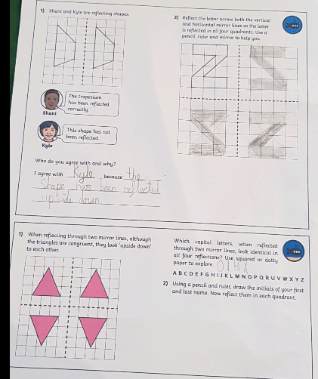
Here’s what Y5&6 have been
focusing on at home today.
Cameron has been reflecting his shapes well and then identifying the co-ordinates.

Slide 22
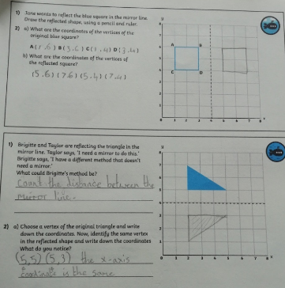
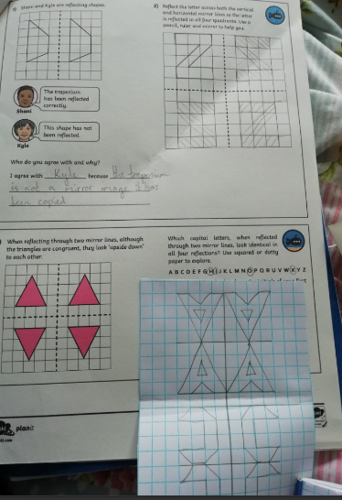
Here’s what Y5&6 have been
focusing on at home today.

Slide 23
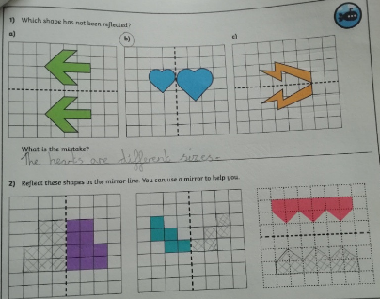
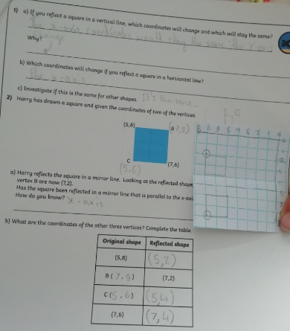
Here’s what Y5&6 have been
focusing on at home today.
Amy has thought really carefully to solve these reflection and coordinate problems.

Slide 24
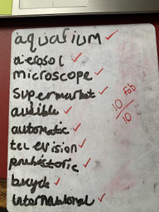
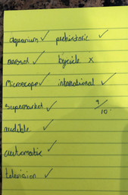
What else have I done at home today?
Reuben has scored 100% today
Chloe has scored 90% today
Henry has scored 10/10 today
Harvey has scored 90% today
Amy has also scored 90% today

Slide 25
Here’s some more of the work at home that’s just been handed in…….

Slide 26
I’ve got more to show you
Here’s my Jane Goodall information from yesterday.

Slide 27
I’ve got more to show you
Even Harvey’s dog Bella is helping to support the plight of the chimpanzees.

Slide 28
I’ve got more to show you
Amy’s maths from yesterday.

