Slide 1
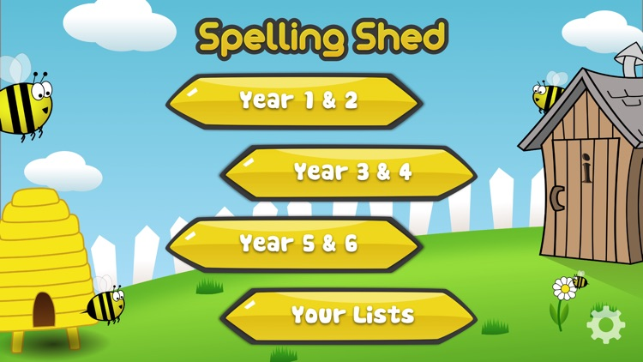
Y5&6 TOP SPELLERS TODAY
1st = Nia 36 points
2nd = Lucy 16 points
3rd = Holly H and Rhys 6 points
4th = Jack 5 points
5th = Chloe, Zac and Heidi 3 points
6th = Megan and Dante 2 points
7th = Henry and Katie 1 points
8th =
9th =
These are the amount of dojos you have received for your efforts today!
Everybody else earns 1 dojo for practising their spellings today!

Slide 2
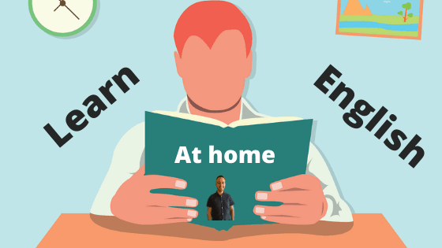
What have we been
studying today at home?

Slide 3
Here’s what Y5&6 have been focusing on at home today
SPaG Challenge
Henry : So Dad, would you like me to help you set up the work bench, ready for today’s work?
Dad : Yes please Henry, that would be great. Could you please put the socket set out and some screw drivers? We will also need some parts from the store cupboard.
Henry : Can I get the parts you need? Do we need to order anything?
Dad : We should have all we need here as it is a Stihl machine. You need to put some gloves on as this machine has got oil pouring out of it.
Henry : I will have to get the parts and sort them first and then go and get the gloves.
Key : Imperative verbs Modal Verbs
Henry has identified any of the modal verbs and imperative verbs in his script.

Slide 4
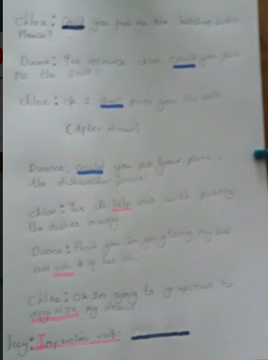
Here’s what Y5&6 have been focusing on at home today
Chloe has created her own script and recognised many of the modal verbs and imperative verbs that she included.

Slide 5
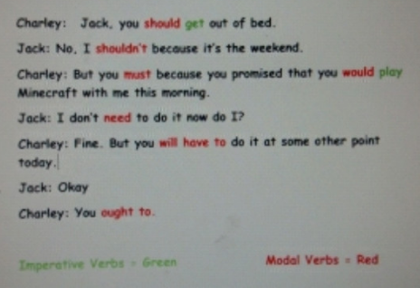
Here’s what Y5&6 have been focusing on at home today
Jack has created his own short script and identified many of the modal verbs and imperative verbs

Slide 6
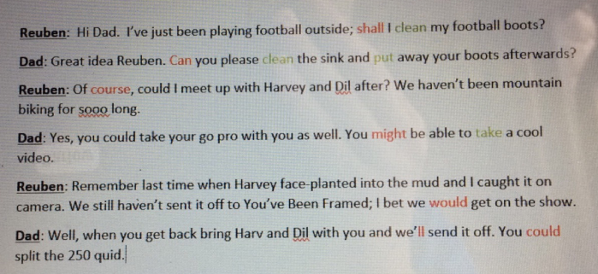
Here’s what Y5&6 have been focusing on at home today
Reuben has created his own short script and identified many of the modal verbs.

Slide 7
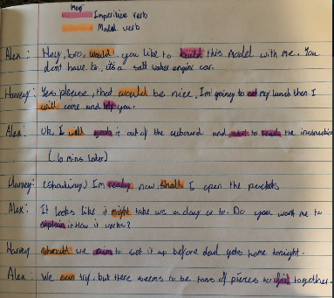
Here’s what Y5&6 have been focusing on at home today
Harvey has created his own short script and identified many of the modal verbs and imperative verbs.

Slide 8
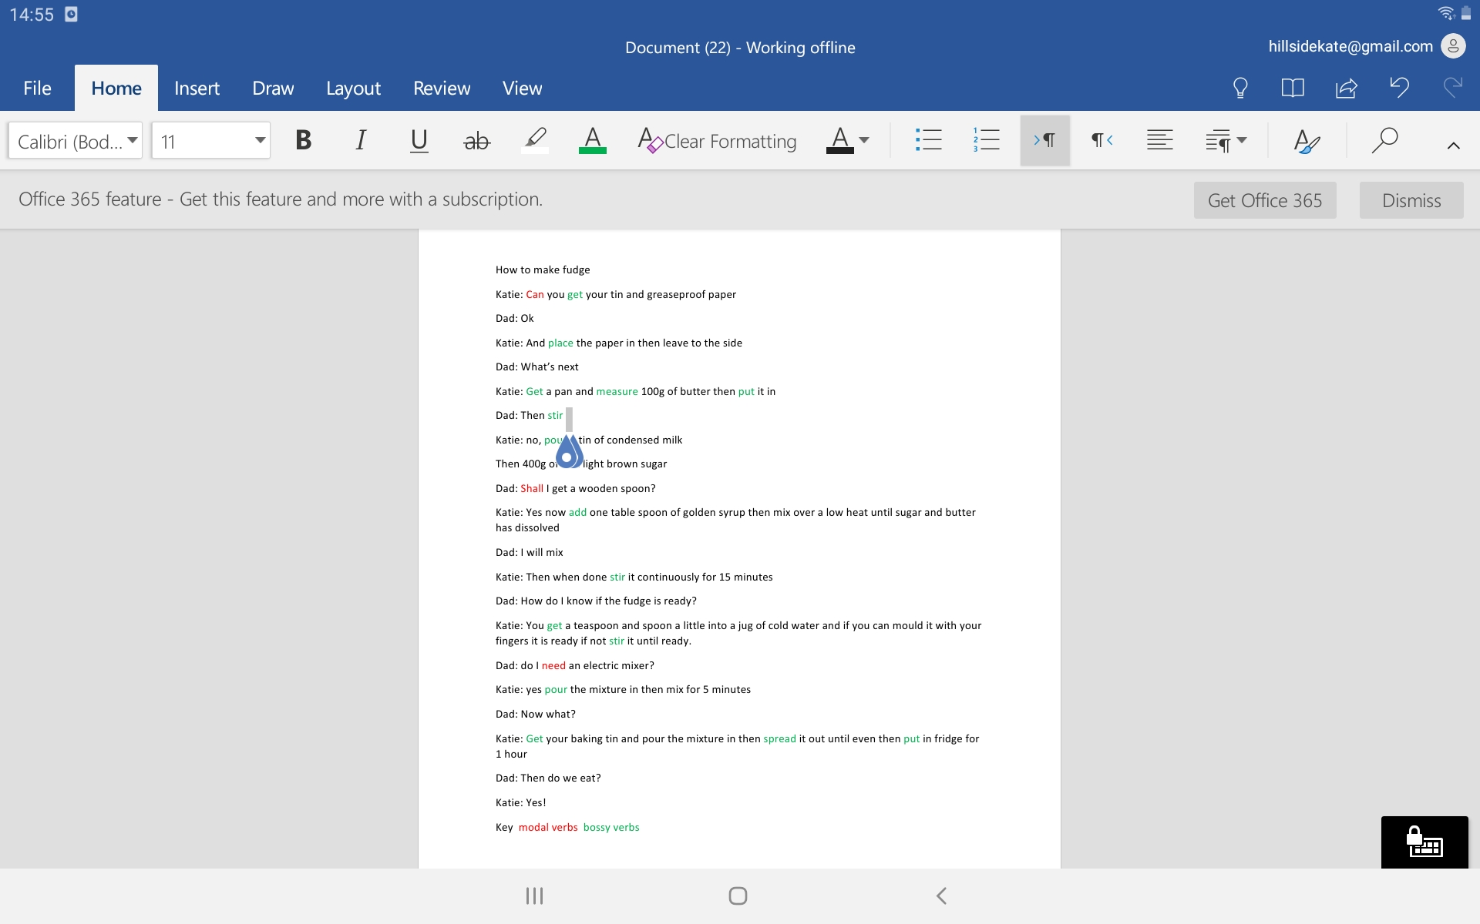
Here’s what Y5&6 have been focusing on at home today
Katie has created her own short script and identified some of the modal verbs and imperative verbs.

Slide 9
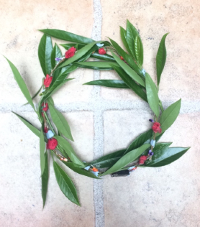
Here’s what Y5&6 have been focusing on at home today
Megan has followed her instruction text to create this wonderful laurel wreath good enough for the Olympics.

Slide 10
Here’s what Y5&6 have been focusing on at home today
Scene 1: (Megan and her cousin Connor are on the forest coaster in Wales).
Megan: Connor can you put your seatbelt on, otherwise you’re going to die!
Connor: What? I can’t hear you!
Megan: PUT YOUR SEATBELT ON NOW!
Connor: Can you stop shouting and tell me again.
Megan: Okay, okay keep your toupé on! I said put your seatbelt on or you will end it for the both of us.
Connor: Calm your farm. I’ve had it on the whole time!
Megan has created her own script and recognised many of the modal verbs and imperative verbs that she included.

Slide 11
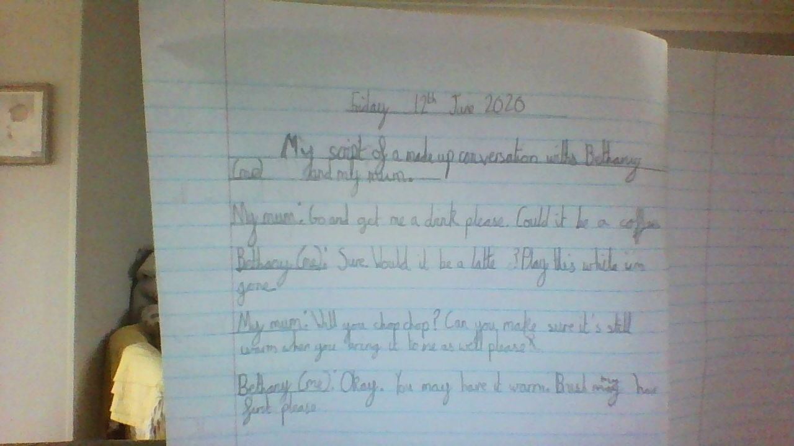
Here’s what Y5&6 have been focusing on at home today
Bethany has created her own script and included many modal verbs and imperative verbs.

Slide 12
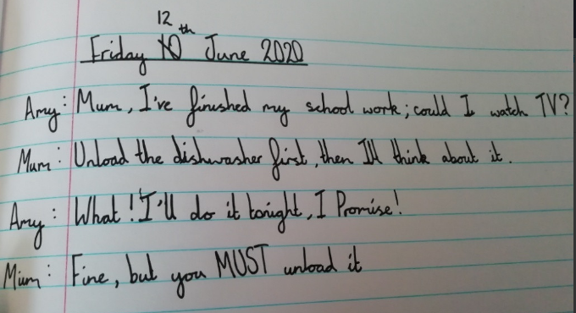
Here’s what Y5&6 have been focusing on at home today
Amy has created her own script and included many modal verbs and imperative verbs.

Slide 13
Here’s what Y5&6 have been
focusing on at home today.

Slide 14
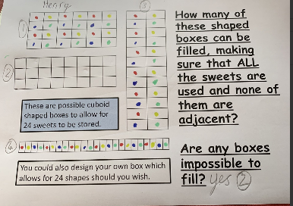
Here’s what Y5&6 have been
focusing on at home today.
Henry has been investigating in maths

Slide 15
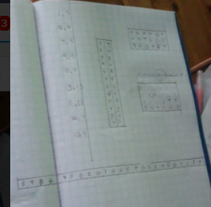
Here’s what Y5&6 have been
focusing on at home today.
Chloe has been investigating in maths

Slide 16
Here’s what Y5&6 have been
focusing on at home today.
Reuben has been investigating in maths.

Slide 17
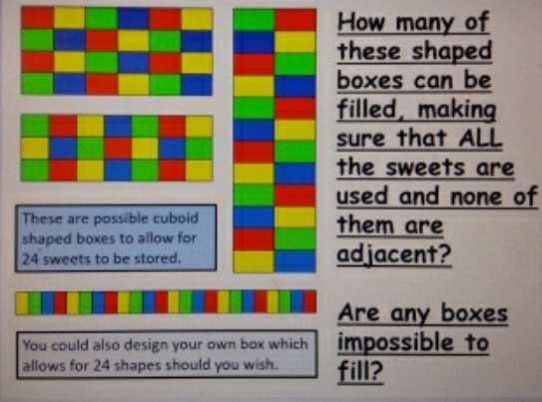
Here’s what Y5&6 have been
focusing on at home today.
Jack has been investigating in maths.

Slide 18
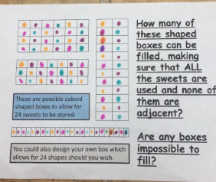
Here’s what Y5&6 have been
focusing on at home today.
Megan has been investigating in maths.

Slide 19
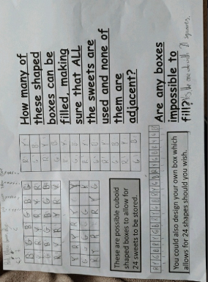
Here’s what Y5&6 have been
focusing on at home today.
Bethany has been investigating in maths.

Slide 20
Here’s some more of the work at home that’s just been handed in…….

Slide 21
I’ve got more to show you
How To Make An Ancient Greek Laurel Wreath
Have you always wanted a wreath just like the Ancient Greeks? All it takes to make are seven simple steps and you’ll have your own Laural Wreath in no time!
You Will Need:
8 - 10 leaves
(You can use fake leaves or you can cut out ones of your own)
Gold, Silver or Green wire
Scissors
Hot Glue Gun or extra wire
Method
Cut the wire to the diameter of your head.
Layout your leaves on the table; four-five on each side. Make sure that you leave some room at the front and back of the wreath.
Make a loop at one end of your wire whilst looping the other end through the hole that you previously made, and secure safely.
One by one, place the leaves on top of the wire and (if you have a hot glue gun) glue on the leaves till you have an Ancient Greek laurel wreath!
If you don’t own a hot glue gun then take a leaf and a piece of wire (approximately 18 centimetres long) and wrap it around the leaf in a zig-zag pattern, till all the leaves are gone. You should end up with an Ancient Greek laurel wreath!
Safety warning
Be careful when handling sharp wire and hot glue guns. Make sure at all times that there is an adult supervising.
Top tip
Try overlapping the leaves to create a more ancient effect.
Heidi’s completed instruction text

Slide 22
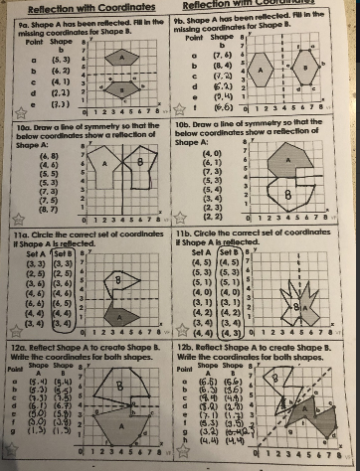
I’ve got more to show you
Heidi has been reflecting her shapes in the mirror lines and identifying the co-ordinates correctly.

Slide 23
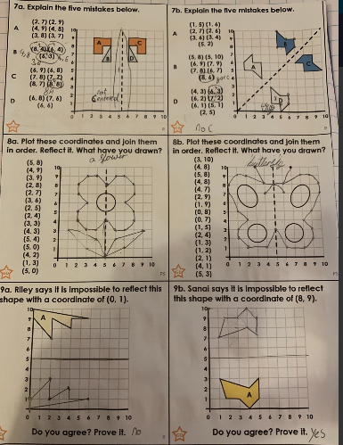
I’ve got more to show you
Zoe has been reflecting her shapes in the mirror lines and identifying the co-ordinates correctly.

Slide 24
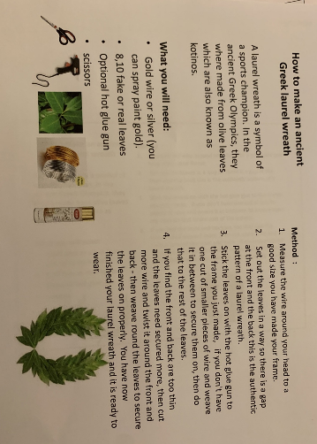
I’ve got more to show you
Zoe’s completed instruction text

Slide 25
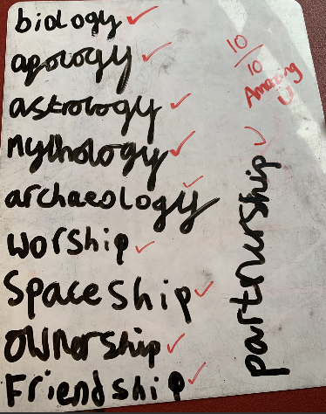
I’ve got more to show you
Henry scored 10 / 10 on his spellings with the suffixes ‘port’ and ‘ology’.

Slide 26
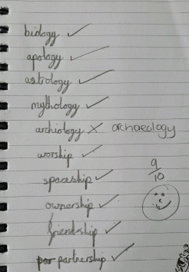
I’ve got more to show you
Bethany scored 9 / 10 on her spellings with the suffixes ‘port’ and ‘ology’.

Slide 27
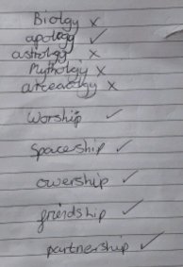
I’ve got more to show you
Chloe has nailed the ‘port’ suffix spellings but needs a bit more practise on the ‘ology’ suffix.
Keep working hard Chloe!

Slide 28
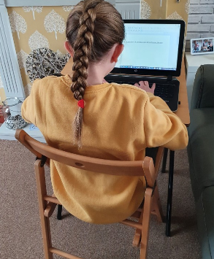
I’ve got more to show you
Bethany was straight down to work this morning (as usual).

Slide 29
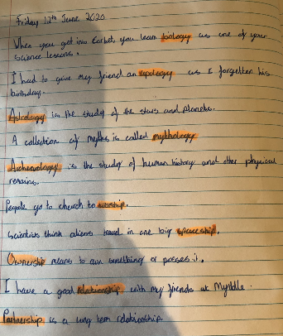
I’ve got more to show you
Harvey used his spellings for this week as part of his own sentences.

Slide 30
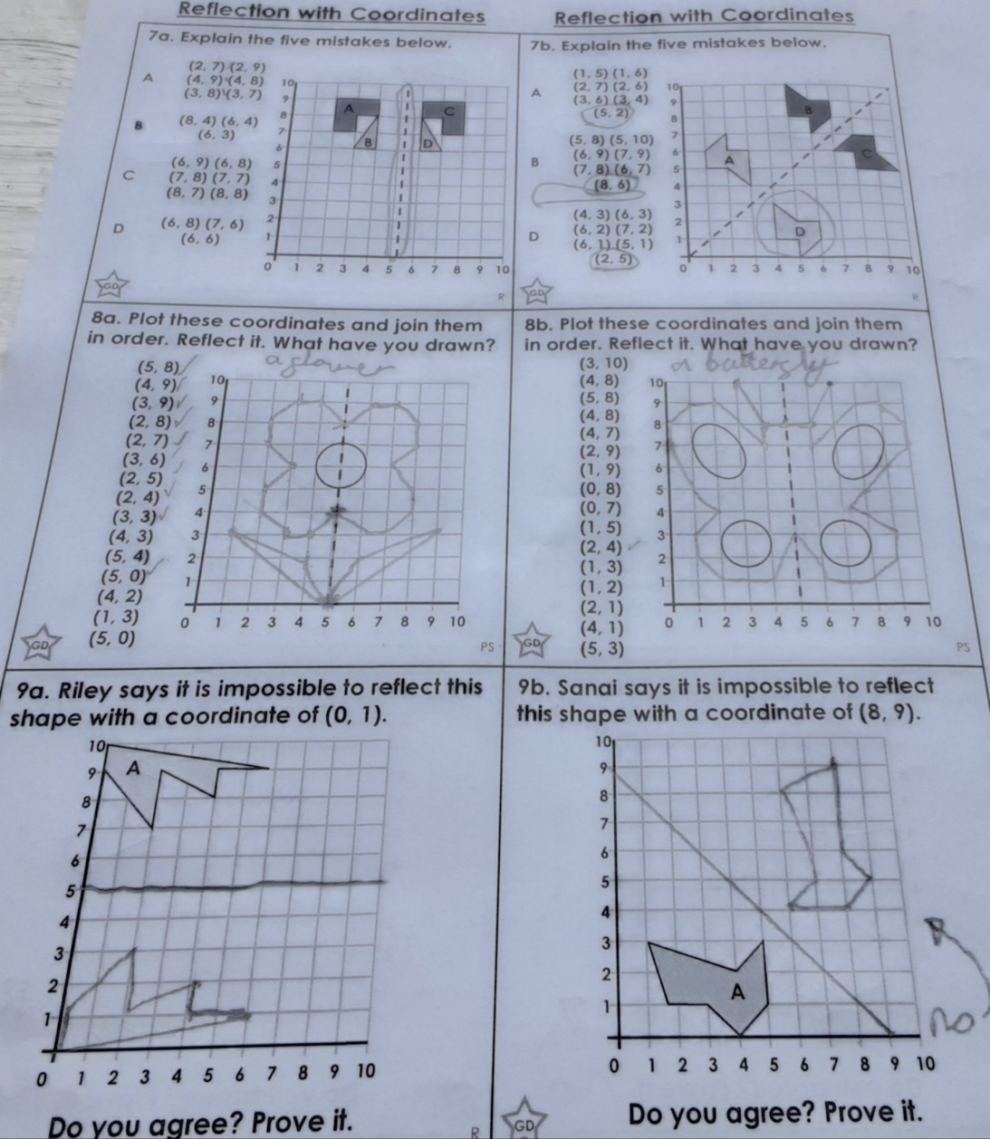
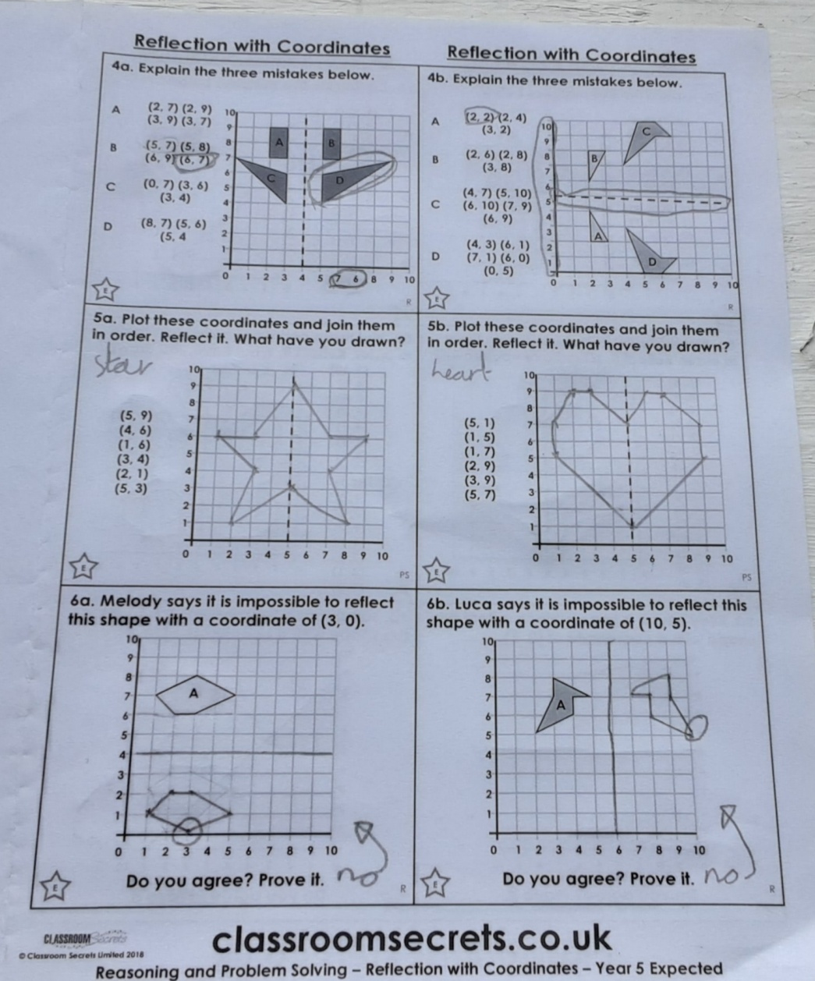
I’ve got more to show you
Lucy has been reflecting her shapes in the mirror lines and identifying the co-ordinates correctly.

Slide 31
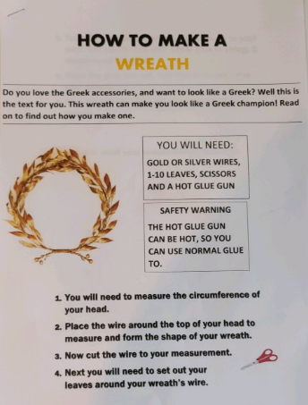
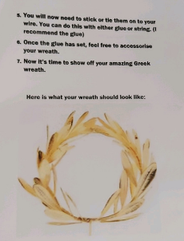
I’ve got more to show you
Dante has completed his instruction text on how to make an ancient Greek laurel wreath.

