Slide 1
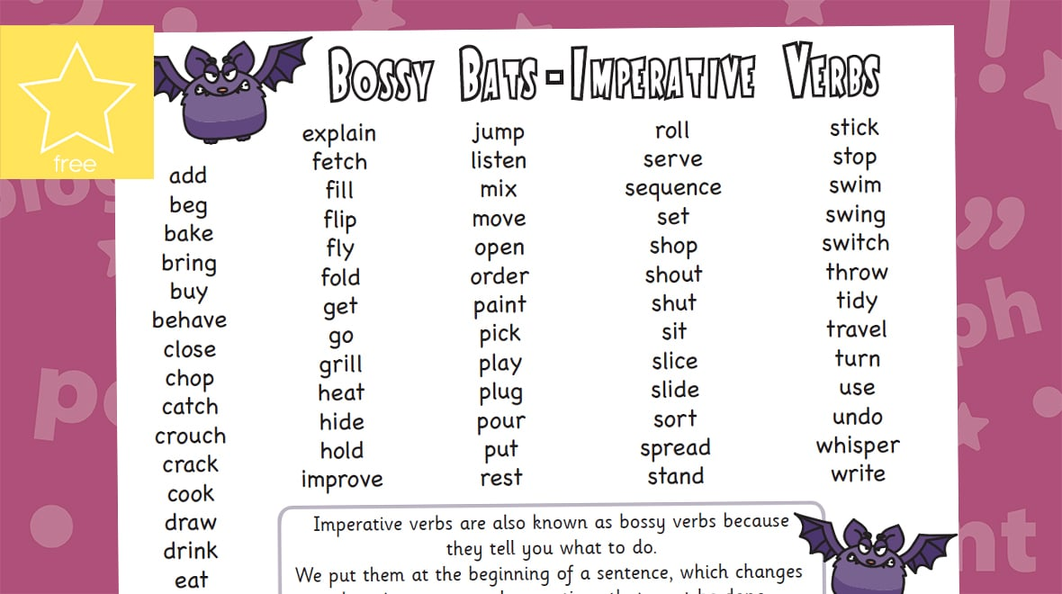
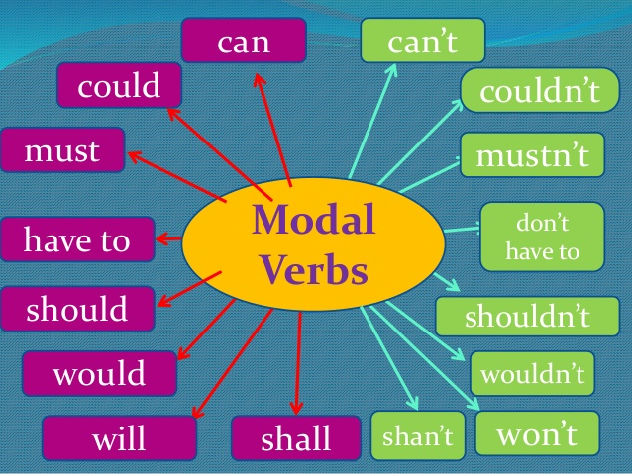
What I’m learning in English today
English – SPaG (Imperative verbs and modal verbs) Date: Friday 12th June 2020
L.Obj: (SPaG) *I can recognise and use modal verbs.
*I can recognise and use imperative verbs.
*I can use an effective script layout.

Slide 2
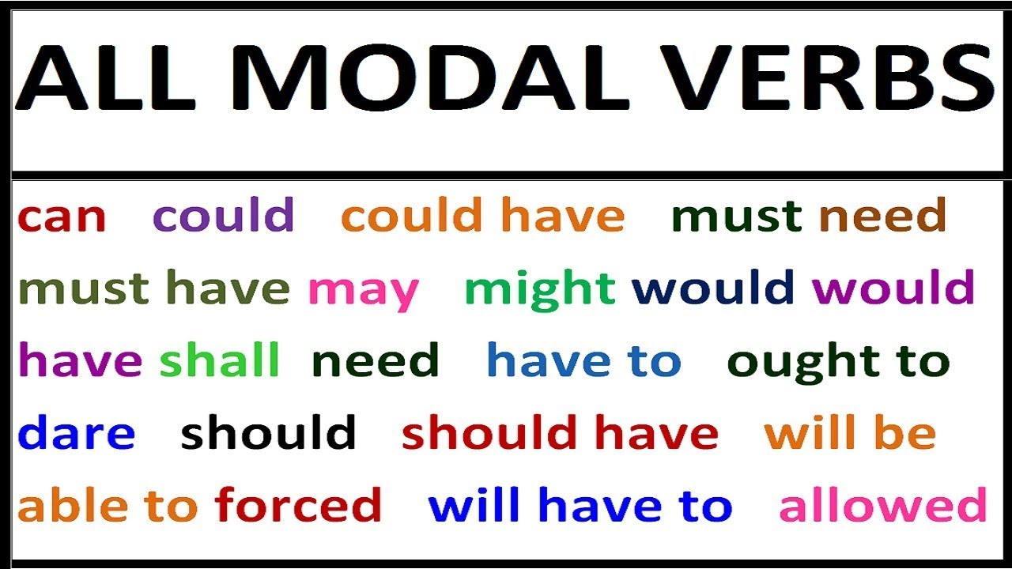
SPaG - Modal verbs
Click on the link here and watch the video.

Slide 3
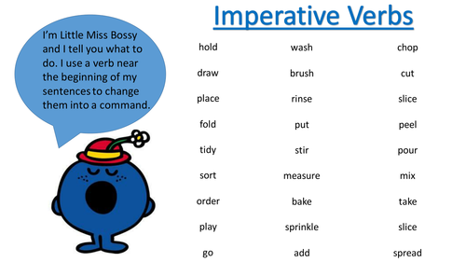
SPaG – Imperative verbs
Click on the link here and watch the video.

Slide 4
SPaG Challenge
Can you produce a short script, with a conversation between yourself and somebody else? Each line that is spoken MUST include either an imperative verb OR a modal verb.
Here is an example…..
Mr Hughes: So Mrs Millward, would you like me to set up a Zoom chat for you and the Myddle Y6s?
Mrs Millward: Oh yes please. Could you please put the children on mute and ask them to save any questions until the end?
Mr Hughes: Yes no problem. I will organise that now and send you the link.
Mrs Millward: Thank you. Let me know if there’s anything else you need me to do to help out.
Mr Hughes: I shall but I’m sure I’ll be okay. Enjoy the rest of your day.
Key: Imperative verbs Modal verbs

