Slide 1
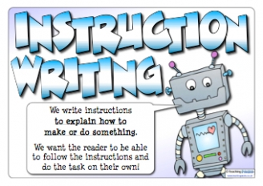
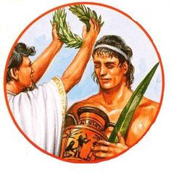
What I’m learning in English today
English – Instruction texts Date: Thursday 11th June 2020
L.Obj: (SPaG starter) *I can recognise and use modal verbs.
*I can continue to write an effective instruction take on how to make an Ancient Greek laurel wreath.

Slide 2
SPaG Starter – Modal verbs
A verb is a 'doing or action word'.
A modal verb is a type of verb that is used to indicate ‘possibility’ or ‘probability’
eg, should, must, would, will, can, could, etc…
Modal verbs can be used in the safety warnings in instructions.

Slide 3
SPaG Starter – Modal verbs
Here’s some examples of modal verbs which may be used in the safety warnings of your instruction text ‘How To Make An Ancient Greek Laurel Wreath’.
Choose 2 of them and use each one in sentences that you will include in your instruction text.
should
must
may
ought to
will
could

Slide 4
Writing an instruction text
Today, your challenge will be to complete the instruction text to explain ‘How To Make An Ancient Greek Laurel Wreath’.
*Use all of the features of an instruction text
*Use a range of imperative verbs and modal verbs
YOU MUST USE THE FOLLOWING PUNCTUATION IN YOUR TEXT…….
( ) ? ! ; -
Day 2 – Further instructions for the method and supporting illustrations, top tips and conclusion

