Slide 1
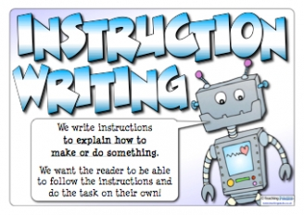
What I’m learning in English today
English – Instruction texts Date: Monday 8th June 2020
L.Obj: (SPaG starter) *I can recognise and use imperative verbs.
*I can name and identify the features of an instruction text.
*I can read an instruction text carefully to locate information and features.

Slide 2
SPaG Starter – Imperative verbs
A verb is a 'doing or action word'.
An imperative verb is one that tells someone to do something, so that the sentence it is in becomes an order or command.
eg, Fold your clothes up.
It is a ‘bossy’ verb!
Imperative verbs are used in instructions.

Slide 3
SPaG Starter – Imperative verbs
All of the ‘imperative’ verbs are highlighted in blue.

Slide 4
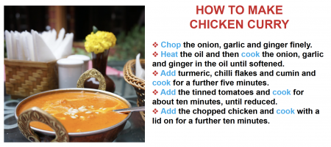
SPaG Starter – Imperative verbs
Here’s some instructions on how to make a chicken curry.
Can you fill in different ‘imperative’ verbs to complete each instruction?
CHALLENGE: Don’t repeat the same ‘imperative’ verb.
1) ______ the onion, ginger and garlic finely.
2) ______ the oil and then ______ the onion, garlic and ginger until softened.
3) _____ turmeric and chilli flakes, then ______ for a further five minutes.
4) ______ in the tinned tomatoes and ______ for a further ten minutes.
5) Finally, ______ the chopped chicken and cook with a lid on for another twelve minutes.

Slide 6
Instructions
Instructions are written for someone who needs to know how to do something.

Slide 7
What are instructions for?
Some examples…

Slide 8
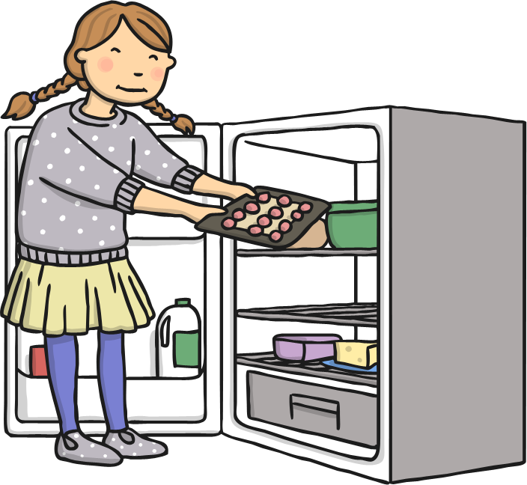
Recipes

Slide 9
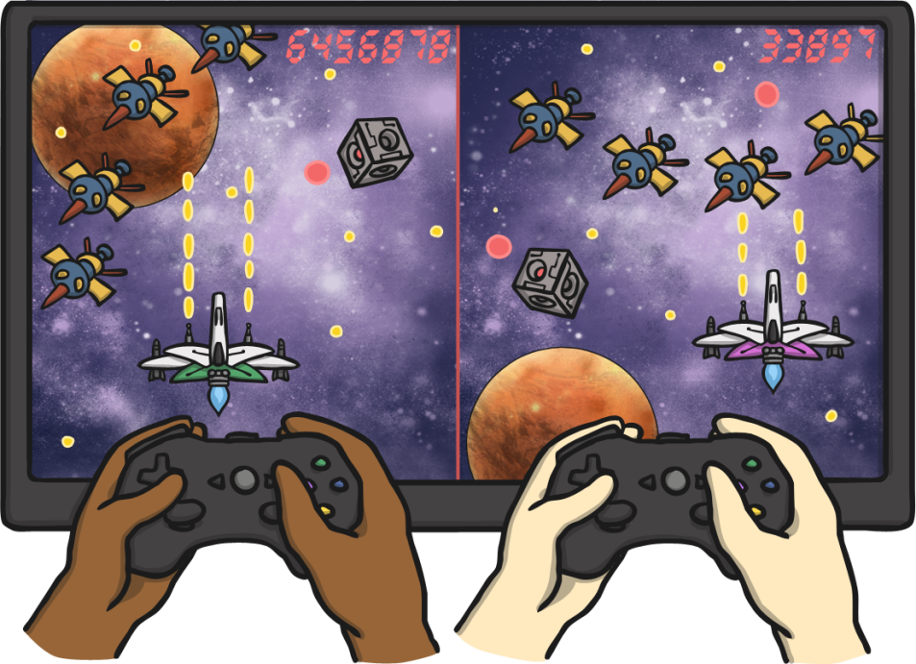
‘How to play a game’

Slide 10
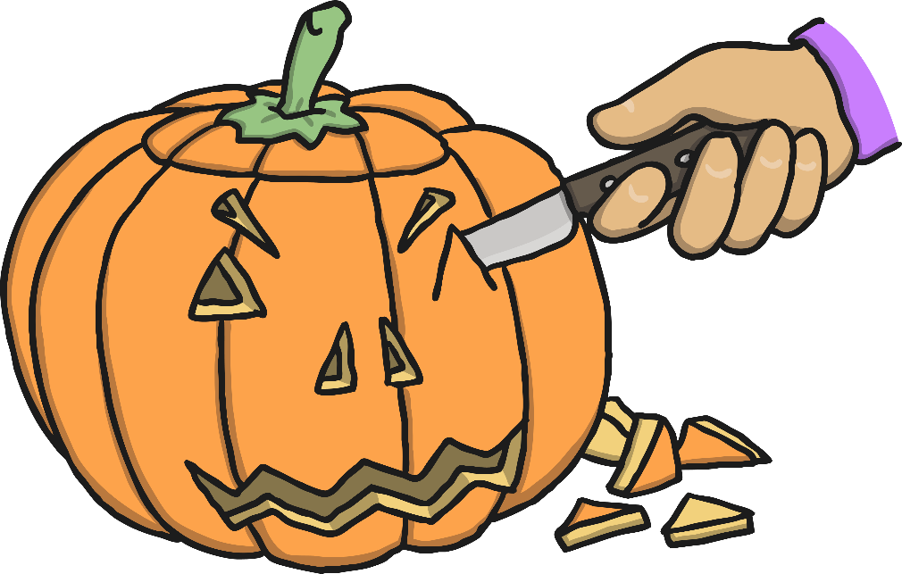
‘How to make a…’

Slide 11
Safety Procedure Posters

Slide 12
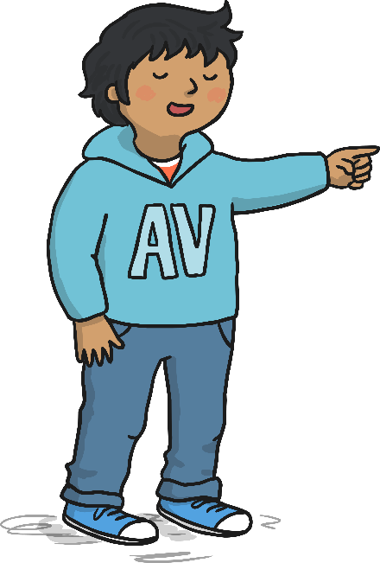
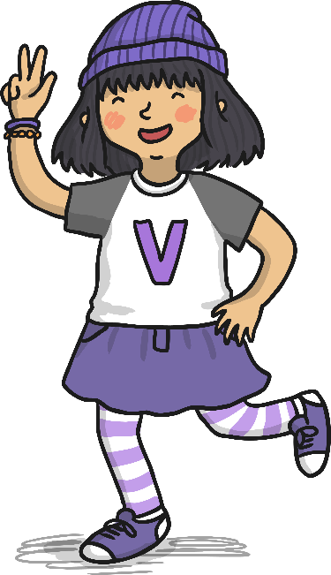
How to Write Instructions
1. Write in the present tense.
2. Use imperative verbs and adverbs to begin each step.
3. Use topic words.
4. Use time conjunctions.
5. Use clear descriptions.

Slide 13
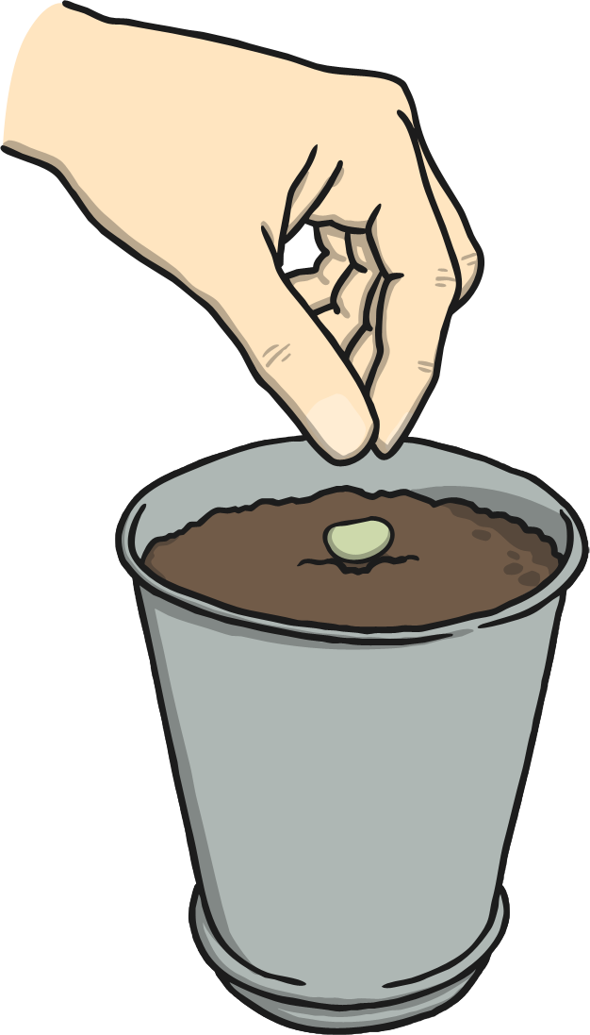
How To Plant A Sunflower Seed
What you need:
A small pot
Soil
Seeds
Watering can
Water
What you do:
First, fill the pot with soil to just below the top.
Then, add a little water to the soil.
Next, carefully put 1 or 2 seeds onto the soil.
Cover the seeds with a little more soil.
Gently pour more water onto the soil.
Top Tip:
Water the soil everyday to help your sunflower grow.
Notes:
Pictures from Create – I searched ‘planting a seed’ and ‘sunflower’

Slide 14
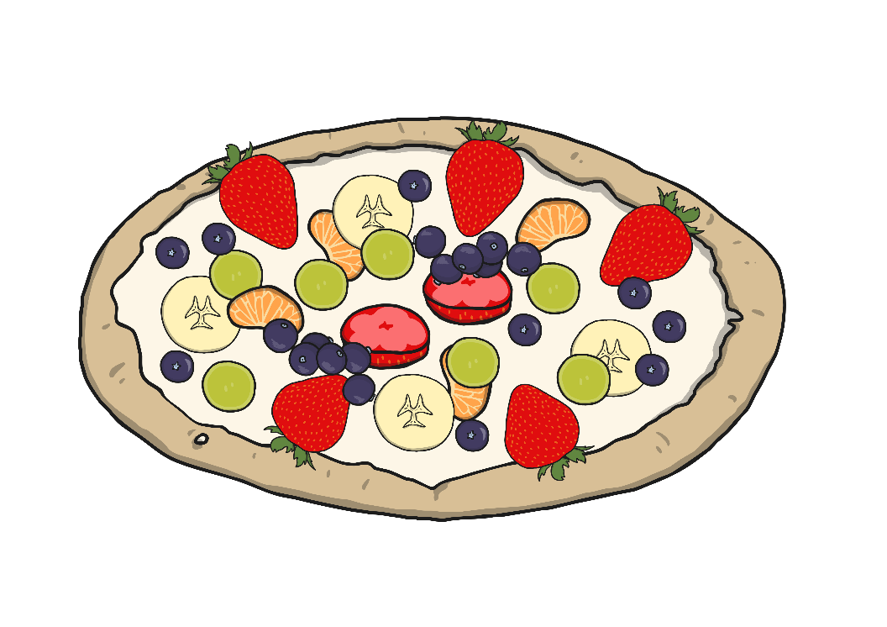
How To Make Fruit Pizzas
You will need:
Digestive biscuits
Natural yoghurt
3 – 4 different types of fruit e.g. Apple, banana, grapes, orange
Plate
Spreading knife
Sharp knife
A grown up!
What to do:
First, place your biscuits on the plate.
Then, spread the yogurt onto the biscuit.
Carefully cut up the fruit into small pieces. (Ask a grown up to help you with the sharp knife)
Finally, put the fruit on top of the yogurt.
Enjoy!
Top Tip:
Keep the fruit pizzas in the fridge once made.
Notes:
Image request has been made to change this pavlova image to have a biscuit base.

Slide 15
Main Activity – Instruction texts
You have been given an example of an instruction text to read.
Y5s –
‘How to fix a puncture on a monster truck’
Y6s (including Heidi, Amy and Nelly) –
How to Prepare a Fantastic Five-a-Day Tasting Menu
Read through the instruction text carefully and then answer the follow up comprehension questions in full sentences. (Types or hand-written)

Slide 16
Comprehension Questions – Y5s – How to fix a puncture on a monster truck
Read the introduction. Can you find 3 examples of imperative verbs which have been used?
Look at the ‘You will need’ feature of the text. Can you find 3 adjectives that have been used for some of the equipment?
Read the ‘Method’ section. Why do you think an electric pump would be an advantage?
How would putting the tyre in water help you?
Can you find 2 time connectives that have been used to start each of the instructions?
Look at instruction 10. What do the adverbs ‘securely’ and ‘meticulously’ mean?
Find 2 uses for the chalk during this process.

Slide 17
Comprehension Questions – Y6s – How to prepare a fantastic five-a-day tasting menu
Explain your opinion of the introduction. Do you think it is well-written? Is it informal or formal? Do you think it would encourage the reader to continue? Why? (3 marks)
Read the ‘You will need’ feature. Why do you think bullet points have been used in this section? (1 mark)
Which part of this section is a safety warning? (1 mark)
Read the ‘Method’ part of the text. Can you find 3 time connectives that have been used to start an instruction? (3 marks)
Match the meaning to each of these adverbs used. (3 marks)
Which word has been used as a synonym for ‘can’t eat’ as it won’t taste nice. (1 mark)
How does the text advise you on when serving them onto plates? (1 mark)
What is the difference between a ‘Safety Tip’ and a ‘Top Tip’? (1 mark)
Total = /14 marks
thoroughly
In a way that avoids errors or mistakes
steadily
in a proper, in depth manner
carefully
taking your time

