Slide 1
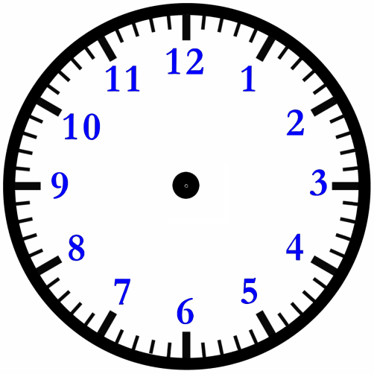
Maths – Tuesday (Toby, Zac, Chloe and Dante)
06:25
08:10
11:48
03:07
_________
_________
_________
_________
____________________________________
__________________
______________________________________________________
______________________________________________________
______________________________________________________
Can you draw the hands on these clocks accurately?
Can you show the times using 24-hour time in ‘pm’?
Can you write these times using words only?

