Slide 1
What I’m learning in Maths today
Maths – Y6 (Time problems) Date: 6.5.20
L.Obj: *I can use a number line to help to count forwards or backwards in time to solve problems based on ‘time’.

Slide 2
Calculation Practise
2/4 x 3/7 = ______
22 704
40 x 80 = ______
427 ÷ 7 = ______
5) 0.1 ÷ 100 = ______
6) 10 x 22 = ______
1 – 0.41 = ______
5² - 20 = _____
100,000 + + 60 = 106,060
5,120 - 215 =
+ =
M
M
T
U
O
O
E
N
N
S
D
D
D
A
A
A
Y
Y
Y
A
A
A
r
r
r
i
i
i
t
t
t
h
h
h
m
m
m
e
e
e
t
i
c
t
i
c
t
i
c
W
e
e
k
7
-
P
a
g
e
1
W
e
e
k
7
-
P
a
g
e
2
W
e
e
k
7
-
P
a
g
e
3
1 mark
1 mark
1 mark
10 x 11 x 2 =
75 - 38 =
56 ÷ 8 =
1
5
9
1 mark
1 mark
1 mark
683 + 917 =
66 x 1 =
6.1 + 3.317 =
9 x 48 =
4 x 83 =
10
11
12
2
3
4
6
7
8
w
w
w
12
w
w
w
5
2
6
w
w
w
+
.
.
.
m
m
m
10
12
1
y
y
y
5
6
m
m
m
=
i
i
i
n
n
n
1 mark
1 mark
i
m
a
t
h
s
.
c
o
.
u
k
1 mark
1 mark
i
m
a
t
h
s
.
c
o
.
u
k
1 mark
1 mark
i
m
a
t
h
s
.
c
o
.
u
k

Slide 3
Calculation Practise
2/4 x 3/7 = 6/28 or 3/14
22 704 = 32
40 x 80 = 3,200
427 ÷ 7 = 61
5) 0.1 ÷ 100 = 0.001
6) 10 x 22 = 220
1 – 0.41 = 0.59
5² - 20 = 105
100,000 + + 60 = 106,060
5,120 - 215 =
+ =
M
M
T
U
O
O
E
N
N
S
D
D
D
A
A
A
Y
Y
Y
A
A
A
r
r
r
i
i
i
t
t
t
h
h
h
m
m
m
e
e
e
t
i
c
t
i
c
t
i
c
W
e
e
k
7
-
P
a
g
e
1
W
e
e
k
7
-
P
a
g
e
2
W
e
e
k
7
-
P
a
g
e
3
1 mark
1 mark
1 mark
10 x 11 x 2 =
75 - 38 =
56 ÷ 8 =
1
5
9
1 mark
1 mark
1 mark
683 + 917 =
66 x 1 =
6.1 + 3.317 =
9 x 48 =
4 x 83 =
10
11
12
2
3
4
6
7
8
w
w
w
12
w
w
w
5
2
6
w
w
w
+
.
.
.
m
m
m
10
12
1
y
y
y
5
6
m
m
m
=
i
i
i
n
n
n
1 mark
1 mark
i
m
a
t
h
s
.
c
o
.
u
k
1 mark
1 mark
i
m
a
t
h
s
.
c
o
.
u
k
1 mark
1 mark
i
m
a
t
h
s
.
c
o
.
u
k

Slide 4
Time for a problem!
Ellie takes the train to Edinburgh. She sets off at 09:25 in the morning and arrives at 09:51. How long was her journey?
+
+
+
09:25
09:30
09:50
09:51

Slide 5
Time for a problem!
Ellie takes the train to Edinburgh. She sets off at 09:25 in the morning and arrives at 09:51. How long was her journey?
+ 20 mins
+ 5 mins
+ 1 min
09:25
09:30
09:50
09:51
26 minutes

Slide 6
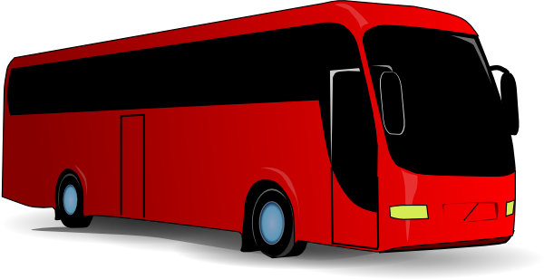
Time for a problem!
Ben travels on a coach to Manchester. His coach sets off at 08:19. The journey is 43 minutes long. At what time did he arrive?
+ 40 mins
+ 1 min
+ 2 mins
08:19
_______
_______
________

Slide 7
Time for a problem!
Ben travels on a coach to Manchester. His coach sets off at 08:19. The journey is 43 minutes long. At what time did he arrive?
+ 40 mins
+ 1 min
+ 2 mins
08:19
08:20
09:00
09:02
09:02

Slide 8
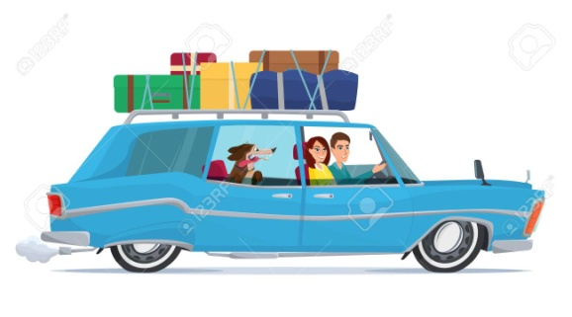
Time for a problem!
Annabel drives to Cardiff. Her journey takes her 1 hour and 41 minutes. She arrives at 11:55. What time did she set off?
- 40 mins
- 1 hour
- 1 minute
________
________
________
11:55

Slide 9
Time for a problem!
Annabel drives to Cardiff. Her journey takes her 1 hour and 41 minutes. She arrives at 11:55. What time did she set off?
- 40 mins
- 1 hour
- 1 minute
10:14
10:15
10:55
11:55
10:14

Slide 10
Time for a problem!
On holiday, Anna cycles to Killarney. She sets off at 12:58 and arrives at 15:27. How long was her journey?
+ _______
+ _______
+ _______
+ _______
12:58
13:00
15:00
15:20
15:27

Slide 11
Time for a problem!
On holiday, Anna cycles to Killarney. She sets off at 12:58 and arrives at 15:27. How long was her journey?
+ 2 hours
+ 20 mins
+ 2 mins
+ 7 mins
12:58
13:00
15:00
15:20
15:27
2 hours and 29 minutes

