Slide 1
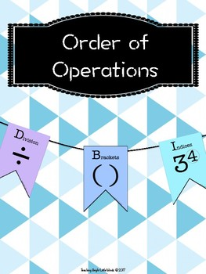
What I’m learning in Maths today
Maths – Y6 (Investigating the order of operations) Date: 20.5.20
L.Obj: *I can investigate the order of operations, including the use of brackets.

Slide 2
Calculation Starter – Kahoot Quiz
Elizabeth, Jack, Bethany, Ruby, Reuben, Malachai and Cassie https://kahoot.it/challenge/05839495?challenge-id=989b5045-acac-493d-bf6e-af3c3fb285dc_1589886618114
Lily, Harvey, Henry and Megan https://kahoot.it/challenge/02760956?challenge-id=989b5045-acac-493d-bf6e-af3c3fb285dc_1589886120380
Zac, Chloe, Toby and Dante https://kahoot.it/challenge/07786231?challenge-id=989b5045-acac-493d-bf6e-af3c3fb285dc_1589885592298

Slide 3
Order of Operations
Activity
Today, you are going to investigate order of operations using all four operations, the numbers 1-30 and brackets.
Go to the next slide to find out your maths challenge.

Slide 4
Make the numbers from 1 – 30 using………..
*the digits 1, 2, 3 and 4 and
*the symbols +, –, × and ÷
All four digits must be used in each equation, and each equation must follow the correct order of operations.
*YOU DON’T HAVE TO USE ALL 4 SYMBOLS IN THE SAME CALCULATION
For example: (2 + 3) × 4 × 1 = 20
© Classroom Secrets Limited 2018

Slide 5
1 = ((4 + 2)) ÷ 3 ) – 1 = 1
2 =
3 =
4 =
5 =
6 = (4 x 3) ÷ (2 x 1) = 6
7 =
8 =
9 =
10 =
11 =
12 =
13 =
14 =
15 =
16 =
17 =
18 =
19 =
20 = (2 + 3) × 4 × 1 = 20
21 =
22 =
23 =
24 =
25 =
26 =
27 =
28 =
29 =
30 =

