Slide 1
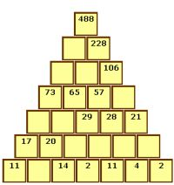
What I’m learning in Maths today
Maths – Y6 (Investigating Towers of Numbers) Date: 19.5.20
L.Obj: *I can investigate towers of numbers using addition calculations

Slide 2
Calculation Starter – Kahoot Quiz
Elizabeth, Jack, Bethany, Ruby, Reuben, Malachai and Cassie https://kahoot.it/challenge/0774247?challenge-id=989b5045-acac-493d-bf6e-af3c3fb285dc_1589803035667
Lily, Harvey, Henry and Megan https://kahoot.it/challenge/06513481?challenge-id=989b5045-acac-493d-bf6e-af3c3fb285dc_1589802977487
Zac, Chloe, Toby and Dante https://kahoot.it/challenge/07544032?challenge-id=989b5045-acac-493d-bf6e-af3c3fb285dc_1589802925562

Slide 3
Towers of Numbers
Today, you are going to investigate towers of numbers.
Activity
TOWERS (4)
Chloe, Dante, Toby and Zac
TOWERS (5)
Megan, Harvey, Henry, Lily, Bethany, Jack, Elizabeth, Malachai, Ruby, Cassie and Reuben

