Slide 1
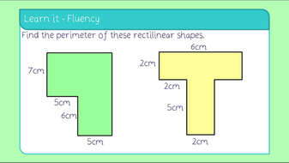
What I’m learning in Maths today
Maths – Y6 (Investigating perimeter) Date: 21.5.20
L.Obj: *I can investigate the perimeter of rectilinear shapes.

Slide 2
Calculation Starter – Kahoot Quiz
Elizabeth, Jack, Bethany, Ruby, Reuben, Malachai and Cassie https://kahoot.it/challenge/02287327?challenge-id=989b5045-acac-493d-bf6e-af3c3fb285dc_1589969472815
Lily, Harvey, Henry and Megan https://kahoot.it/challenge/072623?challenge-id=989b5045-acac-493d-bf6e-af3c3fb285dc_1589968829282
Zac, Chloe, Toby and Dante https://kahoot.it/challenge/05338700?challenge-id=989b5045-acac-493d-bf6e-af3c3fb285dc_1589968285861

Slide 3
Perimeter of Rectilinear Shapes
Activity
Today, you are going to investigate the perimeter of rectilinear shapes.
Go to the next slide to see an example of your challenge.

Slide 4
A gardener has a garden which is 3m x 3m. (See below)
1
She has 12 one metre lengths of fence, which she wants to use to divide the garden so that there is piece of grass surrounded by the 12m of fence.
How many different possible ways are there to fence the garden?
12
2
3
4
11
5
10
6
9
8
7

Slide 5
A gardener has a garden which is 4m x 4m. (See below)
1
2
3
4
She has 16 one metre lengths of fence, which she wants to use to divide the garden so that there is piece of grass surrounded by the 16m of fence.
How many different possible ways are there to fence the garden?
16
5
15
14
6
13
12
7
11
8
10
9

Slide 6
Reuben, Ruby, Jack, Bethany, Elizabeth, Cassie and Malachai
Activity page 5
(answers page 9)
Henry, Harvey, Megan, Lily, Dante, Zac, Toby and Chloe
Activity Page 1
(answers page 2)

