Slide 1
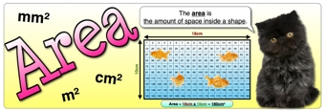
What I’m learning in Maths today
Maths – Y6 (Area investigation) Date: 14.5.20
L.Obj: *I can investigate ‘area’ of triangles, rectangles and parallelograms.
*I understand that to find the area of a triangle, I can use the formula ‘½ based x height’.
*I understand that to find the area of a rectangle or parallelogram, I can use the formula ‘length x width’.

Slide 2
Calculation Practise
Zac, Toby, Chloe, Malachai and Dante
https://kahoot.it/challenge/08090527?challenge
id=989b5045-acac-493d-bf6e
af3c3fb285dc_1589407122410
Reuben, Ruby, Cassie, Elizabeth, Jack, Bethany, Henry, Harvey, Megan and Lily
https://kahoot.it/challenge/04708647?challenge
id=989b5045-acac-493d-bf6e
af3c3fb285dc_1589407637082
100,000 + + 60 = 106,060
5,120 - 215 =
+ =
M
M
T
U
O
O
E
N
N
S
D
D
D
A
A
A
Y
Y
Y
A
A
A
r
r
r
i
i
i
t
t
t
h
h
h
m
m
m
e
e
e
t
i
c
t
i
c
t
i
c
W
e
e
k
7
-
P
a
g
e
1
W
e
e
k
7
-
P
a
g
e
2
W
e
e
k
7
-
P
a
g
e
3
1 mark
1 mark
1 mark
10 x 11 x 2 =
75 - 38 =
56 ÷ 8 =
1
5
9
1 mark
1 mark
1 mark
683 + 917 =
66 x 1 =
6.1 + 3.317 =
9 x 48 =
4 x 83 =
10
11
12
2
3
4
6
7
8
w
w
w
12
w
w
w
5
2
6
w
w
w
+
.
.
.
m
m
m
10
12
1
y
y
y
5
6
m
m
m
=
i
i
i
n
n
n
1 mark
1 mark
i
m
a
t
h
s
.
c
o
.
u
k
1 mark
1 mark
i
m
a
t
h
s
.
c
o
.
u
k
1 mark
1 mark
i
m
a
t
h
s
.
c
o
.
u
k

Slide 3
What would the area of the rectangle and parallelogram be?
(Remember length x width)
11cm
26cm
7cm
15cm
ANSWERS ON THE NEXT SLIDE

Slide 4
What would the area of the rectangle and parallelogram be?
(Remember length x width)
Area = 286cm²
11cm
26cm
Area = 105cm²
7cm
15cm

Slide 5
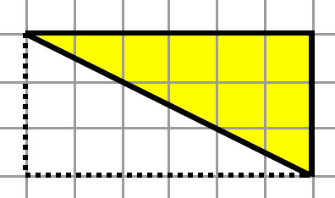
What would the area of these triangles be? (Remember ½ base x height)
9cm
26cm
35cm
6cm
3cm
14cm
ANSWERS ON THE NEXT SLIDE

Slide 6
What would the area of these triangles be? (Remember ½ base x height)
Area = 117cm²
Area = 9cm²
Area = 245cm²

Slide 7
Task 1
Investigation 1
Is A the same size as B?
Is A + B the same size as C?
Why? Prove it.
A
B
C

Slide 8
Task 2
Investigation 2
A
B
C
Is A the same size as B?
Are A + B the same size as C?
Whey? Prove it.
© Classroom Secrets Limited 2018

