Slide 1
What I’m learning in Maths today
Maths – Y6 (Studying Timetables) Date: 1.5.20
L.Obj: *I can understand and interpret timetables.
*I can calculate differences and totals of times using a number line to help.
https://myminimaths.co.uk/year-6-arithmetic-practice-papers/

Slide 2
Calculation Practise
54 ÷ 6 = _______
163 x 4 = _______
12,435 - ______ = 8,300
1 2/8 – 5/8 = _____
_____ - 40 = 578
100 + (48 ÷ 8) = ______
5/7 x 4/8 = ______
100,000 + + 60 = 106,060
5,120 - 215 =
+ =
M
M
T
U
O
O
E
N
N
S
D
D
D
A
A
A
Y
Y
Y
A
A
A
r
r
r
i
i
i
t
t
t
h
h
h
m
m
m
e
e
e
t
i
c
t
i
c
t
i
c
W
e
e
k
7
-
P
a
g
e
1
W
e
e
k
7
-
P
a
g
e
2
W
e
e
k
7
-
P
a
g
e
3
1 mark
1 mark
1 mark
10 x 11 x 2 =
75 - 38 =
56 ÷ 8 =
1
5
9
1 mark
1 mark
1 mark
683 + 917 =
66 x 1 =
6.1 + 3.317 =
9 x 48 =
4 x 83 =
10
11
12
2
3
4
6
7
8
w
w
w
12
w
w
w
5
2
6
w
w
w
+
.
.
.
m
m
m
10
12
1
y
y
y
5
6
m
m
m
=
i
i
i
n
n
n
1 mark
1 mark
i
m
a
t
h
s
.
c
o
.
u
k
1 mark
1 mark
i
m
a
t
h
s
.
c
o
.
u
k
1 mark
1 mark
i
m
a
t
h
s
.
c
o
.
u
k

Slide 3
Calculation Practise
54 ÷ 6 = 9
163 x 4 = 652
12,435 – 4,135 = 8,300
1 2/8 – 5/8 = 5/8
618 - 40 = 578
100 + (48 ÷ 8) = 106
5/7 x 4/8 = 20/56 or 5/14
100,000 + + 60 = 106,060
5,120 - 215 =
+ =
M
M
T
U
O
O
E
N
N
S
D
D
D
A
A
A
Y
Y
Y
A
A
A
r
r
r
i
i
i
t
t
t
h
h
h
m
m
m
e
e
e
t
i
c
t
i
c
t
i
c
W
e
e
k
7
-
P
a
g
e
1
W
e
e
k
7
-
P
a
g
e
2
W
e
e
k
7
-
P
a
g
e
3
1 mark
1 mark
1 mark
10 x 11 x 2 =
75 - 38 =
56 ÷ 8 =
1
5
9
1 mark
1 mark
1 mark
683 + 917 =
66 x 1 =
6.1 + 3.317 =
9 x 48 =
4 x 83 =
10
11
12
2
3
4
6
7
8
w
w
w
12
w
w
w
5
2
6
w
w
w
+
.
.
.
m
m
m
10
12
1
y
y
y
5
6
m
m
m
=
i
i
i
n
n
n
1 mark
1 mark
i
m
a
t
h
s
.
c
o
.
u
k
1 mark
1 mark
i
m
a
t
h
s
.
c
o
.
u
k
1 mark
1 mark
i
m
a
t
h
s
.
c
o
.
u
k

Slide 4
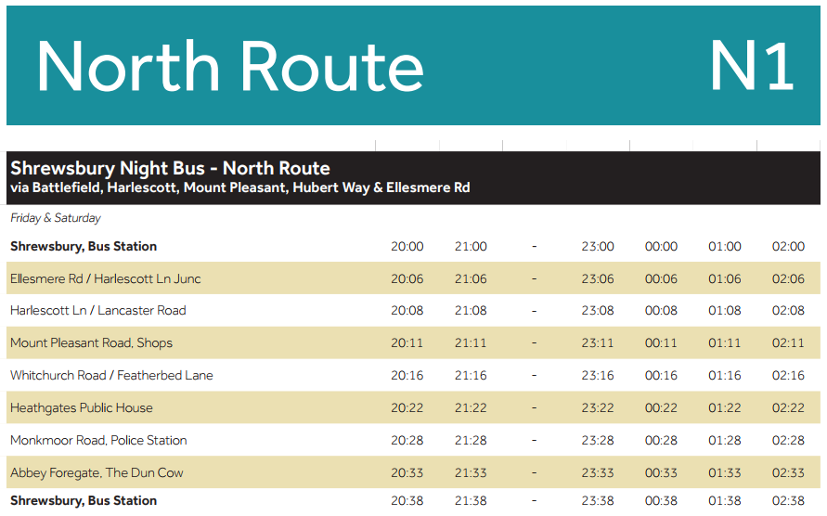
Using Timetables
Click to watch the link.
Then, study the bus timetable below to understand it’s meaning.

Slide 5
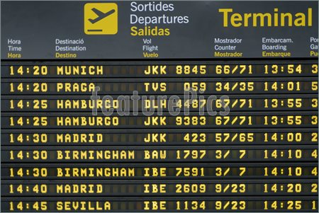
Study the airport timetable to understand it’s meaning.

Slide 6
1). Which stations does Train E not stop at?
2). How long does Train B take to travel from Edinburgh to Inverness?
3). Ellen is at Glasgow station at 1:30pm. She wants to travel to Perth. She catches the next train. At what time will she arrive in Perth?
4). Barnaby gets to Stirling at 11.58 wanting to go to Perth. How long does he have to wait for the next train to Perth?

Slide 7
NOW IT’S YOUR TURN!
Toby, Chloe and Dante:
Page 1
Answers are on page 7
Henry, Megan, Harvey, Bethany, Lily and Jack:
Page 3
Answers are on page 8
Reuben, Malachai, Cassie, Elizabeth and Ruby:
Page 5
Answers are on page 9

