Slide 1
What I’m learning in Maths today
Maths – Y5 (Angles and Lengths) Date: 13.5.20 |  |  |  |  | Teacher assessment
L.Obj: *I can solve and calculate the lengths of the sides in a shape using other measurements to help me.
*I can calculate and measure the size of the angles in a shape using other angles (right angles) to help me.
I | CT | Group | TA | Pair

Slide 2
CALCULATION PRACTISE
The quiz will expire at 3pm
Heidi, Amy, Alissa, Nelly, Cameron, Daniel, Izzy, Holly T and Lucy
https://kahoot.it/challenge/06912040?challenge-id=989b5045-acac-493d-bf6e-af3c3fb285dc_1589292961609
Sophie, Jacob, Zoe, Isla, Nia, Holly H, Rhys, Isobel and Katie
https://kahoot.it/challenge/08794754?challenge-id=989b5045-acac-493d-bf6e-af3c3fb285dc_1589293033917
HIGHLIGHT YOUR LINK ABOVE, THEN COPY AND PASTE IT INTO THE TOOLBAR ON THE INTERNET TO OPEN UP YOUR QUIZ!
(YOU MUST COPY AND PASTE THE LINK – IT WON’T OPEN OTHERWISE)
At the end, it gives you the option to copy a link. If you do this, you will be able to check on how your scores compares with others once everybody has played.

Slide 3
What do you know about the angles in this shape?
B
C
A
D
E
© Classroom Secrets Limited 2018

Slide 4
What do you know about the angles in this shape?
Various answers, for example:
A + B + C + D + E = 360˚ A + B + C = 180˚ E + D = 180˚
B + C + D = 180˚ A + E = 180˚
B
C
A
D
E
© Classroom Secrets Limited 2018

Slide 5
Calculate the length of side A and side B.
A
14cm
B
© Classroom Secrets Limited 2018

Slide 6
Calculate the length of side A and side B.
A = 28cm, B = 14cm
A
14cm
B
© Classroom Secrets Limited 2018

Slide 7
Calculate the angles of A, B, C and D.
B
C
A
D
© Classroom Secrets Limited 2018

Slide 8
Calculate the angles of A, B, C and D.
A = 135°; B = 90°; C = 90°; D = 45°
B
C
A
D
© Classroom Secrets Limited 2018

Slide 9
Side A is 16cm. True or false?
11cm
A
© Classroom Secrets Limited 2018

Slide 10
Side A is 16cm. True or false?
False, side A is 11cm
11cm
A
© Classroom Secrets Limited 2018

Slide 11
Match the angles and lengths to the shape.
A
1. 18cm
2. 135º
3. 10cm
4. 90º
B
C
D
© Classroom Secrets Limited 2018

Slide 12
Match the angles and lengths to the shape.
A
1. 18cm – D
2. 135º – B
3. 10cm – A
4. 90º – C
B
C
D
© Classroom Secrets Limited 2018

Slide 13
Adam thinks he has chosen the correct degrees for the total of angle A and angle B.
Do you agree? Explain why.
B
✓
135°
A
270°
90°
© Classroom Secrets Limited 2018

Slide 14
Adam thinks he has chosen the correct degrees for the total of angle A and angle B.
Do you agree? Explain why.
Adam is not correct because…
B
✓
135°
A
270°
90°
© Classroom Secrets Limited 2018

Slide 15
Adam thinks he has chosen the correct degrees for the total of angle A and angle B.
Do you agree? Explain why.
Adam is not correct because each angle is 45°. 45° + 45° = 90°
B
✓
135°
A
270°
90°
© Classroom Secrets Limited 2018

Slide 16
Amélie has a rectangle with a perimeter of 34cm.
Sides A and C are 3cm shorter than sides B and D.
What length is each side?
B
A
C
D
© Classroom Secrets Limited 2018

Slide 17
Amélie has a rectangle with a perimeter of 34cm.
Sides A and C are 3cm shorter than sides B and D.
What length is each side?
10cm
7cm
7cm
10cm
© Classroom Secrets Limited 2018

Slide 18
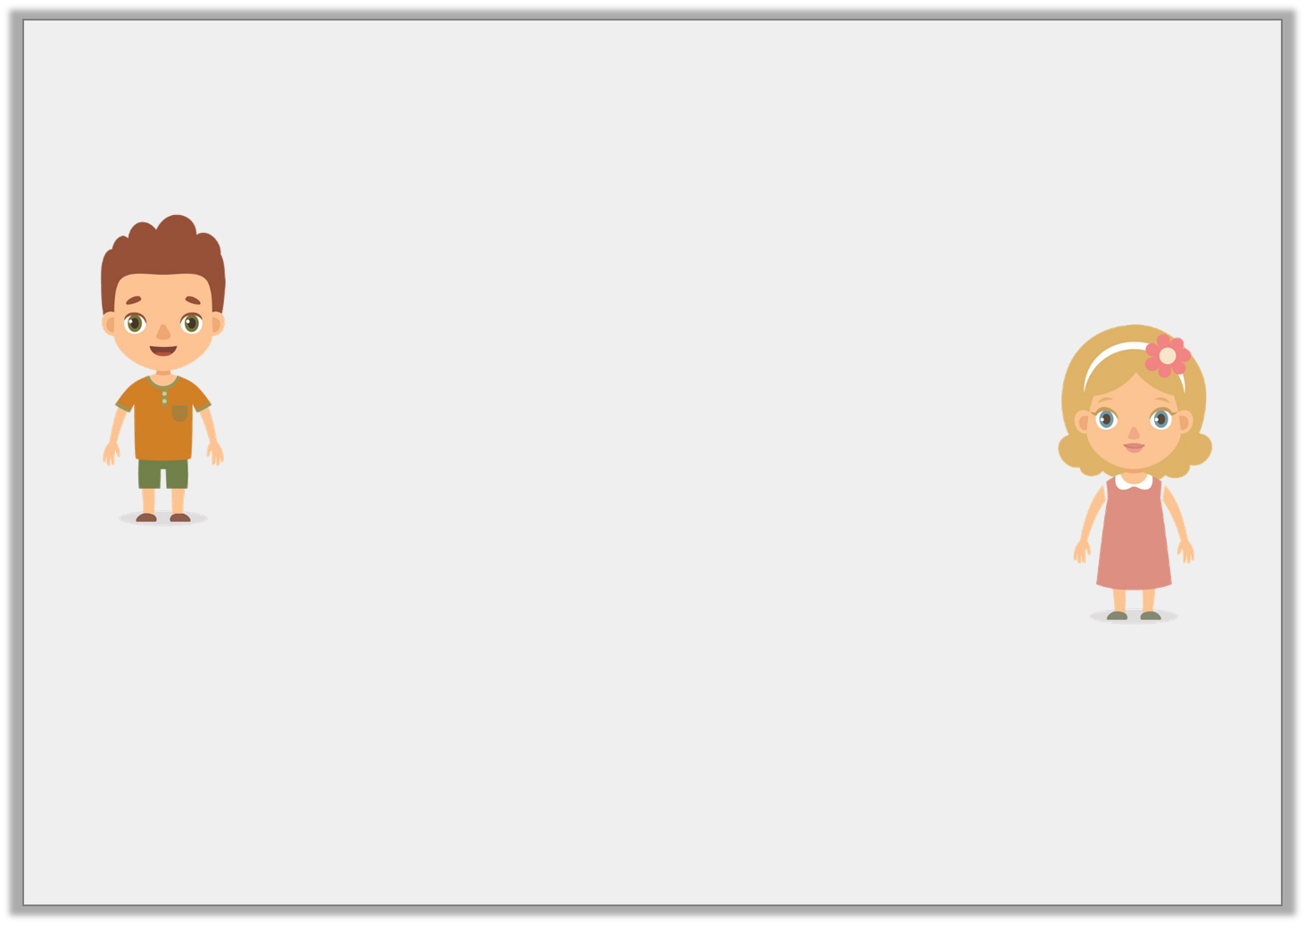
Shane and Elizabeth are calculating angles in a shape.
Who is correct? Why?
A right angle split into 3 will always have 3 angles of 30º.
A right angle split into 3 can have any 3 angles with a sum of 90º.
Shane
Elizabeth
© Classroom Secrets Limited 2018

Slide 19
Shane and Elizabeth are calculating angles in a shape.
Who is correct? Why?
Elizabeth is correct because…
Shane is not correct because…
A right angle split into 3 will always have 3 angles of 30º.
A right angle split into 3 can have any 3 angles with a sum of 90º.
Shane
Elizabeth
© Classroom Secrets Limited 2018

Slide 20
Shane and Elizabeth are calculating angles in a shape.
Who is correct? Why?
Elizabeth is correct because as long as the angles add up to 90°, the angles can be any size.
Shane is not correct because a right angle split into 3 would only have 30° angles if they were split equally.
A right angle split into 3 will always have 3 angles of 30º.
A right angle split into 3 can have any 3 angles with a sum of 90º.
Shane
Elizabeth
© Classroom Secrets Limited 2018

Slide 21
NOW IT’S YOUR TURN!
(D) – Isla, Holly H, Nia and Rhys
(1A, 1B, 2A, 2B, 3A, 3B, 4A and 4B)
(E)- Zoe, Isobel, Daniel, Izzy, Alissa, Lucy, Katie, Jacob, Sophie, Cameron and Holly T
(5A, 5B, 6A, 6B, 7A, 7B, 8A and 8B)
(GD) – Heidi, Nelly and Amy
(9A, 9B, 10A, 10B, 11A, 11B, 12A and 12B)

