Slide 1
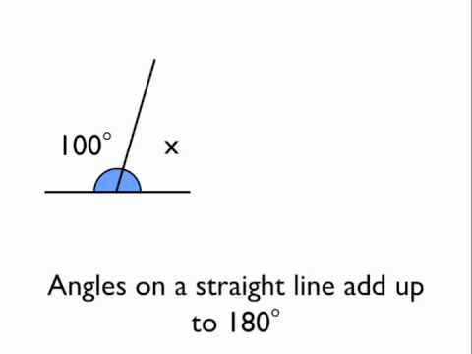
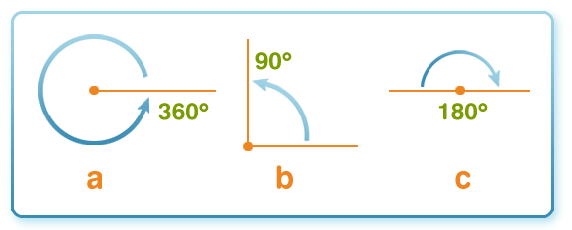
What I’m learning in Maths today
Maths – Y5 (Angles) Date: 6.5.20 |  |  |  |  | Teacher assessment
L.Obj: *I know how many degrees there are in full turn.
*I can calculate missing angles in a full turn (around a point)
I | CT | Group | TA | Pair

Slide 2
Amy, Nelly and Heidi - What is the missing part of the calculation?
4.3 4,300 278 0.278 150 1.5
3 3,000 5.72 57.2 28.6 0.286
Lucy, Katie, Holly T, Daniel, Cameron, Izzy, Sophie, Jacob and Alissa - What is the missing part of the calculation……..?
52 5.2 217 2,170 3.8 0.038
291 29,100 90 9 0.45 450
Rhys, Isobel, Isla, Nia, Holly H and Zoe – What is the missing part of the calculation?
80 8 32 3,200 631 6.31
200 20 0.4 0.004 250 250,000

Slide 3
Heidi, Nelly and Amy - ANSWERS
4.3 4,300 278 0.278 150 1.5
X1,000
÷1,000
÷100
3 3,000 5.72 57.2 28.6 0.286
X1,000
x10
÷100
Katie, Holly T, Izzy, Sophie, Jacob, Alissa, Cameron, Lucy and Daniel - ANSWERS
52 5.2 217 2,170 3.8 0.038
÷10
x10
÷100
291 29,100 90 9 0.45 450
x100
÷10
X1,000
Zoe, Isobel, Holly H, Rhys, Nia and Isla – ANSWERS
80 8 32 3,200 631 6.31
÷10
x100
÷100
200 20 0.4 0.004 250 250,000
÷10
÷100
X1,000

Slide 4
Match these facts to the correct image.
360°
1 right angle
3 right angles
4 right angles
90°
270°
180°
2 right angles
© Classroom Secrets Limited 2019

Slide 5
Match these facts to the correct image.
90°
180°
270°
360°
1 right angle
2 right angles
3 right angles
4 right angles
© Classroom Secrets Limited 2019

Slide 6
What is the missing angle?
92˚
122˚
63˚
?
© Classroom Secrets Limited 2019

Slide 7
What is the missing angle?
92˚
122˚
63˚
83˚
© Classroom Secrets Limited 2019

Slide 8
Four angles make up a full turn.
These are 3 of the angles:
14˚
156˚
78˚
What is the value of the fourth angle?
© Classroom Secrets Limited 2019

Slide 9
Four angles make up a full turn.
These are 3 of the angles:
14˚
156˚
78˚
What is the value of the fourth angle?
112˚
360˚ – 14˚ – 156˚ – 78˚ = 112˚
© Classroom Secrets Limited 2019

Slide 10
Circle 4 angles that will add up to make a full turn.
103˚
95˚
62˚
34˚
100˚
22˚
© Classroom Secrets Limited 2019

Slide 11
Circle 4 angles that will add up to make a full turn.
103˚
95˚
62˚
34˚
100˚
22˚
© Classroom Secrets Limited 2019

Slide 12
True or false?
A fifth (1/5) of a full turn is 50˚.
Is 1/5 of 360° 50°?
© Classroom Secrets Limited 2019

Slide 13
True or false?
A fifth of a full turn is 50˚.
False, a fifth of a turn is 360 ÷ 5 = 72˚
© Classroom Secrets Limited 2019

Slide 14
Use the digit cards to fill in the missing numbers.
5
6
7
8
9
2
1
0
9
4
© Classroom Secrets Limited 2019

Slide 15
Use the digit cards to fill in the missing numbers.
5
6
7
8
9
7
2
1
0
8
9
6
8
4
© Classroom Secrets Limited 2019

Slide 16
NOW IT’S YOUR TURN!
(D) – Isla, Holly H, Nia and Rhys
(Activity Sheet 1A, 1B, 2A, 2B, 3A, 3B, 4A and 4B)
(E)- Daniel, Izzy, Zoe, Isobel, Alissa, Lucy, Katie, Jacob, Sophie, Cameron and Holly T
(Activity Sheet 5A, 5B, 6A, 6B, 7A, 7B, 8A and 8B)
(GD) – Heidi, Nelly and Amy
(Activity Sheet 9A, 9B, 10A, 10B, 11A, 11B, 12A and 12B)

