Slide 1
What I’m learning in Maths today
Maths – Y5 (Shape) Date: 14.5.20 |  |  |  |  | Teacher assessment
L.Obj: *I can explain the meaning of a ‘polygon’.
*I can explain the difference between a ‘regular’ and ‘irregular’ polygon.
I | CT | Group | TA | Pair

Slide 2
Calculation Starter
Amy, Heidi and Nelly
https://kahoot.it/challenge/05486624?challenge-id=989b5045-acac-493d-bf6e-af3c3fb285dc_1589405692444
Katie, Lucy, Holly T, Daniel, Cameron, Alissa, Izzy, Sophie and Jacob
https://kahoot.it/challenge/08104865?challenge-id=989b5045-acac-493d-bf6e-af3c3fb285dc_1589406160837
Zoe, Isla, Holly H, Rhys, Isobel and Nia
https://kahoot.it/challenge/02218229?challenge-id=989b5045-acac-493d-bf6e-af3c3fb285dc_1589406537314
To check your results, make sure that you keep the link that appears at the end of the quiz.

Slide 3
What is a ‘polygon’?

Slide 4
Discuss these statements about polygons.
Are they true or false?
True | False
They have 5 or more sides
They are made up of straight lines
They are 3D shapes
They are 2D shapes
They are a closed shape (no gaps)
They can have curved sides
They include open shapes
© Classroom Secrets Limited 2018

Slide 5
Discuss these statements about polygons.
Are they true or false?
True | False
They are a closed shape (no gaps)
They are 3D shapes
They include open shapes
They are made up of straight lines
They can have curved sides
They are 2D shapes
They have 5 or more sides
© Classroom Secrets Limited 2018

Slide 6
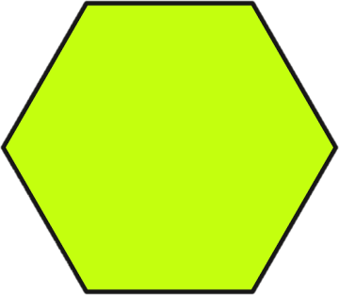
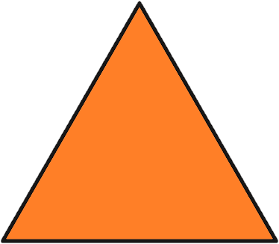
Circle the regular polygons.
© Classroom Secrets Limited 2018

Slide 7
Circle the regular polygons.
© Classroom Secrets Limited 2018

Slide 8
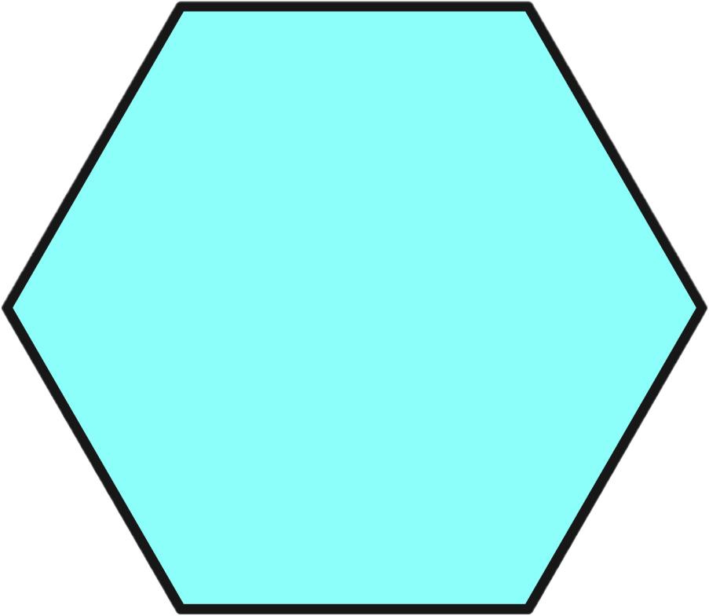
Identify the name of this shape.
Use a ruler and a protractor to decide whether
it is a regular or irregular polygon.
© Classroom Secrets Limited 2018

Slide 9
Identify the name of this shape.
Use a ruler and a protractor to decide whether
it is a regular or irregular polygon.
This is a hexagon. It is a regular polygon.
© Classroom Secrets Limited 2018

Slide 10
This is a regular octagon.
True or false?
© Classroom Secrets Limited 2018

Slide 11
This is a regular octagon.
True or false?
False.
This is an irregular octagon as there are angles and sides of different lengths.
© Classroom Secrets Limited 2018

Slide 12
Has Toni sorted these shapes correctly? Explain your answer.
 | Regular Polygon | Irregular Polygon
Has 5 sides
Not 5 sides
A
B
D
E
F
C
© Classroom Secrets Limited 2018

Slide 13
Has Toni sorted these shapes correctly? Explain your answer.
Toni has not sorted the polygons correctly because C and E are both irregular polygons as they have sides and angles of different sizes.
 | Regular Polygon | Irregular Polygon
Has 5 sides
Not 5 sides
A
B
D
E
F
C
© Classroom Secrets Limited 2018

Slide 14
Jade says:
Is Jade correct? Explain your answer.
A rhombus and a square are both regular polygons because they both have sides of equal length.
© Classroom Secrets Limited 2018

Slide 15
Jade says:
Is Jade correct? Explain your answer.
Jade is incorrect. A square is a regular polygon as it has sides of equal length and each angle measures 90°.
However, a rhombus may have 4 sides of equal length, but it does not have 4 angles of equal size.
A rhombus and a square are both regular polygons because they both have sides of equal length.
© Classroom Secrets Limited 2018

Slide 16
How many regular polygons can you see in this shape?
© Classroom Secrets Limited 2018

Slide 17
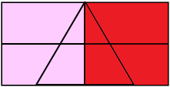
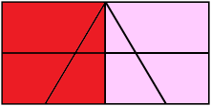
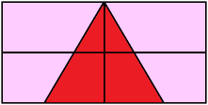
How many regular polygons can you see in this shape?
3 regular polygons (2 regular squares and 1 regular triangle).
© Classroom Secrets Limited 2018

Slide 18
NOW IT’S YOUR TURN!
Isla, Nia, Rhys and Holly H
Activity 1 – 1a, 1b, 2a, 2b, 3a and 3b
Activity 2 – 1a, 2a and 3a
Lucy, Katie, Holly T, Jacob, Sophie, Zoe, Isobel, Cameron, Daniel, Alissa and Izzy
Activity 1 – 5a, 5b, 6a, 6b, 7a and 7b
Activity 2 – 4a, 5a and 6a
Nelly, Amy and Heidi
Activity 1 – 9a, 9b, 10a, 10b, 11a and 11b
Activity 2 – 7a, 8a and 9a

