Slide 1
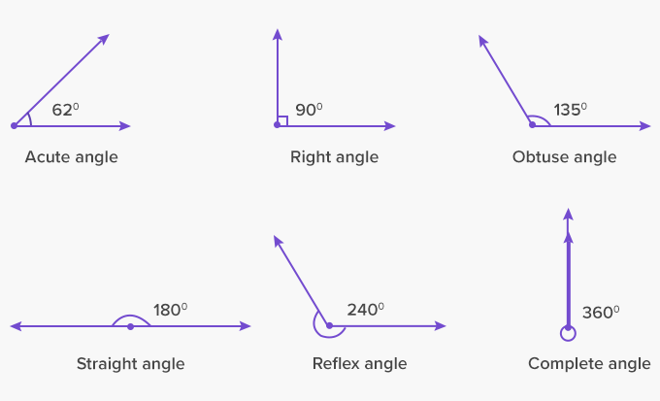
What I’m learning in Maths today
Maths – Y5 (Angles) Date: 4.5.20 |  |  |  |  | Teacher assessment
L.Obj: *I can demonstrate how to measure the size of an angle using a protractor.
*I can recognise an angle as acute, right angle, obtuse or reflex.
I | CT | Group | TA | Pair

Slide 2
Nelly, Heidi and Amy - What is the missing part of the calculation?
89 8.9 3.2 0.032 472 4,720
5 0.05 163 1.63 2,700 2.7
Katie, Lucy, Cameron, Alissa, Sophie, Daniel, Jacob, Izzy and Holly T - What is the missing part of the calculation……..?
14 1,400 18 1.8 3.21 321
2.6 2,600 700 7 0.4 40
Isla, Nia, Rhys, Zoe, Holly H and Isobel – What is the missing part of the calculation?
3 3,000 130 13 24 2.4
62 6,200 0.5 50 3.2 0.32

Slide 3
Heidi, Amy and Nelly – ANSWERS
89 8.9 3.2 0.032 472 4,720
÷10
÷100
x10
5 0.05 163 1.63 2,700 2.7
÷100
÷100
÷1,000
Holly T, Daniel, Lucy, Katie, Alissa, Sophie, Cameron, Izzy, Jacob, - ANSWERS
14 1,400 18 1.8 3.21 321
x100
÷10
x100
2.6 2,600 700 7 0.4 40
x1,000
÷100
x100
Nia, Isla, Zoe, Rhys, Holly H and Isobel – ANSWERS
3 3,000 130 13 24 2.4
x1,000
÷10
÷10
62 6,200 0.5 50 3.2 0.32
x100
x100
÷100

Slide 4
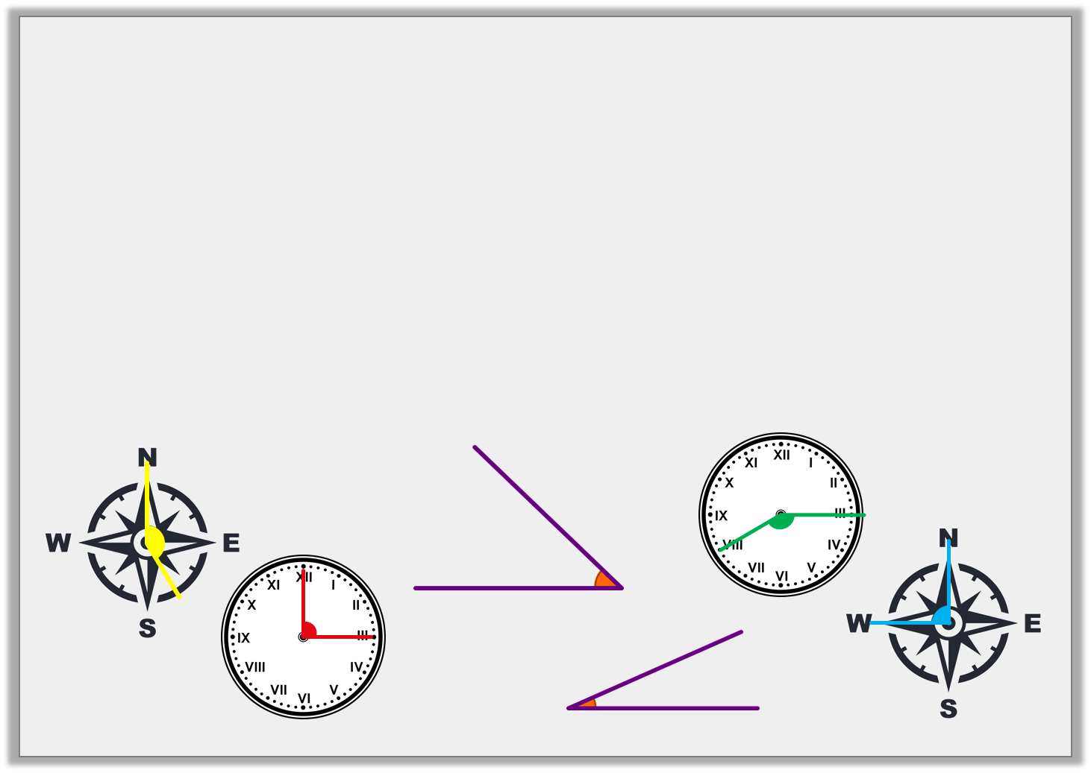
Sort the angles to show their names.
Right angles | Obtuse angles | Acute angles
© Classroom Secrets Limited 2019

Slide 5
Sort the angles.
© Classroom Secrets Limited 2019

Slide 6
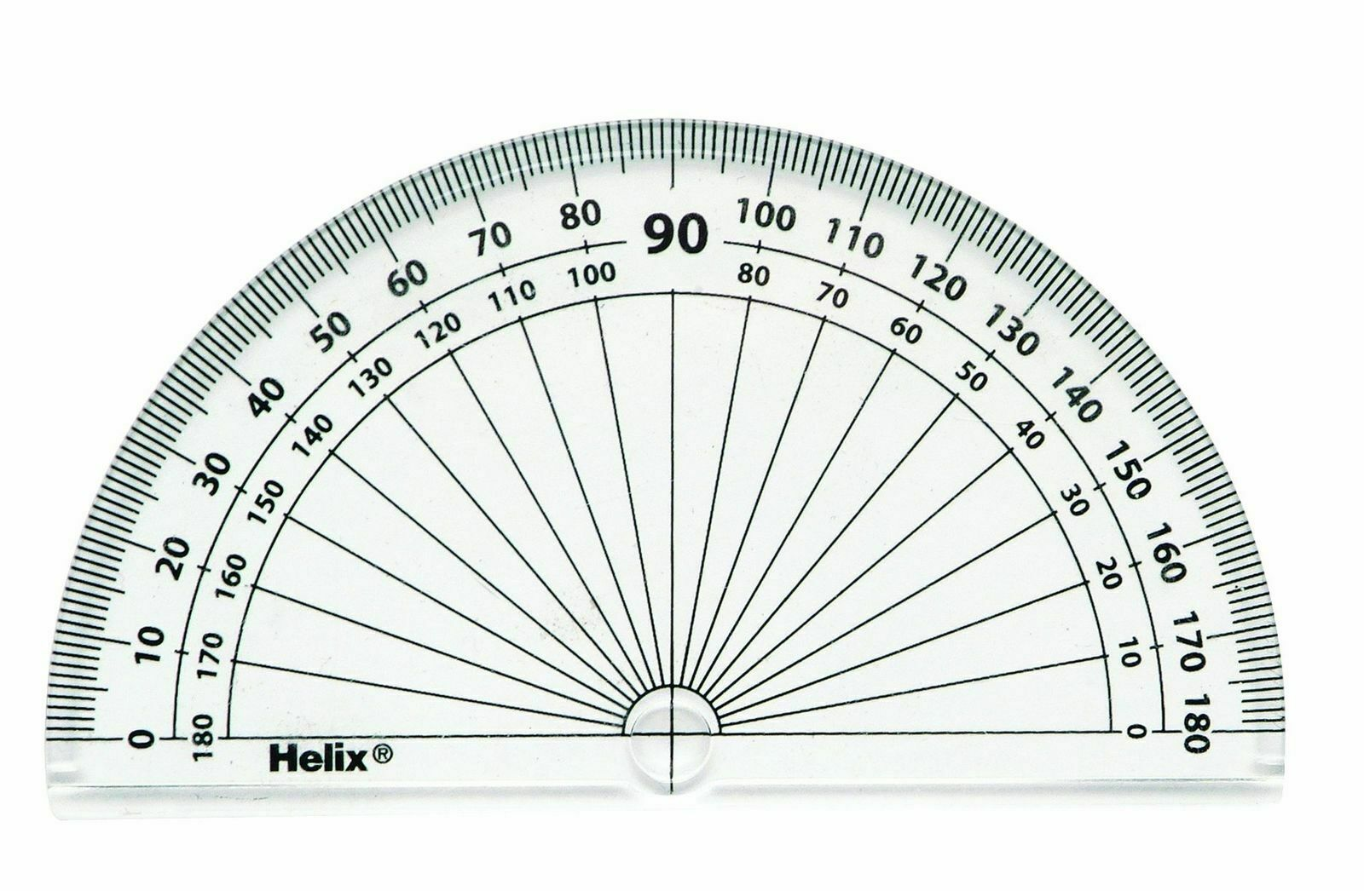
Time to use a protractor
Click to watch
Click to practise

Slide 7
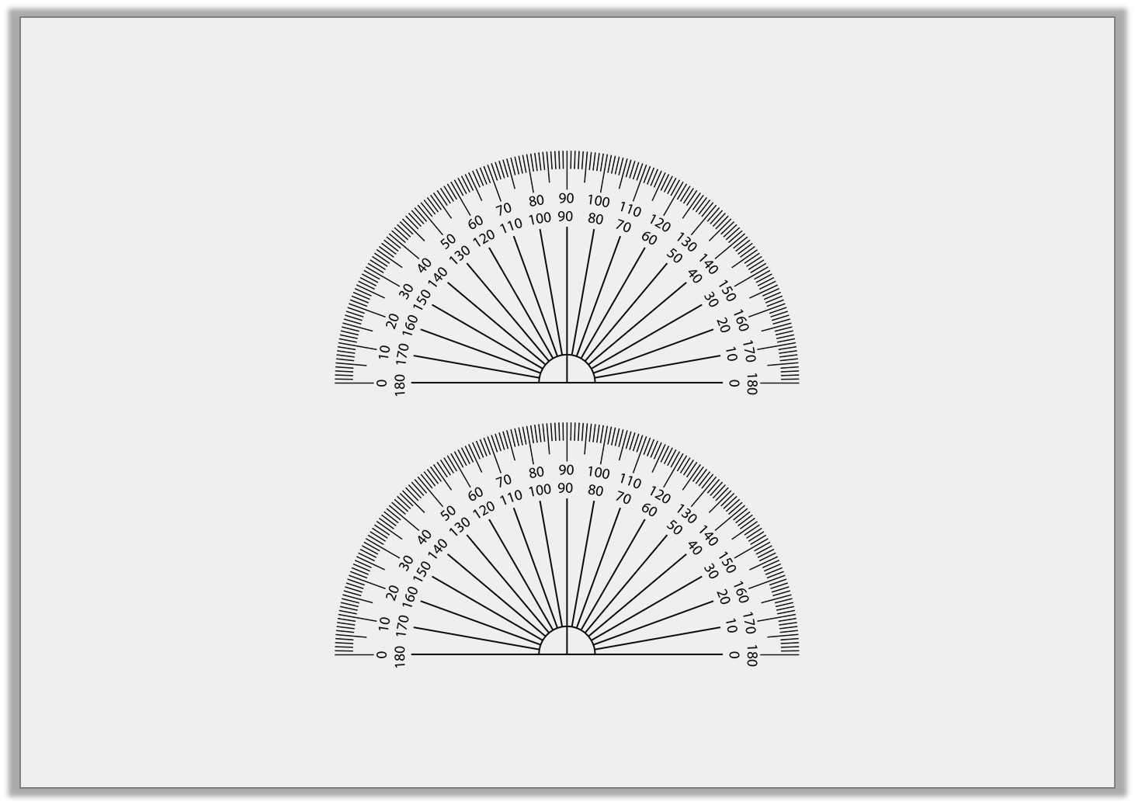
Circle the letter of the angle that is < 90°?
A.
B.
Give the measurement of each angle:
A = |  |  | B =
© Classroom Secrets Limited 2019

Slide 8
Order the angles from smallest to largest:
B.
C.
A.
D.
© Classroom Secrets Limited 2019

Slide 9
Order the angles from smallest to largest:
B.
C.
A.
D.
B |  | C |  | D |  | A
© Classroom Secrets Limited 2019

Slide 10
Circle the letter of the angle that is < 90°?
A.
B.
Give the measurement of each angle:
A = | 95° |  | B = | 45°
© Classroom Secrets Limited 2019

Slide 11
Estimate the size of the acute angles:
Record your estimates in the table:
B.
A.
C.
 | Estimated | Measured
A.
B.
C.
© Classroom Secrets Limited 2019

Slide 12
Estimate the size of the acute angles:
Record your estimates in the table:
B.
35º-45º
A.
A.
55º-65º
C.
70º-80º
 | Estimated | Measured
A. | 55º-65º
B. | 35º-45º
C. | 70º-80º
© Classroom Secrets Limited 2019

Slide 13
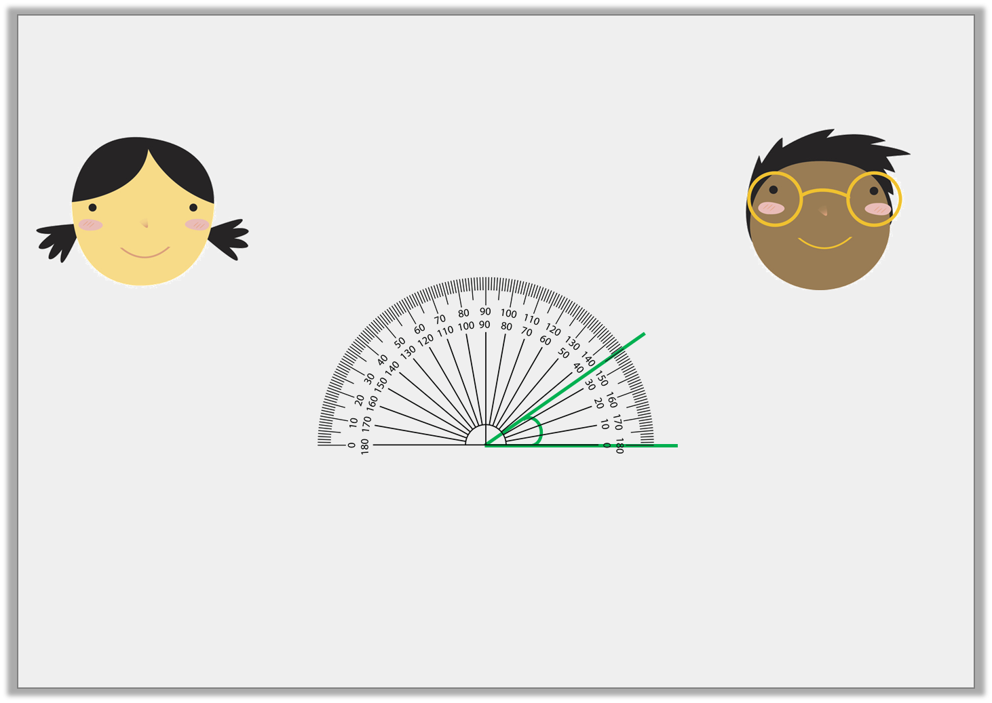
Who has measured the angle correctly?
Explain any errors.
The angle is 35º.
The angle is 145º.
Chloe
Tariq
© Classroom Secrets Limited 2019

Slide 14
Who has measured the angle correctly?
Explain any errors.
Chloe is correct because she has read the inner scale as the baseline is at 0 on the inner scale.
Tariq is incorrect because he has read the angle from 0 on the outside scale.
The angle is 35º.
The angle is 145º.
Chloe
Tariq
© Classroom Secrets Limited 2019

Slide 15
NOW IT’S YOUR TURN!
(D) – Isla, Holly H, Nia and Rhys
(Activity Sheet 1A, 1B, 2A, 2B, 3A, 3B, 4A and 4B)
(E)- Daniel, Izzy, Zoe, Isobel, Alissa, Lucy, Katie, Jacob, Sophie, Cameron and Holly T
(Activity Sheet 5A, 5B, 6A, 6B, 7A, 7B, 8A and 8B)
(GD) – Heidi, Nelly and Amy
(Activity Sheet 9A, 9B, 10A, 10B, 11A, 11B, 12A and 12B)

