Slide 1
What I’m learning in Maths today
Maths – Y5 (Angles) Date: 11.5.20 |  |  |  |  | Teacher assessment
L.Obj: *I can use a protractor to measure the size of the acute and obtuse angles.
*I can calculate the size of a reflex angle by subtracting the acute/obtuse angle from 360°.
I | CT | Group | TA | Pair

Slide 2
Heidi, Amy and Nelly - What is?
72 x 10 72 x 100 72 x 1,000
72 ÷ 10 72 ÷ 100 72 ÷ 1,000
Double 72 ½ of 72 1/6 of 72
4/9 of 72 10% of 72
Katie, Lucy, Cameron, Daniel, Izzy, Alissa, Sophie, Jacob and Holly T - What is?
36 x 10 36 x 100 36 x 1,000
36 ÷ 10 36 ÷ 100 36 ÷ 1,000
Double 36 ½ of 36 1/4 of 36
3/4 of 36 1/3 of 36
Nia, Holly H, Isla, Rhys, Zoe and Isobel – What is?
30 x 10 30 x 100 30 x 1,000
30 ÷ 10 30 ÷ 100 30 ÷ 1,000
Double 30 ½ of 30 1/6 of 30
3/5 of 30

Slide 3
Heidi, Amy and Nelly - ANSWERS
720 7,200 72,000
7.2 0.72 0.072
144 36 12
32 7.2
Katie, Lucy, Cameron, Daniel, Izzy, Alissa, Sophie, Jacob and Holly T - ANSWERS
360 3,600 36,000
36 3.6 0.36
72 18 9
27 12
Nia, Holly H, Isla, Rhys, Zoe and Isobel – ANSWERS
300 3,000 30,000
3 0.3 0.03
60 15 5
18

Slide 4
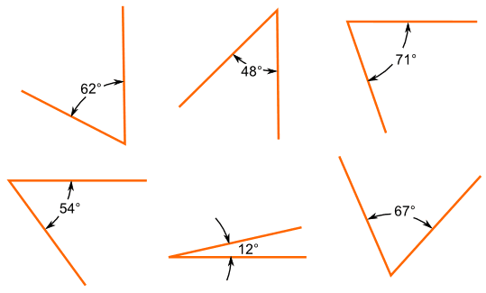
Degrees
Let’s recap
You measure angles in degrees
The symbol for degrees is °

Slide 5
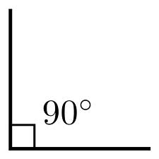
Right angles
A right angle is a quarter of a full turn. It measures 90°

Slide 6
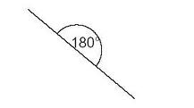
Straight angles
A half of a full turn is called a straight angle. It measures 180°

Slide 7
Full turn
A full turn is when a line turns around in a complete circle. It measures 360°

Slide 8
Acute angles
Any angle that is smaller than a right angle is an acute angle.
REMEMBER a right angle is 90°

Slide 9
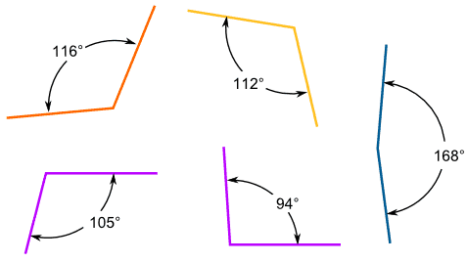
Obtuse angles
An obtuse angle is bigger than a right angle but smaller than a straight angle
REMEMBER a straight angle is 180°

Slide 10
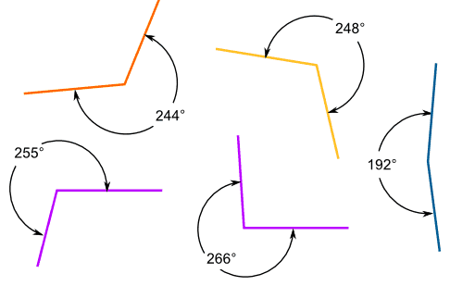
Reflex angles
A reflex angle is bigger than a straight angle.

Slide 11
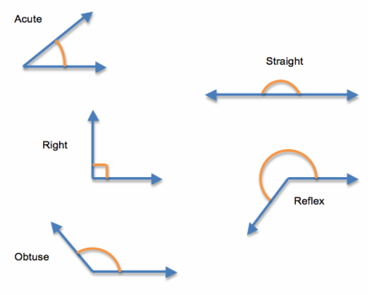
What type of angles are these?
Can you estimate their sizes in degrees?

Slide 12
Acute = 45°
Straight = 180°
Right = 90°
Reflex = 225°
Obtuse = 135°

Slide 13
What kind of angle is this?
Right
Acute
Obtuse
Straight
Reflex
Click on the correct type of angle.

Slide 14
What kind of angle is this?
Right
Acute
Obtuse
Straight
Reflex
Click on the correct type of angle.

Slide 15
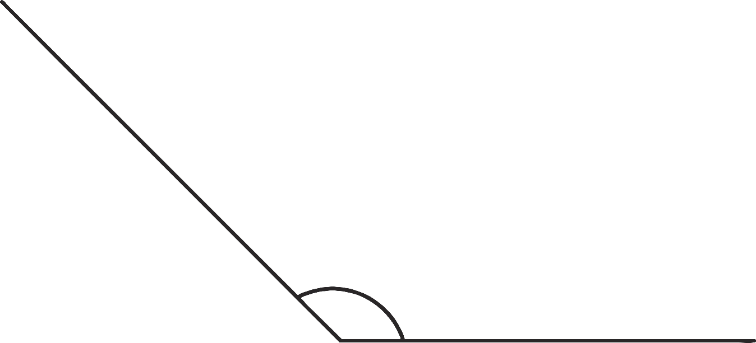
What kind of angle is this?
Right
Acute
Obtuse
Straight
Reflex
Click on the correct type of angle.

Slide 16
What kind of angle is this?
Right
Acute
Obtuse
Straight
Reflex
Click on the correct type of angle.

Slide 17
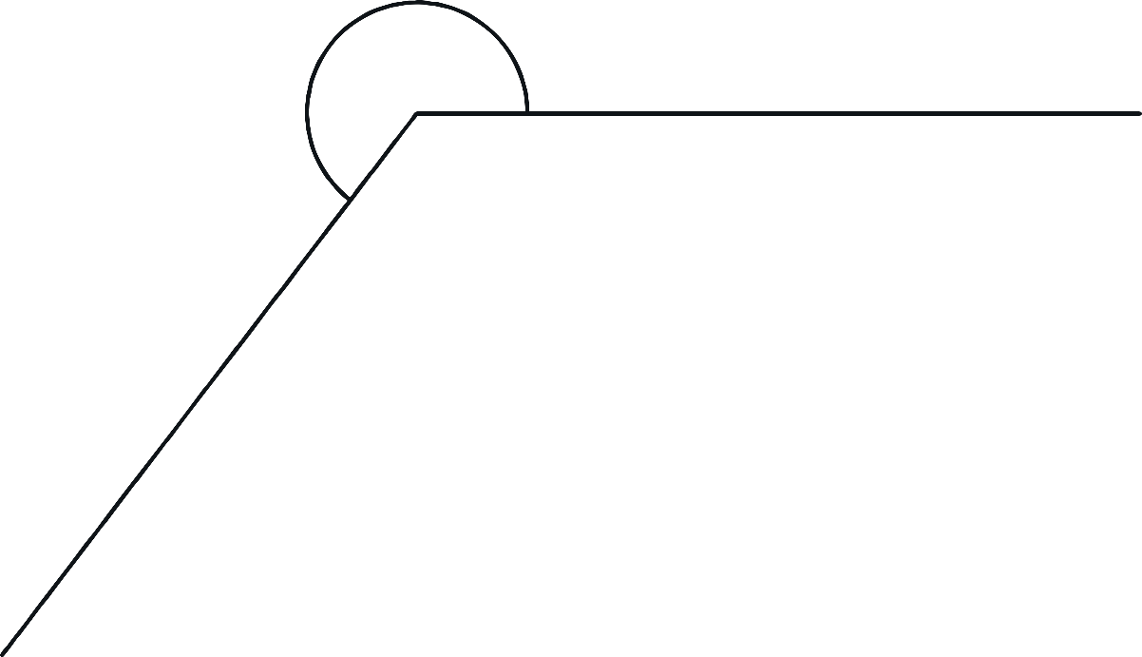
What kind of angle is this?
Right
Acute
Obtuse
Straight
Reflex
Click on the correct type of angle.

Slide 18
Do you know how to use a protractor?

Slide 19
NOW IT’S YOUR TURN!
Isla, Nia, Rhys and Holly H
Maths Activities 1 and 2
Everybody else in Year 5
Y5 Maths Activity Pages 1-4
Measure the acute, obtuse and reflex angles.
(Answers on page 5)

