Slide 1
What I’m learning in Maths today
Maths – Y5 (Angles) Date: 1.5.20
L.Obj: *I can recognise and name different amounts of turn, eg, acute, right angle, obtuse, reflex.
*I can convert fractions of a turn into degrees, eg, ½, ¼, ¾ , 1/8
*I understand different fractions of turn, eg, ½ turn, ¼ turn, ¾ turn.
*I can use the directions N, E, S and W.

Slide 2
Amy, Heidi and Nelly - What is the missing part of the calculation?
70 7,000 29 0.29 318 31.8
8 8,000 2.54 254 12.9 0.129
Katie, Holly T, Izzy, Daniel, Jacob, Sophie, Lucy, Cameron and Alissa - What is the missing part of the calculation……..?
3 3,000 27 0.27 4.7 470
1.7 170 34 0.34 276 2,760
Zoe, Nia, Rhys, Holly H, Isla and Isobel – What is the missing part of the calculation?
9 900 400 40 63 6.3
4.5 450 0.7 0.07 32 3,200

Slide 3
Amy, Heidi and Nelly - ANSWERS
70 7,000 29 0.29 318 31.8
x100
÷100
÷10
8 8,000 2.54 254 12.9 0.129
X1,000
x100
÷100
Alissa, Izzy, Sophie, Daniel, Jacob, Lucy, Cameron, Katie and Holly T- ANSWERS
3 3,000 27 0.27 4.7 470
X1,000
÷100
x100
1.7 170 34 0.34 276 2,760
x100
÷100
x10
Nia, Isla, Rhys, Isobel, Zoe and Holly H – ANSWERS
9 900 400 40 63 6.3
x100
÷10
÷10
4.5 450 0.7 0.07 32 3,200
x100
÷10
x100

Slide 4
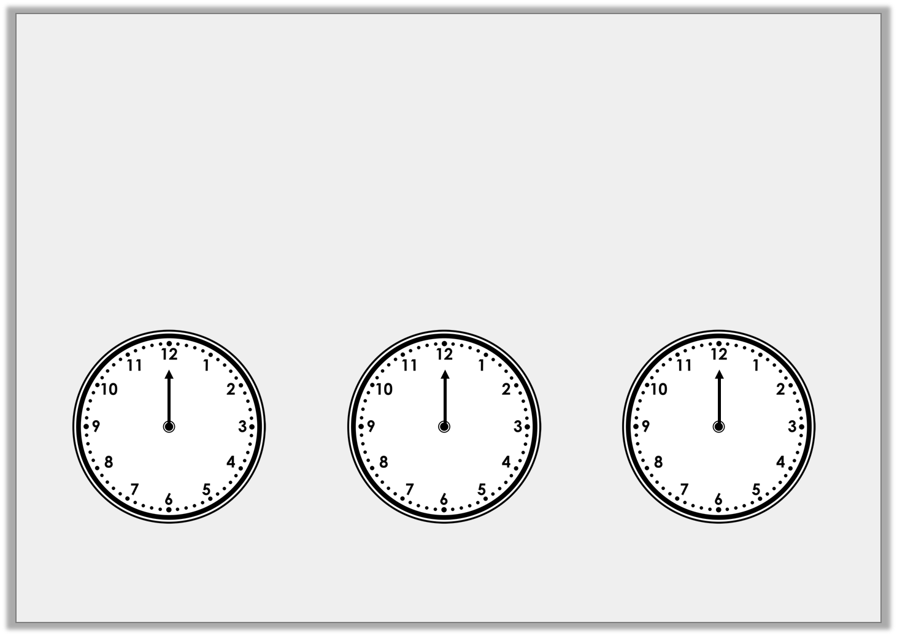
Introduction
The hour hand is stuck on 12.
Draw the minute hand on the clock so the time shown makes an acute angle:
Draw the minute hand on the clock so the time shown makes a right angle:
Draw the minute hand on the clock so the time shown makes an obtuse angle:
© Classroom Secrets Limited 2018

Slide 5
Introduction
The hour hand is stuck on 12.
Draw the minute hand on the clock so the time shown makes an acute angle:
Draw the minute hand on the clock so the time shown makes a right angle:
Draw the minute hand on the clock so the time shown makes an obtuse angle:
Any time between 12:16 – 12:29 and 12:31 – 12:44
Any time between 12:46 and 12:14
Either 12:15 or 12:45
© Classroom Secrets Limited 2018

Slide 6
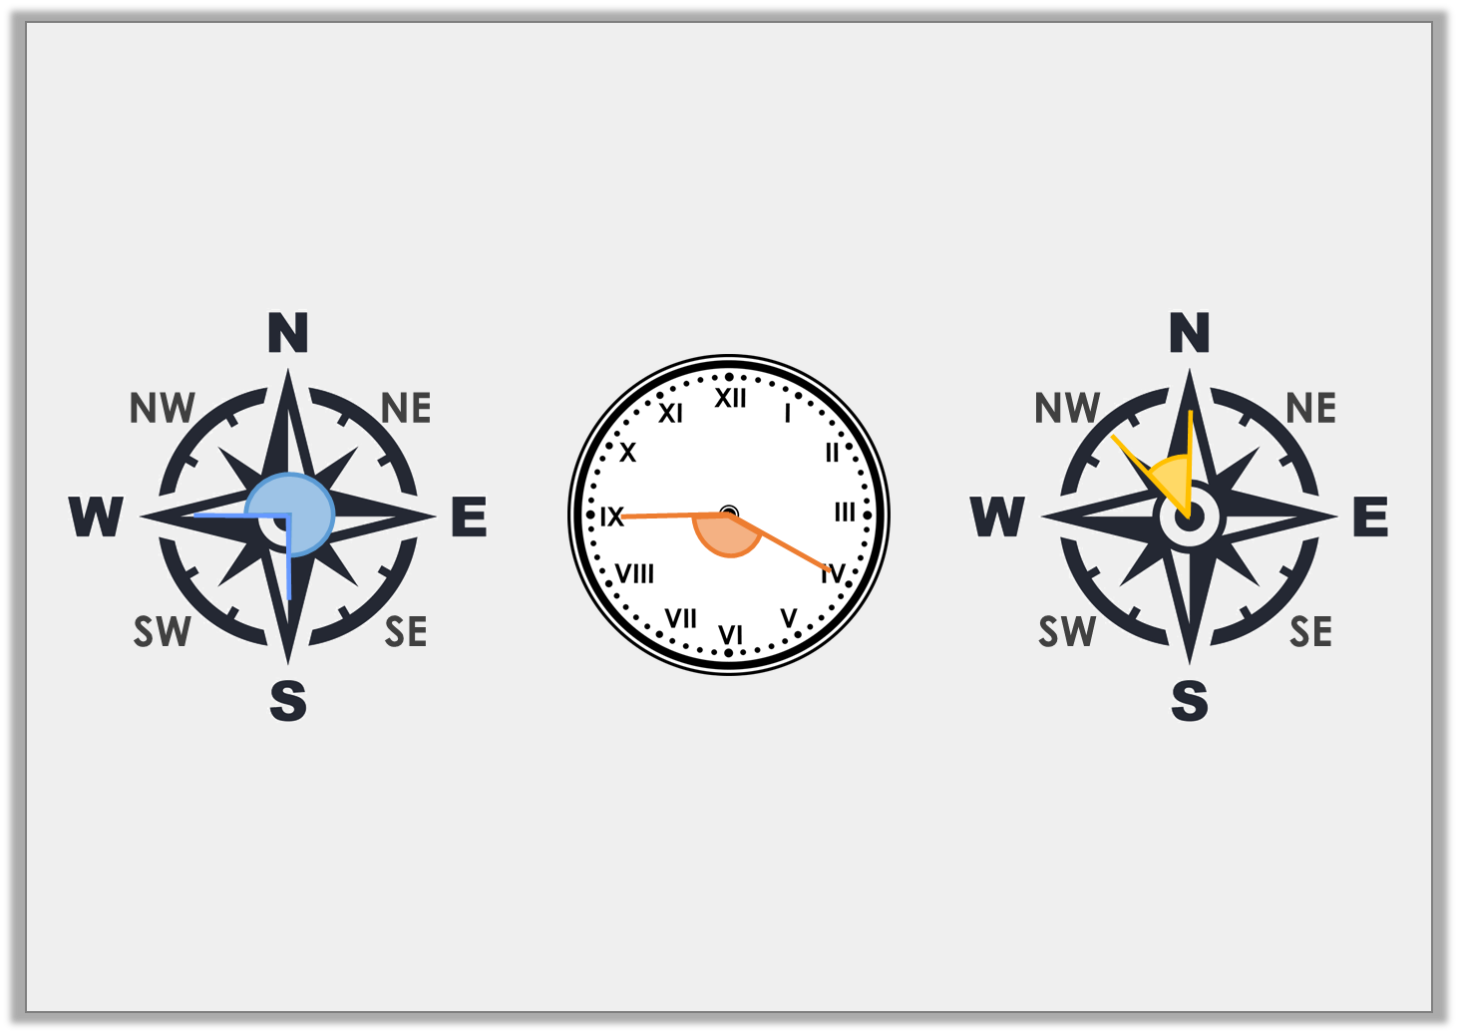
Varied Fluency 1
Label each image with the name of the angle.
A.
B.
C.
© Classroom Secrets Limited 2018

Slide 7
Varied Fluency 1
Label each image with the name of the angle.
A.
B.
C.
Reflex angle
Obtuse angle
Acute angle
© Classroom Secrets Limited 2018

Slide 8
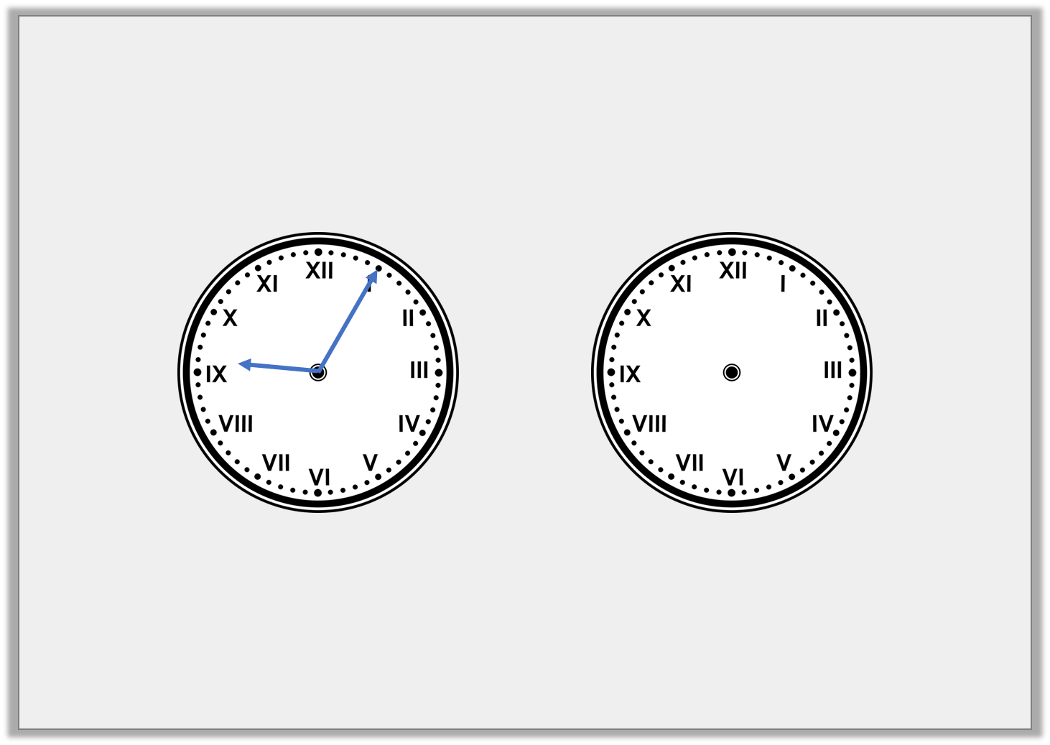
Varied Fluency 2
Look at the time on the clock. Draw where the minute hand will be after a 180° turn clockwise.
© Classroom Secrets Limited 2018

Slide 9
Varied Fluency 2
Look at the time on the clock. Draw where the minute hand will be after a 180° turn clockwise.
© Classroom Secrets Limited 2018

Slide 10
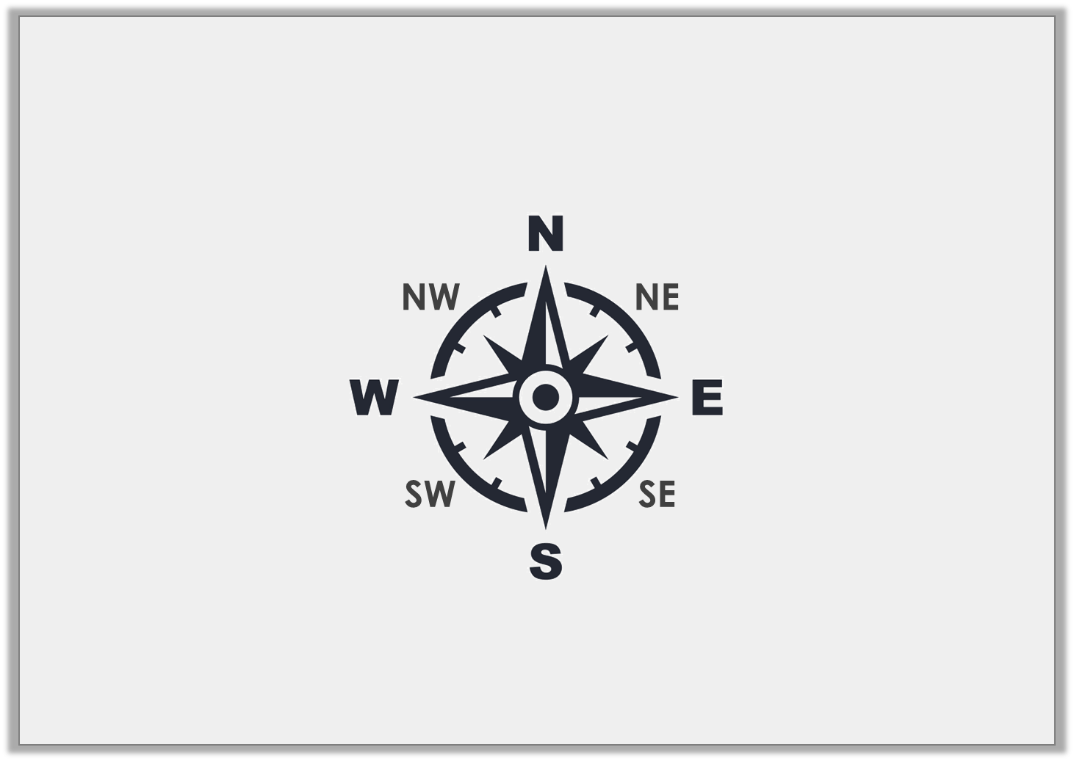
Varied Fluency 3
How many degrees will I move through if I turn from SE to N anti-clockwise?
© Classroom Secrets Limited 2018

Slide 11
Varied Fluency 3
How many degrees will I move through if I turn from SE to N anti-clockwise?
135°
© Classroom Secrets Limited 2018

Slide 12
Varied Fluency 4
Use >, < or = to complete the equation.
3
4
360° |  | turn
© Classroom Secrets Limited 2018

Slide 13
Varied Fluency 4
Use >, < or = to complete the equation.
3
4
360° | > | turn
© Classroom Secrets Limited 2018

Slide 14
NOW IT’S YOUR TURN!
(D) – Isla, Zoe, Holly H, Isobel, Nia, Rhys, Daniel, Izzy, Alissa, Lucy, Katie, Jacob, Sophie, Cameron and Holly T
(1A, 1B, 2A, 2B, 3A, 3B, 4A and 4B)
Move onto (E) if confident!
(E) – Heidi, Nelly and Amy
(5A, 5B, 6A, 6B, 7A, 7B, 8A and 8B)
Move onto (GD) if confident!

