Slide 1
What I’m learning in Maths today
Maths – Y5 (Shapes) Date: 15.5.20
L.Obj: *I can explain the meaning of a ‘polygon’ and the differences between a ‘regular’ and ‘irregular’ shape.
*I can identify if polygons have been placed correctly into a Carroll diagram.
*I can draw regular and irregular polygons accurately with a ruler to solve problems.
Click here to watch the video links
https://www.theschoolrun.com/what-is-a-polygon

Slide 2
Amy, Heidi and Nelly - What is?
15 x 10 15 x 100 15 x 1,000
15 ÷ 10 15 ÷ 100 15 ÷ 1,000
Double 15 ½ of 15 3/5 of 15
2/3 of 15 ¼ of 15 Is 15 a prime number? Why?
Lucy, Katie, Daniel, Alissa, Cameron, Holly T, Izzy, Sophie and Jacob - What is?
11 x 10 11 x 100 11 x 1,000
11 ÷ 10 11 ÷ 100 11 ÷ 1,000
Double 11 ½ of 11 1/10 of 11
11² Is 11 a prime number? Why?
Isobel, Zoe, Nia, Rhys, Holly H and Isla – What is?
6 x 10 6 x 100 6 x 1,000
6 ÷ 10 6 ÷ 100 6 ÷ 1,000
Double 6 ½ of 6 1/10 of 6
1/3 of 6 ¼ of 6 Is 6 a prime number? Why?

Slide 3
Amy, Heidi and Nelly - ANSWERS
150 1,500 15,000
1.5 0.15 0.015
30 7.5 9
10 3.75 No because 3 and 5 are factors of 15
Lucy, Katie, Daniel, Alissa, Cameron, Holly T, Izzy, Sophie and Jacob - ANSWERS
110 1,100 11,000
1.1 0.11 0.011
22 5.5 1.1
121 Yes
Isobel, Zoe, Nia, Rhys, Holly H and Isla – ANSWERS
60 600 6,000
0.6 0.06 0.006
12 3 0.6
2 1.5 No because 2 and 3 are factors of 6

Slide 4
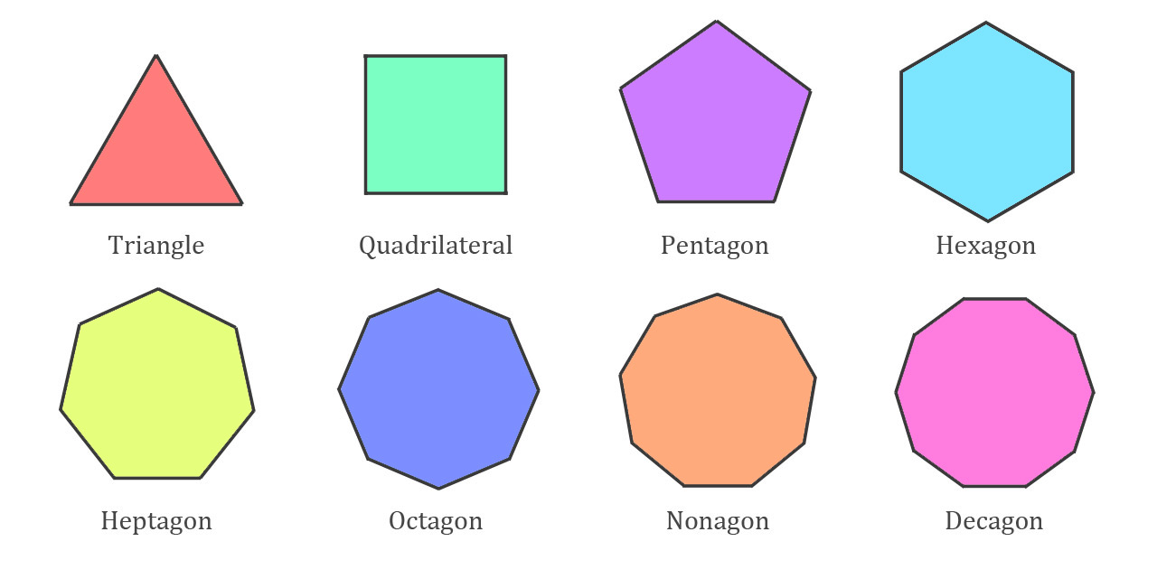
Examples of polygons

Slide 5
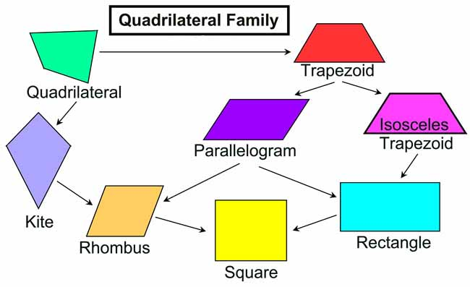

Slide 6
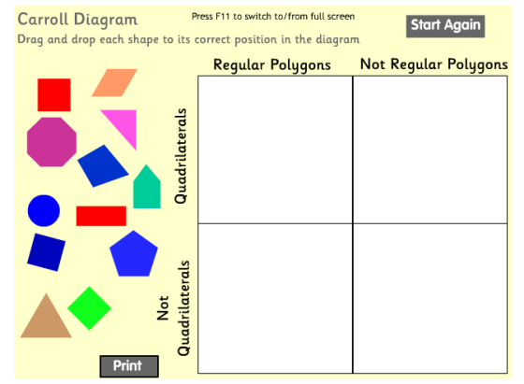
Where would these polygons be placed in this Carroll diagram?

Slide 7
Where would these polygons be placed in this Carroll diagram?

Slide 8
NOW IT’S YOUR TURN!
Isla, Nia, Rhys and Holly H
Questions 1, 2 and 3
Lucy, Katie, Holly T, Jacob, Sophie, Zoe, Isobel, Cameron, Daniel, Alissa and Izzy
Questions 4, 5 and 6
Nelly, Amy and Heidi
Questions 7, 8 and 9

