Slide 1
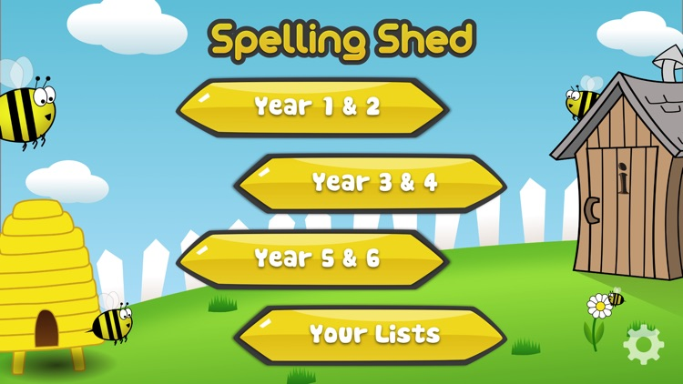
Y5&6 TOP SPELLERS TODAY
1st = Nelly 42 points
2nd = Cassie 27 points
3rd = Henry 18 points
4th = Rhys 14 points
5th = Toby 10 points
6th = Jack and Zoe 9 points
7th – Holly H 6 points
8th = Megan 3 points
9th = Harvey, Chloe, Zac and Isla 2 points
These are the amount of dojos you have received for your efforts today!
Everybody else earns 1 dojo for practising their spellings today!

Slide 2
Here’s what Y5&6 have been
focusing on at home today.

Slide 3
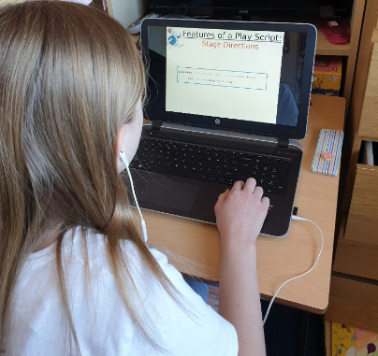
Here’s what Y5&6 have been
focusing on at home today.
I’m studying the features of a playscript

Slide 4
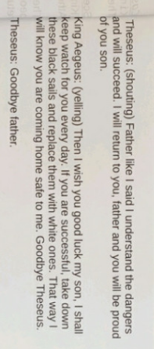
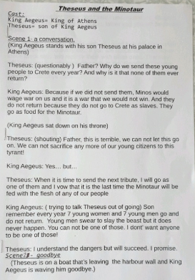
Here’s what Y5&6 have been
focusing on at home today.
Bethany’s been working on her script with the conversation between King Aegeus and Theseus.

Slide 5
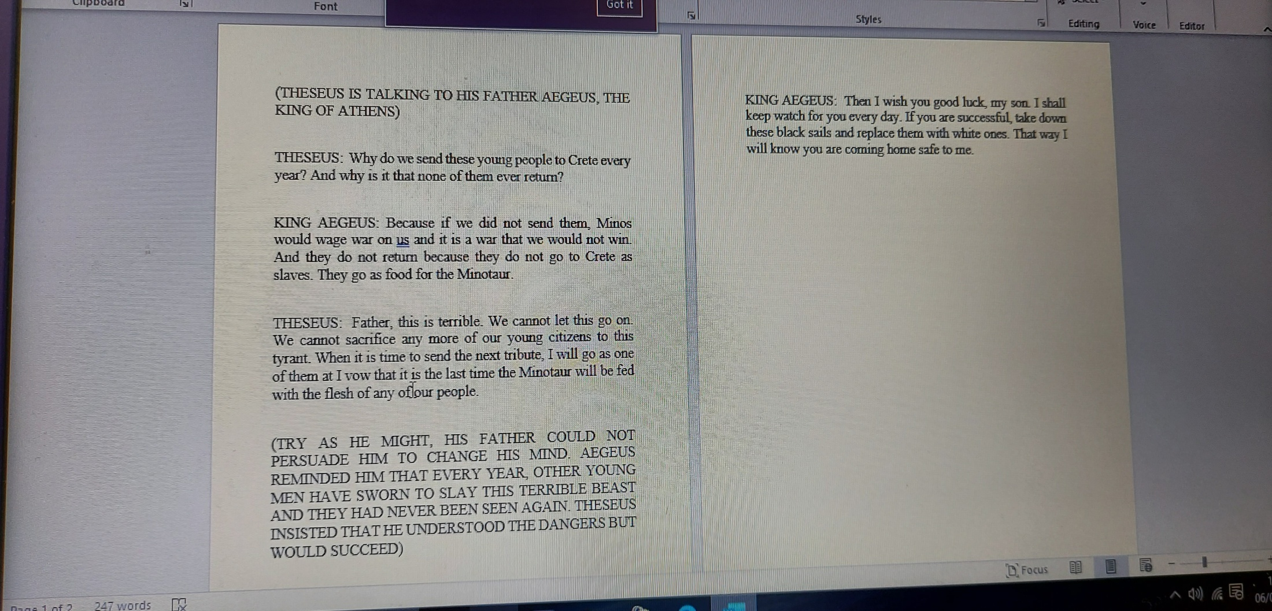
Here’s what Y5&6 have been
focusing on at home today.
Dante’s been working on his script with the conversation between King Aegeus and Theseus.

Slide 6
Here’s what Y5&6 have been
focusing on at home today.
Theseus and the Minotaur
Cast : Theseus
King Aegeus
Scene 1 (King Aegeus stands with his son Theseus at his palace in Athens)
Theseus: Why do we send all these young people to Crete every year Father, and why do they not return?
King Aegeus: If we don’t then the Minos would start a war with us and we would not be able to win. The people do not return to us because they go as food for the evil monster, the Minotaur.
Theseus: (In a worried voice) Father this is terrible, it can not carry on, people should not be sacrificed in this way. The next time the citizens are sent, I will go as one of them. (in a strong voice) This will be the last time the Minotaur will eat the flesh of our people.
King Aegeus: (The King on his hands and knees and in an persuasive voice) Son I am begging you, please do not go. You are my only son and one day you will be King of Athens. (Moving to a chair at a table with Theseus) As the King I want to remind you that each year we send many people and never has anyone been able to slay this monster. Their bodies have never been seen again.
Theseus: (in a serious voice) I understand the dangers that are involved, however I will succeed with this challenge and I will return to you father. (Getting into the boat Theseus shouts) I will make you proud.
King Aegeus: (Standing at the Harbour and shouts in return) I wish you good luck my son. I shall keep watch for you every day. If you are successful then take down the black sails and replace them with white ones. That way I will know you are coming home to me safe.
Henry’s script

Slide 7
Here’s what Y5&6 have been
focusing on at home today.
Theseus and the Minotaur
Cast : Theseus
King Aegeus
Scene 1 (King Aegeus stands with his son Theseus at his palace in Athens)
Jack’s script
Theseus: (Puzzled) Why do we send these young people to Crete every year, and why is it that they never return?
King Aegeus: Because if we didn’t send them, King Minos would wage war on us and it would be a war that we just couldn’t win. And the young people sent do not return because they don’t go to Crete as slaves, they go as food for the Minotaur.
Theseus: Father, this is terrible. We cannot let this go on. We cannot sacrifice anymore of our young citizens to this tyrant. When the time comes to send the next tribute, I will go as one of them and I vow that it is the last time the Minotaur will be fed with the flesh of any of our young people.
Narrator: Try as he might, Theseus’ father could not persuade him to change his mind. Aegeus had reminded that every year, other young men had sworn to slay this monstrous beast and they had never been seen again. Theseus insisted that he understood the dangers but would succeed. He was adamant.
Theseus: (With triumph in his voice) I will return to you father, and you will be proud of your son.
King Aegeus: Then I wish you luck my son, I shall keep watch for you every day. If you are successful, take down these black sails and replace them with these white ones. That way, I will know that you are returning home safe to me.

Slide 8
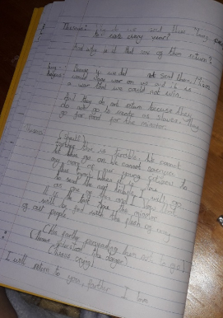
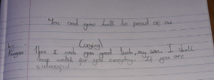
Here’s what Y5&6 have been
focusing on at home today.
Chloe’s been working on her script with the conversation between King Aegeus and Theseus.

Slide 9
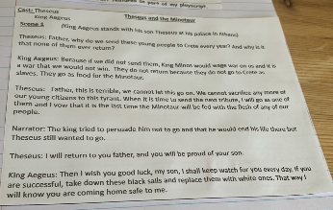
Here’s what Y5&6 have been
focusing on at home today.
Zoe’s been working on her script with the conversation between King Aegeus and Theseus.

Slide 10
Here’s what Y5&6 have been
focusing on at home today.
Theseus and the Minotaur
Theseus: (puzzled look on his face) Why do we send these young people Crete every year? And why is it that none of them ever return?
King Aegeus: (calm tone of voice) Because if we did not send them, Minos would wage war on us and it is a war that we would not win, And they do not return because they do not go to Crete as slaves. They go as food for the Minotaur.
Narrator: Try as he might, his father could not persuade him to change his mind.
King Aegeus: Let me remind you, every year, other young men had sworn to slay this terrible beast and they’ve never been seen again
Theseus: (brave voice with a shaking fist) I understand the dangers but I will succeed I will return to you, father and you will be proud of your son.
King Aegeus: (felt slightly worried but didn’t show it) Then I wish you good luck, my son, I shall keep watch for you every day. If you are successful, take down these black sails and replace them with white ones. That way I will know you are coming home safe to me.
Katie’s script

Slide 11
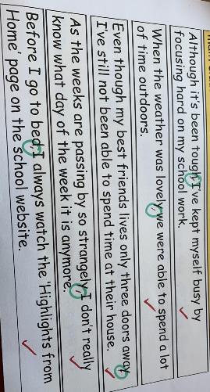
Here’s what Y5&6 have been
focusing on at home today.
Henry has been identifying the missing commas to separate the clauses in the sentences.

Slide 12
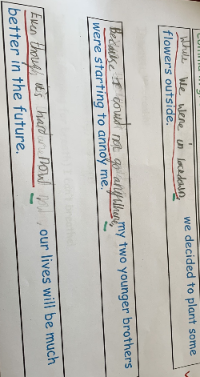
What else have we been doing at home today?
Henry subordinate clauses to begin his complex sentences.

Slide 13
Here’s what Y5&6 have been
focusing on at home today.

Slide 14
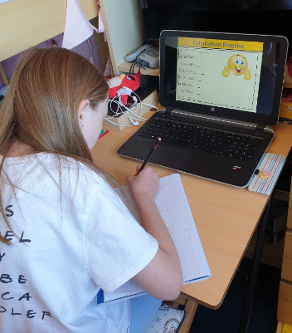
Here’s what Y5&6 have been
focusing on at home today.
I’m working hard on my calculation practise in maths.

Slide 15
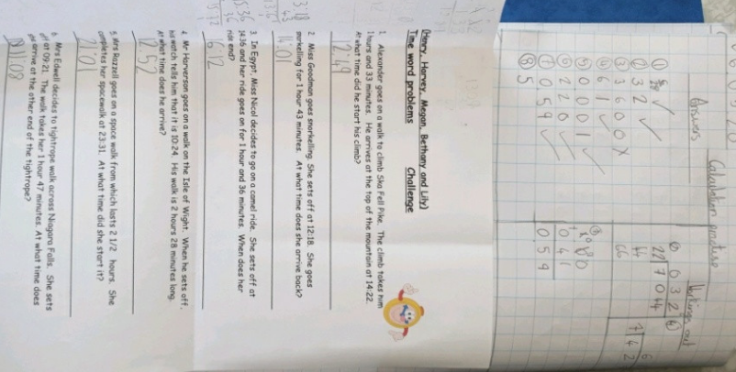
Here’s what Y5&6 have been
focusing on at home today.
Bethany’s worked really hard on her maths.

Slide 16
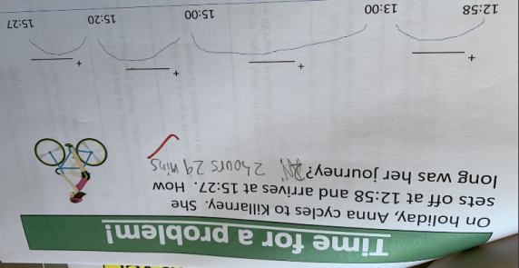
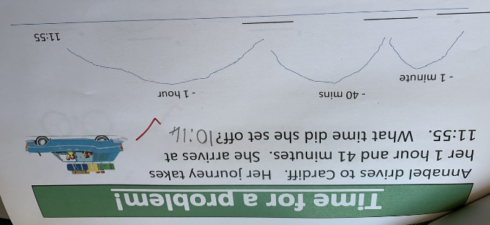
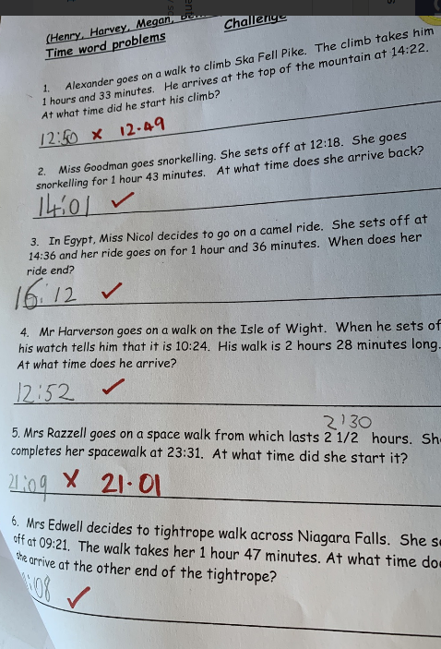
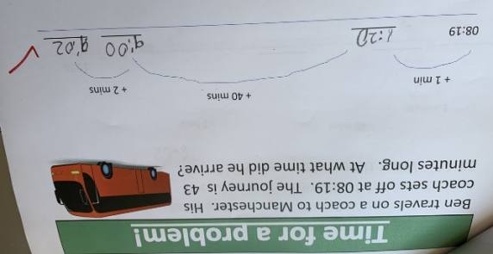
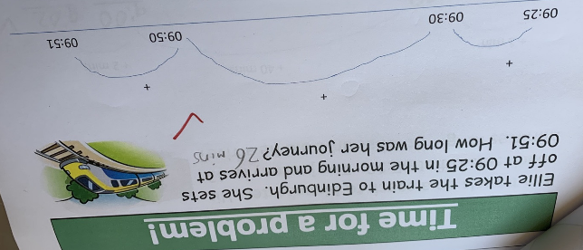
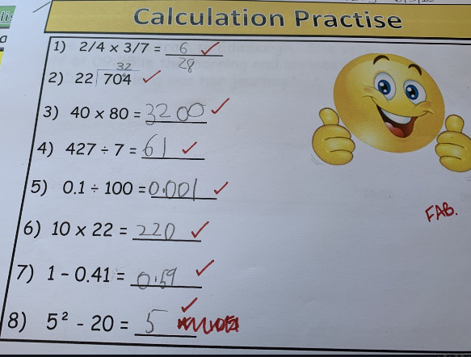
Here’s what Y5&6 have been
focusing on at home today.
Henry’s worked really hard on his maths.

Slide 17
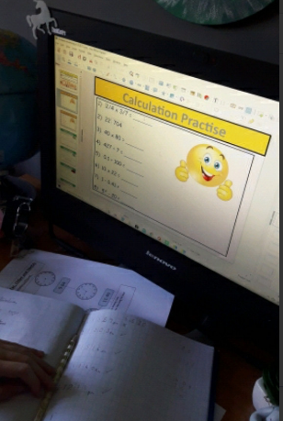
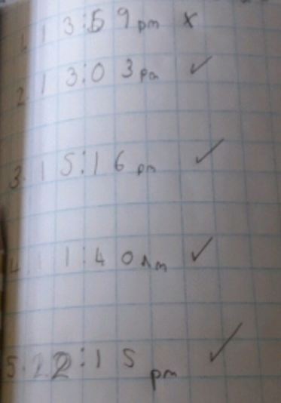
Here’s what Y5&6 have been
focusing on at home today.
Chloe’s worked really hard on her maths.

Slide 18
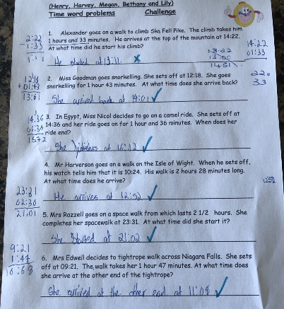
Here’s what Y5&6 have been
focusing on at home today.
Harvey’s worked really hard on his maths.

Slide 19
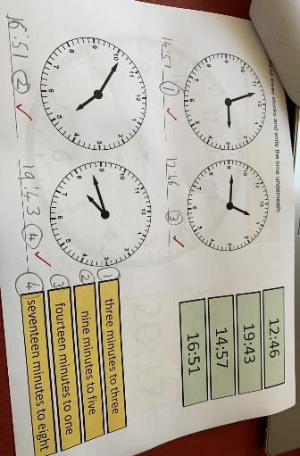
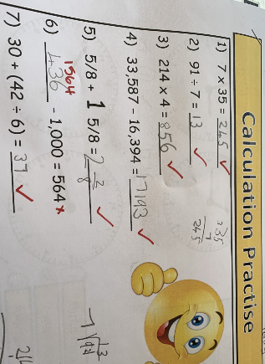
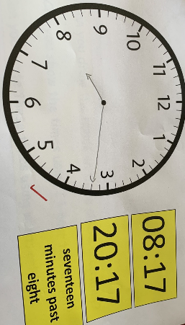
What else have we been doing at home today?
Henry showing his understanding of ‘time’.

Slide 20
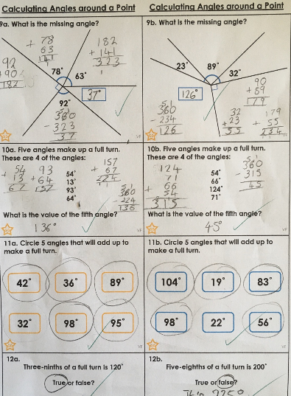
Here’s what Y5&6 have been
focusing on at home today.
Nelly has used addition and subtraction really well to solve the missing angles in these full turns (around a point).

Slide 21
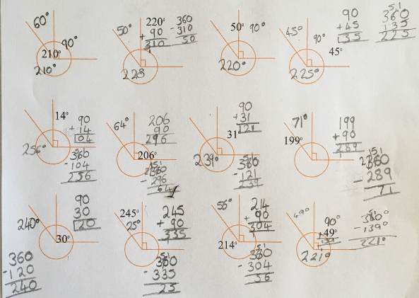
Here’s what Y5&6 have been
focusing on at home today.
Nelly understands that angles in a full turn total 360°.

Slide 22
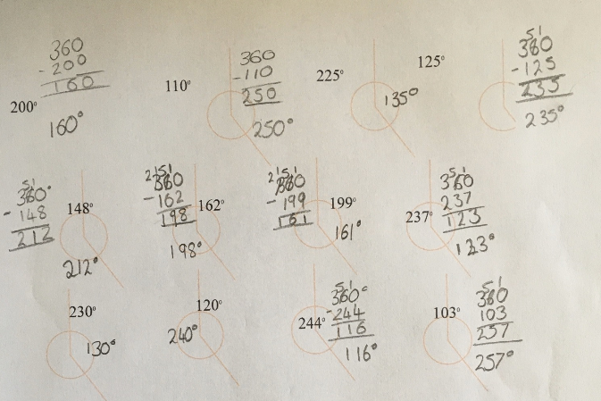
Here’s what Y5&6 have been
focusing on at home today.
Nelly accepted the additional Y5 maths challenge

Slide 23
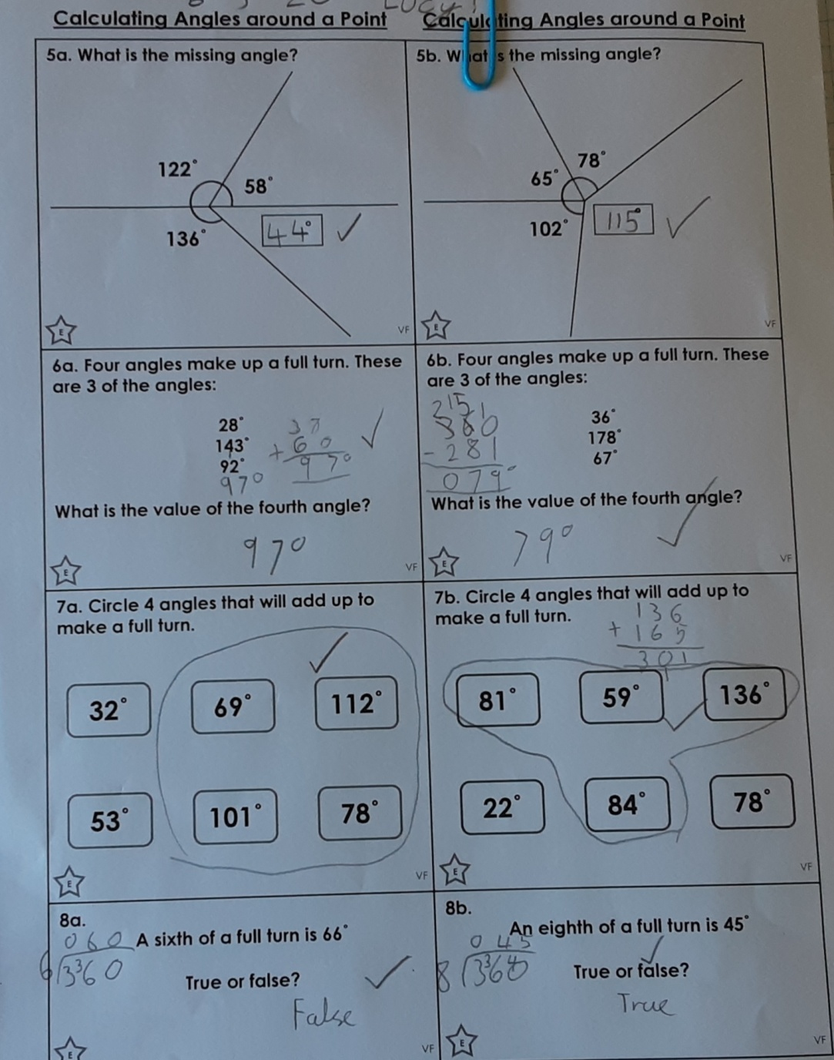
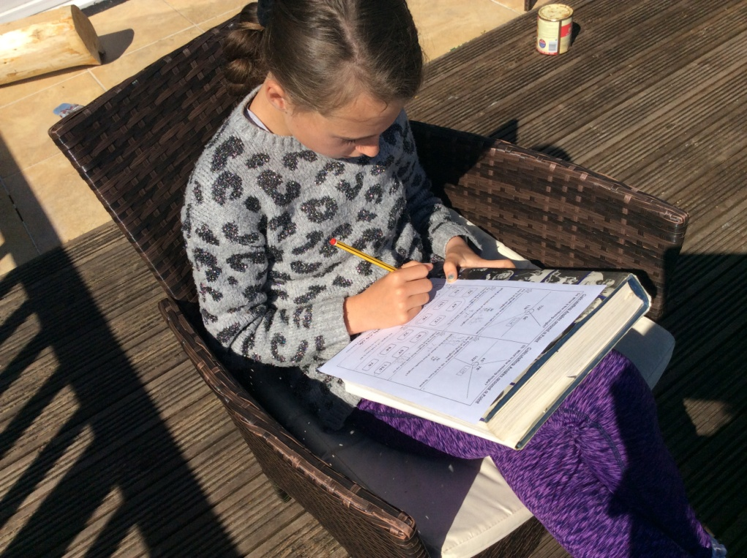
Here’s what Y5&6 have been
focusing on at home today.
I’m calculating the missing angles.

Slide 24
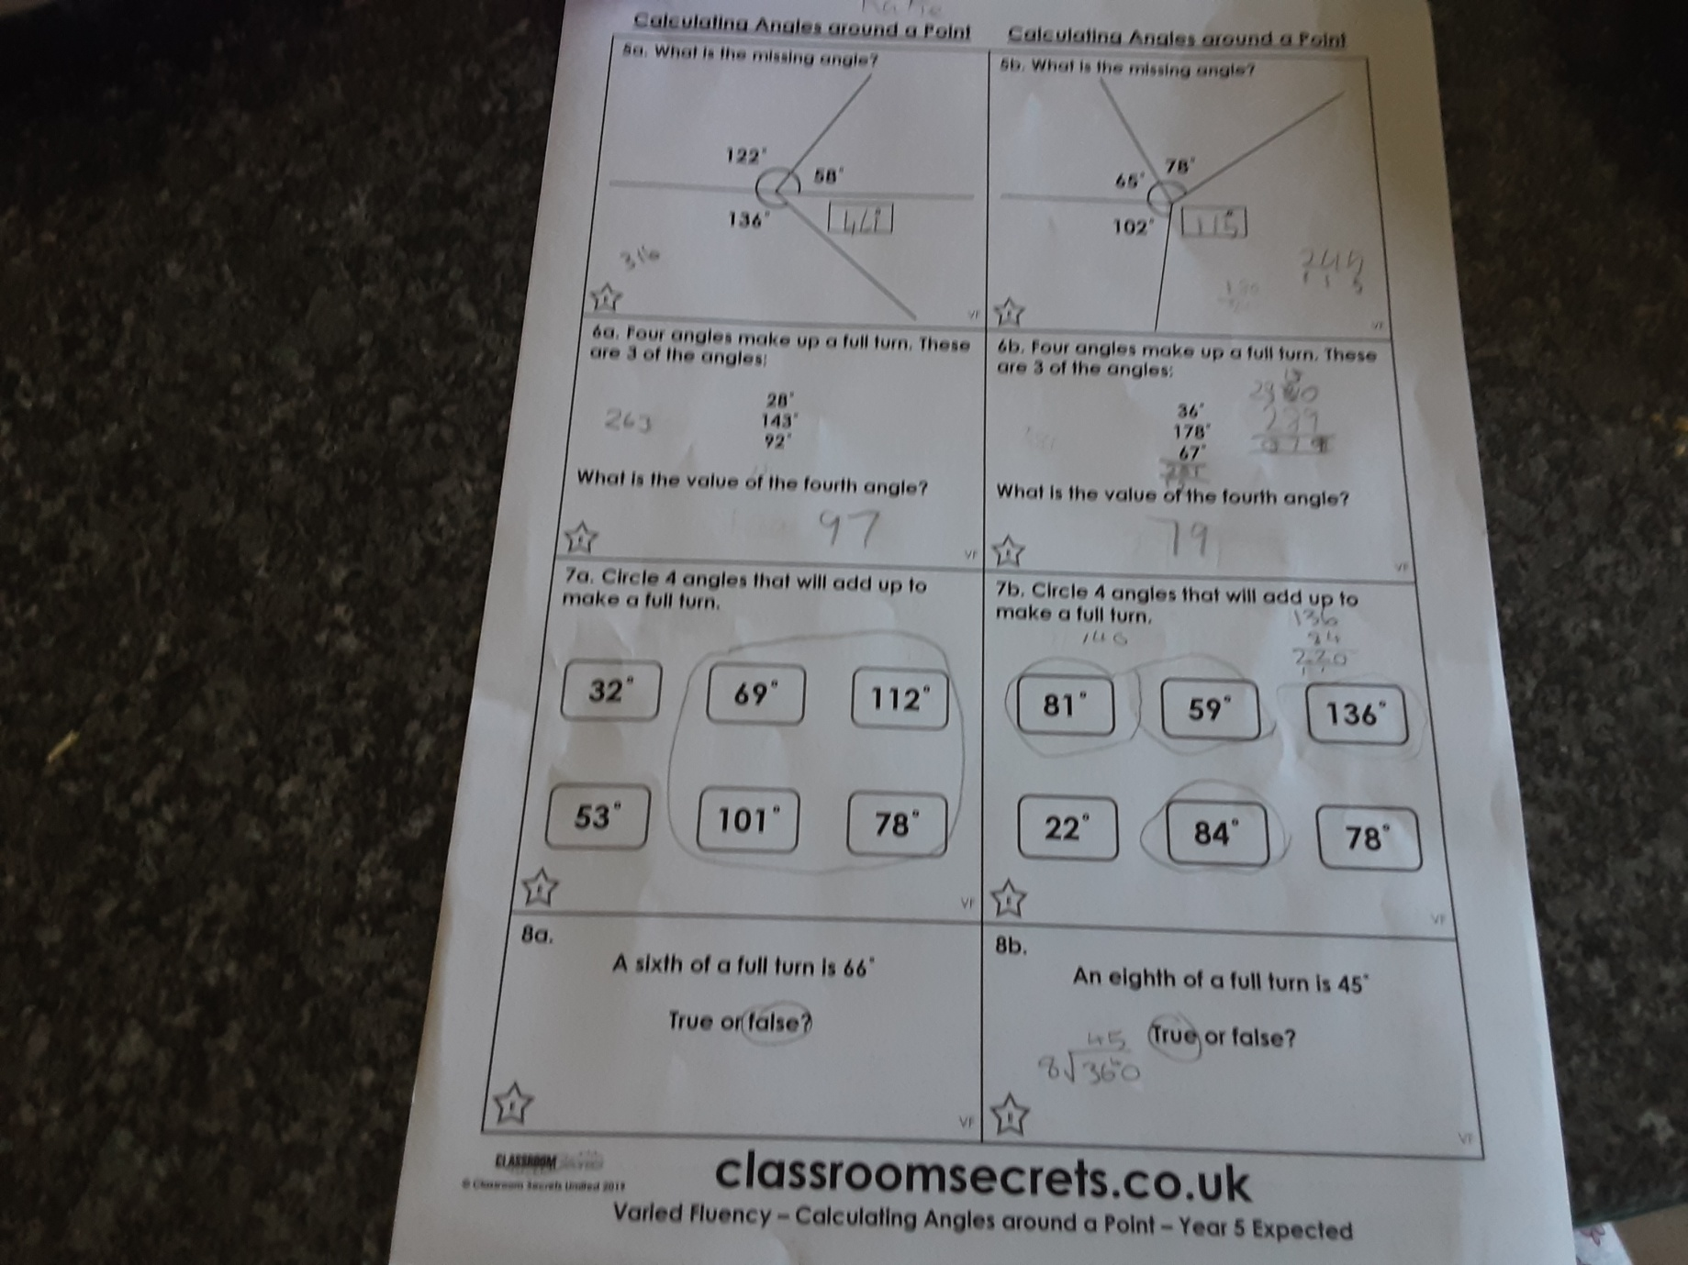
Here’s what Y5&6 have been
focusing on at home today.
Katie has been calculating the missing angles today.

Slide 25
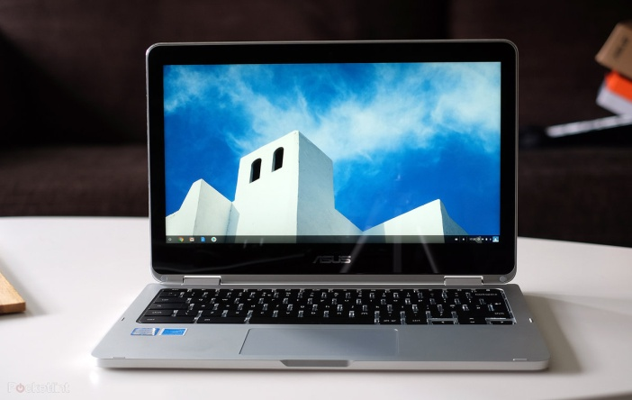
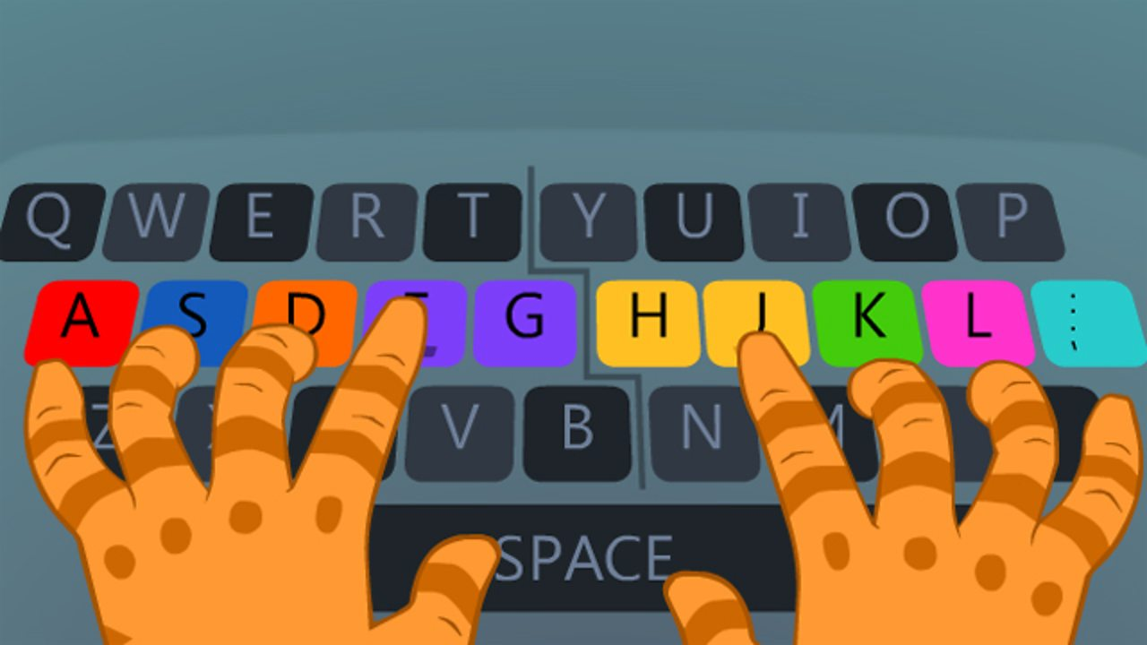
Here’s what Y5&6 have been
focusing on at home today.

Slide 26
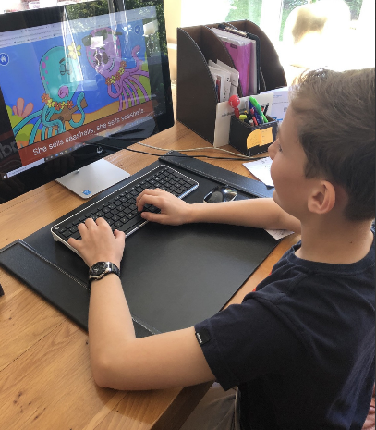
Here’s what Y5&6 have been
focusing on at home today.
Practising my typing skills

Slide 27
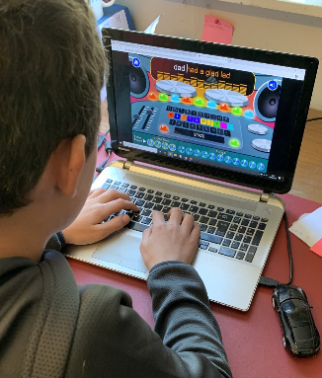
Here’s what Y5&6 have been
focusing on at home today.
Practising my typing skills

Slide 28
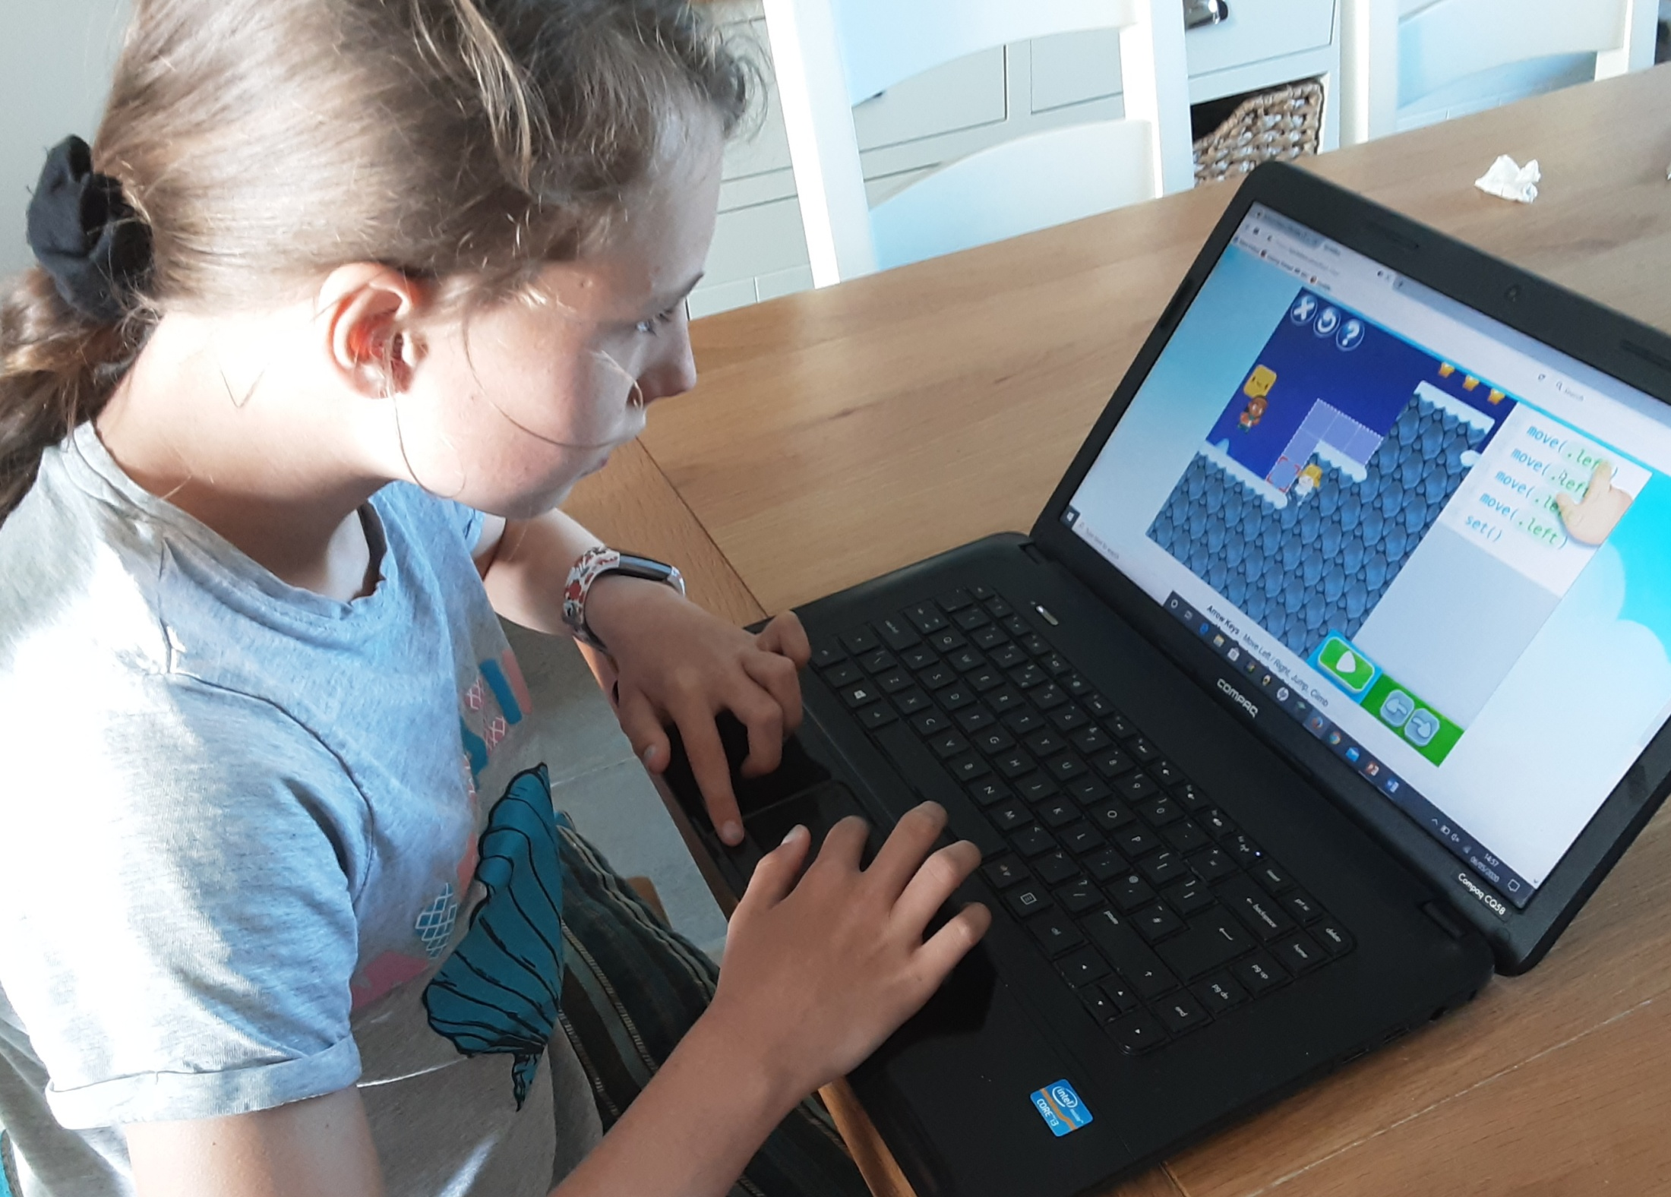
Here’s what Y5&6 have been
focusing on at home today.
Practising my typing skills

Slide 29
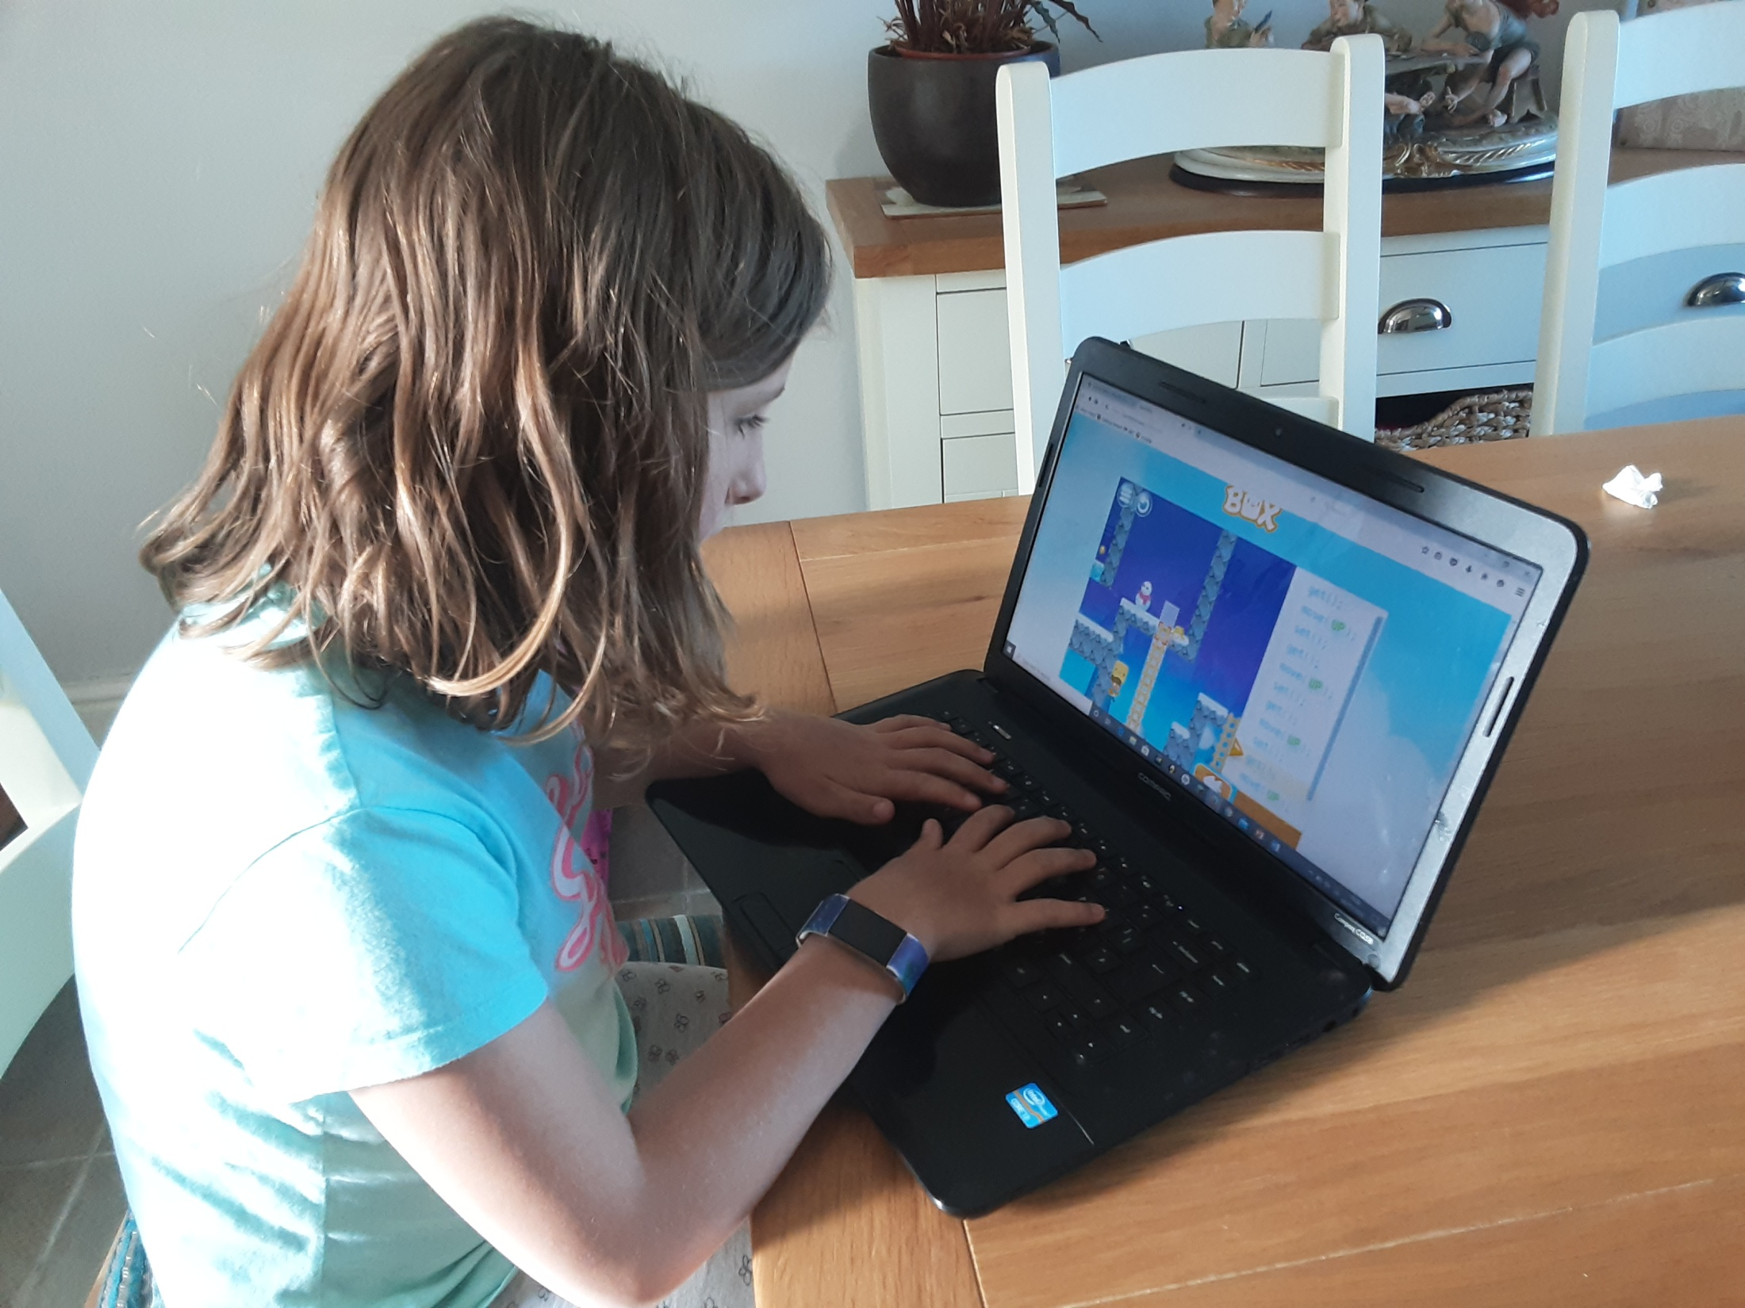
Here’s what Y5&6 have been
focusing on at home today.
Practising my typing skills

Slide 30
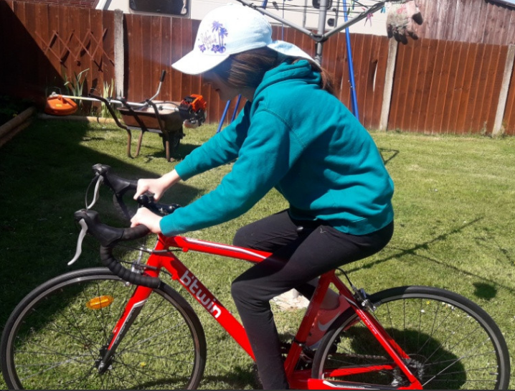
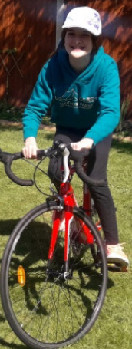
Here’s what Y5&6 have been focusing on at home today.
I’m working on my Bikeability qualifications

Slide 31
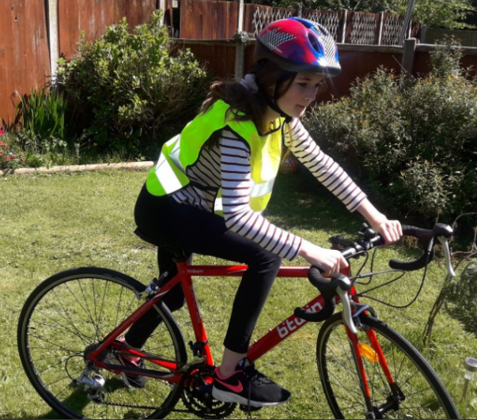
Here’s what Y5&6 have been focusing on at home today.
I’m working on my Bikeability qualifications

Slide 32
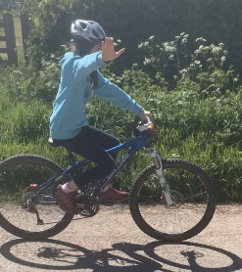
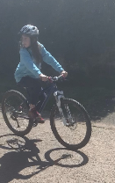
Here’s what Y5&6 have been focusing on at home today.
I’m working on my Bikeability qualifications

Slide 33
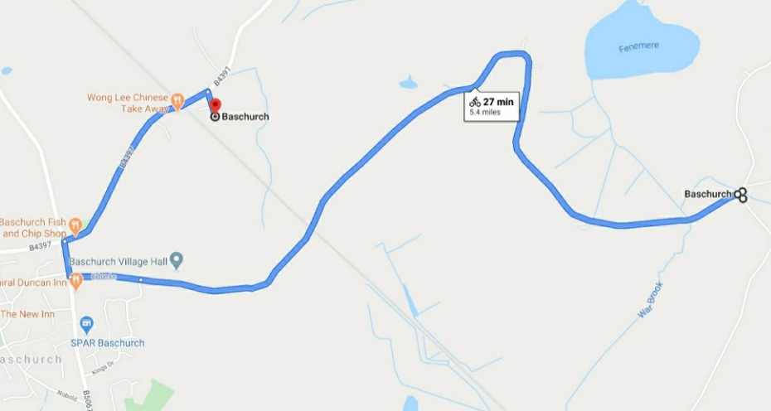
Here’s what Y5&6 have been focusing on at home today.
Jack’s been for a long bike ride today.

Slide 34
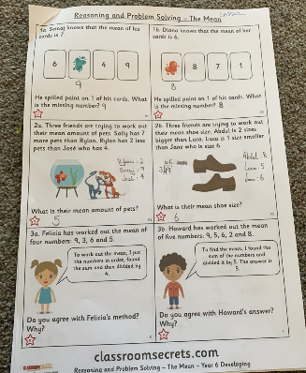
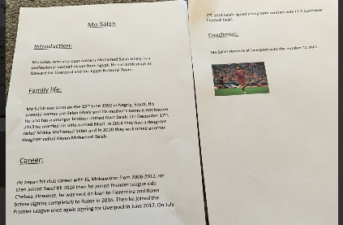
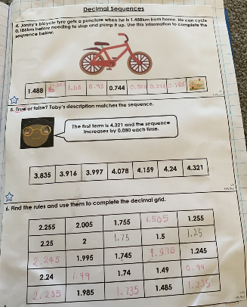
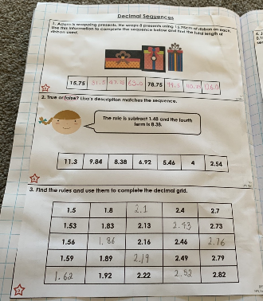
What else have we been doing at home today?
Catching up with Cassie’s work at home

Slide 35
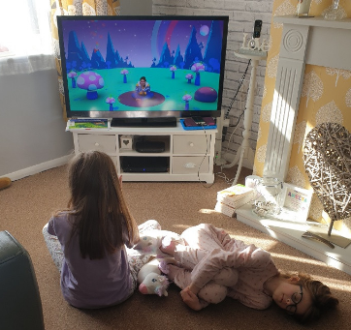
What else have we been doing at home today?
Yoga to start the day.

Slide 36
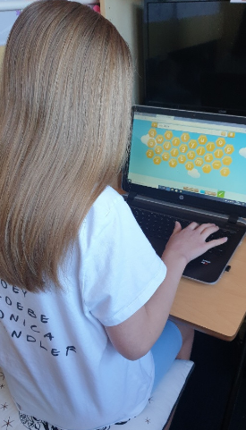
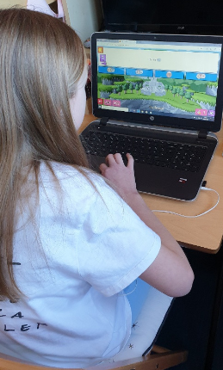
What else have we been doing at home today?
Followed by Spelling Shed and Sumdog

Slide 37
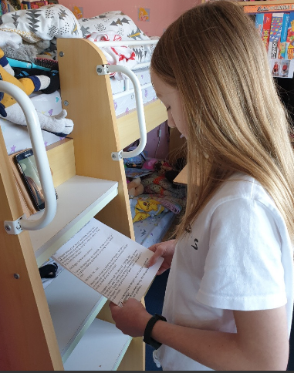
What else have we been doing at home today?
Ruby and I did our script reading via a Zoom call.

Slide 38
What else have we been doing at home today?
Nelly solved the calculation given to her on the school website.

Slide 39
What else have we been doing at home today?
Henry’s categorising of the Olympic events

Slide 40
What else have we been doing at home today?
Preparation for VE Day on Friday

Slide 41
What else have we been doing at home today?
Bethany’s preparation for VE Day on Friday

Slide 42
What else have we been doing at home today?
Day 10

